Slide 1
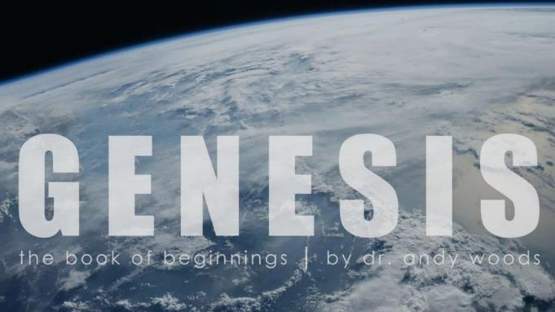

Genesis 12‒50
Israel’s Birth & Preservation

Slide 2
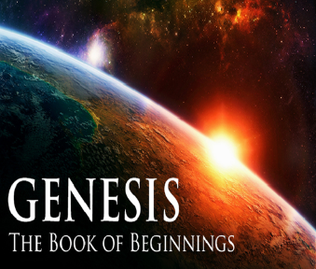
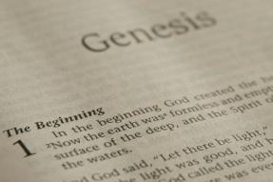
GENESIS STRUCTURE
  Genesis 12-50 (four people)
    Abraham (12:1–25:11)
    Isaac (25:12–26:35)
    Jacob (27–36)
    Joseph (37–50)

Slide 3
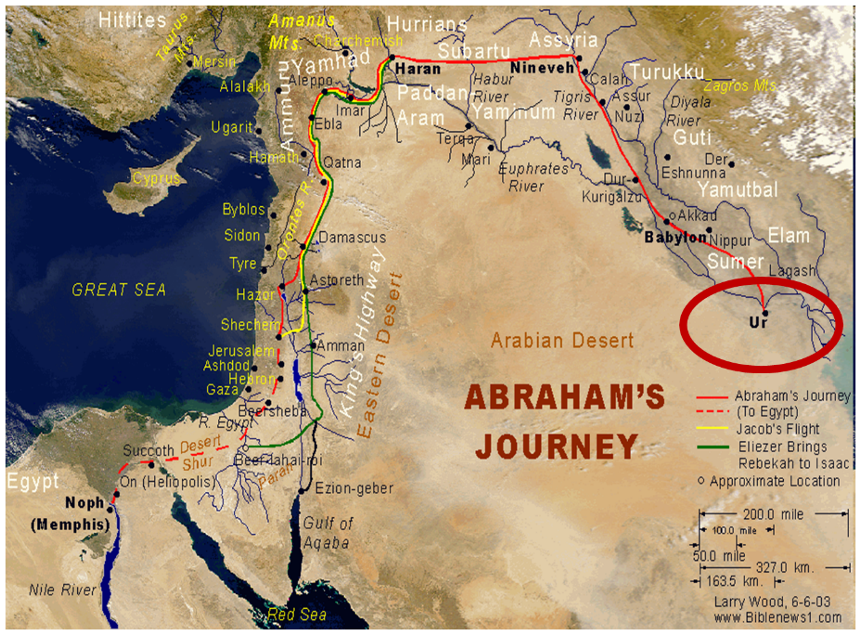

Slide 4
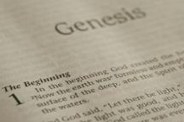
Beginning Themes
Universe Life Man Marriage Evil Clothing | Religion Salvation Language Government Nations Israel
Morris, Genesis Record, 18-20

Slide 5
Distinctions Between 144,000 & Multitude
144,000 | MULTITUDE
Revelation 7:1-8 | Revelation 7:9-17
Numbered | Innumerable
Jews | All nations
Sealed | Slain
Sealed before the Tribulation | Converted out of the Tribulation
Hitchcock and Ice, The Truth Behind Left Behind, 77

Slide 6
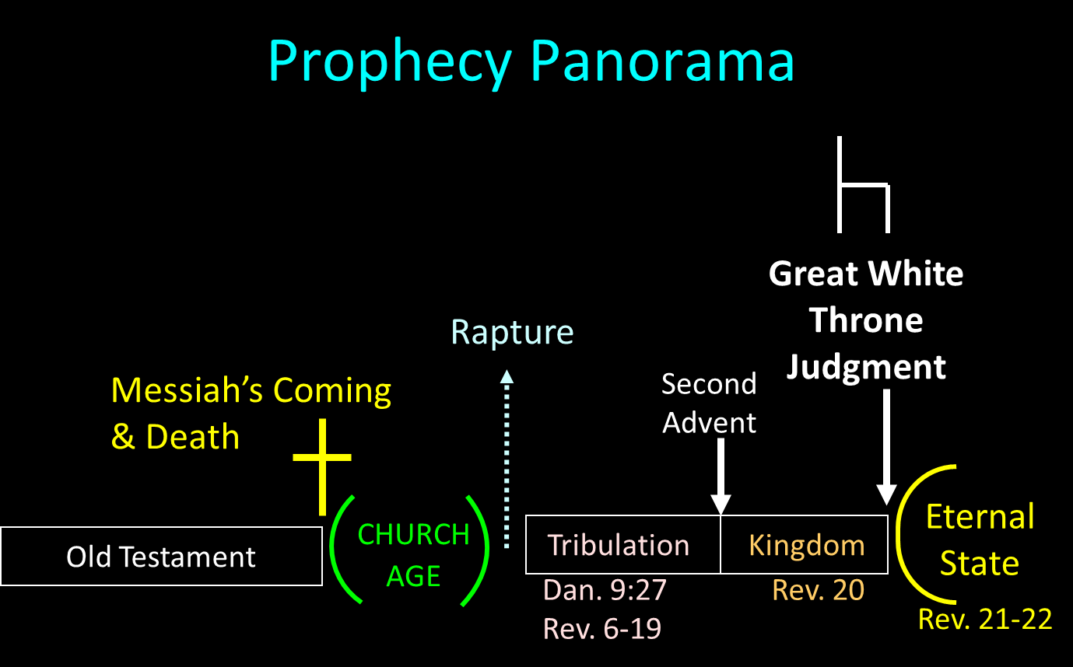

Slide 7
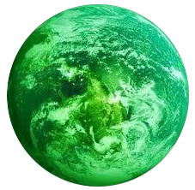
Jerusalem Descending
Notes:
The descending city is described as being like a stone called Jasper, only unlike the earthly stone, this one is clear as crystal. The ultimate state of heaven sounds more like a diamond, doesn’t it?

Slide 8
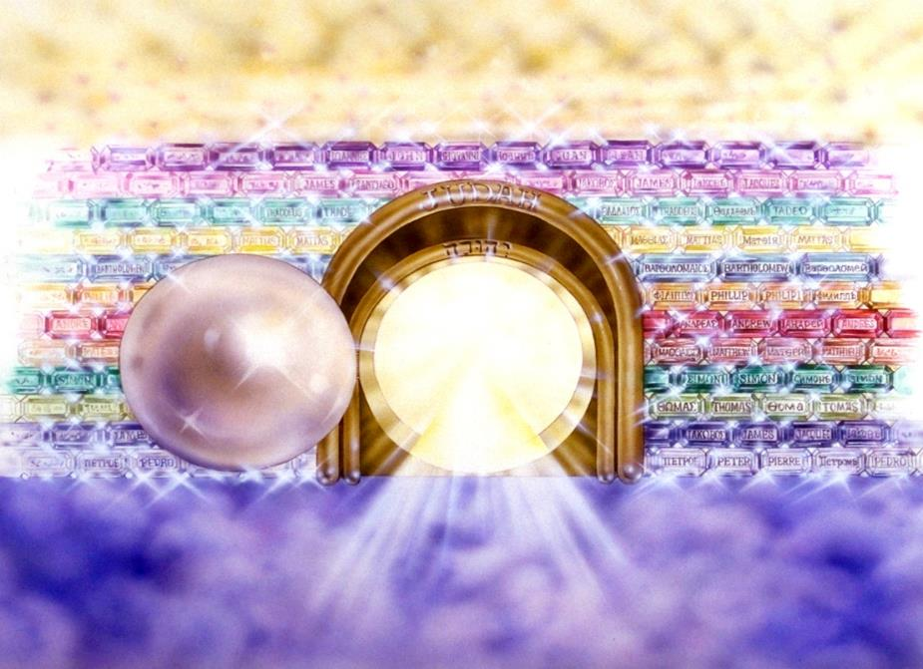
Notes:
Here you see an artist’s ideas of…
12 Gates = 12 Tribes of Israel
12 Foundation Stones = 12 Apostles of the Church

Slide 9
Genesis 29:31‒30:24
Jacob’s Dozen
  Leah’s 4 sons (29:31-35)
  Bilhah’s 2 sons (30:1-8)
  Zilpah’s 2 sons (30:9-13)
  Leah’s 2 sons & daughter (30:14-21)
  Rachel’s first son (30:22-24)

Slide 10
Genesis 29:31‒30:24
Jacob’s Dozen
  Leah’s 4 sons (29:31-35)
  Bilhah’s 2 sons (30:1-8)
  Zilpah’s 2 sons (30:9-13)
  Leah’s 2 sons & daughter (30:14-21)
  Rachel’s first son (30:22-24)

Slide 11
Genesis 29:32-35a
Leah’s Four Sons
      Reuben’s birth (32)
      Simeon’s birth (33)
      Levi’s birth (34)
      Judah’s birth (35a)

Slide 12
Genesis 29:31‒30:24
Jacob’s Dozen
  Leah’s 4 sons (29:31-35)
  Bilhah’s 2 sons (30:1-8)
  Zilpah’s 2 sons (30:9-13)
  Leah’s 2 sons & daughter (30:14-21)
  Rachel’s first son (30:22-24)

Slide 13
II. Genesis 30:1-8
Bilhah’s 2 Sons
    Rachael’s complaint (1)
    Jacob’s response (2)
    Rachel’s offer (3)
    Consummation (4)
    Conception (5)
    Name: Dan (6)
    Second conception (7)
    Name: Naphtali (8)

Slide 14
Genesis 29:31‒30:24
Jacob’s Dozen
  Leah’s 4 sons (29:31-35)
  Bilhah’s 2 sons (30:1-8)
  Zilpah’s 2 sons (30:9-13)
  Leah’s 2 sons & daughter (30:14-21)
  Rachel’s first son (30:22-24)

Slide 15
III. Genesis 30:9-13
Zilpah’s 2 Sons
    Leah’s offer (9)
    Birth (10)
    Name: Gad (11)
    Second birth (12)
    Name: Asher (13)

Slide 16
Genesis 29:31‒30:24
Jacob’s Dozen
  Leah’s 4 sons (29:31-35)
  Bilhah’s 2 sons (30:1-8)
  Zilpah’s 2 sons (30:9-13)
  Leah’s 2 sons & daughter (30:14-21)
  Rachel’s first son (30:22-24)

Slide 17
IV. Genesis 30:14-21
Leah’s Additional 2 Sons & Daughter
    Mandrakes (14-15)
    Consummation (16)
    Leah’s fifth son (17)
    Name: Issachar (18)
    Leah’s sixth son (19)
    Name: Zebulun (20)
    Leah’s daughter: Dina (21)

Slide 18
IV. Genesis 30:14-21
Leah’s Additional 2 Sons & Daughter
    Mandrakes (14-15)
    Consummation (16)
    Leah’s fifth son (17)
    Name: Issachar (18)
    Leah’s sixth son (19)
    Name: Zebulun (20)
    Leah’s daughter: Dina (21)

Slide 19

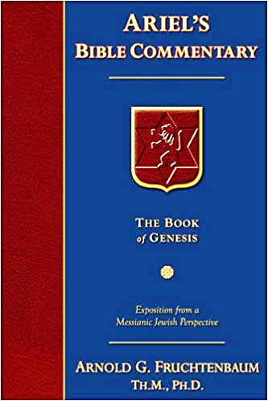
Dr. Arnold G. Fruchtenbaum
The Book of Genesis, 451
“Leah again begins to bear children, with verses 14–16 giving the background concerning the mandrakes. Verse 14a records Reuben’s gift. The timing was: Reuben went out in the days of wheat harvest, which would make it around the months of May and June. The result was: and found mandrakes in the field. In Hebrew, the word for mandrakes is dudaim, literally meaning ‘love apples.’ These are berries that have white and reddish blossoms and a yellow fruit similar to small apples. It is mentioned in Song of Solomon 7:13 and was considered an aphrodisiac; and, therefore, the Hebrew root is the same as the Hebrew word for ‘lover.’…based on it being a sexual stimulant.”

Slide 20
IV. Genesis 30:14-21
Leah’s Additional 2 Sons & Daughter
    Mandrakes (14-15)
    Consummation (16)
    Leah’s fifth son (17)
    Name: Issachar (18)
    Leah’s sixth son (19)
    Name: Zebulun (20)
    Leah’s daughter: Dina (21)

Slide 21
IV. Genesis 30:14-21
Leah’s Additional 2 Sons & Daughter
    Mandrakes (14-15)
    Consummation (16)
    Leah’s fifth son (17)
    Name: Issachar (18)
    Leah’s sixth son (19)
    Name: Zebulun (20)
    Leah’s daughter: Dina (21)

Slide 22
IV. Genesis 30:14-21
Leah’s Additional 2 Sons & Daughter
    Mandrakes (14-15)
    Consummation (16)
    Leah’s fifth son (17)
    Name: Issachar (18)
    Leah’s sixth son (19)
    Name: Zebulun (20)
    Leah’s daughter: Dina (21)

Slide 23
IV. Genesis 30:14-21
Leah’s Additional 2 Sons & Daughter
    Mandrakes (14-15)
    Consummation (16)
    Leah’s fifth son (17)
    Name: Issachar (18)
    Leah’s sixth son (19)
    Name: Zebulun (20)
    Leah’s daughter: Dina (21)

Slide 24
IV. Genesis 30:14-21
Leah’s Additional 2 Sons & Daughter
    Mandrakes (14-15)
    Consummation (16)
    Leah’s fifth son (17)
    Name: Issachar (18)
    Leah’s sixth son (19)
    Name: Zebulun (20)
    Leah’s daughter: Dina (21)

Slide 25
IV. Genesis 30:14-21
Leah’s Additional 2 Sons & Daughter
    Mandrakes (14-15)
    Consummation (16)
    Leah’s fifth son (17)
    Name: Issachar (18)
    Leah’s sixth son (19)
    Name: Zebulun (20)
    Leah’s daughter: Dina (21)

Slide 26
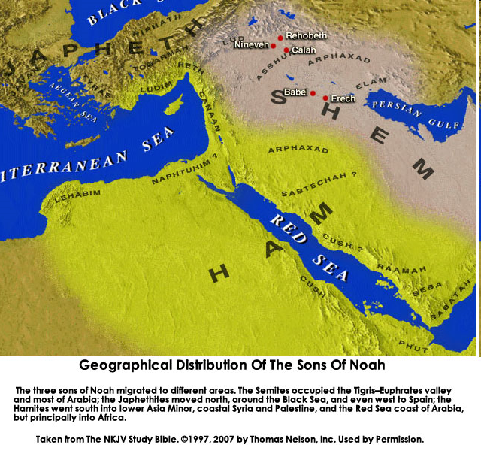


Slide 27
Genesis 29:31‒30:24
Jacob’s Dozen
  Leah’s 4 sons (29:31-35)
  Bilhah’s 2 sons (30:1-8)
  Zilpah’s 2 sons (30:9-13)
  Leah’s 2 sons & daughter (30:14-21)
  Rachel’s first son (30:22-24)

Slide 28
V. Genesis 30:22-24
Rachel’s First Son
    God’s providence (22)
    Rachel’s first natural son (23a)
    Name: Joseph (23b-24)

Slide 29
V. Genesis 30:22-24
Rachel’s First Son
    God’s providence (22)
    Rachel’s first natural son (23a)
    Name: Joseph (23b-24)

Slide 30
Dr. Arnold G. Fruchtenbaum
The Book of Genesis, 175
“The turning point begins with the remembrance of God in verse 1a: And God remembered Noah, and all the beasts, and all the cattle that were with him in the ark. The word remember does not mean remember in the sense that God temporarily forgot about the ark and its inhabitants; rather it means remembering in the sense of movement toward the object. For example, in Genesis 19:29, God remembered Abraham with a view to saving Lot; in Exodus 2:24, God remembered His covenant with the Patriarchs with a view to rescuing Israel; in Jeremiah 2:2, God remembered Israel with a view toward her restoration; in . . .

Slide 31
Dr. Arnold G. Fruchtenbaum
The Book of Genesis, 175
…Jeremiah 31:20, God remembered Ephraim with a view toward extending mercy to him; and in Luke 1:54–55, God remembered Israel with a view toward sending the Messiah to Israel. Furthermore, the sense was that of God remembering a covenant; although in this case the covenant itself had not yet been made. He said earlier in chapter 6, that He would establish His covenant with Noah. Furthermore, in 7:4 God remembered that the rain would only last forty days. All these usages fit into the word ‘remember.’”

Slide 32
V. Genesis 30:22-24
Rachel’s First Son
    God’s providence (22)
    Rachel’s first natural son (23a)
    Name: Joseph (23b-24)

Slide 33
V. Genesis 30:22-24
Rachel’s First Son
    God’s providence (22)
    Rachel’s first natural son (23a)
    Name: Joseph (23b-24)

Slide 34
GENESIS STRUCTURE
  Genesis 12-50 (four people)
    Abraham (12:1–25:11)
    Isaac (25:12–26:35)
    Jacob (27–36)
    Joseph (37–50)

Slide 35
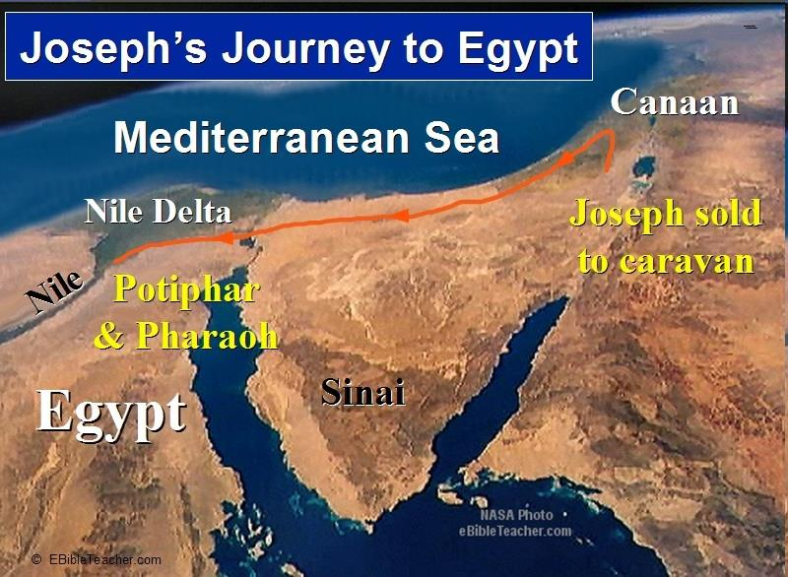

Slide 36
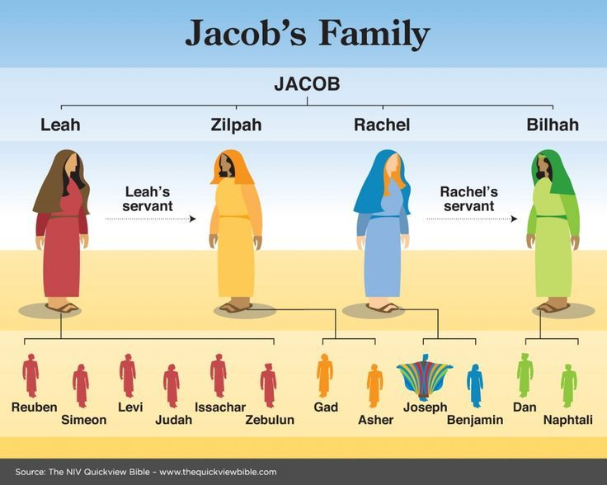

Slide 37
Conclusion

Slide 38
Genesis 29:31‒30:24
Jacob’s Dozen
  Leah’s 4 sons (29:31-35)
  Bilhah’s 2 sons (30:1-8)
  Zilpah’s 2 sons (30:9-13)
  Leah’s 2 sons & daughter (30:14-21)
  Rachel’s first son (30:22-24)

Slide 39
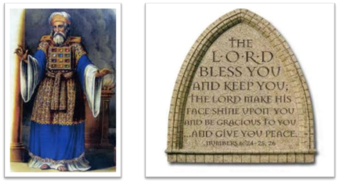
²⁴ The Lord bless you, and keep you; ²⁵ The Lord make His face shine on you, And be gracious to you; ²⁶ The Lord lift up His countenance on you, And give you peace.
Numbers 6:24–26 (NASB95)

