Slide 1


Dr. Andy Woods
Senior Pastor – Sugar Land Bible Church
President – Chafer Theological Seminary

Slide 2

Structure
1 THESSALONIANS 1-3 | 1 THESSALONIANS 4-5
Personal Experience | Practical Exhortation
Looking Back | Looking Forward

Slide 3

Structure
Personal (1–3)
  Genuine conversion (1)
  Impure motives (2:1-16)
  Lack of concern (2:17–3:13)
Practical (4–5)
  Immorality (4:1-8)
  Laziness (4:9-12)
  Eschatology (4:13–5:11)
  Ministry imbalances (5:12-15)
  Progressive sanctification (5:16-28)

Slide 4
Structure
Personal (1–3)
  Genuine conversion (1)
  Impure motives (2:1-16)
  Lack of concern (2:17–3:13)
Practical (4–5)
  Immorality (4:1-8)
  Laziness (4:9-12)
  Eschatology (4:13–5:11)
  Ministry imbalances (5:12-15)
  Progressive sanctification (5:16-28)

Slide 5

Day of the Lord (5:1-11)
Description (5:1-3)
Application (5:4-11)

Slide 6
Day of the Lord (5:1-11)
Description (5:1-3)
Application (5:4-11)

Slide 7


Slide 8


Slide 9
Day of the Lord (5:1-11)
Description (5:1-3)
Application (5:4-11)

Slide 10
Three Reasons Believers Will Not Be in the Tribulation
(1 Thess. 5:9-11)
    We are not appointed unto wrath (9)
    We are exempted from wrath whether morally asleep or awake (10)
    Promises of comfort (11)

Slide 11
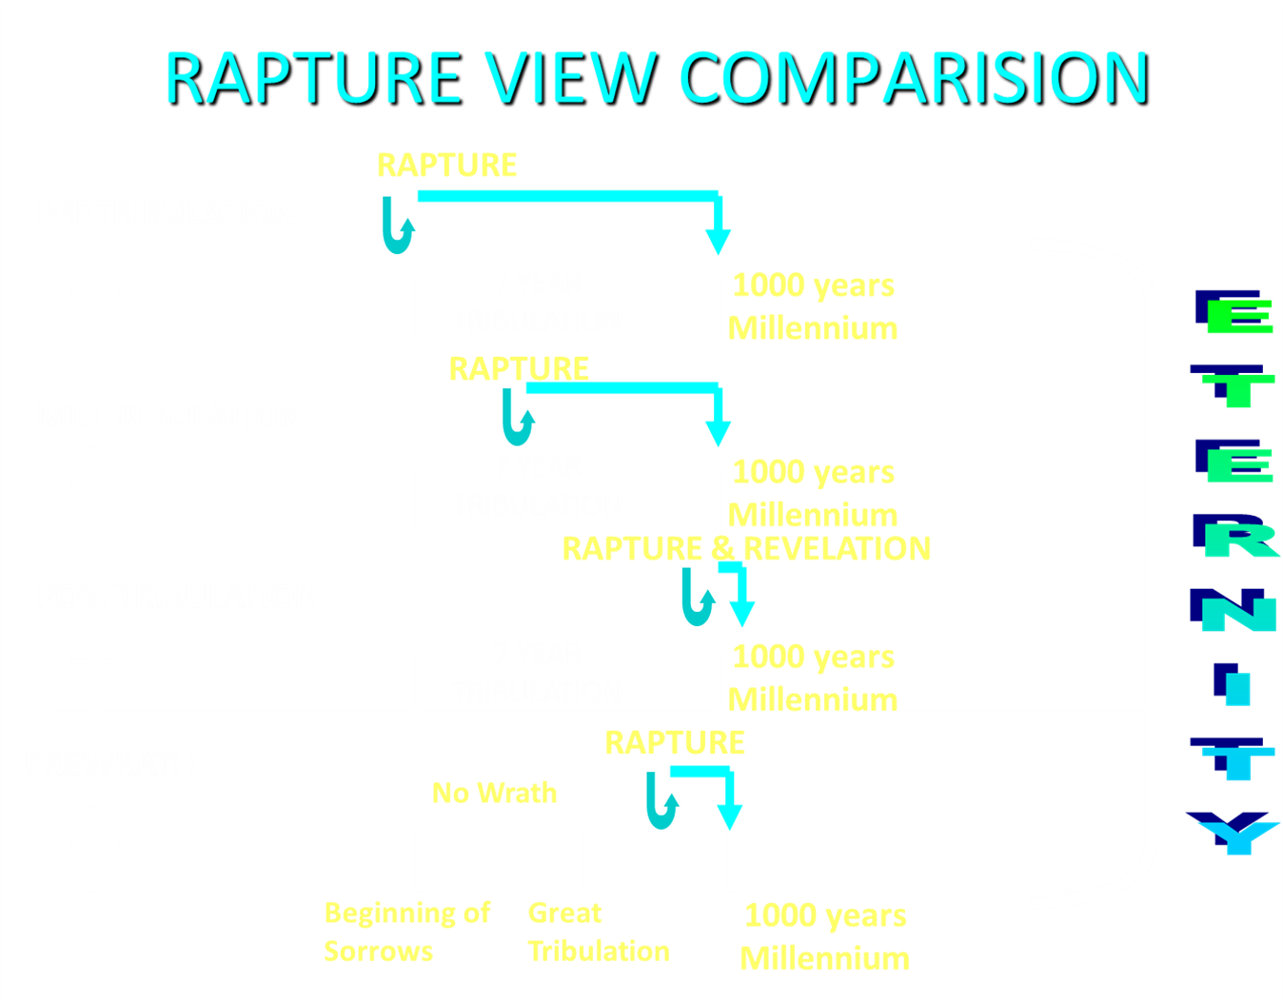

Slide 12
Three Reasons Believers Will Not Be in the Tribulation
(1 Thess. 5:9-11)
    We are not appointed unto wrath (9)
    We are exempted from wrath whether morally asleep or awake (10)
    Promises of comfort (11)

Slide 13

Promised Exemption from Divine Wrath
The promise (1 Thess 1:10; 5:9; Rom 5:9; 8:1; Rev 3:10)
Tribulation = divine wrath/anger (Rev 6:16-17; 11:18; 14:10; 15:1, 7; 16:1, 19; 19:15)

Slide 14
Three Reasons Believers Will Not Be in the Tribulation
(1 Thess. 5:9-11)
    We are not appointed unto wrath (9)
    We are exempted from wrath whether morally asleep or awake (10)
    Promises of comfort (11)

Slide 15


1 Corinthians 15:51
“Behold, I tell you a mystery; we will not all sleep, but we will all be changed.”

Slide 16
Problems with Partial Rapturism?
Every divine blessing is given on the basis of His grace and not human effort (Eph. 2:8-9; Rom. 12:6)
Symbolic parallels mandate that carnal as well as sanctified Christians will be taken up in the rapture (Gen. 19:22; 2 Pe. 2:7)
The promise of the rapture is mentioned in Paul's letter to the carnal Corinthian church (1 Cor. 15:51)
A partial rapture would sever Christ's body (1 Cor 12:12-14)
The partial rapture view subjects believers to God's wrath (Thess 1:10)

Slide 17
Problems with Partial Rapturism?
Partial rapturism makes the Bema Seat Judgment unnecessary (1 Cor. 3:10-15)
Partial rapturists never objectively quantify the exact degree of faithfulness or spiritual maturity that is necessary to participate in the rapture
Partial rapturists appear individually biased
Partial rapturists dispensationally misapply Bible passages (Matt. 25:1-13)
Partial rapturists misapply passages promising a reward to faithful believers (Rev. 3:11)

Slide 18
Three Reasons Believers Will Not Be in the Tribulation
(1 Thess. 5:9-11)
    We are not appointed unto wrath (9)
    We are exempted from wrath whether morally asleep or awake (10)
    Promises of comfort (11)

Slide 19

1 Thessalonians 5:11
“Therefore, encourage one another and build one another up, just as you also are doing.”

Slide 20
1 Thessalonians 5:11
“Therefore, encourage one another and build one another up, just as you also are doing.”

Slide 21
Ephesians 4:1
Therefore…
1-3
4-6

Slide 22
Ephesians: What Is Inside?
1–3 | 4–6
Relationship | Responsibility
Doctrine | Deed
Orthodoxy | Orthopraxy
Knowledge | Wisdom
Belief | Behavior
Position | Practice
Privileges | Responsibility

Slide 23
Galatians 5:1
Therefore…
1-4
5-6

Slide 24
Romans 12:1
Therefore…
1-11
12-16

Slide 25
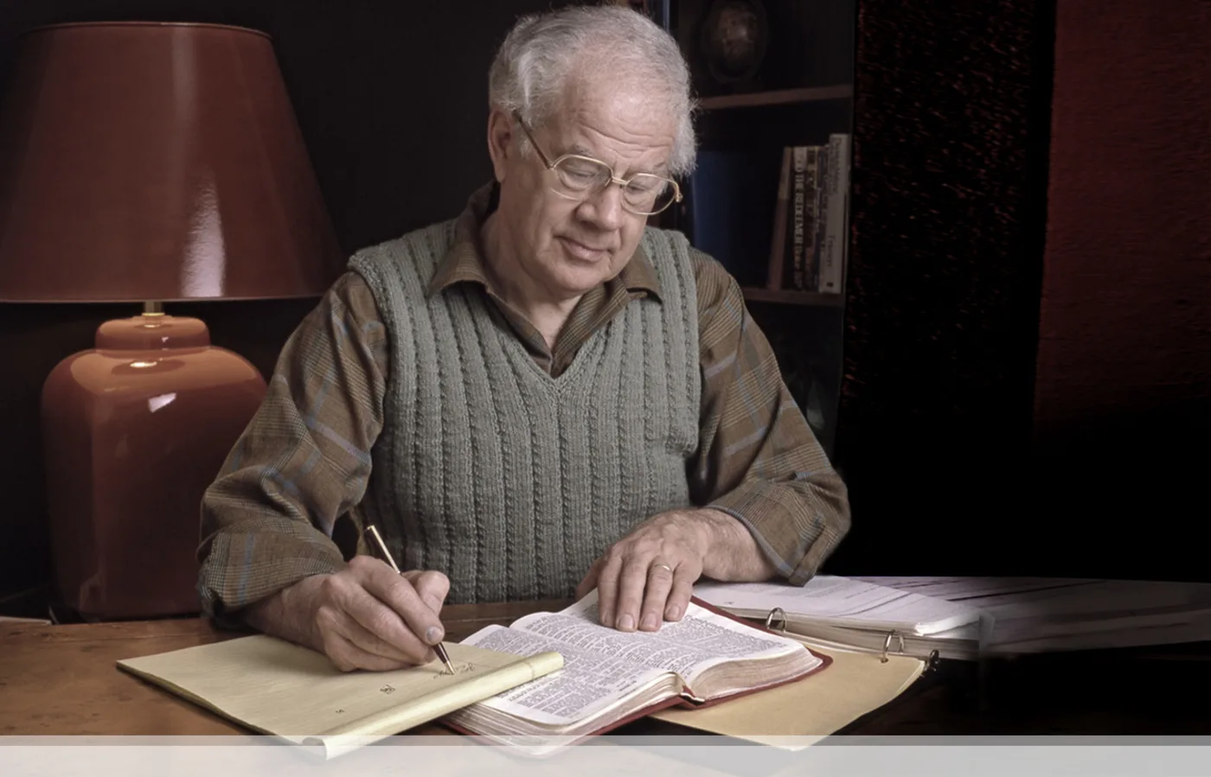

J. Dwight Pentecost
Prophecy For Today, Page 20
“A short time ago, I took occasion to go through the New Testament to mark each reference to the coming of the Lord Jesus Christ and to observe the use made of that teaching about His coming. I was struck a new with the fact that almost without exception, when the coming of Christ is mentioned in the New Testament, it is followed by an exhortation to godliness and holy living.”

Slide 26

2 Peter 3:10-11
“¹⁰ But the day of the Lord will come like a thief, in which the heavens will pass away with a roar and the elements will be destroyed with intense heat, and the earth and its works will be burned up. ¹¹ Since all these things are to be destroyed in this way, what sort of people ought you to be in holy conduct and godliness.”

Slide 27
1 Thessalonians 5:11
“Therefore, encourage one another and build one another up, just as you also are doing.”

Slide 28


John 14:1–4
¹ “Do not let your heart be troubled; believe in God, believe also in Me. ² In My Father’s house are many dwelling places; if it were not so, I would have told you; for I go to prepare a place for you. ³ If I go and prepare a place for you, I will come again and receive you to Myself, that where I am, there you may be also. ⁴ And you know the way where I am going.”

Slide 29

1 Thessalonians 4:13-18
. . .heaven with a shout, with the voice of the archangel and with the trumpet of God, and the dead in Christ will rise first. ¹⁷ Then we who are alive and remain will be caught up together with them in the clouds to meet the Lord in the air, and so we shall always be with the Lord. ¹⁸ Therefore comfort one another with these words."

Slide 30

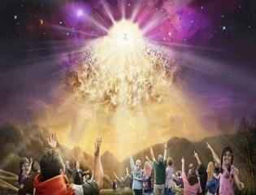

Titus 2:13
“Looking for the blessed hope and the appearing of the glory of our great God and Savior, Christ Jesus.”

Slide 32

Robert H. Gundry, The Church and the Tribulation: Why Christ Won't Come Before the Antichrist Does (Grand Rapids: Zondervan, 1973).

Slide 33

1st Six Seals (Revelation 6)
SEAL 1 – 6:1-2 – Advent of antichrist
SEAL 2 – 6:3-4 – War
SEAL 3 – 6:5-6 – Famine
SEAL 4 – 6:7-8 – Death
SEAL 5 – 6:9-11 – Martyrdoms
SEAL 6 – 6:12-17 – Cosmic disturbances

Slide 35
1 Thessalonians 5:11
“Therefore, encourage one another and build one another up [oikodomeō], just as you also are doing.”

Slide 36


Matthew 16:18
“I also say to you that you are Peter, and upon this rock I will build [oikodomeō] My church; and the gates of Hades WILL NOT overpower it.”

Slide 37
Ephesians 4:11-16
“¹¹ And He gave some as apostles, and some as prophets, and some as evangelists, and some as pastors and teachers, ¹² for the equipping of the saints for the work of service, to the building up of the body of Christ;”

Slide 38
Ephesians 4:11-16
“¹³ until we all attain to the unity of the faith, and of the knowledge of the Son of God, to a mature man, to the measure of the stature which belongs to the fullness of Christ. ¹⁴ As a result, we are no longer to be children, tossed here and there by waves and carried about by every wind of doctrine, by the trickery of men, by craftiness in deceitful scheming;”

Slide 39
Ephesians 4:11-16
“¹⁵ but speaking the truth in love, we are to grow up in all aspects into Him who is the head, even Christ, ¹⁶ from whom the whole body, being fitted and held together by what every joint supplies, according to the proper working of each individual part, causes the growth of the body for the building up of itself in love.”

Slide 40
1 Thessalonians 5:11
“Therefore, encourage one another and build one another up, just as you also are doing.”

Slide 41
Conclusion

Slide 42
Structure
Personal (1–3)
  Genuine conversion (1)
  Impure motives (2:1-16)
  Lack of concern (2:17–3:13)
Practical (4–5)
  Immorality (4:1-8)
  Laziness (4:9-12)
  Eschatology (4:13–5:11)
  Ministry imbalances (5:12-15)
  Progressive sanctification (5:16-28)

Slide 43
Day of the Lord (5:1-11)
Description (5:1-3)
Application (5:4-11)

Slide 44
Structure
Personal (1–3)
  Genuine conversion (1)
  Impure motives (2:1-16)
  Lack of concern (2:17–3:13)
Practical (4–5)
  Immorality (4:1-8)
  Laziness (4:9-12)
  Eschatology (4:13–5:11)
  Ministry imbalances (5:12-15)
  Progressive sanctification (5:16-28)

