Slide 1


Dr. Andy Woods
Senior Pastor – Sugar Land Bible Church
President – Chafer Theological Seminary

Slide 2

Structure
1 THESSALONIANS 1-3 | 1 THESSALONIANS 4-5
Personal Experience | Practical Exhortation
Looking Back | Looking Forward

Slide 3

Structure
Personal (1–3)
  Genuine conversion (1)
  Impure motives (2:1-16)
  Lack of concern (2:17–3:13)
Practical (4–5)
  Immorality (4:1-8)
  Laziness (4:9-12)
  Eschatology (4:13–5:11)
  Ministry imbalances (5:12-15)
  Progressive sanctification (5:16-28)

Slide 4
Structure
Personal (1–3)
  Genuine conversion (1)
  Impure motives (2:1-16)
  Lack of concern (2:17–3:13)
Practical (4–5)
  Immorality (4:1-8)
  Laziness (4:9-12)
  Eschatology (4:13–5:11)
  Ministry imbalances (5:12-15)
  Progressive sanctification (5:16-28)

Slide 5
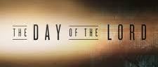
Day of the Lord (5:1-11)
Description (5:1-3)
Application (5:4-11)

Slide 6
Day of the Lord (5:1-11)
Description (5:1-3)
Application (5:4-11)

Slide 7


Slide 8


Slide 9
Day of the Lord (5:1-11)
Description (5:1-3)
Application (5:4-11)

Slide 10
Three Reasons Believers Will Not Be in the Tribulation
(1 Thess. 5:9-11)
    We are not appointed unto wrath (9)
    We are exempted from wrath whether morally asleep or awake (10)
    Promises of comfort (11)

Slide 11
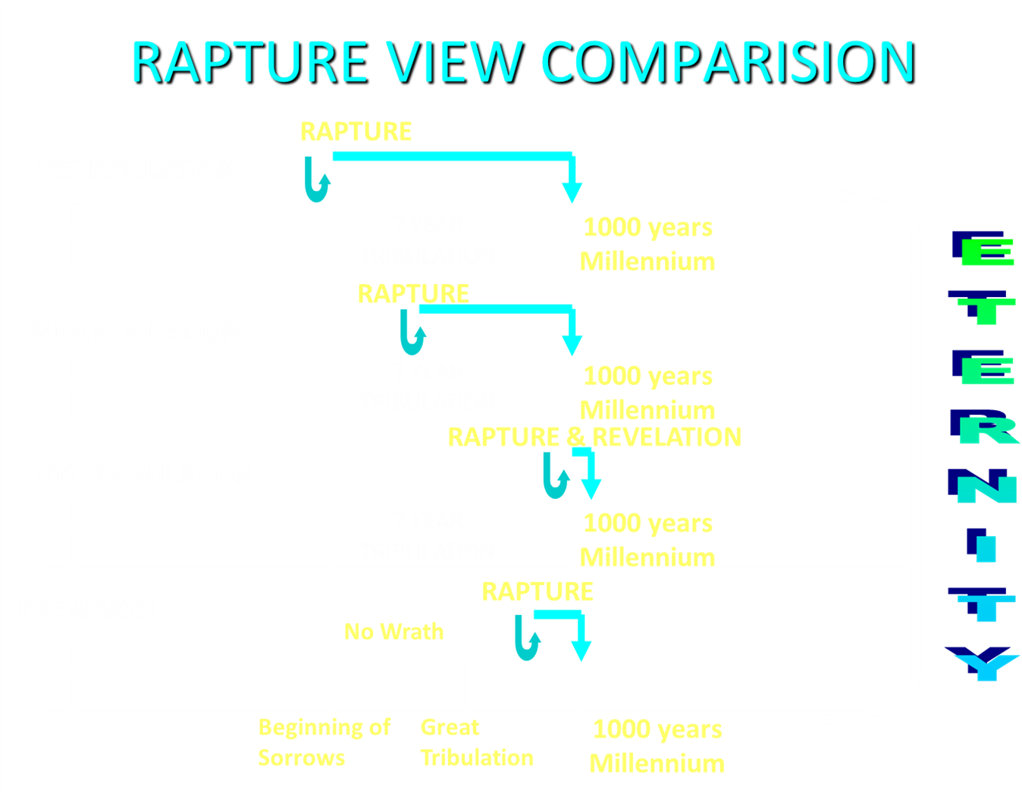

Slide 12
Three Reasons Believers Will Not Be in the Tribulation
(1 Thess. 5:9-11)
    We are not appointed unto wrath (9)
    We are exempted from wrath whether morally asleep or awake (10)
    Promises of comfort (11)

Slide 13

Promised Exemption from Divine Wrath
The promise (1 Thess 1:10; 5:9; Rom 5:9; 8:1; Rev 3:10)
Tribulation = divine wrath/anger (Rev 6:16-17; 11:18; 14:10; 15:1, 7; 16:1, 19; 19:15)

Slide 14


1 Thessalonians 1:10
“and to wait for His Son from heaven, whom He raised from the dead, that is Jesus, who rescues (rhyomai) us from (ek) the wrath (orgē) to come..”

Slide 15



Slide 16
1st Six Seals (Revelation 6)
SEAL 1 – 6:1-2 – Advent of antichrist
SEAL 2 – 6:3-4 – War
SEAL 3 – 6:5-6 – Famine
SEAL 4 – 6:7-8 – Death
SEAL 5 – 6:9-11 – Martyrdoms
SEAL 6 – 6:12-17 – Cosmic disturbances

Slide 17
Revelation 6:16-17
^{“16} and they (unbelievers) said to the mountains and to the rocks, ‘Fall on us and hide us from the presence of Him who sits on the throne, and from the wrath [orgḗ] of the Lamb; ¹⁷ for the great day of their wrath [orgḗ] has come, and who is able to stand?’”

Slide 18

Rev. 6:16-17
Robert L. Thomas, Revelation 1–7: An Exegetical Commentary, ed. Kenneth Barker (Chicago: Moody, 1992), 457-58.
"Mankind in his rebellion correctly analyzes the cosmic and terrestrial disturbances as a part of the great end-time day of wrath from the one sitting on the throne and from the Lamb. The verb ēlethen ("has come") is aorist indicative, referring to a previous arrival of wrath, not something that is about to take place. Men see the arrival of this day at least as early as the cosmic upheavals that characterize the sixth seal (6:12-14), but upon reflection they probably recognize that it was already in effect with the death of one-fourth of the population (6:7-8), the worldwide famine (6:5-6), and the global warfare (6:3-4). The rapid sequence of all of these events could not escape notice, but the light of their true explanation does not dawn upon human consciousness until the severe phenomena of the sixth seal arrive."

Slide 19
Three Tenses of Salvation
Phase | Justification | Sanctification | Glorification
Tense | Past | Present | Future
Saved from sin’s: | Penalty | Power | Presence
Scripture | Eph 2:8-9; Titus 3:5 | Philip 2:12 | Rom 5:10

Slide 20

Romans 13:11-12
“Do this, knowing the time, that it is already the hour for you to awaken from sleep; for now salvation is nearer to us than when we believed. ¹² The night is almost gone, and the day is near. Therefore, let us lay aside the deeds of darkness and put on the armor of light.”

Slide 21

Romans 8:29-30
²⁹ For those whom He foreknew, He also predestined to become conformed to the image of His Son, so that He would be the firstborn among many brethren; ³⁰ and these whom He predestined, He also called; and these whom He called, He also justified; and these whom He justified, He also glorified.

Slide 22

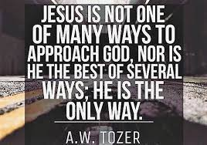
John 14:6
“Jesus said to him, ‘I am the way, and the truth, and the life; no one comes to the Father but through Me.’”

Slide 23
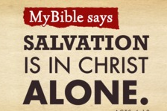
Acts 4:12
“And there is salvation in no one else; for there is no other name under heaven that has been given among men by which we must [dei] be saved.”

Slide 24
Three Reasons Believers Will Not Be in the Tribulation
(1 Thess. 5:9-11)
    We are not appointed unto wrath (9)
    We are exempted from wrath whether morally asleep or awake (10)
    Promises of comfort (11)

Slide 25

1 Thessalonians 4:13-18
¹³ "But we do not want you to be uninformed, brethren, about those who are asleep, so that you will not grieve as do the rest who have no hope. ¹⁴ For if we believe that Jesus died and rose again, even so God will bring with Him those who have fallen asleep in Jesus. ¹⁵ For this we say to you by the word of the Lord, that we who are alive and remain until the coming of the Lord, will not precede those who have fallen asleep. ¹⁶ For the Lord Himself will descend from . . .

Slide 26
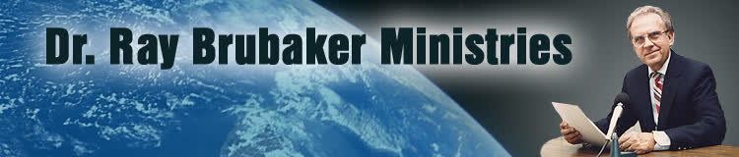
Ray Brubaker
"The Purpose of the Tribulation," Radar News, (December 1968): 6.
“Finally, we should note that the purpose of the tribulation is also to be the testing of lukewarm shallow Laodicean Christians who will be left behind at the coming of Christ. No doubt multitudes who expect to be raptured will be disappointed because like the foolish virgins, they were not watchful. Tribulation is then for the purpose of trying the faith of those who profess to be Christians but who really never repented or are living in disobedience to the will of God.”

Slide 27

G.N.H. Peters
Theocratic Kingdom, 2:332
“It is not simply those who ‘watch’ that shall ‘escape,’ but those, Luke 21:36 who ‘watch and pray always,’ avoiding the corrupting influences around them. The number of translated ones may not be very large (for the number of translated ones given as...types in comparison with the number of those not translated, and with that of the resurrected saints is small so that Dr. Seiss, with whom many concur, is undoubtedly correct in saying: ‘I have no idea that a very large portion of mankind, or even of the professing Church, will be thus taken. The first translation, if I may so speak, will embrace only the select few who watch and pray always,’ etc.””

Slide 28


1 Corinthians 15:51
“Behold, I tell you a mystery; we will not all sleep, but we will all be changed.”

Slide 29
Three Reasons Believers Will Not Be in the Tribulation
(1 Thess. 5:9-11)
    We are not appointed unto wrath (9)
    We are exempted from wrath whether morally asleep or awake (10)
    Promises of comfort (11)

Slide 30

2 Peter 3:10-11
“¹⁰ But the day of the Lord will come like a thief, in which the heavens will pass away with a roar and the elements will be destroyed with intense heat, and the earth and its works will be burned up. ¹¹ Since all these things are to be destroyed in this way, what sort of people ought you to be in holy conduct and godliness.”

Slide 31
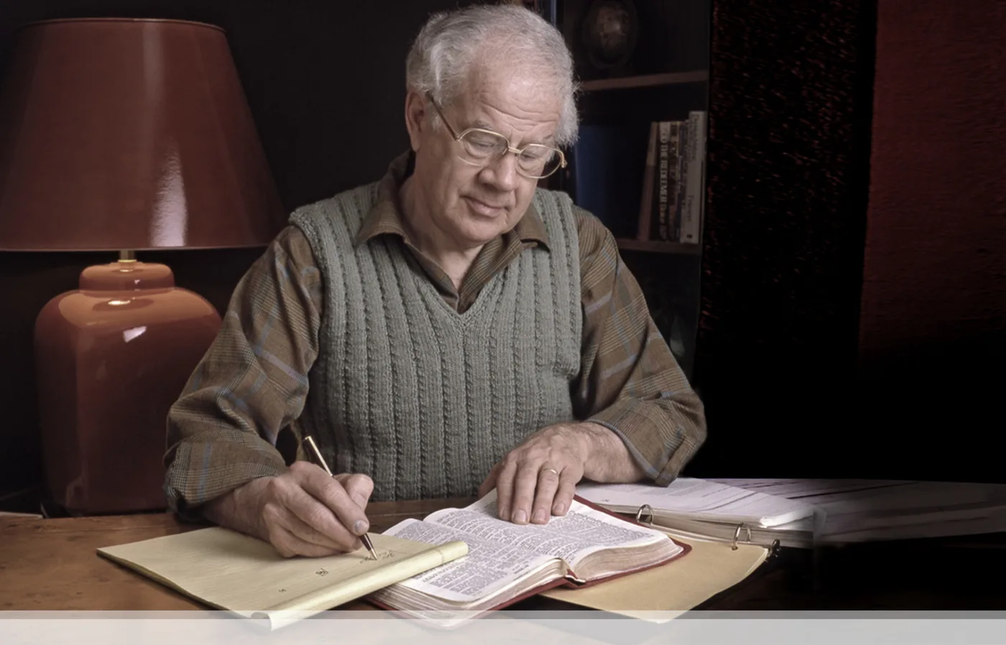

J. Dwight Pentecost
Prophecy For Today, Page 20
“A short time ago, I took occasion to go through the New Testament to mark each reference to the coming of the Lord Jesus Christ and to observe the use made of that teaching about His coming. I was struck a new with the fact that almost without exception, when the coming of Christ is mentioned in the New Testament, it is followed by an exhortation to godliness and holy living.”

Slide 32


John 14:1–4
¹ “Do not let your heart be troubled; believe in God, believe also in Me. ² In My Father’s house are many dwelling places; if it were not so, I would have told you; for I go to prepare a place for you. ³ If I go and prepare a place for you, I will come again and receive you to Myself, that where I am, there you may be also. ⁴ And you know the way where I am going.”

Slide 33
1 Thessalonians 4:13-18
. . .heaven with a shout, with the voice of the archangel and with the trumpet of God, and the dead in Christ will rise first. ¹⁷ Then we who are alive and remain will be caught up together with them in the clouds to meet the Lord in the air, and so we shall always be with the Lord. ¹⁸ Therefore comfort one another with these words."

Slide 34

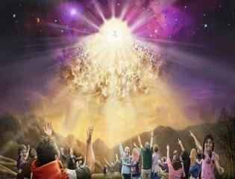

Titus 2:13
“Looking for the blessed hope and the appearing of the glory of our great God and Savior, Christ Jesus.”

Slide 36
Ephesians 4:11-16
“¹¹ And He gave some as apostles, and some as prophets, and some as evangelists, and some as pastors and teachers, ¹² for the equipping of the saints for the work of service, to the building up of the body of Christ;”

Slide 37
Ephesians 4:11-16
“¹³ until we all attain to the unity of the faith, and of the knowledge of the Son of God, to a mature man, to the measure of the stature which belongs to the fullness of Christ. ¹⁴ As a result, we are no longer to be children, tossed here and there by waves and carried about by every wind of doctrine, by the trickery of men, by craftiness in deceitful scheming;”

Slide 38
Ephesians 4:11-16
“¹⁵ but speaking the truth in love, we are to grow up in all aspects into Him who is the head, even Christ, ¹⁶ from whom the whole body, being fitted and held together by what every joint supplies, according to the proper working of each individual part, causes the growth of the body for the building up of itself in love.”

Slide 39
Conclusion

Slide 40
Structure
Personal (1–3)
  Genuine conversion (1)
  Impure motives (2:1-16)
  Lack of concern (2:17–3:13)
Practical (4–5)
  Immorality (4:1-8)
  Laziness (4:9-12)
  Eschatology (4:13–5:11)
  Ministry imbalances (5:12-15)
  Progressive sanctification (5:16-28)

Slide 41
Day of the Lord (5:1-11)
Description (5:1-3)
Application (5:4-11)

Slide 42
Structure
Personal (1–3)
  Genuine conversion (1)
  Impure motives (2:1-16)
  Lack of concern (2:17–3:13)
Practical (4–5)
  Immorality (4:1-8)
  Laziness (4:9-12)
  Eschatology (4:13–5:11)
  Ministry imbalances (5:12-15)
  Progressive sanctification (5:16-28)

