Slide 2
Acts 2 Chapter Summary
Coming of the Holy Spirit (1-4)
Holy Spirit’s Impact (5-13)
Peter’s Sermon (14-36)
Sermon’s Impact (37-47)

Slide 3
Coming of the Holy Spirit Acts 2:37-47
Salvation (37-41)
Church (42-47)

Slide 4
Acts 2:37-41 Salvation
Conviction (37)
Repentance & Baptism (38-39)
Consequence of Repentance (40)
Result (41)

Slide 5
Acts 2:41
“So then, those who had received his word were baptized; and that day there were added about three thousand souls.”

Slide 6
John 1:12
“But as many as received Him, to them He gave the right to become children of God, even to those who believe in His name.”

Slide 7
John 1:12
“But as many as received Him, to them He gave the right to become children of God, even to those who believe in His name.”

Slide 8
Acts 2:41
“So then, those who had received his word were baptized; and that day there were added about three thousand souls.”

Slide 9
Acts 2:41
“So then, those who had received his word were baptized; and that day there were added about three thousand souls.”

Slide 10
Reasons for Understanding 1000 Literally (Revelation 20:1-10)
John’s use of indefinite concepts elsewhere
Revelation 20:3,8
Exception to the “# of years” examples?
Other numbers are taken literally
Two witnesses (11:3), 7000 people (11:13), 4 Angels (7:1) 7 Angels (8:6),144,000 Jews (7:4), 42 months (11:2), 1260 days (11:3)
Not always a symbolic interpretation
(Rev. 17:18)

Slide 12
Message
Birth and growth of the church numerically, geographically, ethnically.
Components
Numerically (progress reports)
Geographically (From Jerusalem to Rome)
Ethnically (From Judaism to Gentile domination)

Slide 13
Progress Reports
Clearest: Acts 2:47; 6:7; 9:31; 12:24; 16:5; 19:20; 28:30-31
Less clear: Acts 1:13, 15; 2:41; 4:4, 31; 5:14, 42; 8:25, 40; 11:21; 13:49; 17:6

Slide 14
Coming of the Holy Spirit Acts 2:37-47
Salvation (37-41)
Church (42-47)

Slide 15
Acts 2:42-47 Church
Priorities (42)
Miracles (43)
Unity (44)
Communal living (45)
Lord’s Table (46)
Evangelism (47)

Slide 16
Acts 2:42-47 Church
Priorities (42)
Miracles (43)
Unity (44)
Communal living (45)
Lord’s Table (46)
Evangelism (47)

Slide 17
Activities of the Local Church (Acts 2:41-47)
Doctrine (Acts 2:42)
Ordinances (Acts 2:41-42, 46)
Prayer (Acts 2:42)
Evangelism (Acts 2:47)
Worship (Acts 2:47)
Benevolence (Acts 2:44-45)
Fellowship (Acts 2:42, 46-47)

Slide 18
Acts 2:42-47 Church
Priorities (42)
Miracles (43)
Unity (44)
Communal living (45)
Lord’s Table (46)
Evangelism (47)

Slide 19
Antichrist’s Satanic Miracles (2 Thessalonians 2:9)
MIRACLE | GREEK | CHRIST’S MINISTRY
Powers | Dynamis | Matt. 11:20
Signs | Semēion | John 20:30
Wonders | Teras | Acts 2:22

Slide 20
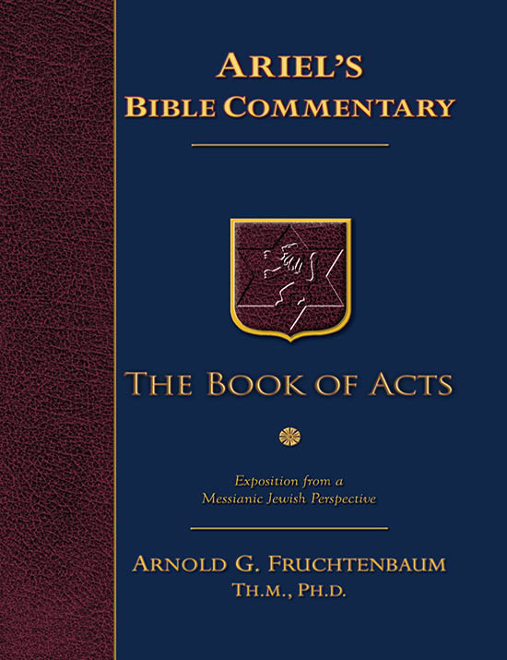
Dr. Arnold G. Fruchtenbaum
The Book of Acts, 83
“The apostles did many signs and wonders. In fact, the only ones who performed miracles in the book of Acts were the apostles or their delegates, such as Stephen (Acts 6:8). These apostolic legates were appointed by the laying on of hands by the apostles. Signs and wonders were not performed by the believers at large.”

Slide 21
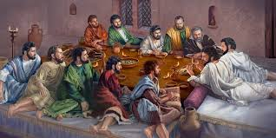
Ephesians 2:20
“having been built on the foundation of the apostles and prophets, Christ Jesus Himself being the corner stone.”

Slide 22
Miracle Clusters In Scripture
NUM. | ERA | AUTHENTICATION
1. | Moses | Law
2. | Joshua | Conquest
3. | Elijah-Elisha | Prophet
4. | Christ | Kingdom offer
5. | Apostles | Church
6. | Tribulation & Millennium | Kingdom establishment

Slide 23
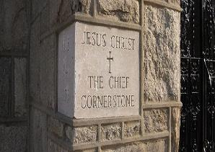
2 Timothy 4:20
“Erastus remained at Corinth, but Trophimus I left sick at Miletus.”

Slide 24
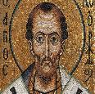
Chrysostom (A.D. 345‒407)
Patriarch of Constantinople, Chrysostom, Homily 29 on First Corinthians.
“This whole place is very obscure: but the obscurity is produced by our ignorance of the facts referred to and by their cessation, being such as then used to occur but now no longer take place. And why do they not happen now? Why look now, the cause too of the obscurity has produced us again another question: namely, why did they then happen, and now do so no more?”

Slide 25
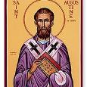
Augustine (A.D. 354‒430)
Bishop of Hippo, Homily 6:10 on the First Epistle of John.
“In the earliest times, the Holy Ghost fell upon them that believed: and they spoke with tongues, which they had not learned, as the Spirit gave them utterance. Acts 2:4 These were signs adapted to the time. For there behooved to be that betokening of the Holy Spirit in all tongues, to show that the Gospel of God was to run through all tongues over the whole earth. That thing was done for a betokening, and it passed away. . . . If then the witness of the presence of the Holy Ghost be not now given through these miracles, by what is it given, by what does one get to know that he has received the Holy Ghost?”

Slide 26
Philip Schaff
History of the Christian Church, vol. 1 , p. 236-37.
“We do not know how long the glossolalia, as thus described by Paul, continued. It passed away gradually with the other extraordinary or strictly supernatural gifts of the apostolic age. It is not mentioned in the Pastoral, nor in the Catholic Epistles. We have but a few allusions to it at the close of the second century. Irenæus (Adv. Haer. 1. v. c. 6 § 1,) speaks of ‘many brethren’ whom he heard in the church having the gift of prophecy and of speaking in ‘diverse tongues’ (παντοδαπαῖς γλώσσαις), bringing the hidden things of men (τὰ κρύφια τῶν ἀνθρώπων) to light and expounding the mysteries of God (τὰ μυστήρια τοῦ θεοῦ). It is not clear whether by the term ‘diverse,’ which does not elsewhere occur, he means a speaking in foreign languages, or in . . .

Slide 27
Philip Schaff
History of the Christian Church, vol. 1 , p. 236-37.
“…diversities of tongues altogether peculiar, like those meant by Paul.” The latter is more probable. Irenæus himself had to learn the language of Gaul. Tertullian (Adv. Marc. V. 8; comp. De Anima, c. 9) obscurely speaks of the spiritual gifts, including the gift of tongues, as being still manifest among the Montanists to whom he belonged. At the time of Chrysostom it had entirely disappeared; at least he accounts for the obscurity of the gift from our ignorance of the fact. From that time on the glossolalia was usually misunderstood as a miraculous and permanent gift of foreign languages for missionary purposes. But the whole history of missions furnishes no clear example of such a gift for such a purpose.”

Slide 28
Acts 2:42-47 Church
Priorities (42)
Miracles (43)
Unity (44)
Communal living (45)
Lord’s Table (46)
Evangelism (47)

Slide 29
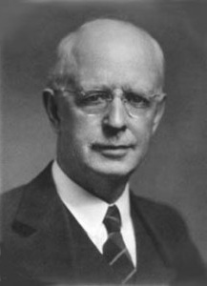
Lewis Sperry Chafer
vol. 7, Systematic Theology (Grand Rapids, MI: Kregel Publications, 1993), 265-66.
“This vital newness of mind is a part of believing, after all, and therefore it may be and is used as a synonym for believing at times (cf. Acts 17:30; 20:21; 26:20; Rom. 2:4; 2Tim. 2:25; 2 Pet. 3:9). Repentance nevertheless cannot be added to believing as a condition of salvation, because upwards of 150 passages of Scripture condition salvation upon believing only (cf. John 3:16; Acts 16:31).”

Slide 30
John 17:20-23
²⁰ “I do not ask on behalf of these alone, but for those also who believe in Me through their word; ²¹ that they may all be one; even as You, Father, are in Me and I in You, that they also may be in Us, so that the world may believe that You sent Me. ²² The glory which You have given Me I have given to them, that they may be one, just as We are one; ²³ I in them and You in Me, that they may be perfected in unity, so that the world may know that You sent Me, and loved them, even as You have loved Me.”

Slide 31
1 Corinthians 12:13
“For by one Spirit we were all baptized into one body, whether Jews or Greeks, whether slaves or free, and we were all made to drink of one Spirit.”

Slide 32
Lewis Sperry Chafer
vol. 5, Systematic Theology (Grand Rapids, MI: Kregel Publications, 1993), 158.
“Thoughtless and absurd is the modern notion that Christ was praying that denominations which exist in this remote time and in a country then unknown might become organically united in one, and therefore it is the duty of all sects to unite and thus help to answer this prayer. As indicated before, this unity is sought at the hand of the Father, indicating that it is a divine undertaking. It is that, and it results in a unity as organic and vital as that between the Father and the Son. This prayer began to be answered on the Day of Pentecost when believers were by the Spirit baptized into one Body, and is constantly answered whenever a soul is saved and thus joined as a member to the Body of Christ by the same baptism of the Spirit.”

Slide 33
Acts 2:42-47 Church
Priorities (42)
Miracles (43)
Unity (44)
Communal living (45)
Lord’s Table (46)
Evangelism (47)

Slide 34
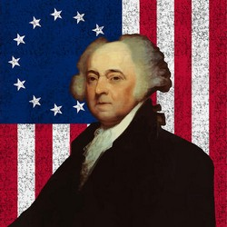
John Adams
John Adams, A Defence of the Constitutions of Government of the United States of America, 3 vols., American Constitutional and Legal History, ed. Leonard W. Levy (London: Dilly, 1787; reprint, NY: Da Capo, 1971), 3:217
“The moment the idea is admitted into society, that property is not as sacred as the laws of God, and that there is not a force of law and public justice to protect it, anarchy and tyranny commence. If ‘Thou Shalt Not Covet,’ and ‘Thou Shalt Not Steal’ were not commandments of Heaven, they must be made inviolable precepts in every society before it can be civilized or made free.”

Slide 35
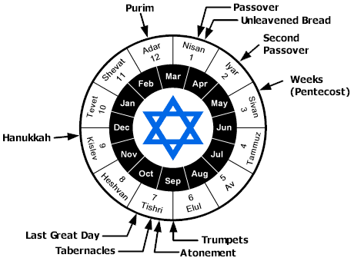

Slide 36
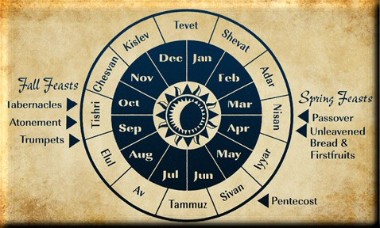

Slide 37
Acts 2:42-47 Church
Priorities (42)
Miracles (43)
Unity (44)
Communal living (45)
Lord’s Table (46)
Evangelism (47)

Slide 38
Acts 2:42-47 Church
Priorities (42)
Miracles (43)
Unity (44)
Communal living (45)
Lord’s Table (46)
Evangelism (47)

Slide 39
Matthew 16:18
“I also say to you that you are Peter, and upon this rock I will build [oikodomeō] My church; and the gates of Hades WILL NOT overpower it.”

Slide 40
Acts 2:47
“praising God and having favor with all the people. And the Lord was adding to their number day by day those who were being saved.” (NASB)
“praising God and having favor with all the people. And the Lord added to the church daily those who were being saved.” (NKJV)

Slide 41
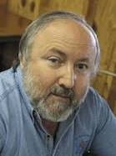
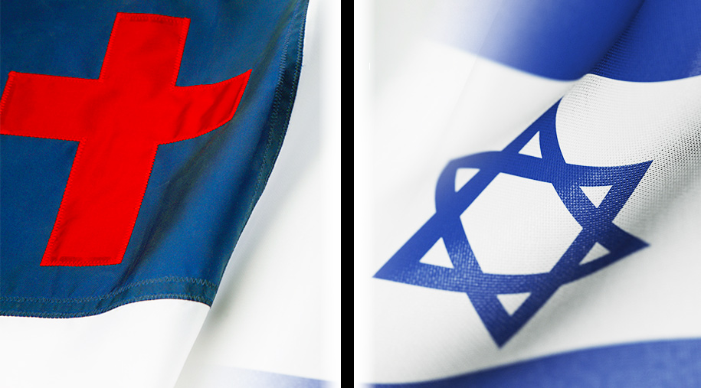
Arnold Fruchtenbaum Arnold G. Fruchtenbaum, “Israel and the Church,” in Issues in Dispensationalism, ed. Wesley R. Willis and John R. Master (Chicago: Moody, 1994), 118.
“In the book of Acts, both Israel and the church exist simultaneously. The term Israel is used twenty times and ekklēsia (church) nineteen times, yet the two groups are always kept distinct.”

Slide 42
Conclusion

Slide 43
Acts 2 Chapter Summary
Coming of the Holy Spirit (1-4)
Holy Spirit’s Impact (5-13)
Peter’s Sermon (14-36)
Sermon’s Impact (37-47)

