Slide 1
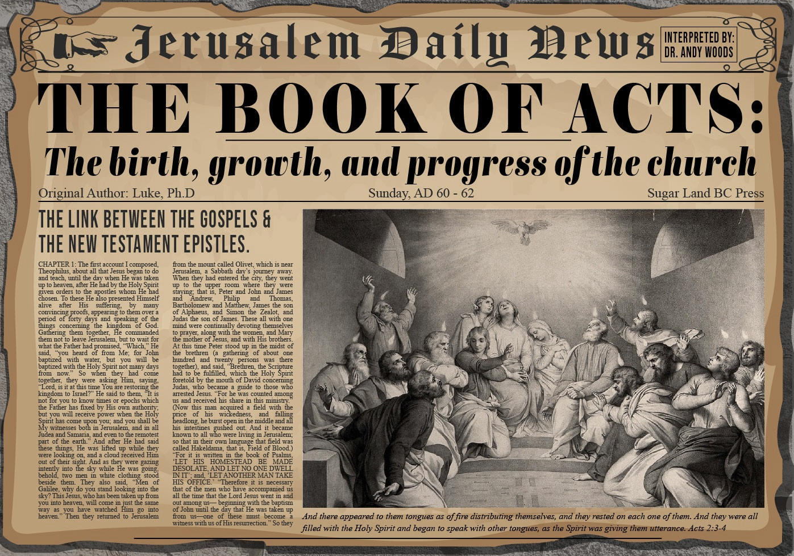


Slide 2
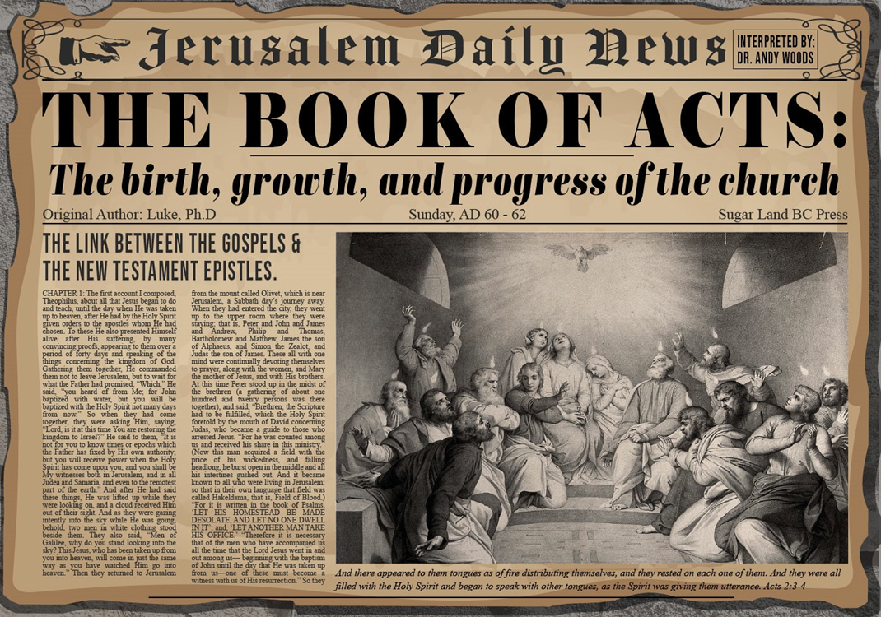
Introductory Matters
Title
Authorship
Biography
Place of writing
Recipient
Purpose
Message
Method
Sources
Date
Structure
Scope
Themes
Unique characteristics

Slide 3
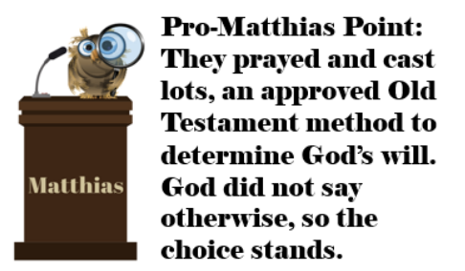
Acts 1
Chapter Summary
  Prologue (1-5)
  Jesus’ Ascension (6-11)
  Return to Jerusalem (12-14)
  Matthias Chosen (15-26)

Slide 4
Acts 2
Chapter Summary
  Coming of the Holy Spirit (1-4)
  Holy Spirit’s Impact (5-13)
  Peter’s Sermon (14-36)
  Sermon’s Impact (37-47)

Slide 5
Acts 2
Chapter Summary
  Coming of the Holy Spirit (1-4)
  Holy Spirit’s Impact (5-13)
  Peter’s Sermon (14-36)
  Sermon’s Impact (37-47)

Slide 6
Coming of the Holy Spirit
Acts 2:1-4
  Occasion (1)
  Events (2-4)

Slide 7
Coming of the Holy Spirit
Acts 2:1-4
  Occasion (1)
  Events (2-4)

Slide 8


Slide 9
Levitical Feasts (Leviticus 23)
Feast | Season | Purpose | Type
Passover | Spring | Redemption | 1 Cor 5:7
Unleavened Bread | Spring | Separation | John 6:35
1st Fruits | Spring | Praise | 1 Cor 15:20
Pentecost | Spring | Praise | Acts 2:1-4
Trumpets | Fall | New Year | Matt 24:31
Atonement | Fall | Lev 16 | Zech 12:10
Booths | Fall | Wilderness provision | Zech 14:16-18

Slide 10


Slide 11
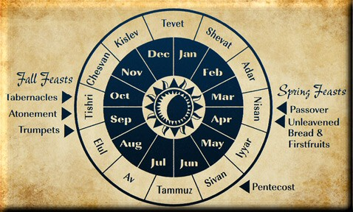

Slide 12
Coming of the Holy Spirit
Acts 2:1-4
  Occasion (1)
  Events (2-4)

Slide 13

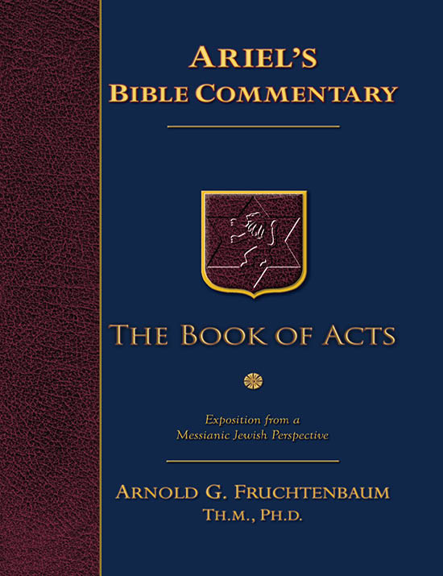
Dr. Arnold G. Fruchtenbaum
The Book of Acts, 63
“The word ‘tongues’ means that the apostles began to speak in a language other than their own native tongue. It was a real, known, spoken language with all the rules of grammar, diction, and syntax common to all languages. It was not merely the rapid repetition of three or four syllables that is passed off as tongues today. The source of this gift of languages was the Holy Spirit: as the Spirit gave them utterance. In other words, the Holy Spirit provided the gift of tongues or languages, which is one of His spiritual gifts.”

Slide 14

Revelation 9:11 (KJV)
“And they had a king over them, which is the angel of the bottomless pit, whose name in the Hebrew tongue (language) is Abaddon, but in the Greek tongue (language) hath his name Apollyon.”

Slide 15
1 Corinthians 14:21-22
“²¹ In the Law it is written, ‘By men of strange tongues and by the lips of strangers I will speak to this people, and even so they will not listen to Me,’ says the Lord. ²² So then tongues are for a sign, not to those who believe but to unbelievers; but prophecy is for a sign, not to unbelievers but to those who believe.”

Slide 16
Miracle Clusters In Scripture
NUM. | ERA | AUTHENTICATION
1. | Moses | Law
2. | Joshua | Conquest
3. | Elijah-Elisha | Prophet
4. | Christ | Kingdom offer
5. | Apostles | Church
6. | Tribulation & Millennium | Kingdom establishment

Slide 17

Genesis 11:1-9
¹ Now the whole earth used the same language and the same words. ² It came about as they journeyed east, that they found a plain in the land of Shinar and settled there. ³ They said to one another, “Come, let us make bricks and burn them thoroughly.” And they used brick for stone, and they used tar for mortar. ⁴ They said, “Come, let us build for ourselves a city, and a tower whose top will . . .

Slide 18
Genesis 11:1-9 (cont’d)
…reach into heaven, and let us make for ourselves a name, otherwise we will be scattered abroad over the face of the whole earth.” ⁵ The Lord came down to see the city and the tower which the sons of men had built. ⁶ The Lord said, “Behold, they are one people, and they all have the same language. And this is what they began to do, and now nothing which they purpose to do will be …

Slide 19
Genesis 11:1-9 (cont’d)
…impossible for them. ⁷ “Come, let Us go down and there confuse their language, so that they will not understand one another’s speech.” ⁸ So the Lord scattered them abroad from there over the face of the whole earth; and they stopped building the city. ⁹ Therefore its name was called Babel, because there the Lord confused the language of the whole earth; and from there the Lord scattered them abroad over the face of the whole earth.

Slide 20

Genesis 1:1-3
“¹ In the beginning God created the heavens and the earth. ² The earth was formless and void, and darkness was over the surface of the deep, and the Spirit of God was moving over the surface of the waters. ³ Then God said, ‘Let there be light’; and there was light.”

Slide 21

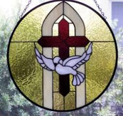
1 Samuel 16:13-14
¹³ Then Samuel took the horn of oil and anointed him in the midst of his brothers; and the Spirit of the Lord came mightily upon David from that day forward. And Samuel arose and went to Ramah. ¹⁴ Now the Spirit of the Lord departed from Saul, and an evil spirit from the Lord terrorized him.

Slide 22
John 14:16-17
¹⁶ I will ask the Father, and He will give you another Helper, that He may be with you forever; ¹⁷ that is the Spirit of truth, whom the world cannot receive, because it does not see Him or know Him, but you know Him because He abides with you and will be in you.

Slide 23
WORK OF THE SPIRIT IN THE OT
 | OT/GOSPELS/ACTS 1 | ACTS 2/TODAY
External vs. Internal | Upon (1 Sam. 16:13) | Within (John 14:17)
Reception of all of the Spirit at the moment of salvation? | Subsequent to salvation (Exod 31:3) | At moment of salvation (Rom 8:9)
How long is the indwelling? | Temporary indwelling (1 Sam 16:14; Ps 51:11) | Permanent indwelling (John 14:16)
Who is indwelt? | Selective indwelling (Joel 2:28) | Universal indwelling (1 Cor 12:13)

Slide 24

When Did the Church Begin?
Christ referred to the Church in the future tense (Matt. 16:18)
Paul referred to the Church as a “mystery” (Eph. 3:4-5, 9)
The Church did not exist prior to Acts 1 since Christ became the head of the Church (Eph. 5:23) after His Ascension (Eph. 1:20-22)
The Church did not exist prior to Acts 1 since spiritual gifts (1 Cor. 12:7; 14:26) only came into existence after His Ascension (Eph. 4:7-11)

Slide 25
When Did the Church Begin?
The Church existed before Paul’s conversion in Acts 9 (Acts 5:11; 8:1,3; Rom. 16:7)
The Baptizing (joining, uniting, identifying) ministry of the Holy Spirit began in Acts 2
  1 Cor. 12:13
  Acts 1:5
  Acts 11:15-16
  Acts 2:1-4, 37-41

Slide 26

1 Corinthians 12:13
“For by one Spirit we were all baptized into one body, whether Jews or Greeks, whether slaves or free, and we were all made to drink of one Spirit.”

Slide 27
Acts 1:5
for John baptized with water, but you will be baptized with the Holy Spirit not many days from now.

Slide 28

Acts 11:15-16
¹⁵ And as I began to speak, the Holy Spirit fell upon them just as He did upon us at the beginning. ¹⁶ And I remembered the word of the Lord, how He used to say, ‘John baptized with water, but you will be baptized with the Holy Spirit.’

Slide 29
Acts 2
Chapter Summary
  Coming of the Holy Spirit (1-4)
  Holy Spirit’s Impact (5-13)
  Peter’s Sermon (14-36)
  Sermon’s Impact (37-47)

Slide 30
Holy Spirit’s Impact
Acts 2:5-13
  Circumstances (5)
  Manifestation of tongues (6-8)
  Nations in the Diaspora (9-12)
  Charge of drunkenness (13)

Slide 31
Holy Spirit’s Impact
Acts 2:5-13
  Circumstances (5)
  Manifestation of tongues (6-8)
  Nations in the Diaspora (9-12)
  Charge of drunkenness (13)

Slide 32
Levitical Feasts (Leviticus 23)
Feast | Season | Purpose | Type
Passover | Spring | Redemption | 1 Cor 5:7
Unleavened Bread | Spring | Separation | John 6:35
1st Fruits | Spring | Praise | 1 Cor 15:20
Pentecost | Spring | Praise | Acts 2:1-4
Trumpets | Fall | New Year | Matt 24:31
Atonement | Fall | Lev 16 | Zech 12:10
Booths | Fall | Wilderness provision | Zech 14:16-18

Slide 33
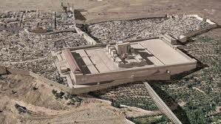
Christ’s Five Trips to Jerusalem In John’s Gospel
Feast | Verse
Passover | 2:23
Unnamed | 5:1
Tabernacles | 7:2
Dedication | 10:22
Passover | 13:1

Slide 34


Slide 35
Holy Spirit’s Impact
Acts 2:5-13
  Circumstances (5)
  Manifestation of tongues (6-8)
  Nations in the Diaspora (9-12)
  Charge of drunkenness (13)

Slide 36
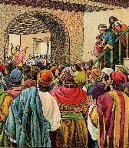
Acts 2:6
“Now when this was noised abroad, the multitude came together, and were confounded, because that every man heard them speak in his own language [dialektos].”

Slide 37
Miracle Clusters In Scripture
NUM. | ERA | AUTHENTICATION
1. | Moses | Law
2. | Joshua | Conquest
3. | Elijah-Elisha | Prophet
4. | Christ | Kingdom offer
5. | Apostles | Church
6. | Tribulation & Millennium | Kingdom establishment

Slide 38
Dr. Arnold G. Fruchtenbaum
The Book of Acts, 68
“The reason was that they heard every man speaking his own language. The Greek word for ‘language’ here is dialektos, the origin of the English word ‘dialect.’ It simply means ‘language.’ It explains what the tongues of verse 4 were: spoken languages with all the rules of grammar, diction, syntax, and all that a language involves. Everyone who was present heard someone speaking in his own native language, the language of the country from which he came.”

Slide 39
Virgil, 1st century B.C. commenting of the priestess on the Isle of Delos.
“She attained her ecstatic state and speech in a haunted cave where drafts and winds made weird sounds and music. When she became united in spirit with the god Apollo, she began to speak in tongues, sometimes understood, sometimes incoherent.”
Cited by John Miles, The Subject of Tongues, an Introduction to Christian Doctrine: An Outline Course, (Grand Rapids; Grand Rapids School of the Bible and Music, 1974), p. 2.

Slide 40
National Geographic
on the Priestess at Delphi.
“In a trance, perhaps induced by narcotic herbs, she sat on a tripod and raved. Priests enriched themselves by translating her incoherent cries into rhymed prophecies.”
Greece and Rome: Builders of Our World, National Geographic Society, 1968), p. 171.

Slide 41
Chrysostom, a 4th Century Christian on Priestess of Delphi.
“…This same Pythoness then is said to be female, to sit at times upon the tripod of Apollos astride, and thus the evil spirit ascending from beneath and entering the lower part of her body, fills the woman with madness, and she with disheveled hair begins to play the bacchanal and to foam at the mouth, and thus being in frenzy to utter the words of her madness.”
Cited by John Miles, The Subject of Tongues, an Introduction to Christian Doctrine: An Outline Course, (Grand Rapids; Grand Rapids School of the Bible and Music, 1974), p. 2.

Slide 42
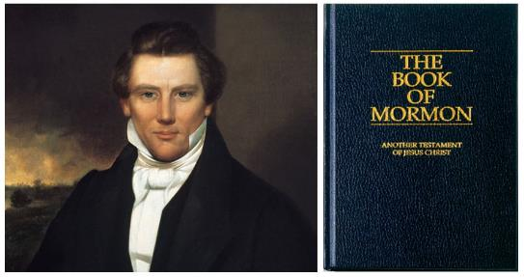
Joseph Smith’s Command
“Arise upon your feet, speak or make some sound, continue to make sounds of some kind, and the Lord will make a language or tongue of it.”
Joseph Dillow, Speaking in Tongues (Grand Rapids: Zondervan Publishing House, 1975), p. 173.

Slide 43
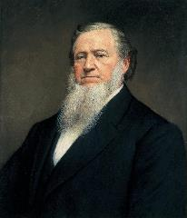
Brigham Young
“Shouting, jerks, and dancing were common in their services, and Brigham Young not only spoke in unknown tongues but interpreted his messages to his hearers.”
Thomas R. Edgar, Miraculous Gifts, (Neptune, New Jersey, Loizeaux Brothers, 1983), p. 255.

Slide 44
Tongues and the Unsaved
“Now before you sit down and write me a letter telling me how real your experience with tongues is, let me tell you about mine. I’ve spoken in tongues on several occasions. I’ve walked down aisles, I’ve prayed through at the altar, I’ve followed the instructions of the spiritual leaders who were telling me how to speak in tongues, and I spoke in tongues. It was very real. It happened. There was nothing unreal about it. But it was not of the Holy Spirit! How do I know? I wasn’t even saved at the time. That’s how I know. I became convinced by the preaching I heard that I must speak in tongues to be right with God. I was determined to do it, and I did it.”
Cited by John Miles, The Subject of Tongues, an Introduction to Christian Doctrine: An Outline Course, (Grand Rapids; Grand Rapids School of the Bible and Music, 1974), p. 3.

Slide 45
Holy Spirit’s Impact
Acts 2:5-13
  Circumstances (5)
  Manifestation of tongues (6-8)
  Nations in the Diaspora (9-12)
  Charge of drunkenness (13)

Slide 47


Slide 48

Daniel 1:1-2
“¹ In the third year of the reign of Jehoiakim king of Judah, Nebuchadnezzar king of Babylon came to Jerusalem and besieged it.² The Lord gave Jehoiakim king of Judah into his hand, along with some of the vessels of the house of God; and he brought them to the land of Shinar, to the house of his god, and he brought the vessels into the treasury of his god.”

Slide 49


Slide 50


1 Peter 5:13
“She who is in Babylon, chosen together with you, sends you greetings, and so does my son, Mark.”

Slide 51

Charles Ryrie
The Ryrie Study Bible, page 1548
1 Peter 5:13 (RSB:NASB1995U): “5:13 She who is in Babylon. The church in Rome, where Peter evidently was writing this letter. my son, Mark. John Mark, the writer of the gospel, who was not Peter’s natural son but his son in the faith.”

Slide 52
Revelation 17:5
“and on her forehead a name was written, a mystery, “BABYLON THE GREAT, THE MOTHER OF HARLOTS AND OF THE ABOMINATIONS OF THE EARTH.”

Slide 53
Galatians 2:7-8
“⁷ But on the contrary, seeing that I had been entrusted with the gospel to the uncircumcised, just as Peter had been to the circumcised ⁸ (for He who effectually worked for Peter in his apostleship to the circumcised effectually worked for me also to the Gentiles).”

Slide 54
Josephus
Antiquities, 15.2.2
“But when Hyrcanus was brought into Parthia the king Phraates treated him after a very gentle manner, as having already learned of what an illustrious family he was; on which account he set him free from his bonds, and gave him a habitation at Babylon, where there were Jews in great numbers. These Jews honored Hyrcanus as their high priest and king, as did all the Jewish nation that dwelt as far as Euphrates; which respect was very much to his satisfaction...”

Slide 56

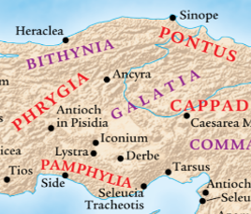
Acts 16:6
“ They passed through the Phrygian and Galatian region, having been forbidden by the Holy Spirit to speak the word in Asia.”

Slide 57
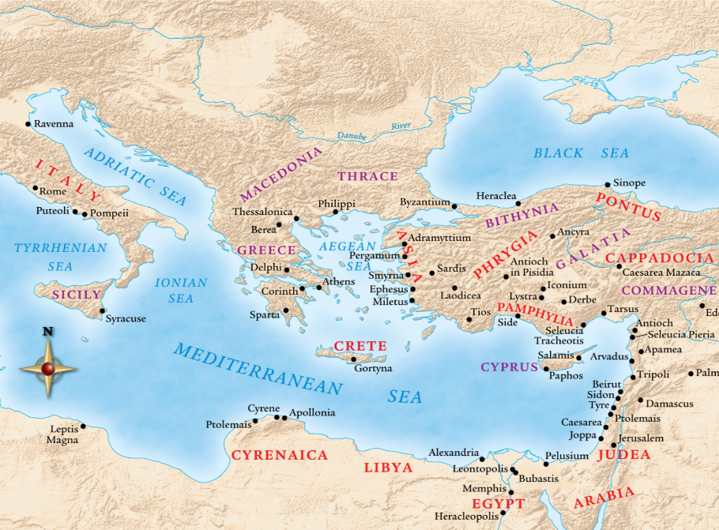

Slide 59
Holy Spirit’s Impact
Acts 2:5-13
  Circumstances (5)
  Manifestation of tongues (6-8)
  Nations in the Diaspora (9-12)
  Charge of drunkenness (13)

Slide 60

Romans 1:18–20
¹⁸ For the wrath of God is revealed from heaven against all ungodliness and unrighteousness of men who suppress the truth in unrighteousness, ¹⁹ because that which is known about God is evident within them; for God made it evident to them. ²⁰ For since the creation of the world His invisible attributes, His eternal power and divine nature, have been clearly seen, being understood through what has been made, so that they are without excuse.

Slide 61
Naturalistic Theories
Swoon theory
Theft theory
Hallucination theory
Wrong tomb theory

Slide 62

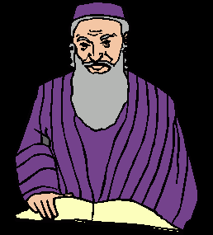
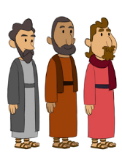
2. Theft Theories
Rome
Jews
Disciples

Slide 63
Levitical Feasts (Leviticus 23)
Feast | Season | Fulfillment | Rejected
Passover | Spring | John 1:29 | John 1:11
Unleavened Bread | Spring | John 6:35 | John 6:41
1st fruits | Spring | 1 Cor. 15:20 | Matt. 28:11-15
Pentecost | Spring | Joel 2:28-32 | Acts 2:13
Trumpets | Fall | New Year | Matt 24:31
Atonement | Fall | Lev 16 | Zech. 12:10
Booths | Fall | Wilderness provision | Zech. 14:16-18

Slide 64
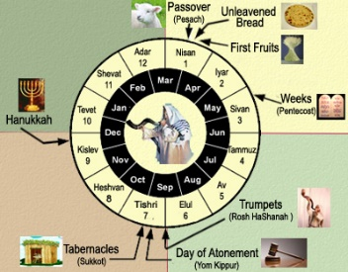
Terry Hulbert
Terry C. Hulbert, The Eschatological Significance of Israel's Annual Feasts. Doctoral Dissertation. Dallas Theological Seminary. 1965. Pages 2, 115-116.
“When God fulfilled the first four feasts, He had provided everything necessary for Israel to enter into literal kingdom blessing‒redemption, separation, resurrection, and the presence of the Holy Spirit. Israel’s rejection of these, however, made a necessary national change of heart before the kingdom could be established…The paschal lamb of God pointed out by John the Baptist was rejected as an imposter. The resurrection of Christ, as it answered to the Feast of First Fruits, was suppressed in it’s proclamation by the bribe money paid to the sentries…Finally, the coming of the Spirit was rejected at Pentecost as the Jews…

Slide 65
Terry Hulbert
Terry C. Hulbert, The Eschatological Significance of Israel's Annual Feasts. Doctoral Dissertation. Dallas Theological Seminary. 1965. Pages 2, 115-116.
…taunted the apostles with charges of drunkenness. By the time of the close of Acts chapter 2, God had done all He could do for Israel until they repented as a nation. Thus, the significance of Peter’s second sermon in Acts 3 was that it re-emphasized the condition of millennial blessing already laid down in the Old Testament, but as yet unfulfilled...Of the upmost importance here is the fact that the shedding of the blood of Christ to take away sin, and with the coming of the Spirit to empower the life of the redeemed, all of the spiritual requirements for the millennial kingdom had been met as far as God was concerned….

Slide 66
Terry Hulbert
Terry C. Hulbert, The Eschatological Significance of Israel's Annual Feasts. Doctoral Dissertation. Dallas Theological Seminary. 1965. Pages 2, 115-116.
…But, God‘s provision could not be operative until man appropriated it. This point cannot be over emphasized, for it is not only the reason for the delay in the fulfillment of the final three feasts, it is the basis for understanding the relationship of the church to the feasts.”

Slide 67
Acts 2
Chapter Summary
  Coming of the Holy Spirit (1-4)
  Holy Spirit’s Impact (5-13)
  Peter’s Sermon (14-36)
  Sermon’s Impact (37-47)

Slide 68
Peter’s Sermon
Acts 2:14-36
  Introduction (14)
  Refutation of Drunkenness Charge (15-35)
  Conclusion (36)

Slide 69
Peter’s Sermon
Acts 2:14-36
  Introduction (14)
  Refutation of Drunkenness Charge (15-35)
  Conclusion (36)

Slide 70
Mistaken Replacement?
Pro
  No Spirit yet
  Lots
  Matthias disappears
  Paul
Con
  No textual indication of an error
  Twelve esteemed (2:14; 6:2)
  God’s choice (1:24)
  Prov 16:33
  Paul unqualified (1:21-22)
  Focus on Peter & Paul

Slide 71


Slide 72
Peter’s Sermon
Acts 2:14-36
  Introduction (14)
  Refutation of Drunkenness Charge (15-35)
  Conclusion (36)

Slide 73
Acts 2:15-35
Refutation of the Charge of Drunkenness
      Too early (15)
      Use of Joel 2:28-32 (16-21)
      Christ’s miracles (22)
      Crucifixion (23)
      Resurrection (24)
      Use of Psalm 16:8-11 (25-29)
      Use of Psalm 132:11 (30-32)
      High priestly ministry (33)
      Use of Psalm 110:1 (34-35)

Slide 74
Acts 2:15-35
Refutation of the Charge of Drunkenness
      Too early (15)
      Use of Joel 2:28-32 (16-21)
      Christ’s miracles (22)
      Crucifixion (23)
      Resurrection (24)
      Use of Psalm 16:8-11 (25-29)
      Use of Psalm 132:11 (30-32)
      High priestly ministry (33)
      Use of Psalm 110:1 (34-35)

Slide 75
Acts 2:15-35
Refutation of the Charge of Drunkenness
      Too early (15)
      Use of Joel 2:28-32 (16-21)
      Christ’s miracles (22)
      Crucifixion (23)
      Resurrection (24)
      Use of Psalm 16:8-11 (25-29)
      Use of Psalm 132:11 (30-32)
      High priestly ministry (33)
      Use of Psalm 110:1 (34-35)

Slide 76
Acts 2:15-35
Refutation of the Charge of Drunkenness
      Too early (15)
      Use of Joel 2:28-32 (16-21)
      Christ’s miracles (22)
      Crucifixion (23)
      Resurrection (24)
      Use of Psalm 16:8-11 (25-29)
      Use of Psalm 132:11 (30-32)
      High priestly ministry (33)
      Use of Psalm 110:1 (34-35)

Slide 77
Acts 2:15-35
Refutation of the Charge of Drunkenness
      Too early (15)
      Use of Joel 2:28-32 (16-21)
      Christ’s miracles (22)
      Crucifixion (23)
      Resurrection (24)
      Use of Psalm 16:8-11 (25-29)
      Use of Psalm 132:11 (30-32)
      High priestly ministry (33)
      Use of Psalm 110:1 (34-35)

Slide 78
Acts 2:15-35
Refutation of the Charge of Drunkenness
      Too early (15)
      Use of Joel 2:28-32 (16-21)
      Christ’s miracles (22)
      Crucifixion (23)
      Resurrection (24)
      Use of Psalm 16:8-11 (25-29)
      Use of Psalm 132:11 (30-32)
      High priestly ministry (33)
      Use of Psalm 110:1 (34-35)

Slide 79
Acts 2:15-35
Refutation of the Charge of Drunkenness
      Too early (15)
      Use of Joel 2:28-32 (16-21)
      Christ’s miracles (22)
      Crucifixion (23)
      Resurrection (24)
      Use of Psalm 16:8-11 (25-29)
      Use of Psalm 132:11 (30-32)
      High priestly ministry (33)
      Use of Psalm 110:1 (34-35)

Slide 80


Slide 81
Acts 2:15-35
Refutation of the Charge of Drunkenness
      Too early (15)
      Use of Joel 2:28-32 (16-21)
      Christ’s miracles (22)
      Crucifixion (23)
      Resurrection (24)
      Use of Psalm 16:8-11 (25-29)
      Use of Psalm 132:11 (30-32)
      High priestly ministry (33)
      Use of Psalm 110:1 (34-35)

Slide 82
Acts 2:15-35
Refutation of the Charge of Drunkenness
      Too early (15)
      Use of Joel 2:28-32 (16-21)
      Christ’s miracles (22)
      Crucifixion (23)
      Resurrection (24)
      Use of Psalm 16:8-11 (25-29)
      Use of Psalm 132:11 (30-32)
      High priestly ministry (33)
      Use of Psalm 110:1 (34-35)

Slide 83
Acts 2:15-35
Refutation of the Charge of Drunkenness
      Too early (15)
      Use of Joel 2:28-32 (16-21)
      Christ’s miracles (22)
      Crucifixion (23)
      Resurrection (24)
      Use of Psalm 16:8-11 (25-29)
      Use of Psalm 132:11 (30-32)
      High priestly ministry (33)
      Use of Psalm 110:1 (34-35)

Slide 84
Peter’s Sermon
Acts 2:14-36
  Introduction (14)
  Refutation of Drunkenness Charge (15-35)
  Conclusion (36)

Slide 85
Acts 2
Chapter Summary
  Coming of the Holy Spirit (1-4)
  Holy Spirit’s Impact (5-13)
  Peter’s Sermon (14-36)
  Sermon’s Impact (37-47)

Slide 86
Coming of the Holy Spirit
Acts 2:37-47
  Salvation (37-41)
  Church (42-47)

Slide 87
Coming of the Holy Spirit
Acts 2:37-47
  Salvation (37-41)
  Church (42-47)

Slide 88
Acts 2:37-41
Salvation
      Conviction (37)
      Repentance & Baptism (38-39)
      Consequence of Repentance (40)
      Result (41)

Slide 89
Acts 2:37-41
Salvation
      Conviction (37)
      Repentance & Baptism (38-39)
      Consequence of Repentance (40)
      Result (41)

Slide 90
Acts 2:37-41
Salvation
      Conviction (37)
      Repentance & Baptism (38-39)
      Consequence of Repentance (40)
      Result (41)

Slide 91
Acts 2:37-41
Salvation
      Conviction (37)
      Repentance & Baptism (38-39)
      Consequence of Repentance (40)
      Result (41)

Slide 92
Acts 2:37-41
Salvation
      Conviction (37)
      Repentance & Baptism (38-39)
      Consequence of Repentance (40)
      Result (41)

Slide 94

Message
  Birth and growth of the church numerically, geographically, ethnically.
  Components
  Numerically (progress reports)
  Geographically (From Jerusalem to Rome)
  Ethnically (From Judaism to Gentile domination)

Slide 95
Coming of the Holy Spirit
Acts 2:37-47
  Salvation (37-41)
  Church (42-47)

Slide 96
Acts 2:42-47
Church
      Priorities (42)
      Miracles (43)
      Unity (44)
      Communal living (45)
      Lord’s Table (46)
      Evangelism (47)

Slide 97
Acts 2:42-47
Church
      Priorities (42)
      Miracles (43)
      Unity (44)
      Communal living (45)
      Lord’s Table (46)
      Evangelism (47)

Slide 98
Acts 2:42-47
Church
      Priorities (42)
      Miracles (43)
      Unity (44)
      Communal living (45)
      Lord’s Table (46)
      Evangelism (47)

Slide 99

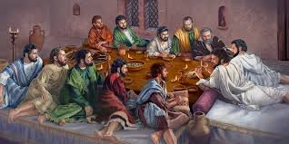
Ephesians 2:20
“having been built on the foundation of the apostles and prophets, Christ Jesus Himself being the corner stone.”

Slide 100
Acts 2:42-47
Church
      Priorities (42)
      Miracles (43)
      Unity (44)
      Communal living (45)
      Lord’s Table (46)
      Evangelism (47)

Slide 101
Acts 2:42-47
Church
      Priorities (42)
      Miracles (43)
      Unity (44)
      Communal living (45)
      Lord’s Table (46)
      Evangelism (47)

Slide 102
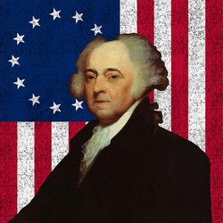
John Adams
“The moment the idea is admitted into society, that property is not as sacred as the laws of God, and that there is not a force of law and public justice to protect it, anarchy and tyranny commence. If ‘Thou Shalt Not Covet,’ and ‘Thou Shalt Not Steal’ were not commandments of Heaven, they must be made inviolable precepts in every society before it can be civilized or made free.”
John Adams, A Defence of the Constitutions of Government of the United States of America, 3 vols., American Constitutional and Legal History, ed. Leonard W. Levy (London: Dilly, 1787; reprint, NY: Da Capo, 1971), 3:217

Slide 103
Acts 2:42-47
Church
      Priorities (42)
      Miracles (43)
      Unity (44)
      Communal living (45)
      Lord’s Table (46)
      Evangelism (47)

Slide 104
Acts 2:42-47
Church
      Priorities (42)
      Miracles (43)
      Unity (44)
      Communal living (45)
      Lord’s Table (46)
      Evangelism (47)

Slide 105
Conclusion

Slide 106
Acts 2
Chapter Summary
  Coming of the Holy Spirit (1-4)
  Holy Spirit’s Impact (5-13)
  Peter’s Sermon (14-36)
  Sermon’s Impact (37-47)

