Slide 1


Genesis 12‒50
Israel’s Birth & Preservation

Slide 2


GENESIS STRUCTURE
  Beginning of the Human race (Gen. 1‒11)
  Beginning of the Hebrew race (Gen. 12‒50)

Slide 3

GENESIS STRUCTURE
  Genesis 1-11 (four events)
    Creation (1-2)
    Fall (3-5)
    Flood (6-9)
    National dispersion (10-11)

Slide 4


Genesis 3:15
“And I will put enmity Between you and the woman, And between your seed and her seed; He shall bruise you on the head, And you shall bruise him on the heel.”

Slide 5
GENESIS STRUCTURE
  Beginning of the Human race (Gen. 1‒11)
  Beginning of the Hebrew race (Gen. 12‒50)

Slide 6

GENESIS STRUCTURE
  Genesis 12-50 (four people)
    Abraham (12:1–25:11)
    Isaac (25:12–26:35)
    Jacob (27–36)
    Joseph (37–50)

Slide 7


Isaiah 43:1
“But now, thus says the Lord, your Creator, O Jacob, And He who formed you, O Israel, 'Do not fear, for I have redeemed you; I have called you by name; you are Mine!'”

Slide 8
Genesis 26
Chapter Summary
  Abrahamic Covenant Reconfirmed (1-5)
  Isaac & Abimelech (6-11)
  Struggle for the Wells (12-22)
  Sojourn in Beersheba (23-25)
  Covenant with Abimelech (26-33)
  Esau’s Wives (34-35)

Slide 9
VI. Genesis 26:34-35
Esau’s Wives
    Esau’s age (34a)
    Names of wives (34b)
    Impact on Esau’s parents (35)

Slide 10
VI. Genesis 26:34-35
Esau’s Wives
    Esau’s age (34a)
    Names of wives (34b)
    Impact on Esau’s parents (35)

Slide 11
VI. Genesis 26:34-35
Esau’s Wives
    Esau’s age (34a)
    Names of wives (34b)
    Impact on Esau’s parents (35)

Slide 12
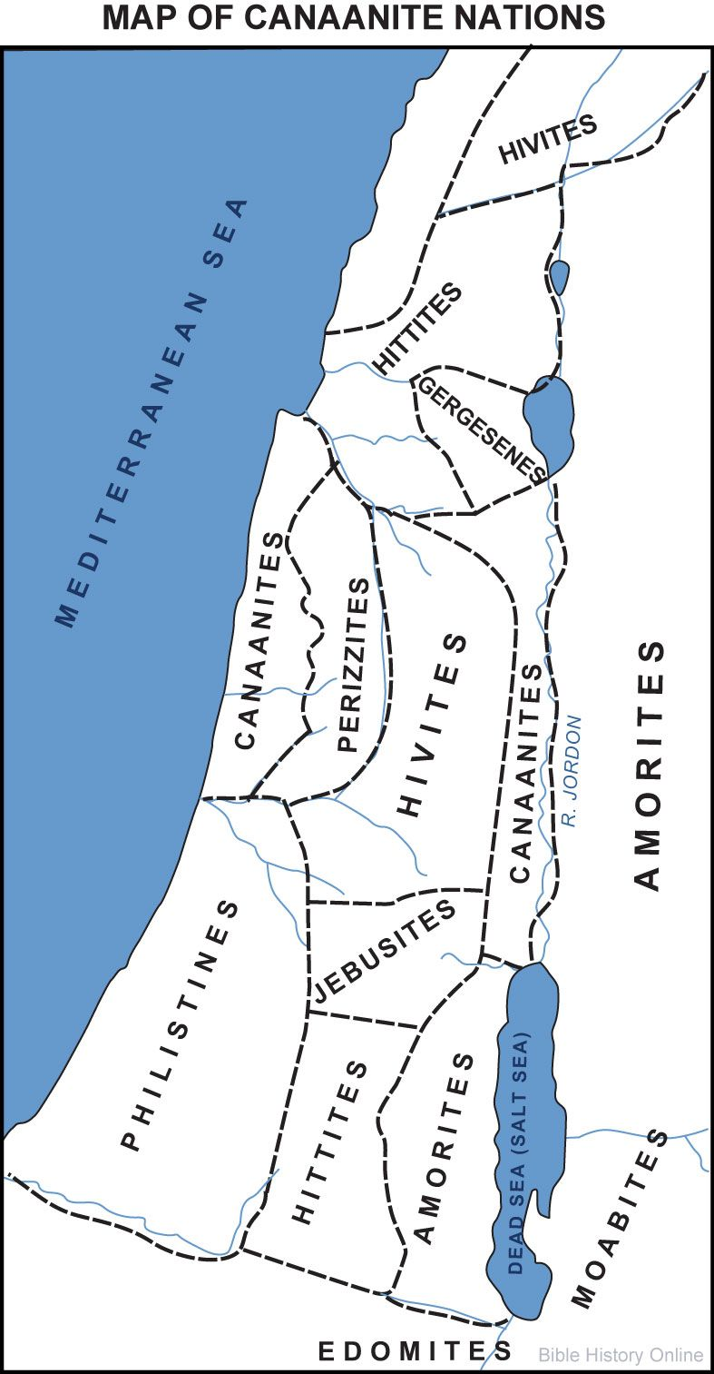


Slide 13


Genesis 15:16
“Then in the fourth generation they will return here, for the wrongdoing of the Amorite is not yet complete.”

Slide 14


Genesis 1:27
“God created man in His own image, in the image of God He created him; male and female He created them.”
Genesis 2:24
“For this reason a man shall leave his father and his mother, and be joined to his wife; and they shall become one flesh.”

Slide 15
VI. Genesis 26:34-35
Esau’s Wives
    Esau’s age (34a)
    Names of wives (34b)
    Impact on Esau’s parents (35)

Slide 16


Dr. Arnold G. Fruchtenbaum
The Book of Genesis, 417
“Genesis 26:35 tells about the effect on his parents of Esau’s marriage to foreign wives: They were a grief of mind unto Isaac and to Rebekah. In Hebrew, it means a ‘bitterness of feeling’ or a ‘bitterness of spirit.’ Esau’s marriages emphasized his continuing unfaithfulness to the Abrahamic Covenant. Just as the selling of the birthright shows he despised his birthright and its covenant-keeping element, now by the same token the marrying of Hittite wives was a further step downward in his unfaithfulness to the covenant.”

Slide 17
Genesis 12‒25
Abraham’s Early Journeys
Unconditional promises (Gen. 12:1-3) From Haran to Canaan (Gen. 12:4-5) In Canaan (Gen. 12:6-9) In Egypt (Gen. 12:10-20) Abram and Lot Separate (Gen. 13:1-13) Reaffirmation of Abram’s promises (Gen. 13:14-18) Abram Rescues Lot (14:1-24) Abrahamic Covenant (15:1-21) Hagar & Ishmael (16:1-16) Circumcision (Gen. 17:1-27) | Sodom & Gomorrah (Gen. 18‒19) Abraham & Abimelech (Gen. 20) Isaac’s birth (Gen. 21:1-7) Ishmael’s expulsion (21:8-21) Abraham & Abimelech’s covenant (21:22-34) Abraham sacrifices Isaac (22) Sarah’s death (23) Isaac’s marriage (24) Abraham & Keturah (25:1-6) Abraham’s death (25:7-11)

Slide 18
Genesis 24
Isaac’s Marriage
  Abraham’s instructions (1-9)
  Servant prays (10-14)
  Servant meets Rebekah (15-27)
  Servant and Laban (28-49)
  Betrothal of Isaac & Rebekah (50-60)
  Marriage of Isaac & Rebekah (61-67)

Slide 19


Slide 20
GENESIS STRUCTURE
  Genesis 1-11 (four events)
    Creation (1-2)
    Fall (3-5)
    Flood (6-9)
    National dispersion (10-11)

Slide 21
GENESIS STRUCTURE
  Genesis 12-50 (four people)
    Abraham (12:1–25:11)
    Isaac (25:12–26:35)
    Jacob (27–36)
    Joseph (37–50)

Slide 22
Genesis 27
Chapter Summary
  Isaac’s intent (1-5)
  The conspiracy (5-17)
  Deception and blessing (18-29)
  Isaac blesses Esau (30-40)
  Plan to flee to Haran (41-46)

Slide 23
Genesis 27
Chapter Summary
  Isaac’s intent (1-5)
  The conspiracy (5-17)
  Deception and blessing (18-29)
  Isaac blesses Esau (30-40)
  Plan to flee to Haran (41-46)

Slide 24
Genesis 27:1-4
Isaac’s Intent
    Circumstances (1a)
    Fetching Isaac (1b)
    Isaac’s instructions (2-4)

Slide 25
Genesis 27:1-4
Isaac’s Intent
    Circumstances (1a)
    Fetching Isaac (1b)
    Isaac’s instructions (2-4)

Slide 26
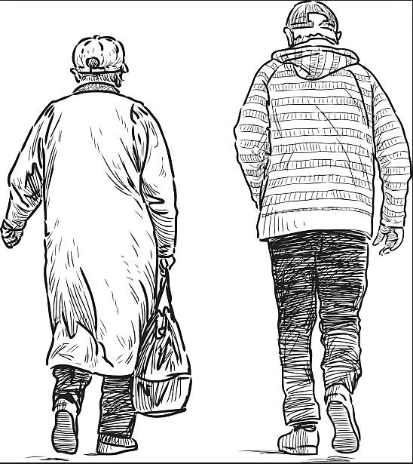
2 Cor. 4:16
“Therefore, we do not lose heart, but though our outer man is decaying, yet our inner man is being renewed day by day.”

Slide 27
Genesis 27:1-4
Isaac’s Intent
    Circumstances (1a)
    Fetching Isaac (1b)
    Isaac’s instructions (2-4)

Slide 28

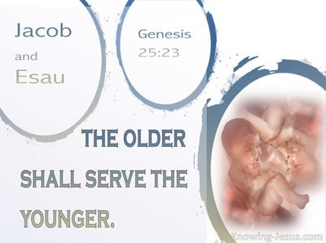
Genesis 25:23
“The Lord said to her, ‘Two nations are in your womb; And two peoples will be separated from your body; And one people shall be stronger than the other; And the older shall serve the younger.’”

Slide 29


Romans 12:2
² “And do not be conformed to this world, but be transformed by the renewing of your mind, so that you may prove what the will of God is, that which is good and acceptable and perfect.”

Slide 30
Genesis 27:1-4
Isaac’s Intent
    Circumstances (1a)
    Fetching Isaac (1b)
    Isaac’s instructions (2-4)

Slide 31
Genesis 27:2-4
Isaac’s Instructions
      Situation (2)
      Esau (3-4a)
      Isaac (4b)

Slide 32
Genesis 27:2-4
Isaac’s Instructions
      Situation (2)
      Esau (3-4a)
      Isaac (4b)

Slide 33
Genesis 27:2-4
Isaac’s Instructions
      Situation (2)
      Esau (3-4a)
      Isaac (4b)

Slide 34
Genesis 26:6-7
Esau
      Hunt (3)
      Cook (4a)

Slide 35
Genesis 26:6-7
Esau
      Hunt (3)
      Cook (4a)

Slide 36
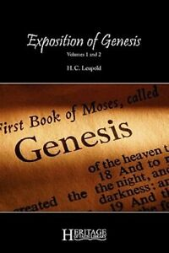
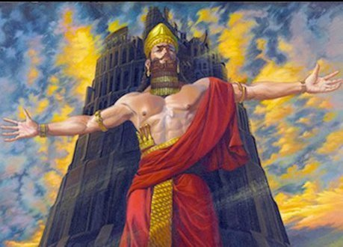
H. C. Leupold
H.C. Leupold, Exposition of Genesis, 1:366.
“For the meaning of the verb form nimrodh, without a doubt, is ‘let us revolt’.”

Slide 37
Dr. Arnold G. Fruchtenbaum
The Book of Genesis, 213
“Verse 9 deals with Nimrod’s relationship to God: He was a mighty hunter before Jehovah. The terminology implies antagonism; antagonism against and in opposition to God.”

Slide 38

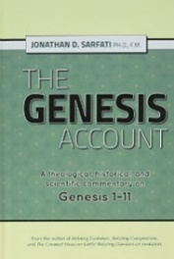
The Jerusalem Targum
Jonathan D. Sarfati, The Genesis Account: A Theological, Historical, and Scientific Commentary on Genesis 1‒11 (Powder Springs, GA: Creation Book Publishers, 2015), 642.
The Jerusalem Targum paraphrases this passage as follows: “He was powerful in hunting and in wickedness before the Lord for he was a hunter of the sons of men, as he said to them, ‘Depart from the judgment of the Lord and hear the judgement of Nimrod.’ Therefore, it is said as Nimrod the strong one, strong in hunting, and wickedness before the Lord.”

Slide 39
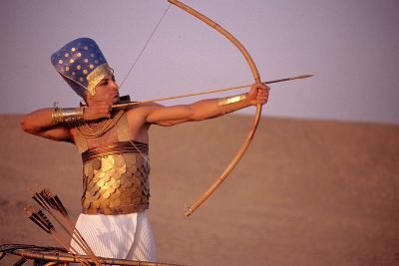
Dr. Arnold G. Fruchtenbaum
The Book of Genesis, 346
“He [Ishmael] now became a hunter. In the context of Genesis, this is not a positive but a negative, as already indicated with Nimrod; for he, too, was a mighty hunter before the Lord.”

Slide 40
Dr. Arnold G. Fruchtenbaum
The Book of Genesis, 402
“Esau was a skillful hunter, just as Nimrod was a skillful hunter (10:8–12). In the context of Genesis, being a skillful hunter is not a positive statement, but a negative one. This is important because throughout church history, Jacob has received a lot of bad press. In most sermons, especially in Christian circles, Jacob is painted very negatively, and attributes are ascribed to Jacob that are not true to the Word of God and certainly do not correspond with God’s own evaluation of Jacob.”

Slide 41
Genesis 26:6-7
Esau
      Hunt (3)
      Cook (4a)

Slide 42
Dr. Arnold G. Fruchtenbaum
The Book of Genesis, 419-20
“What did Isaac want out of this? He wanted venison. So great a blessing for so low a fee revealed Isaac’s attitude. Esau sold his birthright for a bowl of soup; Isaac was willing to misdirect the patriarchal blessing for one venison meal. It should be observed, however, that Ancient Near Eastern Texts often show consumption of food and drink in connection with the bestowal of a blessing.”

Slide 43
Genesis 27:2-4
Isaac’s Instructions
      Situation (2)
      Esau (3-4a)
      Isaac (4b)

Slide 44
Genesis 25:23
“The Lord said to her, ‘Two nations are in your womb; And two peoples will be separated from your body; And one people shall be stronger than the other; And the older shall serve the younger.’”

Slide 45
VI. Genesis 26:34-35
Esau’s Wives
    Esau’s age (34a)
    Names of wives (34b)
    Impact on Esau’s parents (35)

Slide 46
Genesis 27
Chapter Summary
  Isaac’s intent (1-5)
  The conspiracy (5-17)
  Deception and blessing (18-29)
  Isaac blesses Esau (30-40)
  Plan to flee to Haran (41-46)

Slide 47
Genesis 27:5-17
The Conspiracy
    Circumstances (5)
    Rebekah’s instructions (6-10)
    Jacob’s doubts (11-12)
    Rebekah’s response (13)
    Instruments of deception (14-17)

Slide 48
Genesis 27:5-17
The Conspiracy
    Circumstances (5)
    Rebekah’s instructions (6-10)
    Jacob’s doubts (11-12)
    Rebekah’s response (13)
    Instruments of deception (14-17)

Slide 49
Genesis 27:5
Circumstances
      Rebekah (5a)
      Esau (5b)

Slide 50
Genesis 27:5
Circumstances
      Rebekah (5a)
      Esau (5b)

Slide 51
Genesis 27:5
Circumstances
      Rebekah (5a)
      Esau (5b)

Slide 52
Genesis 27:5-17
The Conspiracy
    Circumstances (5)
    Rebekah’s instructions (6-10)
    Jacob’s doubts (11-12)
    Rebekah’s response (13)
    Instruments of deception (14-17)

Slide 53
Genesis 27:6-10
Rebekah’s Instructions
      Addressee (6a)
      Plan for Isaac (6b-7)
      Instructions to Jacob (8-10)

Slide 54
Genesis 27:6-10
Rebekah’s Instructions
      Addressee (6a)
      Plan for Isaac (6b-7)
      Instructions to Jacob (8-10)

Slide 55
Genesis 27:6-10
Rebekah’s Instructions
      Addressee (6a)
      Plan for Isaac (6b-7)
      Instructions to Jacob (8-10)

Slide 56
Genesis 27:6-10
Rebekah’s Instructions
      Addressee (6a)
      Plan for Isaac (6b-7)
      Instructions to Jacob (8-10)

Slide 57
Genesis 27:8-10
Instructions to Jacob
      General (8)
      Jacob to do (9a)
      Rebekah to do (9b)
      Jacob to do (10a)
      Purpose (10b)

Slide 58
Genesis 27:8-10
Instructions to Jacob
      General (8)
      Jacob to do (9a)
      Rebekah to do (9b)
      Jacob to do (10a)
      Purpose (10b)

Slide 59
Genesis 27:8-10
Instructions to Jacob
      General (8)
      Jacob to do (9a)
      Rebekah to do (9b)
      Jacob to do (10a)
      Purpose (10b)

Slide 60
Genesis 27:8-10
Instructions to Jacob
      General (8)
      Jacob to do (9a)
      Rebekah to do (9b)
      Jacob to do (10a)
      Purpose (10b)

Slide 61
Genesis 27:8-10
Instructions to Jacob
      General (8)
      Jacob to do (9a)
      Rebekah to do (9b)
      Jacob to do (10a)
      Purpose (10b)

Slide 62
Genesis 27:8-10
Instructions to Jacob
      General (8)
      Jacob to do (9a)
      Rebekah to do (9b)
      Jacob to do (10a)
      Purpose (10b)

Slide 63
Dr. Arnold G. Fruchtenbaum
The Book of Genesis, 421
“Then what Jacob was to do was: You shall bring it to your father, that he may eat. Verse 10b reveals the purpose: that he may bless you before his death. The mother came up with that scheme. Again, the sin in this chapter is not Jacob’s stealing the patriarchal blessing; that rightfully did belong to Jacob. The sin lay in their deceiving the father.”

Slide 64
Dr. Arnold G. Fruchtenbaum
The Book of Genesis, 421
“Here again is a lapse of faith, as it was with Abraham in chapter 12 and with Sarah in chapter 16. Rebekah had the revelation from God, and so she simply should have trusted God that He would intervene at the proper time and work things out in such a way that indeed Jacob would get the patriarchal blessing. Nevertheless, she felt she had to take matters into her own hands because it seemed that nothing could stop Isaac from giving the patriarchal blessing to Esau, and with that came many material benefits.”

Slide 65
Genesis 27:5-17
The Conspiracy
    Circumstances (5)
    Rebekah’s instructions (6-10)
    Jacob’s doubts (11-12)
    Rebekah’s response (13)
    Instruments of deception (14-17)

Slide 66
Genesis 27:11-12
Jacob’s Doubts
      Contrast (11)
      Danger (12)

Slide 67
Genesis 27:11-12
Jacob’s Doubts
      Contrast (11)
      Danger (12)

Slide 68
Dr. Arnold G. Fruchtenbaum
The Book of Genesis, 421-22
“However, in 27:11–12, Jacob expressed some doubts about his mother’s plan, with verse 11 spelling out the contrast between himself and Esau: And Jacob said to Rebekah his mother, Behold, Esau my brother is a hairy man. The Hebrew word for hairy here is sair, and that is the basis for the name of the central mountain range of Edom known as Mount Seir. As for Jacob, he continued: and I am a smooth man.”

Slide 69
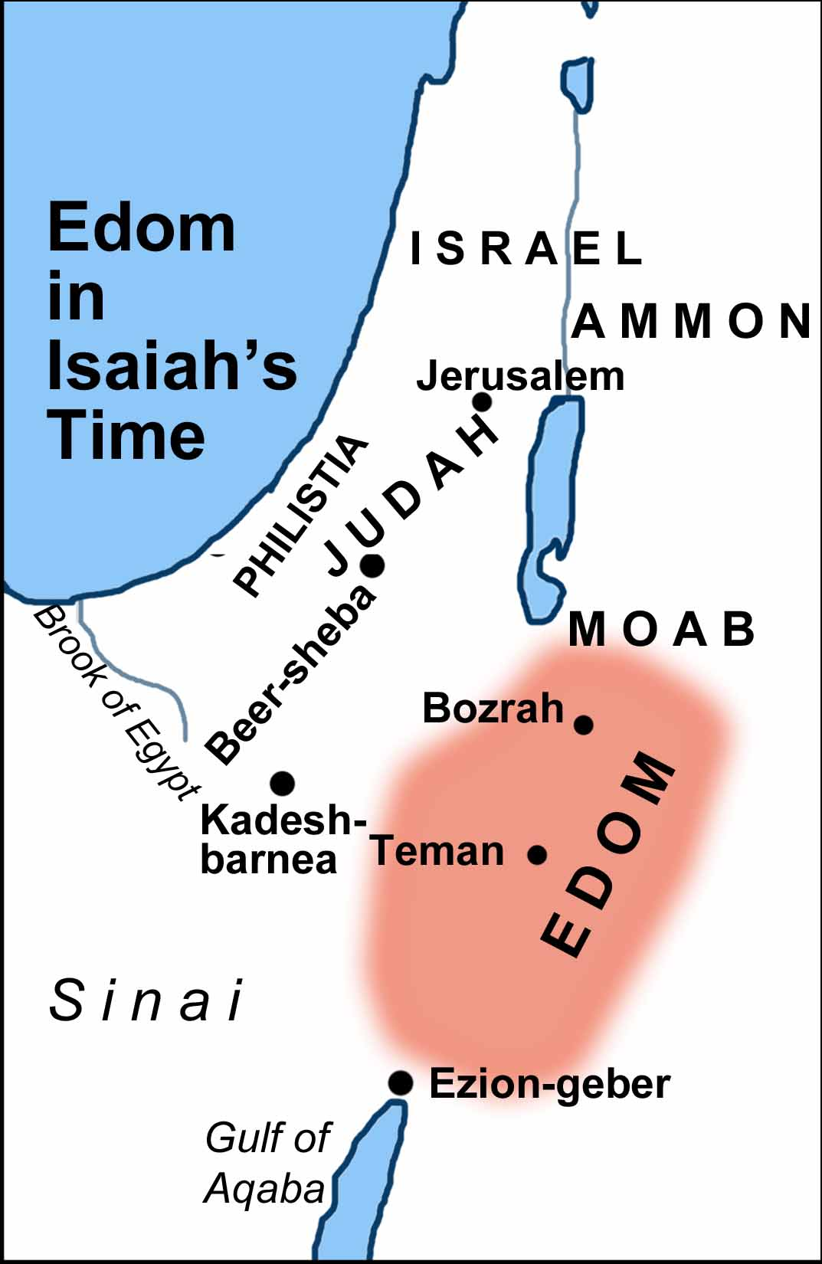

Slide 70
Genesis 27:11-12
Jacob’s Doubts
      Contrast (11)
      Danger (12)

Slide 71
Genesis 27:5-17
The Conspiracy
    Circumstances (5)
    Rebekah’s instructions (6-10)
    Jacob’s doubts (11-12)
    Rebekah’s response (13)
    Instruments of deception (14-17)

Slide 72
Genesis 27:13
Rebekah’s Response
      Upon Rebekah (13a)
      Upon Jacob (13b)

Slide 73
Genesis 27:13
Rebekah’s Response
      Upon Rebekah (13a)
      Upon Jacob (13b)

Slide 74
Genesis 27:13
Rebekah’s Response
      Upon Rebekah (13a)
      Upon Jacob (13b)

Slide 75
Genesis 27:5-17
The Conspiracy
    Circumstances (5)
    Rebekah’s instructions (6-10)
    Jacob’s doubts (11-12)
    Rebekah’s response (13)
    Instruments of deception (14-17)

Slide 76
Genesis 27:14-17
Instruments of Deception
      Food prepared (14)
      Clothes of deception (15-16)
      Food of deception (17)

Slide 77
Genesis 27:14-17
Instruments of Deception
      Food prepared (14)
      Clothes of deception (15-16)
      Food of deception (17)

Slide 78
Genesis 27:14-17
Instruments of Deception
      Food prepared (14)
      Clothes of deception (15-16)
      Food of deception (17)

Slide 79
Genesis 26:15-16
Esau
      Smell (15)
      Feel (16)

Slide 80
Genesis 26:15-16
Esau
      Smell (15)
      Feel (16)

Slide 81
Genesis 26:15-16
Esau
      Smell (15)
      Feel (16)

Slide 82
Genesis 27:14-17
Instruments of Deception
      Food prepared (14)
      Clothes of deception (15-16)
      Food of deception (17)

Slide 83
Dr. Arnold G. Fruchtenbaum
The Book of Genesis, 422
“In her preparations, she was able to cover all but one of the senses, either actively or passively. As for the sense of sight, Isaac was blind; and so that was not an issue. As for the sense of smell, Jacob was wearing Esau’s clothing. As for the sense of taste, the goat would taste like the venison. As for the sense of touch, the goatskins would be hairy. The sense of hearing was the only problem she could not really cover, and that fact will become a problem to a point of danger. The setup for the situation is that Rebekah cooks like Esau and Jacob smells and feels like Esau.”

Slide 84

Satanic/Demonic Miracles
Exod. 7–8
Deut. 13:1-3
Job 1:12-19; 2:7-8
1 Sam. 28?
Matt. 7:21-23; 24:24
Acts 8:9; 16:16
Gal. 1:6-9
2 Thess. 2:9
Rev. 13:3, 13, 15; 16:13-14

Slide 85


2 Thessalonians 2:9
“that is, the one whose coming is in accord with the activity of Satan, with all power and signs and false wonders.”

Slide 86
Antichrist’s Satanic Miracles (2 Thessalonians 2:9)
MIRACLE | GREEK | CHRIST’S MINISTRY
Powers | Dynamis | Matt. 11:20
Signs | Semēion | John 20:30
Wonders | Teras | Acts 2:22

Slide 87
Genesis 27
Chapter Summary
  Isaac’s intent (1-5)
  The conspiracy (5-17)
  Deception and blessing (18-29)
  Isaac blesses Esau (30-40)
  Plan to flee to Haran (41-46)

Slide 88
Genesis 27:18-29
Deception and Blessing
    Deception (18-27a)
    Blessing (27b-29)

Slide 89
Genesis 27:18-29
Deception and Blessing
    Deception (18-27a)
    Blessing (27b-29)

Slide 90
Genesis 27:18-27a
Deception
      Jacob’s entrance (18)
      Jacob’s first lie (19)
      Jacob’s second lie (20)
      Isaac’s test (21-23)
      Jacob’s third lie (24)
      Meal (25)
      Kiss (26-27a)

Slide 91
Genesis 27:18-27a
Deception
      Jacob’s entrance (18)
      Jacob’s first lie (19)
      Jacob’s second lie (20)
      Isaac’s test (21-23)
      Jacob’s third lie (24)
      Meal (25)
      Kiss (26-27a)

Slide 92
Genesis 27:18-27a
Deception
      Jacob’s entrance (18)
      Jacob’s first lie (19)
      Jacob’s second lie (20)
      Isaac’s test (21-23)
      Jacob’s third lie (24)
      Meal (25)
      Kiss (26-27a)

Slide 93
Genesis 25:23
“The Lord said to her, ‘Two nations are in your womb; And two peoples will be separated from your body; And one people shall be stronger than the other; And the older shall serve the younger.’”

Slide 94
Dr. Arnold G. Fruchtenbaum
The Book of Genesis, 424
“So Jacob lied, and his deception of his father was indeed sinful; that is where Jacob’s sin lay. It should be noted that the sin is not the stealing of the patriarchal blessing, but the deception of the father. However, what Isaac and Esau were trying to do was even more sinful, because they were trying to thwart the very purpose of God.”

Slide 95
Genesis 27:18-27a
Deception
      Jacob’s entrance (18)
      Jacob’s first lie (19)
      Jacob’s second lie (20)
      Isaac’s test (21-23)
      Jacob’s third lie (24)
      Meal (25)
      Kiss (26-27a)

Slide 96
Genesis 27:18-27a
Deception
      Jacob’s entrance (18)
      Jacob’s first lie (19)
      Jacob’s second lie (20)
      Isaac’s test (21-23)
      Jacob’s third lie (24)
      Meal (25)
      Kiss (26-27a)

Slide 97
Genesis 26:21-23
Isaac’s Test
      Suspicion (21)
      Deception (22)
      Reason (23a)
      Result (23b)

Slide 98
Genesis 26:21-23
Isaac’s Test
      Suspicion (21)
      Deception (22)
      Reason (23a)
      Result (23b)

Slide 99
Genesis 26:21-23
Isaac’s Test
      Suspicion (21)
      Deception (22)
      Reason (23a)
      Result (23b)

Slide 100

Charles Ryrie
The Ryrie Study Bible, page 35
Genesis 27:17-19 (RSB:NASB1995U): Jacob had to resort to lying (vv. 19, 24), and Isaac allowed his senses of touch (v. 22), taste (v. 25), and smell (v. 27) to overrule what he heard (v. 22). The blessing included both benediction (v. 28) and prediction (v. 29).”

Slide 101
Genesis 26:21-23
Isaac’s Test
      Suspicion (21)
      Deception (22)
      Reason (23a)
      Result (23b)

Slide 102
Genesis 26:21-23
Isaac’s Test
      Suspicion (21)
      Deception (22)
      Reason (23a)
      Result (23b)

Slide 103
Genesis 27:18-27a
Deception
      Jacob’s entrance (18)
      Jacob’s first lie (19)
      Jacob’s second lie (20)
      Isaac’s test (21-23)
      Jacob’s third lie (24)
      Meal (25)
      Kiss (26-27a)

Slide 104
Genesis 27:18-27a
Deception
      Jacob’s entrance (18)
      Jacob’s first lie (19)
      Jacob’s second lie (20)
      Isaac’s test (21-23)
      Jacob’s third lie (24)
      Meal (25)
      Kiss (26-27a)

Slide 105
Genesis 27:18-27a
Deception
      Jacob’s entrance (18)
      Jacob’s first lie (19)
      Jacob’s second lie (20)
      Isaac’s test (21-23)
      Jacob’s third lie (24)
      Meal (25)
      Kiss (26-27a)

Slide 106
Genesis 27:18-29
Deception and Blessing
    Deception (18-27a)
    Blessing (27b-29)

Slide 107
Genesis 27:27b-29
Blessing
      Blessings of God (27b)
      Agricultural blessings (28)
      Lordship blessings (29a-b)
      Blessing and curse (29c)

Slide 108
Genesis 27:27b-29
Blessing
      Blessings of God (27b)
      Agricultural blessings (28)
      Lordship blessings (29a-b)
      Blessing and curse (29c)

Slide 109
Genesis 27:27b-29
Blessing
      Blessings of God (27b)
      Agricultural blessings (28)
      Lordship blessings (29a-b)
      Blessing and curse (29c)

Slide 110
Genesis 27:27b-29
Blessing
      Blessings of God (27b)
      Agricultural blessings (28)
      Lordship blessings (29a-b)
      Blessing and curse (29c)

Slide 111
Genesis 26:29a-b
Isaac’s Test
      Nations (29a)
      Brethren (29b)

Slide 112
Genesis 26:29a-b
Isaac’s Test
      Nations (29a)
      Brethren (29b)

Slide 113

Zechariah 14:16-18
“¹⁶ Then it will come about that any who are left of all the nations that went against Jerusalem will go up from year to year to worship the King, the Lord of hosts, and to celebrate the Feast of Booths. ¹⁷ And it will be that whichever of the families of the earth does not go up to Jerusalem to worship the King, the Lord of hosts, there will be no rain on them. ¹⁸ If the family of Egypt does not go up or enter, then no rain will fall on them; it will be the plague with which the Lord smites the nations who do not go up to celebrate the Feast of Booths.”

Slide 114

Revelation 20:7-9
“⁷ When the thousand years are completed [teleō], Satan will be released from his prison, ⁸ and will come out to deceive the nations which are in the four corners of the earth, Gog and Magog, to gather them together for the war; the number of them is like the sand of the seashore. ⁹ And they came up on the broad plain of the earth and surrounded the camp of the saints and the beloved city, and fire came down from heaven and devoured them.”

Slide 115
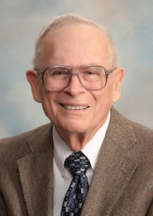
Robert Thomas
Four Views on the Book of Revelation, page 207.
“At the end of the Millennium that city will be Satan’s prime objective with his rebel army, because Israel will be a leader among the nations.”

Slide 116
Genesis 26:29a-b
Isaac’s Test
      Nations (29a)
      Brethren (29b)

Slide 117
Genesis 25:23
“The Lord said to her, ‘Two nations are in your womb; And two peoples will be separated from your body; And one people shall be stronger than the other; And the older shall serve the younger.’”

Slide 118

Cain Murders Abel
(4:3-8)
  4:3-5a
  Messianic line through Abel (Gen 3:21; Heb 11:4) contrary to Eve’s false expectation (4:1)
  Begins selection of younger over older pattern (Abel over Cain, Seth over Cain, Shem over Japheth, Isaac over Ishmael, Jacob over Esau, Judah and Joseph over their brothers, and Ephraim over Manasseh)

Slide 119
Genesis 27:27b-29
Blessing
      Blessings of God (27b)
      Agricultural blessings (28)
      Lordship blessings (29a-b)
      Blessing and curse (29c)

Slide 120

Genesis 12:3
“And I will bless those who bless you, And the one who curses [kalal] you I will curse [aor]. And in you all the families of the earth will be blessed.”

Slide 121
Dr. Arnold G. Fruchtenbaum
The Book of Genesis, 426
“Therefore, contrary to Isaac’s expectations or hope, the Abrahamic Covenant was to be sustained through Jacob and not through Esau. Thus, Isaac blessed Jacob, and this was the result of divine intervention in spite of Jacob’s sin. Isaac blessed Jacob against his own will, as indeed later Balaam will bless Israel against his own will.”

Slide 122
Genesis 27
Chapter Summary
  Isaac’s intent (1-5)
  The conspiracy (5-17)
  Deception and blessing (18-29)
  Isaac blesses Esau (30-40)
  Plan to flee to Haran (41-46)

Slide 123
Genesis 27:30-40
Isaac Blesses Esau
    Return of Esau (30)
    Esau prepares meal (31)
    Isaac’s realization (32-33)
    Esau’s reaction (34)
    Isaac’s reaction (35)
    Esau’s request (36)
    Isaac’s answer (37)
    Esau’s lament (38)
    Esau’s blessing (39-40)

Slide 124
Genesis 27:30-40
Isaac Blesses Esau
    Return of Esau (30)
    Esau prepares meal (31)
    Isaac’s realization (32-33)
    Esau’s reaction (34)
    Isaac’s reaction (35)
    Esau’s request (36)
    Isaac’s answer (37)
    Esau’s lament (38)
    Esau’s blessing (39-40)

Slide 125
Genesis 27:30-40
Isaac Blesses Esau
    Return of Esau (30)
    Esau prepares meal (31)
    Isaac’s realization (32-33)
    Esau’s reaction (34)
    Isaac’s reaction (35)
    Esau’s request (36)
    Isaac’s answer (37)
    Esau’s lament (38)
    Esau’s blessing (39-40)

Slide 126
Genesis 27:30-40
Isaac Blesses Esau
    Return of Esau (30)
    Esau prepares meal (31)
    Isaac’s realization (32-33)
    Esau’s reaction (34)
    Isaac’s reaction (35)
    Esau’s request (36)
    Isaac’s answer (37)
    Esau’s lament (38)
    Esau’s blessing (39-40)

Slide 127
Genesis 27:32-33
Isaac’s Realization
      Identification (32)
      Reaction (33)

Slide 128
Genesis 27:32-33
Isaac’s Realization
      Identification (32)
      Reaction (33)

Slide 129
Genesis 27:32-33
Isaac’s Realization
      Identification (32)
      Reaction (33)

Slide 130
Genesis 27:30-40
Isaac Blesses Esau
    Return of Esau (30)
    Esau prepares meal (31)
    Isaac’s realization (32-33)
    Esau’s reaction (34)
    Isaac’s reaction (35)
    Esau’s request (36)
    Isaac’s answer (37)
    Esau’s lament (38)
    Esau’s blessing (39-40)

Slide 131
Genesis 27:34
Esau’s Reaction
      Cry (34a)
      Request (34b)

Slide 132
Genesis 27:34
Esau’s Reaction
      Cry (34a)
      Request (34b)

Slide 133
Genesis 27:34
Esau’s Reaction
      Cry (34a)
      Request (34b)

Slide 134
Genesis 27:30-40
Isaac Blesses Esau
    Return of Esau (30)
    Esau prepares meal (31)
    Isaac’s realization (32-33)
    Esau’s reaction (34)
    Isaac’s reaction (35)
    Esau’s request (36)
    Isaac’s answer (37)
    Esau’s lament (38)
    Esau’s blessing (39-40)

Slide 135
Genesis 27:35
Isaac’s Reaction
      Truth (35a)
      Lie (35b)

Slide 136
Genesis 27:35
Isaac’s Reaction
      Truth (35a)
      Lie (35b)

Slide 137
Genesis 25:23
“The Lord said to her, ‘Two nations are in your womb; And two peoples will be separated from your body; And one people shall be stronger than the other; And the older shall serve the younger.’”

Slide 138
Genesis 27:35
Isaac’s Reaction
      Truth (35a)
      Lie (35b)

Slide 139
Genesis 25:23
“The Lord said to her, ‘Two nations are in your womb; And two peoples will be separated from your body; And one people shall be stronger than the other; And the older shall serve the younger.’”

Slide 140
Genesis 27:30-40
Isaac Blesses Esau
    Return of Esau (30)
    Esau prepares meal (31)
    Isaac’s realization (32-33)
    Esau’s reaction (34)
    Isaac’s reaction (35)
    Esau’s request (36)
    Isaac’s answer (37)
    Esau’s lament (38)
    Esau’s blessing (39-40)

Slide 141
Genesis 27:36
Esau’s Request
      Complaint (36a)
      Request (36b)

Slide 142
Genesis 27:36
Esau’s Request
      Complaint (36a)
      Request (36b)

Slide 143
Dr. Arnold G. Fruchtenbaum
The Book of Genesis, 428
“In 27:36 came Esau’s complaint and request. Esau’s complaint was: And he said, Is not he rightly named Jacob [yaaqov]? for he has supplanted me these two times. In Hebrew, the word supplanted comes from the same root as akav, ‘Jacob.’ The meaning coming from Esau’s lips goes from ‘over-reacher’ or ‘supplanter’ to ‘deceiver.’ The meaning of the name now moved from a positive to a negative implication, but it was done by Esau and not by God. Again, Jacob’s name comes from the Hebrew root akav, which basically means ‘heel.’ It also has the meaning in verbal form ‘to hold the heel in order to get before.’”

Slide 144
Dr. Arnold G. Fruchtenbaum
The Book of Genesis, 428
“That is its usage in Jeremiah 9:4. It has the meaning of ‘heel-grabber,’ one who trips another by the heel or overtakes and supplants him in the race. Therefore, by way of etymology, Jacob equaling ‘supplanter’ is a developed meaning, not the actual meaning of the word. Jacob twice ‘overtook’ Esau; that is, Jacob ‘tripped’ him and ‘supplanted’ him in the race. Esau’s rhetorical question was: ‘Is he called Jacob, ‘over-reacher,’ that he has twice overreached me?’ ‘Is it because he bears this name that it has now twice come to pass?’ In other words, the question was: ‘Is it all in the name?’”

Slide 145
Dr. Arnold G. Fruchtenbaum
The Book of Genesis, 428
“Of course, it was not all in the name but rather in the outworking of God’s plan. According to Esau, the two times were, first: He took away my birthright, which was a lie since Esau had sold his birthright; and second: and behold, now he has taken away my blessing. This second claim, too, was a lie, since the blessing belonged to the one with the birthright.”

Slide 146
Genesis 27:36
Esau’s Request
      Complaint (36a)
      Request (36b)

Slide 147
Genesis 27:30-40
Isaac Blesses Esau
    Return of Esau (30)
    Esau prepares meal (31)
    Isaac’s realization (32-33)
    Esau’s reaction (34)
    Isaac’s reaction (35)
    Esau’s request (36)
    Isaac’s answer (37)
    Esau’s lament (38)
    Esau’s blessing (39-40)

Slide 148
Dr. Arnold G. Fruchtenbaum
The Book of Genesis, 429
“In other words, the blessing given to Jacob is irrevocable. Indeed, the Nuzi Tablets teach that such oral testaments were binding, and there is an example in the Nuzi Court Record of Tarmiye. Tarmiye’s two older brothers contested his inheritance of a slave girl, and Tarmiye’s defense was based upon his father’s oral testament. The tablet reads as follows: ‘My father Huya was sick and lay on a couch; then my father seized my hand and spoke thus to me: My other sons being older have acquired a wife, so I give here Sululi-Istar as your wife.’”

Slide 149
Dr. Arnold G. Fruchtenbaum
The Book of Genesis, 429
“Indeed, the court ruled in his favor, because these oral-type testaments were considered binding. Isaac began his statement in verse 2 by saying: I am old and know not the day of my death. The Nuzi Tablets also begin the same way when introducing the final disposition of property. So here again with Isaac’s blessing of his sons was a strong correlation with Ancient Near Eastern Texts.”

Slide 150
Genesis 27:30-40
Isaac Blesses Esau
    Return of Esau (30)
    Esau prepares meal (31)
    Isaac’s realization (32-33)
    Esau’s reaction (34)
    Isaac’s reaction (35)
    Esau’s request (36)
    Isaac’s answer (37)
    Esau’s lament (38)
    Esau’s blessing (39-40)

Slide 151
Genesis 27:38
Esau’s Lament
      Lament (38a)
      Cry (38b)

Slide 152
Genesis 27:38
Esau’s Lament
      Lament (38a)
      Cry (38b)

Slide 153
Genesis 27:38
Esau’s Lament
      Lament (38a)
      Cry (38b)

Slide 154
Genesis 27:30-40
Isaac Blesses Esau
    Return of Esau (30)
    Esau prepares meal (31)
    Isaac’s realization (32-33)
    Esau’s reaction (34)
    Isaac’s reaction (35)
    Esau’s request (36)
    Isaac’s answer (37)
    Esau’s lament (38)
    Esau’s blessing (39-40)

Slide 155
Genesis 27:39-40
Esau’s Blessings
      Land (39)
      Nation (40)

Slide 156
Genesis 27:39-40
Esau’s Blessings
      Land (39)
      Nation (40)

Slide 157
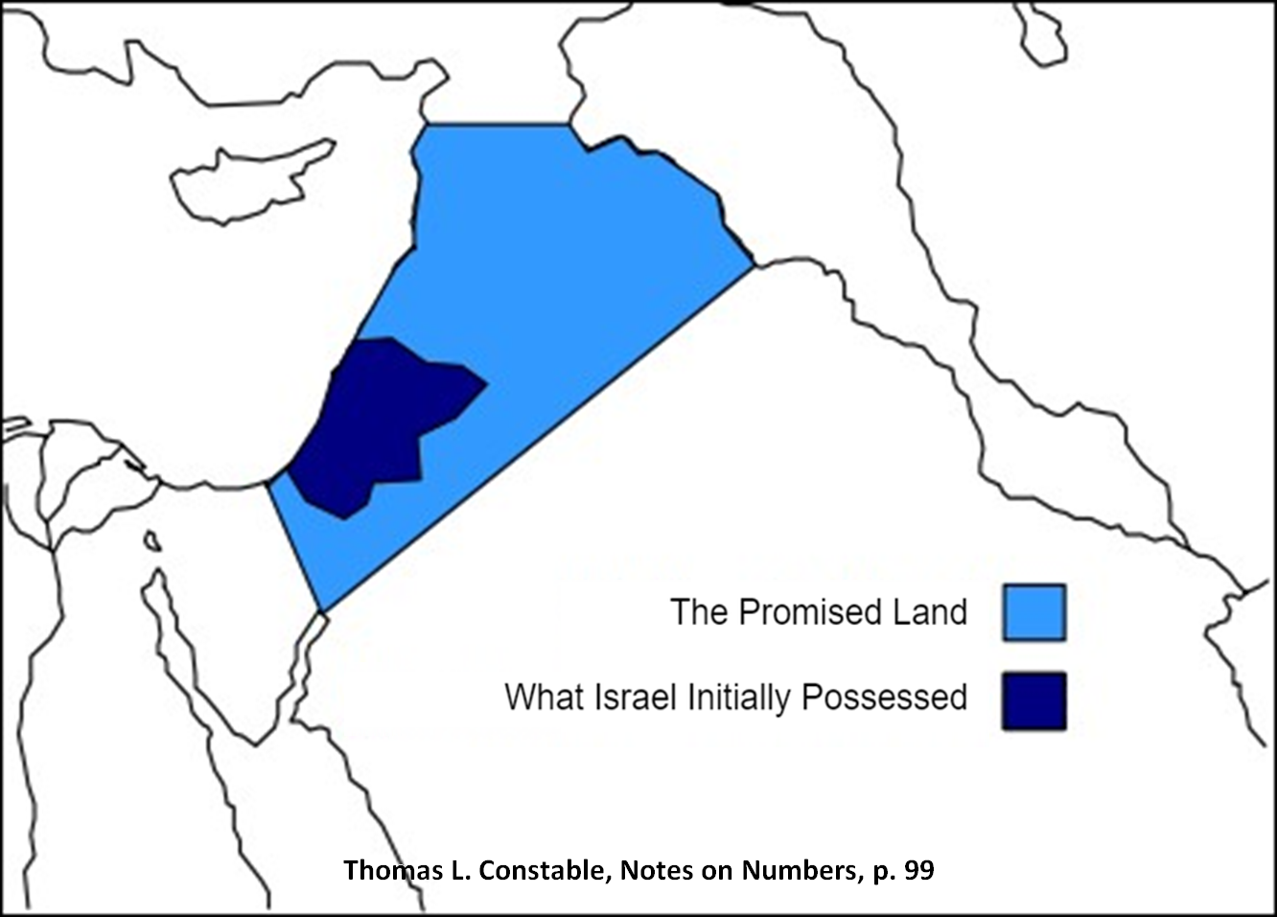

Slide 158
Dr. Arnold G. Fruchtenbaum
The Book of Genesis, 429-30
“At this point, there is a blessing for Esau, in 27:39–40. In verse 39, he first of all speaks concerning Esau: Behold, of the fatness of the earth shall be your dwelling. In the Hebrew text there is a min partitive; literally, it should read: ‘Away from the fatness of the earth shall be your dwelling.’ The next phrase, of the dew of heaven from above, also has a min partitive, literally meaning ‘away from the dew of heaven.’ The point is that while in some translations, it sounds similar to the blessing he gave to Jacob, in the Hebrew text it is actually the opposite of what was promised to Jacob. It means that since Esau’s place is away from this and away from that, Esau will not inherit the Land. Whatever his blessing, it will be away from the Land; he will not be the inheritor of this Land.”

Slide 159
Genesis 27:39-40
Esau’s Blessings
      Land (39)
      Nation (40)

Slide 160
Genesis 27:40
Nation
      Sword (40a)
      Subjugation (40b)
      Freedom (40c)

Slide 161
Genesis 27:40
Nation
      Sword (40a)
      Subjugation (40b)
      Freedom (40c)

Slide 162


Slide 163
Genesis 27:40
Nation
      Sword (40a)
      Subjugation (40b)
      Freedom (40c)

Slide 164
Genesis 25:23
“The Lord said to her, ‘Two nations are in your womb; And two peoples will be separated from your body; And one people shall be stronger than the other; And the older shall serve the younger.’”

Slide 165
Genesis 27:40
Nation
      Sword (40a)
      Subjugation (40b)
      Freedom (40c)

Slide 166
Dr. Arnold G. Fruchtenbaum
The Book of Genesis, 430
“In subsequent history, when the Jews went into Babylonian Captivity, the Edomites left their territory at Mount Seir in the Trans-Jordan and moved into the southern part of Judah, where they became known as Idumeans.”

Slide 167
Dr. Arnold G. Fruchtenbaum
The Book of Genesis, 430
“In addition, later these Idumeans were conquered by one of the descendants of the Maccabees, John Hyrcanos, who conquered them in 129 b.c., forcibly converted them to Judaism, and then incorporated Idumea into the Jewish Judean State. Eventually, these converted Idumeans produced the dynastic rule of the House of Herod.”

Slide 168


John 13:19; 14:29
“^{13:19} From now on I am telling you before it comes to pass, so that when it does occur, you may believe that I am He… ^{14:29} Now I have told you before it happens, so that when it happens, you may believe.”

Slide 169
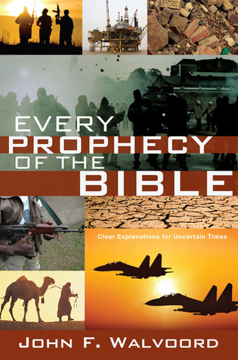

Slide 170
Genesis 27
Chapter Summary
  Isaac’s intent (1-5)
  The conspiracy (5-17)
  Deception and blessing (18-29)
  Isaac blesses Esau (30-40)
  Plan to flee to Haran (41-46)

Slide 171
Genesis 27:41-46
Plan to Flee to Haran
    Cause (41)
    Rebekah’s solution (42-46)

Slide 172
Genesis 27:41-46
Plan to Flee to Haran
    Cause (41)
    Rebekah’s solution (42-46)

Slide 173

Matthew 5:21-22
“²¹ “You have heard that the ancients were told, ‘You shall not commit murder’ and ‘Whoever commits murder shall be liable to the court.’ ²² But I say to you that everyone who is angry with his brother shall be guilty before the court; and whoever says to his brother, ‘You good-for-nothing,’ shall be guilty before the supreme court; and whoever says, ‘You fool,’ shall be guilty enough to go into the fiery hell.”

Slide 174
Matthew 5:27-28
“²⁷ You have heard that it was said, ‘You shall not commit adultery’; ²⁸ but I say to you that everyone who looks at a woman with lust for her has already committed adultery with her in his heart.”

Slide 175
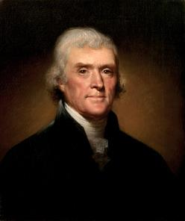
Thomas Jefferson
On April 21, 1803, Jefferson wrote to Dr. Benjamin Rush, also a signer of the Declaration
"My views ... are the result of a life of inquiry and reflection, and very different from the anti-Christian system imputed to me by those who know nothing of my opinions. To the corruptions of Christianity, I am, indeed, opposed; but not to the genuine precepts of Jesus Himself. I am a Christian in the only sense in which He wished any one to be; sincerely attached to his doctrines in preference to all others...His system of morals...if filled up in the style and spirit of the rich fragments He left us, would be the most perfect and sublime that has ever been taught by man...His moral doctrines...were more pure and . . .

Slide 176
Thomas Jefferson
On April 21, 1803, Jefferson wrote to Dr. Benjamin Rush, also a signer of the Declaration
...perfect than those of the most correct of the philosophers...gathering all into one family under the bonds of love, charity, peace, common wants and common aids. A development of this head will evince the peculiar superiority of the system of Jesus over all others. The precepts of philosophy, and of the Hebrew code, laid hold of actions only. He pushed his scrutinies into the heart of man; erected his tribunal in the region of his thoughts, and purified the waters at the fountain head.”

Slide 177
Genesis 27:41-46
Plan to Flee to Haran
    Cause (41)
    Rebekah’s solution (42-46)

Slide 178
Genesis 27:42-46
Rebekah’s Solution
      Discovery (42a)
      Problem (42b)
      Instruction (43-44a)
      Purpose (44b-45)
      Excuse (46)

Slide 179
Genesis 27:42-46
Rebekah’s Solution
      Discovery (42a)
      Problem (42b)
      Instruction (43-44a)
      Purpose (44b-45)
      Excuse (46)

Slide 180
Genesis 27:42-46
Rebekah’s Solution
      Discovery (42a)
      Problem (42b)
      Instruction (43-44a)
      Purpose (44b-45)
      Excuse (46)

Slide 181
Genesis 3:15
“And I will put enmity Between you and the woman, And between your seed and her seed; He shall bruise you on the head, And you shall bruise him on the heel.”

Slide 182
Messiah must be Jewish or from the line of Jacob
Numbers 24:17

Slide 183
Balaam's 7 Oracles Blessing Israel (23-24)
First oracle (23:1-12), Balaam explained that God’s blessings upon Israel were irrevocable.
Second oracle (23:13-26), Balaam explained that the source of Israel’s blessing was her unique relationship to Yahweh
Third oracle (23:27–24:14), Balaam extolled Israel’s beauty.
Fourth oracle (24:15-19), Balaam explained that a future messianic deliverer (Gen 49:10) would spring forth and exercise dominion from Israel.

Slide 184
Balaam's 7 Oracles Blessing Israel (23-24)
Fifth oracle (Num 24:20) predicts Amalek’s destruction. Amalek was the first foe that Israel had to fight against after leaving Egypt (Exod 17).
Sixth oracle (24:21-22) predicts the destruction of the Midianite group known as the Kenites as well as Assyria.
The nations of the seventh oracle are difficult to identify (24:23-24).

Slide 185

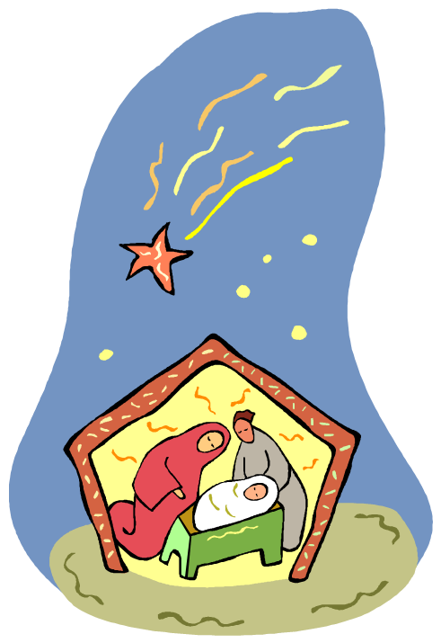
Numbers 24:17
“I see him, but not now; I behold him, but not near; A star shall come forth from Jacob, A scepter shall rise from Israel, And shall crush through the forehead of Moab, And tear down all the sons of Sheth.”

Slide 186
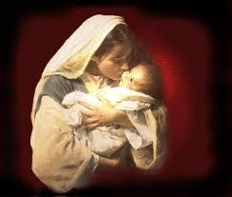
Satanic Attempts to Stop Messiah’s Birth
Cain & Abel (Gen. 4)
Sons of God (Gen. 6)
Pharaoh persecutes Israel (Exod. 1)
Joash protected from Athaliah (2 Chron. 22‒23)
Haman persecutes Israel (Esther)
Antiochus Epiphanés (Dan. 11:31)
Herod persecutes Christ (Matt 2; Rev 12:4)

Slide 187
Genesis 27:42-46
Rebekah’s Solution
      Discovery (42a)
      Problem (42b)
      Instruction (43-44a)
      Purpose (44b-45)
      Excuse (46)

Slide 188
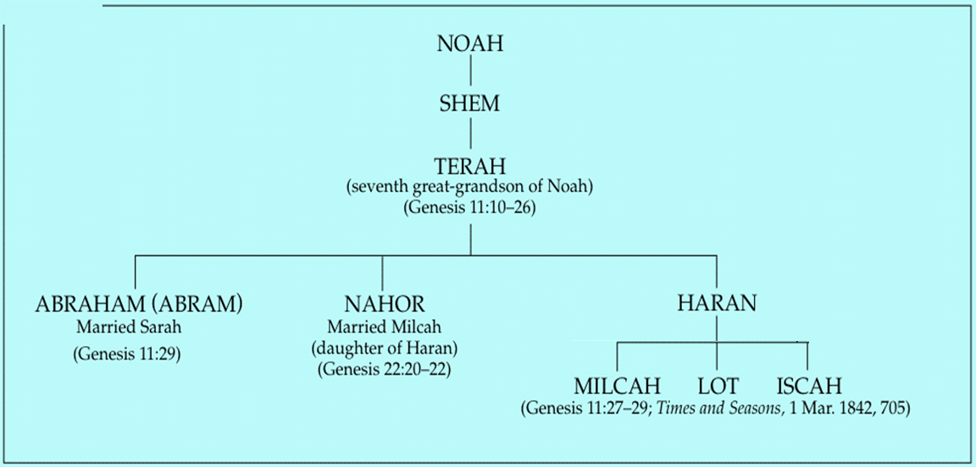

Slide 189

Nahor’s children through Milcah (Gen. 22:20b-23)
1. Uz (Job 1:1) | 5. Hazo
2. Buz | 6. Pildash
3. Aram | 7. Jidlaph
4. Chesed | 8. Bethuel (Gen. 24)

Slide 191
Genesis 27:42-46
Rebekah’s Solution
      Discovery (42a)
      Problem (42b)
      Instruction (43-44a)
      Purpose (44b-45)
      Excuse (46)

Slide 192
Genesis 9:6
“Whoever sheds man’s blood, By man his blood shall be shed, For in the image of God He made man.”

Slide 193
Noahic vs. Abrahamic & Mosaic Covenants
Name | NOAHIC | ABRAHAMIC | MOSAIC
Human agent | Noah | Abraham | Moses
Scripture | Gen. 8‒9 | Gen. 12‒17 | Exod. 19‒40
Covenant (Berith) | Gen. 9:9 | Gen. 15:18 | Exod. 19:5
Party | World, humanity | Israel, Hebrews | Israel, Hebrews
Israel | Pre-Israel | Post-Israel | Post-Israel

Slide 194
Noahic vs. Abrahamic & Mosaic Covenants
Covenant | NOAHIC | ABRAHAMIC | MOSAIC
Conditional or unconditional | Unconditional | Unconditional | Conditional
Promises | No more flood judgment, enduring earth, capital punishment | Ownership of land, seed, and blessing | Enjoyment or possession of land, seed, and blessing
Sign | Rainbow | Circumcision | Sabbath
Purpose | Restrain & preserve | Redemptive | Redemptive
Directly binding today? | Yes | No | No

Slide 195
Genesis 27:42-46
Rebekah’s Solution
      Discovery (42a)
      Problem (42b)
      Instruction (43-44a)
      Purpose (44b-45)
      Excuse (46)

Slide 196
VI. Genesis 26:34-35
Esau’s Wives
    Esau’s age (34a)
    Names of wives (34b)
    Impact on Esau’s parents (35)

Slide 198
Conclusion

Slide 199
Genesis 27
Chapter Summary
  Isaac’s intent (1-5)
  The conspiracy (5-17)
  Deception and blessing (18-29)
  Isaac blesses Esau (30-40)
  Plan to flee to Haran (41-46)

Slide 200

²⁴ The Lord bless you, and keep you; ²⁵ The Lord make His face shine on you, And be gracious to you; ²⁶ The Lord lift up His countenance on you, And give you peace.
Numbers 6:24–26 (NASB95)

