Slide 1
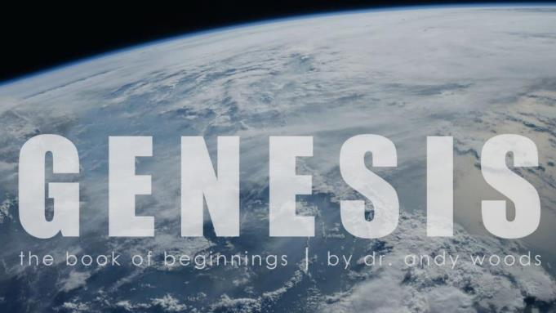
Genesis 12‒50
Israel’s Birth & Preservation

Slide 2
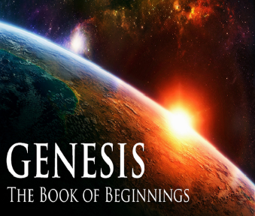
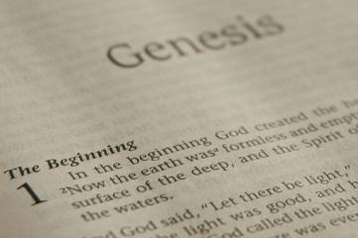
GENESIS STRUCTURE
Beginning of the Human race (Gen. 1‒11)
Beginning of the Hebrew race (Gen. 12‒50)

Slide 3
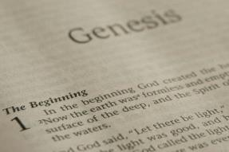
GENESIS STRUCTURE
Genesis 1-11 (four events)
Creation (1-2)
Fall (3-5)
Flood (6-9)
National dispersion (10-11)

Slide 4
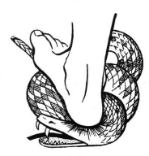
Genesis 3:15
“And I will put enmity Between you and the woman, And between your seed and her seed; He shall bruise you on the head, And you shall bruise him on the heel.”

Slide 5
GENESIS STRUCTURE
Beginning of the Human race (Gen. 1‒11)
Beginning of the Hebrew race (Gen. 12‒50)

Slide 6
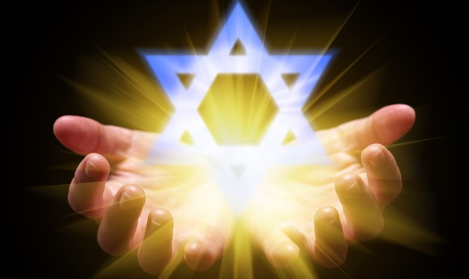
Isaiah 43:1
“But now, thus says the Lord, your Creator, O Jacob, And He who formed you, O Israel, 'Do not fear, for I have redeemed you; I have called you by name; you are Mine!'”

Slide 7
GENESIS STRUCTURE
Genesis 12-50 (four people)
Abraham (12:1–25:11)
Isaac (25:12–26:35)
Jacob (27–36)
Joseph (37–50)

Slide 8
Genesis 26 Chapter Summary
Abrahamic Covenant Reconfirmed (1-5)
Isaac & Abimelech (6-11)
Struggle for the Wells (12-22)
Sojourn in Beersheba (23-25)
Esau’s Wives (34-35)

Slide 9
Genesis 26 Chapter Summary
Abrahamic Covenant Reconfirmed (1-5)
Isaac & Abimelech (6-11)
Struggle for the Wells (12-22)
Sojourn in Beersheba (23-25)
Esau’s Wives (34-35)

Slide 10
I. Genesis 26:1-5 Abrahamic Covenant Reconfirmed
Setting (1)
Divine revelation (2-5)
Appearance (2a)
Content (2b-5)

Slide 11
Genesis 26 Chapter Summary
Abrahamic Covenant Reconfirmed (1-5)
Isaac & Abimelech (6-11)
Struggle for the Wells (12-22)
Sojourn in Beersheba (23-25)
Esau’s Wives (34-35)

Slide 12
II. Genesis 26:6-11 Isaac and Abimelech
Occasion (6-7)
Discovery (8)
Confrontation (9-10)
Charge (11)

Slide 13
II. Genesis 26:6-11 Isaac and Abimelech
Occasion (6-7)
Discovery (8)
Confrontation (9-10)
Charge (11)

Slide 14
Genesis 26:6-7 Occasion
Place (6)
Lie (7)

Slide 15
Genesis 26:6-7 Occasion
Place (6)
Lie (7)

Slide 16
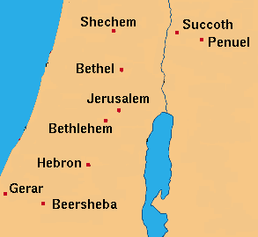

Slide 17
Genesis 26:6-7 Occasion
Place (6)
Lie (7)

Slide 18
Genesis 12‒25 Abraham’s Early Journeys
Unconditional promises (Gen. 12:1-3) From Haran to Canaan (Gen. 12:4-5) In Canaan (Gen. 12:6-9) In Egypt (Gen. 12:10-20) Abram and Lot Separate (Gen. 13:1-13) Reaffirmation of Abram’s promises (Gen. 13:14-18) Abram Rescues Lot (14:1-24) Abrahamic Covenant (15:1-21) Hagar & Ishmael (16:1-16) Circumcision (Gen. 17:1-27) | Sodom & Gomorrah (Gen. 18‒19) Abraham & Abimelech (Gen. 20) Isaac’s birth (Gen. 21:1-7) Ishmael’s expulsion (21:8-21) Abraham & Abimelech’s covenant (21:22-34) Abraham sacrifices Isaac (22) Sarah’s death (23) Isaac’s marriage (24) Abraham & Keturah (25:1-6) Abraham’s death (25:7-11)

Slide 19
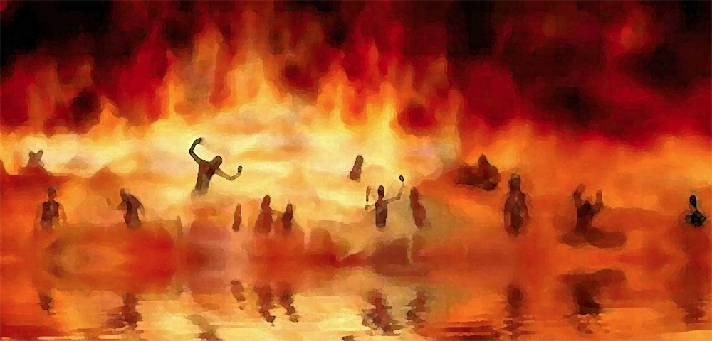
Revelation 21:8
“But for the cowardly and unbelieving and abominable and murderers and immoral persons and sorcerers and idolaters and all liars, their part will be in the lake that burns with fire and brimstone, which is the second death.”

Slide 20
Genesis 12‒25 Abraham’s Early Journeys
Unconditional promises (Gen. 12:1-3) From Haran to Canaan (Gen. 12:4-5) In Canaan (Gen. 12:6-9) In Egypt (Gen. 12:10-20) Abram and Lot Separate (Gen. 13:1-13) Reaffirmation of Abram’s promises (Gen. 13:14-18) Abram Rescues Lot (14:1-24) Abrahamic Covenant (15:1-21) Hagar & Ishmael (16:1-16) Circumcision (Gen. 17:1-27) | Sodom & Gomorrah (Gen. 18‒19) Abraham & Abimelech (Gen. 20) Isaac’s birth (Gen. 21:1-7) Ishmael’s expulsion (21:8-21) Abraham & Abimelech’s covenant (21:22-34) Abraham sacrifices Isaac (22) Sarah’s death (23) Isaac’s marriage (24) Abraham & Keturah (25:1-6) Abraham’s death (25:7-11)

Slide 21
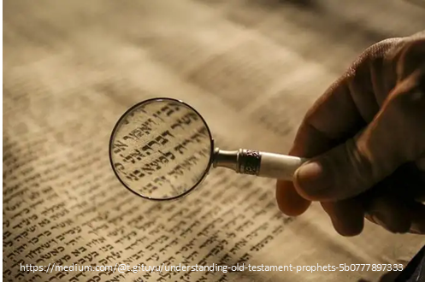
Romans 15:4
“For whatever was written in earlier times was written for our instruction, so that through perseverance and the encouragement of the Scriptures we might have hope.”

Slide 22
II. Genesis 26:6-11 Isaac and Abimelech
Occasion (6-7)
Discovery (8)
Confrontation (9-10)
Charge (11)

Slide 23
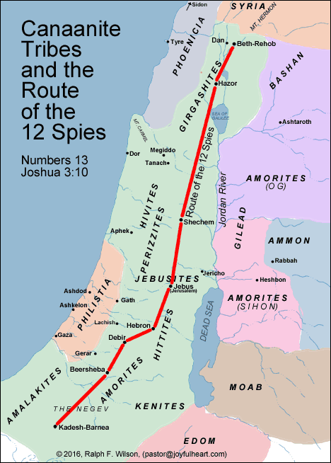

Slide 24
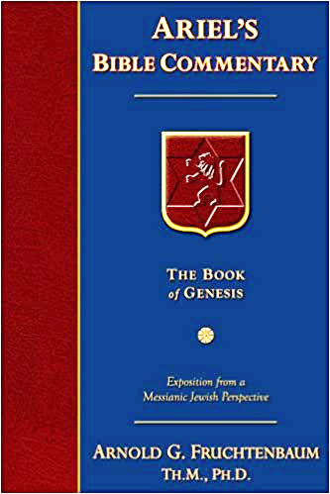
Dr. Arnold G. Fruchtenbaum
The Book of Genesis, 406
“This was not the same Abimelech of chapter 20 and of 21:22–34. Abimelech was a dynastic name for the king of Gerar, and therefore was more of a title, such as ‘Pharaoh’ is a title, while the personal name would differ. Just as ‘Pharaoh’ was a dynastic name for the king of Egypt, Abimelech was a dynastic name for the king of Gerar. He is mentioned as being king of the Philistines. The Philistines were not yet living in the area at that time, and so the term Philistines is used proleptically, meaning that this is the place where later the Philistines settled.”

Slide 25
II. Genesis 26:6-11 Isaac and Abimelech
Occasion (6-7)
Discovery (8)
Confrontation (9-10)
Charge (11)

Slide 26
Genesis 26:9-10 Confrontation
Accusation (9a)
Excuse (9b)
Danger of the lie (10)

Slide 27
Genesis 26:9-10 Confrontation
Accusation (9a)
Excuse (9b)
Danger of the lie (10)

Slide 28
Charles Ryrie The Ryrie Study Bible, page 33
Genesis 26:1 (RSB:NASB1995U): “26:1…Abimelech is a dynastic title, such as ‘pharaoh.’ Because this occurred 97 years later, the Abimelech mentioned here was probably not the same as the ruler of chap. 20.”

Slide 29
Genesis 12‒25 Abraham’s Early Journeys
Unconditional promises (Gen. 12:1-3) From Haran to Canaan (Gen. 12:4-5) In Canaan (Gen. 12:6-9) In Egypt (Gen. 12:10-20) Abram and Lot Separate (Gen. 13:1-13) Reaffirmation of Abram’s promises (Gen. 13:14-18) Abram Rescues Lot (14:1-24) Abrahamic Covenant (15:1-21) Hagar & Ishmael (16:1-16) Circumcision (Gen. 17:1-27) | Sodom & Gomorrah (Gen. 18‒19) Abraham & Abimelech (Gen. 20) Isaac’s birth (Gen. 21:1-7) Ishmael’s expulsion (21:8-21) Abraham & Abimelech’s covenant (21:22-34) Abraham sacrifices Isaac (22) Sarah’s death (23) Isaac’s marriage (24) Abraham & Keturah (25:1-6) Abraham’s death (25:7-11)

Slide 30
Genesis 26:9-10 Confrontation
Accusation (9a)
Excuse (9b)
Danger of the lie (10)

Slide 31
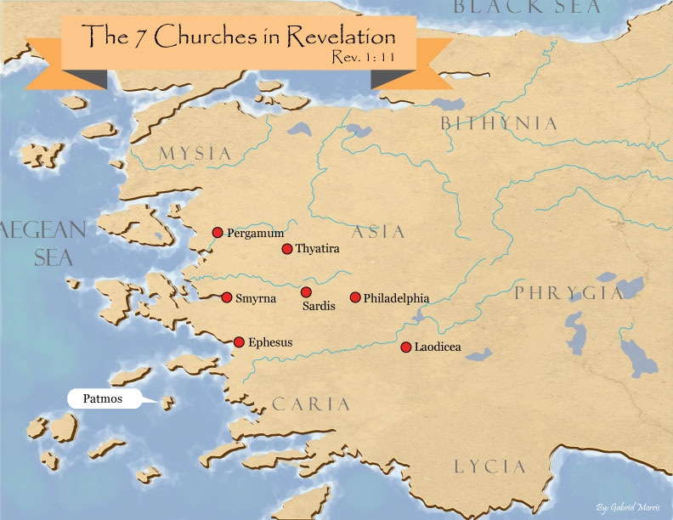

Slide 32
Genesis 26:9-10 Confrontation
Accusation (9a)
Excuse (9b)
Danger of the lie (10)

Slide 33
VI. 8 New Promises Genesis 12:1-3
Land (Gen. 12:1b)
Great nation (Gen. 12:2a)
Personal blessing (Gen. 12:2b)
Great name (Gen. 12:2c)
Blessing to others (Gen. 12:2d)
Blessing to blessers (Gen. 12:3a)
Cursing to cursers (Gen. 12:3b)
Blessing to the world (Gen. 12:3c)

Slide 34
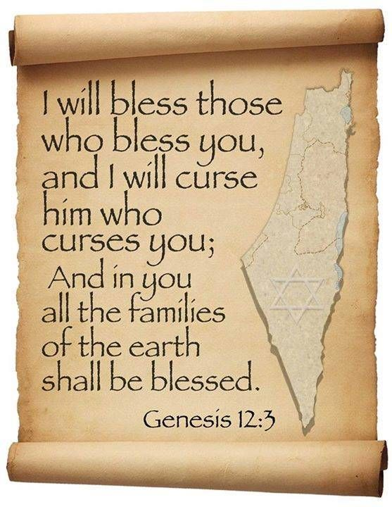
Genesis 12:3
“And I will bless those who bless you, And the one who curses [kalal] you I will curse [aor]. And in you all the families of the earth will be blessed.”

Slide 35
Dr. Arnold G. Fruchtenbaum
The Book of Genesis, 242
“The first word for curse is kalal, which means ‘to treat lightly,’ ‘to hold in contempt,’ or ‘to curse.’ To merely treat Abram and the Jews lightly is to incur the curse of God. The second word for curse used in this phrase (him that curses you will I curse) is aor, from the Hebrew root arah, which means ‘to impose a barrier,’ ‘to ban.’ This is a much stronger word for curse than the first one in the phrase…Therefore, even a light curse against Abram or against the Jews will bring a heavier curse from God.”

Slide 36
II. Genesis 26:6-11 Isaac and Abimelech
Occasion (6-7)
Discovery (8)
Confrontation (9-10)
Charge (11)

Slide 37
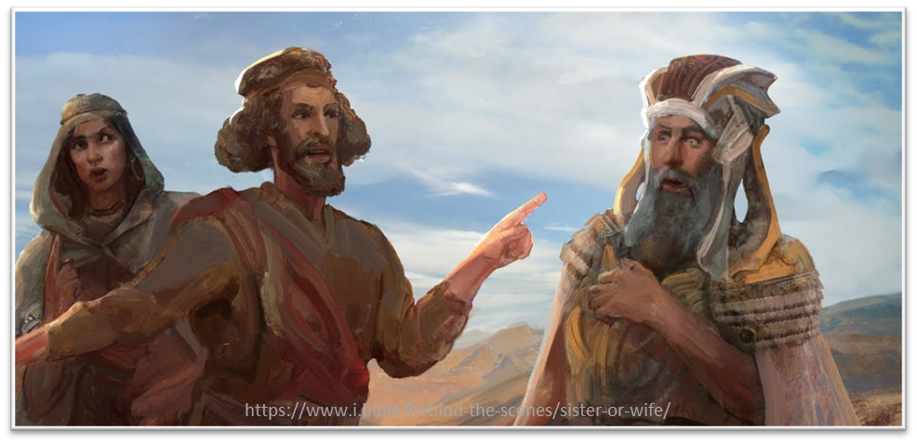
Dr. Arnold G. Fruchtenbaum
The Book of Genesis, 337
“The irony here is that a pagan king condemned a patriarch for his sin.”

Slide 39
Henry Clarence Thiessen
Lectures in Systematic Theology, rev. ed. (Grand Rapids: Eerdmans, 1979), 191.
“The Scriptures speak of human nature as totally depraved. However, the doctrine of ‘total depravity’ is easily misunderstood and misinterpreted. From the negative standpoint, it is important to know both what it does not mean and what it does mean. This does not mean that every sinner is devoid of all qualities pleasing to men; that he commits, or is prone to every form of sin; or that he is bitterly opposed to God as it is possible for him to be. Jesus recognized the existence of pleasing qualities in some individuals (Mark 10:21); He said that the scribes and Pharisees did some things God demanded (Matt. 23:23); Paul asserted that some Gentiles ‘do instinctively the things of the law’ (Rom. 2:14); God told Abraham that the iniquity of the Amorites would grow worse (Gen. 15:16); and Paul says that ‘evil men and imposters will proceed from bad to worse’ (2 Tim. 3:13).”

Slide 40
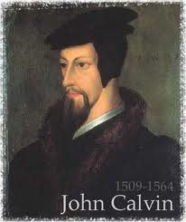
Total Depravity
What total depravity is not:
Man is as evil as he can possibly be & indulges every possible sin
Man is incapable of doing good things
Gen. 3:22
Matt. 7:11
Acts 10:1-2
Rom. 2:14-15

Slide 41
Total Depravity
What total depravity is:
Every area of man’s being is touched by sin
Intellect (Prov. 3:5-6; 14:12; 2 Cor. 4:4; Rom. 3:11a)
Conscience (1 Tim 4:2)
Will (Rom 1:28; 3:11b)
Deeds (Rom. 3:12)
Speech (Rom. 3:13-14)
Feet (Rom. 3:15)

Slide 42
Total Depravity
What total depravity is:
Every area of man’s being is touched by sin (cont’d)
Heart (Mark 7:21; Eph 4:18)
Body (Gen 3:19; Rom. 8:23)
Total being (Rom 1:18–3:20)
Man is incapable of earning merit favor from God (Isa 64:6; Eph. 2:8-9)

Slide 43
Conclusion

Slide 44
Genesis 26 Chapter Summary
Abrahamic Covenant Reconfirmed (1-5)
Isaac & Abimelech (6-11)
Struggle for the Wells (12-22)
Sojourn in Beersheba (23-25)
Esau’s Wives (34-35)

Slide 45
II. Genesis 26:6-11 Isaac and Abimelech
Occasion (6-7)
Discovery (8)
Confrontation (9-10)
Charge (11)

Slide 46
Genesis 26 Chapter Summary
Abrahamic Covenant Reconfirmed (1-5)
Isaac & Abimelech (6-11)
Struggle for the Wells (12-22)
Sojourn in Beersheba (23-25)
Esau’s Wives (34-35)

Slide 47
²⁴ The Lord bless you, and keep you; ²⁵ The Lord make His face shine on you, And be gracious to you; ²⁶ The Lord lift up His countenance on you, And give you peace.
Numbers 6:24–26 (NASB95)

