Slide 2
Introductory Matters
Title
Authorship
Biography
Place of writing
Recipient
Purpose
Message
Method
Sources
Date
Structure
Scope
Themes
Unique characteristics

Slide 3
Acts 1 Chapter Summary
Prologue (1-5)
Jesus’ Ascension (6-11)
Return to Jerusalem (12-14)
Matthias Chosen (15-26)

Slide 4
Acts 1 Chapter Summary
Prologue (1-5)
Jesus’ Ascension (6-11)
Return to Jerusalem (12-14)
Matthias Chosen (15-26)

Slide 5
I. Prologue Acts 1:1-5
Connection to Luke’s Gospel (1-2a)
Jesus’ Post-Resurrection Ministry (2b-3)
Promise of the Holy Spirit (4-5)

Slide 6
I. Prologue Acts 1:1-5
Connection to Luke’s Gospel (1-2a)
Jesus’ Post-Resurrection Ministry (2b-3)
Promise of the Holy Spirit (4-5)

Slide 7
Luke 1:1–4
¹ Inasmuch as many have undertaken to compile an account of the things accomplished among us, ² just as they were handed down to us by those who from the beginning were eyewitnesses and servants of the word, ³ it seemed fitting for me as well, having investigated everything carefully from the beginning, to write it out for you in consecutive order, most excellent Theophilus; ⁴ so that you may know the exact truth about the things you have been taught.

Slide 8
I. Prologue Acts 1:1-5
Connection to Luke’s Gospel (1-2a)
Jesus’ Post-Resurrection Ministry (2b-3)
Promise of the Holy Spirit (4-5)

Slide 9
Isaiah 9:6-7
⁶ For a child will be born to us, a son will be given to us; And the government will rest on His shoulders; And His name will be called Wonderful Counselor, Mighty God, Eternal Father, Prince of Peace.⁷ There will be no end to the increase of His government or of peace, On the throne of David and over his kingdom, To establish it and to uphold it with justice and righteousness From then on and forevermore. The zeal of the Lord of hosts will accomplish this.

Slide 10
Matthew’s Purposes
To explain that Jesus in whom they had believed was the long-awaited Jewish Messiah
To explain why the kingdom had been postponed even though the king had arrived
To explain the interim program of God during the kingdom’s absence

Slide 11
I. Prologue Acts 1:1-5
Connection to Luke’s Gospel (1-2a)
Jesus’ Post-Resurrection Ministry (2b-3)
Promise of the Holy Spirit (4-5)

Slide 12
1 Corinthians 12:13
“For by one Spirit we were all baptized into one body, whether Jews or Greeks, whether slaves or free, and we were all made to drink of one Spirit.”

Slide 13
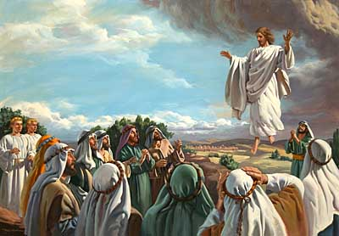
Acts 1 Chapter Summary
Prologue (1-5)
Jesus’ Ascension (6-11)
Return to Jerusalem (12-14)
Matthias Chosen (15-26)

Slide 14
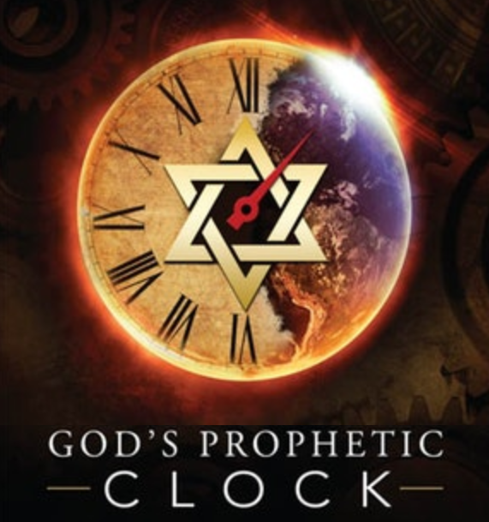
Acts 1:6-7
“⁶ So when they had come together, they were asking Him, saying, ‘Lord, is it at this time You are restoring the kingdom to Israel?’ ⁷ He said to them, ‘It is not for you to know times or epochs which the Father has fixed by His own authority.’”

Slide 15
Ezekiel 36:24-28
“For I will take you from the nations, gather you from all the lands and bring you into your own land. ²⁵ Then I will sprinkle clean water on you, and you will be clean; I will cleanse you from all your filthiness and from all your idols. ²⁶ Moreover, I will give you a new heart and put a new spirit within you; and I will remove the heart of stone from your flesh and give you a heart of flesh. ²⁷ I will put My Spirit within you and cause you to walk in My statutes, and you will be careful to observe My ordinances. ²⁸ You will live in the land that I gave to your forefathers; so you will be My people, and I will be your God.”

Slide 16
Zechariah 12:10
“I will pour out on the house of David and on the inhabitants of Jerusalem, the Spirit of grace and of supplication, so that they will look on Me whom they have pierced; and they will mourn for Him, as one mourns for an only son, and they will weep bitterly over Him like the bitter weeping over a firstborn.”

Slide 17
Acts 1:6-7
“⁶ So when they had come together, they were asking Him, saying, ‘Lord, is it at this time You are restoring the kingdom to Israel?’ ⁷ He said to them, ‘It is not for you to know times or epochs which the Father has fixed by His own authority.’”

Slide 18
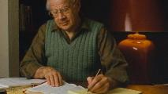
J. Dwight Pentecost
Dwight Pentecost, Thy Kingdom Come (Wheaton, IL: Victor Books, 1990), 269.
“This passage makes it clear that while the covenanted form of the Theocracy has not been cancelled and has only been postponed, this present age is definitely not a development of the Davidic form of the kingdom.”

Slide 19
“He showeth that the apostles were gathered together when as this question was moved, that we may know that it came not of the foolishness of one or two that it was moved, but it was moved by the common consent of them all; but marvellous is their rudeness, that when as they had been diligently instructed by the space of three whole years, they betray no less ignorance than if they had heard never a word. There are as many errors in this question as words. They ask him as concerning a kingdom; but they dream of an earthly kingdom, which should flow with riches, with dainties, with external peace, and with such like good things...”
John Calvin
Commentary on Acts 1:6

Slide 20
“They are also greatly deceived herein, in that they restrain Christ’s kingdom unto the carnal Israel, which was to be spread abroad, even unto the uttermost parts of the world…but, in the meantime, they declared thereby how bad scholars they were under so good a Master. Therefore doth Christ briefly comprehend in this short answer all the errors whereinto they fell in this their question, as I shall straightway declare.”
John Calvin
Commentary on Acts 1:6

Slide 21
Hank Hanegraaff
The Apocalypse Code: Find out What the Bible Really Says About the End Times and Why It Matters (Nashville, TN: Nelson, 2007), 199.
“The quintessential point of understanding for John as well as for the rest of the disciples began to dawn at the time of Christ’s postresurrection appearances. Previously they had been under the same misconceptions as modern-day Christian Zionists. They had expected Jesus to establish Jerusalem as the capital of a sovereign Jewish empire. The notion was so ingrained in their psyches that even as Jesus was about to ascend into heaven, they asked, “Lord are you at this time going to restore the kingdom to Israel?” (Acts 1:6). Jesus not only corrects their erroneous thinking, but expands their horizons from a tiny strip of land on the east coast of the Mediterranean to the farthest reaches of the earth.”

Slide 22
Hank Hanegraaff
The Apocalypse Code: Find out What the Bible Really Says About the End Times and Why It Matters (Nashville, TN: Nelson, 2007), 199.
“‘You will receive power when the Holy Spirit comes on you,’ said Jesus, as he was about to be taken up into heaven; ‘and you will be my witnesses in Jerusalem, and in all Judea and Samaria, and to the ends of the earth’ (Acts 1:8). In effect, Jesus left his disciples with instructions to exit Jerusalem, embrace the earth, and never again entertain the thought of establishing an earthly Jerusalem. The disciples are no longer permitted to view Israel in exclusivistic parochial categories; their sights instead must be elevated to an inclusive Israel. As Paul put it in the book of Romans, ‘Not all who are descended from Israel are Israel. Nor because they are his descendants are they all Abraham’s children’ (Romans 9:6–7). True Israel consists of people from ‘from every tribe and language and people and nation’ (Revelation 5:9).”

Slide 23
Rick Warren
Purpose Driven Life, 285-86.
“When the disciples wanted to talk about prophecy, Jesus quickly switched the conversation to evangelism. He wanted them to concentrate on their mission in the world. He said in essence, ‘The details of my return are none of your business. What is your business is the mission I have given you. Focus on that!’ If you want Jesus to come back sooner, focus on fulfilling your mission, not figuring out prophecy. Speculating on the exact timing of Christ’s return is futile, because Jesus said, ‘No one knows about that day or hour, not even the angels in heaven, nor the Son, but only the Father.’ Since Jesus said He didn’t know the day or hour, why should you try to figure it out? What we do know for sure is this: Jesus will not return until everyone God wants to hear the Good News has heard it.”

Slide 24
Rick Warren
Purpose Driven Life, 285-86.
“Jesus said, ‘The Good News about God’s kingdom will be preached in all the world, to every nation. Then the end will come.’ If you want Jesus to come back sooner, focus on fulfilling your mission, not figuring out prophecy. It is easy to get distracted and sidetracked from your mission because Satan would rather have you do anything besides sharing your faith. He will let you do all kinds of good things as long as you don’t take anyone to heaven with you. But the moment you become serious about your mission, expect the Devil to throw all kinds of diversions at you. When that happens, remember the words of Jesus: ‘Anyone who lets himself be distracted from the work I plan for him is not fit for the Kingdom of God.’”

Slide 25
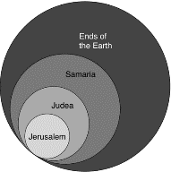
Acts 1:8
“but you will receive power when the Holy Spirit has come upon you; and you shall be My witnesses both in Jerusalem, and in all Judea and Samaria, and even to the remotest part of the earth.”

Slide 26
Revelation 20:4-6
“⁴ Then I saw thrones, and they sat on them, and judgment was given to them. And I saw the souls of those who had been beheaded because of their testimony of Jesus and because of the word of God, and those who had not worshiped the beast or his image, and had not received the mark on their forehead and on their hand; and they came to life [zaō] and reigned with Christ for …

Slide 27
Revelation 20:4-6
… a thousand years. ⁵ The rest of the dead did not come to life [zaō] until the thousand years were completed. This is the first resurrection [anastasis]. ⁶ Blessed and holy is the one who has a part in the first resurrection [anastasis]; over these the second death has no power, but they will be priests of God and of Christ and will reign with Him for a thousand years.”

Slide 28
Acts 1:8
“but you will receive power when the Holy Spirit has come upon you; and you shall be My witnesses both in Jerusalem, and in all Judea and Samaria, and even to the remotest part of the earth.”

Slide 29
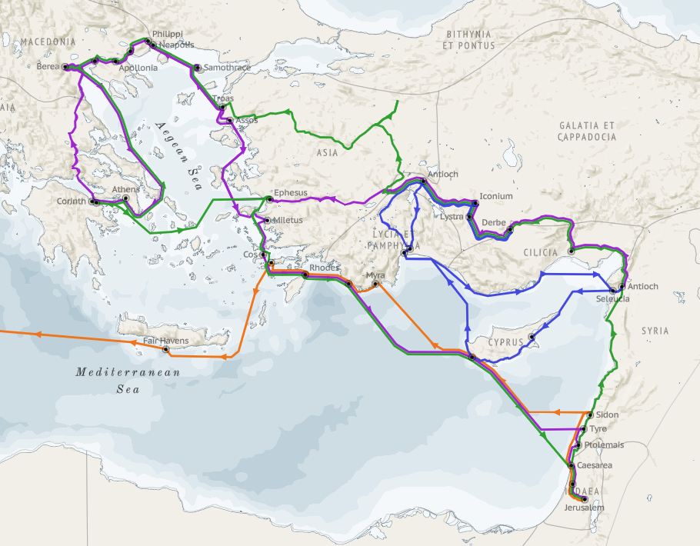
Structure (Acts 1:8)
Jerusalem (Acts 1–7)
Judea and Samaria (Acts 8–12)
Remotest part of the earth (Acts 13–28)
1st missionary journey (Acts 13–14)
Jerusalem council (Acts 15:1-35)
2nd missionary journey (Acts 15:36 –18:22)
3rd missionary journey (Acts 18:23–21:17)
Trip to Rome (Acts 21:18–28:31)

Slide 30
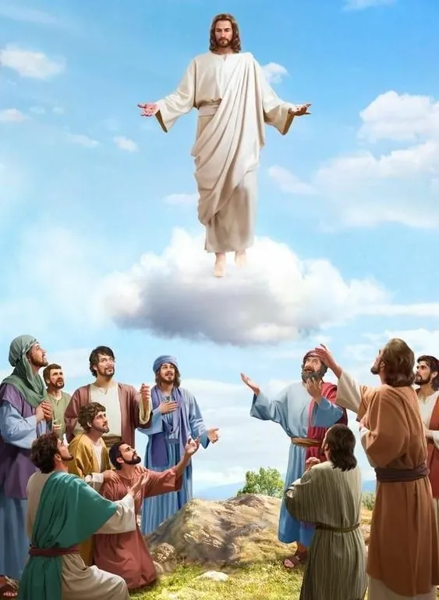
Christ’s Return (Acts 1:11)
Physical
Visible
Bodily
Earthly (Job 19:24-25)
To the Mount of Olives (Zech. 14:4)

Slide 31
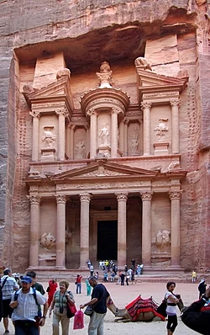
Place of Hebrew Refuge: Petra in Mt. Seir in S. Jordan
Prepared by God (Rev. 12:6)
Divine provision of food & water (Isa. 33:16; Rev. 12:6)
Wilderness (Rev. 12:6, 14)
Mountains (Isa. 33:16; Matt. 24:16)
Defensible (Isa. 33:16)
Jordan (Dan. 11:41)
Bozrah (Micah 2:12)
Fruchtenbaum, Footsteps of the Messiah, 294-97

Slide 32
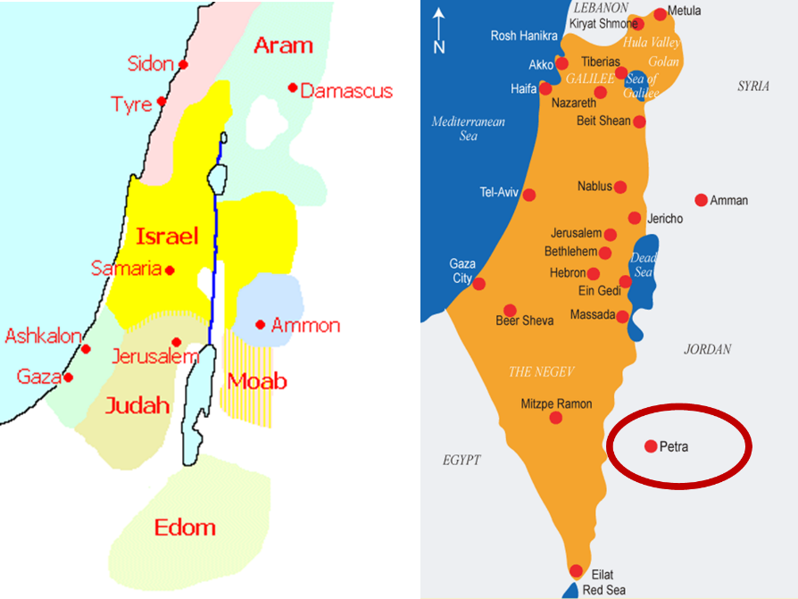

Slide 33
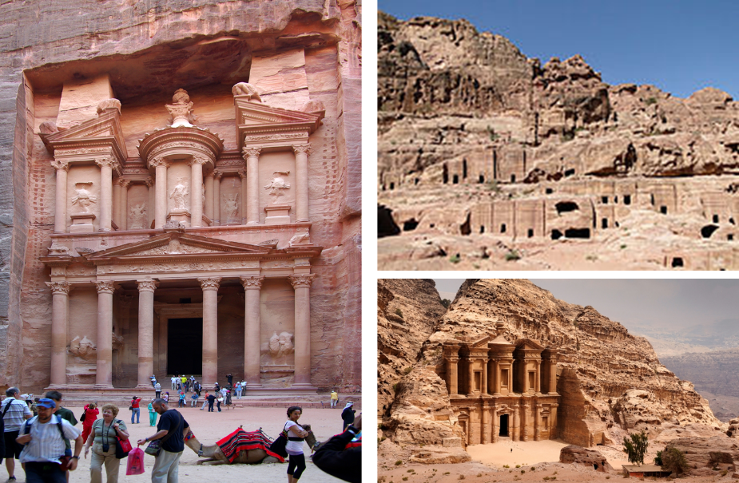

Slide 34
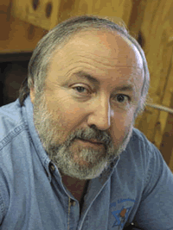
Arnold Fruchtenbaum Footseps of the Messiah, Page 296-97
“Another suggestion is the city now known as Petra…this author prefers the identification with Petra. Petra is located in a basin within Mount Seir, and is totally surrounded by mountains and cliffs. The only way in and out of the city is through a narrow passageway that extends for about a mile and can only be negotiated by foot or by horseback. This makes the city easy to defend, and its surrounding high cliffs give added meaning and confirmation to Isaiah 33:16. Only a few abreast can enter through this passage at any one time, giving this city even greater defensibility.”

Slide 35
Arnold Fruchtenbaum Footseps of the Messiah, Page 296-97
“The name Bozrah means ‘sheepfold.’ An ancient sheepfold had a narrow entrance so that the shepherd could count his sheep. Once inside the fold, the sheep had more room to move around. Petra is shaped like a giant sheepfold, with its narrow passage opening up to a spacious circle surrounded by cliffs…Furthermore, by modern Petra is a site known as Butzeira, which retains the Hebrew Botzrah...It will be a very defensible city located in Mount Seir...Furthermore, as they flee and while they are living there, food and water will be miraculously provided.”

Slide 36
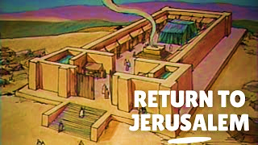
Acts 1 Chapter Summary
Prologue (1-5)
Jesus’ Ascension (6-11)
Return to Jerusalem (12-14)
Matthias Chosen (15-26)

Slide 37
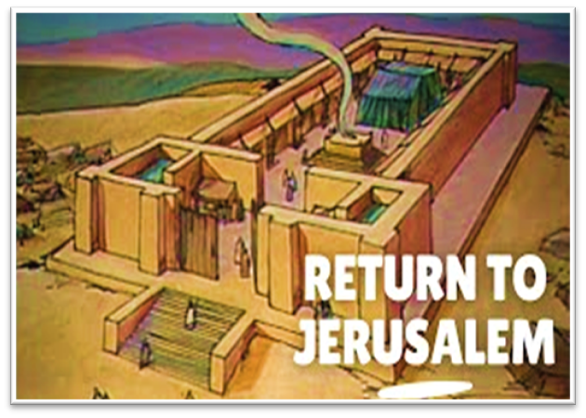
Charles Ryrie Ryrie Study Bible, page 1340
Acts 1:12: “(RSB:NASB1995U): 1:12 a Sabbath day’s journey. About 2,000 cubits, or a little more than half a mile (almost one km)—the distance the rabbis allowed Jews to journey on the Sabbath. This limitation was apparently arrived at on the basis of Ex. 16:29 interpreted by Num. 35:5.”﻿

Slide 38
Matthew 24:15-16, 20
“¹⁵ Therefore when you see the abomination of desolation which was spoken of through Daniel the prophet, standing in the holy place (let the reader understand) ¹⁶ then those who are in Judea must flee to the mountains…²⁰ But pray that your flight will not be in the winter, or on a Sabbath.”

Slide 39
Acts 1 Chapter Summary
Prologue (1-5)
Jesus’ Ascension (6-11)
Return to Jerusalem (12-14)
Matthias Chosen (15-26)

Slide 40
IV. Matthias Chosen Acts 1:15-26
Peter’s Proposition (15-20)
Apostolic Qualifications (21-22)
Matthias Selected (23-26)

Slide 41
IV. Matthias Chosen Acts 1:15-26
Peter’s Proposition (15-20)
Apostolic Qualifications (21-22)
Matthias Selected (23-26)

Slide 42
Message
Birth and growth of the church numerically, geographically, ethnically.
Components
Numerically (progress reports)
Geographically (From Jerusalem to Rome)
Ethnically (From Judaism to Gentile domination)

Slide 43
Progress Reports
Clearest: Acts 1:15; 2:47; 6:7; 9:31; 12:24; 16:5; 19:20; 28:30-31
Less clear: Acts 1:15; 2:41; 4:4, 31; 5:14, 42; 8:25, 40; 11:21; 13:49; 17:6

Slide 44
2 Timothy 3:16-17
“All Scripture is inspired by God [theopneustos] and profitable for teaching, for reproof, for correction, for training in righteousness; so that the man of God may be adequate, equipped for every good work.”
Notes:
hapaxlegomena

Slide 45
2 Peter 1:19-21
“¹⁹ So we have the prophetic word made more sure, to which you do well to pay attention as to a lamp shining in a dark place, until the day dawns and the morning star arises in your hearts. ²⁰ But know this first of all, that no prophecy of Scripture is a matter of one’s own interpretation, ²¹ for no prophecy was ever made by an act of human will, but men moved [pherō] by the Holy Spirit spoke from God.”

Slide 46
INSPIRATION OF SCRIPTURE V. 20-21
Men Wrote as they were inspired by Holy Spirit
“pherō” = to carry
Acts 27:15,17
Opposite of Knowledge of False Teachers
Which is their own imagination
Jer. 23:16

Slide 47
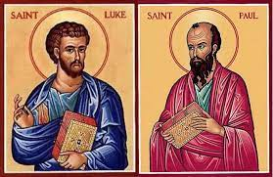
Biography
Paul’s companion (2 Tim 4:11)
Physician (Col 4:14)
Gentile
Col 4:11
Acts 1:19

Slide 48
IV. Matthias Chosen Acts 1:15-26
Peter’s Proposition (15-20)
Apostolic Qualifications (21-22)
Matthias Selected (23-26)

Slide 49
IV. Matthias Chosen Acts 1:15-26
Peter’s Proposition (15-20)
Apostolic Qualifications (21-22)
Matthias Selected (23-26)

Slide 50
2 Thessalonians 2:3
“Let no one in any way deceive you, for it will not come unless the apostasy [apostasia] comes first, and the man of lawlessness is revealed, the son of destruction.”

Slide 51
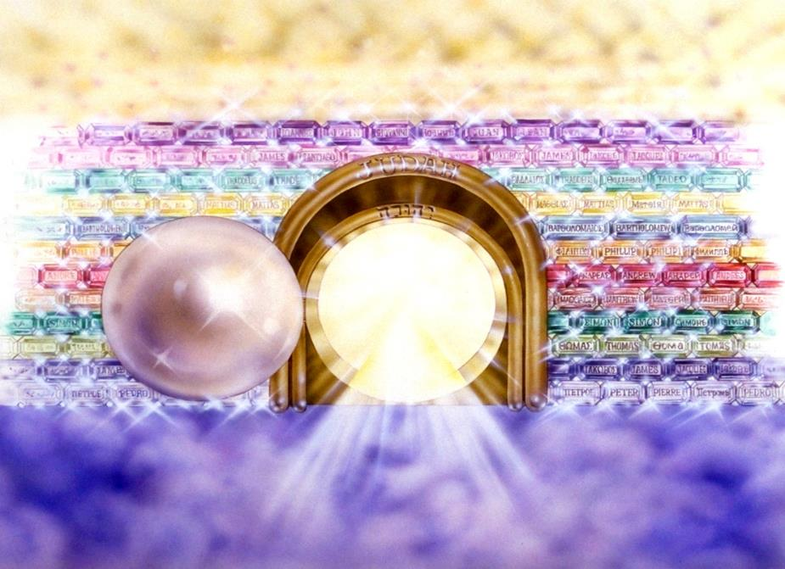
Notes:
Here you see an artist’s ideas of…
12 Gates = 12 Tribes of Israel
12 Foundation Stones = 12 Apostles of the Church

Slide 52
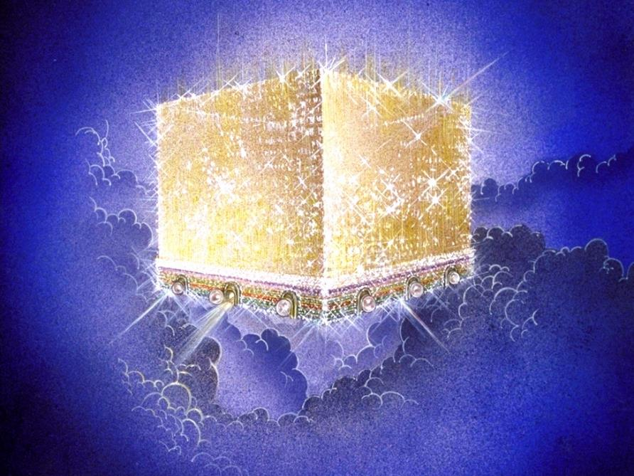
Notes:
Every city needs light. God, the ultimate source of power, illumines the city from his glory. Have you ever taken time to look at a sunset just after it has rained? As the sun sets, there is a kind of a glow cast on everything. It captures the spirit. This is just a little foretaste of the glory and splendor of heaven.

Slide 53
Message
Birth and growth of the church numerically, geographically, ethnically.
Components
Numerically (progress reports)
Geographically (From Jerusalem to Rome)
Ethnically (From Judaism to Gentile domination)

Slide 54
Mistaken Replacement?
Pro
No Spirit yet
Lots
Matthias disappears
Paul
Con
No textual indication of an error
Twelve esteemed (2:14; 6:2)
God’s choice (1:24)
Prov 16:33
Paul unqualified (1:21-22)
Focus on Peter & Paul

Slide 55
Conclusion

Slide 56
Acts 1 Chapter Summary
Prologue (1-5)
Jesus’ Ascension (6-11)
Return to Jerusalem (12-14)
Matthias Chosen (15-26)

