Slide 1
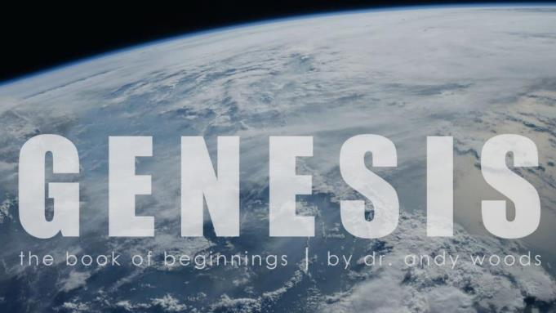
Genesis 12‒50
Israel’s Birth & Preservation

Slide 2
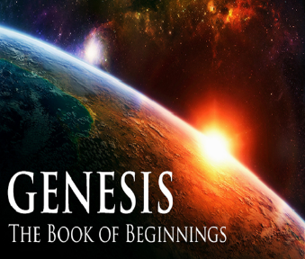
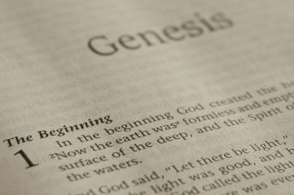
GENESIS STRUCTURE
Beginning of the Human race (Gen. 1‒11)
Beginning of the Hebrew race (Gen. 12‒50)

Slide 3
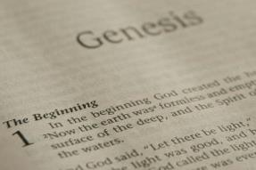
GENESIS STRUCTURE
Genesis 1-11 (four events)
Creation (1-2)
Fall (3-5)
Flood (6-9)
National dispersion (10-11)

Slide 4
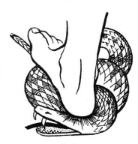
Genesis 3:15
“And I will put enmity Between you and the woman, And between your seed and her seed; He shall bruise you on the head, And you shall bruise him on the heel.”

Slide 5
GENESIS STRUCTURE
Beginning of the Human race (Gen. 1‒11)
Beginning of the Hebrew race (Gen. 12‒50)

Slide 6
GENESIS STRUCTURE
Genesis 12-50 (four people)
Abraham (12:1–25:11)
Isaac (25:12–26:35)
Jacob (27–36)
Joseph (37–50)

Slide 7
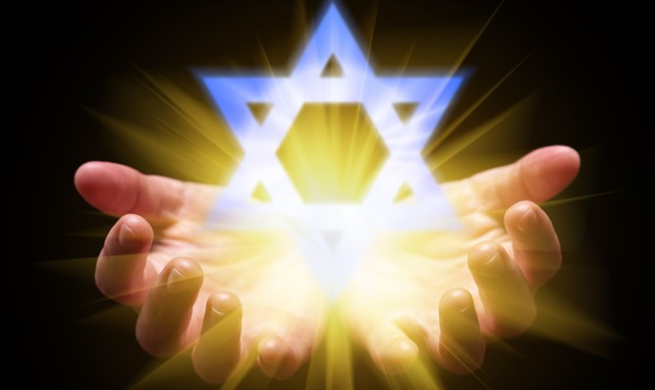
Isaiah 43:1
“But now, thus says the Lord, your Creator, O Jacob, And He who formed you, O Israel, 'Do not fear, for I have redeemed you; I have called you by name; you are Mine!'”

Slide 8
GENESIS STRUCTURE
Genesis 12-50 (four people)
Abraham (12:1–25:11)
Isaac (25:12–26:35)
Jacob (27–36)
Joseph (37–50)

Slide 9
Genesis 22 Abraham Sacrifices Isaac
Abraham tested (1-10)
Substitutionary provision (11-14)
Covenant reaffirmed (15-19)
Rebekah’s lineage (20-24)

Slide 10
Genesis 22:20-24 Rebekah’s Lineage
Timing (20a)
Nahor’s children (20b-24)
From Milcah (20b-23)
From Reumah (24)

Slide 11
Genesis 12‒23 Abraham’s Early Journeys
Unconditional promises (Gen. 12:1-3) From Haran to Canaan (Gen. 12:4-5) In Canaan (Gen. 12:6-9) In Egypt (Gen. 12:10-20) Abram and Lot Separate (Gen. 13:1-13) Reaffirmation of Abram’s promises (Gen. 13:14-18) Abram Rescues Lot (14:1-24) Abrahamic Covenant (15:1-21) Hagar & Ishmael (16:1-16) | Circumcision (Gen. 17:1-27) Sodom & Gomorrah (Gen. 18‒19) Abraham & Abimelech (Gen. 20) Isaac’s birth (Gen. 21:1-7) Ishmael’s expulsion (21:8-21) Abraham & Abimelech’s covenant (21:22-34) Abraham sacrifices Isaac (22) Sarah’s death (23)

Slide 12
Genesis 23 Sarah’s Death
Sarah’s death (1-2)
Sarah’s burial site (3-18)
Sarah’s burial (19-20)

Slide 13
Genesis 23 Sarah’s Death
Sarah’s death (1-2)
Sarah’s burial site (3-18)
Sarah’s burial (19-20)

Slide 14
Genesis 23:1-2 Sarah’s Death
Sarah’s age (1)
Sarah’s death (2)

Slide 15
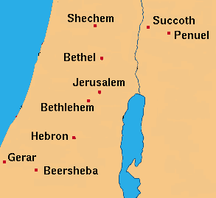

Slide 16
Genesis 23 Sarah’s Death
Sarah’s death (1-2)
Sarah’s burial site (3-18)
Sarah’s burial (19-20)

Slide 17
Genesis 23:3-18 Sarah’s Burial Site
Abraham’s request (3-4)
Hittites’ response (5-6)
Abraham’s offer (7-9)
Ephron’s counter-offer (10-11)
Abraham’s counter-offer (12-13)
Ephron’s asking price (14-15)
Abraham accepts Ephron’s price (16)
Sealing of the purchase (17-18)

Slide 18
Genesis 23:3-18 Sarah’s Burial Site
Abraham’s request (3-4)
Hittites’ response (5-6)
Abraham’s offer (7-9)
Ephron’s counter-offer (10-11)
Abraham’s counter-offer (12-13)
Ephron’s asking price (14-15)
Abraham accepts Ephron’s price (16)
Sealing of the purchase (17-18)

Slide 19
GENESIS 10 Outline
Introduction (1)
Japheth's line (2-5)
Ham’s Line (6-20)
Shem’s line (21-31)
Conclusion (32)

Slide 20
Ham’s Sons (vs. 6)
Cush
Mizraim
Put
Canaan

Slide 21
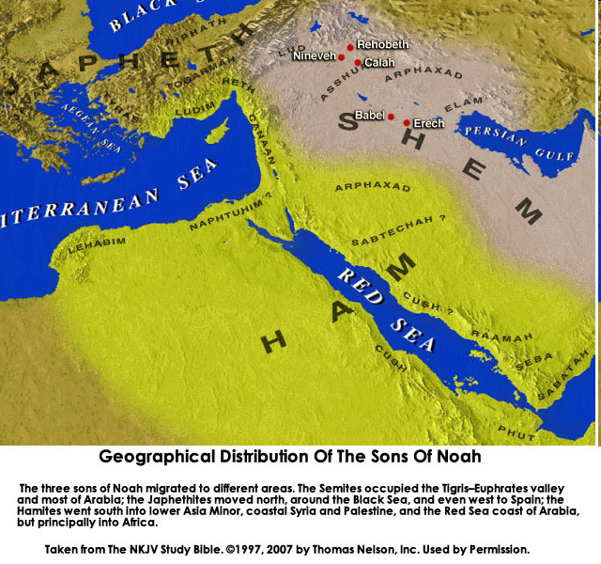

Slide 22
Canaan’s Sons (vs. 15-18)
Sidon
Heth
Jebusite
Amorite
Girgashite
Hivite
Arkite
Sinite
Arvadite
Zemarite
Hamathite

Slide 23
Names & Titles Demonstrating Satan’s Post-Fall, Earthly Authority (Job 1:7; 2:2; Luke 4:5-8; Rom. 8:19-22)
Prince of this world (John 12:31; 14:30; 16:11)
God of this age (2 Cor. 4:4)
Prince and power of the air (Eph. 2:2)
Who the believer wrestles with (Eph. 6:12)
Roaring lion (1 Pet. 5:8)
Whole world lies in his power (1 John 5:19)

Slide 24
Genesis 23:3-18 Sarah’s Burial Site
Abraham’s request (3-4)
Hittites’ response (5-6)
Abraham’s offer (7-9)
Ephron’s counter-offer (10-11)
Abraham’s counter-offer (12-13)
Ephron’s asking price (14-15)
Abraham accepts Ephron’s price (16)
Sealing of the purchase (17-18)

Slide 25
8 New Promises Genesis 12:1-3
Land (Gen. 12:1b)
Great nation (Gen. 12:2a)
Personal blessing (Gen. 12:2b)
Great name (Gen. 12:2c)
Blessing to others (Gen. 12:2d)
Blessing to blessers (Gen. 12:3a)
Cursing to cursers (Gen. 12:3b)
Blessing to the world (Gen. 12:3c)

Slide 26
Genesis 23:3-18 Sarah’s Burial Site
Abraham’s request (3-4)
Hittites’ response (5-6)
Abraham’s offer (7-9)
Ephron’s counter-offer (10-11)
Abraham’s counter-offer (12-13)
Ephron’s asking price (14-15)
Abraham accepts Ephron’s price (16)
Sealing of the purchase (17-18)

Slide 27
Genesis 23:3-18 Sarah’s Burial Site
Abraham’s request (3-4)
Hittites’ response (5-6)
Abraham’s offer (7-9)
Ephron’s counter-offer (10-11)
Abraham’s counter-offer (12-13)
Ephron’s asking price (14-15)
Abraham accepts Ephron’s price (16)
Sealing of the purchase (17-18)

Slide 28
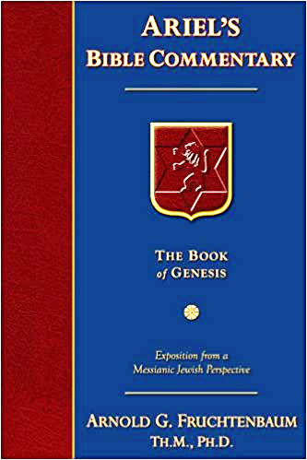
Dr. Arnold G. Fruchtenbaum
The Book of Genesis, 368
“Verse 11 gives the offer: Nay, my lord, hear me: the field give I you, and the cave that is therein, I give it [to] you; in the presence of the children of my people give I it to you: bury your dead. Here again is what appears to be an offer of a free place to bury, but the free offer was not intended to be taken seriously because that was just the way things were done in the ancient Middle East. Abraham understood that he was not to accept the offer as given.”

Slide 29
Genesis 23:3-18 Sarah’s Burial Site
Abraham’s request (3-4)
Hittites’ response (5-6)
Abraham’s offer (7-9)
Ephron’s counter-offer (10-11)
Abraham’s counter-offer (12-13)
Ephron’s asking price (14-15)
Abraham accepts Ephron’s price (16)
Sealing of the purchase (17-18)

Slide 30
Genesis 23:3-18 Sarah’s Burial Site
Abraham’s request (3-4)
Hittites’ response (5-6)
Abraham’s offer (7-9)
Ephron’s counter-offer (10-11)
Abraham’s counter-offer (12-13)
Ephron’s asking price (14-15)
Abraham accepts Ephron’s price (16)
Sealing of the purchase (17-18)

Slide 31
Dr. Arnold G. Fruchtenbaum
The Book of Genesis, 368
“Then came Ephron’s asking price in 23:14–15: And Ephron answered Abraham, saying unto him, My lord, hearken unto me: a piece of the land worth four hundred shekels of silver, what is that between me and you? Yes, he was willing to sell the land and the cave for four hundred shekels of silver. Then, with the question: What is that betwixt me and you, he implied that this was not too high a price. In fact, this was a highly inflated price because the average cost then was four shekels per acre; but Abraham, at this price, will be paying about forty shekels per acre. Again, this followed a Middle. . .

Slide 32
Dr. Arnold G. Fruchtenbaum
The Book of Genesis, 368
. . .East custom in that the initial asking price was intended to be deliberately a high price, and then they would begin negotiating downward. So the offer was at a very high price, and then Abraham could: Bury therefore [his] dead.”

Slide 33
Genesis 23:3-18 Sarah’s Burial Site
Abraham’s request (3-4)
Hittites’ response (5-6)
Abraham’s offer (7-9)
Ephron’s counter-offer (10-11)
Abraham’s counter-offer (12-13)
Ephron’s asking price (14-15)
Abraham accepts Ephron’s price (16)
Sealing of the purchase (17-18)

Slide 34
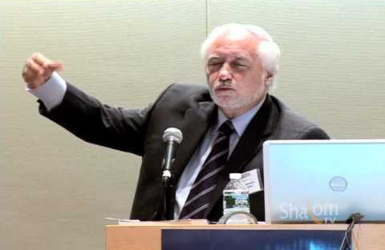
Jacques Paul Gauthier, “Sovereignty Over The Old City of Jerusalem: A Study of the Historical, Religious, Political and Legal Aspects of the Question of the Old City,”
PhD Thesis, University of Geneva International Law School, 2007).

Slide 35
Genesis 23:3-18 Sarah’s Burial Site
Abraham’s request (3-4)
Hittites’ response (5-6)
Abraham’s offer (7-9)
Ephron’s counter-offer (10-11)
Abraham’s counter-offer (12-13)
Ephron’s asking price (14-15)
Abraham accepts Ephron’s price (16)
Sealing of the purchase (17-18)

Slide 36
Dr. Arnold G. Fruchtenbaum
The Book of Genesis, 369-70
“The reason was that Hittite law included feudal responsibilities for landowners, in that service to be rendered to kings by landowners fell only if one purchased a complete lot but not on someone who purchased only part of the lot. Therefore, if Abraham purchased only the cave, then Ephron would still have feudal responsibilities to the king regarding it. The Hittite Law Code required the owner of a complete unit of the land to perform the king’s ilku or feudal services The reason Ephron did not want to sell only the cave is . . . ”

Slide 37
Dr. Arnold G. Fruchtenbaum
The Book of Genesis, 369-70
“…is that he would still be obligated to render feudal services. Therefore, by getting rid of all of it, the whole unit, that would free him from paying feudal responsibilities to the king for that section. As part of the deed, he also mentioned the trees, and the mention of trees is characteristic of Hittite business documents. It all fits well into the second millennium b.c.”

Slide 38
Genesis 23 Sarah’s Death
Sarah’s death (1-2)
Sarah’s burial site (3-18)
Sarah’s burial (19-20)

Slide 39
Genesis 23:19-20 Sarah’s Burial
The timing (19a)
The act (19b)
Abraham’s only land possession (20)

Slide 40
Genesis 23:19-20 Sarah’s Burial
The timing (19a)
The act (19b)
Abraham’s only land possession (20)

Slide 41
Genesis 23:19-20 Sarah’s Burial
The timing (19a)
The act (19b)
Abraham’s only land possession (20)

Slide 42
Genesis 23:19-20 Sarah’s Burial
The timing (19a)
The act (19b)
Abraham’s only land possession (20)

Slide 43
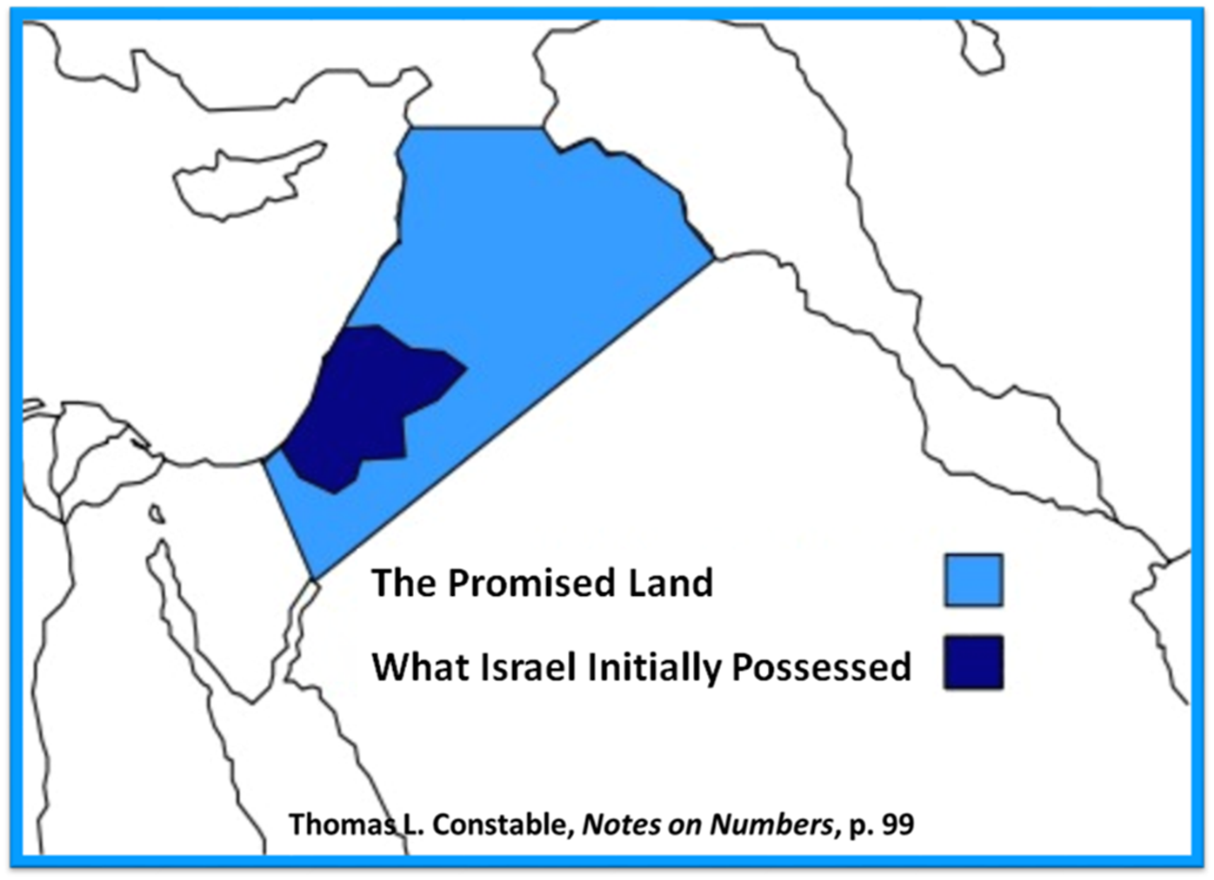

Slide 44
Charles Ryrie Ryrie Study Bible, page 30
Genesis 22:19: “Not only Sarah, but Abraham, Isaac, Rebekah, Leah, and Jacob were buried there (see 25:9; 49:31; 50:13).”﻿

Slide 45
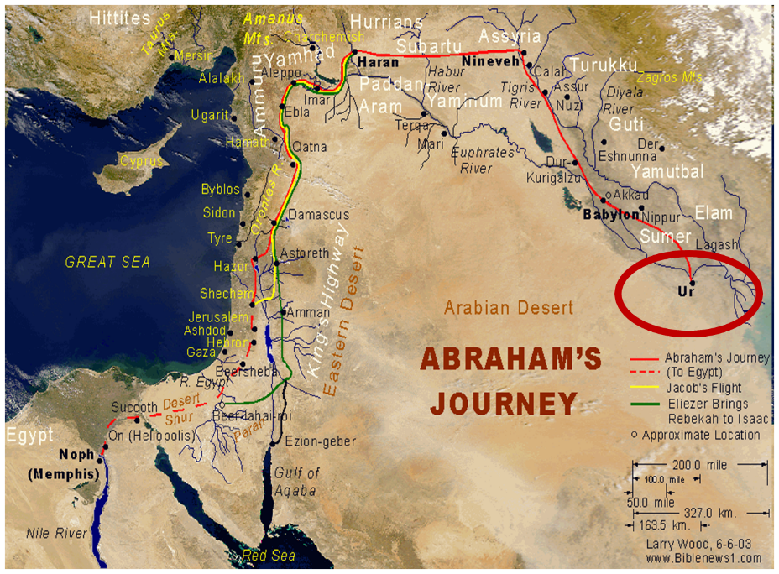

Slide 46
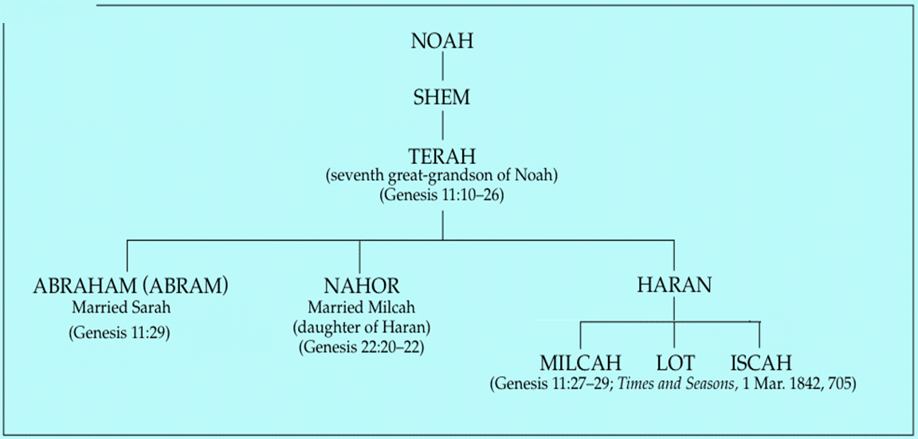

Slide 47
Conclusion

Slide 48
Genesis 12‒23 Abraham’s Early Journeys
Unconditional promises (Gen. 12:1-3) From Haran to Canaan (Gen. 12:4-5) In Canaan (Gen. 12:6-9) In Egypt (Gen. 12:10-20) Abram and Lot Separate (Gen. 13:1-13) Reaffirmation of Abram’s promises (Gen. 13:14-18) Abram Rescues Lot (14:1-24) Abrahamic Covenant (15:1-21) Hagar & Ishmael (16:1-16) | Circumcision (Gen. 17:1-27) Sodom & Gomorrah (Gen. 18‒19) Abraham & Abimelech (Gen. 20) Isaac’s birth (Gen. 21:1-7) Ishmael’s expulsion (21:8-21) Abraham & Abimelech’s covenant (21:22-34) Abraham sacrifices Isaac (22) Sarah’s death (23)

Slide 49
Genesis 23 Sarah’s Death
Sarah’s death (1-2)
Sarah’s burial site (3-18)
Sarah’s burial (19-20)

Slide 50
Genesis 12‒24 Abraham’s Early Journeys
Unconditional promises (Gen. 12:1-3) From Haran to Canaan (Gen. 12:4-5) In Canaan (Gen. 12:6-9) In Egypt (Gen. 12:10-20) Abram and Lot Separate (Gen. 13:1-13) Reaffirmation of Abram’s promises (Gen. 13:14-18) Abram Rescues Lot (14:1-24) Abrahamic Covenant (15:1-21) Hagar & Ishmael (16:1-16) | Circumcision (Gen. 17:1-27) Sodom & Gomorrah (Gen. 18‒19) Abraham & Abimelech (Gen. 20) Isaac’s birth (Gen. 21:1-7) Ishmael’s expulsion (21:8-21) Abraham & Abimelech’s covenant (21:22-34) Abraham sacrifices Isaac (22) Sarah’s death (23) Isaac’s marriage (24)

Slide 51
²⁴ The Lord bless you, and keep you; ²⁵ The Lord make His face shine on you, And be gracious to you; ²⁶ The Lord lift up His countenance on you, And give you peace.
Numbers 6:24–26 (NASB95)

