Slide 1

Ezekiel 36‒39
The Middle East Meltdown 2022
Dr. Andy Woods
Senior Pastor – Sugar Land Bible Church
President – Chafer Theological Seminary

Slide 2
Ezekiel 33‒48
Ezekiel recommissioned (33)
False shepherds removed (34)
Edom destroyed (35)
Israel’s restoration: physical & spiritual (36)
Israel’s restoration illustrated (37)
Means of restoration: Northern invasion (38)
Results of the Northern invasion: conversion (39)
Millennial Temple (40‒46)
Tribal land allotment (47‒48)

Slide 3
Ezekiel 36
Israel to prosper again (1-15)
Israel’s sins inhibiting prosperity (16-21)
Israel to be restored: physically & spiritually (22-38)

Slide 4
Ezekiel 33‒48
Ezekiel recommissioned (33)
False shepherds removed (34)
Edom destroyed (35)
Israel’s restoration: physical & spiritual (36)
Israel’s restoration illustrated (37)
Means of restoration: Northern invasion (38)
Results of the Northern invasion: conversion (39)
Millennial Temple (40‒46)
Tribal land allotment (47‒48)

Slide 5
Ezekiel 37
Vision: Valley of the Dry Bones (1-14)
  Vision (1-10)
  Interpretation (11-14)
Sign: Two Sticks (15-28)
  Sign (15-17)
  Interpretation (18-28)

Slide 6
Ezekiel 33‒48
Ezekiel recommissioned (33)
False shepherds removed (34)
Edom destroyed (35)
Israel’s restoration: physical & spiritual (36)
Israel’s restoration illustrated (37)
Means of restoration: Northern invasion (38)
Results of the Northern invasion: conversion (39)
Millennial Temple (40‒46)
Tribal land allotment (47‒48)

Slide 7
Ezekiel 38‒39
Invasion planned (38:1-13)
Invasion executed (38:14-16)
Invasion defeated (38:17‒39:20)
Invasion’s results (39:21-29)

Slide 8
Ezekiel 38‒39
Invasion planned (38:1-13)
Invasion executed (38:14-16)
Invasion defeated (38:17‒39:20)
Invasion’s results (39:21-29)

Slide 9
I. Invasion Planned (Ezekiel 38:1-13)
  God’s intention (1-9)
  Gog’s intention (10-13)

Slide 10


Slide 11

Ancient Names From Ezekiel 38:1-9
Magog (Central Asia), Rosh (Russia), Meshec (Turkey), Tubal (Turkey), Persia (Iran), Put (Libya), Cush (Sudan), Gomer (Turkey), | Togarmah (Turkey) Sheba (Saudi Arabia) Dedan (Saudi Arabia or Yemen) Tarshish (Spain) Merchants of Tarshish (Conglomeration of Western powers including Europe) Israel

Slide 12
Ezekiel 38‒39
Invasion planned (38:1-13)
Invasion executed (38:14-16)
Invasion defeated (38:17‒39:20)
Invasion’s results (39:21-29)

Slide 13
Ezekiel 38‒39
Invasion planned (38:1-13)
Invasion executed (38:14-16)
Invasion defeated (38:17‒39:20)
Invasion’s results (39:21-29)

Slide 14
III. Invasion Defeated (Ezekiel 38:17‒39:20)
  Armies destroyed (38:17‒39:8)
  Weapons burned (39:9-10)
  Soldiers buried (39:11-16)
  Soldiers eaten (39:17-20)

Slide 15
III. Invasion Defeated (Ezekiel 38:17‒39:20)
  Armies destroyed (38:17‒39:8)
  Weapons burned (39:9-10)
  Soldiers buried (39:11-16)
  Soldiers eaten (39:17-20)

Slide 16
Ezekiel 33‒48
Ezekiel recommissioned (33)
False shepherds removed (34)
Edom destroyed (35)
Israel’s restoration: physical & spiritual (36)
Israel’s restoration illustrated (37)
Means of restoration: Northern invasion (38)
Results of the Northern invasion: conversion (39)
Millennial Temple (40‒46)
Tribal land allotment (47‒48)

Slide 17
III. Invasion Defeated (Ezekiel 38:17‒39:20)
  Armies destroyed (38:17‒39:8)
  Weapons burned (39:9-10)
  Soldiers buried (39:11-16)
  Soldiers eaten (39:17-20)

Slide 18
III. Invasion Defeated (Ezekiel 38:17‒39:20)
  Armies destroyed (38:17‒39:8)
  Weapons burned (39:9-10)
  Soldiers buried (39:11-16)
  Soldiers eaten (39:17-20)

Slide 19


Genesis 12:3
“And I will bless those who bless you, And the one who curses you I will curse. And in you all the families of the earth will be blessed.”

Slide 20
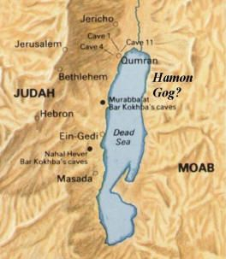

Slide 21
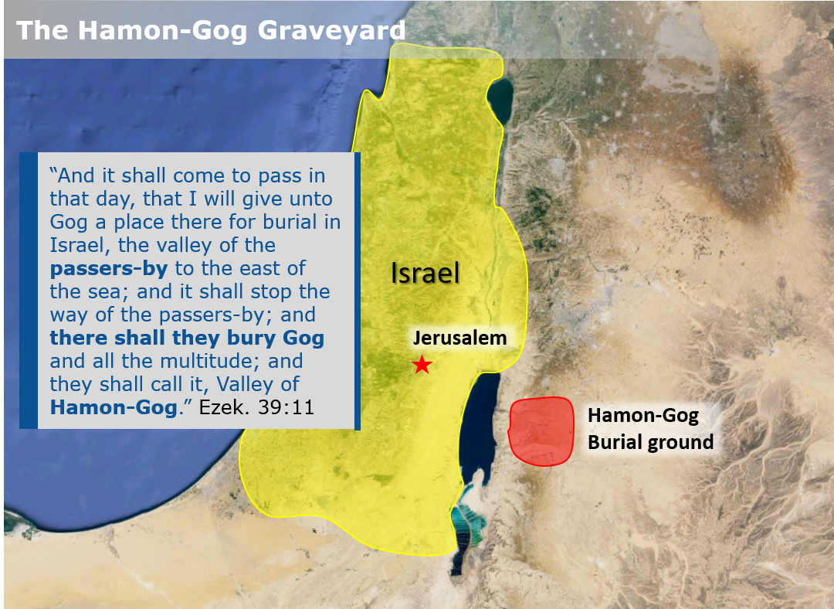

Slide 22
What?
Divine annihilation of the coalition (38:19-22)
Birds and beasts feast on the carnage (39:4-5, 17-20)
Seven-month burying of the dead (39:11-12, 14-16)
Seven-year burning of weapons (39:9-10)
Israel’s salvation and restoration (39:22, 29)

Slide 23


Slide 24

Daniel 12:11-12
“¹¹ From the time that the regular sacrifice is abolished and the abomination of desolation is set up, there will be 1,290 days. ¹² How blessed is he who keeps waiting and attains to the 1,335 days!”
24

Slide 25
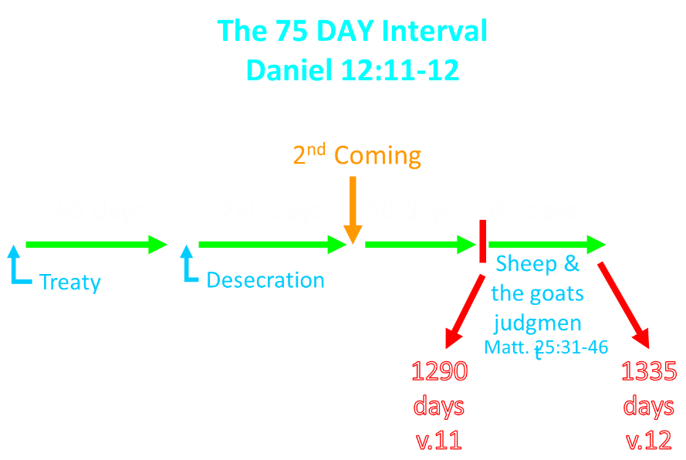

Slide 26

Dr. Arnold Fruchtenbaum
Footsteps of the Messiah, 355.
“The Millennium will not begin the day immediately following the last day of the Great Tribulation because there will be a seventy-five day interval. During this time between the Great Tribulation and the start of the Messianic Age, a number of events will occur. The existence of this interval is demonstrated in Daniel 12:11-12.”

Slide 27
The 75 DAY Interval
Daniel 12:11-12
The Beast cast into the Lake of Fire (Rev. 19:20)
The False Prophet cast into the Lake of Fire (Rev. 19:20)
The binding of Satan (Rev. 20:1-3)
The Judgment of the Jews (Ezek. 20:33-44)
The Judgment of the Gentiles (Matt. 25:31-46)
Resurrection of OT saints (Dan. 12:2) & Tribulation martyrs (Rev. 20:4-5)
Rewarding of OT saints & Tribulation martyrs (Dan. 12:3)
Fruchtenbaum, Footsteps of the Messiah, 356-66

Slide 28
Millennium Rev.20 | Eternal State Rev.21-22
Sin restrained | Sin removed
Curse restrained | Curse removed
Death | No death
Mortals / resurrected | Resurrected only
Mortals Destinies undecided | All Destinies sealed
Renovation | Recreation
Temporary | Eternal
Transitional | Non-transitional
Dispensation | Not a dispensation

Slide 29
Dispensational Theology is a System of Theology
Traditional-normative dispensational theology is a system that embodies three essential, fundamental concepts called the sine qua non (lit. “without which is not”):
The consistent use of a plain, normal, literal, grammatical-historical method of interpretation;
Which reveals that the Church is distinct from Israel;
God’s overall purpose is to bring glory to Himself (Eph. 1:6, 12, 14).
Dr. Charles Ryrie, Dispensationalism, pp. 38-41

Slide 30
Doxological Purpose
God’s ultimate purpose for the ages is to glorify Himself. Scripture is not human-centered, as though salvation were the principle point, but God-centered, because His glory is at the center.
The glory of God is the primary principle that unifies all dispensations, the program of salvation being just one of the means by which God glorifies Himself. Each successive revelation of God’s plan for the ages, as well as His dealing with the elect, non-elect, angels, and nations all manifest His glory.
Dictionary of Premillennial Theology, Charles Ryrie, p. 94

Slide 31
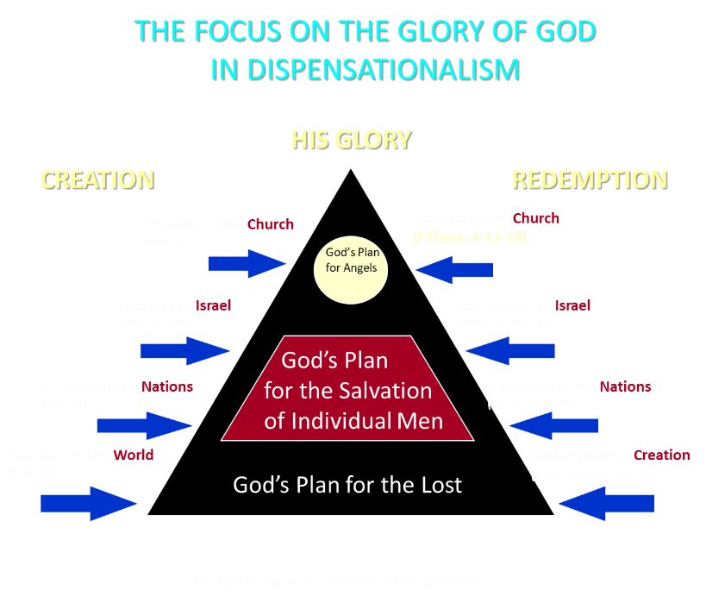

Slide 32
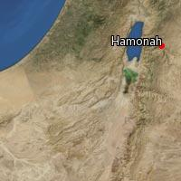

Slide 33


Slide 34
III. Invasion Defeated (Ezekiel 38:17‒39:20)
  Armies destroyed (38:17‒39:8)
  Weapons burned (39:9-10)
  Soldiers buried (39:11-16)
  Soldiers eaten (39:17-20)

Slide 35
What?
Divine annihilation of the coalition (38:19-22)
Birds and beasts feast on the carnage (39:4-5, 17-20)
Seven-month burying of the dead (39:11-12, 14-16)
Seven-year burning of weapons (39:9-10)
Israel’s salvation and restoration (39:22, 29)

Slide 36
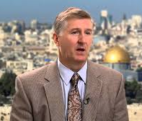
Mountains of Israel?
Mark Hitchcock, The Amazing Claims of Bible Prophecy: What You Need to Know in These Uncertain Times (Harvest House: Eugene, OR, 2010), 211.
“According to Ezekiel 39:2, 4, Israel must possess the ‘mountains of Israel’ when this invasion occurs...The famous Six Day war in Israel in 1967 helped set the stage for this to be fulfilled. Before the Six Day War, all the mountains of Israel, with the exception of a small strip of west Jerusalem, were in the hands of the Jordanian Arabs. Only since 1967 have the mountains of Israel been in Israel, thus setting the stage for the fulfillment of this prophecy.”

Slide 37


Dr. Arnold G. Fruchtenbaum
THE MODERN STATE OF ISRAEL IN BIBLE PROPHECY
Paper presented to the PTSG on 12-7-21
pps. 18-19
“But where in the Land of Israel will the invading armies be destroyed? The exact location is revealed in Ezekiel 39:2 and 4a: ‘and I will turn you about, and will lead you on, and will cause you to come up from the uttermost parts of the north; and I will bring you upon the mountains of Israel…you shall fall upon the mountains of Israel.’ The phrase ‘the mountains of Israel’ refers to the central mountain range that makes up the backbone of the country. In the Hebrew Scriptures, these mountains were known as the Hill Country of Ephraim and the Hill Country of Judah. Some of the famous biblical cities that lie within these mountains include Dothan, Shechem, Samaria, Shiloh, Bethel, Ai, Ramah, Bethlehem, Hebron, Debir, and most importantly, Jerusalem, which seems to be the target of the invading army. However, from 1948 until the Six-Day War in 1967, these mountains were not in Israel, but in Jordan.”

Slide 38
Dr. Arnold G. Fruchtenbaum
THE MODERN STATE OF ISRAEL IN BIBLE PROPHECY
Paper presented to the PTSG on 12-7-21
pps. 18-19
“They are now referred to politically as the West Bank. In 1948, Jordanian forces took over these mountains and annexed them as part of Jordan. All Israel had was a small corridor leading west to Jerusalem. The border between Israel and Jordan ran down the foot of these mountains, then cut into the mountains, dividing Jerusalem in two, and then went out again and continued along the foot of these mountains. Israel had maybe five percent or less of the mountains, while the rest belonged to Jordan. Only since 1967 have the mountains of Israel been in Israel. Besides the Temple compound falling into Jewish hands, another by-product of the Six-Day War was that these mountains also fell under Israeli sovereignty. Therefore, not only could this prophecy not have been fulfilled before 1948, but it could also not have been fulfilled before 1967.”

Slide 39
Dr. Arnold G. Fruchtenbaum
THE MODERN STATE OF ISRAEL IN BIBLE PROPHECY
Paper presented to the PTSG on 12-7-21
pps. 18-19
“The mountains of Israel (the West Bank) are yet to have a very important and relevant role in Bible prophecy. As for the present State of Israel, they became part of Israel in 1967. This is yet another way the modern Jewish State fits within Bible prophecy.”

Slide 40
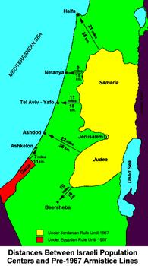

Slide 41
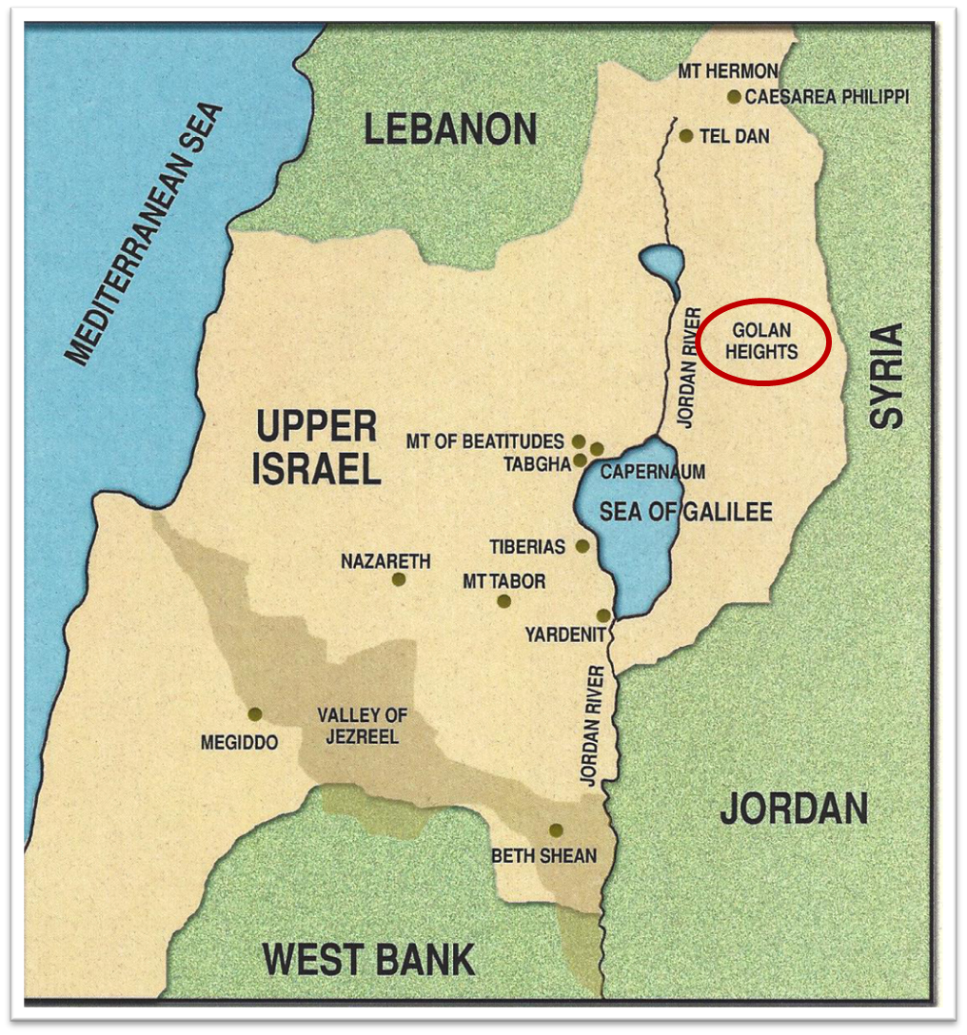

Slide 42
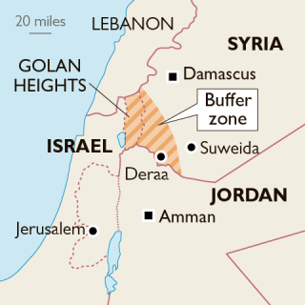

Slide 43

Charles L. Feinberg
The Prophecy of Ezekiel: The Glory of the Lord, Paperback ed. (Chicago: Moody, 1969; reprint, Chicago: Moody, 1984), 231.
“In verse 18 the actual or literal passes over into the figurative with the reference to princes, then rams. Bashan was famous for its fine pastures and well-fed cattle (cf. Deut. 32:14; Ps. 22:12; Amos 4:1)…It is a vivid figure to bring out the idea of vast carnage, deserved judgment and irrevocable doom.”

Slide 44
Charles L. Feinberg
The Prophecy of Ezekiel: The Glory of the Lord, Paperback ed. (Chicago: Moody, 1969; reprint, Chicago: Moody, 1984), 230-31.
“Now there is presented the third emphasis of the greatness of the invasion and the subsequent slaughter at the hand of the Lord. Incidentally, the figure gives a clue as to the time setting for the entire passage. It is the same scene as that a Revelation 19, the great supper of God, and the chronology is clear. The events will transpire at the end of the great tribulation and just before the millennial reign of the Messiah of Israel.”

Slide 45
When?
Beginning of the Millennium
End of the Millennium
End of the Tribulation
Before the Tribulation
First half of the Tribulation
Two phase view

Slide 46


Slide 47
CONCLUSION

Slide 48
Ezekiel 38‒39
Invasion planned (38:1-13)
Invasion executed (38:14-16)
Invasion defeated (38:17‒39:20)
Invasion’s results (39:21-29)

Slide 49
IV. Invasion’s Results (Ezekiel 39:21-29)
  God’s glory manifested (21-24)
  Israel restored (25-29)

