Slide 1
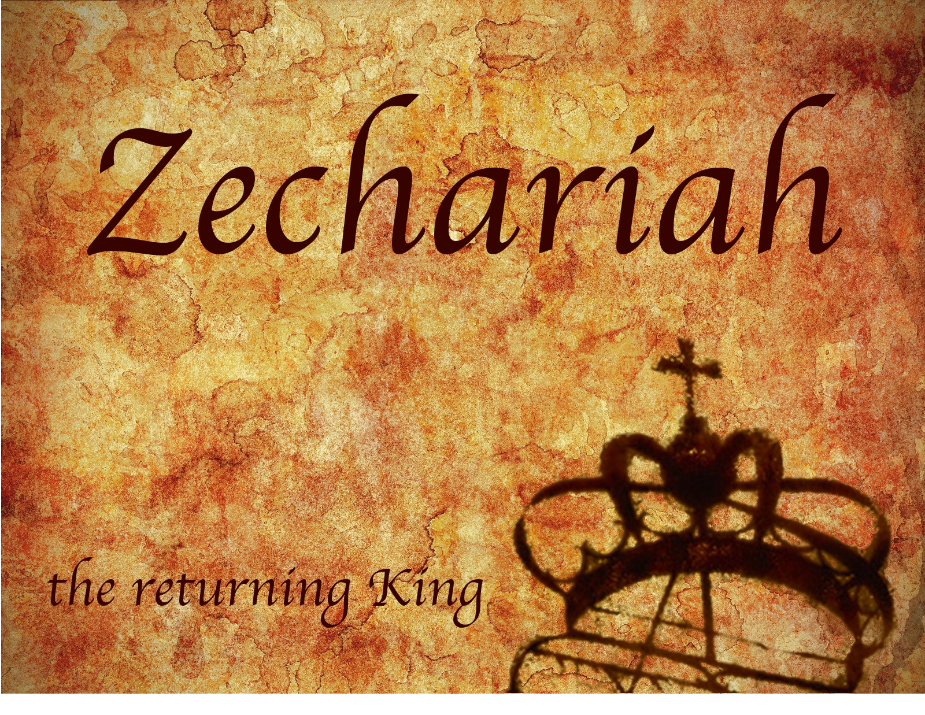

Zechariah
God Remembers!

Slide 2
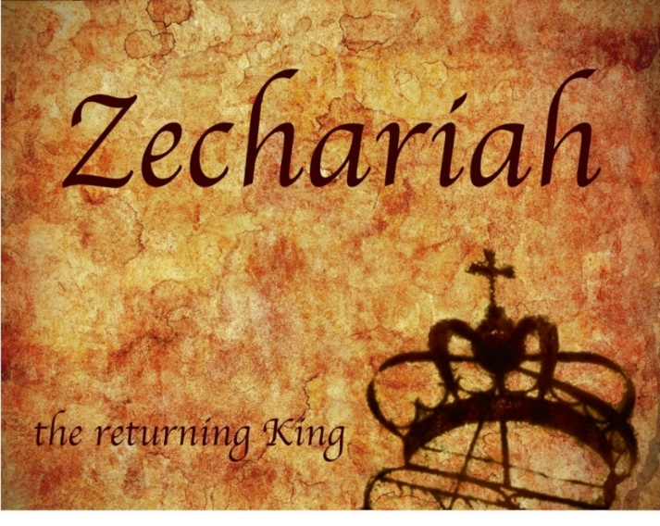
Structure
Introductory call to repentance (1:1-6)
Eight-night visions (1:7–6:15)
Question and answers about fasting (7–8)
Two burdens (9–14)

Slide 3
Structure
Introductory call to repentance (1:1-6)
Eight-night visions (1:7–6:15)
Question and answers about fasting (7–8)
Two burdens (9–14)

Slide 4
ZECHARIAH’S EIGHT NIGHT VISIONS
Vision | Reference | Meaning
The Red-horse Rider among the Myrtles | 1:7-17 | God’s anger against the nations & blessing on restored Israel.
The Four Horns & the Four Craftsmen | 1:18-21 | God’s judgment on the nations that afflict Israel.
The Surveyor with a Measuring Line | Chapter 2 | God’s future blessing on restored Israel.
The Cleansing & Crowning of Joshua the Hight Priest. | Chapter 3 | Israel’s future cleansing from sin & reinstatement as a priestly nation.
The Golden Lampstand & the Two Olive Trees | Chapter 4 | Israel as the light to the nations under Messiah, the King-Priest.
The Flying Scroll | 5:1-4 | The severity & totality of divine judgment on individual Israelites.
The Woman in the Ephah | 5:5-11 | The removal of national Israel’s sin of rebellion against God.
The Four Chariots | 6:1-8 | Divine judgment on Gentile nations.

Slide 5
II. Eight Night Visions
(1:7‒6:15)
  Riders & horses among the myrtle trees (1:7-17)
  Four horns & four craftsmen (1:18-21)
  Man with the measuring line (2)
  Cleansing of the High Priest Joshua (3)
  Lampstand & olive tree (4)
  Flying scroll (5:1-4)
  Woman in the basket (5:5-11)
  Four chariots (6:1-8)
  Conclusion: crowning of Joshua (6:9-15)

Slide 6
Structure
Introductory call to repentance (1:1-6)
Eight-night visions (1:7–6:15)
Question and answers about fasting (7–8)
Two burdens (9–14)

Slide 7
III. Questions & Answers Concerning Fasting
(7‒8)
  Question (7:1-3)
  Four divine answers (7:4‒8:23)
    Condemnation of empty ritualism (7:4-7)
    Condemnation of past covenant failure (7:8-14)
    Prediction of Jerusalem’s restoration (8:1-17)
    Prediction of future blessing (8:18-23)

Slide 8
Structure
Introductory call to repentance (1:1-6)
Eight-night visions (1:7–6:15)
Question and answers about fasting (7–8)
Two burdens (9–14)

Slide 9

IV. Two Burdens
(9‒14)
  Israel’s postponed deliverance due to her rejection of her Messiah (9‒11)
  Israel’s future deliverance due to her acceptance of her Messiah (12‒14)

Slide 10
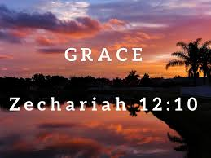
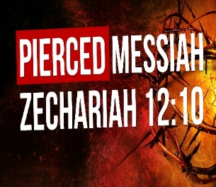
Zechariah 12
(Israel’s Physical & Spiritual Salvation)
Israel’s physical deliverance (12:1-9)
  The nations that will attack Israel (1-3)
  The God who will protect Israel (4-9)
Israel’s spiritual deliverance (12:10-14)
  God’s Spirit: the cause of revival (10a)
  Israel’s remorse: the result of revival (11-14)

Slide 11
Zechariah 13
(Israel’s Physical & Spiritual Salvation)
Spiritual cleansing (13:1-5)
Comprehensive deliverance (13:6-9)

Slide 12
Zechariah 13
(Israel’s Physical & Spiritual Salvation)
Spiritual cleansing (13:1-5)
Comprehensive deliverance (13:6-9)

Slide 13
Zechariah 13
(Israel’s Physical & Spiritual Salvation)
Spiritual cleansing (13:1-5)
  Fountain (1)
  Idolatry removed (2a)
  False prophets removed (2b-5)

Slide 14
Zechariah 13
(Israel’s Physical & Spiritual Salvation)
Spiritual cleansing (13:1-5)
  Fountain (1)
  Idolatry removed (2a)
  False prophets removed (2b-5)

Slide 15


Charles L. Feinberg
God Remembers: A Study of Zechariah (Wheaton: Van Kampen, 1950, p. 233.
“The connection between chapters 12 and 13 is so close that a chapter division is really uncalled for. The same people, the same subject, and the same time are in view in both chapters. The relationship between 12:10-14 and 13:1-6 is not only logical but chronological as well. Once Israel is brought to a penitent condition and is brought face to face with her crucified Messiah, then the provision of God for cleansing will be appropriate.’”

Slide 16
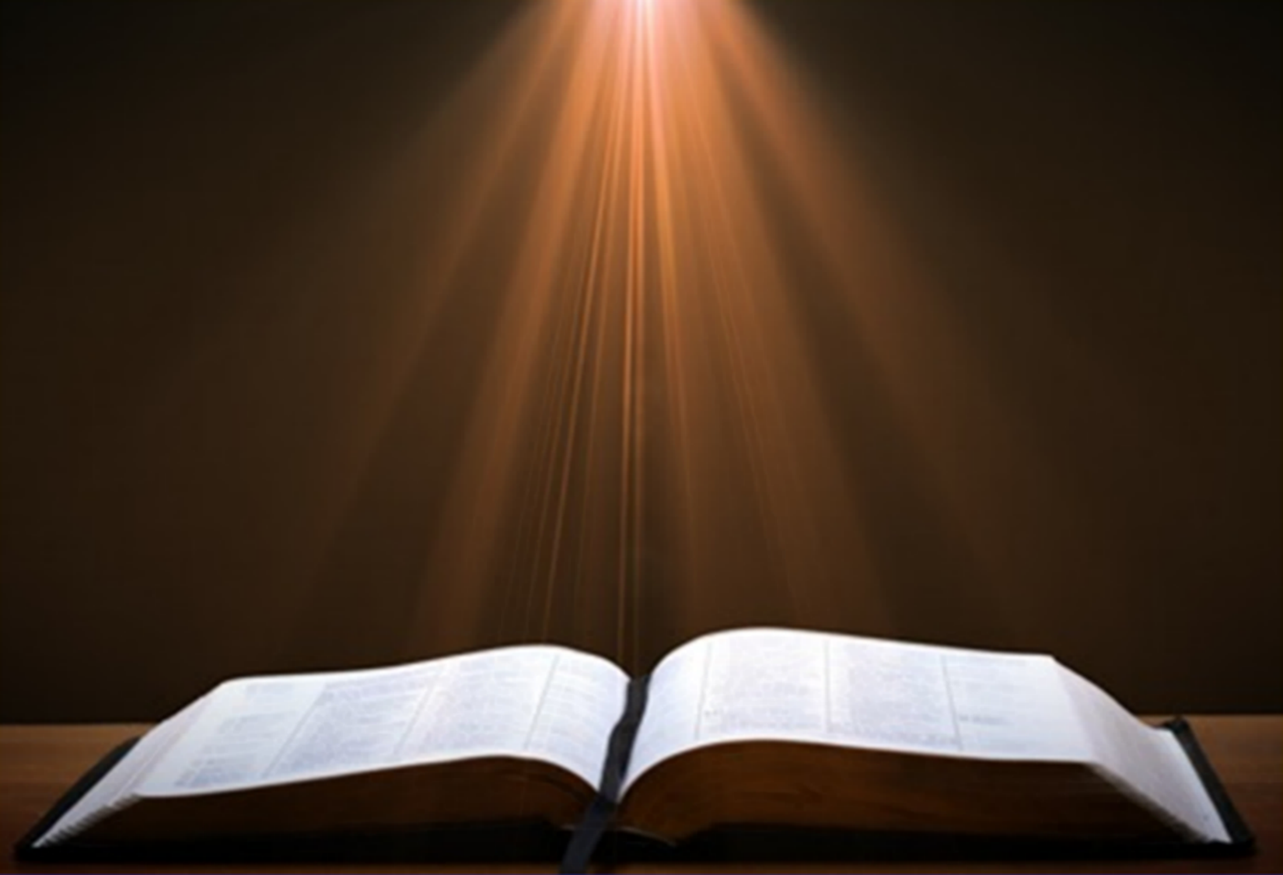
Ezekiel 36:24-28
“For I will take you from the nations, gather you from all the lands and bring you into your own land. ²⁵ Then I will sprinkle clean water on you, and you will be clean; I will cleanse you from all your filthiness and from all your idols. ²⁶ Moreover, I will give you a new heart and put a new spirit within you; and I will remove the heart of stone from your flesh and give you a heart of flesh. ²⁷ I will put My Spirit within you and cause you to walk in My statutes, and you will be careful to observe My ordinances. ²⁸ You will live in the land that I gave to your forefathers; so you will be My people, and I will be your God.”

Slide 17
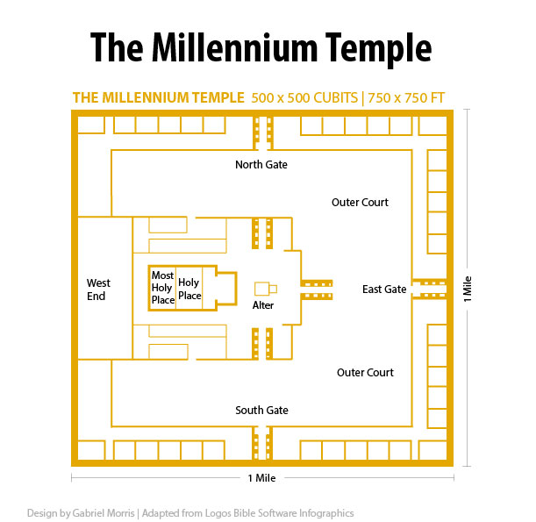

Slide 18
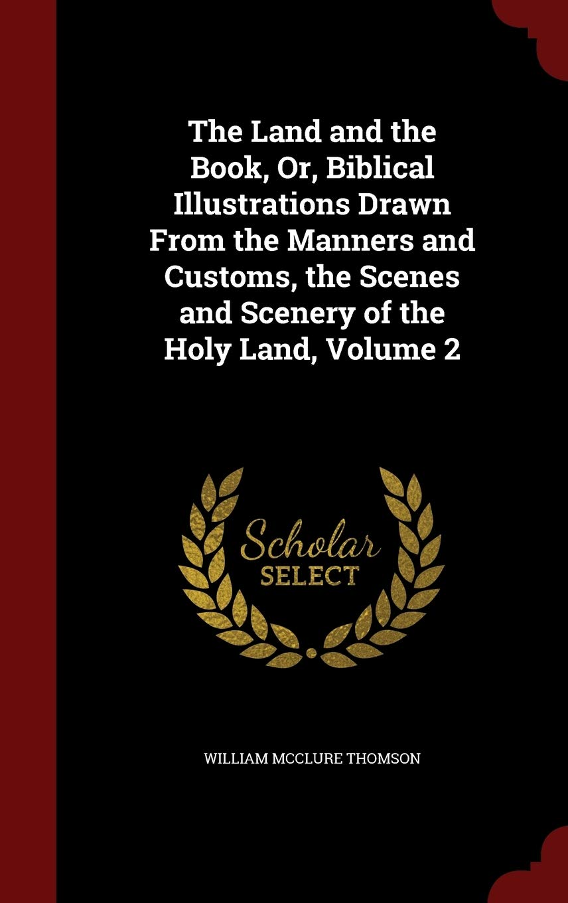
Thomson, W. M. The Land and the Book. 2 vols. New York: Harper & Brothers Publishers, 1873, Vol. 2, p. 240.
“I have repeatedly found wells closed up tight and the mouth plastered over with mortar. Such wells are reserved until times of greatest need, when all other sources of supply have failed.”

Slide 19
Zechariah 13
(Israel’s Physical & Spiritual Salvation)
Spiritual cleansing (13:1-5)
  Fountain (1)
  Idolatry removed (2a)
  False prophets removed (2b-5)

Slide 20
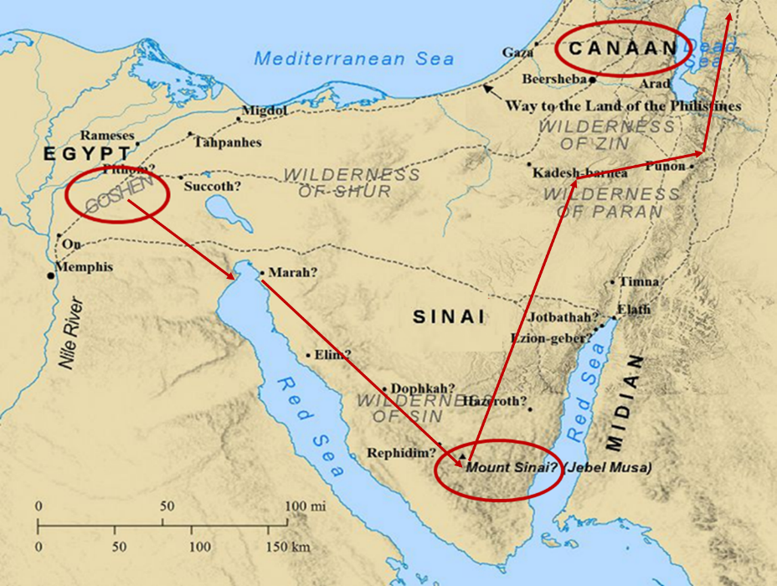

Slide 21
Six Parts of a Suzerain-Vassal Treaty in Deuteronomy
Preamble (1:1-5)
Prologue (1:6–4:40)
Covenant obligations (5–26)
Storage and reading instructions (27:2-3; 31:9, 24, 26)
Witnesses (32:1)
Blessings and curses (28)

Slide 22
Six Parts of a Suzerain-Vassal Treaty in Deuteronomy
Preamble (1:1-5)
Prologue (1:6–4:40)
Covenant obligations (5–26)
Storage and reading instructions (27:2-3; 31:9, 24, 26)
Witnesses (32:1)
Blessings and curses (28)

Slide 23

Deuteronomy 28:49-50
⁴⁹ “The Lord will bring a nation against you from far away, from the end of the earth, as the eagle swoops down; a nation whose language you will not understand, ⁵⁰ a nation with a defiant attitude, who will have no respect for the old, nor show favor to the young.”

Slide 24
Zechariah 13
(Israel’s Physical & Spiritual Salvation)
Spiritual cleansing (13:1-5)
  Fountain (1)
  Idolatry removed (2a)
  False prophets removed (2b-5)

Slide 25
OT Prophecies About Christ
Prophecy | Scripture | Years in Advance
Manner of Birth | Isaiah 7:14 | 700 years
Place of Birth | Micah 5:2 | 700 years
Nationality | Numbers 24:17 | 1400 years
Tribe | Genesis 49:10 | 1800 years
Time of and Response to His Messiahship | Dan. 9:25-26 | 600 years

Slide 26
OT Prophecies About Christ
Prophecy | Scripture | Years in Advance
Crucified Between Thieves | Isaiah 53:9 | 700 years
Pierced | Isaiah 53:5 | 700 years
No Broken Bones | Psalm 22:17 | 1000 years
Gamble for His Clothing | Psalm 22:18 | 1000 years
Buried in Rich Man’s Tomb | Isaiah 53:9 | 700 years
Notes:
109 prophecies…
Peter Stoner – SCIENCE SPEAKS, An Evaluation of Certain Christian Evidences
To fulfill just 8 prophecies =1 X 10 to the twenty-eighth power!
Can we visualize this with an illustration? Suppose we took an atheistic professor, blindfolded him and covered the state of Texas two feet deep with silver dollars. Then we put a check on one of those silver dollars and mixed them up. The odds of one person fulfilling just these eight prophecies would be the same as this atheistic professor selecting the silver dollar upon which we have placed a check, in his first try.
https://www.bereanpublishers.com/the-odds-of-eight-messianic-prophecies-coming-true/

Slide 27
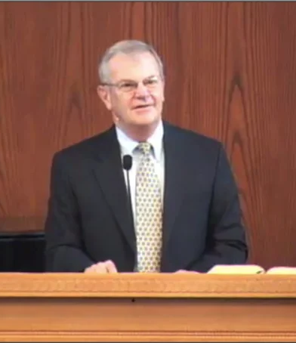
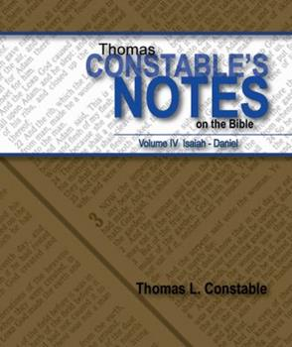
Thomas L. Constable
Constable’s online notes on Zechariah, p. 124.
“This dangerous situation for the false prophets will lead them to hide their identity as prophets. They will not identify themselves in traditional ways (cf. 2 Kings 1:8), but will deny that they are prophets, in order to avoid punishment. They will go so far as claiming to have been sold into slavery as field hands when they were only boys, so they could not possibly be prophets.”

Slide 28
Zechariah 13
(Israel’s Physical & Spiritual Salvation)
Spiritual cleansing (13:1-5)
Comprehensive deliverance (13:6-9)

Slide 29
Zechariah 13
(Israel’s Physical & Spiritual Salvation)
Comprehensive deliverance (13:6-9)
  Shepherd struck (6-7a)
  Sheep scattered (7b)
  Two-thirds perish (8a)
  One-third rescued & refined (8b-9)

Slide 30
Zechariah 13
(Israel’s Physical & Spiritual Salvation)
Comprehensive deliverance (13:6-9)
  Shepherd struck (6-7a)
  Sheep scattered (7b)
  Two-thirds perish (8a)
  One-third rescued & refined (8b-9)

Slide 31
Six Parts of a Suzerain-Vassal Treaty in Deuteronomy
Preamble (1:1-5)
Prologue (1:6–4:40)
Covenant obligations (5–26)
Storage and reading instructions (27:2-3; 31:9, 24, 26)
Witnesses (32:1)
Blessings and curses (28)

Slide 32
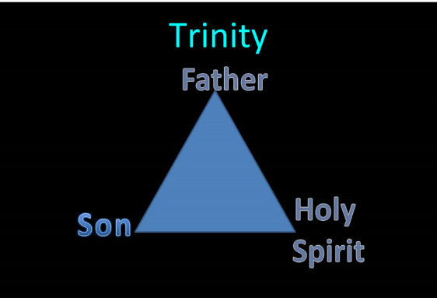

Slide 33
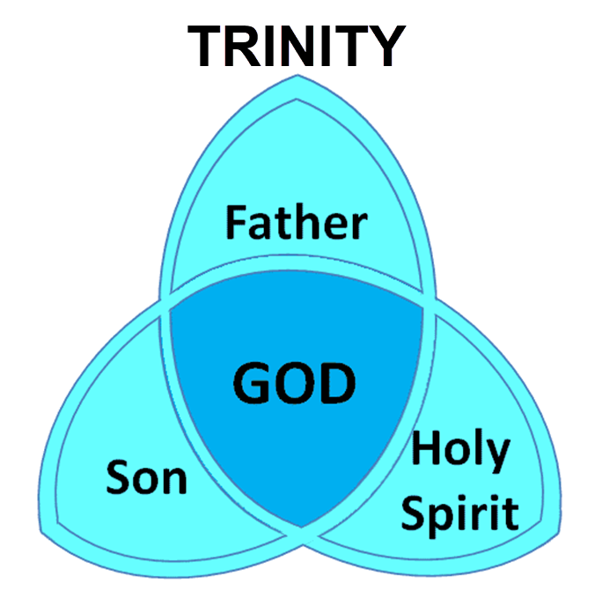

Slide 34
Zechariah 13
(Israel’s Physical & Spiritual Salvation)
Comprehensive deliverance (13:6-9)
  Shepherd struck (6-7a)
  Sheep scattered (7b)
  Two-thirds perish (8a)
  One-third rescued & refined (8b-9)

Slide 35
Israel's Judgments
Division of the kingdom in 931 B.C. (1 Kgs. 12)
Assyrian judgment in 722 B.C. (2 Kgs. 17)
Babylonian captivity in 586 B.C. (2 Kgs. 25)
Rome Diaspora in A.D. 70 (Luke 19:41-44)

Slide 36
Zechariah 13
(Israel’s Physical & Spiritual Salvation)
Comprehensive deliverance (13:6-9)
  Shepherd struck (6-7a)
  Sheep scattered (7b)
  Two-thirds perish (8a)
  One-third rescued & refined (8b-9)

Slide 37

Zechariah 13:8-9
⁸“It will come about in all the land,” Declares the Lord, “That two parts in it will be cut off and perish; But the third will be left in it. ⁹“And I will bring the third part through the fire, Refine them as silver is refined, And test them as gold is tested. They will call on My name, And I will answer them; I will say, ‘They are My people,’ And they will say, ‘The Lord is my God.’ ”

Slide 38

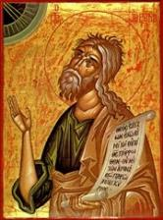
Jeremiah 30:7
“Alas! for that day is great, There is none like it; And it is the time of Jacob’s distress (Gen. 32:8; 35:10), But he will be saved from it.”

Slide 39
Zechariah 13
(Israel’s Physical & Spiritual Salvation)
Comprehensive deliverance (13:6-9)
  Shepherd struck (6-7a)
  Sheep scattered (7b)
  Two-thirds perish (8a)
  One-third rescued & refined (8b-9)

Slide 40

Matthew 23:37-39
³⁷ “Jerusalem, Jerusalem, who kills the prophets and stones those who are sent to her! How often I wanted to gather [episynagō] your children together, the way a hen gathers [episynagō] her chicks under her wings, and you were unwilling. ³⁸ Behold, your house is being left to you desolate! ³⁹ For I say to you, from now on you will not see Me until you say, ‘Blessed is He who comes in the name of the Lord!’”

Slide 41
Sovereignty (Rom 9–11)
Israel in the past: elected (Rom 9)
Israel in the present: rejected (Rom 10)
Israel in the future: accepted (Rom 11)

Slide 42
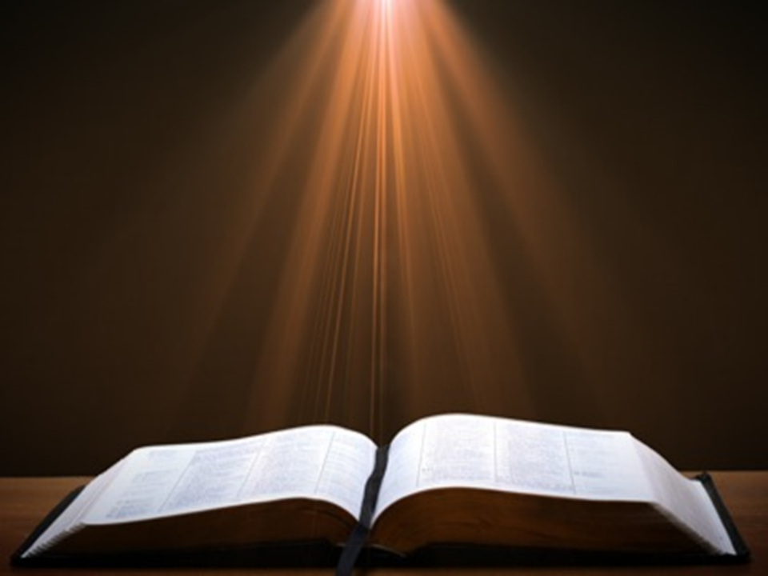
Ezekiel 20:33-38
³³ “As I live,” declares the Lord God, “surely with a mighty hand and with an outstretched arm and with wrath poured out, I shall be king over you. ³⁴ I will bring you out from the peoples and gather you from the lands where you are scattered, with a mighty hand and with an outstretched arm and with wrath poured out; ³⁵ and I will bring you into the wilderness of the peoples, and there I will enter into judgment with . . .

Slide 43
Ezekiel 20:33-38
. . .you face to face. ³⁶ As I entered into judgment with your fathers in the wilderness of the land of Egypt, so I will enter into judgment with you,” declares the Lord God. ³⁷ “I will make you pass under the rod, and I will bring you into the bond of the covenant; ³⁸ and I will purge from you the rebels and those who transgress against Me; I will bring them out of the land where they sojourn, but they will not enter the land of Israel. Thus you will know that I am the Lord.

Slide 44
Jeremiah 31:31-34
“Behold, days are coming,” declares the Lord, “when I will make a new covenant with the house of Israel and with the house of Judah, ³² not like the covenant which I made with their fathers in the day I took them by the hand to bring them out of the land of Egypt, My covenant which they broke, although I was a husband to them,” declares the Lord. ³³ “But this is the covenant which I will make with the house of Israel after those days,” declares the Lord, “I will put My law within them and on their heart I will . . .

Slide 45
Jeremiah 31:31-34
. . .write it; and I will be their God, and they shall be My people. ³⁴ They will not teach again, each man his neighbor and each man his brother, saying, ‘Know the Lord,’ for they will all know Me, from the least of them to the greatest of them,” declares the Lord, “for I will forgive their iniquity, and their sin I will remember no more.”

Slide 46
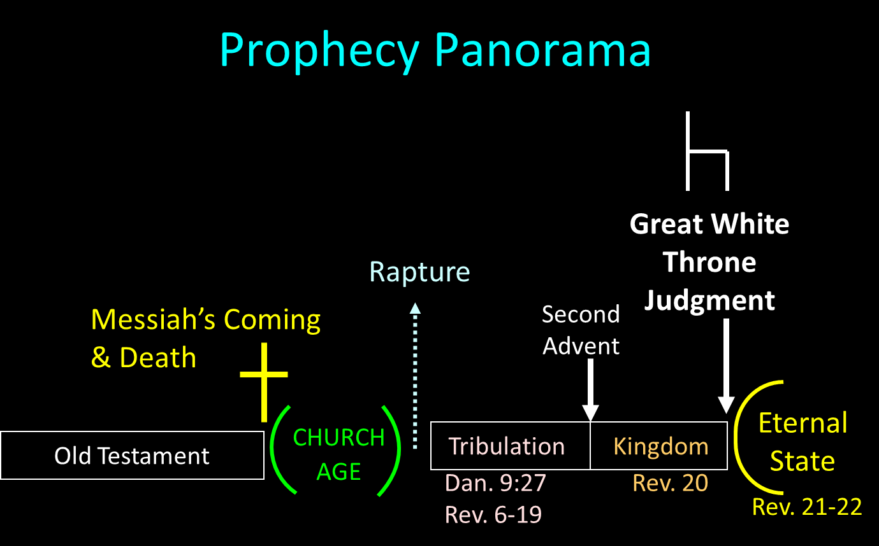

Slide 47
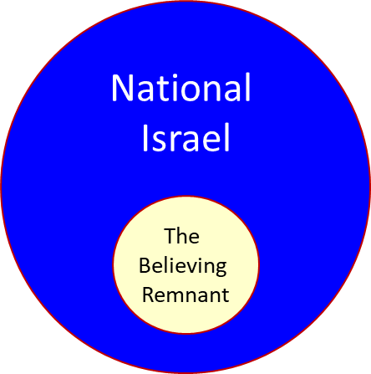

Slide 48
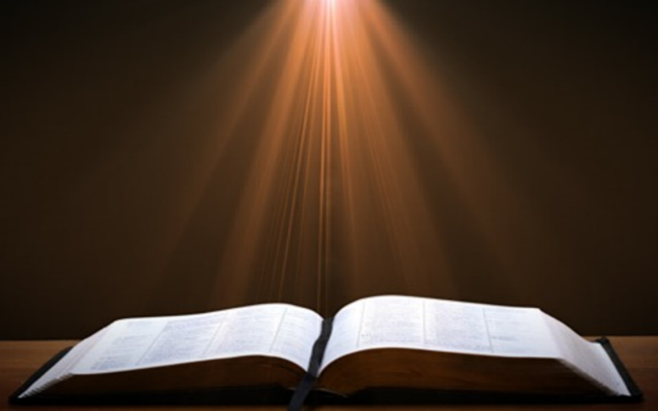
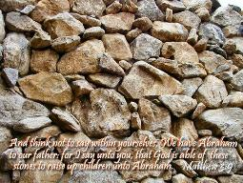
Matthew 3:9
“and do not suppose that you can say to yourselves, ‘We have Abraham for our father’; for I say to you that from these stones God is able to raise up children to Abraham.”

Slide 49

Romans 2:28-29
“²⁸ For he is not a Jew who is one outwardly, nor is circumcision that which is outward in the flesh. ²⁹ But he is a Jew who is one inwardly; and circumcision is that which is of the heart, by the Spirit, not by the letter; and his praise is not from men, but from God.”

Slide 50
Romans 9:6
“But it is not as though the word of God has failed. For they are not all Israel who are descended from Israel.”

Slide 51

Revelation 2:9
“I know your tribulation and your poverty (but you are rich), and the blasphemy by those who say they are Jews and are not, but are a synagogue of Satan.”

Slide 52
Revelation 3:9
“Behold, I will cause those of the synagogue of Satan, who say that they are Jews and are not, but lie—I will make them come and bow down at your feet, and make them know that I have loved you.”

Slide 53
J. Vernon McGee
McGee, J. Vernon. Thru the Bible with J. Vernon McGee. 5 vols. Pasadena, Calif.: Thru The Bible Radio; and Nashville: Thomas Nelson, Inc., 1983. P. 3:983.
“'The third shall be left therein' refers to the same remnant that shall ask, 'What are these wounds in thine hands?' [v. 6]. They will have come through the horrors of the Great Tribulation Period in which two-thirds of their people have perished.”

Slide 54
Conclusion

Slide 55
Zechariah 13
(Israel’s Physical & Spiritual Salvation)
Spiritual cleansing (13:1-5)
Comprehensive deliverance (13:6-9)

