Slide 1

Ezekiel 36‒39
The Middle East Meltdown 2022
Dr. Andy Woods
Senior Pastor – Sugar Land Bible Church
President – Chafer Theological Seminary

Slide 2
Ezekiel 33‒48
Ezekiel recommissioned (33)
False shepherds removed (34)
Edom destroyed (35)
Israel’s restoration: physical & spiritual (36)
Israel’s restoration illustrated (37)
Means of restoration: Northern invasion (38)
Results of the Northern invasion: conversion (39)
Millennial Temple (40‒46)
Tribal land allotment (47‒48)

Slide 3
Ezekiel 36
Israel to prosper again (1-15)
Israel’s sins inhibiting prosperity (16-21)
Israel to be restored: physically & spiritually (22-38)

Slide 4
Ezekiel 33‒48
Ezekiel recommissioned (33)
False shepherds removed (34)
Edom destroyed (35)
Israel’s restoration: physical & spiritual (36)
Israel’s restoration illustrated (37)
Means of restoration: Northern invasion (38)
Results of the Northern invasion: conversion (39)
Millennial Temple (40‒46)
Tribal land allotment (47‒48)

Slide 5
Ezekiel 37
Vision: Valley of the Dry Bones (1-14)
  Vision (1-10)
  Interpretation (11-14)
Sign: Two Sticks (15-28)
  Sign (15-17)
  Interpretation (18-28)

Slide 6
Ezekiel 33‒48
Ezekiel recommissioned (33)
False shepherds removed (34)
Edom destroyed (35)
Israel’s restoration: physical & spiritual (36)
Israel’s restoration illustrated (37)
Means of restoration: Northern invasion (38)
Results of the Northern invasion: conversion (39)
Millennial Temple (40‒46)
Tribal land allotment (47‒48)

Slide 7
Ezekiel 38‒39
Invasion planned (38:1-13)
Invasion executed (38:14-16)
Invasion defeated (38:17‒39:20)
Invasion’s results (39:21-29)

Slide 8
Ezekiel 38‒39
Invasion planned (38:1-13)
Invasion executed (38:14-16)
Invasion defeated (38:17‒39:20)
Invasion’s results (39:21-29)

Slide 9
I. Invasion Planned (Ezekiel 38:1-13)
  God’s intention (1-9)
  Gog’s intention (10-13)

Slide 10


Slide 11

Ancient Names From Ezekiel 38:1-9
Magog (Central Asia), Rosh (Russia), Meshec (Turkey), Tubal (Turkey), Persia (Iran), Put (Libya), Cush (Sudan), Gomer (Turkey), | Togarmah (Turkey) Sheba (Saudi Arabia) Dedan (Saudi Arabia or Yemen) Tarshish (Spain) Merchants of Tarshish (Conglomeration of Western powers including Europe) Israel

Slide 12
Ezekiel 38‒39
Invasion planned (38:1-13)
Invasion executed (38:14-16)
Invasion defeated (38:17‒39:20)
Invasion’s results (39:21-29)

Slide 13
Ezekiel 38‒39
Invasion planned (38:1-13)
Invasion executed (38:14-16)
Invasion defeated (38:17‒39:20)
Invasion’s results (39:21-29)

Slide 14
III. Invasion Defeated (Ezekiel 38:17‒39:20)
  Armies destroyed (38:17‒39:8)
  Weapons burned (39:9-10)
  Soldiers buried (39:11-16)
  Soldiers eaten (39:17-20)

Slide 15
III. Invasion Defeated (Ezekiel 38:17‒39:20)
  Armies destroyed (38:17‒39:8)
  Weapons burned (39:9-10)
  Soldiers buried (39:11-16)
  Soldiers eaten (39:17-20)

Slide 16
Ezekiel 33‒48
Ezekiel recommissioned (33)
False shepherds removed (34)
Edom destroyed (35)
Israel’s restoration: physical & spiritual (36)
Israel’s restoration illustrated (37)
Means of restoration: Northern invasion (38)
Results of the Northern invasion: conversion (39)
Millennial Temple (40‒46)
Tribal land allotment (47‒48)

Slide 17

Ezekiel 39:2, 4
“² and I will turn you around, drive you on, take you up from the remotest parts of the north and bring you against the mountains of Israel…⁴You will fall on the mountains of Israel, you and all your troops and the peoples who are with you; I will give you as food to every kind of predatory bird and beast of the field.”

Slide 18

Ezekiel 38:12
“to capture spoil and to seize plunder, to turn your hand against the waste places which are now inhabited, and against the people who are gathered from the nations, who have acquired cattle and goods, who live at the center of the world.”

Slide 19
Ezekiel 38:13
“Sheba and Dedan and the merchants of Tarshish with all its villages will say to you, ‘Have you come to capture spoil? Have you assembled your company to seize plunder, to carry away silver and gold, to take away cattle and goods, to capture great spoil?’”

Slide 20
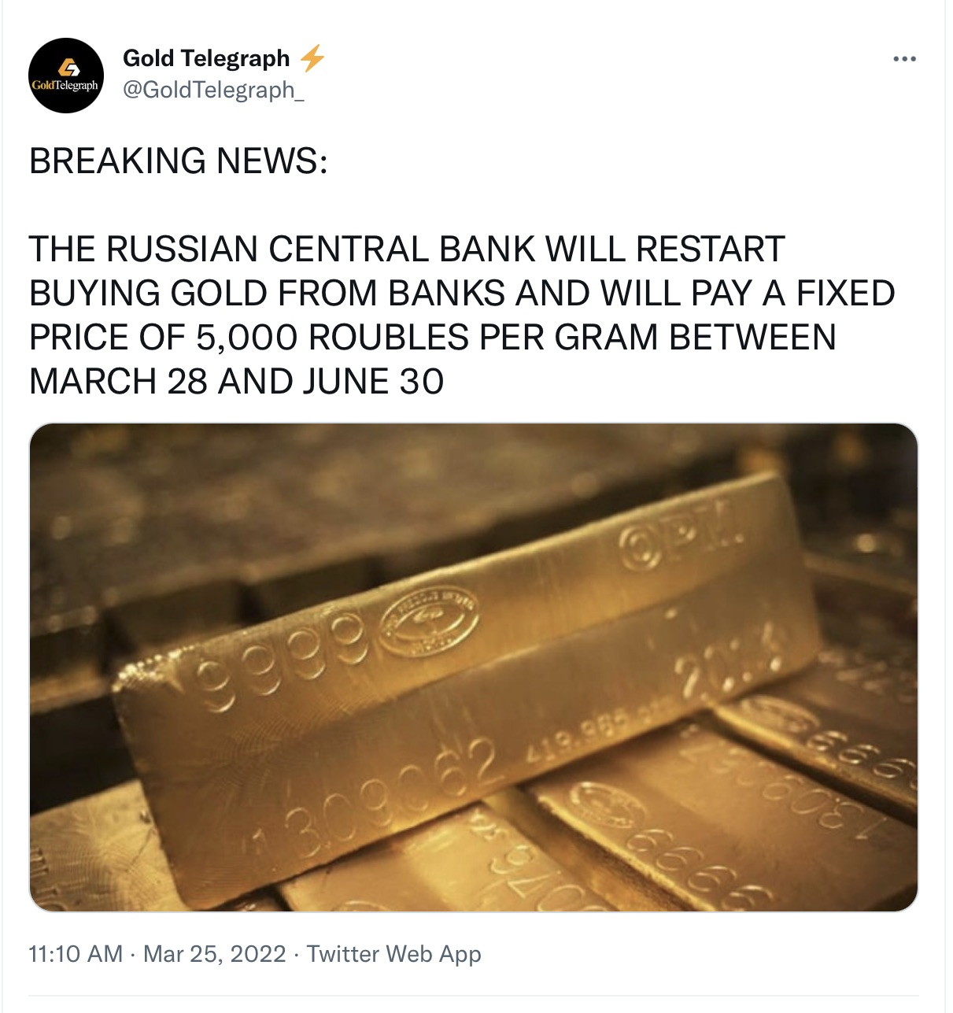
20

Slide 21

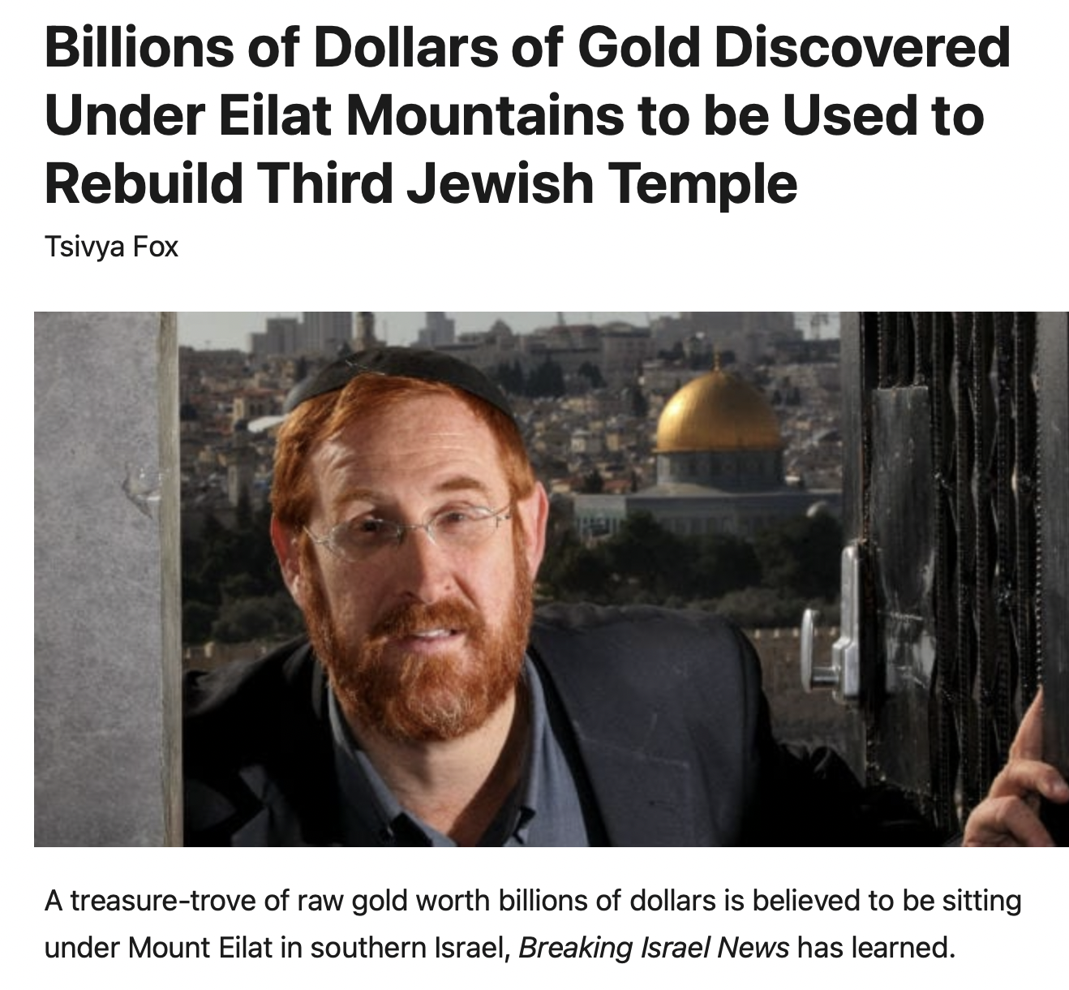

Slide 22
Ezekiel 39:2, 4
“² and I will turn you around, drive you on, take you up from the remotest parts of the north and bring you against the mountains of Israel…⁴You will fall on the mountains of Israel, you and all your troops and the peoples who are with you; I will give you as food to every kind of predatory bird and beast of the field.”

Slide 23
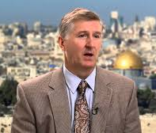
Mountains of Israel?
Mark Hitchcock, The Amazing Claims of Bible Prophecy: What You Need to Know in These Uncertain Times (Harvest House: Eugene, OR, 2010), 211.
“According to Ezekiel 39:2, 4, Israel must possess the ‘mountains of Israel’ when this invasion occurs...The famous Six Day war in Israel in 1967 helped set the stage for this to be fulfilled. Before the Six Day War, all the mountains of Israel, with the exception of a small strip of west Jerusalem, were in the hands of the Jordanian Arabs. Only since 1967 have the mountains of Israel been in Israel, thus setting the stage for the fulfillment of this prophecy.”

Slide 24


Dr. Arnold G. Fruchtenbaum
THE MODERN STATE OF ISRAEL IN BIBLE PROPHECY
Paper presented to the PTSG on 12-7-21, pps. 18-19
“But where in the Land of Israel will the invading armies be destroyed? The exact location is revealed in Ezekiel 39:2 and 4a: ‘and I will turn you about, and will lead you on, and will cause you to come up from the uttermost parts of the north; and I will bring you upon the mountains of Israel…you shall fall upon the mountains of Israel.’ The phrase ‘the mountains of Israel’ refers to the central mountain range that makes up the backbone of the country. In the Hebrew Scriptures, these mountains were known as the Hill Country of Ephraim and the Hill Country of Judah. Some of the famous biblical cities that lie within these mountains include Dothan, Shechem, Samaria, Shiloh, Bethel, Ai, Ramah, Bethlehem, Hebron, Debir, and most importantly, Jerusalem, which seems to be the target of the invading army. However, from 1948 until the Six-Day War in 1967, these mountains were not in Israel, but in Jordan.”

Slide 25
Dr. Arnold G. Fruchtenbaum
THE MODERN STATE OF ISRAEL IN BIBLE PROPHECY
Paper presented to the PTSG on 12-7-21, pps. 18-19
“They are now referred to politically as the West Bank. In 1948, Jordanian forces took over these mountains and annexed them as part of Jordan. All Israel had was a small corridor leading west to Jerusalem. The border between Israel and Jordan ran down the foot of these mountains, then cut into the mountains, dividing Jerusalem in two, and then went out again and continued along the foot of these mountains. Israel had maybe five percent or less of the mountains, while the rest belonged to Jordan. Only since 1967 have the mountains of Israel been in Israel. Besides the Temple compound falling into Jewish hands, …

Slide 26
Dr. Arnold G. Fruchtenbaum
THE MODERN STATE OF ISRAEL IN BIBLE PROPHECY
Paper presented to the PTSG on 12-7-21, pps. 18-19
…another by-product of the Six-Day War was that these mountains also fell under Israeli sovereignty. Therefore, not only could this prophecy not have been fulfilled before 1948, but it could also not have been fulfilled before 1967…“The mountains of Israel (the West Bank) are yet to have a very important and relevant role in Bible prophecy. As for the present State of Israel, they became part of Israel in 1967. This is yet another way the modern Jewish State fits within Bible prophecy.”

Slide 27
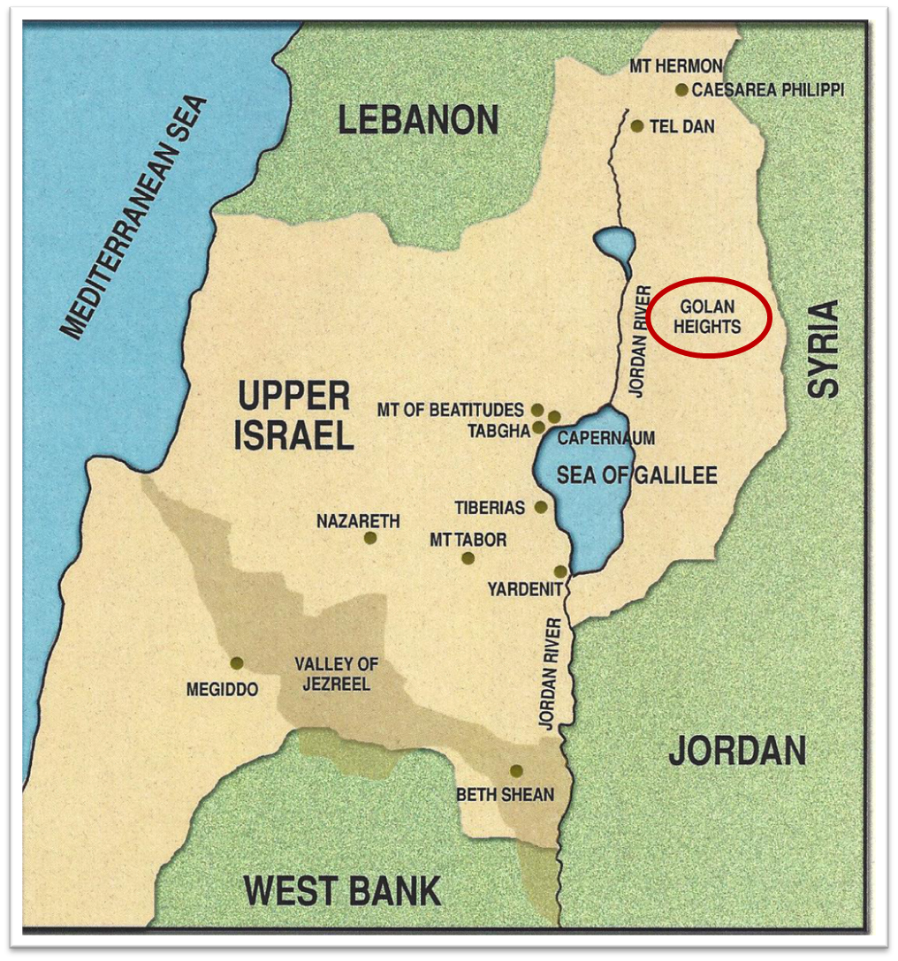

Slide 28
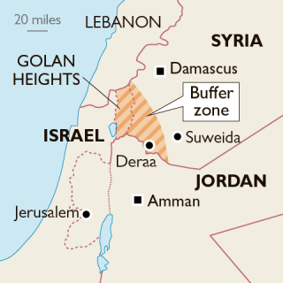

Slide 29
Ezekiel 39:2, 4
“² and I will turn you around, drive you on, take you up from the remotest parts of the north and bring you against the mountains of Israel…⁴ You will fall on the mountains of Israel, you and all your troops and the peoples who are with you; I will give you as food to every kind of predatory bird and beast of the field.”

Slide 30
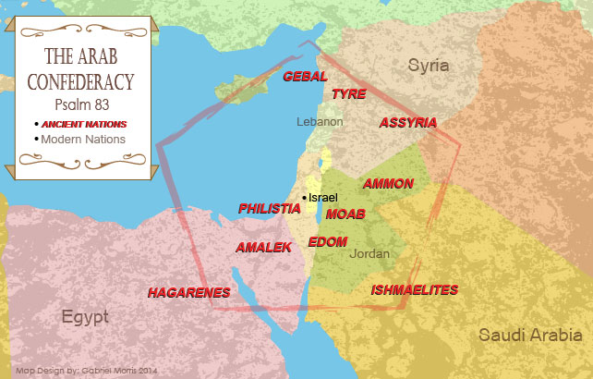

Slide 31
What?
Divine annihilation of the coalition (38:19-22)
Birds and beasts feast on the carnage (39:4-5, 17-20)
Seven-month burying of the dead (39:11-12, 14-16)
Seven-year burning of weapons (39:9-10)
Israel’s salvation and restoration (39:22, 29)

Slide 32


Slide 34
Dispensational Theology is a System of Theology
Dr. Charles Ryrie, Dispensationalism, pp. 38-41
Traditional-normative dispensational theology is a system that embodies three essential, fundamental concepts called the sine qua non (lit. “without which is not”):
The consistent use of a plain, normal, literal, grammatical-historical method of interpretation;
Which reveals that the Church is distinct from Israel;
God’s overall purpose is to bring glory to Himself (Eph. 1:6, 12, 14).

Slide 35
Doxological Purpose
Dictionary of Premillennial Theology, Charles Ryrie, p. 94
God’s ultimate purpose for the ages is to glorify Himself. Scripture is not human-centered, as though salvation were the principle point, but God-centered, because His glory is at the center.
The glory of God is the primary principle that unifies all dispensations, the program of salvation being just one of the means by which God glorifies Himself. Each successive revelation of God’s plan for the ages, as well as His dealing with the elect, non-elect, angels, and nations all manifest His glory.

Slide 36
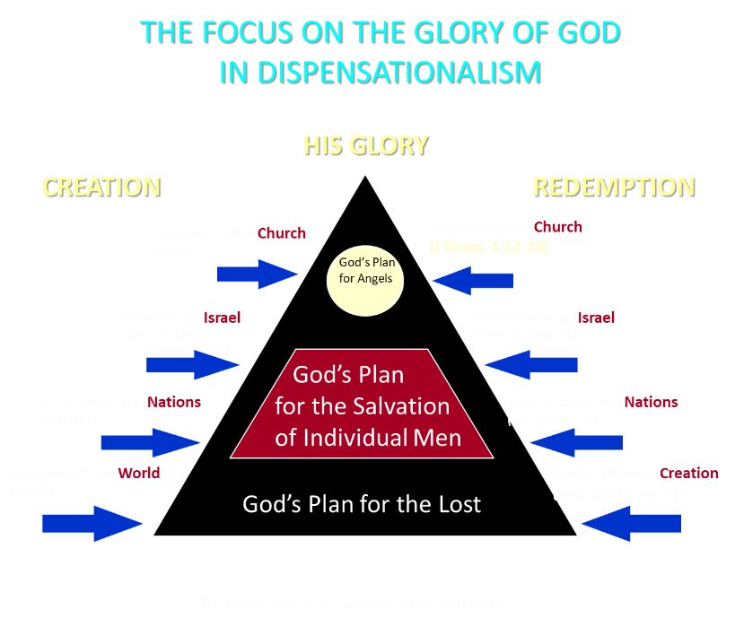

Slide 37

Charles L. Feinberg
The Prophecy of Ezekiel: The Glory of the Lord, Paperback ed. (Chicago: Moody, 1969; reprint, Chicago: Moody, 1984), 228.
“Though the judgment on the enemies will occur in Israel, the catastrophe will extend far beyond to the ends of the earth to accomplish the purpose of God. Once more the Lord will relate His purpose in Israel to that for all the world. It is the concept of concentric circles where that which is accomplished at the very center reaches out irresistibly to the farthest confines of the circumference. God is the Lord of the nations. His true character will appear in its proper light as both righteous and mighty. Such emphasis is made of this thought throughout the book of Ezekiel because this is the design of God in all history, and there is no more important concept in all the universe.”

Slide 38
III. Invasion Defeated (Ezekiel 38:17‒39:20)
  Armies destroyed (38:17‒39:8)
  Weapons burned (39:9-10)
  Soldiers buried (39:11-16)
  Soldiers eaten (39:17-20)

Slide 39


Genesis 12:3
“And I will bless those who bless you, And the one who curses you I will curse. And in you all the families of the earth will be blessed.”

Slide 40
What?
Divine annihilation of the coalition (38:19-22)
Birds and beasts feast on the carnage (39:4-5, 17-20)
Seven-month burying of the dead (39:11-12, 14-16)
Seven-year burning of weapons (39:9-10)
Israel’s salvation and restoration (39:22, 29)

Slide 41
When?
Beginning of the Millennium
End of the Millennium
End of the Tribulation
Before the Tribulation
First half of the Tribulation
Two phase view

Slide 42
When?
Beginning of the Millennium
End of the Millennium
End of the Tribulation
Before the Tribulation
First half of the Tribulation
Two phase view

Slide 43


Slide 44
Millennium Rev.20 | Eternal State Rev.21-22
Sin restrained | Sin removed
Curse restrained | Curse removed
Death | No death
Mortals / resurrected | Resurrected only
Mortals Destinies undecided | All Destinies sealed
Renovation | Recreation
Temporary | Eternal
Transitional | Non-transitional

Slide 45
Millennium and Eternal State
 | Rev 20:1-10 | Rev 21–22
Time | 20:4 | 22:5
Luminaries | Isa 30:26 | 21:23; 22:5
Temple | Ezek 40–48 | 21:22
Death | Isa 65:20 | 21:4
Satanic activity | 20:7 | 20:10
Rebellion | 20:8-9 | 21:27

Slide 46
III. Invasion Defeated (Ezekiel 38:17‒39:20)
  Armies destroyed (38:17‒39:8)
  Weapons burned (39:9-10)
  Soldiers buried (39:11-16)
  Soldiers eaten (39:17-20)

Slide 47
Genesis 12:3
“And I will bless those who bless you, And the one who curses you I will curse. And in you all the families of the earth will be blessed.”

Slide 48
What?
Divine annihilation of the coalition (38:19-22)
Birds and beasts feast on the carnage (39:4-5, 17-20)
Seven-month burying of the dead (39:11-12, 14-16)
Seven-year burning of weapons (39:9-10)
Israel’s salvation and restoration (39:22, 29)

Slide 49


Slide 50
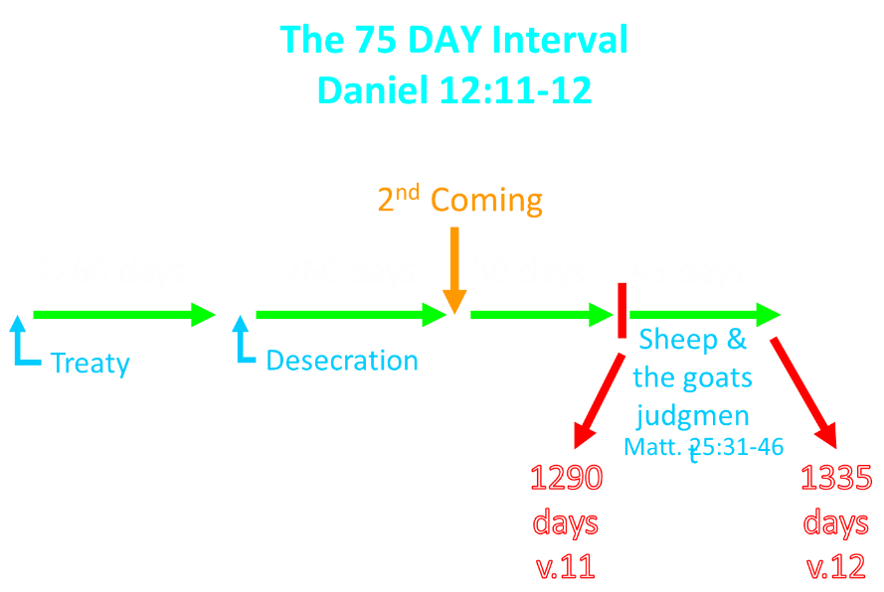

Slide 51

Arnold Fruchtenbaum
(2003). The Footsteps of the Messiah: a study of the sequence of prophetic events (Rev. ed., p. 367). Tustin, CA: Ariel Ministries.
“The Millennium will not begin the day immediately following the last day of the Great Tribulation because there will be a seventy-five day interval. During this time between the Great Tribulation and the start of the Messianic Age, a number of events will occur. The existence of this interval is demonstrated in Daniel 12:11-12.”

Slide 52
The 75 DAY Interval
Daniel 12:11-12
The Beast cast into the Lake of Fire (Rev. 19:20)
The False Prophet cast into the Lake of Fire (Rev. 19:20)
The binding of Satan (Rev. 20:1-3)
The Judgment of the Jews (Ezek. 20:33-44)
The Judgment of the Gentiles (Matt. 25:31-46)
Resurrection of OT saints (Dan. 12:2) & Tribulation martyrs (Rev. 20:4-5)
Rewarding of OT saints & Tribulation martyrs (Dan. 12:3)
Fruchtenbaum, Footsteps of the Messiah, 367-78

Slide 53
Dispensational Theology is a System of Theology
Traditional-normative dispensational theology is a system that embodies three essential, fundamental concepts called the sine qua non (lit. “without which is not”):
The consistent use of a plain, normal, literal, grammatical-historical method of interpretation;
Which reveals that the Church is distinct from Israel;
God’s overall purpose is to bring glory to Himself (Eph. 1:6, 12, 14).
Dr. Charles Ryrie, Dispensationalism, pp. 38-41

Slide 54
Doxological Purpose
God’s ultimate purpose for the ages is to glorify Himself. Scripture is not human-centered, as though salvation were the principle point, but God-centered, because His glory is at the center.
The glory of God is the primary principle that unifies all dispensations, the program of salvation being just one of the means by which God glorifies Himself. Each successive revelation of God’s plan for the ages, as well as His dealing with the elect, non-elect, angels, and nations all manifest His glory.
Dictionary of Premillennial Theology, Charles Ryrie, p. 94

Slide 56
CONCLUSION

Slide 57
III. Invasion Defeated (Ezekiel 38:17‒39:20)
  Armies destroyed (38:17‒39:8)
  Weapons burned (39:9-10)
  Soldiers buried (39:11-16)
  Soldiers eaten (39:17-20)

