Slide 1
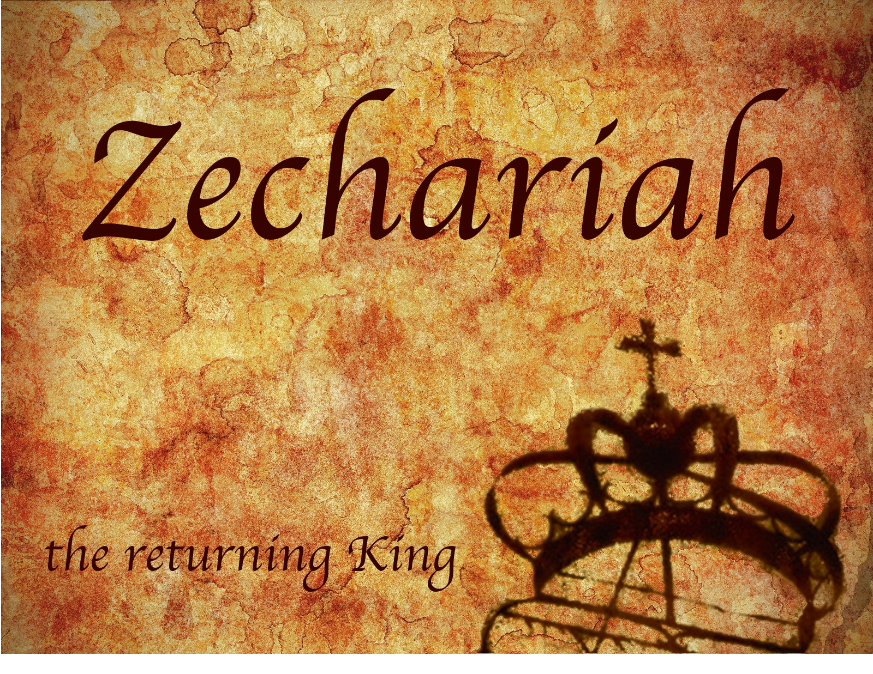
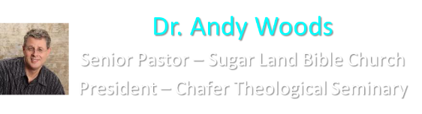
Zechariah
God Remembers!

Slide 2
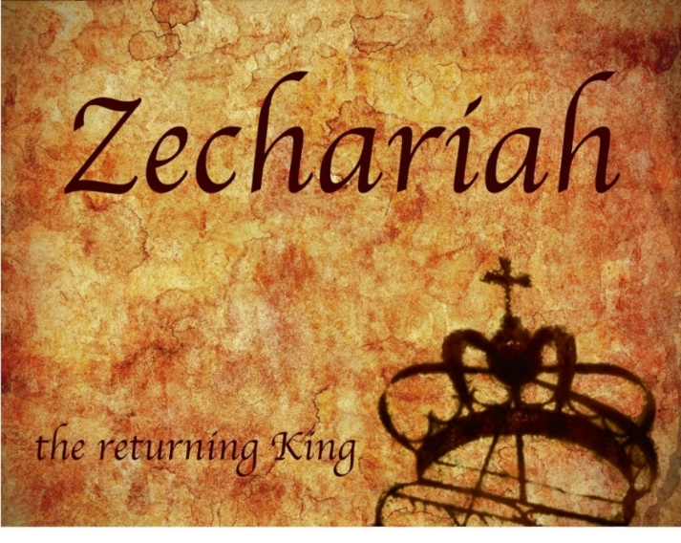
Structure
Introductory call to repentance (1:1-6)
Eight-night visions (1:7–6:15)
Question and answers about fasting (7–8)
Two burdens (9–14)

Slide 3
Structure
Introductory call to repentance (1:1-6)
Eight-night visions (1:7–6:15)
Question and answers about fasting (7–8)
Two burdens (9–14)

Slide 4
ZECHARIAH’S EIGHT NIGHT VISIONS
Vision | Reference | Meaning
The Red-horse Rider among the Myrtles | 1:7-17 | God’s anger against the nations & blessing on restored Israel.
The Four Horns & the Four Craftsmen | 1:18-21 | God’s judgment on the nations that afflict Israel.
The Surveyor with a Measuring Line | Chapter 2 | God’s future blessing on restored Israel.
The Cleansing & Crowning of Joshua the Hight Priest. | Chapter 3 | Israel’s future cleansing from sin & reinstatement as a priestly nation.
The Golden Lampstand & the Two Olive Trees | Chapter 4 | Israel as the light to the nations under Messiah, the King-Priest.
The Flying Scroll | 5:1-4 | The severity & totality of divine judgment on individual Israelites.
The Woman in the Ephah | 5:5-11 | The removal of national Israel’s sin of rebellion against God.
The Four Chariots | 6:1-8 | Divine judgment on Gentile nations.

Slide 5
II. Eight Night Visions
(1:7‒6:15)
  Riders & horses among the myrtle trees (1:7-17)
  Four horns & four craftsmen (1:18-21)
  Man with the measuring line (2)
  Cleansing of the High Priest Joshua (3)
  Lampstand & olive tree (4)
  Flying scroll (5:1-4)
  Woman in the basket (5:5-11)
  Four chariots (6:1-8)
  Conclusion: crowning of Joshua (6:9-15)

Slide 6
Structure
Introductory call to repentance (1:1-6)
Eight-night visions (1:7–6:15)
Question and answers about fasting (7–8)
Two burdens (9–14)

Slide 7
III. Questions & Answers Concerning Fasting
(7‒8)
  Question (7:1-3)
  Four divine answers (7:4‒8:23)
    Condemnation of empty ritualism (7:4-7)
    Condemnation of past covenant failure (7:8-14)
    Prediction of Jerusalem’s restoration (8:1-17)
    Prediction of future blessing (8:18-23)

Slide 8
Structure
Introductory call to repentance (1:1-6)
Eight-night visions (1:7–6:15)
Question and answers about fasting (7–8)
Two burdens (9–14)

Slide 9
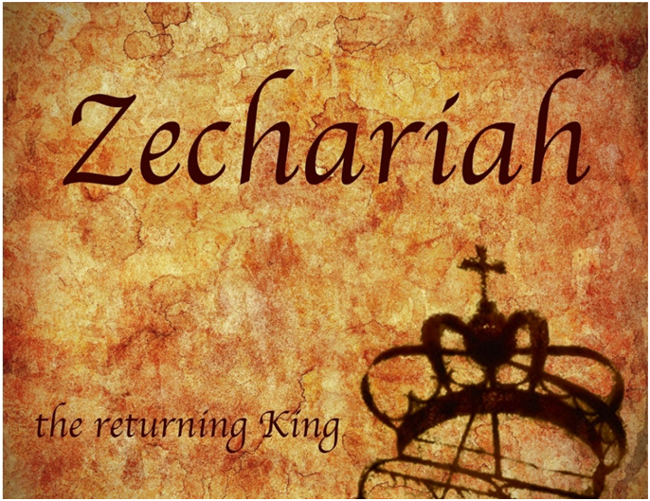
IV. Two Burdens
(9‒14)
  Israel’s postponed deliverance due to her rejection of her Messiah (9‒11)
  Israel’s future deliverance due to her acceptance of her Messiah (12‒14)

Slide 10
IV. Two Burdens
(9‒14)
  Israel’s postponed deliverance due to her rejection of her Messiah (9‒11)
  Israel’s future deliverance due to her acceptance of her Messiah (12‒14)

Slide 11

First Burden Outline
(9‒11)
    Divine warrior hymn (9)
    True shepherd (10)
    False shepherd (11)

Slide 12
First Burden Outline
(9‒11)
    Divine warrior hymn (9)
    True shepherd (10)
    False shepherd (11)

Slide 13
Divine Warrior Hymn
(9:1-17)
Judgment on the oppressing nations (1-8)
Messiah (9-10)
Covenant protection (11-17)

Slide 14
First Burden Outline
(9‒11)
    Divine warrior hymn (9)
    True shepherd (10)
    False shepherd (11)

Slide 15
True Shepherd
(10:1-12)
Messianic prosperity (1-3)
Restoration of the Northern & Southern kingdoms (4-7)
Messianic regathering (8-12)

Slide 16
First Burden Outline
(9‒11)
    Divine warrior hymn (9)
    True shepherd (10)
    False shepherd (11)

Slide 17
False Shepherd
(11:1-17)
The wailing land (1-3)
Reasons for the wailing (4-14)
The coming false shepherd (15-17)

Slide 18
False Shepherd
(11:1-17)
The wailing land (1-3)
Reasons for the wailing (4-14)
The coming false shepherd (15-17)

Slide 19
The Wailing Land
(11:1-3)
    Cedars of Lebanon (1)
    Cypress & Oaks of Bashan (2)
    Shepherds & Lions (3)

Slide 20
False Shepherd
(11:1-17)
The wailing land (1-3)
Reasons for the wailing (4-14)
The coming false shepherd (15-17)

Slide 21
Reasons for the Wailing
(11:4-14)
    Zechariah pastors the doomed flock (4-7)
    God no longer favors the flock (8-11)
    Israel to reject her Messiah (12-13)
    Cessation of the nation’s unity (14)

Slide 22
Reasons for the Wailing
(11:4-14)
    Zechariah pastors the doomed flock (4-7)
    God no longer favors the flock (8-11)
    Israel to reject her Messiah (12-13)
    Cessation of the nation’s unity (14)

Slide 23
Reasons for the Wailing
(11:4-14)
    Zechariah pastors the doomed flock (4-7)
    God no longer favors the flock (8-11)
    Israel to reject her Messiah (12-13)
    Cessation of the nation’s unity (14)

Slide 24
Reasons for the Wailing
(11:4-14)
    Zechariah pastors the doomed flock (4-7)
    God no longer favors the flock (8-11)
    Israel to reject her Messiah (12-13)
    Cessation of the nation’s unity (14)

Slide 25
Reasons for the Wailing
(11:4-14)
    Zechariah pastors the doomed flock (4-7)
    God no longer favors the flock (8-11)
    Israel to reject her Messiah (12-13)
    Cessation of the nation’s unity (14)

Slide 26
Israel's Judgments
Division of the kingdom in 931 B.C. (1 Kgs. 12)
Assyrian judgment in 722 B.C. (2 Kgs. 17)
Babylonian captivity in 586 B.C. (2 Kgs. 25)
Rome Diaspora in A.D. 70 (Luke 19:41-44)

Slide 27
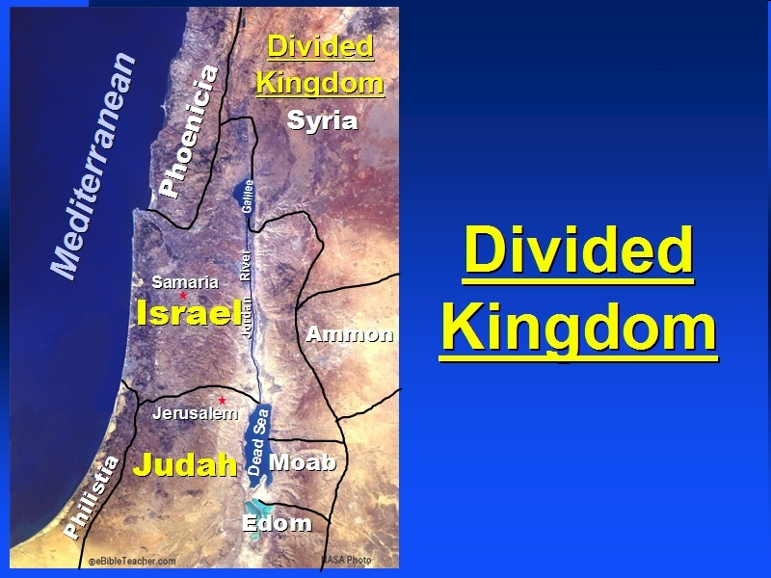

Slide 28
Ezekiel 37
Vision: Valley of the Dry Bones (1-14)
  Vision (1-10)
  Interpretation (11-14)
Sign: Two Sticks (15-28)
  Sign (15-17)
  Interpretation (18-28)

Slide 29
False Shepherd
(11:1-17)
The wailing land (1-3)
Reasons for the wailing (4-14)
The coming false shepherd (15-17)

Slide 30
The Coming False Shepherd
(11:15-17)
    Raised up (15-16)
    Destroyed (17)

Slide 31
The Coming False Shepherd
(11:15-17)
    Raised up (15-16)
    Destroyed (17)

Slide 32
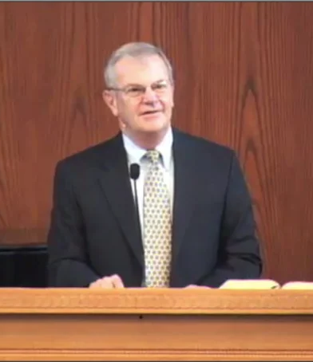
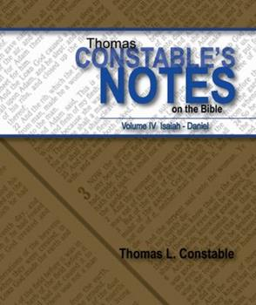
Thomas L. Constable
Constable’s online notes on Zechariah, p. 112.
“The Lord next directed Zechariah to present himself as a ‘foolish’ (worthless, v. 17, i.e., morally deficient, cf. Prov. 1:7) ‘shepherd,’ since his flock had rejected the Good Shepherd (cf. Ezek. 34:3-4).”

Slide 33
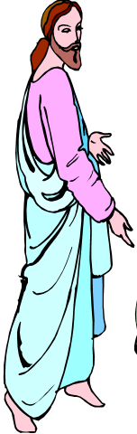
7 “I AM” statements in John
I am the Bread of Life | 6:35
I am the Light of the world | 8:12
I am the Gate for the sheep | 10:7; cf. v.9
I am the Good Shepherd | 10:11,14
I am the Resurrection and the Life | 11:25
I am the Way and the Truth and the Life | 14:6
I am the true Vine | 15:1; cf. v.5

Slide 34
Thomas L. Constable
Constable’s online notes on Zechariah, p. 112.
“Tearing off the hoofs of the sheep probably represents the avaricious shepherd, searching for the last edible morsel that he can extract from his charges whom he has consumed.”

Slide 35
The Coming False Shepherd
(11:15-17)
    Raised up (15-16)
    Destroyed (17)

Slide 36

Eugene Merrill
Commentary on Zechariah, p. 303.
“However, the ultimate fulfillment must be the Antichrist, who will make a covenant with Israel—but then break it and proceed to persecute the Jews (Ezek. 34:2-4; Dan. 9:27; 11:36-39; John 5:43; 2 Thess. 2:3-10; Rev. 13:1-8). Perhaps the whole collective leadership of Israel, from Zechariah's time forward— culminating in Antichrist—is in view.”

Slide 37
Merrill F. Unger
Unger, Merrill F. Zechariah. Grand Rapids: Zondervan Publishing House, 1963. p. 205.
“With this climactic scene the first prophetic burden describing the first advent and rejection of Messiah, the Shepherd-King (chapters 9—11) comes to a close. The way is thus opened for the second burden and the second advent and acceptance of Messiah, the King (chapters 12—14).”

Slide 38
IV. Two Burdens
(9‒14)
  Israel’s postponed deliverance due to her rejection of her Messiah (9‒11)
  Israel’s future deliverance due to her acceptance of her Messiah (12‒14)

Slide 39
IV. Two Burdens
(9‒14)
  Israel’s postponed deliverance due to her rejection of her Messiah (9‒11)
  Israel’s future deliverance due to her acceptance of her Messiah (12‒14)

Slide 40
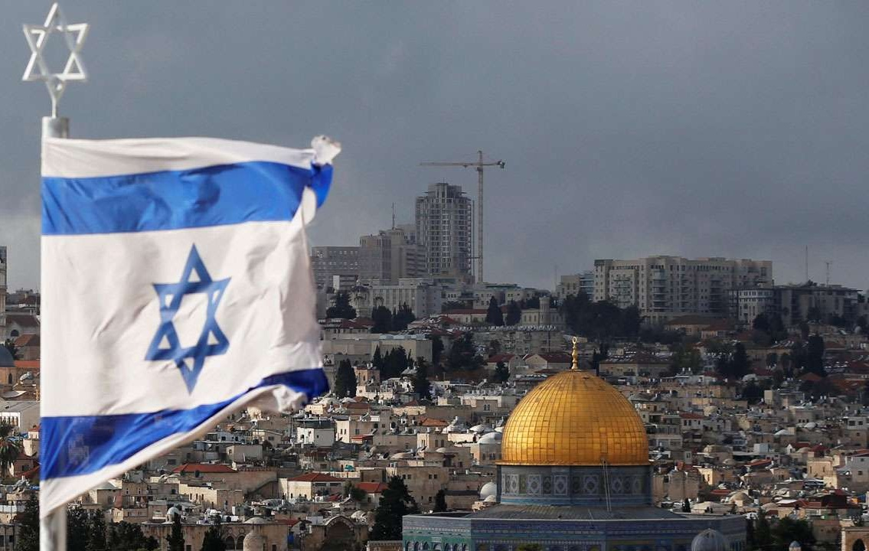
Zechariah 12:3
And in that day will I make Jerusalem a burdensome stone for all people: All that burden themselves with it shall be cut in pieces, Though all the people of the earth be gathered together against it.

Slide 41
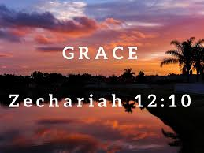
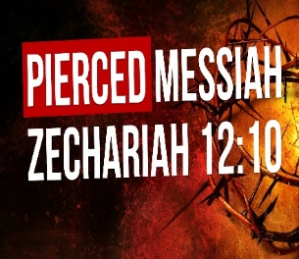
Zechariah 12
(Israel’s Physical & Spiritual Salvation)
Israel’s physical deliverance (12:1-9)
  The nations that will attack Israel (1-3)
  The God who will protect Israel (4-9)
Israel’s spiritual deliverance (12:10-14)
  God’s Spirit: the cause of revival (10a)
  Israel’s remorse: the result of revival (11-14)

Slide 42
Zechariah 12
(Israel’s Physical & Spiritual Salvation)
Israel’s physical deliverance (12:1-9)
  The nations that will attack Israel (1-3)
  The God who will protect Israel (4-9)
Israel’s spiritual deliverance (12:10-14)
  God’s Spirit: the cause of revival (10a)
  Israel’s remorse: the result of revival (11-14)

Slide 43
Zechariah 12
(Israel’s Physical & Spiritual Salvation)
Israel’s physical deliverance (12:1-9)
  The nations who will attack Israel (1-3)
  The God who will protect Israel (4-9)
Israel’s spiritual deliverance (12:10-14)
  God’s Spirit: the cause of revival (10a)
  Israel’s remorse: the result of revival (11-14)

Slide 44

Charles L. Feinberg
God Remembers: A Study of Zechariah (Wheaton: Van Kampen, 1950, p. 218, 222.
“The last section of the latter part of Zechariah’s prophecy deals with events in the distant future…As a portion of the prophetic Scriptures it is second to none in importance in this book or any other Old Testament book. It is indispensable to an understanding of the events of the last days for Israel‒the time of the Great Tribulation and the establishment of God’s kingdom on earth...In the time of our passage all the nations of earth will be bitten by the virus of anti-Semitism.”

Slide 45
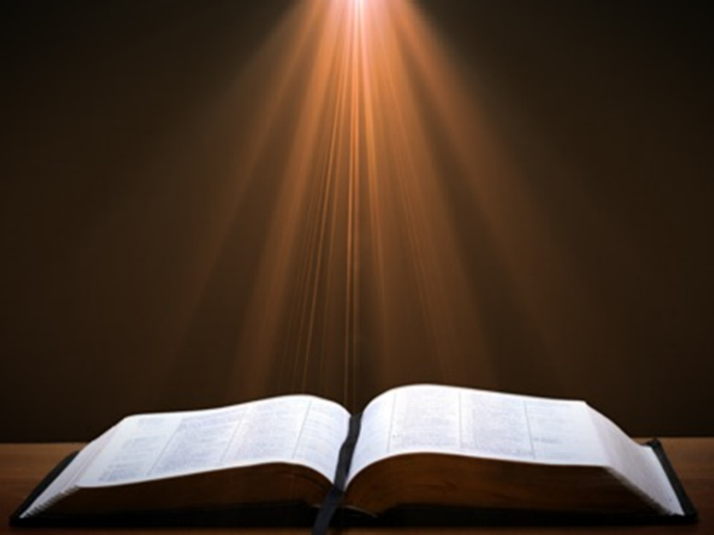
Genesis 1:1-3
“¹ In the beginning God created the heavens and the earth. ² The earth was formless and void, and darkness was over the surface of the deep, and the Spirit of God was moving over the surface of the waters. ³ Then God said, ‘Let there be light’; and there was light.”

Slide 46
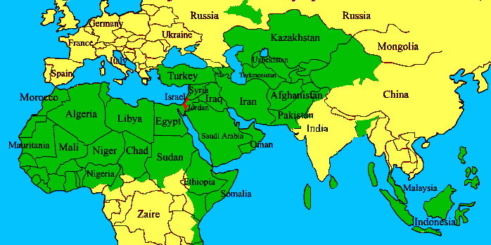
ISRAEL

Slide 47
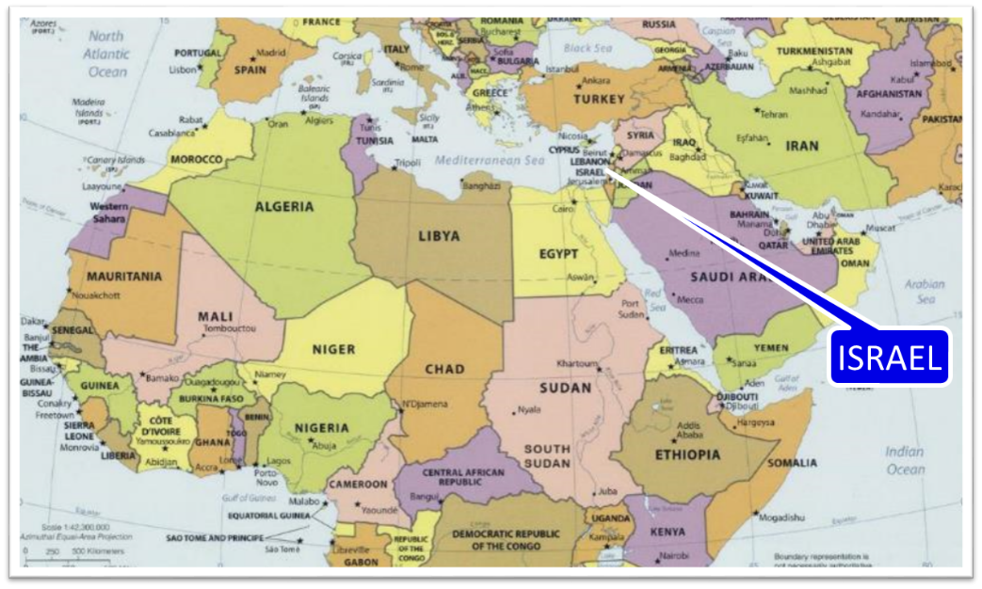

Slide 48

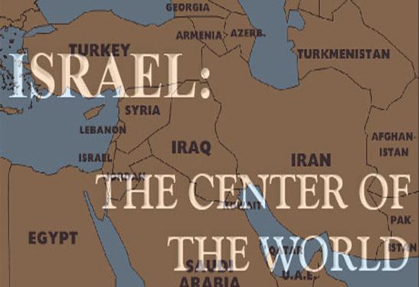
Ezekiel 5:5
“Thus says the Lord God, ‘This is Jerusalem; I have set her at the center of the nations, with lands around her.'”

Slide 49

Ezekiel 38:12
“to capture spoil and to seize plunder, to turn your hand against the waste places which are now inhabited, and against the people who are gathered from the nations, who have acquired cattle and goods, who live at the center of the world.”

Slide 50
Charles L. Feinberg
The Prophecy of Ezekiel: The Glory of the Lord, Paperback ed. (Chicago: Moody, 1969; reprint, Chicago: Moody, 1984), 223.
“An interesting phrase is employed to define the place where God’s people will be dwelling. It is called the middle (literally, the navel) of the earth as explained in 5:5. The land of Israel is in the center of the earth as far as God’s purposes for the world are concerned (cf. Deut. 32:8). Rabbinic literature states: ‘As the navel is set in the center of the human body, so the land of Israel is the navel of the world…Situated in the center of the world, in Jerusalem in the center of the land of Israel, and the sanctuary in the center of Jerusalem, and the holy place in the center of the sanctuary, and the ark in the center of the holy place, and the foundation stone before the holy place, because from it the world was founded.’ Midrash, Tanachma, Qedoshim.”

Slide 51

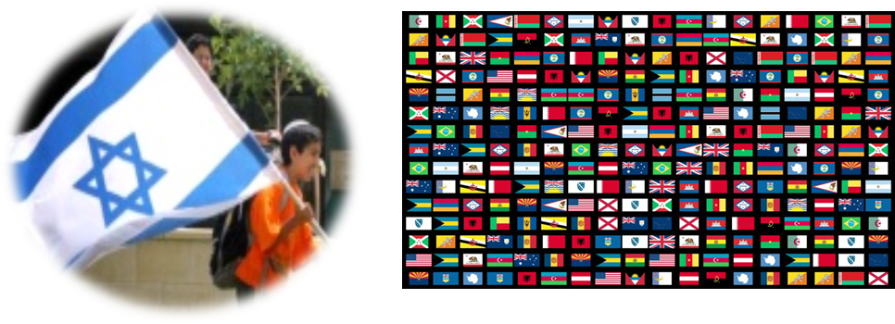
Zechariah 12:3
“³ It will come about in that day that I will make Jerusalem a heavy stone for all the peoples; all who lift it will be severely injured. And all the nations of the earth will be gathered against it.”

Slide 52

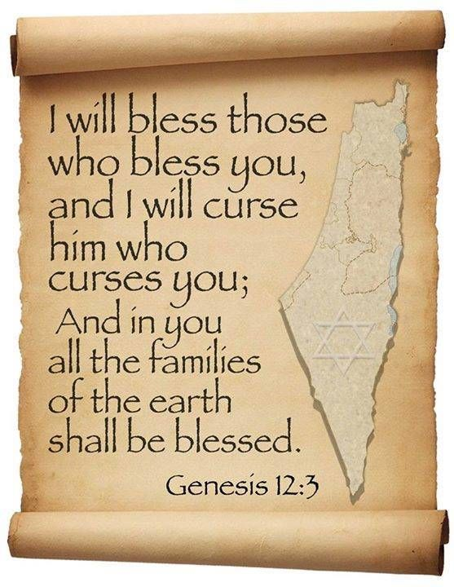
Genesis 12:3
“And I will bless those who bless you, And the one who curses you I will curse. And in you all the families of the earth will be blessed.”

Slide 53
Genesis 12:3
“And I will bless those who bless you, And the one who curses you I will curse. And in you all the families of the earth will be blessed.”

Slide 54
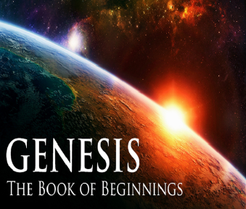
VI. 8 New Promises
Genesis 12:1-3
    Land (Gen. 12:1b)
    Great nation (Gen. 12:2a)
    Personal blessing (Gen. 12:2b)
    Great name (Gen. 12:2c)
    Blessing to others (Gen. 12:2d)
    Blessing to blessers (Gen. 12:3a)
    Cursing to cursers (Gen. 12:3b)
    Blessing to the world (Gen. 12:3c)

Slide 55
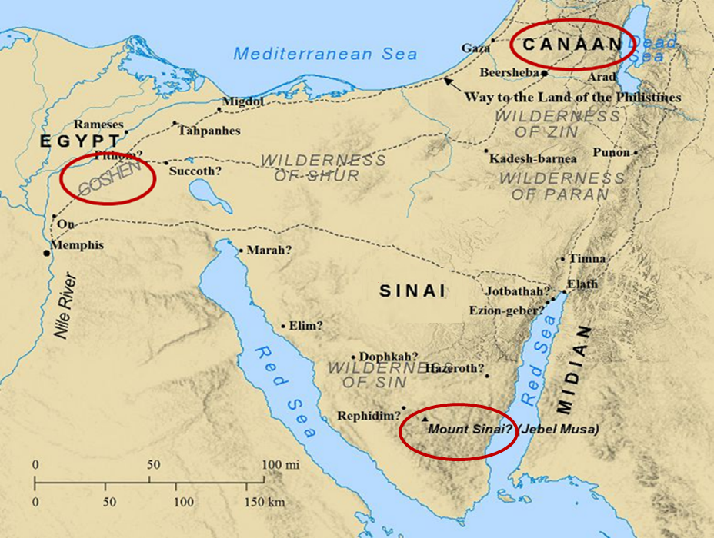

Slide 56

Joel 3:2
“I will gather all the nations And bring them down to the valley of Jehoshaphat. Then I will enter into judgment with them there On behalf of My people and My inheritance, Israel, Whom they have scattered among the nations; And they have divided up My land.”

Slide 57
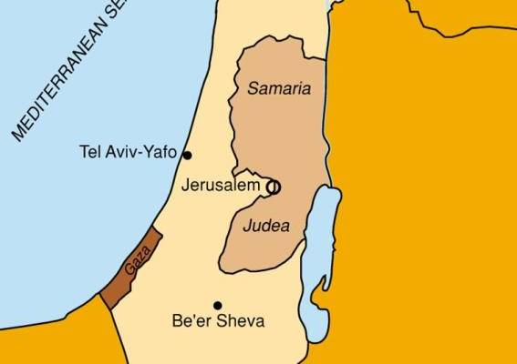

Slide 58
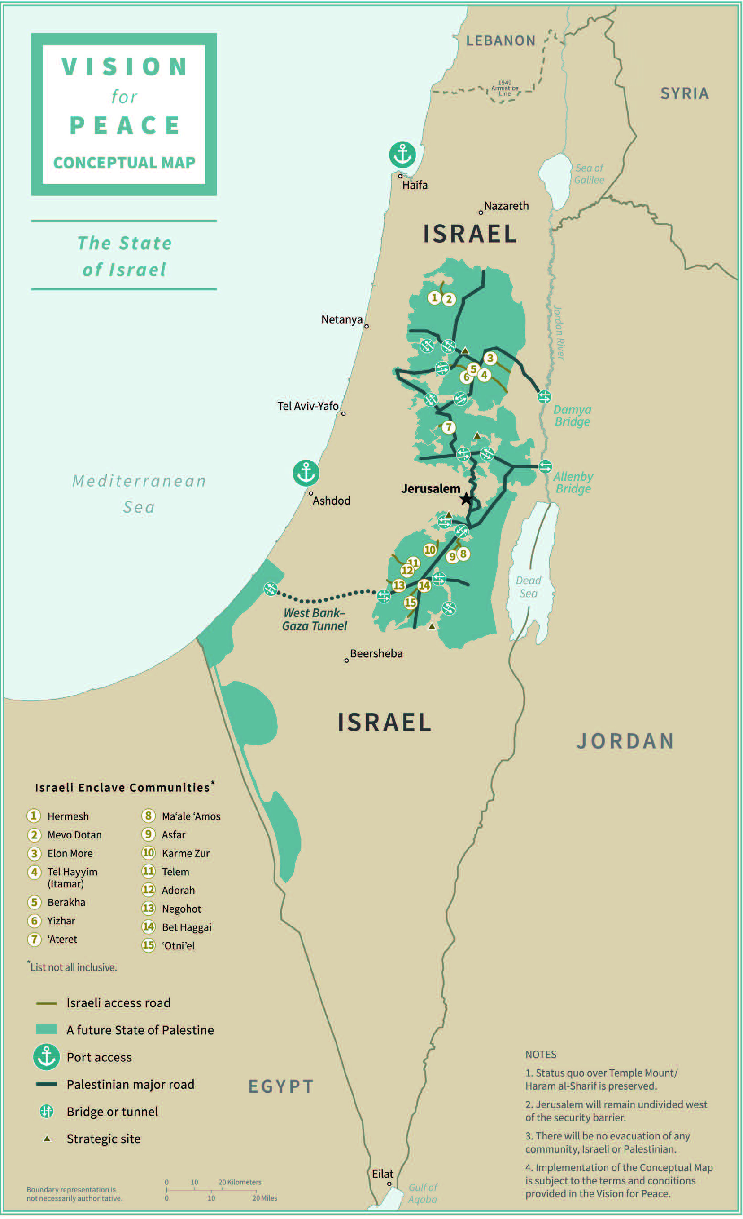

Slide 59
Zechariah 12:3
“³ It will come about in that day that I will make Jerusalem a heavy stone for all the peoples; all who lift it will be severely injured. And all the nations of the earth will be gathered against it.”

Slide 60
Zechariah 14:2
“² For I will gather all the nations against Jerusalem to battle, and the city will be captured, the houses plundered, the women ravished and half of the city exiled, but the rest of the people will not be cut off from the city.”

Slide 61
Zechariah 12
(Israel’s Physical & Spiritual Salvation)
Israel’s physical deliverance (12:1-9)
  The nations that will attack Israel (1-3)
  The God who will protect Israel (4-9)
Israel’s spiritual deliverance (12:10-14)
  God’s Spirit: the cause of revival (10a)
  Israel’s remorse: the result of revival (11-14)

Slide 62
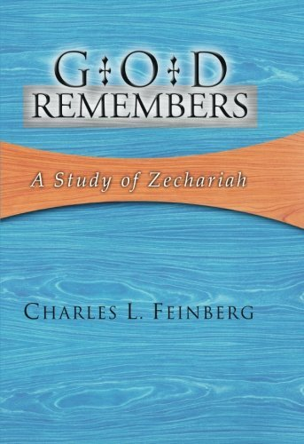
Charles L. Feinberg
God Remembers: A Study of Zechariah (Wheaton: Van Kampen, 1950, p. 223.
“The seriousness of this blow to the armies of the enemy will be readily understood when it is remembered that Calvary held a large place in Eastern warfare. Imagine the confusion in the ranks of the beleaguering armies when their horses are thrown into deadly freight and are blinded, and the horsemen are smitten with madness.”

Slide 63
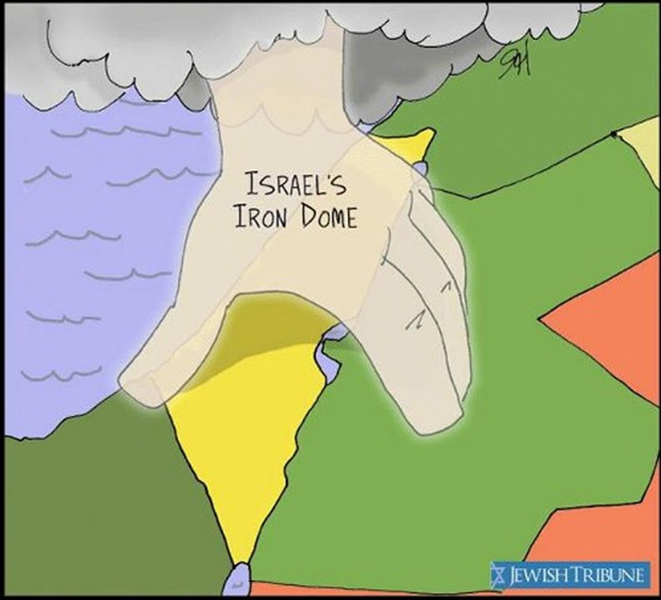

Slide 64

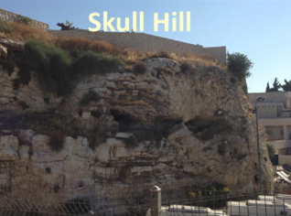
Revelation 11:8
“And their dead bodies will lie in the street of the great city which mystically is called Sodom and Egypt, where also their Lord was crucified.”

Slide 65
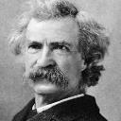
Mark Twain
The Innocents Abroad, Complete, 1st ed. (A Public Domain Book, 1869), 267, 285, 302. These quotes can be found in chapters 47, 49, 52.
“... A desolate country whose soil is rich enough, but is given over wholly to weeds… a silent mournful expanse…. a desolation is here that not even imagination can grace with the pomp of life and action…. we never saw a human being on the whole route…. there was hardly a tree or shrub anywhere. Even the olive tree and the cactus, those fast friends of a worthless soil, had almost deserted the country.”

Slide 66
Why?
COUNTRY | GROSS DOMESTIC PRODUCT
ISRAEL | $123 BILLION
Egypt | $81 billion
Syria | $26 billion
Lebanon | $21 billion
Jordan | $12 billion
Source: CIA World Fact Book, 2005

Slide 67
Why?
COUNTRY | GROSS DOMESTIC PRODUCT (in U.S. $)
ISRAEL | $467 BILLION
Egypt | $396 billion
Jordan | $45 billion
Lebanon | $19 billion
Syria (no data after 2010) | $60 billion (est. 2010)
Source: I.M.F., 2021

Slide 68

Ezekiel 38:12
“to capture spoil and to seize plunder, to turn your hand against the waste places which are now inhabited, and against the people who are gathered from the nations, who have acquired cattle and goods, who live at the center of the world.”

Slide 69

Ezekiel 36:24-26
²⁴ “For I will take you from the nations, gather you from all the lands and bring you into your own land. ²⁵ Then I will sprinkle clean water on you, and you will be clean; I will cleanse you from all your filthiness and from all your idols. ²⁶ Moreover, I will give you a new heart and put a new spirit within you; and I will remove the heart of stone from your flesh and give you a heart of flesh.”

Slide 70
Charles L. Feinberg
God Remembers: A Study of Zechariah (Wheaton: Van Kampen, 1950, p. 223.
“The tents of Judah will be saved first...[this] probably indicates their defenselessness…God will work so that human pride will not be indulged.…The Lord will deliver the defenseless country before the fortified and well defended capital, so that both may realize that the victory is of the Lord.”

Slide 71
Zechariah 12
(Israel’s Physical & Spiritual Salvation)
Israel’s physical deliverance (12:1-9)
  The nations that will attack Israel (1-3)
  The God who will protect Israel (4-9)
Israel’s spiritual deliverance (12:10-14)
  God’s Spirit: the cause of revival (10a)
  Israel’s remorse: the result of revival (11-14)

Slide 72
Zechariah 12
(Israel’s Physical & Spiritual Salvation)
Israel’s physical deliverance (12:1-9)
  The nations that will attack Israel (1-3)
  The God who will protect Israel (4-9)
Israel’s spiritual deliverance (12:10-14)
  God’s Spirit: the cause of revival (10a)
  Israel’s remorse: the result of revival (11-14)

Slide 73

Ezekiel 36:24-28
“For I will take you from the nations, gather you from all the lands and bring you into your own land. ²⁵ Then I will sprinkle clean water on you, and you will be clean; I will cleanse you from all your filthiness and from all your idols. ²⁶ Moreover, I will give you a new heart and put a new spirit within you; and I will remove the heart of stone from your flesh and give you a heart of flesh. ²⁷ I will put My Spirit within you and cause you to walk in My statutes, and you will be careful to observe My ordinances. ²⁸ You will live in the land that I gave to your forefathers; so you will be My people, and I will be your God.”

Slide 74
Ezekiel 37:7-11
So I prophesied as I was commanded; and as I prophesied, there was a noise, and behold, a rattling; and the bones came together, bone to its bone. ⁸ And I looked, and behold, sinews were on them, and flesh grew and skin covered them; but there was no breath in them. ⁹ Then He said to me, “Prophesy to the breath, prophesy, son of man, and say to the breath, ‘Thus says the Lord God, “Come from the four winds, O breath, and breathe on these slain, that they come to life.”’” ¹⁰ So I prophesied as He . . .

Slide 75
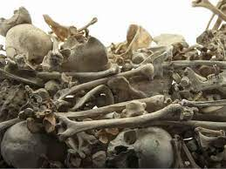
Ezekiel 37:7-11
. . . commanded me, and the breath came into them, and they came to life and stood on their feet, an exceedingly great army. ¹¹ Then He said to me, “Son of man, these bones are the whole house of Israel; behold, they say, ‘Our bones are dried up and our hope has perished. We are completely cut off’.”

Slide 76
Israel’s Two Regatherings
THE PRESENT (FIRST) REGATHERING | THE PERMANENT (SECOND) REGATHERING
Return to part of the land | Return to all the land
Return in unbelief | Return in faith
Restored to the land only | Restored to the land and the Lord
Sets the stage for Tribulation (discipline) | Sets the stage for Millennium (blessing)
Adapted from: Price, Jerusalem In Prophecy, 219

Slide 77
OT Prophecies About Christ
Prophecy | Scripture | Years in Advance
Manner of Birth | Isaiah 7:14 | 700 years
Place of Birth | Micah 5:2 | 700 years
Nationality | Numbers 24:17 | 1400 years
Tribe | Genesis 49:10 | 1800 years
Time of and Response to His Messiahship | Dan. 9:25-26 | 600 years

Slide 78
OT Prophecies About Christ
Prophecy | Scripture | Years in Advance
Crucified Between Thieves | Isaiah 53:9 | 700 years
Pierced | Isaiah 53:5 | 700 years
No Broken Bones | Psalm 22:17 | 1000 years
Gamble for His Clothing | Psalm 22:18 | 1000 years
Buried in Rich Man’s Tomb | Isaiah 53:9 | 700 years
Notes:
109 prophecies…
Peter Stoner – SCIENCE SPEAKS, An Evaluation of Certain Christian Evidences
To fulfill just 8 prophecies =1 X 10 to the twenty-eighth power!
Can we visualize this with an illustration? Suppose we took an atheistic professor, blindfolded him and covered the state of Texas two feet deep with silver dollars. Then we put a check on one of those silver dollars and mixed them up. The odds of one person fulfilling just these eight prophecies would be the same as this atheistic professor selecting the silver dollar upon which we have placed a check, in his first try.
https://www.bereanpublishers.com/the-odds-of-eight-messianic-prophecies-coming-true/

Slide 79
Zechariah 12
(Israel’s Physical & Spiritual Salvation)
Israel’s physical deliverance (12:1-9)
  The nations that will attack Israel (1-3)
  The God who will protect Israel (4-9)
Israel’s spiritual deliverance (12:10-14)
  God’s Spirit: the cause of revival (10a)
  Israel’s remorse: the result of revival (11-14)

Slide 80
Charles L. Feinberg
God Remembers: A Study of Zechariah (Wheaton: Van Kampen, 1950, p. 223.
“The mourning of Hadadrimmon...in the valley of Megiddo was on the occasion of the slaying of the godly King Josiah by Pharaoh-Necho of Egypt...[2 Chronicles 35:22-27]. The Chronicles passage reveals how great was the lamentation over the king. And rightly so, for ‘this was the greatest sorrow, which had fallen on Judah. Josiah was the last hope of it’s declining kingdom…In Josiah’s death the last gleam of the sunset of Judah faded into night.’”

Slide 81

Zechariah 12:12-13
“¹² The land will mourn, every family by itself; the family of the house of David by itself and their wives by themselves; the family of the house of Nathan by itself and their wives by themselves; ¹³ the family of the house of Levi by itself and their wives by themselves; the family of the Shimeites by itself and their wives by themselves.”

Slide 82
Zechariah 12:12-13
“¹² The land will mourn, every family by itself; the family of the house of David by itself and their wives by themselves; the family of the house of Nathan by itself and their wives by themselves; ¹³ the family of the house of Levi by itself and their wives by themselves; the family of the Shimeites by itself and their wives by themselves.”

Slide 83
Zechariah 12:12-13
“¹² The land will mourn, every family by itself; the family of the house of David by itself and their wives by themselves; the family of the house of Nathan by itself and their wives by themselves; ¹³ the family of the house of Levi by itself and their wives by themselves; the family of the Shimeites by itself and their wives by themselves.”

Slide 84
Zechariah 12:12-13
“¹² The land will mourn, every family by itself; the family of the house of David by itself and their wives by themselves; the family of the house of Nathan by itself and their wives by themselves; ¹³ the family of the house of Levi by itself and their wives by themselves; the family of the Shimeites by itself and their wives by themselves.”

Slide 85
Zechariah 12:12-13
“¹² The land will mourn, every family by itself; the family of the house of David by itself and their wives by themselves; the family of the house of Nathan by itself and their wives by themselves; ¹³ the family of the house of Levi by itself and their wives by themselves; the family of the Shimeites by itself and their wives by themselves.”

Slide 86
Zechariah 12:12-13
“¹² The land will mourn, every family by itself; the family of the house of David by itself and their wives by themselves; the family of the house of Nathan by itself and their wives by themselves; ¹³ the family of the house of Levi by itself and their wives by themselves; the family of the Shimeites by itself and their wives by themselves.”

Slide 87
Zechariah 12:12-13
“¹² The land will mourn, every family by itself; the family of the house of David by itself and their wives by themselves; the family of the house of Nathan by itself and their wives by themselves; ¹³ the family of the house of Levi by itself and their wives by themselves; the family of the Shimeites by itself and their wives by themselves.”

Slide 88
Zechariah 12:12-13
“¹² The land will mourn, every family by itself; the family of the house of David by itself and their wives by themselves; the family of the house of Nathan by itself and their wives by themselves; ¹³ the family of the house of Levi by itself and their wives by themselves; the family of the Shimeites by itself and their wives by themselves.”

Slide 89

Romans 11:25-26
“²⁵ For I do not want you, brethren, to be uninformed of this mystery—so that you will not be wise in your own estimation—that a partial hardening has happened to Israel until the fullness of the Gentiles has come in; ²⁶ and so all Israel will be saved; just as it is written, ‘The Deliverer will come from Zion, He will remove ungodliness from Jacob.’”

Slide 90
The Coming Universal Israeli National Revival
(Zechariah 12:12-13)
David ‒ kings (13a)
Nathan ‒ prophets (13b)
Levi ‒ priests (14a)
Shimeites ‒ ordinary Levites (Num. 3:21)-citizens (14b)

Slide 91
Zechariah 13:8-9
⁸“It will come about in all the land,” Declares the Lord, “That two parts in it will be cut off and perish; But the third will be left in it. ⁹“And I will bring the third part through the fire, Refine them as silver is refined, And test them as gold is tested. They will call on My name, And I will answer them; I will say, ‘They are My people,’ And they will say, ‘The Lord is my God.’ ”

Slide 92

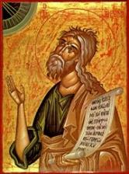
Jeremiah 30:7
“Alas! for that day is great, There is none like it; And it is the time of Jacob’s distress (Gen. 32:8; 35:10), But he will be saved from it.”

Slide 93
Conclusion

Slide 94
Zechariah 12
(Israel’s Physical & Spiritual Salvation)
Israel’s physical deliverance (12:1-9)
  The nations that will attack Israel (1-3)
  The God who will protect Israel (4-9)
Israel’s spiritual deliverance (12:10-14)
  God’s Spirit: the cause of revival (10a)
  Israel’s remorse: the result of revival (11-14)

