Slide 1


Zechariah
God Remembers!

Slide 2

Structure
Introductory call to repentance (1:1-6)
Eight-night visions (1:7–6:15)
Question and answers about fasting (7–8)
Two burdens (9–14)

Slide 3
Structure
Introductory call to repentance (1:1-6)
Eight-night visions (1:7–6:15)
Question and answers about fasting (7–8)
Two burdens (9–14)

Slide 4
ZECHARIAH’S EIGHT NIGHT VISIONS
Vision | Reference | Meaning
The Red-horse Rider among the Myrtles | 1:7-17 | God’s anger against the nations & blessing on restored Israel.
The Four Horns & the Four Craftsmen | 1:18-21 | God’s judgment on the nations that afflict Israel.
The Surveyor with a Measuring Line | Chapter 2 | God’s future blessing on restored Israel.
The Cleansing & Crowning of Joshua the Hight Priest. | Chapter 3 | Israel’s future cleansing from sin & reinstatement as a priestly nation.
The Golden Lampstand & the Two Olive Trees | Chapter 4 | Israel as the light to the nations under Messiah, the King-Priest.
The Flying Scroll | 5:1-4 | The severity & totality of divine judgment on individual Israelites.
The Woman in the Ephah | 5:5-11 | The removal of national Israel’s sin of rebellion against God.
The Four Chariots | 6:1-8 | Divine judgment on Gentile nations.

Slide 5
II. Eight Night Visions
(1:7‒6:15)
  Riders & horses among the myrtle trees (1:7-17)
  Four horns & four craftsmen (1:18-21)
  Man with the measuring line (2)
  Cleansing of the High Priest Joshua (3)
  Lampstand & olive tree (4)
  Flying scroll (5:1-4)
  Woman in the basket (5:5-11)
  Four chariots (6:1-8)
  Conclusion: crowning of Joshua (6:9-15)

Slide 6
Structure
Introductory call to repentance (1:1-6)
Eight-night visions (1:7–6:15)
Question and answers about fasting (7–8)
Two burdens (9–14)

Slide 7
III. Questions & Answers Concerning Fasting
(7‒8)
  Question (7:1-3)
  Four divine answers (7:4‒8:23)
    Condemnation of empty ritualism (7:4-7)
    Condemnation of past covenant failure (7:8-14)
    Prediction of Jerusalem’s restoration (8:1-17)
    Prediction of future blessing (8:18-23)

Slide 8
Structure
Introductory call to repentance (1:1-6)
Eight-night visions (1:7–6:15)
Question and answers about fasting (7–8)
Two burdens (9–14)

Slide 9
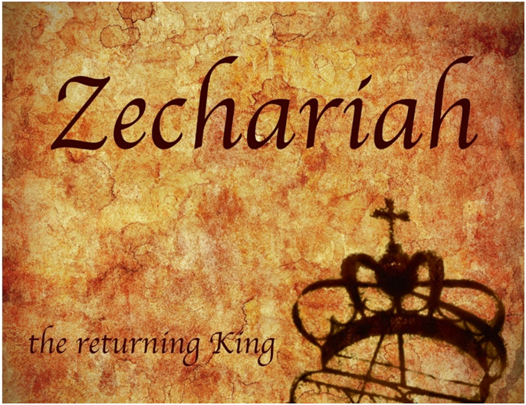
IV. Two Burdens
(9‒14)
  Israel’s postponed deliverance due to her rejection of her Messiah (9‒11)
  Israel’s future deliverance due to her acceptance of her Messiah (12‒14)

Slide 10
IV. Two Burdens
(9‒14)
  Israel’s postponed deliverance due to her rejection of her Messiah (9‒11)
  Israel’s future deliverance due to her acceptance of her Messiah (12‒14)

Slide 11

First Burden Outline
(9‒11)
    Divine warrior hymn (9)
    True shepherd (10)
    False shepherd (11)

Slide 12
First Burden Outline
(9‒11)
    Divine warrior hymn (9)
    True shepherd (10)
    False shepherd (11)

Slide 13
Divine Warrior Hymn
(9:1-17)
Judgment on the oppressing nations (1-8)
Messiah (9-10)
Covenant protection (11-17)

Slide 14
First Burden Outline
(9‒11)
    Divine warrior hymn (9)
    True shepherd (10)
    False shepherd (11)

Slide 15
True Shepherd
(10:1-12)
Messianic prosperity (1-3)
Restoration of the Northern & Southern kingdoms (4-7)
Messianic regathering (8-12)

Slide 16
First Burden Outline
(9‒11)
    Divine warrior hymn (9)
    True shepherd (10)
    False shepherd (11)

Slide 17
False Shepherd
(11:1-17)
The wailing land (1-3)
Reasons for the wailing (4-14)
The coming false shepherd (15-17)

Slide 18
False Shepherd
(11:1-17)
The wailing land (1-3)
Reasons for the wailing (4-14)
The coming false shepherd (15-17)

Slide 19
The Waling Land
(11:1-3)
    Cedars of Lebanon (1)
    Cypress & Oaks of Bashan (2)
    Shepherds & Lions (3)

Slide 20
The Waling Land
(11:1-3)
    Cedars of Lebanon (1)
    Cypress & Oaks of Bashan (2)
    Shepherds & Lions (3)

Slide 21
The Waling Land
(11:1-3)
    Cedars of Lebanon (1)
    Cypress & Oaks of Bashan (2)
    Shepherds & Lions (3)

Slide 22
The Waling Land
(11:1-3)
    Cedars of Lebanon (1)
    Cypress & Oaks of Bashan (2)
    Shepherds & Lions (3)

Slide 23
False Shepherd
(11:1-17)
The wailing land (1-3)
Reasons for the wailing (4-14)
The coming false shepherd (15-17)

Slide 24
Reasons for the Waling
(11:4-14)
    Zechariah pastors the doomed flock (4-7)
    God no longer favors the flock (8-11)
    Israel to reject her Messiah (12-13)
    Cessation of the nation’s unity (14)

Slide 25
Reasons for the Waling
(11:4-14)
    Zechariah pastors the doomed flock (4-7)
    God no longer favors the flock (8-11)
    Israel to reject her Messiah (12-13)
    Cessation of the nation’s unity (14)

Slide 26
Six Parts of a Suzerain-Vassal Treaty in Deuteronomy
Preamble (1:1-5)
Prologue (1:6–4:40)
Covenant obligations (5–26)
Storage and reading instructions (27:2-3; 31:9, 24, 26)
Witnesses (32:1)
Blessings and curses (28)

Slide 27


Genesis 12:3
“And I will bless those who bless you, And the one who curses you I will curse. And in you all the families of the earth will be blessed.”

Slide 28

8 New Promises
Genesis 12:1-3
    Land (Gen. 12:1b)
    Great nation (Gen. 12:2a)
    Personal blessing (Gen. 12:2b)
    Great name (Gen. 12:2c)
    Blessing to others (Gen. 12:2d)
    Blessing to blessers (Gen. 12:3a)
    Cursing to cursers (Gen. 12:3b)
    Blessing to the world (Gen. 12:3c)

Slide 29

Deuteronomy 28:49-50
⁴⁹ “The Lord will bring a nation against you from far away, from the end of the earth, as the eagle swoops down; a nation whose language you will not understand, ⁵⁰ a nation with a defiant attitude, who will have no respect for the old, nor show favor to the young.”

Slide 30
Israel's Judgments
Division of the kingdom in 931 B.C. (1 Kgs. 12)
Assyrian judgment in 722 B.C. (2 Kgs. 17)
Babylonian captivity in 586 B.C. (2 Kgs. 25)
Rome Diaspora in A.D. 70 (Luke 19:41-44)

Slide 31
Merrill F. Unger
Unger, Merrill F. Zechariah. Grand Rapids: Zondervan Publishing House, 1963. p. 194.
“The Eastern shepherd carried a rod or stout club hewed from a tree to beat away wild beasts attacking the sheep and a crooked staff for retrieving the sheep from difficult places [cf. Ps. 23:4].”

Slide 32
Israel's Judgments
Division of the kingdom in 931 B.C. (1 Kgs. 12)
Assyrian judgment in 722 B.C. (2 Kgs. 17)
Babylonian captivity in 586 B.C. (2 Kgs. 25)
Rome Diaspora in A.D. 70 (Luke 19:41-44)

Slide 33
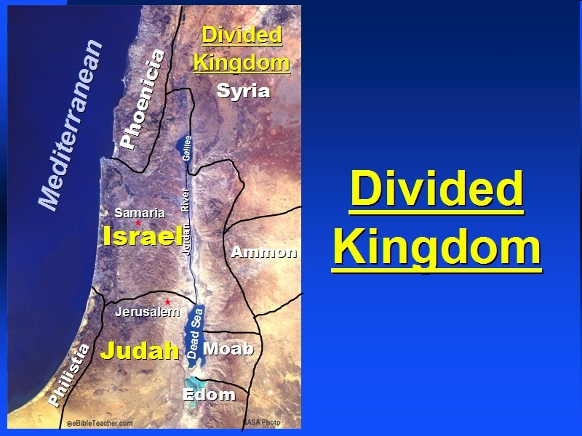

Slide 34
Ezekiel 37
Vision: Valley of the Dry Bones (1-14)
  Vision (1-10)
  Interpretation (11-14)
Sign: Two Sticks (15-28)
  Sign (15-17)
  Interpretation (18-28)

Slide 35
Reasons for the Waling
(11:4-14)
    Zechariah pastors the doomed flock (4-7)
    God no longer favors the flock (8-11)
    Israel to reject her Messiah (12-13)
    Cessation of the nation’s unity (14)

Slide 36
Joyce Baldwin
Baldwin, Joyce G. Haggai, Zechariah, Malachi: An Introduction and Commentary. Tyndale Old Testament Commentaries series. Leicester, Eng., and Downers Grove, Ill.: Inter-Varsity Press, 1972. Page 181.
“…probably the most enigmatic in the whole Old Testament.”

Slide 37
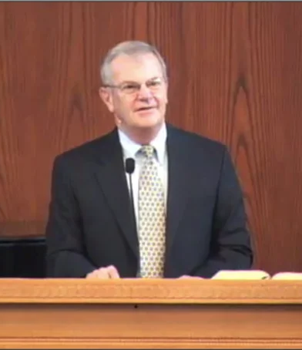
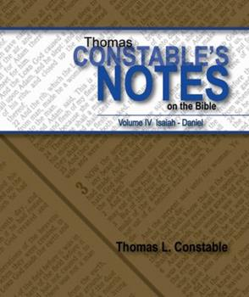
Thomas L. Constable
Constable’s online notes on Zechariah, p. 106-107.
“Zechariah, as God's representative, did away with ‘three shepherds’ that had been leading his flock within the first ‘month’ that he took charge of the sheep. These appear to have been real shepherds and a real month. At the very least, Zechariah's action prefigured that of Messiah, in taking over the leadership of His flock from other leaders of Israel who did not appreciate His leadership. Who these shepherds were or will be has been the subject of much debate.”

Slide 38
Merrill F. Unger
Unger, Merrill F. Zechariah. Grand Rapids: Zondervan Publishing House, 1963. p. 195.
“‘…the only construction which is at all to any notice, is that which regards the language as descriptive of the three rulers in the Jewish state – the priests, the teachers of the law, and the civil magistrates.’ These were the people of influential prestige by whom the nation’s affairs were managed and to whose wickedness, which reached its acme when they crucified the Messiah, the destruction of the state is to be ascribed. The one month…can best be understood as referring to the period of culminating unbelief just before the national leaders crucified our Lord and thus sealed the fate of the Jewish state. During this period the nation rejected our Lord, and the Lord rejected the nation by disavowing its leaders.”

Slide 39

Evidence of Abrahamic Covenant’s Unconditional Nature
ANE covenant ratification ceremony (Gen 15)
Lack of stated conditions for Israel’s obedience (Gen 15)
Covenant's eternality (Gen 17:7, 13, 19; Ps. 90:2)
Covenant's immutability (Heb 6:13-18; Mal. 3:6)
Trans-generational reaffirmation despite perpetual national disobedience (Jer 31:35-37)
Walvoord, The Millennial Kingdom, 149-52

Slide 40


Slide 41
H. C. Leupold
H.C. Leupold, Exposition of Zechariah, 214.
“The term 'covenant' is here used in a looser sense, not as descriptive of a formal agreement entered into by contracting parties, but to indicate that, when the peoples round about Israel did her no harm, this was due to the fact that God had put them under as strong a restraint as might be exerted upon a nation by a covenant solemnly sworn to.”

Slide 42
Thomas L. Constable
Constable’s online notes on Zechariah, p. 108-109.
“The faithful Israelites who were listening to Zechariah, ‘the afflicted of’ God's ‘flock’(cf. v. 7), realized that what he had done in breaking the staff was in harmony with ‘the word of the LORD.’”

Slide 43
Six Parts of a Suzerain-Vassal Treaty in Deuteronomy
Preamble (1:1-5)
Prologue (1:6–4:40)
Covenant obligations (5–26)
Storage and reading instructions (27:2-3; 31:9, 24, 26)
Witnesses (32:1)
Blessings and curses (28)

Slide 44
Deuteronomy 28:49-50
⁴⁹ “The Lord will bring a nation against you from far away, from the end of the earth, as the eagle swoops down; a nation whose language you will not understand, ⁵⁰ a nation with a defiant attitude, who will have no respect for the old, nor show favor to the young.”

Slide 45
Reasons for the Waling
(11:4-14)
    Zechariah pastors the doomed flock (4-7)
    God no longer favors the flock (8-11)
    Israel to reject her Messiah (12-13)
    Cessation of the nation’s unity (14)

Slide 46
Thomas L. Constable
Constable’s online notes on Zechariah, p. 109-110.
“The Lord instructed Zechariah to ‘throw’ the 30 shekels of silver ‘to the potter’ since it was, sarcastically, such a handsome (‘magnificent’) price. His service had been worth far more than that…Throwing something to the potter was evidently a proverbial way of expressing disdain for it, since potters were typically poor and lowly craftsmen.”

Slide 47
J. Vernon McGee
McGee, J. Vernon. Thru the Bible with J. Vernon McGee. 5 vols. Pasadena, Calif.: Thru The Bible Radio; and Nashville: Thomas Nelson, Inc., 1983. P. 3:968.
“It is credited to Jeremiah simply because in Jesus' day Jeremiah was the first of the books of the prophets, and that section was identified by the name of the first book.”

Slide 48
Reasons for the Waling
(11:4-14)
    Zechariah pastors the doomed flock (4-7)
    God no longer favors the flock (8-11)
    Israel to reject her Messiah (12-13)
    Cessation of the nation’s unity (14)

Slide 49
Israel's Judgments
Division of the kingdom in 931 B.C. (1 Kgs. 12)
Assyrian judgment in 722 B.C. (2 Kgs. 17)
Babylonian captivity in 586 B.C. (2 Kgs. 25)
Rome Diaspora in A.D. 70 (Luke 19:41-44)

Slide 51
Ezekiel 37
Vision: Valley of the Dry Bones (1-14)
  Vision (1-10)
  Interpretation (11-14)
Sign: Two Sticks (15-28)
  Sign (15-17)
  Interpretation (18-28)

Slide 52
False Shepherd
(11:1-17)
The wailing land (1-3)
Reasons for the wailing (4-14)
The coming false shepherd (15-17)

Slide 53
The Coming False Shepherd
(11:15-17)
    Raised up (15-16)
    Destroyed (17)

Slide 54
The Coming False Shepherd
(11:15-17)
    Raised up (15-16)
    Destroyed (17)

Slide 55
Thomas L. Constable
Constable’s online notes on Zechariah, p. 112.
“The Lord next directed Zechariah to present himself as a ‘foolish’ (worthless, v. 17, i.e., morally deficient, cf. Prov. 1:7) ‘shepherd,’ since his flock had rejected the Good Shepherd (cf. Ezek. 34:3-4).”

Slide 56
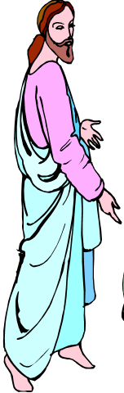
7 “I AM” statements in John
I am the Bread of Life | 6:35
I am the Light of the world | 8:12
I am the Gate for the sheep | 10:7; cf. v.9
I am the Good Shepherd | 10:11,14
I am the Resurrection and the Life | 11:25
I am the Way and the Truth and the Life | 14:6
I am the true Vine | 15:1; cf. v.5

Slide 57
Thomas L. Constable
Constable’s online notes on Zechariah, p. 112.
“Tearing off the hoofs of the sheep probably represents the avaricious shepherd, searching for the last edible morsel that he can extract from his charges whom he has consumed.”

Slide 58
The Coming False Shepherd
(11:15-17)
    Raised up (15-16)
    Destroyed (17)

Slide 59
Eugene Merrill
Commentary on Zechariah, p. 303.
“However, the ultimate fulfillment must be the Antichrist, who will make a covenant with Israel—but then break it and proceed to persecute the Jews (Ezek. 34:2-4; Dan. 9:27; 11:36-39; John 5:43; 2 Thess. 2:3-10; Rev. 13:1-8). Perhaps the whole collective leadership of Israel, from Zechariah's time forward— culminating in Antichrist—is in view.”

Slide 60
Merrill F. Unger
Unger, Merrill F. Zechariah. Grand Rapids: Zondervan Publishing House, 1963. p. 205.
“With this climactic scene the first prophetic burden describing the first advent and rejection of Messiah, the Shepherd-King (chapters 9—11) comes to a close. The way is thus opened for the second burden and the second advent and acceptance of Messiah, the King (chapters 12—14).”

Slide 61
IV. Two Burdens
(9‒14)
  Israel’s postponed deliverance due to her rejection of her Messiah (9‒11)
  Israel’s future deliverance due to her acceptance of her Messiah (12‒14)

Slide 62
IV. Two Burdens
(9‒14)
  Israel’s postponed deliverance due to her rejection of her Messiah (9‒11)
  Israel’s future deliverance due to her acceptance of her Messiah (12‒14)

Slide 63
Conclusion

Slide 64
First Burden Outline
(9‒11)
    Divine warrior hymn (9)
    True shepherd (10)
    False shepherd (11)

Slide 65
False Shepherd
(11:1-17)
The wailing land (1-3)
Reasons for the wailing (4-14)
The coming false shepherd (15-17)

Slide 66
IV. Two Burdens
(9‒14)
  Israel’s postponed deliverance due to her rejection of her Messiah (9‒11)
  Israel’s future deliverance due to her acceptance of her Messiah (12‒14)

