Slide 1


Zechariah
God Remembers!

Slide 2

Structure
Introductory call to repentance (1:1-6)
Eight-night visions (1:7–6:15)
Question and answers about fasting (7–8)
Two burdens (9–14)

Slide 3
Structure
Introductory call to repentance (1:1-6)
Eight-night visions (1:7–6:15)
Question and answers about fasting (7–8)
Two burdens (9–14)

Slide 4
ZECHARIAH’S EIGHT NIGHT VISIONS
Vision | Reference | Meaning
The Red-horse Rider among the Myrtles | 1:7-17 | God’s anger against the nations & blessing on restored Israel.
The Four Horns & the Four Craftsmen | 1:18-21 | God’s judgment on the nations that afflict Israel.
The Surveyor with a Measuring Line | Chapter 2 | God’s future blessing on restored Israel.
The Cleansing & Crowning of Joshua the Hight Priest. | Chapter 3 | Israel’s future cleansing from sin & reinstatement as a priestly nation.
The Golden Lampstand & the Two Olive Trees | Chapter 4 | Israel as the light to the nations under Messiah, the King-Priest.
The Flying Scroll | 5:1-4 | The severity & totality of divine judgment on individual Israelites.
The Woman in the Ephah | 5:5-11 | The removal of national Israel’s sin of rebellion against God.
The Four Chariots | 6:1-8 | Divine judgment on Gentile nations.

Slide 5
II. Eight Night Visions
(1:7‒6:15)
  Riders & horses among the myrtle trees (1:7-17)
  Four horns & four craftsmen (1:18-21)
  Man with the measuring line (2)
  Cleansing of the High Priest Joshua (3)
  Lampstand & olive tree (4)
  Flying scroll (5:1-4)
  Woman in the basket (5:5-11)
  Four chariots (6:1-8)
  Conclusion: crowning of Joshua (6:9-15)

Slide 6
Structure
Introductory call to repentance (1:1-6)
Eight-night visions (1:7–6:15)
Question and answers about fasting (7–8)
Two burdens (9–14)

Slide 7
III. Questions & Answers Concerning Fasting
(7‒8)
  Question (7:1-3)
  Four divine answers (7:4‒8:23)
    Condemnation of empty ritualism (7:4-7)
    Condemnation of past covenant failure (7:8-14)
    Prediction of Jerusalem’s restoration (8:1-17)
    Prediction of future blessing (8:18-23)

Slide 8
Structure
Introductory call to repentance (1:1-6)
Eight-night visions (1:7–6:15)
Question and answers about fasting (7–8)
Two burdens (9–14)

Slide 9
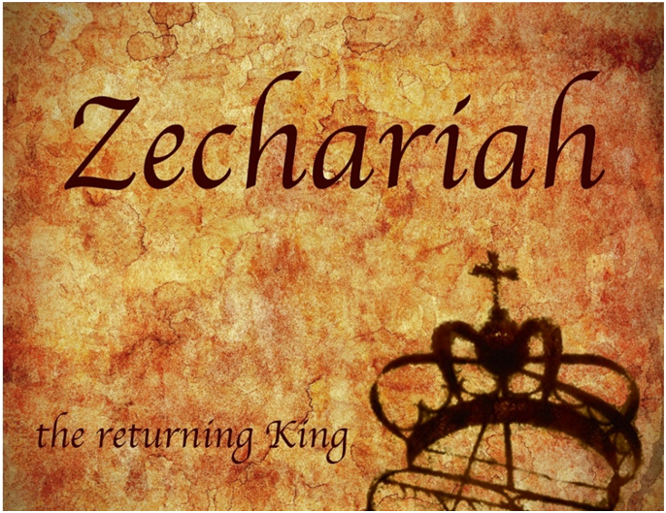
IV. Two Burdens
(9‒14)
  Israel’s postponed deliverance due to her rejection of her Messiah (9‒11)
  Israel’s future deliverance due to her acceptance of her Messiah (12‒14)

Slide 10
IV. Two Burdens
(9‒14)
  Israel’s postponed deliverance due to her rejection of her Messiah (9‒11)
  Israel’s future deliverance due to her acceptance of her Messiah (12‒14)

Slide 11

First Burden Outline
(9‒11)
    Divine warrior hymn (9)
    True shepherd (10)
    False shepherd (11)

Slide 12
First Burden Outline
(9‒11)
    Divine warrior hymn (9)
    True shepherd (10)
    False shepherd (11)

Slide 13
Divine Warrior Hymn
(9:1-17)
Judgment on the oppressing nations (1-8)
Messiah (9-10)
Covenant protection (11-17)

Slide 14
First Burden Outline
(9‒11)
    Divine warrior hymn (9)
    True shepherd (10)
    False shepherd (11)

Slide 15
True Shepherd
(10:1-12)
Messianic prosperity (1-3)
Restoration of the Northern & Southern kingdoms (4-7)
Messianic regathering (8-12)

Slide 16
True Shepherd
(10:1-12)
Messianic prosperity (1-3)
Restoration of the Northern & Southern kingdoms (4-7)
Messianic regathering (8-12)

Slide 17
Messianic Prosperity
(10:1-3)
    Challenge (1)
    Idols inhibiting prosperity (2)
    True shepherd to judge the false shepherds (3)

Slide 18
Messianic Prosperity
(10:1-3)
    Challenge (1)
    Idols inhibiting prosperity (2)
    True shepherd to judge the false shepherds (3)

Slide 19
True Shepherd
(10:1-12)
Messianic prosperity (1-3)
Restoration of the Northern & Southern kingdoms (4-7)
Messianic regathering (8-12)

Slide 20
Restoration of the N & S Kingdoms
(10:4-7)
    The king (4-5)
    The kingdoms (6-7)

Slide 21
Restoration of the N & S Kingdoms
(10:4-7)
    The king (4-5)
    The kingdoms (6-7)

Slide 22
Merrill F. Unger
Unger, Merrill F. Zechariah. Grand Rapids: Zondervan Publishing House, 1963. p. 180.
“The scene is that of the strengthening of the Jews in Palestine [Israel] at the time of the invasion from the North under 'the beast' (Dan. 7:8) in conjunction with the events of Armageddon (Rev. 16:14; 19:17-20).”

Slide 23
Restoration of the N & S Kingdoms
(10:4-7)
    The king (4-5)
    The kingdoms (6-7)

Slide 24
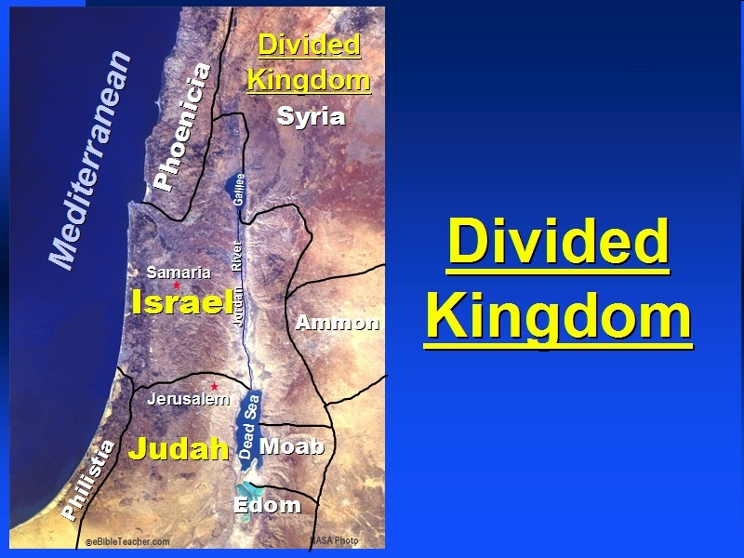

Slide 25
Six Parts of a Suzerain-Vassal Treaty in Deuteronomy
Preamble (1:1-5)
Prologue (1:6–4:40)
Covenant obligations (5–26)
Storage and reading instructions (27:2-3; 31:9, 24, 26)
Witnesses (32:1)
Blessings and curses (28)

Slide 26
Israel's Judgments
Division of the kingdom in 931 B.C. (1 Kgs. 12)
Assyrian judgment in 722 B.C. (2 Kgs. 17)
Babylonian captivity in 586 B.C. (2 Kgs. 25)
Rome Diaspora in A.D. 70 (Luke 19:41-44)

Slide 27
Ezekiel 37
Vision: Valley of the Dry Bones (1-14)
  Vision (1-10)
  Interpretation (11-14)
Sign: Two Sticks (15-28)
  Sign (15-17)
  Interpretation (18-28)

Slide 28
Israel's Judgments
Division of the kingdom in 931 B.C. (1 Kgs. 12)
Assyrian judgment in 722 B.C. (2 Kgs. 17)
Babylonian captivity in 586 B.C. (2 Kgs. 25)
Rome Diaspora in A.D. 70 (Luke 19:41-44)

Slide 29
True Shepherd
(10:1-12)
Messianic prosperity (1-3)
Restoration of the Northern & Southern kingdoms (4-7)
Messianic regathering (8-12)

Slide 30
Messianic Regathering
(10:8-12)
    The regathering (8-9)
    The geography (10-11)
    The strengthening (12)

Slide 31
Messianic Regathering
(10:8-12)
    The regathering (8-9)
    The geography (10-11)
    The strengthening (12)

Slide 32
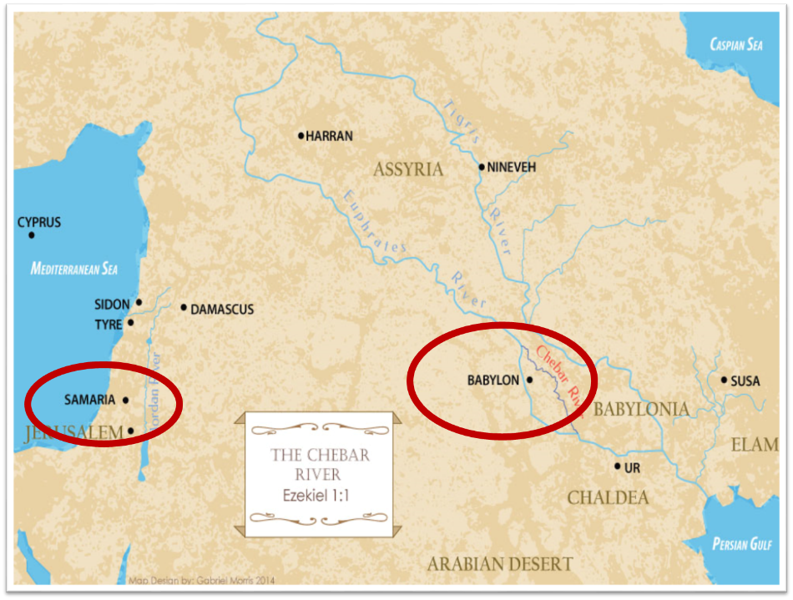

Slide 33
Messianic Regathering
(10:8-12)
    The regathering (8-9)
    The geography (10-11)
    The strengthening (12)

Slide 34


Slide 39


Genesis 12:3
“And I will bless those who bless you, And the one who curses you I will curse. And in you all the families of the earth will be blessed.”

Slide 40

VI. 8 New Promises
Genesis 12:1-3
    Land (Gen. 12:1b)
    Great nation (Gen. 12:2a)
    Personal blessing (Gen. 12:2b)
    Great name (Gen. 12:2c)
    Blessing to others (Gen. 12:2d)
    Blessing to blessers (Gen. 12:3a)
    Cursing to cursers (Gen. 12:3b)
    Blessing to the world (Gen. 12:3c)

Slide 41
Messianic Regathering
(10:8-12)
    The regathering (8-9)
    The geography (10-11)
    The strengthening (12)

Slide 42
Conclusion

Slide 43
First Burden Outline
(9‒11)
    Divine warrior hymn (9)
    True shepherd (10)
    False shepherd (11)

Slide 44
True Shepherd
(10:1-12)
Messianic prosperity (1-3)
Restoration of the Northern & Southern kingdoms (4-7)
Messianic regathering (11-17)

Slide 45
First Burden Outline
(9‒11)
    Divine warrior hymn (9)
    True shepherd (10)
    False shepherd (11)

