Slide 1


Zechariah
God Remembers!

Slide 2

Structure
Introductory call to repentance (1:1-6)
Eight-night visions (1:7–6:15)
Question and answers about fasting (7–8)
Two burdens (9–14)

Slide 3
Structure
Introductory call to repentance (1:1-6)
Eight-night visions (1:7–6:15)
Question and answers about fasting (7–8)
Two burdens (9–14)

Slide 4
ZECHARIAH’S EIGHT NIGHT VISIONS
Vision | Reference | Meaning
The Red-horse Rider among the Myrtles | 1:7-17 | God’s anger against the nations & blessing on restored Israel.
The Four Horns & the Four Craftsmen | 1:18-21 | God’s judgment on the nations that afflict Israel.
The Surveyor with a Measuring Line | Chapter 2 | God’s future blessing on restored Israel.
The Cleansing & Crowning of Joshua the Hight Priest. | Chapter 3 | Israel’s future cleansing from sin & reinstatement as a priestly nation.
The Golden Lampstand & the Two Olive Trees | Chapter 4 | Israel as the light to the nations under Messiah, the King-Priest.
The Flying Scroll | 5:1-4 | The severity & totality of divine judgment on individual Israelites.
The Woman in the Ephah | 5:5-11 | The removal of national Israel’s sin of rebellion against God.
The Four Chariots | 6:1-8 | Divine judgment on Gentile nations.

Slide 5
II. Eight Night Visions
(1:7‒6:15)
  Riders & horses among the myrtle trees (1:7-17)
  Four horns & four craftsmen (1:18-21)
  Man with the measuring line (2)
  Cleansing of the High Priest Joshua (3)
  Lampstand & olive tree (4)
  Flying scroll (5:1-4)
  Woman in the basket (5:5-11)
  Four chariots (6:1-8)
  Conclusion: crowning of Joshua (6:9-15)

Slide 6
Structure
Introductory call to repentance (1:1-6)
Eight-night visions (1:7–6:15)
Question and answers about fasting (7–8)
Two burdens (9–14)

Slide 7
III. Questions & Answers Concerning Fasting
(7‒8)
  Question (7:1-3)
  Four divine answers (7:4‒8:23)
    Condemnation of empty ritualism (7:4-7)
    Condemnation of past covenant failure (7:8-14)
    Prediction of Jerusalem’s restoration (8:1-17)
    Prediction of future blessing (8:18-23)

Slide 8
Structure
Introductory call to repentance (1:1-6)
Eight-night visions (1:7–6:15)
Question and answers about fasting (7–8)
Two burdens (9–14)

Slide 9
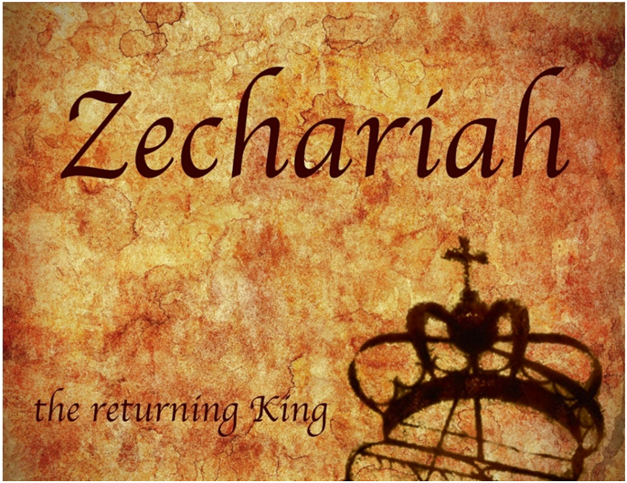
IV. Two Burdens
(9‒14)
  Israel’s postponed deliverance due to her rejection of her Messiah (9‒11)
  Israel’s future deliverance due to her acceptance of her Messiah (12‒14)

Slide 10
IV. Two Burdens
(9‒14)
  Israel’s postponed deliverance due to her rejection of her Messiah (9‒11)
  Israel’s future deliverance due to her acceptance of her Messiah (12‒14)

Slide 11

First Burden Outline
(9‒11)
    Divine warrior hymn (9)
    True shepherd (10)
    False shepherd (11)

Slide 12
First Burden Outline
(9‒11)
    Divine warrior hymn (9)
    True shepherd (10)
    False shepherd (11)

Slide 13
Divine Warrior Hymn
(9:1-17)
Judgment on the oppressing nations (1-8)
Messiah (9-10)
Covenant protection (11-17)

Slide 14
First Burden Outline
(9‒11)
    Divine warrior hymn (9)
    True shepherd (10)
    False shepherd (11)

Slide 15
True Shepherd
(10:1-12)
Messianic prosperity (1-3)
Restoration of the Northern & Southern kingdoms (4-7)
Messianic regathering (8-12)

Slide 16
True Shepherd
(10:1-12)
Messianic prosperity (1-3)
Restoration of the Northern & Southern kingdoms (4-7)
Messianic regathering (8-12)

Slide 17
Messianic Prosperity
(10:1-3)
    Challenge (1)
    Idols inhibiting prosperity (2)
    True shepherd to judge the false shepherds (3)

Slide 18
Messianic Prosperity
(10:1-3)
    Challenge (1)
    Idols inhibiting prosperity (2)
    True shepherd to judge the false shepherds (3)

Slide 19
Six Parts of a Suzerain-Vassal Treaty in Deuteronomy
Preamble (1:1-5)
Prologue (1:6–4:40)
Covenant obligations (5–26)
Storage and reading instructions (27:2-3; 31:9, 24, 26)
Witnesses (32:1)
Blessings and curses (28)

Slide 20
Messianic Prosperity
(10:1-3)
    Challenge (1)
    Idols inhibiting prosperity (2)
    True shepherd to judge the false shepherds (3)

Slide 21
Joyce Baldwin
Baldwin, Joyce G. Haggai, Zechariah, Malachi: An Introduction and Commentary. Tyndale Old Testament Commentaries series. Leicester, Eng., and Downers Grove, Ill.: Inter-Varsity Press, 1972. Page 171.
“A modern parallel is the renewed interest in magic, spiritism and other survivals of primitive times. The more widespread modern equivalent is to ignore God altogether and tacitly to assume that no problem is beyond man's unaided power to solve.”

Slide 22

Steve Berger
Steve Berger & Sarah Berger, Have Heart: Bridging the Gulf Between Heaven and Earth (Franklin, TN: Grace Chapel, 2010).
“And then one night, Josiah [their son] showed up in a dream” (p. 69)
“Josiah came into the sanctuary…It wasn’t like he just appeared there. It was a sense of him coming into the aisle, and he got down on one knee and bent into my ear…Then, as quickly as he came, he left. It wasn’t that he disappeared; rather, it was a sense of him leaving the sanctuary…. He had a sense of speed about him, not that he was hurried, but as if life on earth was much slower than in Heaven—it’s a different place, a different plane. I stood up and went over to my wife and told her, ‘Josiah was just here.’” p. 99-100.

Slide 23
Steve Berger
Steve Berger & Sarah Berger, Have Heart: Bridging the Gulf Between Heaven and Earth (Franklin, TN: Grace Chapel, 2010).
“God granted Josiah permission to make an appearance…it demonstrates his continued presence in not only our lives but in the lives of his friends as well” (p. 100; italics added).
“Yes, the residents of Heaven are personally present, they are aware, and they are near!” p. 100-101.
“We want all of us to continue to have relationship with Siah right up until the day that we are face-to-face in Heaven with him” (p. 103).

Slide 24
Steve Berger
Steve Berger & Sarah Berger, Have Heart: Bridging the Gulf Between Heaven and Earth (Franklin, TN: Grace Chapel, 2010).
“The cloud of witnesses [of ‘Christian loved ones in Heaven’] is personal, and we believe it is part of their work in the spiritual realm to cheer on their loved ones still on earth…” (p. 107; italics added).
“Our loved ones may show up in dreams or visits or other ways (who can limit God’s imagination?), but the fact is that we’re connected….There is a thin veil, and we’re connected to them, forever, in Christ” (p. 110)

Slide 25
Steve Berger
Steve Berger & Sarah Berger, Have Heart: Bridging the Gulf Between Heaven and Earth (Franklin, TN: Grace Chapel, 2010).
“You don’t father or mother a child for nineteen years and then hear God say, ‘Oh, now you can’t talk to him. You no longer have a relationship with him until you see him face to face in Heaven….’ We still talk to Josiah, and it’s going to be so great when we’re together again” (p. 125).

Slide 26

2 Samuel 12:22-23
²² “While the child was still alive, I fasted and wept; for I said, ‘Who knows, the Lord may be gracious to me, that the child may live.’ ²³ But now he has died; why should I fast? Can I bring him back again? I will go to him, but he will not return to me.”

Slide 27
Luke 16:24-26
“²⁴ And he cried out and said, ‘Father Abraham, have mercy on me, and send Lazarus so that he may dip the tip of his finger in water and cool off my tongue, for I am in agony in this flame.’ ²⁵ But Abraham said, ‘Child, remember that during your life you received your good things, and likewise Lazarus bad things; but now he is being comforted here, and you are in agony. ²⁶ And besides all this, between us and you there is a great chasm fixed, so that those who wish to come over from here to you will not be able, and that none may cross over from there to us.’”

Slide 28
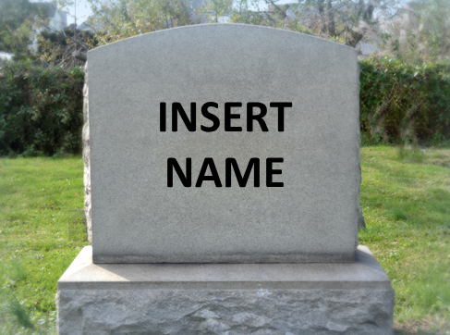
Hebrews 9:27
And inasmuch as it is appointed for men to die once and after this comes judgment.

Slide 29
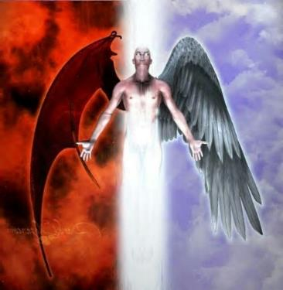
2 Corinthians 11:14
“No wonder, for even Satan disguises himself as an angel of light.”

Slide 30

Bible Verses Against Necromancy
Lev. 19:31
Deut. 18:9-14
1 Sam. 28:7-8
2 Kgs. 21:6
1 Chron. 10:13
Isa. 8:19-20

Slide 31

1 Timothy 4:1
“But the Spirit explicitly says that in later times some will fall away from the faith, paying attention to deceitful spirits and doctrines of demons.”

Slide 32
Messianic Prosperity
(10:1-3)
    Challenge (1)
    Idols inhibiting prosperity (2)
    True shepherd to judge the false shepherds (3)

Slide 33
True Shepherd
(10:1-12)
Messianic prosperity (1-3)
Restoration of the Northern & Southern kingdoms (4-7)
Messianic regathering (8-12)

Slide 34
Restoration of the N & S Kingdoms
(10:4-7)
    The king (4-5)
    The kingdoms (6-7)

Slide 35
Restoration of the N & S Kingdoms
(10:4-7)
    The king (4-5)
    The kingdoms (6-7)

Slide 36
Merrill F. Unger
Unger, Merrill F. Zechariah. Grand Rapids: Zondervan Publishing House, 1963. p. 180.
“The scene is that of the strengthening of the Jews in Palestine [Israel] at the time of the invasion from the North under 'the beast' (Dan. 7:8) in conjunction with the events of Armageddon (Rev. 16:14; 19:17-20).”

Slide 37
Restoration of the N & S Kingdoms
(10:4-7)
    The king (4-5)
    The kingdoms (6-7)

Slide 38
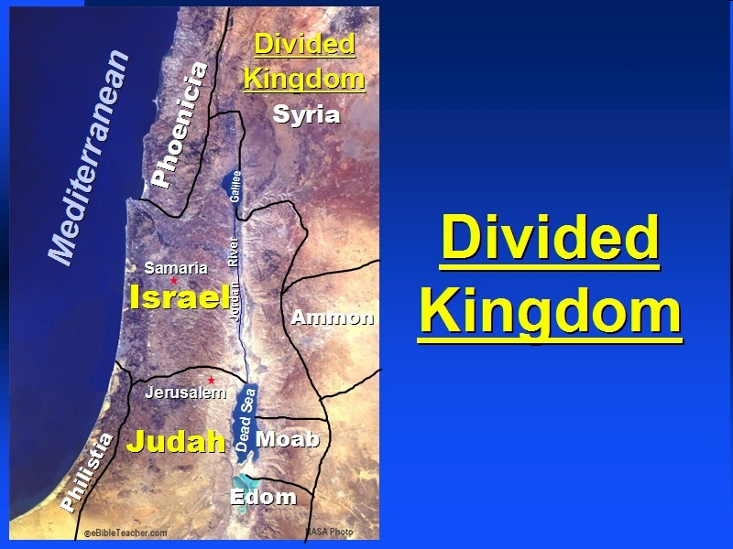

Slide 39
Six Parts of a Suzerain-Vassal Treaty in Deuteronomy
Preamble (1:1-5)
Prologue (1:6–4:40)
Covenant obligations (5–26)
Storage and reading instructions (27:2-3; 31:9, 24, 26)
Witnesses (32:1)
Blessings and curses (28)

Slide 40
Israel's Judgments
Division of the kingdom in 931 B.C. (1 Kgs. 12)
Assyrian judgment in 722 B.C. (2 Kgs. 17)
Babylonian captivity in 586 B.C. (2 Kgs. 25)
Rome Diaspora in A.D. 70 (Luke 19:41-44)

Slide 41
Ezekiel 37
Vision: Valley of the Dry Bones (1-14)
  Vision (1-10)
  Interpretation (11-14)
Sign: Two Sticks (15-28)
  Sign (15-17)
  Interpretation (18-28)

Slide 42
Israel's Judgments
Division of the kingdom in 931 B.C. (1 Kgs. 12)
Assyrian judgment in 722 B.C. (2 Kgs. 17)
Babylonian captivity in 586 B.C. (2 Kgs. 25)
Rome Diaspora in A.D. 70 (Luke 19:41-44)

Slide 43
True Shepherd
(10:1-12)
Messianic prosperity (1-3)
Restoration of the Northern & Southern kingdoms (4-7)
Messianic regathering (8-12)

Slide 44
Messianic Regathering
(10:8-12)
    The regathering (8-9)
    The geography (10-11)
    The strengthening (12)

Slide 45
Messianic Regathering
(10:8-12)
    The regathering (8-9)
    The geography (10-11)
    The strengthening (12)

Slide 46
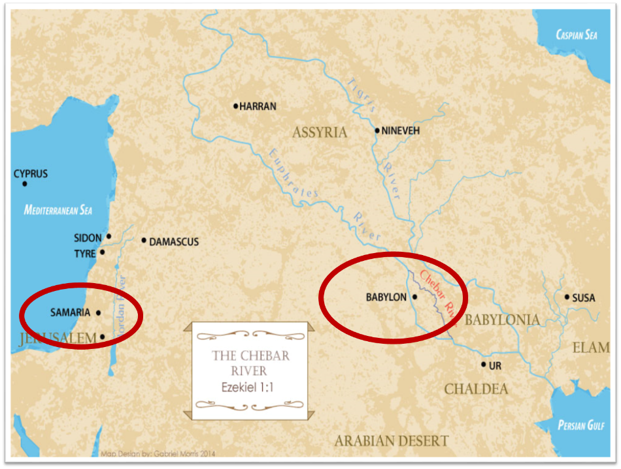

Slide 47
Messianic Regathering
(10:8-12)
    The regathering (8-9)
    The geography (10-11)
    The strengthening (12)

Slide 48


Slide 53


Genesis 12:3
“And I will bless those who bless you, And the one who curses you I will curse. And in you all the families of the earth will be blessed.”

Slide 54

VI. 8 New Promises
Genesis 12:1-3
    Land (Gen. 12:1b)
    Great nation (Gen. 12:2a)
    Personal blessing (Gen. 12:2b)
    Great name (Gen. 12:2c)
    Blessing to others (Gen. 12:2d)
    Blessing to blessers (Gen. 12:3a)
    Cursing to cursers (Gen. 12:3b)
    Blessing to the world (Gen. 12:3c)

Slide 55
Messianic Regathering
(10:8-12)
    The regathering (8-9)
    The geography (10-11)
    The strengthening (12)

Slide 56
Conclusion

Slide 57
First Burden Outline
(9‒11)
    Divine warrior hymn (9)
    True shepherd (10)
    False shepherd (11)

Slide 58
True Shepherd
(10:1-12)
Messianic prosperity (1-3)
Restoration of the Northern & Southern kingdoms (4-7)
Messianic regathering (11-17)

Slide 59
First Burden Outline
(9‒11)
    Divine warrior hymn (9)
    True shepherd (10)
    False shepherd (11)

