Slide 1


Genesis 12‒50
Israel’s Birth & Preservation

Slide 2


GENESIS STRUCTURE
  Beginning of the Human race (Gen. 1‒11)
  Beginning of the Hebrew race (Gen. 12‒50)

Slide 3

GENESIS STRUCTURE
  Genesis 1-11 (four events)
    Creation (1-2)
    Fall (3-5)
    Flood (6-9)
    National dispersion (10-11)

Slide 4


Genesis 3:15
“And I will put enmity Between you and the woman, And between your seed and her seed; He shall bruise you on the head, And you shall bruise him on the heel.”

Slide 5
GENESIS STRUCTURE
  Beginning of the Human race (Gen. 1‒11)
  Beginning of the Hebrew race (Gen. 12‒50)

Slide 6

GENESIS STRUCTURE
  Genesis 12-50 (four people)
    Abraham (12:1–25:11)
    Isaac (25:12–26:35)
    Jacob (27–36)
    Joseph (37–50)

Slide 7


Isaiah 43:1
“But now, thus says the Lord, your Creator, O Jacob, And He who formed you, O Israel, 'Do not fear, for I have redeemed you; I have called you by name; you are Mine!'”

Slide 8
GENESIS STRUCTURE
  Genesis 12-50 (four people)
    Abraham (12:1–25:11)
    Isaac (25:12–26:35)
    Jacob (27–36)
    Joseph (37–50)

Slide 9
Genesis 12‒19
Abram’s Early Journeys
  Unconditional promises (Gen. 12:1-3)
  From Haran to Canaan (Gen. 12:4-5)
  In Canaan (Gen. 12:6-9)
  In Egypt (Gen. 12:10-20)
  Abram and Lot Separate (Gen. 13:1-13)
  Reaffirmation of Abram’s promises (Gen. 13:14-18)
  Abram Rescues Lot (14:1-24)
  Abrahamic Covenant (15:1-21)
  Hagar & Ishmael (16:1-16)
  Circumcision (Gen. 17:1-27)
  Sodom & Gomorrah (Gen. 18‒19)

Slide 10
Genesis 17:1‒27
Circumcision
    Covenant Restated (17:1-8)
    Covenant Token (17:9-14)
    Sarah’s Role (17:15-21)
    Abraham’s Obedience (17:22-27)

Slide 11
Genesis 17:1‒27
Circumcision
    Covenant Restated (17:1-8)
    Covenant Token (17:9-14)
    Sarah’s Role (17:15-21)
    Abraham’s Obedience (17:22-27)

Slide 12
Covenant Restated
Genesis 17:1-8
    Timing (1a)
    Divine disclosure (1b-2)
    Abram’s response (3a)
    Amplification of promises (3b-8)

Slide 13
Genesis 17:1‒27
Circumcision
    Covenant Restated (17:1-8)
    Covenant Token (17:9-14)
    Sarah’s Role (17:15-21)
    Abraham’s Obedience (17:22-27)

Slide 14
Covenant Token
Genesis 17:9-14
    The obligation (9)
    The token (10-11)
    The inclusions (12-13a)
    The duration (13b)
    The penalty (14)

Slide 15
Genesis 17:1‒27
Circumcision
    Covenant Restated (17:1-8)
    Covenant Token (17:9-14)
    Sarah’s Role (17:15-21)
    Abraham’s Obedience (17:22-27)

Slide 16
Sarah’s Role
Genesis 17:15-21
    Sarah’s name change (15)
    Sarah’s blessings (16)
    Abraham’s response (17)
    Abraham’s misunderstanding (18)
    God’s response: Isaac (19)
    God’s response: Ishmael (20)
    Concluding remarks: Isaac (21)

Slide 17
Genesis 17:1‒27
Circumcision
    Covenant Restated (17:1-8)
    Covenant Token (17:9-14)
    Sarah’s Role (17:15-21)
    Abraham’s Obedience (17:22-27)

Slide 18
Abraham’s Obedience
Genesis 17:22-27
    Cessation (22)
    Circumcision (23)
    Abraham’s age (24)
    Ishmael’s age (25)
    Timing (26)
    Abraham's house (27)

Slide 19
Abraham’s Obedience
Genesis 17:22-27
    Cessation (22)
    Circumcision (23)
    Abraham’s age (24)
    Ishmael’s age (25)
    Timing (26)
    Abraham's house (27)

Slide 20


Dr. Arnold G. Fruchtenbaum
The Book of Genesis, 240
“This is the first of seven times that Abraham receives a direct revelation from God. In 12:1–3 is God’s initial call to Abram outside the Land of Canaan; in 12:7 is the first appearance to Abraham in the Land; in 13:14–17, Abraham encounters God after the separation of Lot; in 15:1–21, God signs and seals the Abrahamic Covenant; in 17:1–21, Abraham receives the token of the covenant; in 18:1–33, God speaks to him in conjunction with the destruction of Sodom; and in 22:1–2 and 22:11–18, God directs Abraham to offer Isaac.”

Slide 21

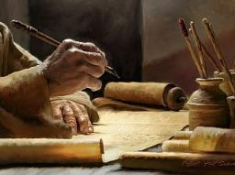
2 Timothy 3:16-17
“All Scripture is inspired by God [theopneustos] and profitable for teaching, for reproof, for correction, for training in righteousness; so that the man of God may be adequate, equipped for every good work.”

Slide 22

2 Peter 1:3-4
“³ Seeing that His divine power has granted to us everything pertaining to life and godliness, through the true knowledge of Him who called us by His own glory and excellence. ⁴ For by these He has granted to us His precious and magnificent promises, so that by them you may become partakers of the divine nature, having escaped the corruption that is in the world by lust.”

Slide 23
SLBC Position Statement No. 7
Temporary Spiritual Gifts
“This church teaches that the miraculous sign gifts, including the gift of tongues, (always the ability to speak in a previously unlearned, known language) along with the gift of healings were temporal gifts, given by the Holy Spirit solely to authenticate both the apostles and their message before the close of the canon of Scripture (1 Cor. 13:8-10). We do not believe that these are active as gifts today. However, we affirm that God is sovereign and may heal today. We believe that the majority of what is termed ‘miraculous’ within the contemporary charismatic movement is something other than the Biblical gifts of tongues or healing.”

Slide 24
Abraham’s Obedience
Genesis 17:22-27
    Cessation (22)
    Circumcision (23)
    Abraham’s age (24)
    Ishmael’s age (25)
    Timing (26)
    Abraham's house (27)

Slide 25
Abraham’s Obedience
Genesis 17:22-27
    Cessation (22)
    Circumcision (23)
    Abraham’s age (24)
    Ishmael’s age (25)
    Timing (26)
    Abraham's house (27)

Slide 26
Abraham’s Obedience
Genesis 17:22-27
    Cessation (22)
    Circumcision (23)
    Abraham’s age (24)
    Ishmael’s age (25)
    Timing (26)
    Abraham's house (27)

Slide 27
Abraham’s Obedience
Genesis 17:22-27
    Cessation (22)
    Circumcision (23)
    Abraham’s age (24)
    Ishmael’s age (25)
    Timing (26)
    Abraham's house (27)

Slide 28
Abraham’s Obedience
Genesis 17:22-27
    Cessation (22)
    Circumcision (23)
    Abraham’s age (24)
    Ishmael’s age (25)
    Timing (26)
    Abraham's house (27)

Slide 29
Concluding Thoughts
Circumcision
    Sign of the Abrahamic Covenant
    Does not give salvation
    A circumcised heart

Slide 30
Concluding Thoughts
Circumcision
    Sign of the Abrahamic Covenant
    Does not give salvation
    A circumcised heart

Slide 31
Covenant Signs
  Noahic Covenant: Rainbow (Gen 9)
  Abrahamic Covenant: Circumcision (Gen 17)
  Mosaic Covenant: Sabbath (Exod 20; Lev 25: Jer 25:11; 29:10; 2 Chron 36:21)
  New Covenant: Communion (Luke 22)

Slide 32
Concluding Thoughts
Circumcision
    Sign of the Abrahamic Covenant
    Does not give salvation
    A circumcised heart

Slide 33
Concluding Thoughts
Circumcision
    Sign of the Abrahamic Covenant
    Does not give salvation
    A circumcised heart

Slide 34

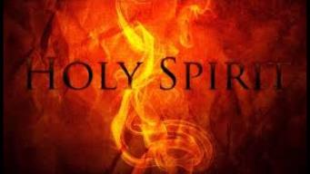
1 Corinthians 12:13
“For by one Spirit we were all baptized into one body, whether Jews or Greeks, whether slaves or free, and we were all made to drink of one Spirit.”

Slide 35
Genesis 12‒19
Abram’s Early Journeys
  Unconditional promises (Gen. 12:1-3)
  From Haran to Canaan (Gen. 12:4-5)
  In Canaan (Gen. 12:6-9)
  In Egypt (Gen. 12:10-20)
  Abram and Lot Separate (Gen. 13:1-13)
  Reaffirmation of Abram’s promises (Gen. 13:14-18)
  Abram Rescues Lot (14:1-24)
  Abrahamic Covenant (15:1-21)
  Hagar & Ishmael (16:1-16)
  Circumcision (Gen. 17:1-27)
  Sodom & Gomorrah (Gen. 18‒19)

Slide 36
Genesis 18‒19
Sodom & Gomorrah
    Visitation (18:1-15)
    Prediction (18:16-33)
    Destruction (19:1-38)

Slide 37
Genesis 18‒19
Sodom & Gomorrah
    Visitation (18:1-15)
    Prediction (18:16-33)
    Destruction (19:1-38)

Slide 38
Visitation
Genesis 18:1-15
    Hosting (1-8)
    Promise of Isaac (9-15)

Slide 39
Visitation
Genesis 18:1-15
    Hosting (1-8)
    Promise of Isaac (9-15)

Slide 40
1. Hosting
Genesis 18:1-8
    The appearance (1)
    The invitation (2-5a)
    The acceptance (5b)
    The hospitality (6-8)

Slide 41
1. Hosting
Genesis 18:1-8
    The appearance (1)
    The invitation (2-5a)
    The acceptance (5b)
    The hospitality (6-8)

Slide 42
Dr. Arnold G. Fruchtenbaum
The Book of Genesis, 240
“This is the first of seven times that Abraham receives a direct revelation from God. In 12:1–3 is God’s initial call to Abram outside the Land of Canaan; in 12:7 is the first appearance to Abraham in the Land; in 13:14–17, Abraham encounters God after the separation of Lot; in 15:1–21, God signs and seals the Abrahamic Covenant; in 17:1–21, Abraham receives the token of the covenant; in 18:1–33, God speaks to him in conjunction with the destruction of Sodom; and in 22:1–2 and 22:11–18, God directs Abraham to offer Isaac.”

Slide 43
1. Hosting
Genesis 18:1-8
    The appearance (1)
    The invitation (2-5a)
    The acceptance (5b)
    The hospitality (6-8)

Slide 44
1. Hosting
Genesis 18:1-8
    The appearance (1)
    The invitation (2-5a)
    The acceptance (5b)
    The hospitality (6-8)

Slide 45

Genesis 1:27
God created man in His own image, in the image of God He created him; male and female He created them.

Slide 46


Genesis 9:6
“Whoever sheds man’s blood, By man his blood shall be shed, For in the image of God He made man.”

Slide 47
1. Hosting
Genesis 18:1-8
    The appearance (1)
    The invitation (2-5a)
    The acceptance (5b)
    The hospitality (6-8)

Slide 48

Genesis 6:1-4
“¹ Now it came about, when men began to multiply on the face of the land, and daughters were born to them, ² that the sons of God saw that the daughters of men were beautiful; and they took wives for themselves, whomever they chose. ³ Then the Lord said, ‘My Spirit shall not strive with man forever, because he also is flesh; nevertheless his days shall be one hundred and twenty years.’ ⁴ The Nephilim were on the earth in those days, and also afterward, when the . . .

Slide 49
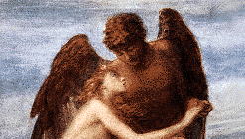
Genesis 6:1-4
. . . sons of God came in to the daughters of men, and they bore children to them. Those were the mighty men who were of old, men of renown.”

Slide 50
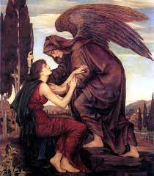
Objections to the Angel View
Angels do not marry? (Matt. 22:30)
Angels are spirits (Heb. 1:14)

Slide 51

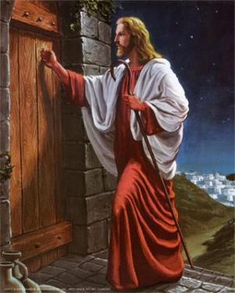
Revelation 3:20
“Behold, I stand at the door and knock; if anyone hears My voice and opens the door, I will come in to him and will dine with him, and he with Me.”

Slide 52
Visitation
Genesis 18:1-15
    Hosting (1-8)
    Promise of Isaac (9-15)

Slide 53
2. Promise of Isaac
Genesis 18:9-15
    Focus on Sarah (9)
    Promise (10a)
    Sarah’s unbelief (10b-12)
    Promise reaffirmed (13-14)
    Sarah’s response (15a)
    God’s response (15b)

Slide 54
2. Promise of Isaac
Genesis 18:9-15
    Focus on Sarah (9)
    Promise (10a)
    Sarah’s unbelief (10b-12)
    Promise reaffirmed (13-14)
    Sarah’s response (15a)
    God’s response (15b)

Slide 55
2. Promise of Isaac
Genesis 18:9-15
    Focus on Sarah (9)
    Promise (10a)
    Sarah’s unbelief (10b-12)
    Promise reaffirmed (13-14)
    Sarah’s response (15a)
    God’s response (15b)

Slide 56
2. Promise of Isaac
Genesis 18:9-15
    Focus on Sarah (9)
    Promise (10a)
    Sarah’s unbelief (10b-12)
    Promise reaffirmed (13-14)
    Sarah’s response (15a)
    God’s response (15b)

Slide 57
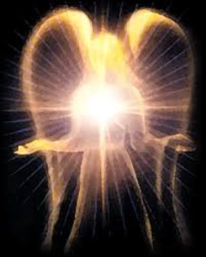
Satan’s Original State and First Sin
Isaiah 14:12-15
  5 “I will” statements
    Ascend to heaven (13)
    Raise my throne above the stars of God (13)
    Sit enthroned on the Mt. of the Assembly (13)
    Ascend above the tops of the clouds (14)
    Make myself like the Most High (14)

Slide 58
2. Promise of Isaac
Genesis 18:9-15
    Focus on Sarah (9)
    Promise (10a)
    Sarah’s unbelief (10b-12)
    Promise reaffirmed (13-14)
    Sarah’s response (15a)
    God’s response (15b)

Slide 59


John 13:19; 14:29
“^{13:19} From now on I am telling you before it comes to pass, so that when it does occur, you may believe that I am He… ^{14:29} Now I have told you before it happens, so that when it happens, you may believe.”

Slide 60
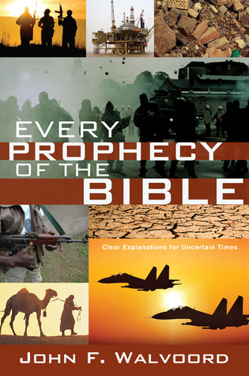

Slide 61
2. Promise of Isaac
Genesis 18:9-15
    Focus on Sarah (9)
    Promise (10a)
    Sarah’s unbelief (10b-12)
    Promise reaffirmed (13-14)
    Sarah’s response (15a)
    God’s response (15b)

Slide 62
2. Promise of Isaac
Genesis 18:9-15
    Focus on Sarah (9)
    Promise (10a)
    Sarah’s unbelief (10b-12)
    Promise reaffirmed (13-14)
    Sarah’s response (15a)
    God’s response (15b)

Slide 63
Conclusion

Slide 64
Genesis 18‒19
Sodom & Gomorrah
    Visitation (18:1-15)
    Prediction (18:16-33)
    Destruction (19:1-38)

Slide 65

“The Lord bless you and keep you; the Lord make his face shine on you and be gracious to you; the Lord turn his face toward you and give you peace.” (NIV)

