Slide 1


Zechariah
God Remembers!

Slide 2

Structure
Introductory call to repentance (1:1-6)
Eight-night visions (1:7–6:15)
Question and answers about fasting (7–8)
Two burdens (9–14)

Slide 3
ZECHARIAH’S EIGHT NIGHT VISIONS
Vision | Reference | Meaning
The Red-horse Rider among the Myrtles | 1:7-17 | God’s anger against the nations & blessing on restored Israel.
The Four Horns & the Four Craftsmen | 1:18-21 | God’s judgment on the nations that afflict Israel.
The Surveyor with a Measuring Line | Chapter 2 | God’s future blessing on restored Israel.
The Cleansing & Crowning of Joshua the Hight Priest. | Chapter 3 | Israel’s future cleansing from sin & reinstatement as a priestly nation.
The Golden Lampstand & the Two Olive Trees | Chapter 4 | Israel as the light to the nations under Messiah, the King-Priest.
The Flying Scroll | 5:1-4 | The severity & totality of divine judgment on individual Israelites.
The Woman in the Ephah | 5:5-11 | The removal of national Israel’s sin of rebellion against God.
The Four Chariots | 6:1-8 | Divine judgment on Gentile nations.

Slide 4
II. Eight Night Visions
(1:7‒6:15)
  Riders & horses among the myrtle trees (1:7-17)
  Four horns & four craftsmen (1:18-21)
  Man with the measuring line (2)
  Cleansing of the High Priest Joshua (3)
  Lampstand & olive tree (4)
  Flying scroll (5:1-4)
  Woman in the basket (5:5-11)
  Four chariots (6:1-8)
  Conclusion: crowning of Joshua (6:9-15)

Slide 5
Structure
Introductory call to repentance (1:1-6)
Eight-night visions (1:7–6:15)
Question and answers about fasting (7–8)
Two burdens (9–14)

Slide 6

III. Questions & Answers Concerning Fasting
(7‒8)
  Question (7:1-3)
  Four divine answers (7:4‒8:23)
    Condemnation of empty ritualism (7:4-7)
    Condemnation of past covenant failure (7:8-14)
    Prediction of Jerusalem’s restoration (8:1-17)
    Prediction of future blessing (8:18-23)

Slide 7
III. Questions & Answers Concerning Fasting
(7‒8)
  Question (7:1-3)
  Four divine answers (7:4‒8:23)
    Condemnation of empty ritualism (7:4-7)
    Condemnation of past covenant failure (7:8-14)
    Prediction of Jerusalem’s restoration (8:1-17)
    Prediction of future blessing (8:18-23)

Slide 8
Question
(7:1-3)
    Date (1)
    Questioner (2)
    Question (3)

Slide 9
III. Questions & Answers Concerning Fasting
(7‒8)
  Question (7:1-3)
  Four divine answers (7:4‒8:23)
    Condemnation of empty ritualism (7:4-7)
    Condemnation of past covenant failure (7:8-14)
    Prediction of Jerusalem’s restoration (8:1-17)
    Prediction of future blessing (8:18-23)

Slide 10
III. Questions & Answers Concerning Fasting
(7‒8)
  Question (7:1-3)
  Four divine answers (7:4‒8:23)
    Condemnation of empty ritualism (7:4-7)
    Condemnation of past covenant failure (7:8-14)
    Prediction of Jerusalem’s restoration (8:1-17)
    Prediction of future blessing (8:18-23)

Slide 11
Empty Ritualism
(7:4-7)
Israel’s insincerity (4-5)
Israel’s selfishness (6-7)

Slide 12
III. Questions & Answers Concerning Fasting
(7‒8)
  Question (7:1-3)
  Four divine answers (7:4‒8:23)
    Condemnation of empty ritualism (7:4-7)
    Condemnation of past covenant failure (7:8-14)
    Prediction of Jerusalem’s restoration (8:1-17)
    Prediction of future blessing (8:18-23)

Slide 13
Covenant Rebellion
(7:8-14)
Covenant requirements (8-10)
Covenant rebellion (11-12)
Covenant judgment (13-14)

Slide 14
III. Questions & Answers Concerning Fasting
(7‒8)
  Question (7:1-3)
  Four divine answers (7:4‒8:23)
    Condemnation of empty ritualism (7:4-7)
    Condemnation of past covenant failure (7:8-14)
    Prediction of Jerusalem’s restoration (8:1-17)
    Prediction of future blessing (8:18-23)

Slide 15
Prediction of Jerusalem's Restoration
(8:1-17)
Prediction (1-8)
Application (9-17)

Slide 16
Prediction of Jerusalem's Restoration
(8:1-17)
Prediction (1-8)
Application (9-17)

Slide 17
Prediction
(8:1-8)
God’s return to Zion (1-3)
Peace in Jerusalem (4-5)
Restoration from exile (6-8)

Slide 18
Prediction
(8:1-8)
God’s return to Zion (1-3)
Peace in Jerusalem (4-5)
Restoration from exile (6-8)

Slide 19
Six Parts of a Suzerain-Vassal Treaty in Deuteronomy
Preamble (1:1-5)
Prologue (1:6–4:40)
Covenant obligations (5–26)
Storage and reading instructions (27:2-3; 31:9, 24, 26)
Witnesses (32:1)
Blessings and curses (28)

Slide 20


Jeremiah 30:7
“Alas! for that day is great, There is none like it; And it is the time of Jacob’s distress (Gen. 32:8; 35:10), But he will be saved from it.”

Slide 21

Promised Exemption from Divine Wrath
The promise (1 Thess 1:10; 5:9; Rom 5:9; 8:1; Rev 3:10)
Tribulation = divine wrath/anger (Rev 6:16-17; 11:18; 14:10; 15:1, 7; 16:1, 19; 19:15)

Slide 22

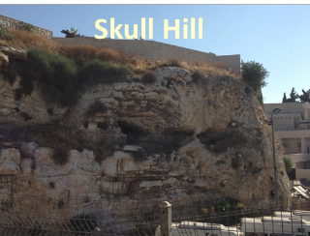
Revelation 11:8
“And their dead bodies will lie in the street of the great city which mystically is called Sodom and Egypt, where also their Lord was crucified.”

Slide 23
Prediction
(8:1-8)
God’s return to Zion (1-3)
Peace in Jerusalem (4-5)
Restoration from exile (6-8)

Slide 24
Deuteronomy 28:49-50
⁴⁹ “The Lord will bring a nation against you from far away, from the end of the earth, as the eagle swoops down; a nation whose language you will not understand, ⁵⁰ a nation with a defiant attitude, who will have no respect for the old, nor show favor to the young.”

Slide 25
Ralph L. Smith
Smith, Ralph L. Micah-Malachi. Word Biblical Commentary series.
Waco, Tex.: Word Books, Publisher, 1984. p. 233.
“In one of the most amazing and challenging statements about measurement of the health of society, Zechariah suggests that we look at the place the old and the young have in that society.”

Slide 26
Prediction
(8:1-8)
God’s return to Zion (1-3)
Peace in Jerusalem (4-5)
Restoration from exile (6-8)

Slide 27
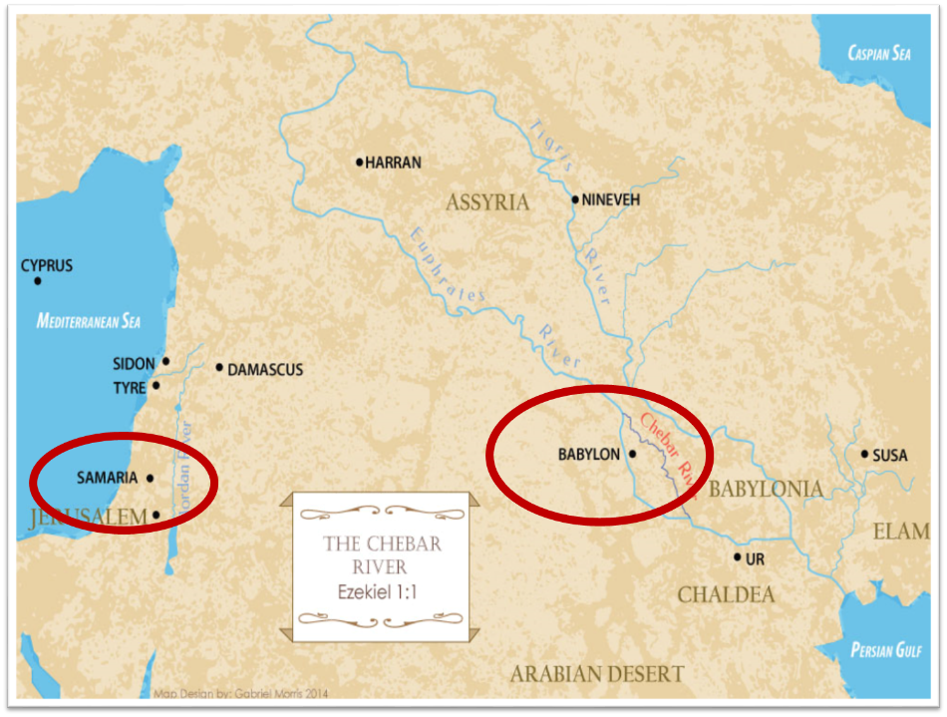

Slide 28
Israel's Judgments
Division of the kingdom in 931 B.C. (1 Kgs. 12)
Assyrian judgment in 722 B.C. (2 Kgs. 17)
Babylonian captivity in 586 B.C. (2 Kgs. 25)
Rome Diaspora in A.D. 70 (Luke 19:41-44)

Slide 29
ISRAEL’S TWO REGATHERINGS
THE PRESENT (FIRST) REGATHERING | THE PERMANENT (SECOND) REGATHERING
Return to part of the land | Return to all the land
Return in unbelief | Return in faith
Restored to the land only | Restored to the land and the Lord
Sets the stage for Tribulation (discipline) | Sets the stage for Millennium (blessing)
Adapted from: Price, Jerusalem In Prophecy, 219

Slide 30

Ezekiel 36:24-28
²⁴ “For I will take you from the nations, gather you from all the lands and bring you into your own land. ²⁵ Then I will sprinkle clean water on you, and you will be clean; I will cleanse you from all your filthiness and from all your idols. ²⁶ Moreover, I will give you a new heart and put a new spirit within you; and I will remove the heart of stone from your flesh and give you a heart of flesh. ²⁷ I will put My Spirit within you and cause you to walk in My statutes, and you will be careful to observe My ordinances. ²⁸ You will live in the land that I gave to your forefathers; so you will be My people, and I will be your God.”

Slide 31

Ezekiel 37:7-11
⁷ So I prophesied as I was commanded; and as I prophesied, there was a noise, and behold, a rattling; and the bones came together, bone to its bone. ⁸ And I looked, and behold, sinews were on them, and flesh grew and skin covered them; but there was no breath in them. ⁹ Then He said to me, “Prophesy to the breath, prophesy, son of man, and say to the breath, ‘Thus says the Lord God, “Come from the four winds, O breath, and breathe on these slain, that they come to life.”’” ¹⁰ So I prophesied as He . . .

Slide 32
Ezekiel 37:7-11
. . .commanded me, and the breath came into them, and they came to life and stood on their feet, an exceedingly great army. ¹¹ Then He said to me, “Son of man, these bones are the whole house of Israel; behold, they say, ‘Our bones are dried up and our hope has perished. We are completely cut off’.”

Slide 33
Prediction of Jerusalem's Restoration
(8:1-17)
Prediction (1-8)
Application (9-17)

Slide 34
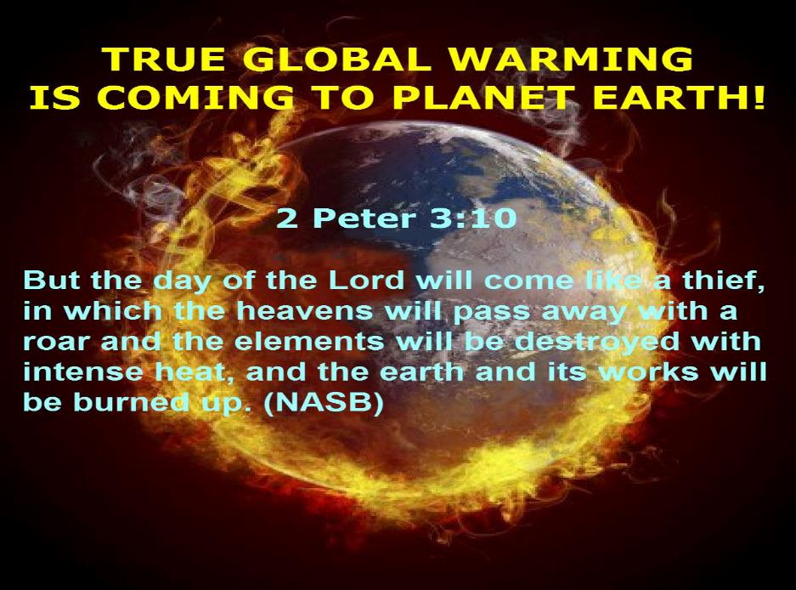

Slide 35
Application
(8:9-17)
Rebuild the Temple (9-13)
Trust in God’s promises (14-15)
Obey the covenant (16-17)

Slide 36
Application
(8:9-17)
Rebuild the Temple (9-13)
Trust in God’s promises (14-15)
Obey the covenant (16-17)

Slide 37
Six Parts of a Suzerain-Vassal Treaty in Deuteronomy
Preamble (1:1-5)
Prologue (1:6–4:40)
Covenant obligations (5–26)
Storage and reading instructions (27:2-3; 31:9, 24, 26)
Witnesses (32:1)
Blessings and curses (28)

Slide 38
Application
(8:9-17)
Rebuild the Temple (9-13)
Trust in God’s promises (14-15)
Obey the covenant (16-17)

Slide 39


Slide 40
Six Parts of a Suzerain-Vassal Treaty in Deuteronomy
Preamble (1:1-5)
Prologue (1:6–4:40)
Covenant obligations (5–26)
Storage and reading instructions (27:2-3; 31:9, 24, 26)
Witnesses (32:1)
Blessings and curses (28)

Slide 41
Application
(8:9-17)
Rebuild the Temple (9-13)
Trust in God’s promises (14-15)
Obey the covenant (16-17)

Slide 42



Slide 43
Conclusion

Slide 44
III. Questions & Answers Concerning Fasting
(7‒8)
  Question (7:1-3)
  Four divine answers (7:4‒8:23)
    Condemnation of empty ritualism (7:4-7)
    Condemnation of past covenant failure (7:8-14)
    Prediction of Jerusalem’s restoration (8:1-17)
    Prediction of future blessing (8:18-23)

Slide 45
Prediction of Jerusalem's Restoration
(8:1-17)
Prediction (1-8)
Application (9-17)

Slide 46
III. Questions & Answers Concerning Fasting
(7‒8)
  Question (7:1-3)
  Four divine answers (7:4‒8:23)
    Condemnation of empty ritualism (7:4-7)
    Condemnation of past covenant failure (7:8-14)
    Prediction of Jerusalem’s restoration (8:1-17)
    Prediction of future blessing (8:18-23)

