Slide 1

Ezekiel 36‒39
The Middle East Meltdown 2022
Dr. Andy Woods
Senior Pastor – Sugar Land Bible Church
President – Chafer Theological Seminary

Slide 2

Ezekiel 1:1-3
¹ “Now it came about in the thirtieth year, on the fifth day of the fourth month, while I was by the river Chebar among the exiles, the heavens were opened and I saw visions of God. ² (On the fifth of the month in the fifth year of King Jehoiachin’s exile, ³ the word of the Lord came expressly to Ezekiel the priest, son of Buzi, in the land of the Chaldeans by the river Chebar; and there the hand of the Lord came upon him.).”

Slide 3
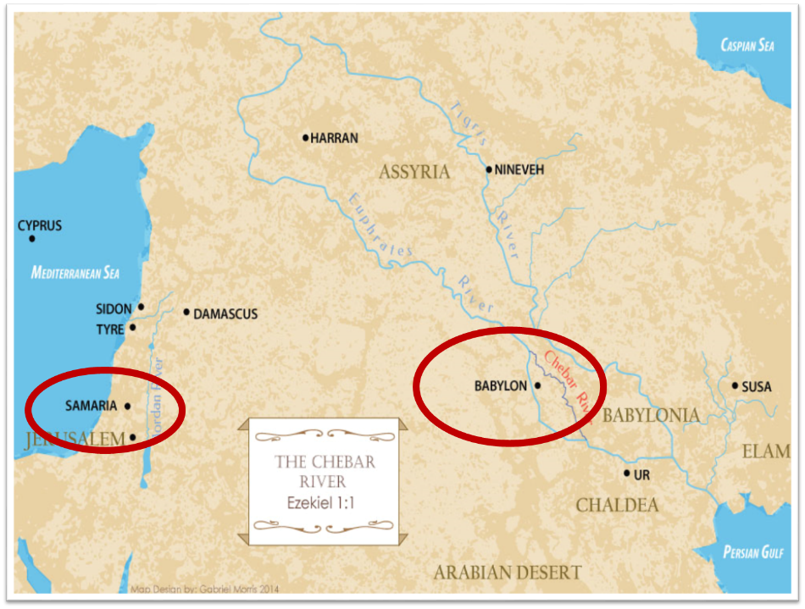

Slide 4
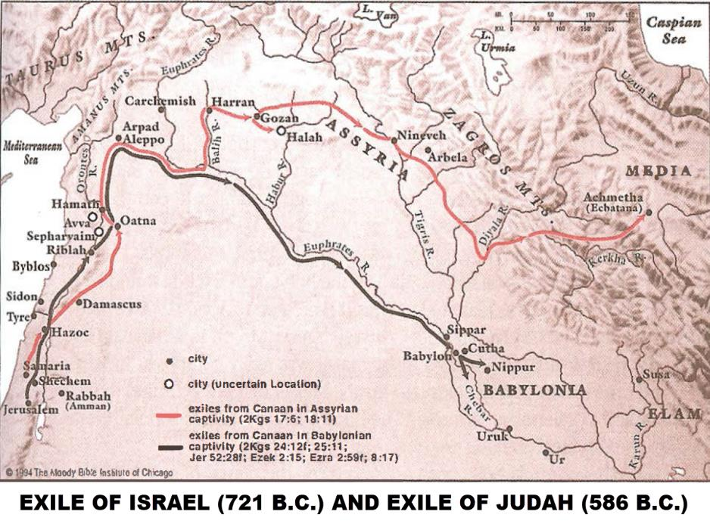

Slide 5
VISIONS
Date | Event | Scripture
7/31/593 | Call to ministry | 1:1-2
8/7/593 | Appointment as a watchman | 3:16
9/17/592 | Temple vision | 8:1
8/14/591 | Review of Israel’s history | 20:1-2
1/15/588 | Siege of Jerusalem begins | 24:1
4/23/587–4/13/586 | Message Against Tyre | 26:1
1/7/587 | Message Against Egypt | 29:1
4/26/571 | Egypt given as payment for Babylon’s siege | 29:17
4/29/587 | Message Against Pharaoh | 30:20
6/21/587 | Message Against Pharaoh | 31:1
3/3/585 | Lament over Pharaoh | 32:1
4/13/586–4/1/585 | Announcement of Egypt’s “death” | 32:17
1/8/585 | News of Jerusalem’s destruction reaches Ezekiel | 33:21
4/28/573 | Vision of the future temple | 40:1

Slide 6
Nebuchadnezzar’s 3 sieges of Judah
 | 1 | 2 | 3
Year | 605 | 597 | 586
Scripture | 2 Kings 24:1; Dan.1:1 | 2 Kings 24:10-16; Ezek. 1:1-2 | 2 Kings 25:1-2, Ezek. 33:21
Judah’s king | Jehoiakim | Jehoiachin | Zedekiah
Those taken | Daniel & some princes | Ezekiel & majority 10k | Remnant captured; Jerusalem & Temple destroyed

Slide 7
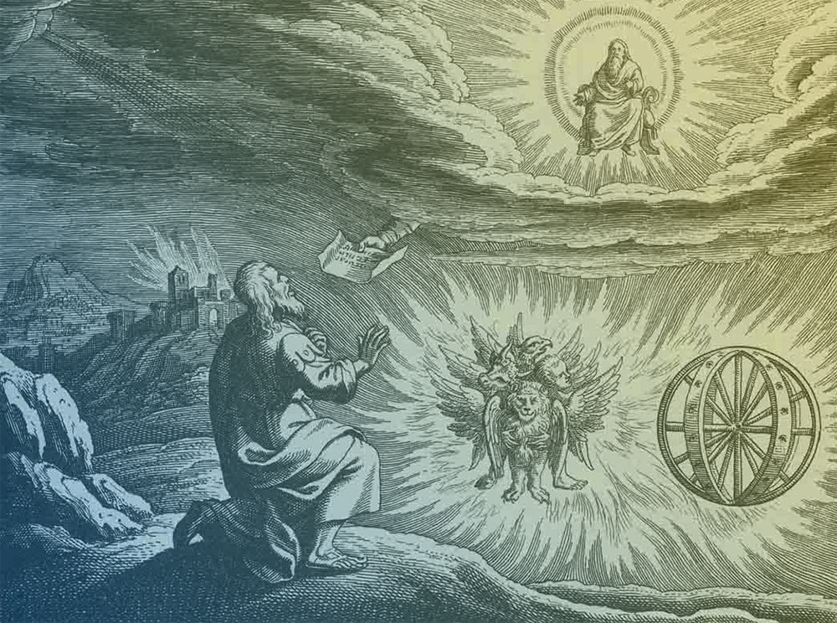
Source: Charles Dyer, Notes on Ezekiel
Judgment upon Judah (1-24)
Judgment upon the nations (25-32)
Israel’s future restoration (33-48)

Slide 8
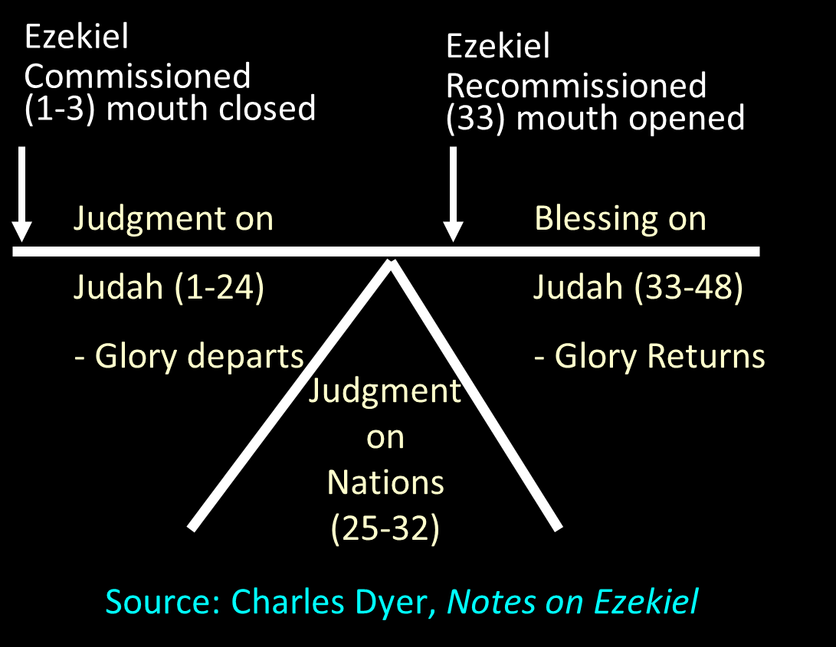

Slide 9
Source: Charles Dyer, Notes on Ezekiel
Judgment upon Judah (1-24)
Judgment upon the nations (25-32)
Israel’s future restoration (33-48)

Slide 10
Ezekiel’s Message
God’s prophecies of impending judgment and ultimate restoration afflict the comfortable through the removal of false sources of security (1–24) just as they also comfort the afflicted through reminders of the ultimate destruction of God’s enemies (25–32) as well as the glorious future of God’s people (33–48).

Slide 11
Ezekiel 33‒48
Ezekiel recommissioned (33)
False shepherds removed (34)
Edom destroyed (35)
Israel’s restoration: physical & spiritual (36)
Israel’s restoration illustrated (37)
Means of restoration: Northern invasion (38)
Results of the Northern invasion: conversion (39)
Millennial Temple (40‒46)
Tribal land allotment (47‒48)

Slide 12
Ezekiel 33‒48
Ezekiel recommissioned (33)
False shepherds removed (34)
Edom destroyed (35)
Israel’s restoration: physical & spiritual (36)
Israel’s restoration illustrated (37)
Means of restoration: Northern invasion (38)
Results of the Northern invasion: conversion (39)
Millennial Temple (40‒46)
Tribal land allotment (47‒48)

Slide 13
Ezekiel 33‒48
Ezekiel recommissioned (33)
False shepherds removed (34)
Edom destroyed (35)
Israel’s restoration: physical & spiritual (36)
Israel’s restoration illustrated (37)
Means of restoration: Northern invasion (38)
Results of the Northern invasion: conversion (39)
Millennial Temple (40‒46)
Tribal land allotment (47‒48)

Slide 14
Ezekiel 33‒48
Ezekiel recommissioned (33)
False shepherds removed (34)
Edom destroyed (35)
Israel’s restoration: physical & spiritual (36)
Israel’s restoration illustrated (37)
Means of restoration: Northern invasion (38)
Results of the Northern invasion: conversion (39)
Millennial Temple (40‒46)
Tribal land allotment (47‒48)

Slide 15
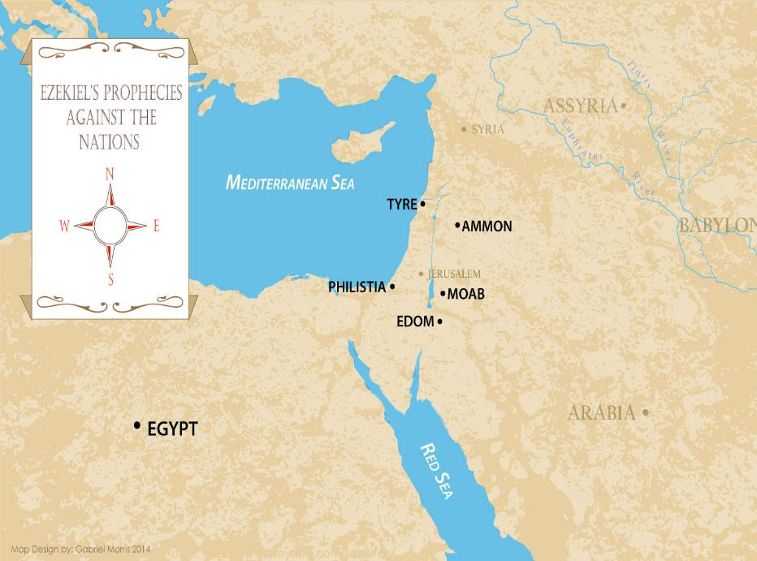

Slide 16
Source: Charles Dyer, Notes on Ezekiel
Judgment upon Judah (1-24)
Judgment upon the nations (25-32)
Israel’s future restoration (33-48)

Slide 18


Slide 19
Ezekiel 33‒48
Ezekiel recommissioned (33)
False shepherds removed (34)
Edom destroyed (35)
Israel’s restoration: physical & spiritual (36)
Israel’s restoration illustrated (37)
Means of restoration: Northern invasion (38)
Results of the Northern invasion: conversion (39)
Millennial Temple (40‒46)
Tribal land allotment (47‒48)

Slide 20
Ezekiel 33‒48
Ezekiel recommissioned (33)
False shepherds removed (34)
Edom destroyed (35)
Israel’s restoration: physical & spiritual (36)
Israel’s restoration illustrated (37)
Means of restoration: Northern invasion (38)
Results of the Northern invasion: conversion (39)
Millennial Temple (40‒46)
Tribal land allotment (47‒48)

Slide 21
Ezekiel 33‒48
Ezekiel recommissioned (33)
False shepherds removed (34)
Edom destroyed (35)
Israel’s restoration: physical & spiritual (36)
Israel’s restoration illustrated (37)
Means of restoration: Northern invasion (38)
Results of the Northern invasion: conversion (39)
Millennial Temple (40‒46)
Tribal land allotment (47‒48)

Slide 22
Ezekiel 33‒48
Ezekiel recommissioned (33)
False shepherds removed (34)
Edom destroyed (35)
Israel’s restoration: physical & spiritual (36)
Israel’s restoration illustrated (37)
Means of restoration: Northern invasion (38)
Results of the Northern invasion: conversion (39)
Millennial Temple (40‒46)
Tribal land allotment (47‒48)

Slide 23
Ezekiel 33‒48
Ezekiel recommissioned (33)
False shepherds removed (34)
Edom destroyed (35)
Israel’s restoration: physical & spiritual (36)
Israel’s restoration illustrated (37)
Means of restoration: Northern invasion (38)
Results of the Northern invasion: conversion (39)
Millennial Temple (40‒46)
Tribal land allotment (47‒48)

Slide 24
ISRAEL’S FOUR TEMPLES
Solomon’s pre-exilic temple (Kings and Chronicles)
Zerubbabel’s post exilic temple (Ezra 1-6; John 2:20)
Antichrist's temple (Dan. 9:27; Matt. 24:15; 2 Thess. 2:4; Rev. 11:1-2)
Millennial temple (Ezek. 40-48)

Slide 25
ISRAEL’S FOUR TEMPLES
Solomon’s pre-exilic temple (Kings and Chronicles)
Zerubbabel’s post exilic temple (Ezra 1-6; John 2:20)
Antichrist's temple (Dan. 9:27; Matt. 24:15; 2 Thess. 2:4; Rev. 11:1-2)
Millennial temple (Ezek. 40-48)

Slide 26


Slide 27


Slide 28
Ezekiel 33‒48
Ezekiel recommissioned (33)
False shepherds removed (34)
Edom destroyed (35)
Israel’s restoration: physical & spiritual (36)
Israel’s restoration illustrated (37)
Means of restoration: Northern invasion (38)
Results of the Northern invasion: conversion (39)
Millennial Temple (40‒46)
Tribal land allotment (47‒48)

Slide 29
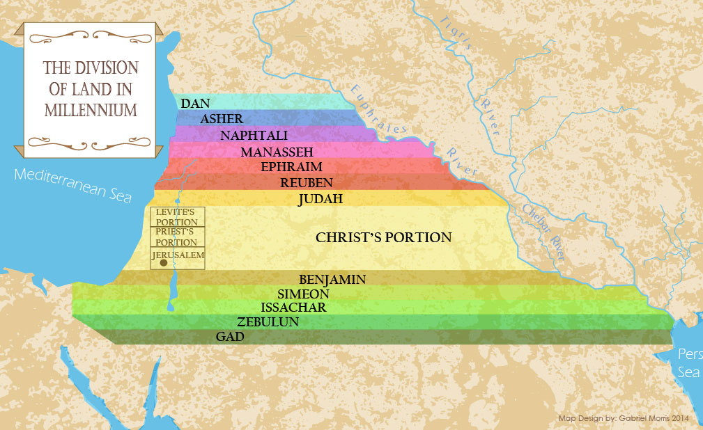

Slide 30
Ezekiel 33‒48
Ezekiel recommissioned (33)
False shepherds removed (34)
Edom destroyed (35)
Israel’s restoration: physical & spiritual (36)
Israel’s restoration illustrated (37)
Means of restoration: Northern invasion (38)
Results of the Northern invasion: conversion (39)
Millennial Temple (40‒46)
Tribal land allotment (47‒48)

Slide 31
Conclusion

Slide 32
Ezekiel 33‒48
Ezekiel recommissioned (33)
False shepherds removed (34)
Edom destroyed (35)
Israel’s restoration: physical & spiritual (36)
Israel’s restoration illustrated (37)
Means of restoration: Northern invasion (38)
Results of the Northern invasion: conversion (39)
Millennial Temple (40‒46)
Tribal land allotment (47‒48)

Slide 33


John 5:24
“Truly, truly, I say to you, he who hears My word, and believes Him who sent Me, has eternal life, and does not come into judgment, but has passed out of death into life.”

