Slide 1


Genesis 12‒50
Israel’s Birth & Preservation

Slide 2


GENESIS STRUCTURE
  Beginning of the Human race (Gen. 1‒11)
  Beginning of the Hebrew race (Gen. 12‒50)

Slide 3

GENESIS STRUCTURE
  Genesis 1-11 (four events)
    Creation (1-2)
    Fall (3-5)
    Flood (6-9)
    National dispersion (10-11)

Slide 4


Genesis 3:15
“And I will put enmity Between you and the woman, And between your seed and her seed; He shall bruise you on the head, And you shall bruise him on the heel.”

Slide 5
GENESIS STRUCTURE
  Beginning of the Human race (Gen. 1‒11)
  Beginning of the Hebrew race (Gen. 12‒50)

Slide 6

GENESIS STRUCTURE
  Genesis 12-50 (four people)
    Abraham (12:1–25:11)
    Isaac (25:12–26:35)
    Jacob (27–36)
    Joseph (37–50)

Slide 7


Isaiah 43:1
“But now, thus says the Lord, your Creator, O Jacob, And He who formed you, O Israel, 'Do not fear, for I have redeemed you; I have called you by name; you are Mine!'”

Slide 8
GENESIS STRUCTURE
  Genesis 12-50 (four people)
    Abraham (12:1–25:11)
    Isaac (25:12–26:35)
    Jacob (27–36)
    Joseph (37–50)

Slide 9
Genesis 12‒14
Abram’s Early Journeys
  Unconditional promises (Gen. 12:1-3)
  From Haran to Canaan (Gen. 12:4-5)
  In Canaan (Gen. 12:6-9)
  In Egypt (Gen. 12:10-20)
  Abram and Lot Separate (Gen. 13:1-13)
  Reaffirmation of Abram’s promises (Gen. 13:14-18)
  Abram Rescues Lot (14:1-24)

Slide 10
Genesis 12‒14
Abram’s Early Journeys
  Unconditional promises (Gen. 12:1-3)
  From Haran to Canaan (Gen. 12:4-5)
  In Canaan (Gen. 12:6-9)
  In Egypt (Gen. 12:10-20)
  Abram and Lot Separate (Gen. 13:1-13)
  Reaffirmation of Abram’s promises (Gen. 13:14-18)
  Abram Rescues Lot (14:1-24)

Slide 11
Genesis 14:1‒24
Abram Rescues Lot
    War (14:1-12)
    Rescue (14:13-16)
    Interaction with two kings (14:17-24)

Slide 12
Genesis 14:1‒24
Abram Rescues Lot
    War (14:1-12)
    Rescue (14:13-16)
    Interaction with two kings (14:17-24)

Slide 13
War
Genesis 14:1-12
    Invaders (Gen. 14:1)
    Invaded (Gen. 14:2)
    Place (Gen. 14:3)
    Reason (Gen. 14:4)
    Time (Gen. 14:5a)
    Specifics (Gen. 14:5b-6)
    Direction (Gen. 14:7)
    War (Gen. 14:8-11)
    Lot captured (Gen. 14:12)

Slide 14
War
Genesis 14:1-12
    Invaders (Gen. 14:1)
    Invaded (Gen. 14:2)
    Place (Gen. 14:3)
    Reason (Gen. 14:4)
    Time (Gen. 14:5a)
    Specifics (Gen. 14:5b-6)
    Direction (Gen. 14:7)
    War (Gen. 14:8-11)
    Lot captured (Gen. 14:12)

Slide 15

Genesis 11:1-4
¹ Now the whole earth used the same language and the same words. ² It came about as they journeyed east, that they found a plain in the land of Shinar and settled there. ³ They said to one another, “Come, let us make bricks and burn them thoroughly.” And they used brick for stone, and they used tar for mortar. ⁴ They said, “Come, let us build for ourselves a city, and a tower whose top will reach into heaven, and let us make for ourselves a name, otherwise we will be scattered abroad over the face of the whole earth.”

Slide 16


Slide 17
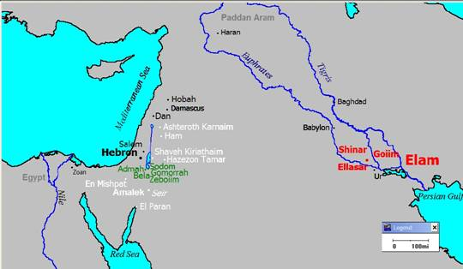

Slide 18


Dr. Arnold G. Fruchtenbaum
The Book of Genesis, 261
“Nevertheless, what should be noted here is that for the first time in the biblical text, non-Hebrew names appear. This shows the effect of the judgment of the confusion of languages and tongues. This again shows that Hebrew indeed was the original language before the event of the Tower of Babel.”

Slide 19
War
Genesis 14:1-12
    Invaders (Gen. 14:1)
    Invaded (Gen. 14:2)
    Place (Gen. 14:3)
    Reason (Gen. 14:4)
    Time (Gen. 14:5a)
    Specifics (Gen. 14:5b-6)
    Direction (Gen. 14:7)
    War (Gen. 14:8-11)
    Lot captured (Gen. 14:12)

Slide 20
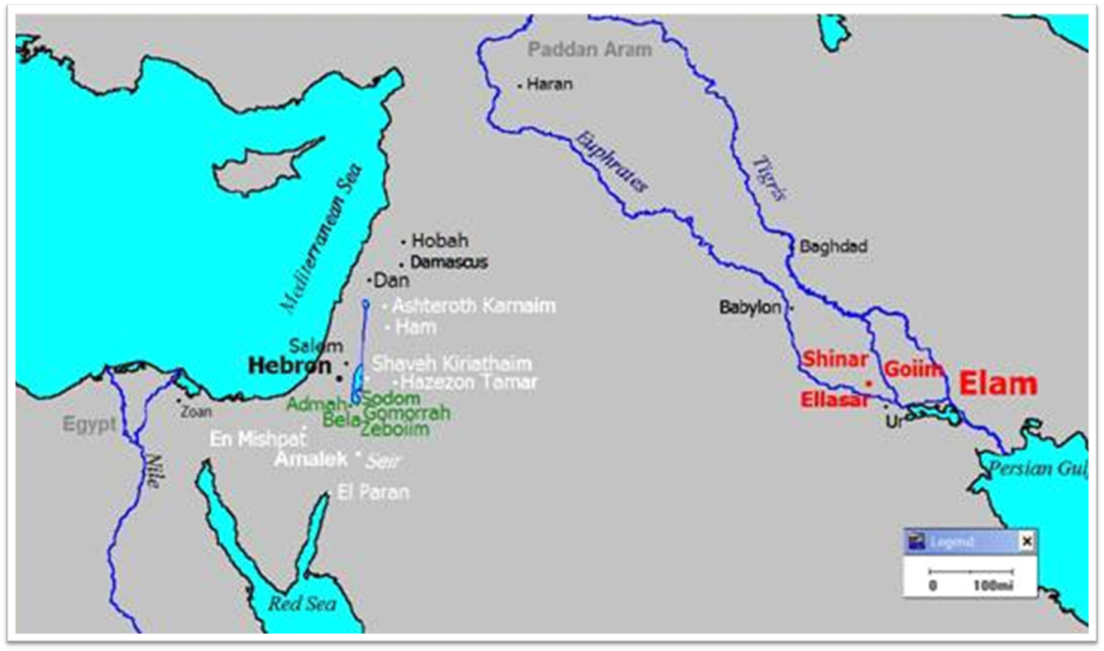

Slide 21
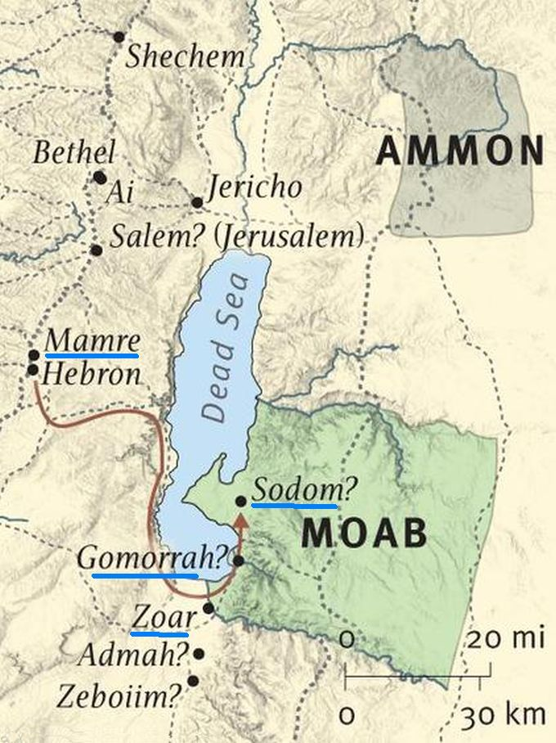

Slide 22
War
Genesis 14:1-12
    Invaders (Gen. 14:1)
    Invaded (Gen. 14:2)
    Place (Gen. 14:3)
    Reason (Gen. 14:4)
    Time (Gen. 14:5a)
    Specifics (Gen. 14:5b-6)
    Direction (Gen. 14:7)
    War (Gen. 14:8-11)
    Lot captured (Gen. 14:12)

Slide 23
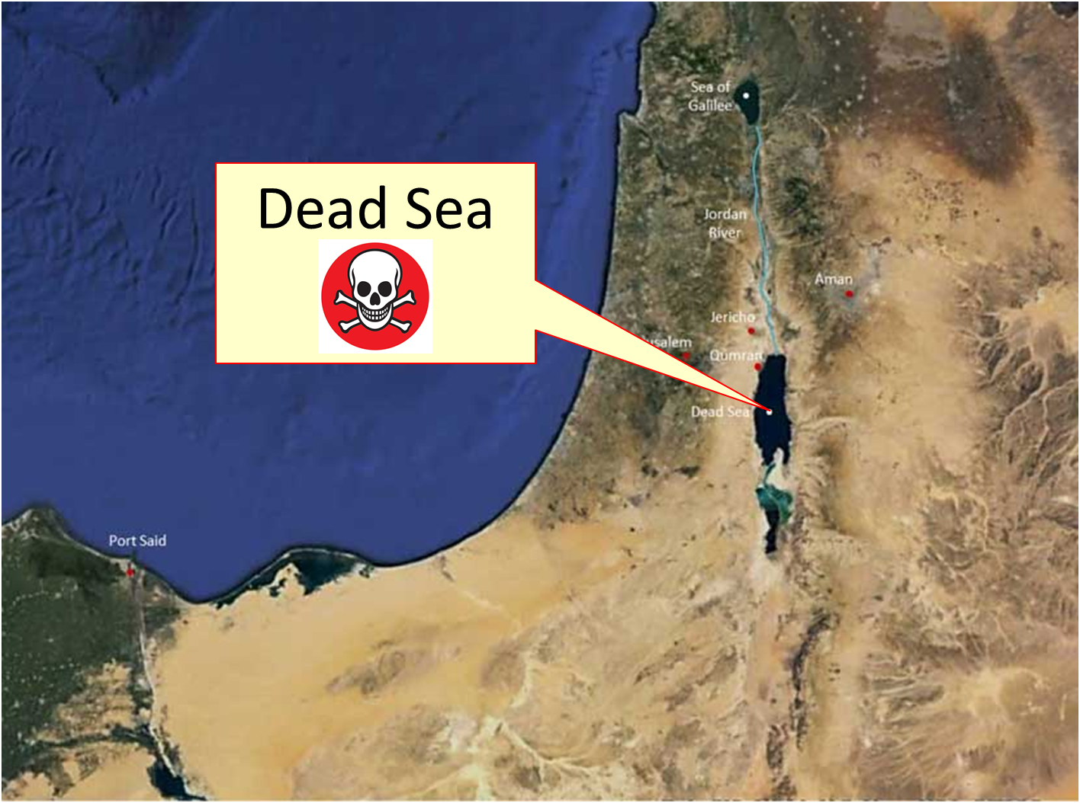

Slide 24
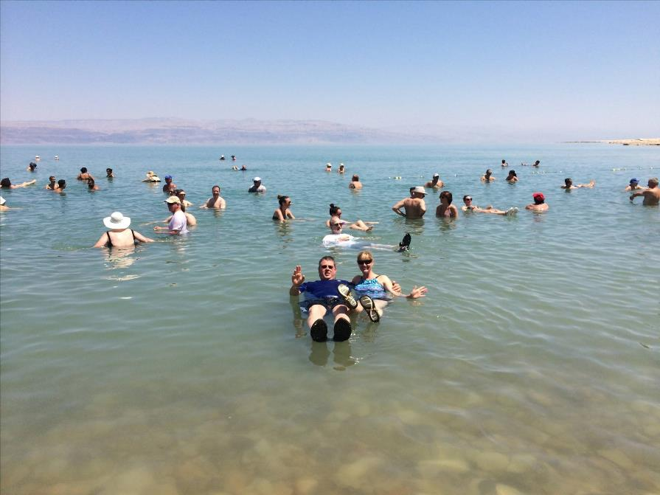

Slide 25
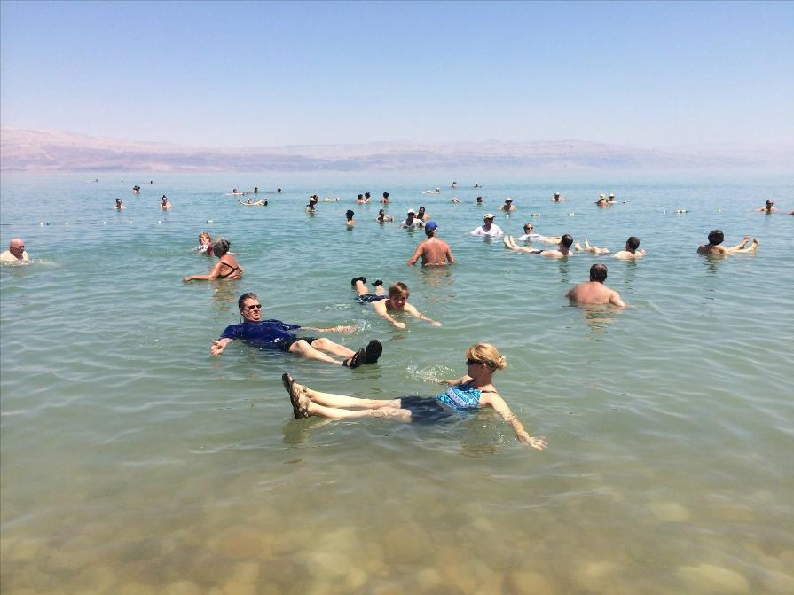

Slide 26
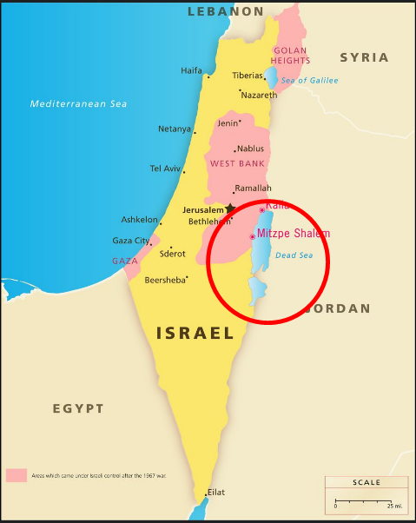
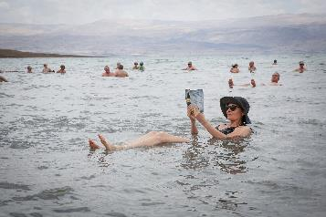
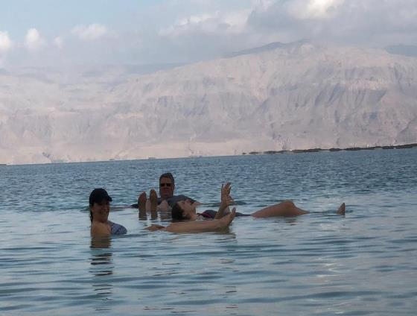
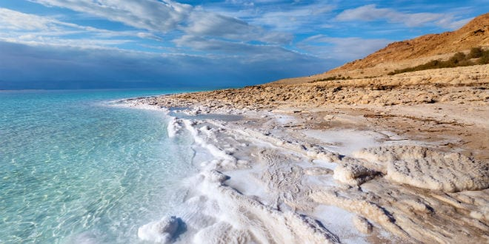
DEAD SEA

Slide 27
War
Genesis 14:1-12
    Invaders (Gen. 14:1)
    Invaded (Gen. 14:2)
    Place (Gen. 14:3)
    Reason (Gen. 14:4)
    Time (Gen. 14:5a)
    Specifics (Gen. 14:5b-6)
    Direction (Gen. 14:7)
    War (Gen. 14:8-11)
    Lot captured (Gen. 14:12)

Slide 28
War
Genesis 14:1-12
    Invaders (Gen. 14:1)
    Invaded (Gen. 14:2)
    Place (Gen. 14:3)
    Reason (Gen. 14:4)
    Time (Gen. 14:5a)
    Specifics (Gen. 14:5b-6)
    Direction (Gen. 14:7)
    War (Gen. 14:8-11)
    Lot captured (Gen. 14:12)

Slide 29
War
Genesis 14:1-12
    Invaders (Gen. 14:1)
    Invaded (Gen. 14:2)
    Place (Gen. 14:3)
    Reason (Gen. 14:4)
    Time (Gen. 14:5a)
    Specifics (Gen. 14:5b-6)
    Direction (Gen. 14:7)
    War (Gen. 14:8-11)
    Lot captured (Gen. 14:12)

Slide 30
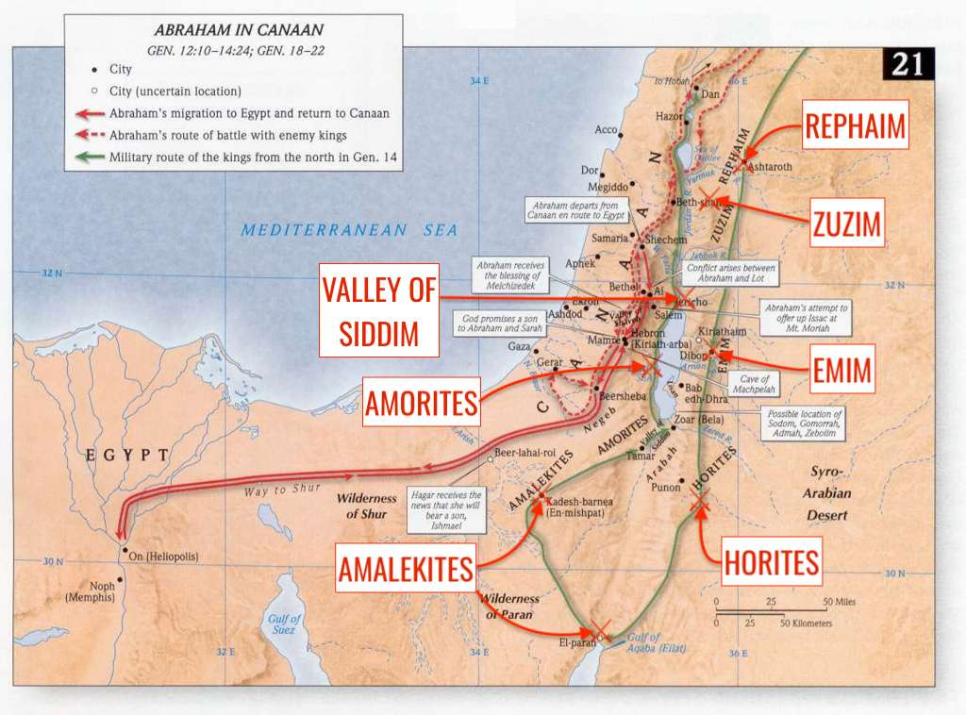

Slide 31
War
Genesis 14:1-12
    Invaders (Gen. 14:1)
    Invaded (Gen. 14:2)
    Place (Gen. 14:3)
    Reason (Gen. 14:4)
    Time (Gen. 14:5a)
    Specifics (Gen. 14:5b-6)
    Direction (Gen. 14:7)
    War (Gen. 14:8-11)
    Lot captured (Gen. 14:12)

Slide 32
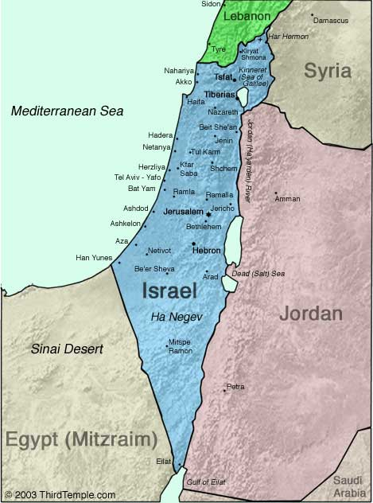
Negev

Slide 33
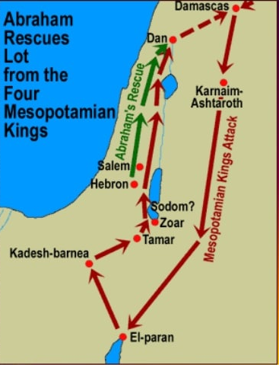

Slide 35
War
Genesis 14:1-12
    Invaders (Gen. 14:1)
    Invaded (Gen. 14:2)
    Place (Gen. 14:3)
    Reason (Gen. 14:4)
    Time (Gen. 14:5a)
    Specifics (Gen. 14:5b-6)
    Direction (Gen. 14:7)
    War (Gen. 14:8-11)
    Lot captured (Gen. 14:12)

Slide 36
War
Genesis 14:8-11
  Invaded (8a)
  Place (8b)
  Invaders (9)
  Summary (10a)
  Two kings die (10b)
  Three kings flee (10c)
  Two kings plundered (11)

Slide 37
War
Genesis 14:8-11
  Invaded (8a)
  Place (8b)
  Invaders (9)
  Summary (10a)
  Two kings die (10b)
  Three kings flee (10c)
  Two kings plundered (11)

Slide 39
War
Genesis 14:8-11
  Invaded (8a)
  Place (8b)
  Invaders (9)
  Summary (10a)
  Two kings die (10b)
  Three kings flee (10c)
  Two kings plundered (11)

Slide 40
War
Genesis 14:8-11
  Invaded (8a)
  Place (8b)
  Invaders (9)
  Summary (10a)
  Two kings die (10b)
  Three kings flee (10c)
  Two kings plundered (11)

Slide 42
War
Genesis 14:8-11
  Invaded (8a)
  Place (8b)
  Invaders (9)
  Summary (10a)
  Two kings die (10b)
  Three kings flee (10c)
  Two kings plundered (11)

Slide 43
War
Genesis 14:8-11
  Invaded (8a)
  Place (8b)
  Invaders (9)
  Summary (10a)
  Two kings die (10b)
  Three kings flee (10c)
  Two kings plundered (11)

Slide 44
War
Genesis 14:8-11
  Invaded (8a)
  Place (8b)
  Invaders (9)
  Summary (10a)
  Two kings die (10b)
  Three kings flee (10c)
  Two kings plundered (11)

Slide 45
War
Genesis 14:8-11
  Invaded (8a)
  Place (8b)
  Invaders (9)
  Summary (10a)
  Two kings die (10b)
  Three kings flee (10c)
  Two kings plundered (11)

Slide 46
War
Genesis 14:1-12
    Invaders (Gen. 14:1)
    Invaded (Gen. 14:2)
    Place (Gen. 14:3)
    Reason (Gen. 14:4)
    Time (Gen. 14:5a)
    Specifics (Gen. 14:5b-6)
    Direction (Gen. 14:7)
    War (Gen. 14:8-11)
    Lot captured (Gen. 14:12)

Slide 47
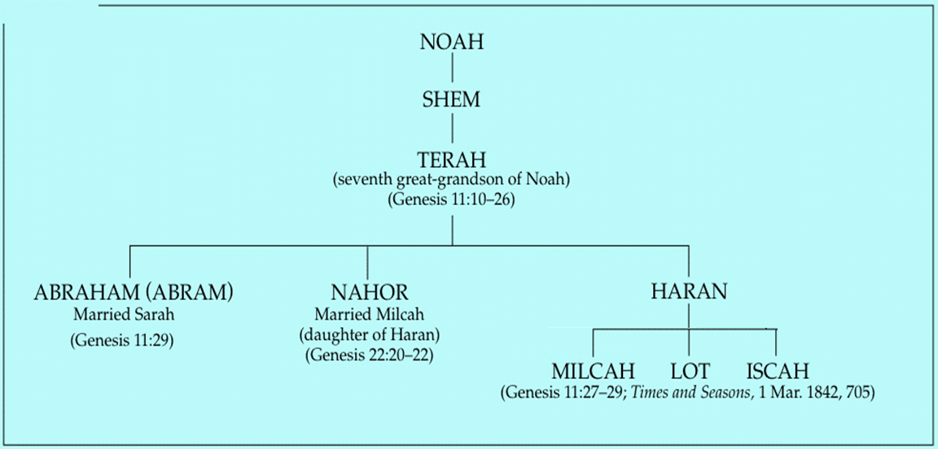

Slide 48
Genesis 14:1‒24
Abram Rescues Lot
    War (14:1-12)
    Rescue (14:13-16)
    Interaction with two kings (14:17-24)

Slide 49
Rescue
Genesis 14:13-16
    Abram’s notification (Gen. 14:13)
    Abram’s arms (Gen. 14:14)
    Abram’s attack (Gen. 14:15)
    Abram’s rescue (Gen. 14:16)

Slide 50
Rescue
Genesis 14:13-16
    Abram’s notification (Gen. 14:13)
    Abram’s arms (Gen. 14:14)
    Abram’s attack (Gen. 14:15)
    Abram’s rescue (Gen. 14:16)

Slide 52
Rescue
Genesis 14:13-16
    Abram’s notification (Gen. 14:13)
    Abram’s arms (Gen. 14:14)
    Abram’s attack (Gen. 14:15)
    Abram’s rescue (Gen. 14:16)

Slide 53
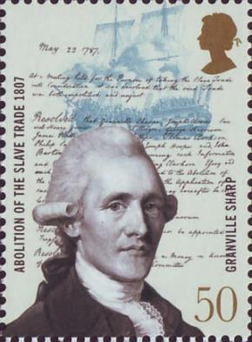
Granville Sharp
"No Englishman can be truly loyal who opposed the principles of English law whereby the people are required to have arms of defence in peace, for mutual as well as private defence…The laws of England always required the people to be armed, and not only armed, but to be expert in arms."
Les Adams, The Second Amendment Primer: A Citizen’s Guidebook to the History, Sources, and Authorities for the Constitutional Guarantee of the Right to Keep and Bear Arms (NY: Skyhorse, 2013), 63.

Slide 55
Rescue
Genesis 14:13-16
    Abram’s notification (Gen. 14:13)
    Abram’s arms (Gen. 14:14)
    Abram’s attack (Gen. 14:15)
    Abram’s rescue (Gen. 14:16)

Slide 57
Rescue
Genesis 14:13-16
    Abram’s notification (Gen. 14:13)
    Abram’s arms (Gen. 14:14)
    Abram’s attack (Gen. 14:15)
    Abram’s rescue (Gen. 14:16)

Slide 58

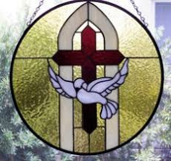
1 Samuel 16:13-14
¹³ Then Samuel took the horn of oil and anointed him in the midst of his brothers; and the Spirit of the Lord came mightily upon David from that day forward. And Samuel arose and went to Ramah. ¹⁴ Now the Spirit of the Lord departed from Saul, and an evil spirit from the Lord terrorized him.

Slide 59
Dr. Arnold G. Fruchtenbaum
The Book of Genesis, 266
“However, although they were rescued by Abram, representing the true God, they experienced the grace of God and the knowledge of the true God through Abram and Melchizedek. Nevertheless, these freed citizens of Sodom, Gomorrah, Admah, and Zeboiim all failed to respond spiritually and turn away from their sins. Although they were rescued at this point, all of these people died in Genesis 19 when Sodom and Gomorrah were destroyed.”

Slide 60
Genesis 14:1‒24
Abram Rescues Lot
    War (14:1-12)
    Rescue (14:13-16)
    Interaction with two kings (14:17-24)

Slide 61
Interaction with Two Kings
Genesis 14:17-24
    Abram & the King of Sodom (Gen. 14:17)
    Abram & the King of Salem (Gen. 14:18-20)
    Abram & the King of Sodom (Gen. 14:21-24)

Slide 62
Interaction with Two Kings
Genesis 14:17-24
    Abram & the King of Sodom (Gen. 14:17)
    Abram & the King of Salem (Gen. 14:18-20)
    Abram & the King of Sodom (Gen. 14:21-24)

Slide 64
Interaction with Two Kings
Genesis 14:17-24
    Abram & the King of Sodom (Gen. 14:17)
    Abram & the King of Salem (Gen. 14:18-20)
    Abram & the King of Sodom (Gen. 14:21-24)

Slide 65
Abram & The King of Salem
Genesis 14:18-20
  Name (18a)
  King (18b)
  Priest (18c)
  Blessing to Abram (19)
  Blessing to God (20a)
  Reception of tithes (20b)

Slide 66
Abram & The King of Salem
Genesis 14:18-20
  Name (18a)
  King (18b)
  Priest (18c)
  Blessing to Abram (19)
  Blessing to God (20a)
  Reception of tithes (20b)

Slide 67
Abram & The King of Salem
Genesis 14:18-20
  Name (18a)
  King (18b)
  Priest (18c)
  Blessing to Abram (19)
  Blessing to God (20a)
  Reception of tithes (20b)

Slide 68
Abram & The King of Salem
Genesis 14:18-20
  Name (18a)
  King (18b)
  Priest (18c)
  Blessing to Abram (19)
  Blessing to God (20a)
  Reception of tithes (20b)

Slide 69
Genesis 3:15
“And I will put enmity Between you and the woman, And between your seed and her seed; He shall bruise you on the head, And you shall bruise him on the heel.”

Slide 70

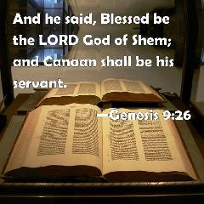
Genesis 9:26
“He also said, “Blessed be the Lord, The God of Shem; And let Canaan be his servant.”

Slide 71

God’s Messianic Purposes Beginning in Genesis
Proto-evangelium from Adam & Eve (3:15)
Seth (4:25)
Noah (Gen 5:29)
Shem (9:26)
Abraham (12:3)
Isaac (21:12)
Jacob (25:23)
Judah (49:10)

Slide 72
6 Reasons Why Melchizedek is a Type of Christ (7:1-3)
Jerusalem
Peace and Righteousness
King and Priest
No beginning and ending
Bread and wine
Priest of the Most High

Slide 73
Melchizedek is Not a Theophany
No known genealogy
“Like” the Son of God
No message from God to man
Ruler over a geo-political place

Slide 74
Dr. Arnold G. Fruchtenbaum
The Book of Genesis, 268, 270-71
“While many have taught that Melchizedek was a preincarnate Christ, this simply cannot be. This was not a theophany, because theophanies came and went; they appeared, gave their proclamation, message, or commandment and then disappeared. Theophanies never held an office here on earth. Here, Melchizedek holds two offices: that of king and that of priest...Again, he was not a theophany (or he was only a type), for several reasons. First, theophanies merely appeared and disappeared, not holding an earthly office like king or priest. Second, Hebrews 5:1, which begins listing several prerequisites for priesthood, makes the point that a priest had to be human.”

Slide 75
Dr. Arnold G. Fruchtenbaum
The Book of Genesis, 268, 270-71
“The Messiah did not become human until the Incarnation. So for Melchizedek to first be a priest, he first had to be human. Third, Hebrews states that he was like the Son of God, not that he was the Son of God: He was made like unto the Son of God. Therefore, there is no biblical basis for making Melchizedek a theophany or the preincarnate Christ. Melchizedek was a human being who was said to be a type of the Messiah in that he was both king and priest. When the Book of Hebrews mentions that he had no genealogy—no father, no mother—the main point of the author of Hebrews is that there is no record of a genealogy for Melchizedek, no mention of a father or a mother.”

Slide 76
Dr. Arnold G. Fruchtenbaum
The Book of Genesis, 268, 270-71
“It does not say that he did not have one, only that there is no record of it. The point Hebrews is making is that the correct genealogy was vital for the Levitical Priesthood. Unless one could prove that he was a descendant of Aaron, he could not serve as a priest under the Levitical Law. However, the Melchizedekian Priesthood was not based upon descent, but it was based strictly on divine appointment. When Hebrews states: neither beginning nor end, it does not say he did not have one; it just means that there is no beginning or end of his priesthood in the biblical record. The typology being drawn is that of a continuous priesthood, as is the case with Jesus.”

Slide 77
Dr. Arnold G. Fruchtenbaum
The Book of Genesis, 268, 270-71
“Others try to defend the theophany view by pointing out that the name Melchizedek means ‘king of righteousness’; and, therefore, he had to be a preincarnate Christ. However, the last part of the name, zedek, was a Jebusite dynastic name for the kings of Jerusalem. This is seen in Joshua 10:1, where the king of Jerusalem then was named Adonizedek, which means the ‘lord of righteousness’, yet this was a wicked, idol-worshipping, Canaanite, Jebusite king. So using the meaning of the name to prove a theophany does not work here, since zedek was merely a dynastic title of Jebusite kings of Jerusalem, as in the case of Melchizedek and Adonizedek.”

Slide 78
Abram & The King of Salem
Genesis 14:18-20
  Name (18a)
  King (18b)
  Priest (18c)
  Blessing to Abram (19)
  Blessing to God (20a)
  Reception of tithes (20b)

Slide 79
Abram & The King of Salem
Genesis 14:18-20
  Name (18a)
  King (18b)
  Priest (18c)
  Blessing to Abram (19)
  Blessing to God (20a)
  Reception of tithes (20b)

Slide 80
Abram & The King of Salem
Genesis 14:18-20
  Name (18a)
  King (18b)
  Priest (18c)
  Blessing to Abram (19)
  Blessing to God (20a)
  Reception of tithes (20b)

Slide 81
Dr. Arnold G. Fruchtenbaum
The Book of Genesis, 268
“In verse 20b is Abram’s response to Melchizedek: And he gave him a tenth of all. Abram is again proving to be a blessing to others. What should be noted, however, is that Abram is giving a tenth of the spoils of war, not his income. Many have used this passage to try to claim that tithing was an Old Testament law even before the Mosaic Law, and they do this because they recognize that the Mosaic Law is no longer in effect. If, therefore, they want to teach tithing, they have to use a different basis for tithing; and so they often refer to this event. However, one should note the following points. First, there was…

Slide 82
Dr. Arnold G. Fruchtenbaum
The Book of Genesis, 268
…no commandment to do so; Abram did it voluntarily. Second, this was a one-time event; there is no record of him doing it repeatedly. Third, this was not a tithe from his income; there is no record of Abram giving a tenth of the income he received from all the wealth gifted to him by Pharaoh, etc. This is one-tenth from the spoils of war, and the spoils originally belonged to others.”

Slide 83
Interaction with Two Kings
Genesis 14:17-24
    Abram & the King of Sodom (Gen. 14:17)
    Abram & the King of Salem (Gen. 14:18-20)
    Abram & the King of Sodom (Gen. 14:21-24)

Slide 84
Abram & The King of Sodom
Genesis 14:21-24
  Kings' offer (21)
  Abram’s response (22-24)
    Oath (22)
    Content (23)
    Exceptions (24)

Slide 85
Abram & The King of Sodom
Genesis 14:21-24
  Kings' offer (21)
  Abram’s response (22-24)
    Oath (22)
    Content (23)
    Exceptions (24)

Slide 86
Abram & The King of Sodom
Genesis 14:21-24
  Kings' offer (21)
  Abram’s response (22-24)
    Oath (22)
    Content (23)
    Exceptions (24)

Slide 87
Abram & The King of Sodom
Genesis 14:21-24
  Kings' offer (21)
  Abram’s response (22-24)
    Oath (22)
    Content (23)
    Exceptions (24)

Slide 88
Abram & The King of Sodom
Genesis 14:21-24
  Kings' offer (21)
  Abram’s response (22-24)
    Oath (22)
    Content (23)
    Exceptions (24)

Slide 89
Abram & The King of Sodom
Genesis 14:21-24
  Kings' offer (21)
  Abram’s response (22-24)
    Oath (22)
    Content (23)
    Exceptions (24)

Slide 90
VI. 8 New Promises
Genesis 12:1-3
    Land (Gen. 12:1b)
    Great nation (Gen. 12:2a)
    Personal blessing (Gen. 12:2b)
    Great name (Gen. 12:2c)
    Blessing to others (Gen. 12:2d)
    Blessing to blessers (Gen. 12:3a)
    Cursing to cursers (Gen. 12:3b)
    Blessing to the world (Gen. 12:3c)

Slide 91


Genesis 12:3
“And I will bless those who bless you, And the one who curses you I will curse. And in you all the families of the earth will be blessed.”

Slide 92
VI. 8 New Promises
Genesis 12:1-3
    Land (Gen. 12:1b)
    Great nation (Gen. 12:2a)
    Personal blessing (Gen. 12:2b)
    Great name (Gen. 12:2c)
    Blessing to others (Gen. 12:2d)
    Blessing to blessers (Gen. 12:3a)
    Cursing to cursers (Gen. 12:3b)
    Blessing to the world (Gen. 12:3c)

Slide 93
Genesis 12:3
“And I will bless those who bless you, And the one who curses you I will curse. And in you all the families of the earth will be blessed.”

Slide 94
Conclusion

Slide 95
Genesis 14:1‒24
Abram Rescues Lot
    War (14:1-12)
    Rescue (14:13-16)
    Interaction with two kings (14:17-24)

Slide 96

“The Lord bless you and keep you; the Lord make his face shine on you and be gracious to you; the Lord turn his face toward you and give you peace.” (NIV)

