Slide 1
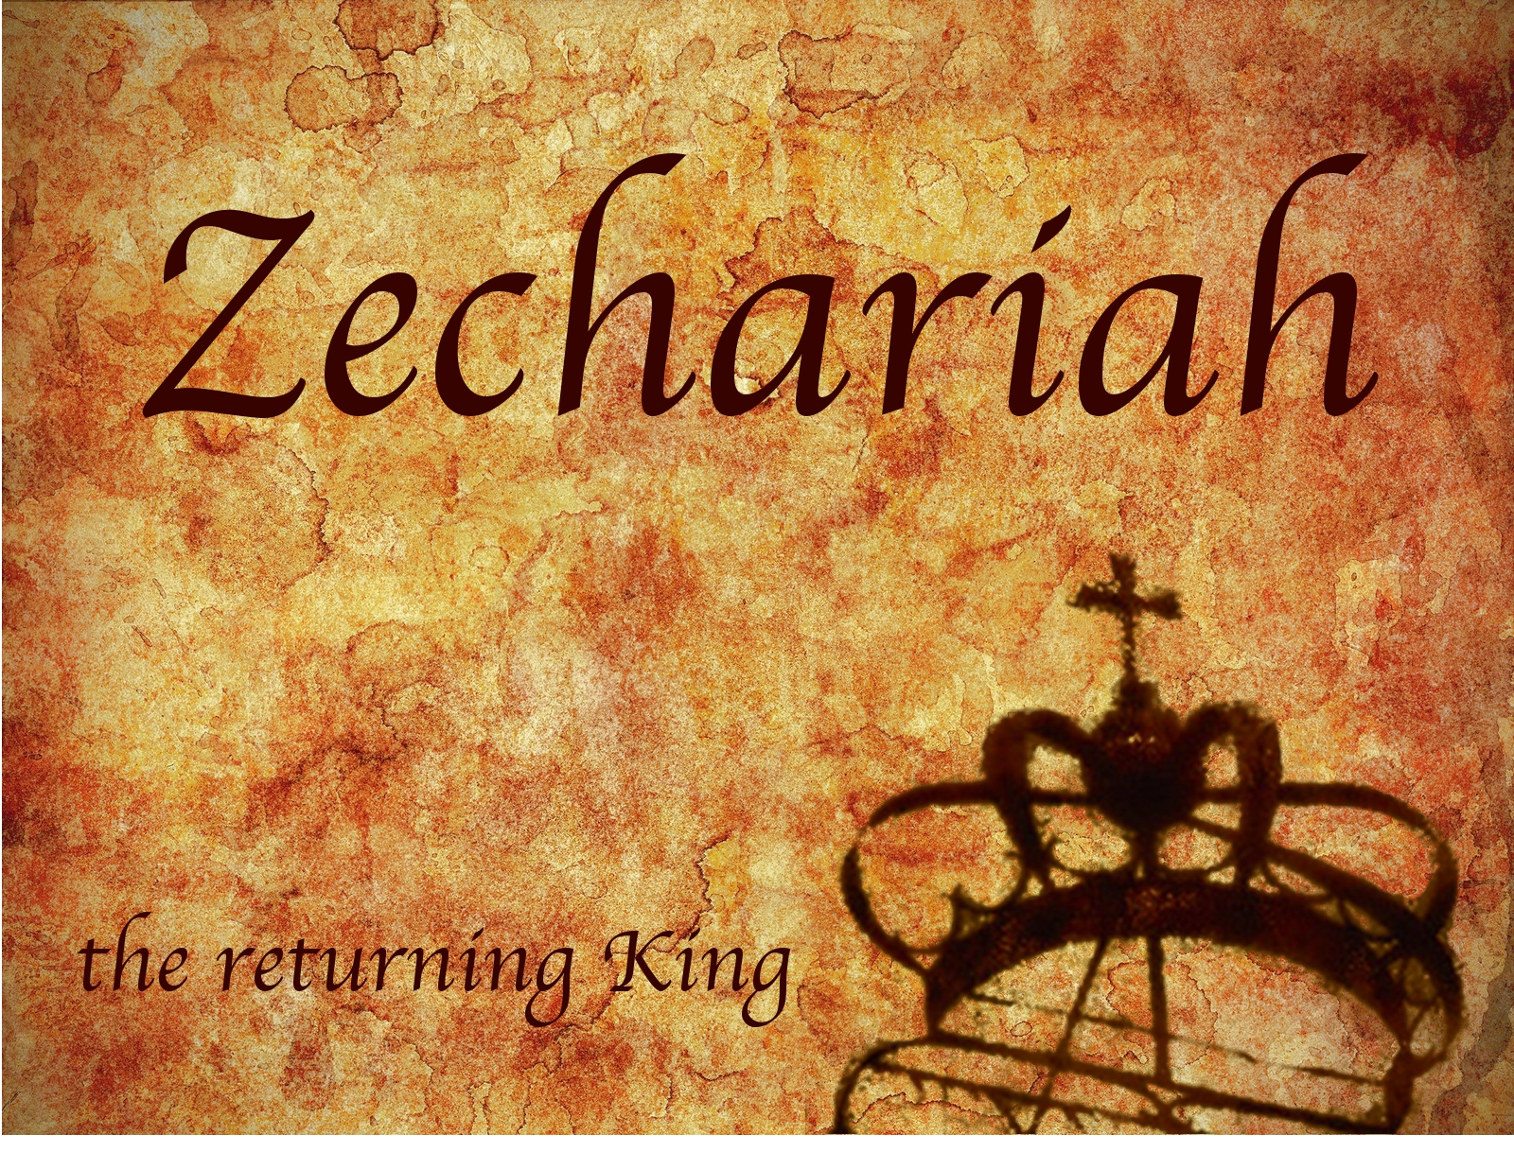
Zechariah
God Remembers!

Slide 2
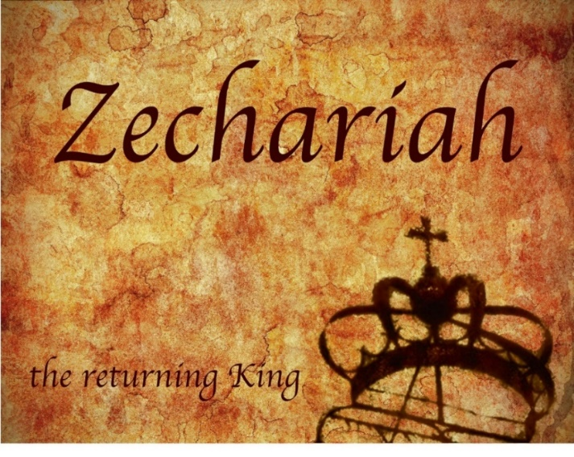
Structure
Introductory call to repentance (1:1-6)
Eight-night visions (1:7–6:15)
Question and answers about fasting (7–8)
Two burdens (9–14)

Slide 3
II. Eight Night Visions (1:7‒6:15)
Riders & horses among the myrtle trees (1:7-17)
Four horns & four craftsmen (1:18-21)
Man with the measuring line (2)
Cleansing of the High Priest Joshua (3)
Lampstand & olive tree (4)
Flying scroll (5:1-4)
Woman in the basket (5:5-11)
Four chariots (6:1-8)
Conclusion: crowning of Joshua (6:9-15)

Slide 4
ZECHARIAH’S EIGHT NIGHT VISIONS
Vision | Reference | Meaning
The Red-horse Rider among the Myrtles | 1:7-17 | God’s anger against the nations & blessing on restored Israel.
The Four Horns & the Four Craftsmen | 1:18-21 | God’s judgement on the nations that afflict Israel.
The Surveyor with a Measuring Line | Chapter 2 | God’s future blessing on restored Israel.
The Cleansing & Crowning of Joshua the Hight Priest. | Chapter 3 | Israel’s future cleansing from sin & reinstatement as a priestly nation.
The Golden Lampstand & the Two Olive Trees | Chapter 4 | Israel as the light to the nations under Messiah, the King-Priest.
The Flying Scroll | 5:1-4 | The severity & totality of divine judgment on individual Israelites.
The Woman in the Ephah | 5:5-11 | The removal of national Israel’s sin of rebellion against God.
The Four Chariots | 6:1-8 | Divine judgment on Gentile nations.

Slide 5
5. The Lampstand & Olive Trees (4:1-14)
Vision Described (1-3)
Setting (1)
Lampstand with seven lamps (2)
Two olive trees (3)
Vision Interpreted (4-14)
God’s strength (4-7)
Zerubbabel to rebuild the Temple (8-10)
God’s two anointed servants (11-14)

Slide 6
5. The Lampstand & Olive Trees (4:1-14)
Vision Described (1-3)
Setting (1)
Lampstand with seven lamps (2)
Two olive trees (3)
Vision Interpreted (4-14)
God’s strength (4-7)
Zerubbabel to rebuild the Temple (8-10)
God’s two anointed servants (11-14)

Slide 7
5. The Lampstand & Olive Trees (4:1-14)
Vision Described (1-3)
Setting (1)
Lampstand with seven lamps (2)
Two olive trees (3)
Vision Interpreted (4-14)
God’s strength (4-7)
Zerubbabel to rebuild the Temple (8-10)
God’s two anointed servants (11-14)

Slide 8
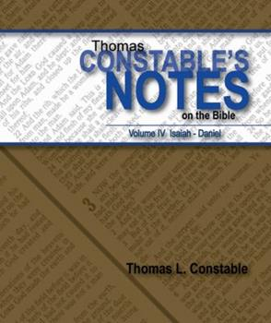
Thomas L. Constable
Constable’s online notes on Zechariah, p. 46.
“Zechariah's guiding angel ‘roused’ the prophet from his visionary slumber. Evidently when the last scene of his vision ended, Zechariah remained in a sleep-like condition. Even in an ecstatic state, human beings remain dull and obtuse to divine revelation, and must receive supernatural enlightenment.”

Slide 9
5. The Lampstand & Olive Trees (4:1-14)
Vision Described (1-3)
Setting (1)
Lampstand with seven lamps (2)
Two olive trees (3)
Vision Interpreted (4-14)
God’s strength (4-7)
Zerubbabel to rebuild the Temple (8-10)
God’s two anointed servants (11-14)

Slide 10
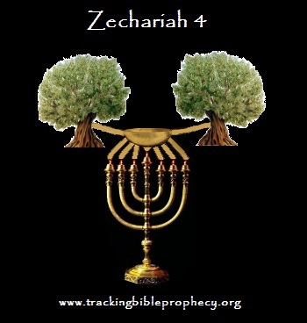

Slide 11
5. The Lampstand & Olive Trees (4:1-14)
Vision Described (1-3)
Setting (1)
Lampstand with seven lamps (2)
Two olive trees (3)
Vision Interpreted (4-14)
God’s strength (4-7)
Zerubbabel to rebuild the Temple (8-10)
God’s two anointed servants (11-14)

Slide 12
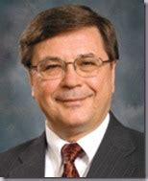
Charles H. Dyer
Old Testament Explorer, p. 824.
“…he saw a gold lampstand, possibly shaped like the menorah that provided light in the temple. Above the lamp was a bowl that served as a reservoir for the olive oil used as fuel in the seven lights at the top of each branch. Individual channels led from the bowl to the lights, providing a constant source of fuel to keep the lamp burning. Beside the reservoir were two olive trees that provided olive oil to keep the reservoir filled. In effect, Zechariah saw a lamp that would never go out because it had a constant supply of oil.”

Slide 13
Thomas L. Constable
Constable’s online notes on Zechariah, p. 48.
“There were also two olive trees, one standing on either side of the bowl. Human maintenance of the lamps was unnecessary, since the oil flowed from the trees, to the reservoir, to the lamps. This important feature of the vision stresses God's singular provision of the oil (cf. v. 6).”

Slide 15
5. The Lampstand & Olive Trees (4:1-14)
Vision Described (1-3)
Setting (1)
Lampstand with seven lamps (2)
Two olive trees (3)
Vision Interpreted (4-14)
God’s strength (4-7)
Zerubbabel to rebuild the Temple (8-10)
God’s two anointed servants (11-14)

Slide 16
5. The Lampstand & Olive Trees (4:1-14)
Vision Described (1-3)
Setting (1)
Lampstand with seven lamps (2)
Two olive trees (3)
Vision Interpreted (4-14)
God’s strength (4-7)
Zerubbabel to rebuild the Temple (8-10)
God’s two anointed servants (11-14)

Slide 18
Matthew 16:18
“I also say to you that you are Peter, and upon this rock I will build [oikodomeō] My church; and the gates of Hades WILL NOT overpower it.”
18

Slide 19
Thomas L. Constable
Constable’s online notes on Zechariah, p. 50.
“The work would only succeed because of the supernatural grace (help) that the Lord would provide by His ‘Spirit’ (cf. Gen. 1:2; Exod. 15:8, 10; 28:3; 31:3; Num. 11:17-29; Judg. 3:10; 6:34; 11:29; 13:25; 14:6, 19; 15:14, 19; 2 Sam. 22:16; Ezek. 37:1-14). This is, of course, true of any work that seeks to carry out God's will in the world (cf. 2 Cor. 12:9).”

Slide 20
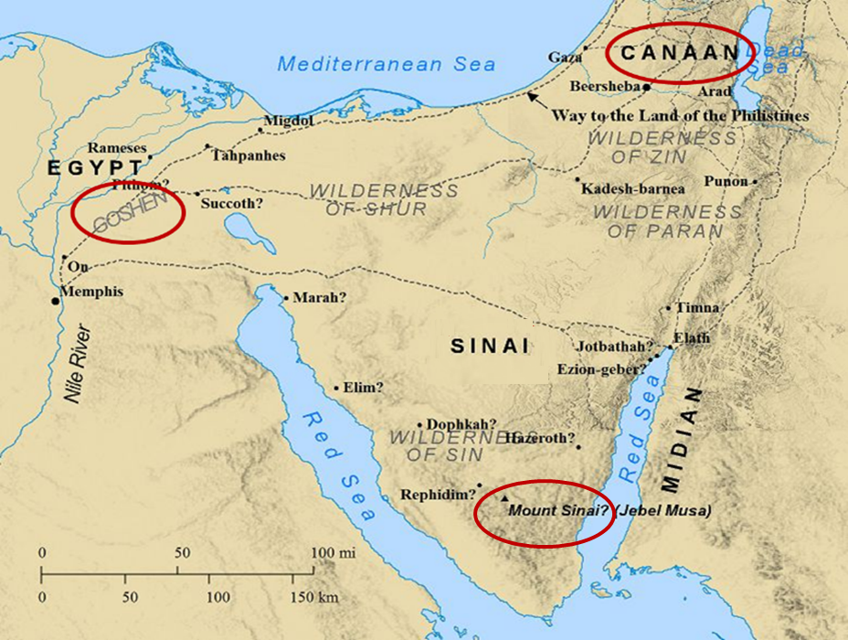

Slide 21
Thomas L. Constable
Constable’s online notes on Zechariah, p. 50-51.
“Mountains epitomize large obstacles (cf. Isa. 40:4; 41:15; 49:11; Matt. 17:20; 21:21; Mark 11:23; 1 Cor. 13:2)…The whole process of temple restoration seemed like a mountainous job to the few exiles who returned from captivity. In addition, there was much opposition to building (Ezra 4:1-5, 24), and the Israelites themselves proved unwilling to persevere in the task (Hag. 1:14; 2:1-9). Nevertheless, God would reduce this mountain to a flat plain by assisting the workers.”

Slide 22
Galatians 3:3
“Are you so foolish? Having begun by the Spirit, are you now being perfected by the flesh?”

Slide 23
5. The Lampstand & Olive Trees (4:1-14)
Vision Described (1-3)
Setting (1)
Lampstand with seven lamps (2)
Two olive trees (3)
Vision Interpreted (4-14)
God’s strength (4-7)
Zerubbabel to rebuild the Temple (8-10)
God’s two anointed servants (11-14)

Slide 24
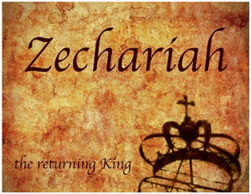
8. Occasion
538 B.C. | Cyrus’ decree | 520‒518 B.C. | Ministries of Zechariah & Haggai
536 B.C. | Temple foundation laid | 519 B.C. | Darius confirms Cyrus’ decree
534 B.C. | Temple building interrupted | ----- | Resumption of Temple building
----- | Temple project stalled for 15 years | 516 B.C. | Temple completed

Slide 25
8. Occasion
538 B.C. ‒ Cyrus’ decree
536 B.C. ‒ Temple foundation laid
534 B.C. ‒ Temple building interrupted
Temple project stalled for 15 years
520‒518 B.C. ‒ Ministries of Zechariah & Haggai
519 B.C. ‒ Darius confirmation of Cyrus’ decree
Resumption of Temple building
516 B.C. ‒ Temple completed

Slide 26
John 13:19; 14:29
“^{13:19} From now on I am telling you before it comes to pass, so that when it does occur, you may believe that I am He… ^{14:29} Now I have told you before it happens, so that when it happens, you may believe.”

Slide 27
ISRAEL’S FOUR TEMPLES
Solomon’s pre-exilic temple (Kings and Chronicles)
Zerubbabel’s post exilic temple (Ezra 1-6; John 2:20)
Antichrist's temple (Dan. 9:27; Matt. 24:15; 2 Thess. 2:4; Rev. 11:1-2)
Millennial temple (Ezek. 40-48)

Slide 28
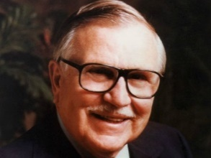
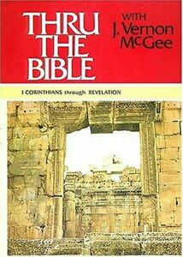
J. V. McGee
McGee, J. Vernon. Thru the Bible with J. Vernon McGee. 5 vols. Pasadena, Calif.: Thru The Bible Radio; and Nashville: Thomas Nelson, Inc., 1983. p. 3:924.
“'For who hath despised the day of small things?' I can tell you who has—we despise the day of small things. We Americans are impressed with the big and brassy. We like our Christian work to be a success story. And we measure success by the size of the building and the crowds that come to it. Well, I am becoming more and more convinced that the Lord is working in quiet ways and in quiet places today.”

Slide 29
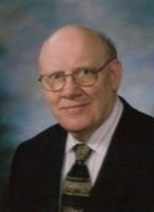
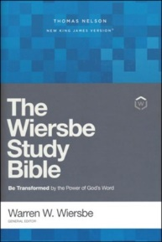
Warren Wiersbe
Wiersbe, Warren W. "Zechariah." In The Bible Exposition Commentary/Prophets, pp. 447-76. Colorado Springs, Colo.: Cook Communications Ministries; and Eastbourne, England: Kingsway Communications Ltd., 2002. P. 456.
“Bible history is the record of God using small things. When God wanted to set the plan of salvation in motion, He started with a little baby named Isaac (Gen. 21). When He wanted to overthrow Egypt and set His people free, He used a baby's tears (Ex. 2:1-10). He used a shepherd boy and a sling to defeat a giant (1 Sam. 17) and a little lad's lunch to feed a multitude (John 6). He delivered the Apostle Paul from death by using a basket and a rope (Acts 9:23-25). Never despise the day of small things, for God is glorified in small things and uses them to accomplish great things.”

Slide 30
Thomas L. Constable
Constable’s online notes on Zechariah, p. 52.
“The people would be ashamed that they had despised the rebuilding project as insignificant (cf. Ezra 3:12; Hag. 2:3). The Lord Himself was ‘glad’ to ‘see…Zerubbabel’ building with his ‘plumb line,’ as His omniscient eyes (‘these seven’) surveyed all that was happening in the world, especially in Jerusalem (cf. 3:9; 2 Chron. 16:9). The Hebrew words translated ‘plumb line’ may mean ‘separated [i.e., chosen] stone.’ In this case, the idea would be that the Lord, in addition to His people, would rejoice when He saw the capstone put in place (cf. v. 7; Ezra 6:16-22).”

Slide 31
5. The Lampstand & Olive Trees (4:1-14)
Vision Described (1-3)
Setting (1)
Lampstand with seven lamps (2)
Two olive trees (3)
Vision Interpreted (4-14)
God’s strength (4-7)
Zerubbabel to rebuild the Temple (8-10)
God’s two anointed servants (11-14)

Slide 33
Thomas L. Constable
Constable’s online notes on Zechariah, p. 53.
“Again the interpreting angel expressed surprise that Zechariah needed an explanation of these things (cf. v. 5). He did not want to give an interpretation if Zechariah could figure it out himself. Normally God does not provide additional information until we have done all we can to discover His meaning. To do so would discourage human effort Godward.”

Slide 34
Thomas L. Constable
Constable’s online notes on Zechariah, p. 54-55.
“The point of this vision, and its accompanying oracles, was the Lord's ability to bring a seemingly impossible project to completion—successfully and gloriously—through His anointed servants (Messiah, and Zerubbabel and Joshua) and His supernatural enablement (cf. 2 Cor. 12:9). The lesson is applicable to any project that God has ordained and called His people to execute, including rebuilding the temple and building the church (Matt. 16:18).”

Slide 35
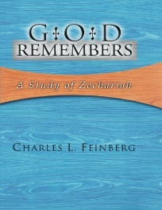
Charles L. Feinberg
God Remembers: A Study of Zechariah (Wheaton: Van Kampen, 1950, p. 81.
“To recapitulate, the chief features of this message to Zerubbabel were: (1) the insufficiency and inadequacy of all human strength and resources; (2) the all sufficiency of the power of the Spirit of God for the accomplishment of the work of God; (3) the unceasing, abundant, and inexhaustible supply of this power at his, Zerubbabel’s disposal; (4) the assurance of the obliteration of all hindrances to the building; (5) the heartening hope of the completion of the work by the one commencing it; (6) the importance of the entire work of building as a prefiguring of the activity of the Messiah in a coming day; (7) the delight of God in the construction of the temple; (8) the positions of privilege of both Joshua and Zerubbabel as the media whereby the testimony of God is transmitted to the people; and (9) the typifying of the ministry of the Messiah in both the religious and civil offices.”

Slide 36
Conclusion

Slide 37
5. The Lampstand & Olive Trees (4:1-14)
Vision Described (1-3)
Setting (1)
Lampstand with seven lamps (2)
Two olive trees (3)
Vision Interpreted (4-14)
God’s strength (4-7)
Zerubbabel to rebuild the Temple (8-10)
God’s two anointed servants (11-14)

Slide 38
II. Eight Night Visions (1:7‒6:15)
Riders & horses among the myrtle trees (1:7-17)
Four horns & four craftsmen (1:18-21)
Man with the measuring line (2)
Cleansing of the High Priest Joshua (3)
Lampstand & olive tree (4)
Flying scroll (5:1-4)
Woman in the basket (5:5-11)
Four chariots (6:1-8)
Conclusion: crowning of Joshua (6:9-15)

