Slide 1


Genesis 12‒50
Israel’s Birth & Preservation

Slide 2


GENESIS STRUCTURE
  Beginning of the Human race (Gen. 1‒11)
  Beginning of the Hebrew race (Gen. 12‒50)

Slide 3

GENESIS STRUCTURE
  Genesis 1-11 (four events)
    Creation (1-2)
    Fall (3-5)
    Flood (6-9)
    National dispersion (10-11)

Slide 4


Genesis 3:15
“And I will put enmity Between you and the woman, And between your seed and her seed; He shall bruise you on the head, And you shall bruise him on the heel.”

Slide 5
GENESIS STRUCTURE
  Beginning of the Human race (Gen. 1‒11)
  Beginning of the Hebrew race (Gen. 12‒50)

Slide 6

GENESIS STRUCTURE
  Genesis 12-50 (four people)
    Abraham (12:1–25:11)
    Isaac (25:12–26:35)
    Jacob (27–36)
    Joseph (37–50)

Slide 7


Isaiah 43:1
“But now, thus says the Lord, your Creator, O Jacob, And He who formed you, O Israel, 'Do not fear, for I have redeemed you; I have called you by name; you are Mine!'”

Slide 8
GENESIS STRUCTURE
  Genesis 12-50 (four people)
    Abraham (12:1–25:11)
    Isaac (25:12–26:35)
    Jacob (27–36)
    Joseph (37–50)

Slide 9
Genesis 12‒13
Abram’s Early Journeys
  Unconditional promises (Gen. 12:1-3)
  From Haran to Canaan (Gen. 12:4-5)
  In Canaan (Gen. 12:6-9)
  In Egypt (Gen. 12:10-20)
  Abram and Lot Separate (Gen. 13:1-13)
  Reaffirmation of Abram’s promises (Gen. 13:14-18)

Slide 10
Genesis 12‒13
Abram’s Early Journeys
  Unconditional promises (Gen. 12:1-3)
  From Haran to Canaan (Gen. 12:4-5)
  In Canaan (Gen. 12:6-9)
  In Egypt (Gen. 12:10-20)
  Abram and Lot Separate (Gen. 13:1-13)
  Reaffirmation of Abram’s promises (Gen. 13:14-18)

Slide 11
VI. 8 New Promises
Genesis 12:1-3
    Land (Gen. 12:1b)
    Great nation (Gen. 12:2a)
    Personal blessing (Gen. 12:2b)
    Great name (Gen. 12:2c)
    Blessing to others (Gen. 12:2d)
    Blessing to blessers (Gen. 12:3a)
    Cursing to cursers (Gen. 12:3b)
    Blessing to the world (Gen. 12:3c)

Slide 12


Slide 13
Genesis 12‒13
Abram’s Early Journeys
  Unconditional promises (Gen. 12:1-3)
  From Haran to Canaan (Gen. 12:4-5)
  In Canaan (Gen. 12:6-9)
  In Egypt (Gen. 12:10-20)
  Abram and Lot Separate (Gen. 13:1-13)
  Reaffirmation of Abram’s promises (Gen. 13:14-18)

Slide 15
Genesis 12‒13
Abram’s Early Journeys
  Unconditional promises (Gen. 12:1-3)
  From Haran to Canaan (Gen. 12:4-5)
  In Canaan (Gen. 12:6-9)
  In Egypt (Gen. 12:10-20)
  Abram and Lot Separate (Gen. 13:1-13)
  Reaffirmation of Abram’s promises (Gen. 13:14-18)

Slide 16
Genesis 12‒13
Abram’s Early Journeys
  Unconditional promises (Gen. 12:1-3)
  From Haran to Canaan (Gen. 12:4-5)
  In Canaan (Gen. 12:6-9)
  In Egypt (Gen. 12:10-20)
  Abram and Lot Separate (Gen. 13:1-13)
  Reaffirmation of Abram’s promises (Gen. 13:14-18)

Slide 17


Slide 18
Genesis 12‒13
Abram’s Early Journeys
  Unconditional promises (Gen. 12:1-3)
  From Haran to Canaan (Gen. 12:4-5)
  In Canaan (Gen. 12:6-9)
  In Egypt (Gen. 12:10-20)
  Abram and Lot Separate (Gen. 13:1-13)
  Reaffirmation of Abram’s promises (Gen. 13:14-18)

Slide 19
Genesis 13:1‒13
Abraham & Lot Divide
  From Egypt to the Negev (1-2)
  From the Negev to Bethel & Ai (3-4)
  Conflict Among the Herdsmen (5-7)
  Abram’s Offer (8-9)
  Lot’s Response (10-11a)
  Separation (11b-12)
  Divine Commentary on Sodom (13)

Slide 20

Genesis 6:11-13
“¹¹ Now the earth was corrupt in the sight of God, and the earth was filled with violence. ¹² And God looked on the earth, and behold, it was corrupt; for humanity had corrupted its way upon the earth. ¹³ Then God said to Noah, ‘The end of humanity has come before Me; for the earth is filled with violence because of people; and behold, I am about to destroy them with the earth.’”

Slide 21


Dr. Arnold G. Fruchtenbaum
The Book of Genesis, 255
“The section closes with 13:13 giving the divine evaluation of Sodom: Now the men of Sodom were wicked. The Hebrew word for wicked describes external wickedness. It goes on to state they were sinners against Jehovah exceedingly. The Hebrew means ‘very sinners.’ Moreover, they were ‘very sinners’ against Jehovah, meaning God was offended…There is also a parallel here with the account of Noah. In both cases there is a concern of extreme wickedness (6:5, 8:21), and this corruption had to be wiped out (6:12–13, 19:13). In both accounts, it was one person and family that was spared.”

Slide 22
Genesis 12‒13
Abram’s Early Journeys
  Unconditional promises (Gen. 12:1-3)
  From Haran to Canaan (Gen. 12:4-5)
  In Canaan (Gen. 12:6-9)
  In Egypt (Gen. 12:10-20)
  Abram and Lot Separate (Gen. 13:1-13)
  Reaffirmation of Abram’s promises (Gen. 13:14-18)

Slide 23
Genesis 13:14‒18
Abram’s Promises Reaffirmed
  The Dimensions (14)
  The Donation (15a)
  The Duration (15b)
  The Descendants (16)
  The Destination (17)
  The Departure (18)

Slide 24
Genesis 13:14‒18
Abram’s Promises Reaffirmed
  The Dimensions (14)
  The Donation (15a)
  The Duration (15b)
  The Descendants (16)
  The Destination (17)
  The Departure (18)

Slide 25
Dr. Arnold G. Fruchtenbaum
The Book of Genesis, 240
“This is the first of seven times that Abraham receives a direct revelation from God. In 12:1–3 is God’s initial call to Abram outside the Land of Canaan; in 12:7 is the first appearance to Abraham in the Land; in 13:14–17, Abraham encounters God after the separation of Lot; in 15:1–21, God signs and seals the Abrahamic Covenant; in 17:1–21, Abraham receives the token of the covenant; in 18:1–33, God speaks to him in conjunction with the destruction of Sodom; and in 22:1–2 and 22:11–18, God directs Abraham to offer Isaac.”

Slide 26
VI. 8 New Promises
Genesis 12:1-3
    Land (Gen. 12:1b)
    Great nation (Gen. 12:2a)
    Personal blessing (Gen. 12:2b)
    Great name (Gen. 12:2c)
    Blessing to others (Gen. 12:2d)
    Blessing to blessers (Gen. 12:3a)
    Cursing to cursers (Gen. 12:3b)
    Blessing to the world (Gen. 12:3c)

Slide 27


Proverbs 3:5-6
“Trust in the Lord with all your heart And do not lean on your own understanding. In all your ways acknowledge Him, And He will make your paths straight.”

Slide 28
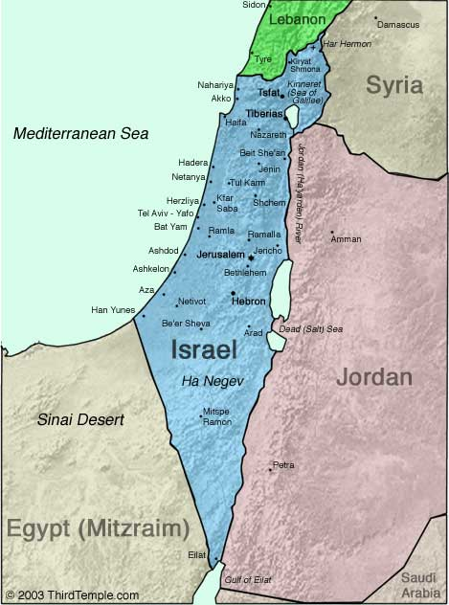
Negev

Slide 29


Slide 30
Genesis 13:14‒18
Abram’s Promises Reaffirmed
  The Dimensions (14)
  The Donation (15a)
  The Duration (15b)
  The Descendants (16)
  The Destination (17)
  The Departure (18)

Slide 31
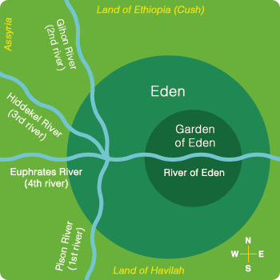

Slide 33
Genesis 13:14‒18
Abram’s Promises Reaffirmed
  The Dimensions (14)
  The Donation (15a)
  The Duration (15b)
  The Descendants (16)
  The Destination (17)
  The Departure (18)

Slide 34

Psalm 90:2
“Before the mountains were born Or You gave birth to the earth and the world, Even from everlasting (olam) to everlasting (olam), You are God.”

Slide 35
Daniel 12:2
“Many of those who sleep in the dust of the ground will awake, these to everlasting (olam) life, but the others to disgrace and everlasting (olam) contempt.”

Slide 36
Israel's Judgments
Division of the kingdom in 931 B.C. (1 Kgs. 12)
Assyrian judgment in 722 B.C. (2 Kgs. 17)
Babylonian captivity in 586 B.C. (2 Kgs. 25)
Rome Diaspora in A.D. 70 (Luke 19:41-44)

Slide 37


Slide 38
Genesis 13:14‒18
Abram’s Promises Reaffirmed
  The Dimensions (14)
  The Donation (15a)
  The Duration (15b)
  The Descendants (16)
  The Destination (17)
  The Departure (18)

Slide 39


Slide 40
Genesis 13:14‒18
Abram’s Promises Reaffirmed
  The Dimensions (14)
  The Donation (15a)
  The Duration (15b)
  The Descendants (16)
  The Destination (17)
  The Departure (18)

Slide 41
Negev

Slide 42
Israel's Judgments
Division of the kingdom in 931 B.C. (1 Kgs. 12)
Assyrian judgment in 722 B.C. (2 Kgs. 17)
Babylonian captivity in 586 B.C. (2 Kgs. 25)
Rome Diaspora in A.D. 70 (Luke 19:41-44)

Slide 44
Dr. Arnold G. Fruchtenbaum
The Book of Genesis, 258
“It is verses like this that become totally meaningless in the amillennial view of the end times, which interprets the Land promise as nothing more than a symbol of Heaven. Such a view, which denies that a literal thousand-year reign of Messiah on the earth is prophesied by the Bible, renders verses such as 13:17 totally nonsensical. Is God asking Abram here to come up to Heaven and take a look around to see if he likes it because someday he is going to get to possess Heaven? This is hardly the meaning of the text. The text is obviously talking about a piece of real estate upon which he was living at that time.”

Slide 45
Dr. Arnold G. Fruchtenbaum
The Book of Genesis, 258
“He was told to walk around with his feet all over the Land, because someday he was going to possess it. A view like this cannot just be spiritualized away in order to make it fit a preconceived theology. No doubt, the New Testament teaches Abram also looked for a city, a heavenly one; but one aspect does not contradict the other or cancel out the other. It is not “either/or” but “both/and.” Abram was promised both a physical inheritance on earth as well as a spiritual one in Heaven.”

Slide 46
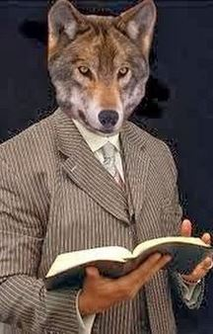
“He (or she) who spiritualizes tells spiritual lies.”

Slide 48
Genesis 13:14‒18
Abram’s Promises Reaffirmed
  The Dimensions (14)
  The Donation (15a)
  The Duration (15b)
  The Descendants (16)
  The Destination (17)
  The Departure (18)

Slide 49
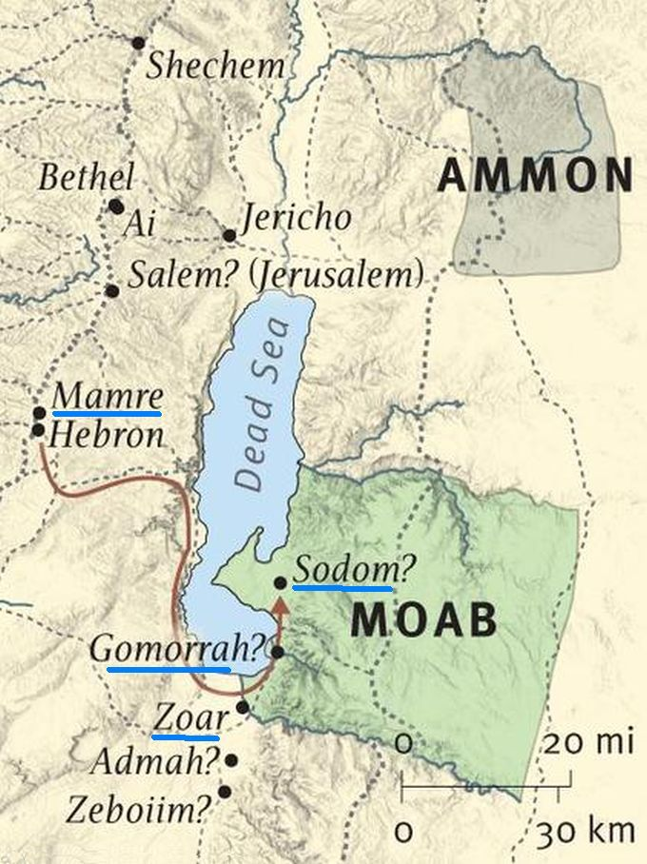

Slide 50

GENESIS 10
Outline
  Introduction (1)
  Japheth's line (2-5)
  Ham’s Line (6-20)
  Shem’s line (21-31)
  Conclusion (32)

Slide 51
Ham’s Sons (vs. 6)
  Cush
  Mizraim
  Put
  Canaan

Slide 52
4. Canaan’s Sons (vs. 15-18)
    Sidon
    Heth
    Jebusite
    Amorite
    Girgashite
    Hivite
    Arkite
    Sinite
    Arvadite
    Zemarite
    Hamathite
    Perrizite

Slide 53
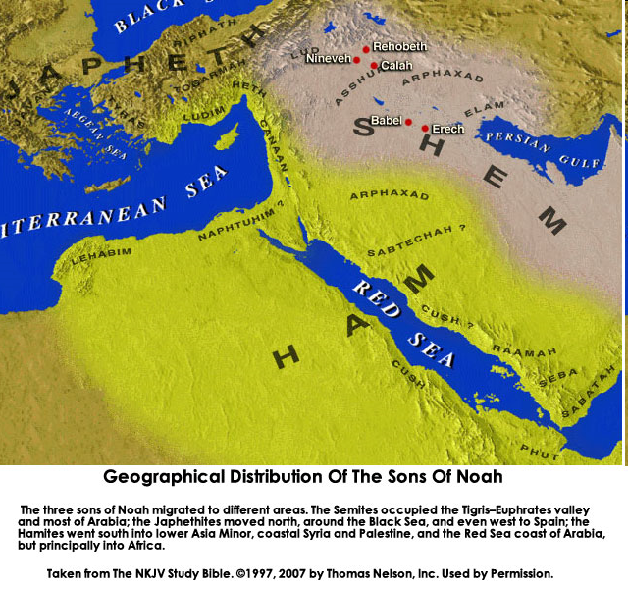
CANNAN

Slide 54
Dr. Arnold G. Fruchtenbaum
The Book of Genesis, 258-59
“This way, he would get to know the Land very well. As he walked through the Land, he took physical possession of the Land, prophetically speaking, since he did not get to own the Land in his lifetime; but he will own the Land in the Messianic Kingdom…Here also: He built an altar unto Jehovah by the oaks of Mamre. Again, Abram built a true altar in a pagan worship place. By walking through the Land, Abram was prophetically taking physical possession of the Land; and by building these altars in pagan places, Abram was also taking spiritual possession of the Land.”

Slide 55
Conclusion

Slide 56
Genesis 13:14‒18
Abram’s Promises Reaffirmed
  The Dimensions (14)
  The Donation (15a)
  The Duration (15b)
  The Descendants (16)
  The Destination (17)
  The Departure (18)

Slide 57

“The Lord bless you and keep you; the Lord make his face shine on you and be gracious to you; the Lord turn his face toward you and give you peace.” (NIV)

