Slide 1
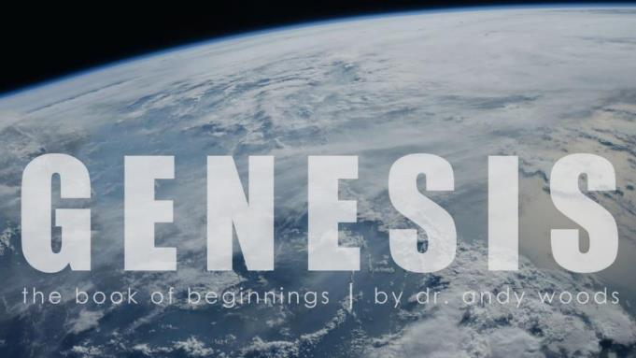
Genesis 12‒50
Israel’s Birth & Preservation

Slide 2
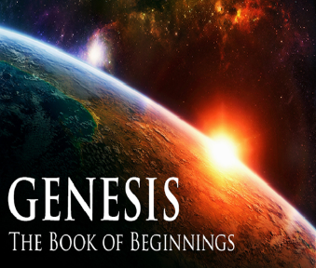
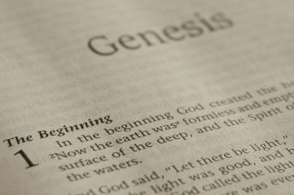
GENESIS STRUCTURE
Beginning of the Human race (Gen. 1‒11)
Beginning of the Hebrew race (Gen. 12‒50)

Slide 3
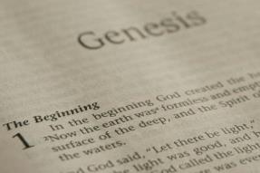
GENESIS STRUCTURE
Genesis 1-11 (four events)
Creation (1-2)
Fall (3-5)
Flood (6-9)
National dispersion (10-11)

Slide 4
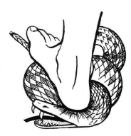
Genesis 3:15
“And I will put enmity Between you and the woman, And between your seed and her seed; He shall bruise you on the head, And you shall bruise him on the heel.”

Slide 5
GENESIS STRUCTURE
Beginning of the Human race (Gen. 1‒11)
Beginning of the Hebrew race (Gen. 12‒50)

Slide 6
GENESIS STRUCTURE
Genesis 12-50 (four people)
Abraham (12:1–25:11)
Isaac (25:12–26:35)
Jacob (27–36)
Joseph (37–50)

Slide 7
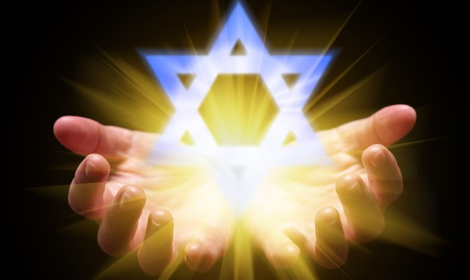
Isaiah 43:1
“But now, thus says the Lord, your Creator, O Jacob, And He who formed you, O Israel, 'Do not fear, for I have redeemed you; I have called you by name; you are Mine!'”

Slide 8
GENESIS STRUCTURE
Genesis 12-50 (four people)
Abraham (12:1–25:11)
Isaac (25:12–26:35)
Jacob (27–36)
Joseph (37–50)

Slide 9
Genesis 12‒13 Abram’s Early Journeys
Unconditional promises (Gen. 12:1-3)
From Haran to Canaan (Gen. 12:4-5)
In Canaan (Gen. 12:6-9)
In Egypt (Gen. 12:10-20)
Abram and Lot Separate (Gen. 13:1-13)

Slide 10
Genesis 12‒13 Abram’s Early Journeys
Unconditional promises (Gen. 12:1-3)
From Haran to Canaan (Gen. 12:4-5)
In Canaan (Gen. 12:6-9)
In Egypt (Gen. 12:10-20)
Abram and Lot Separate (Gen. 13:1-13)

Slide 11
VI. 8 New Promises Genesis 12:1-3
Land (Gen. 12:1b)
Great nation (Gen. 12:2a)
Personal blessing (Gen. 12:2b)
Great name (Gen. 12:2c)
Blessing to others (Gen. 12:2d)
Blessing to blessers (Gen. 12:3a)
Cursing to cursers (Gen. 12:3b)
Blessing to the world (Gen. 12:3c)

Slide 12
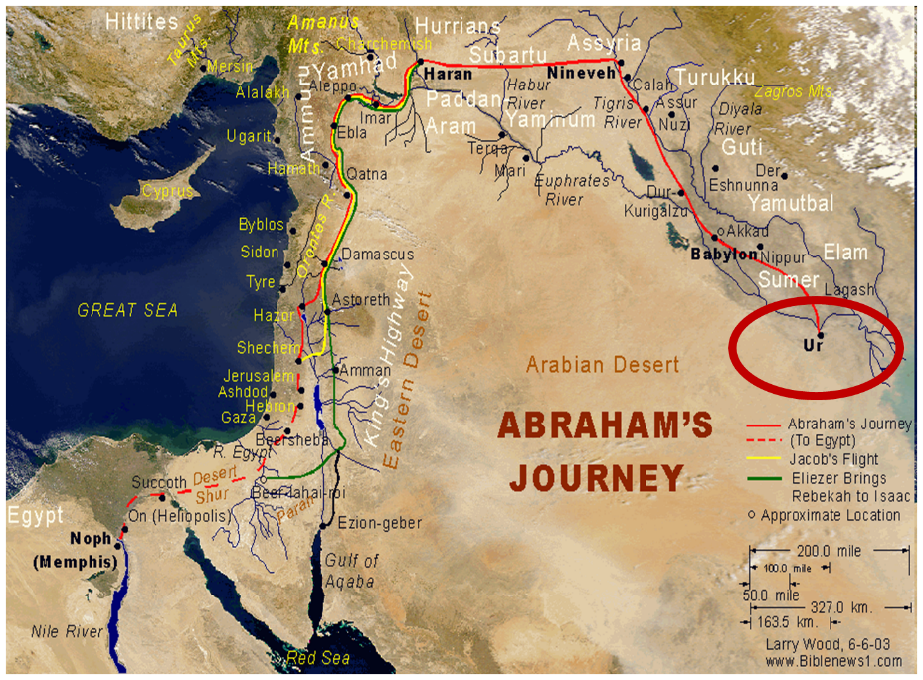

Slide 13
Genesis 12‒13 Abram’s Early Journeys
Unconditional promises (Gen. 12:1-3)
From Haran to Canaan (Gen. 12:4-5)
In Canaan (Gen. 12:6-9)
In Egypt (Gen. 12:10-20)
Abram and Lot Separate (Gen. 13:1-13)

Slide 15
Genesis 12‒13 Abram’s Early Journeys
Unconditional promises (Gen. 12:1-3)
From Haran to Canaan (Gen. 12:4-5)
In Canaan (Gen. 12:6-9)
In Egypt (Gen. 12:10-20)
Abram and Lot Separate (Gen. 13:1-13)

Slide 16
Genesis 12‒13 Abram’s Early Journeys
Unconditional promises (Gen. 12:1-3)
From Haran to Canaan (Gen. 12:4-5)
In Canaan (Gen. 12:6-9)
In Egypt (Gen. 12:10-20)
Abram and Lot Separate (Gen. 13:1-13)

Slide 17
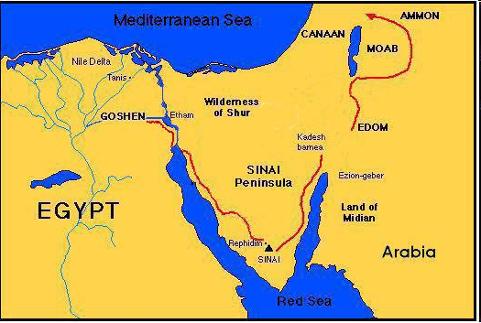

Slide 19
Genesis 12‒13 Abram’s Early Journeys
Unconditional promises (Gen. 12:1-3)
From Haran to Canaan (Gen. 12:4-5)
In Canaan (Gen. 12:6-9)
In Egypt (Gen. 12:10-20)
Abram and Lot Separate (Gen. 13:1-13)

Slide 20
Genesis 13:1‒13 Abraham & Lot Divide
From Egypt to the Negev (1-2)
From the Negev to Bethel & Ai (3-4)
Conflict Among the Herdsmen (5-7)
Abram’s Offer (8-9)
Lot’s Response (10-11a)
Separation (11b-12)
Divine Commentary on Sodom (13)

Slide 21
Genesis 13:1‒13 Abraham & Lot Divide
From Egypt to the Negev (1-2)
From the Negev to Bethel & Ai (3-4)
Conflict Among the Herdsmen (5-7)
Abram’s Offer (8-9)
Lot’s Response (10-11a)
Separation (11b-12)
Divine Commentary on Sodom (13)

Slide 23
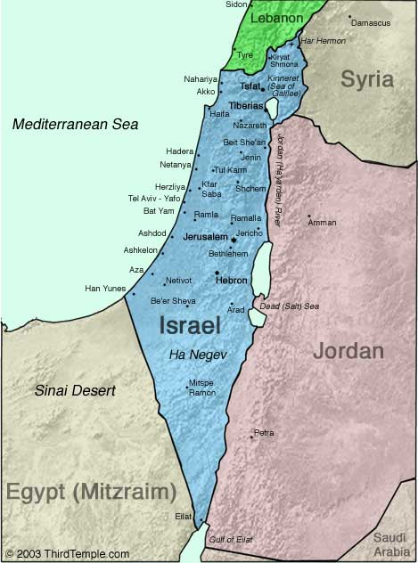
Negev

Slide 24
VI. 8 New Promises Genesis 12:1-3
Land (Gen. 12:1b)
Great nation (Gen. 12:2a)
Personal blessing (Gen. 12:2b)
Great name (Gen. 12:2c)
Blessing to others (Gen. 12:2d)
Blessing to blessers (Gen. 12:3a)
Cursing to cursers (Gen. 12:3b)
Blessing to the world (Gen. 12:3c)

Slide 25
Genesis 13:1‒13 Abraham & Lot Divide
From Egypt to the Negev (1-2)
From the Negev to Bethel & Ai (3-4)
Conflict Among the Herdsmen (5-7)
Abram’s Offer (8-9)
Lot’s Response (10-11a)
Separation (11b-12)
Divine Commentary on Sodom (13)

Slide 26
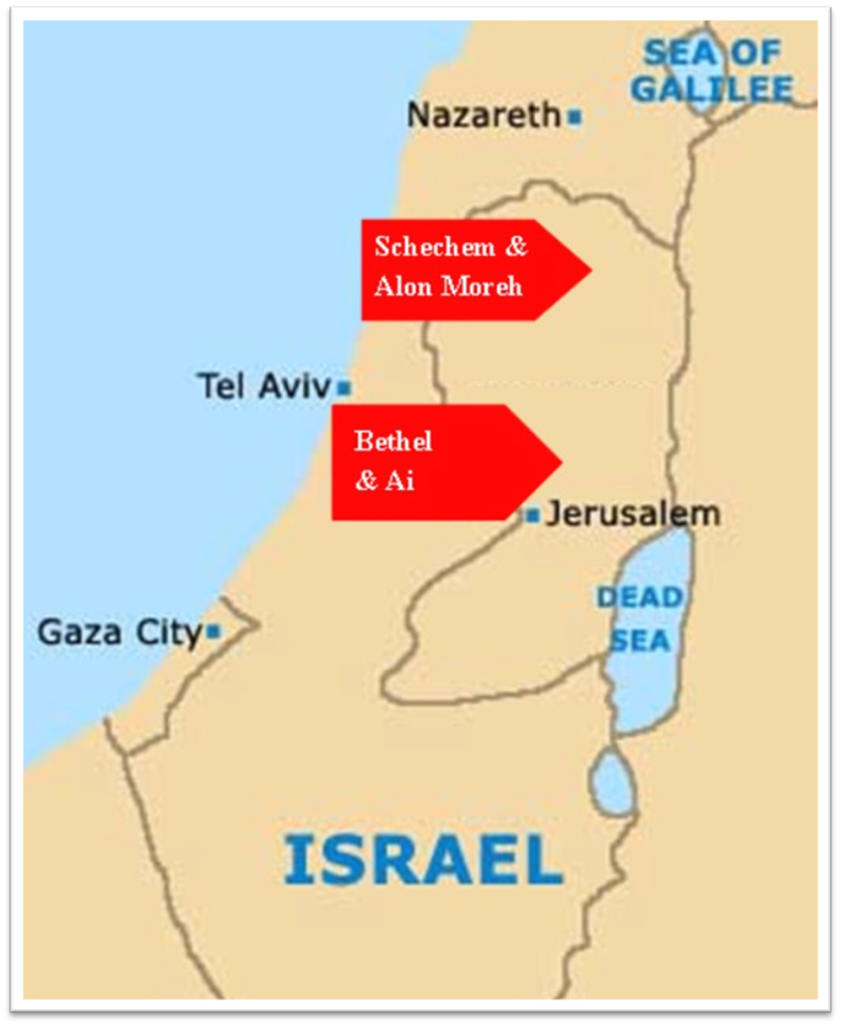

Slide 27
Genesis 13:1‒13 Abraham & Lot Divide
From Egypt to the Negev (1-2)
From the Negev to Bethel & Ai (3-4)
Conflict Among the Herdsmen (5-7)
Abram’s Offer (8-9)
Lot’s Response (10-11a)
Separation (11b-12)
Divine Commentary on Sodom (13)

Slide 28
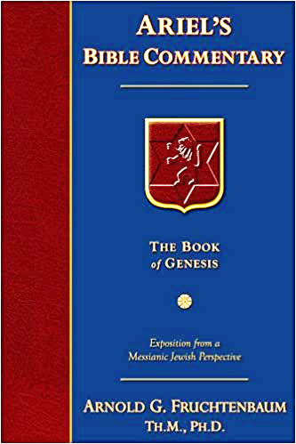
Dr. Arnold G. Fruchtenbaum
The Book of Genesis, 254
“The Hebrew word for strife is merivah, the same word used of the strife in the Wilderness Wanderings (Exod. 17:7; Num. 20:13, 20:24, 27:14; Ps. 81:7, 95:8). While in Exodus, Numbers, and the Psalms the word merivah became a technical name for a specific place in the Sinai wilderness, here the word is used merely as a descriptive term for what is going on...”

Slide 29
GENESIS 10 Outline
Introduction (1)
Japheth's line (2-5)
Ham’s Line (6-20)
Shem’s line (21-31)
Conclusion (32)

Slide 30
Ham’s Sons (vs. 6)
Cush
Mizraim
Put
Canaan

Slide 31
4. Canaan’s Sons (vs. 15-18)
Sidon
Heth
Jebusite
Amorite
Girgashite
Hivite
Arkite
Sinite
Arvadite
Zemarite
Hamathite
Perrizite

Slide 32
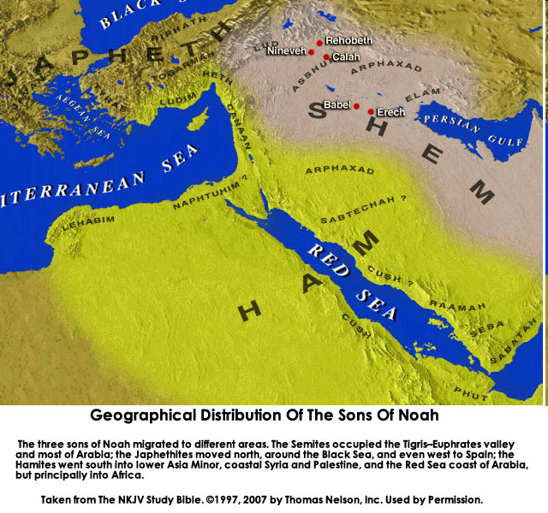

Slide 33
Genesis 13:1‒13 Abraham & Lot Divide
From Egypt to the Negev (1-2)
From the Negev to Bethel & Ai (3-4)
Conflict Among the Herdsmen (5-7)
Abram’s Offer (8-9)
Lot’s Response (10-11a)
Separation (11b-12)
Divine Commentary on Sodom (13)

Slide 34
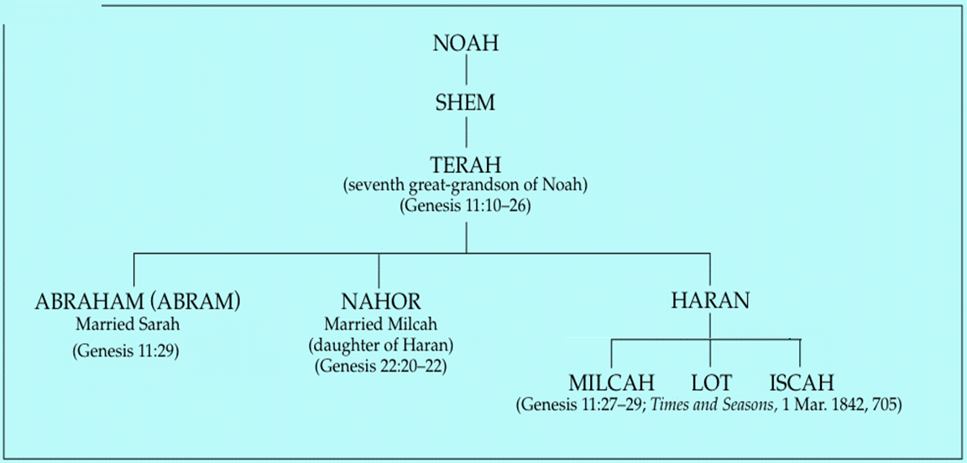

Slide 35
Genesis 13:1‒13 Abraham & Lot Divide
From Egypt to the Negev (1-2)
From the Negev to Bethel & Ai (3-4)
Conflict Among the Herdsmen (5-7)
Abram’s Offer (8-9)
Lot’s Response (10-11a)
Separation (11b-12)
Divine Commentary on Sodom (13)

Slide 36
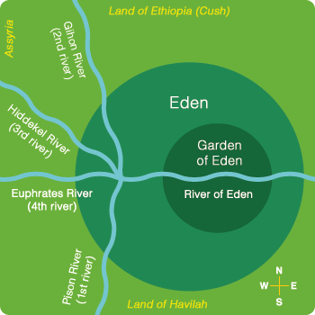

Slide 38
Genesis 13:1‒13 Abraham & Lot Divide
From Egypt to the Negev (1-2)
From the Negev to Bethel & Ai (3-4)
Conflict Among the Herdsmen (5-7)
Abram’s Offer (8-9)
Lot’s Response (10-11a)
Separation (11b-12)
Divine Commentary on Sodom (13)

Slide 39
Dr. Arnold G. Fruchtenbaum
The Book of Genesis, 256
“Before leaving the discussion of Abram and Lot’s separation, it should be noted that Lot’s progression and association went through five steps. First, he looked toward Sodom and could see what good territory that was (13:10). Second, he chose the area of Sodom (13:11). Third, he pitched his tent near Sodom (13:12); and at this point, he was outside the city, still living the life of a nomad just as earlier Abram was outside Shechem and outside Bethel. Fourth, Lot lived in Sodom (Gene. 14:11–12, II Pet. 2:7–8); and fifth, he sat at the Gate of Sodom, meaning he became a citizen of the city, and he became an elder of the city (19:1).”

Slide 40
Genesis 13:1‒13 Abraham & Lot Divide
From Egypt to the Negev (1-2)
From the Negev to Bethel & Ai (3-4)
Conflict Among the Herdsmen (5-7)
Abram’s Offer (8-9)
Lot’s Response (10-11a)
Separation (11b-12)
Divine Commentary on Sodom (13)

Slide 41
Genesis 6:11-13
“¹¹ Now the earth was corrupt in the sight of God, and the earth was filled with violence. ¹² And God looked on the earth, and behold, it was corrupt; for humanity had corrupted its way upon the earth. ¹³ Then God said to Noah, ‘The end of humanity has come before Me; for the earth is filled with violence because of people; and behold, I am about to destroy them with the earth.’”

Slide 42
Dr. Arnold G. Fruchtenbaum
The Book of Genesis, 255
“The section closes with 13:13 giving the divine evaluation of Sodom: Now the men of Sodom were wicked. The Hebrew word for wicked describes external wickedness. It goes on to state they were sinners against Jehovah exceedingly. The Hebrew means ‘very sinners.’ Moreover, they were ‘very sinners’ against Jehovah, meaning God was offended…There is also a parallel here with the account of Noah. In both cases there is a concern of extreme wickedness (6:5, 8:21), and this corruption had to be wiped out (6:12–13, 19:13). In both accounts, it was one person and family that was spared.”

Slide 43
Conclusion

Slide 44
Genesis 13:1‒13 Abraham & Lot Divide
From Egypt to the Negev (1-2)
From the Negev to Bethel & Ai (3-4)
Conflict Among the Herdsmen (5-7)
Abram’s Offer (8-9)
Lot’s Response (10-11a)
Separation (11b-12)
Divine Commentary on Sodom (13)

Slide 45
“The Lord bless you and keep you; the Lord make his face shine on you and be gracious to you; the Lord turn his face toward you and give you peace.” (NIV)

