Slide 1
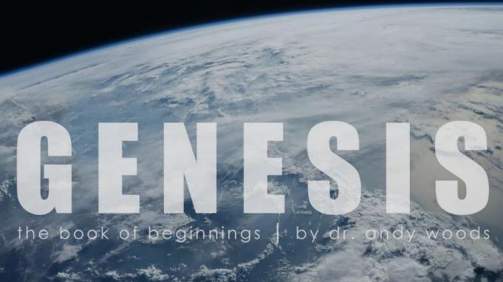

Genesis 10‒11
National Dispersion

Slide 2

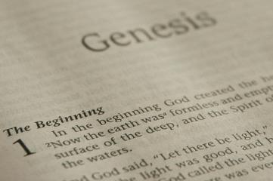
GENESIS STRUCTURE
  Beginning of the Human race (Gen. 1‒11)
  Beginning of the Hebrew race (Gen. 12‒50)

Slide 3
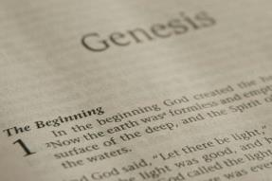
GENESIS STRUCTURE
  Genesis 1-11 (four events)
    Creation (1-2)
    Fall (3-5)
    Flood (6-9)
    National dispersion (10-11)

Slide 4
GENESIS STRUCTURE
  Genesis 1-11 (four events)
    Creation (1-2)
    Fall (3-5)
    Flood (6-9)
    National dispersion (10-11)

Slide 5

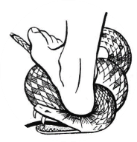
Genesis 3:15
“And I will put enmity Between you and the woman, And between your seed and her seed; He shall bruise you on the head, And you shall bruise him on the heel.”

Slide 6
GENESIS STRUCTURE
  Genesis 1-11 (four events)
    Creation (1-2)
    Fall (3-5)
    Flood (6-9)
    National dispersion (10-11)

Slide 7
GENESIS STRUCTURE
  Genesis 1-11 (four events)
    Creation (1-2)
    Fall (3-5)
    Flood (6-9)
    National dispersion (10-11)

Slide 8

Outline
  Table of nations (Gen 10)
  Tower of Babel (Gen 11:1-9)
  Genealogy from Shem to Terah (Gen 11:10-32)

Slide 9
Outline
  Table of nations (Gen 10)
  Tower of Babel (Gen 11:1-9)
  Genealogy from Shem to Terah (Gen 11:10-32)

Slide 10
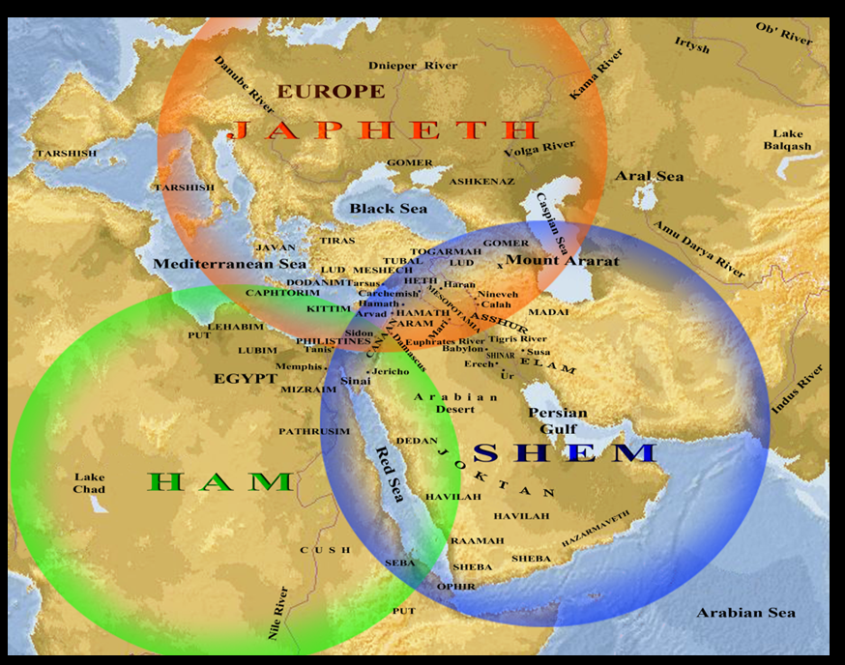

Slide 11
Genesis 10–11 Questions & Answers
  Origin of the nations?
  Dispersal of the nations?
  Corruption of the nations?
  What happened in the days of Peleg? (Gen. 10:25)
  Nimrod’s empire in Shinar? (Gen. 10:10)
  How did Nimrod get to Assyria? (Gen. 10:11-12)

Slide 12
Outline
  Table of nations (Gen 10)
  Tower of Babel (Gen 11:1-9)
  Genealogy from Shem to Terah (Gen 11:10-32)

Slide 13
GENESIS 11:1-9
Outline
  The Former World (1-2)
  The Rebellion (3-4)
  God’s Condescension (5)
  God’s Observations (6)
  God’s Intervention (7-8a)
  The Results (8b-9)

Slide 14
Outline
  Table of nations (Gen 10)
  Tower of Babel (Gen 11:1-9)
  Genealogy from Shem to Terah (Gen 11:10-32)

Slide 15
Genesis 9:26
“He also said, ‘Blessed be the Lord, The God of Shem; And let Canaan be his servant.’”

Slide 16

God’s Messianic Purposes Beginning in Genesis
Proto-evangelium from Adam & Eve (3:15)
Seth (4:25)
Noah (Gen 5:29)
Shem (9:26)
Abraham (12:3)
Isaac (21:12)
Jacob (25:23)
Judah (49:10)

Slide 17
God’s Messianic Purposes Beginning in Genesis
Proto-evangelium from Adam & Eve (3:15)
Seth (4:25)
Noah (Gen 5:29)
Shem (9:26)
Abraham (12:3)
Isaac (21:12)
Jacob (25:23)
Judah (49:10)

Slide 18
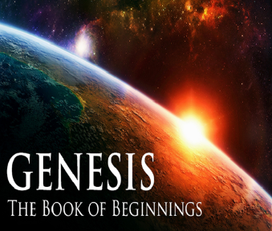
Genesis 11:10-26 Outline
  Shem (11:10-11)
  Arphachshad (11:12-13)
  Shelah (11:14-15)
  Eber (11:16-17)
  Peleg (11:18-19)
  Reu (11:20-21)
  Serug (11:22-23)
  Nahor (11:24-25)
  Terah (11:26)

Slide 19
Genesis 11:10-26 Outline
  Shem (11:10-11)
  Arphachshad (11:12-13)
  Shelah (11:14-15)
  Eber (11:16-17)
  Peleg (11:18-19)
  Reu (11:20-21)
  Serug (11:22-23)
  Nahor (11:24-25)
  Terah (11:26)

Slide 20
Genesis 11:10-26 Outline
  Shem (11:10-11)
  Arphachshad (11:12-13)
  Shelah (11:14-15)
  Eber (11:16-17)
  Peleg (11:18-19)
  Reu (11:20-21)
  Serug (11:22-23)
  Nahor (11:24-25)
  Terah (11:26)

Slide 21
Three Concluding Observations
(Gen 11:10-26)
    Age of patriarch at birth of seed-son demonstrate no genealogical gaps
    Antediluvian and Patriarchal overlap
    Shorter patriarchal ages indicate changed world conditions

Slide 22
Three Concluding Observations
(Gen 11:10-26)
    Age of patriarch at birth of seed-son demonstrate no genealogical gaps
    Antediluvian and Patriarchal overlap
    Shorter patriarchal ages indicate changed world conditions

Slide 23
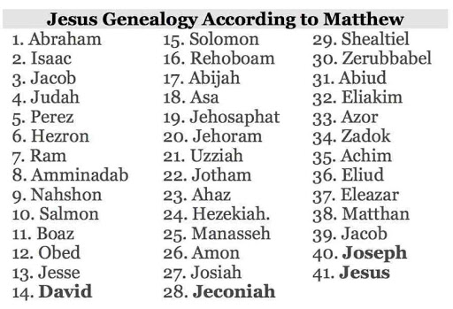

Slide 24

Norman Geisler
Systematic Theology, vol. 2 (Minneapolis, MN: Bethany, 2003), 648.
“If there is one gap, there may be more—indeed, we know there are more. For example, Matthew 1:8 says: ‘Jehoram the father of Uzziah,’ but the parallel listing in 1 Chronicles 3:11–14 illustrates missing generations between Jehoram and Uzziah (Azariah), namely, Ahaziah, Joash, and Amaziah. Just how many gaps there are in biblical genealogies and how much time they represent is not known. Even so, gaps there are and, hence, complete chronologies cannot be made; only accurate genealogies (lines of descent) are given.”

Slide 25
Genealogical Gaps?
Matthew 1:1-17?
  Matt. 1:8-9 vs. 1 Chr. 3:10-12
  Matthew sums up larger portion of history
  The genealogies of Gen. 5; 11 give the age of father at the time the son is born
  Matt. 1:17 (3 groups of 14)
  Gematria (sum of Hebrew letters in David’s name adds up to 14)

Slide 26
Matthew’s Purposes
Earliest Gospel written to Hebrew-Christians
To explain that Jesus in whom they had believed was indeed the long-awaited Jewish Messiah
To explain why the kingdom had been postponed despite the fact that the king had arrived
To explain the interim program of God during the kingdom’s absence

Slide 27
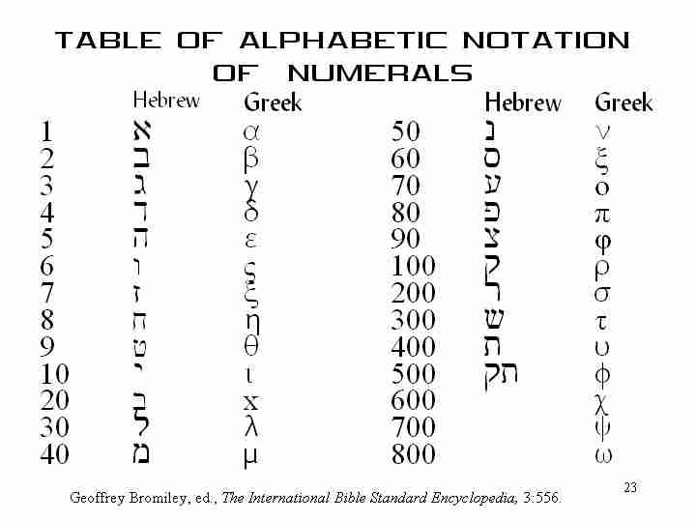

Slide 28
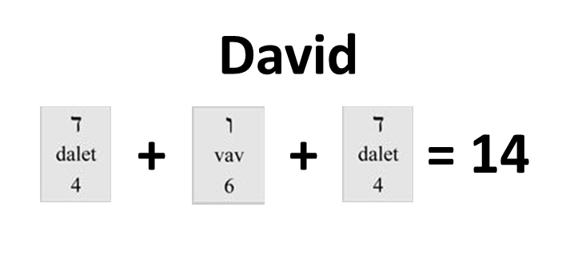

Slide 29

Age of the Earth?
  971-931 BC = Solomonic reign
  966 = Solomon rebuilds temple (1 Kgs 6:1b)
  - 480 years for the Exodus’ date (1 Kgs 6:1a)
  = 1446 BC for Exodus’ date
  - 430 years for Jacob’s migration to Egypt (Exod 12:40)
  = 1876 BC for Jacob’s migration to Egypt (Gen 46)
  Genealogies of Gen 5; 11
  = 4000 BC for the earth’s age

Slide 30
Age of the Earth?
  971-931 BC = Solomonic reign
  966 = Solomon rebuilds temple (1 Kgs 6:1b)
  - 480 years for the Exodus’ date (1 Kgs 6:1a)
  = 1446 BC for Exodus’ date
  - 430 years for Jacob’s migration to Egypt (Exod 12:40)
  = 1876 BC for Jacob’s migration to Egypt (Gen 46)
  Genealogies of Gen 5; 11
  = 4000 BC for the earth’s age

Slide 31
Age of the Earth?
  971-931 BC = Solomonic reign
  966 = Solomon rebuilds temple (1 Kgs 6:1b)
  - 480 years for the Exodus’ date (1 Kgs 6:1a)
  = 1446 BC for Exodus’ date
  - 430 years for Jacob’s migration to Egypt (Exod 12:40)
  = 1876 BC for Jacob’s migration to Egypt (Gen 46)
  Genealogies of Gen 5; 11
  = 4000 BC for the earth’s age

Slide 32

1 Kings 6:1
“Now it came about in the four hundred and eightieth year after the sons of Israel came out of the land of Egypt, in the fourth year of Solomon’s reign over Israel, in the month of Ziv which is the second month, that he began to build the house of the Lord.”

Slide 33
1 Kings 6:1
“Now it came about in the four hundred and eightieth year after the sons of Israel came out of the land of Egypt, in the fourth year of Solomon’s reign over Israel, in the month of Ziv which is the second month, that he began to build the house of the Lord.”

Slide 34
Age of the Earth?
  971-931 BC = Solomonic reign
  966 = Solomon rebuilds temple (1 Kgs 6:1b)
  - 480 years for the Exodus’ date (1 Kgs 6:1a)
  = 1446 BC for Exodus’ date
  - 430 years for Jacob’s migration to Egypt (Exod 12:40)
  = 1876 BC for Jacob’s migration to Egypt (Gen 46)
  Genealogies of Gen 5; 11
  = 4000 BC for the earth’s age

Slide 35
1 Kings 6:1
“Now it came about in the four hundred and eightieth year after the sons of Israel came out of the land of Egypt, in the fourth year of Solomon’s reign over Israel, in the month of Ziv which is the second month, that he began to build the house of the Lord.”

Slide 36
Age of the Earth?
  971-931 BC = Solomonic reign
  966 = Solomon rebuilds temple (1 Kgs 6:1b)
  - 480 years for the Exodus’ date (1 Kgs 6:1a)
  = 1446 BC for Exodus’ date
  - 430 years for Jacob’s migration to Egypt (Exod 12:40)
  = 1876 BC for Jacob’s migration to Egypt (Gen 46)
  Genealogies of Gen 5; 11
  = 4000 BC for the earth’s age

Slide 37
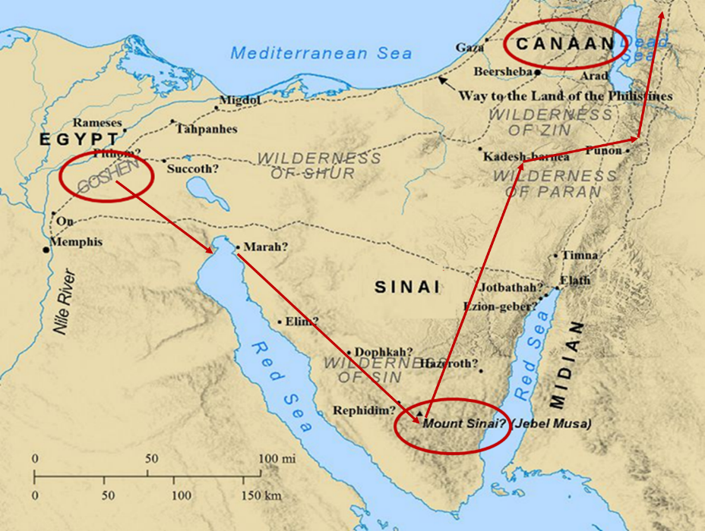

Slide 38
Age of the Earth?
  971-931 BC = Solomonic reign
  966 = Solomon rebuilds temple (1 Kgs 6:1b)
  - 480 years for the Exodus’ date (1 Kgs 6:1a)
  = 1446 BC for Exodus’ date
  - 430 years for Jacob’s migration to Egypt (Exod 12:40)
  = 1876 BC for Jacob’s migration to Egypt (Gen 46)
  Genealogies of Gen 5; 11
  = 4000 BC for the earth’s age

Slide 39
Exodus 12:40-41
“⁴⁰ Now the time that the sons of Israel lived in Egypt was four hundred and thirty years. ⁴¹ And at the end of four hundred and thirty years, to the very day, all the hosts of the Lord went out from the land of Egypt.”

Slide 40
Exodus 12:40-41
“⁴⁰ Now the time that the sons of Israel lived in Egypt was four hundred and thirty years. ⁴¹ And at the end of four hundred and thirty years, to the very day, all the hosts of the Lord went out from the land of Egypt.”

Slide 41
Age of the Earth?
  971-931 BC = Solomonic reign
  966 = Solomon rebuilds temple (1 Kgs 6:1b)
  - 480 years for the Exodus’ date (1 Kgs 6:1a)
  = 1446 BC for Exodus’ date
  - 430 years for Jacob’s migration to Egypt (Exod 12:40)
  = 1876 BC for Jacob’s migration to Egypt (Gen 46)
  Genealogies of Gen 5; 11
  = 4000 BC for the earth’s age

Slide 42
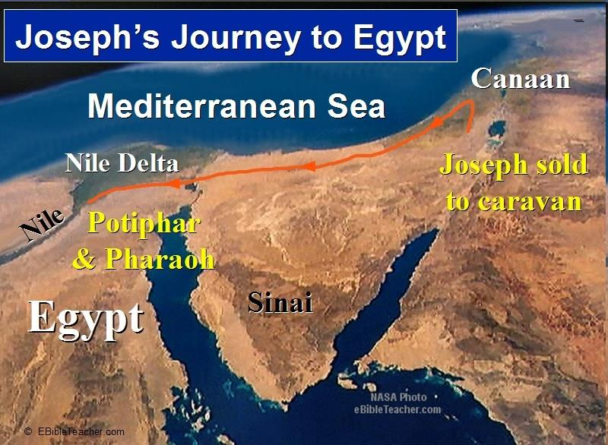

Slide 43
Age of the Earth?
  971-931 BC = Solomonic reign
  966 = Solomon rebuilds temple (1 Kgs 6:1b)
  - 480 years for the Exodus’ date (1 Kgs 6:1a)
  = 1446 BC for Exodus’ date
  - 430 years for Jacob’s migration to Egypt (Exod 12:40)
  = 1876 BC for Jacob’s migration to Egypt (Gen 46)
  Genealogies of Gen 5; 11
  = 4000 BC for the earth’s age

Slide 44
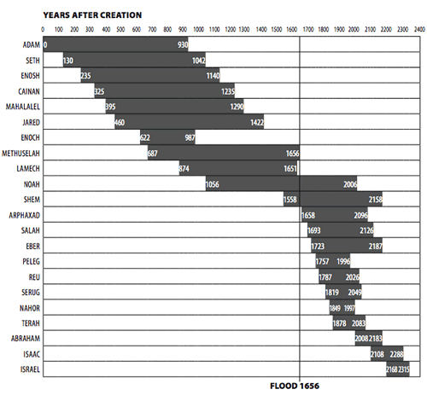

Slide 45
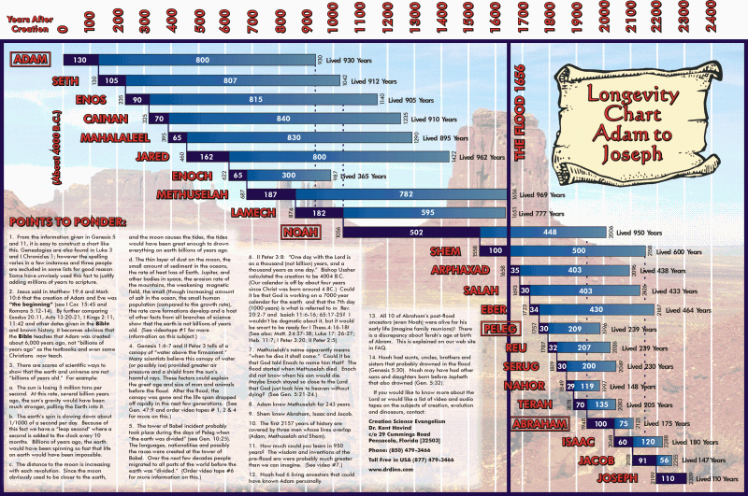

Slide 46
Age of the Earth?
  971-931 BC = Solomonic reign
  966 = Solomon rebuilds temple (1 Kgs 6:1b)
  - 480 years for the Exodus’ date (1 Kgs 6:1a)
  = 1446 BC for Exodus’ date
  - 430 years for Jacob’s migration to Egypt (Exod 12:40)
  = 1876 BC for Jacob’s migration to Egypt (Gen 46)
  Genealogies of Gen 5; 11
  = 4000 BC for the earth’s age

Slide 47


Dr. Hugh Ross
Ross, H.N., The Fingerprint of God (1991), p. 178.
“If the time since the creation of the universe were scaled down to a single year, the whole of human history would be less than one minute.”

Slide 48
Matthew 19:4-6
“³ Some Pharisees came to Jesus, testing Him and asking, “Is it lawful for a man to divorce his wife for any reason at all?” ⁴ And He answered and said, “Have you not read that He who created them from the beginning made them male and female, ⁵ and said, ‘For this reason a man shall leave his father and mother and be joined to his wife, and the two shall become one flesh’? ⁶ So they are no longer two, but one flesh. What therefore God has joined together, let no man separate.”

Slide 49
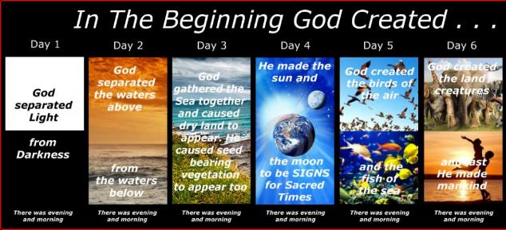
Shaping and Populating (Gen 1:1)
Day 1: | Light | Day 4: | Luminaries
Day 2: | Water, sky | Day 5: | Sea animals, birds
Day 3: | Land, vegetation | Day 6: | Land animals, man

Slide 50
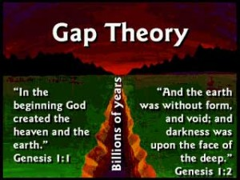
Mark 10:6
“But from the beginning of creation (apo de archēs kisteōs), God made them male and female.”

Slide 51
Mark 13:19
“For those days will be a time of tribulation such as has not occurred since the beginning of the creation (ap archēs kisteōs) which God created until now, and never will.”
(apo de archēs kisteōs)

Slide 52
2 Peter 3:4
“and saying, ‘Where is the promise of His coming? For ever since the fathers fell asleep, all continues just as it was from the beginning of creation (ap archēs kisteōs).’”
(apo de archēs kisteōs)

Slide 53
Luke 11:50-51
“⁵⁰ so that the blood of all the prophets, shed since the foundation of the world, may be charged against this generation, ⁵¹ from the blood of Abel to the blood of Zechariah, who was killed between the altar and the house of God; yes, I tell you, it shall be charged against this generation.”

Slide 54

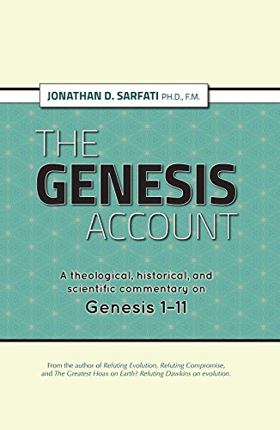
Dr. Jonathan D. Sarfati
Jonathan D. Sarfati, The Genesis Account: A Theological, Historical, and Scientific Commentary on Genesis 1‒11 (Powder Springs, GA: Creation Book Publishers, 2015), 339.
“I.e. prophets have been slain for almost as long as the world has existed. Since Seth was a replacement for Abel and was born when Adam was 130 (Genesis 4:25, 5:3), this makes sense because Abel’s death would have occurred only 3% of the way into that timeline.”

Slide 55
Romans 1:20
“For since the creation of the world His invisible attributes, His eternal power and divine nature, have been clearly seen, being understood through what has been made, so that they are without excuse.”

Slide 56
Dr. Jonathan D. Sarfati
Jonathan D. Sarfati, The Genesis Account: A Theological, Historical, and Scientific Commentary on Genesis 1‒11 (Powder Springs, GA: Creation Book Publishers, 2015), 338.
“This makes sense only if Jesus affirmed that Genesis was intended to be interpreted straightforwardly. I.e. where the earth was created about 4,000 years before He spoke those words, and Adam and Eve were created on Day 6, which, on the scale of 4,000 years, is almost indistinguishable from the beginning (0.0004% away on that number line). This contrasts with the usual evolutionary view…So either Jesus is right or the idea of long ages is right—they can’t both be right.”

Slide 57
Dr. Hugh Ross
Ross, H.N., The Fingerprint of God (1991), p. 178.
“If the time since the creation of the universe were scaled down to a single year, the whole of human history would be less than one minute.”

Slide 58

Dominoes in a Row

Slide 59
Creation with the Appearance of Age?
  Adam and Eve (Gen 1–2)
  Water to wine (John 2:1-12)
  Feeding of the multitudes (Matt 14:13-21; 15:29-39)
  Mount St. Helens
  Fall, flood

Slide 60
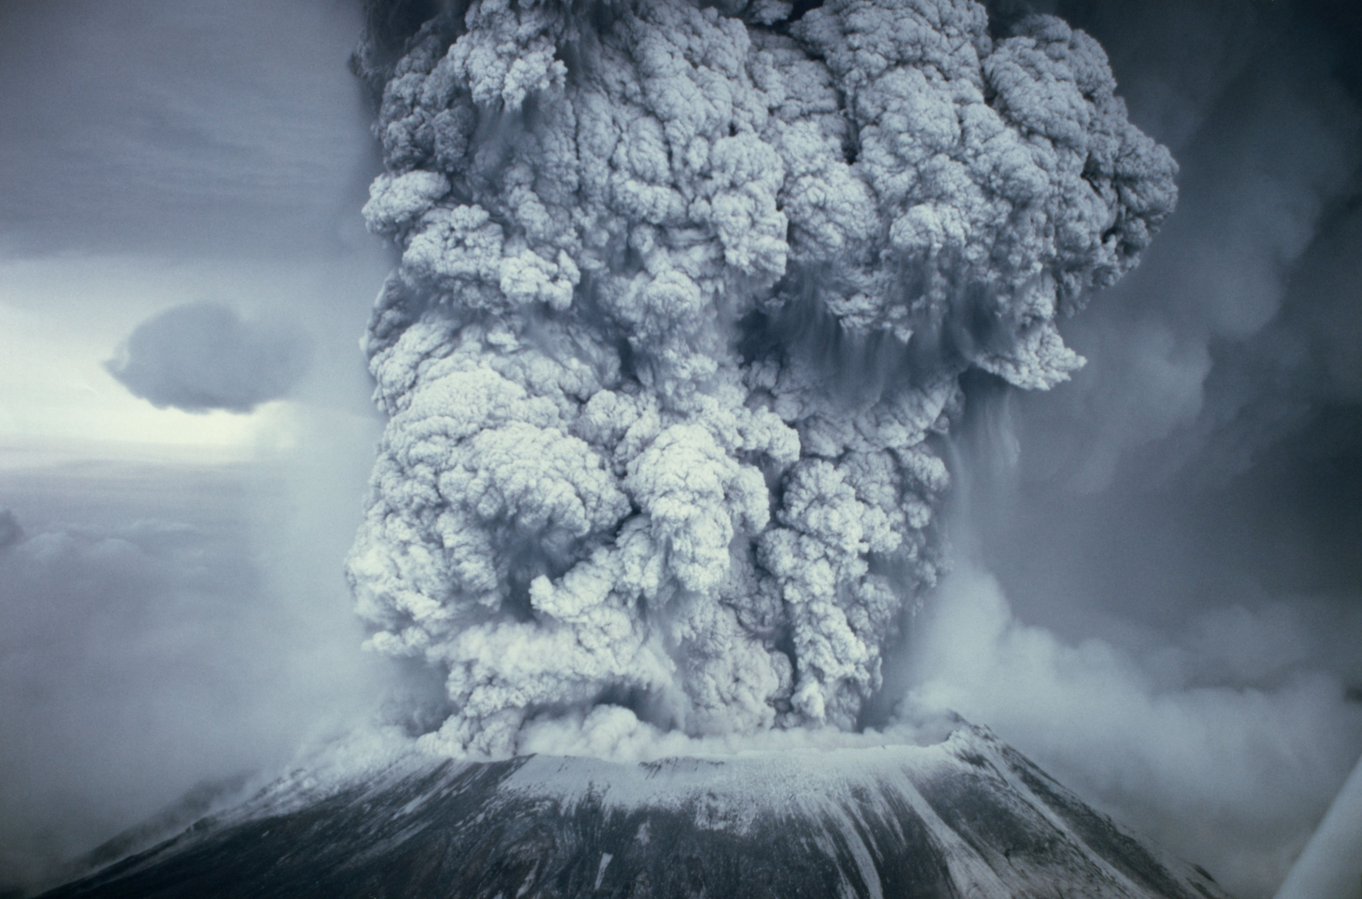

Slide 61

Romans 8:19-23
¹⁹ “For the anxious longing of the creation waits eagerly for the revealing of the sons of God. ²⁰ For the creation was subjected to futility, not willingly, but because of Him who subjected it, in hope ²¹ that the creation itself also will be set free from its slavery to corruption into the freedom of the glory of the children of God. ²² For we know that the whole creation groans and suffers the . . .

Slide 62
Romans 8:19-23
. . . pains of childbirth together until now. ²³ And not only this, but also we ourselves, having the first fruits of the Spirit, even we ourselves groan within ourselves, waiting eagerly for our adoption as sons, the redemption of our body.”

Slide 63
UNIFORMITARIANISM IS NOT BIBLICISM
 | ERA | SCRIPTURE | DISTINCTIVES
1. | CREATION | Genesis 1-2 | No death
2. | FALL | Genesis 3-6 | Death, painful pregnancy & toil, long life spans, no human government
3. | FLOOD | Genesis 7-10 | Shorter life spans, human government, one language, no nations
4. | BABEL | Genesis 11-present | No global government, multiple languages, nations, ethnicities
5. | ANTICHRIST | Rapture to 2nd Advent | Global government, restrainer removed
6. | KINGDOM | Rev. 20:1-10 | Long life spans, kingdom conditions, reality of death, renovated earth
7. | ETERNAL STATE | Rev. 21-22 | No death, new earth

Slide 64

Earliest Known Human Writing
“No date appears before the start of human civilizations about 5,500 years ago and the beginning of written pictorial history.”
Richard Overy, “The 50 Key Dates of World History” (Oct. 19, 2007)

Slide 65
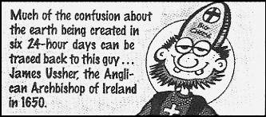

Slide 66
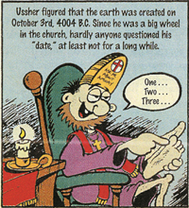

Slide 67

AUTHORSHIP
Charles Darwin
Karl Marx
Julius Wellhausen
John Dewey
Sigmund Freud
John Maynard Keynes
Soren Kierkegaard

Slide 68
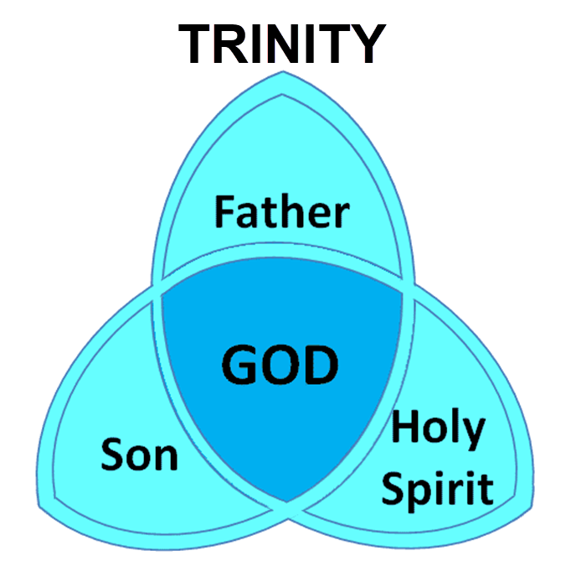

Slide 69
Rehabilitating Ussher
Archbishop James Ussher (A.D. 1581‒1656) was also a distinguished theologian, “recognized as one of the greatest scholars of his time.” He was one of only six theologians allowed to address the Parliament and the King. The Evangelical Dictionary of Theology states, “He was much sought after by contemporaries for his knowledge and beauty of character, and his personal impact was probably even greater than his scholarly legacy.”
Van Bebber and Taylor, Creation and Time, p. 102 quoting, The Evangelical Dictionary of Theology

Slide 70
Three Concluding Observations
(Gen 11:10-26)
    Age of patriarch at birth of seed-son demonstrate no genealogical gaps
    Antediluvian and Patriarchal overlap
    Shorter patriarchal ages indicate changed world conditions

Slide 71
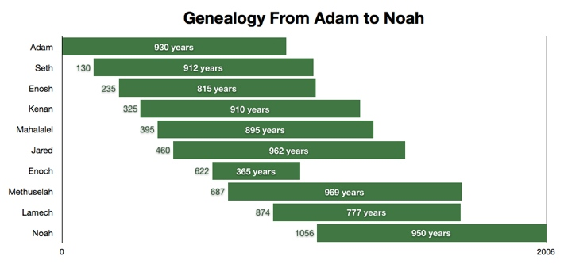

Slide 72

Dr. Arnold G. Fruchtenbaum
The Book of Genesis, 232
“…only four life spans link together the continuity of tradition from Adam to Jacob, and these make three links. The four life spans are Adam, Lamech, Shem and Jacob. The three links are from Adam to Lamech, since Adam was living when Lamech was born; from Lamech to Shem, since Lamech was living when Shem was born; and from Shem to Isaac and Jacob, since Shem was still living when both Isaac and Jacob were born. Therefore, there are not many gaps in the tradition to retain the history.”

Slide 73
Dr. Arnold G. Fruchtenbaum
The Book of Genesis, 232
“Along this line, the following points should be made: Noah lived until Terah, the father of Abraham, was 128 years old; Shem and Eber outlived Terah; Eber outlived Abraham; and, based upon when Terah died, Shem died when Isaac or Jacob was 48 years old…So as to the question of how history was maintained and how the tradition was kept, there is really no problem here because quite a bit of overlapping occurs within these genealogies.”

Slide 74
Three Concluding Observations
(Gen 11:10-26)
    Age of patriarch at birth of seed-son demonstrate no genealogical gaps
    Antediluvian and Patriarchal overlap
    Shorter patriarchal ages indicate changed world conditions

Slide 75
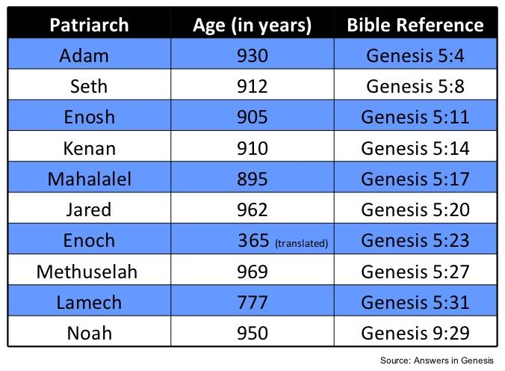

Slide 77
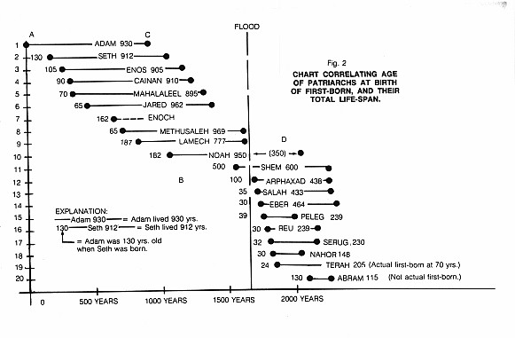

Slide 78
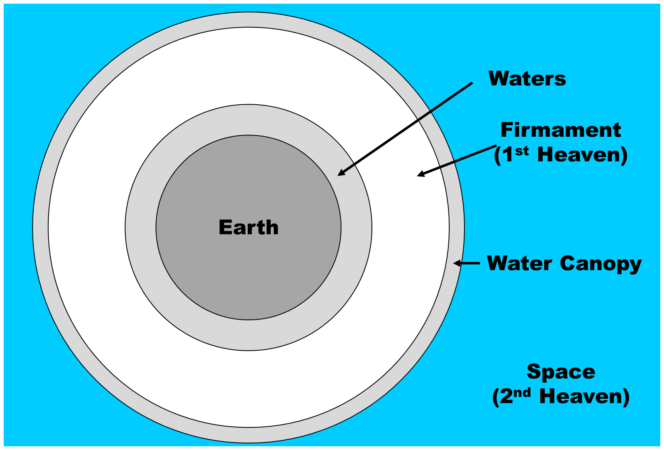

Slide 79


Slide 80
Day 2 Canopy Theory
(Gen 1:6-8)
Implied – Gen. 1:6-7; Ps. 148:4
Explains
  Long life spans of early man – Gen. 5:5, 27
  Strange beasts – (Gen. 1:24-25; Job 40‒41)
  Where the flood waters came from – (Gen. 2:5-6)
  Why man’s post-flood life span cut short – (Gen. 11:24-25)

Slide 81
Eight-Fold Pattern
Genesis 11:10-11
  Generation of Shem: First
  Name: Shem
  Meaning: Name
  Name of seed son: Arphachshad
  Age at birth of seed-son: 100 years
  Additional years lived: 500 years
  Total years lived: 600 years
  Begat other sons & daughters: Yes

Slide 82
Eight-Fold Pattern
Genesis 11:12-13
  Generation of Shem: Second
  Name: Arphachshad
  Meaning: Unclear
  Name of seed son: Shelah
  Age at birth of seed-son: 35 years
  Additional years lived: 403 years
  Total years lived: 438 years
  Begat other sons & daughters: Yes

Slide 83
Dr. Arnold G. Fruchtenbaum
The Book of Genesis, 231
“…there is a gradual decrease in the age of man. A sharp drop occurs between Shem and Arpachshad, between the first and second generation, during which time the Flood occurred. What probably caused the sudden decrease was the Flood. This was part of God’s divine judgment on humanity.”

Slide 84
Eight-Fold Pattern
Genesis 11:16-17
  Generation of Shem: Fourth
  Name: Eber
  Meaning: Cross over
  Name of seed son: Peleg
  Age at birth of seed-son: 34 years
  Additional years lived: 430 years
  Total years lived: 464 years
  Begat other sons & daughters: Yes

Slide 85
Eight-Fold Pattern
Genesis 11:18-19
  Generation of Shem: Fifth
  Name: Peleg
  Meaning: Division
  Name of seed son: Reu
  Age at birth of seed-son: 30 years
  Additional years lived: 209 years
  Total years lived: 239 years
  Begat other sons & daughters: Yes

Slide 86
Dr. Arnold G. Fruchtenbaum
The Book of Genesis Record, 231-32
“A second sharp drop occurs between Eber and Peleg, which are the fourth and fifth generations. It was between the fourth and fifth generation that the Tower of Babel event occurred. Therefore, with these two divine judgments, a sharp drop in the longevity of man occurs. If the canopy theory is correct, that might account for it. However, even without the canopy theory, divine judgment will easily account for this decrease, because it is following the divine judgments that the sharp drops occurred.”

Slide 87
UNIFORMITARIANISM IS NOT BIBLICISM
 | ERA | SCRIPTURE | DISTINCTIVES
1. | CREATION | Genesis 1-2 | No death
2. | FALL | Genesis 3-6 | Death, painful pregnancy & toil, long life spans, no human government
3. | FLOOD | Genesis 7-10 | Shorter life spans, human government, one language, no nations
4. | BABEL | Genesis 11-present | No global government, multiple languages, nations, ethnicities
5. | ANTICHRIST | Rapture to 2nd Advent | Global government, restrainer removed
6. | KINGDOM | Rev. 20:1-10 | Long life spans, kingdom conditions, reality of death, renovated earth
7. | ETERNAL STATE | Rev. 21-22 | No death, new earth

Slide 88
Psalm 90:10
“As for the days of our life, they contain seventy years, Or if due to strength, eighty years, Yet their pride is but labor and sorrow; For soon it is gone and we fly away.”

Slide 89
Conclusion

Slide 90
Genesis 11:10-26 Outline
  Shem (11:10-11)
  Arphachshad (11:12-13)
  Shelah (11:14-15)
  Eber (11:16-17)
  Peleg (11:18-19)
  Reu (11:20-21)
  Serug (11:22-23)
  Nahor (11:24-25)
  Terah (11:26)

Slide 91
GENESIS STRUCTURE
  Beginning of the Human race (Gen. 1‒11)
  Beginning of the Hebrew race (Gen. 12‒50)

Slide 92

GENESIS STRUCTURE
  Genesis 12-50 (four people)
  Abraham (12:1–25:11)
  Isaac (25:12–26:35)
  Jacob (27–36)
  Joseph (37–50)

Slide 93


Isaiah 43:1
“But now, thus says the Lord, your Creator, O Jacob, And He who formed you, O Israel, 'Do not fear, for I have redeemed you; I have called you by name; you are Mine!'”

Slide 94
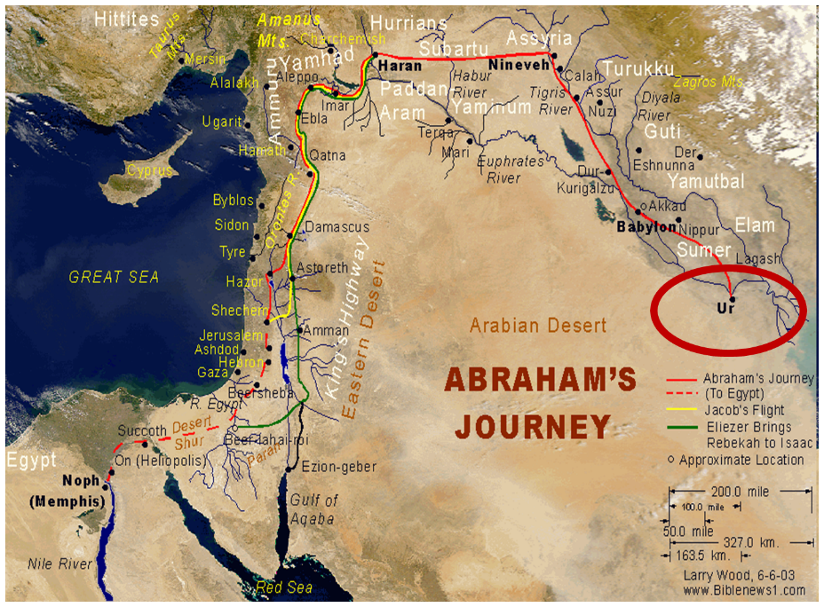

Slide 95
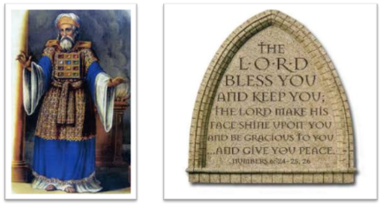
“The Lord bless you and keep you; the Lord make his face shine on you and be gracious to you; the Lord turn his face toward you and give you peace.” (NIV)

