Slide 1
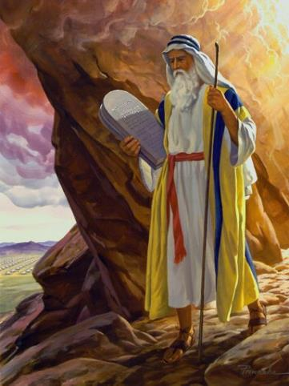
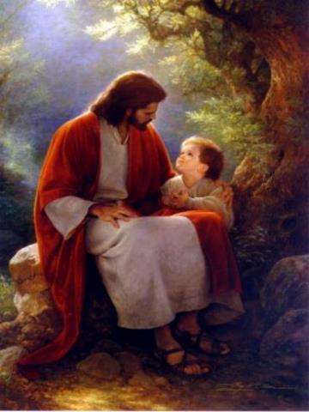
Law and Grace: An Overview
Jim McGowan, Th.D.
Sugar Land Bible Church
07-18-2021
…but grace and truth were realized through Jesus Christ - John 1:17
For the Law was given through Moses…
Special thanks to Dr. Vern Peterman for access to his insights and resources.

Slide 2
Session 28 Outline
  Review
    Purpose, Aim, and Objective
    Session 27 – Matthew 5:11–18
  Until Then – Matthew 5:19–20
    General Information
  Concluding Observations
    Comparisons & Contrasts

Slide 3

OUR PURPOSE, AIM AND OBJECTIVE
Law and Grace
…is to Compare and Contrast Law and Grace so as to properly understand these two important themes and how they are related to the life of the New Testament Believer.

Slide 4

C. I. Scofield, D. D.
The Grace of God, The Fundamentals Vol. 3, Chapter VII, p. 98
We have, most of us, been reared and now live under the influence of Galatianism. Protestant theology, alas, is for the most part, thoroughly Galatianized, in that neither law nor grace are given their distinct and separated places, as in the counsels of God, but are mingled together in one incoherent system.
The law is no longer, as in the Divine intent, a ministration of death (2 Cor. 3:7), of cursing (Gal. 3:10), of conviction (Rom. 3:19), because we are taught that we must try to keep it, and that by Divine help we may.
Nor, on the other hand, does grace bring us blessed deliverance from the dominion of sin, for we are kept under the law as a rule of life despite the plain declaration, “Sin shall not have dominion over you: for ye are not under the law, but under grace” (Rom. 6:14). (emphasis mine)

Slide 5
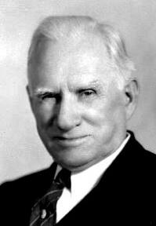
William R. Newell
Romans Verse-by-Verse (p. 274).
Grand Rapids, MI: Christian Classics Ethereal Library.
It is because Reformed theology has kept us Gentiles under the Law,—if not as a means of righteousness, then as “a rule of life,” that all the trouble has arisen. The Law is no more a rule of life than it is a means of righteousness. Walking in the Spirit has now taken the place of walking by ordinances. God has another principle under which He has put his saints: “Ye are not under law, but, under grace! (Rom. 6:14)” (italics mine)
PDF Download Here: https://archive.org/details/Romans_Verse_By_Verse-NewellWR

Slide 6

Henry Ironside
The Continual Burnt Offering: Daily Meditations on the Word of God (p. 265). Neptune, NJ: Loizeaux Brothers.
In Romans 7 we have a man renewed by the Spirit of God, but struggling under law, hoping thereby to subdue or find deliverance from the power of the old Adamic nature. In chapter 8 we have God’s way of deliverance through the death and resurrection of Christ with which the believer is identified before God. The chapter begins with “no condemnation” and ends with “no separation.” All who are in Christ Jesus are accepted in the Beloved and as free from every charge of guilt as He is Himself. He paid our penalty on the cross. Now we are linked up with Him in resurrection, not under law but under grace.

Slide 7
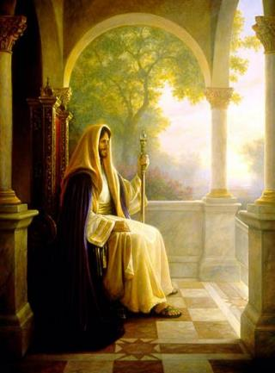
Matthew’s 3-Fold Purpose
Law and Grace: Review Session 27 The SOM – Matthew 5:1–8:1 (Luke 6:17–49)
To explain:
  that Jesus in whom they had believed was the long-awaited Jewish Messiah
  why the kingdom had been postponed despite the fact that the king had arrived
  the interim program of God during the kingdom’s absence

Slide 8




Matthew & the Kingdom
Law and Grace: Review Session 27 The SOM – Matthew 5:1–8:1 (Luke 6:17–49)
 | offered
 | rejected
 | postponed Interim program
 | ultimately accepted

Slide 9
Matthew’s Message
Law and Grace: Review Session 27 The SOM – Matthew 5:1–8:1 (Luke 6:17–49)
Jesus is the predicted Jewish king who ushered in an interim program by building the sons of the kingdom into the Church in between Israel’s past rejection and future acceptance of her king.

Slide 10
Session 28 Outline
  Review
    Purpose, Aim, and Objective
    Session 27 – Matthew 5:11–18
  Until Then – Matthew 5:19–20
    General Information
  Concluding Observations
    Comparisons & Contrasts

Slide 11

Matthew 5:11–20
¹¹ “Blessed are you when people insult you and persecute you, and falsely say all kinds of evil against you because of Me. ¹² “Rejoice and be glad, for your reward in heaven is great; for in the same way they persecuted the prophets who were before you. ¹³ “You are the salt of the earth; but if the salt has become tasteless, how can it be made salty again? It is no longer good for anything, except to be thrown out and trampled under foot by men. ¹⁴ “You are the light of the world. A city set on a hill cannot be hidden; ¹⁵ nor does anyone light a lamp and put it under a . . .

Slide 12
Matthew 5:11–20
. . .basket, but on the lampstand, and it gives light to all who are in the house. ¹⁶ “Let your light shine before men in such a way that they may see your good works, and glorify your Father who is in heaven. ¹⁷ “Do not think that I came to abolish the Law or the Prophets; I did not come to abolish but to fulfill. ¹⁸ “For truly I say to you, until heaven and earth pass away, not the smallest letter or stroke shall pass from the Law until all is accomplished. ¹⁹“Whoever then annuls one of the least of these commandments, and teaches others to do the same, shall be. . .

Slide 13
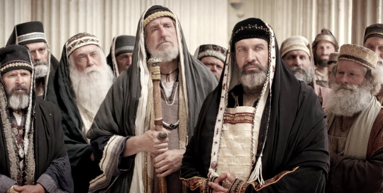
Matthew 5:11–20
. . . called least in the kingdom of heaven; but whoever keeps and teaches them, he shall be called great in the kingdom of heaven. ²⁰ “For I say to you that unless your righteousness surpasses that of the scribes and Pharisees, you will not enter the kingdom of heaven.

Slide 14
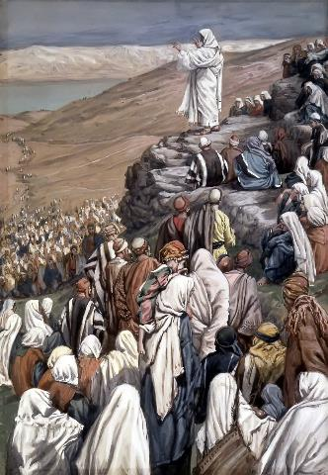

Law and Grace: Review Session 27 The SOM – Matthew 5:1–8:1 (Luke 6:17–49)
To Whom is Jesus speaking in the SOM?
Rose are red
And violets are bluish
All of those listening to Jesus are Jewish!

Slide 15

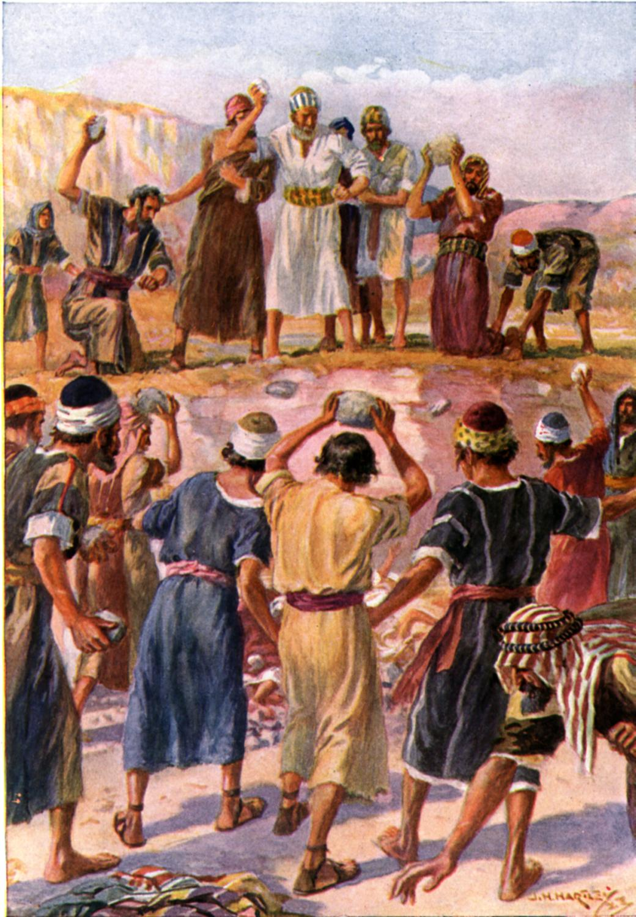
Matthew 5:11–12
¹¹ “Blessed are you when people insult you and persecute you, and falsely say all kinds of evil against you because of Me. ¹² “Rejoice and be glad, for your reward in heaven is great; for in the same way they persecuted the prophets who were before you.

Slide 16
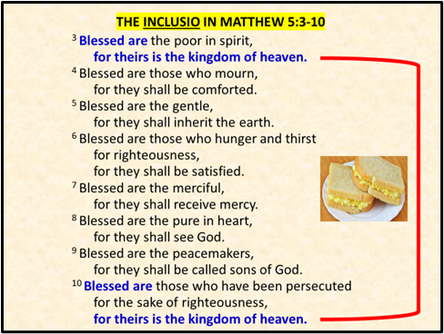
Happy Persecution Day?
Mathew 5:11-12
Law and Grace: Review Session 27 The SOM – Matthew 5:1–8:1 (Luke 6:17–49)
Vv. 11-12 broaden the persecution spoken of in v. 10, “Blessed are those who have been persecuted for the sake of righteousness…” but also, more importantly, Jesus adds here, “because of Me” associating true righteousness with Himself as opposed to, the Pharisees.

Slide 17

Happy Persecution Day?
Mathew 5:11-12
Law and Grace: Review Session 27 The SOM – Matthew 5:1–8:1 (Luke 6:17–49)
In vv. 11-12, Jesus also connected His listeners with the O.T. prophets by declaring that the persecution they endure would evidence their true righteousness too! Again, keep in mind that this true righteousness stands in contradistinction to that of the Pharisees.

Slide 18
Happy Persecution Day?
Mathew 5:11-12
Law and Grace: Review Session 27 The SOM – Matthew 5:1–8:1 (Luke 6:17–49)
Mathew 5:11-12 is a veiled reference to Jesus’ deity.
RELATIONSHIP OF THE BLESSED PERSECUTED
Prophets | servants of | God of Israel
Believing Jewish Audience | servants of | Jesus, the God-Man & Messiah of Israel
Believing Jewish Audience | equivalent to | Prophets
Jesus | equated with | God

Slide 19

Happy Persecution Day?
Mathew 5:11-12
Law and Grace: Review Session 27 The SOM – Matthew 5:1–8:1 (Luke 6:17–49)
For those Israelites who proclaim Jesus to be the Messiah, the King of Israel, persecution awaits.
For those in the Church who proclaim Christ as the God-Man and Savior, persecution awaits.
2 Timothy 3:12
Indeed, all who desire to live godly in Christ Jesus will be persecuted.

Slide 20
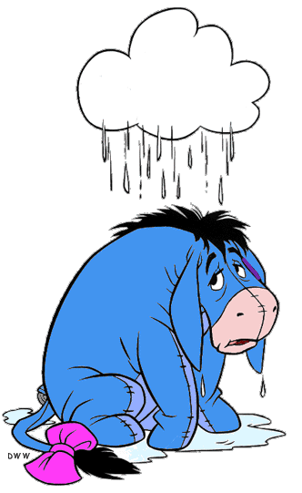


Happy Persecution Day?
Mathew 5:11-12
Law and Grace: Review Session 27 The SOM – Matthew 5:1–8:1 (Luke 6:17–49)
Matthew 5:11–12
¹² “Rejoice and be glad, for your reward in heaven is great; for in the same way they persecuted the prophets who were before you.

Slide 21
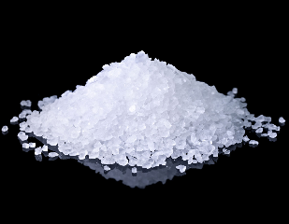
Matthew 5:13
¹³ “You are the salt of the earth; but if the salt has become tasteless, how can it be made salty again? It is no longer good for anything, except to be thrown out and trampled under foot by men.

Slide 22
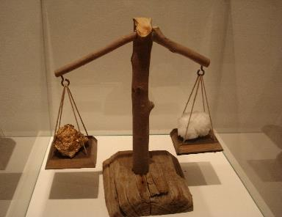
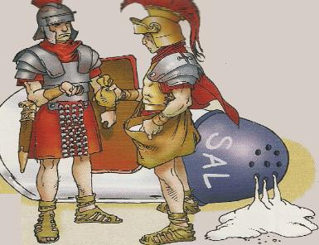
Law and Grace: Review Session 27 The SOM – Matthew 5:1–8:1 (Luke 6:17–49)
The Salt
Matthew 5:13
Salt was coveted and so valuable that it was equivalent to gold during the time of Christ.
The Latin word from which we get our word ‘salary’ “salarium” meant ‘salt money’.

Slide 23
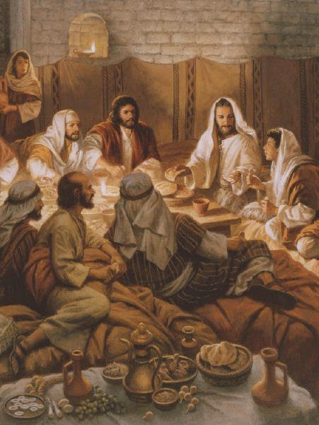
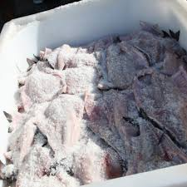
Law and Grace: Review Session 27 The SOM – Matthew 5:1–8:1 (Luke 6:17–49)
The Salt
Matthew 5:13
Salt was also used as today for seasoning for meals and as a preservative since there was no refrigeration.

Slide 24
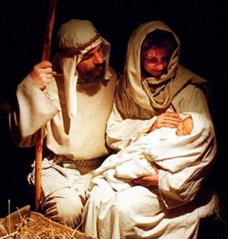
Law and Grace: Review Session 27 The SOM – Matthew 5:1–8:1 (Luke 6:17–49)
The Salt
Matthew 5:13
And salt was also used as a general antiseptic. As such it was common to mix olive oil and salt together and rub it on newborns (Eze. 16:4).

Slide 25
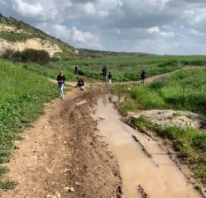
Matthew 5:13
¹³ “You are the salt of the earth; but if the salt has become tasteless, how can it be made salty again? It is no longer good for anything, except to be thrown out and trampled under foot by men.

Slide 26
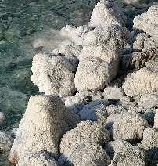
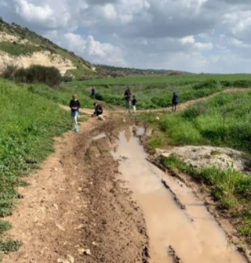
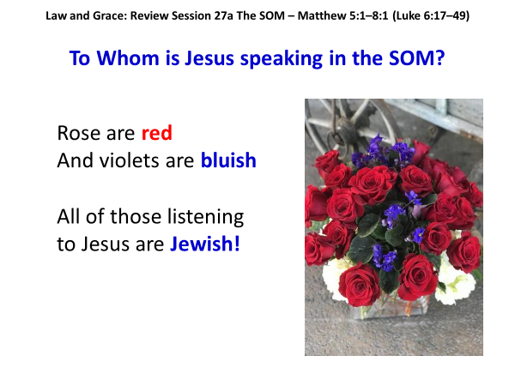
Law and Grace: Review Session 27 The SOM – Matthew 5:1–8:1 (Luke 6:17–49)
The Salt
Matthew 5:13
Over time, the savory aspect of salt will leach out and render it worthless. When this happened, it would be thrown into the roadway to help keep the roadway from getting muddy.

Slide 27
Galatians 6:8-10
⁸ For the one who sows to his own flesh will from the flesh reap corruption, but the one who sows to the Spirit will from the Spirit reap eternal life. ⁹ Let us not lose heart in doing good, for in due time we will reap if we do not grow weary. ¹⁰ So then, while we have opportunity, let us do good to all people, and especially to those who are of the household of the faith.

Slide 28
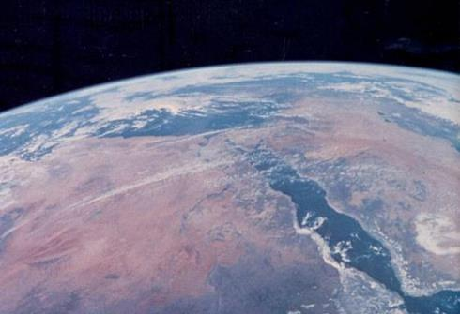
Matthew 5:14
“You are the light of the world. A city set on a hill cannot be hidden;
Israel,
the light of the world

Slide 29
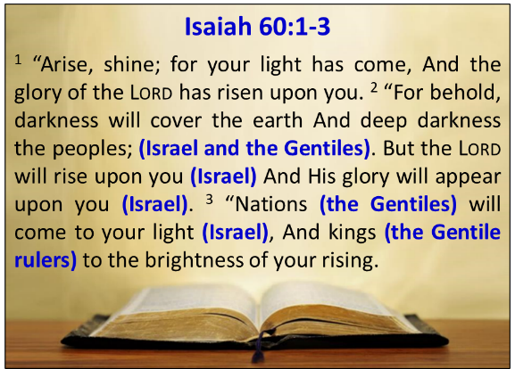
Law and Grace: Review Session 27 The SOM – Matthew 5:1–8:1 (Luke 6:17–49)
Israel will be the light of the world
Matthew 5:14
God had Isaiah write these words about the people and land of Israel in the kingdom:

Slide 30
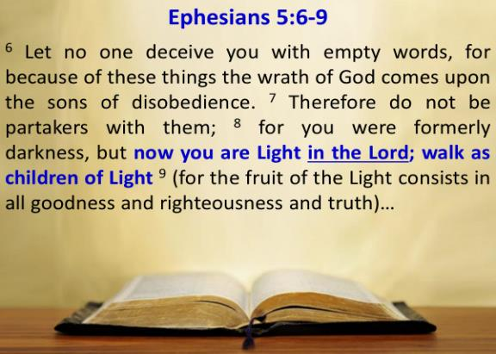
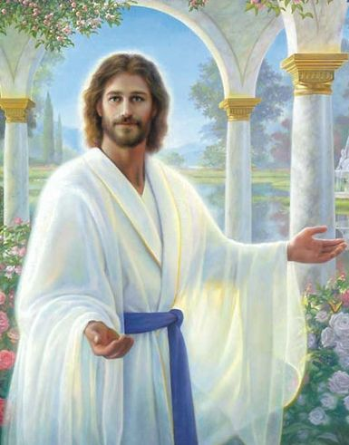
Law and Grace: Review Session 27 The SOM – Matthew 5:1–8:1 (Luke 6:17–49)
The Body of Christ is also Light
‘in Christ’ who is the Light
To be a ‘child of’ or ‘son of’ in biblical terms: to be like in character and close in relationship.

Slide 31
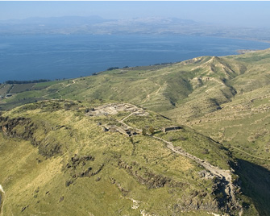
Matthew 5:14
“You are the light of the world. A city set on a hill cannot be hidden;

Slide 32
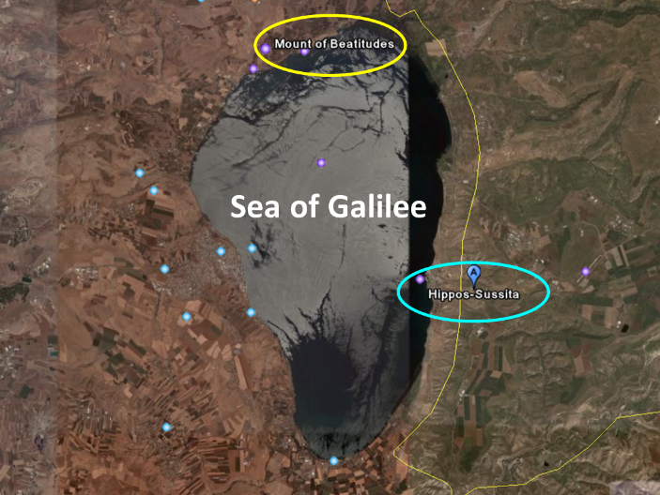
Law and Grace: Review Session 27 The SOM – Matthew 5:1–8:1 (Luke 6:17–49)
City on a Hill
Matthew 5:14

Slide 33
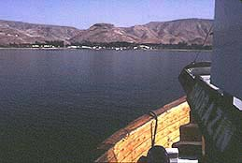
Law and Grace: Review Session 27 The SOM – Matthew 5:1–8:1 (Luke 6:17–49)
Hippos: A City on a hill…
On the left, looking from Hippos toward the Mount of Beatitudes and on the right, the opposite view from a boat on the Sea of Galilee.
Hippos
Hippos

Slide 34
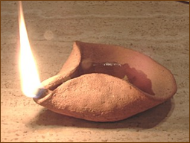
Matthew 5:15–16
¹⁵ nor does anyone light a lamp and put it under a basket, but on the lampstand, and it gives light to all who are in the house. ¹⁶ “Let your light shine before men in such a way that they may see your good works, and glorify your Father who is in heaven.

Slide 35
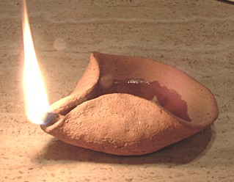
Law and Grace: Review Session 27 The SOM – Matthew 5:1–8:1 (Luke 6:17–49)
Lit Lamps In Israel’s Land
Matthew 5:15-16
Lamps typically burned olive oil, and the woman of the house was responsible to keep the lamp lit all of the time.

Slide 36

Law and Grace: Review Session 27 The SOM – Matthew 5:1–8:1 (Luke 6:17–49)
Our Spiritual Light
OPEN & EVIDENT? or PRIVATE & SECRET?
Matthew 5:15-16

Slide 37
Matthew 5:17–20
¹⁷ “Do not think that I came to abolish the Law or the Prophets; I did not come to abolish but to fulfill. ¹⁸ “For truly I say to you, until heaven and earth pass away, not the smallest letter or stroke shall pass from the Law until all is accomplished. ¹⁹ “Whoever then annuls one of the least of these commandments, and teaches others to do the same, shall be called least in the kingdom of heaven; but whoever keeps and teaches them, he shall be called great in the kingdom of heaven. ²⁰ “For I say to you that unless your righteousness surpasses that of the scribes and Pharisees, you will not enter the kingdom of heaven.

Slide 38
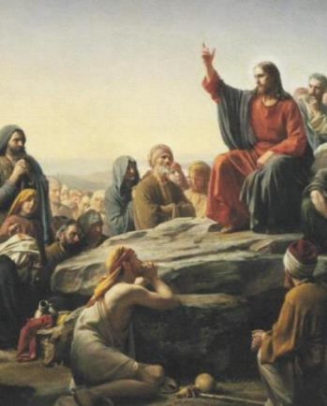
Law and Grace: Review Session 27 The SOM – Matthew 5:1–8:1 (Luke 6:17–49)
What Jesus came to do…may surprise you!
Matthew 5:17-20
Jesus came to the people of Israel to:
  keep the Law of Moses,
  to uphold the Law of Moses,
  and to reclaim the Law of Moses from the corruption of Pharisaic Judaism!

Slide 39
Law and Grace: Review Session 27 The SOM – Matthew 5:1–8:1 (Luke 6:17–49)
What Jesus came to do…may surprise you!
Matthew 5:17-20
Henry Ironside
The Continual Burnt Offering: Daily Meditations on the Word of God (p. 265). Neptune, NJ: Loizeaux Brothers.
In [Romans] chapter 8…through the death and resurrection of Christ with which the believer is identified before God….we are linked up with Him in resurrection, not under law but under grace.
William R. Newell
Romans Verse-by-Verse (p. 274).
Grand Rapids, MI: Christian Classics Ethereal Library.
“Walking in the Spirit has now taken the place of walking by ordinances.”

Slide 40
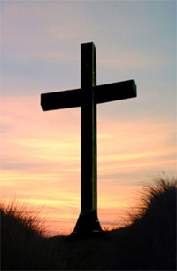
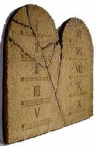

Law and Grace: Review Session 27 The SOM – Matthew 5:1–8:1 (Luke 6:17–49)
What Jesus came to do…may surprise you!
Matthew 5:17-20
But among us in the church, Christ’s death accomplished our dying to the Law of Moses, so that the life of Christ Himself would do the living in us! (Rom. 7:4-6; Gal. 2:19, 20; 2 Cor. 4:11)

Slide 41
Romans 7:4-6
⁴ Therefore, my brethren, you also were made to die to the Law through the body of Christ, so that you might be joined to another, to Him who was raised from the dead, in order that we might bear fruit for God. ⁵ For while we were in the flesh, the sinful passions, which were aroused by the Law, were at work in the members of our body to bear fruit for death. ⁶ But now we have been released from the Law, having died to that by which we were bound, so that we serve in newness of the Spirit and not in oldness of the letter.

Slide 42
Galatians 2:19–20
¹⁹ “For through the Law I died to the Law, so that I might live to God. ²⁰ “I have been crucified with Christ; and it is no longer I who live, but Christ lives in me; and the life which I now live in the flesh I live by faith in the Son of God, who loved me and gave Himself up for me.
2 Corinthians 4:11
For we who live are constantly being delivered over to death for Jesus’ sake, so that the life of Jesus also may be manifested in our mortal flesh.

Slide 43
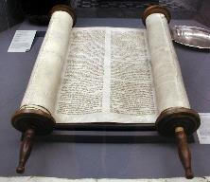
Matthew 5:17–18
¹⁷ “Do not think that I came to abolish the Law or the Prophets; I did not come to abolish but to fulfill. ¹⁸ “For truly I say to you, until heaven and earth pass away, not the smallest letter or stroke shall pass from the Law until all is accomplished.

Slide 44
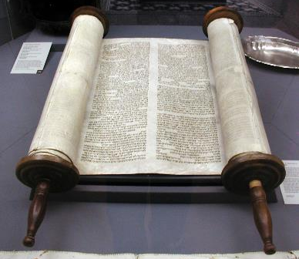
Law and Grace: Review Session 27 The SOM – Matthew 5:1–8:1 (Luke 6:17–49)
Christ fulfilled & will fulfill the Law & the Prophets (1)
Matthew 5:17-20
Christ fulfilled the Law and the Prophets by living righteously in full accordance with all of the 613 Laws of Moses.

Slide 45
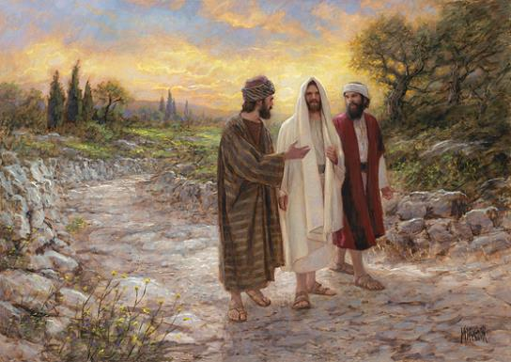
Law and Grace: Review Session 27 The SOM – Matthew 5:1–8:1 (Luke 6:17–49)
Christ fulfilled & will fulfill the Law & the Prophets (2)
Matthew 5:17-20
Christ fulfilled the Law and the Prophets by fulfilling all that was prophesied about Him in the Law and the Prophets.

Slide 46
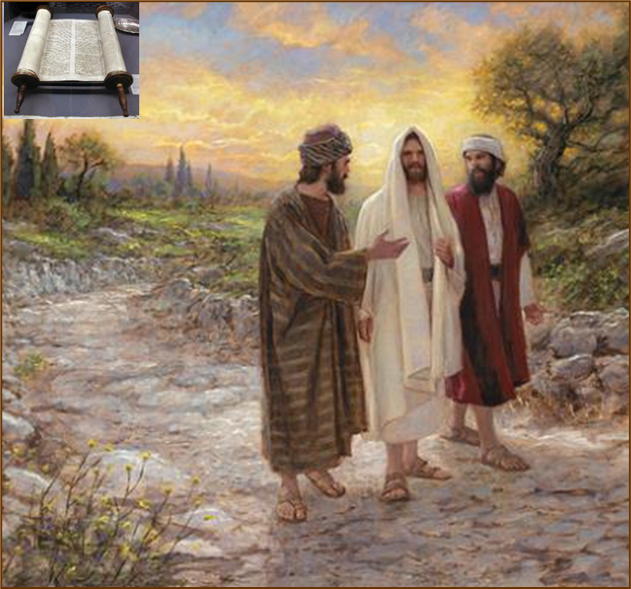
Luke 24:25–27
²⁵ And He said to them, “O foolish men and slow of heart to believe in all that the prophets have spoken! ²⁶ “Was it not necessary for the Christ to suffer these things and to enter into His glory?” ²⁷ Then beginning with Moses and with all the prophets, He explained to them the things concerning Himself in all the Scriptures.

Slide 47
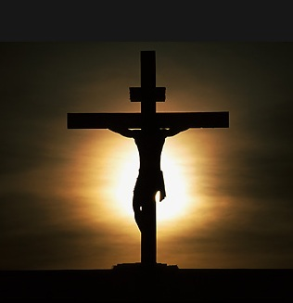
Law and Grace: Review Session 27 The SOM – Matthew 5:1–8:1 (Luke 6:17–49)
Christ fulfilled & will fulfill the Law & the Prophets (1)
Matthew 5:17-20
And Christ died the death that the Law required of each Law-breaker, just as the prophets said He would, for all of us.
Christ’s death also ratified Israel’s New Covenant.

Slide 48
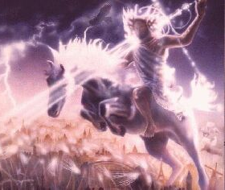
Law and Grace: Review Session 27 The SOM – Matthew 5:1–8:1 (Luke 6:17–49)
Christ fulfilled & will fulfill the Law & the Prophets (2)
Matthew 5:17-20
Christ will fulfill everything that the Law and the Prophets said He would fulfill in His Second Coming and reigning in the Coming Kingdom as King of Israel and as the King of kings and Lord of lords over all of the Gentiles.

Slide 49
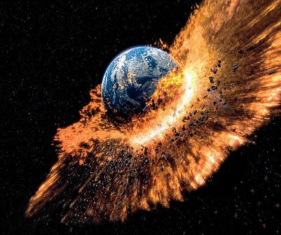
Law and Grace: Review Session 27 The SOM – Matthew 5:1–8:1 (Luke 6:17–49)
Christ fulfilled & will fulfill the Law & the Prophets (2)
Matthew 5:17-20
Every prophecy concerning Him will be fulfilled until the day heaven and earth pass away.

Slide 50
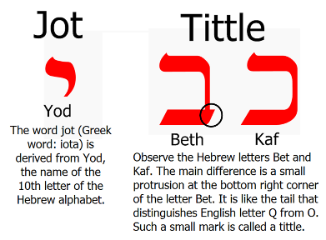
Matthew 5:18
“For truly I say to you, until heaven and earth pass away, not the smallest letter or stroke shall pass from the Law until all is accomplished.

Slide 51

Law and Grace: Review Session 27 The SOM – Matthew 5:1–8:1 (Luke 6:17–49)

Slide 52
Session 28 Outline
  Review
    Purpose, Aim, and Objective
    Session 27 – Matthew 5:11–18
  Until Then – Matthew 5:19–20
    General Information
  Concluding Observations
    Comparisons & Contrasts

Slide 53
Matthew 5:19-20
¹⁹ “Whoever then annuls one of the least of these commandments, and teaches others to do the same, shall be called least in the kingdom of heaven; but whoever keeps and teaches them, he shall be called great in the kingdom of heaven. ²⁰ “For I say to you that unless your righteousness surpasses that of the scribes and Pharisees, you will not enter the kingdom of heaven.

Slide 54
Matthew 5:19
¹⁹ “Whoever then annuls one of the least of these commandments, and teaches others to do the same, shall be called least in the kingdom of heaven; but whoever keeps and teaches them, he shall be called great in the kingdom of heaven.

Slide 55
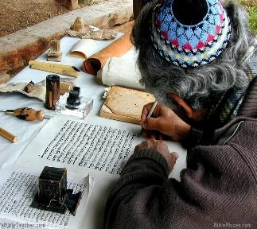
Law and Grace: Session 28 The SOM – Matthew 5:1–8:1 (Luke 6:17–49)
Surpassing Righteousness & Kingdom Entry
Matthew 5:19
V. 19 stresses the importance of True Righteousness as revealed by how an Israelite views and treats the Law.
In Mark’s Gospel Jesus focuses on what He means by this when He targets Pharisaical Judaism (Mark 7:9; 13).

Slide 56
Mark 7:9; 13
⁹ [Jesus] was also saying to them, “You are experts at setting aside the commandment of God in order to keep your tradition… ¹³ thus invalidating the word of God by your tradition which you have handed down; and you do many things such as that.”

Slide 57
Matthew 5:20
²⁰ “For I say to you that unless your righteousness surpasses that of the scribes and Pharisees, you will not enter the kingdom of heaven.

Slide 58

Law and Grace: Session 28 The SOM – Matthew 5:1–8:1 (Luke 6:17–49)
Surpassing Righteousness & Kingdom Entry
Matthew 5:20
Verse 20 calls the Israelite back to the standard of righteousness taught in the Old Testament and by Jesus, regarding the Law of Moses, a standard that exceeds that of Pharisaical Judaism.

Slide 59

Law and Grace: Session 28 The SOM – Matthew 5:1–8:1 (Luke 6:17–49)
Surpassing Righteousness & Kingdom Entry
Matthew 5:20
Christ reveals a shocking and astounding revelation to His Jewish audience: Not every Jew would enter the Coming Kingdom!

Slide 60
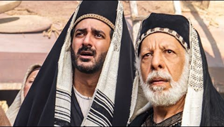
Matthew 5:20
²⁰ “For I say to you that unless your righteousness surpasses that of the scribes and Pharisees, you will not enter the kingdom of heaven.

Slide 61

Law and Grace: Session 28 The SOM – Matthew 5:1–8:1 (Luke 6:17–49)

Slide 62

Matthew 7:13-14
¹³ Enter through the narrow gate; for the gate is wide and the way is broad that leads to destruction, and there are many who enter through it. ¹⁴ For the gate is small and the way is narrow that leads to life, and there are few who find it.

Slide 63
Matthew 7:21; 23
²¹ “Not everyone who says to Me, ‘Lord, Lord,’ will enter the kingdom of heaven,… ²³ “…I will declare to them, ‘I never knew you; depart from Me, you who practice lawlessness.’

Slide 64
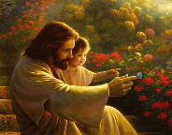
Matthew 18:1-3
¹ At that time the disciples came to Jesus and said, "Who then is greatest in the kingdom of heaven?" ² And He called a child to Himself and set him before them, ³ and said, "Truly I say to you, unless you are converted and become like children, you will not enter the kingdom of heaven.

Slide 65

Matthew 19:23-24
²³ And Jesus said to His disciples, “Truly I say to you, it is hard for a rich man to enter the kingdom of heaven. ²⁴ Again I say to you, it is easier for a camel to go through the eye of a needle, than for a rich man to enter the kingdom of God.” (cf. Luke 18:24-25 & Mark 10:23-25)

Slide 66
Matthew 21:31
“Which of the two did the will of his father?" They said, "The first." Jesus said to them, "Truly I say to you that the tax collectors and prostitutes will get into the kingdom of God before you.”

Slide 67
Matthew 23:13
“But woe to you, scribes and Pharisees, hypocrites, because you shut off the kingdom of heaven from people; for you do not enter in yourselves, nor do you allow those who are entering to go in.”

Slide 68
Session 28 Outline
  Review
    Purpose, Aim, and Objective
    Session 27 – Matthew 5:11–18
  Until Then – Matthew 5:19–20
    General Information
  Concluding Observations
    Comparisons & Contrasts

Slide 69
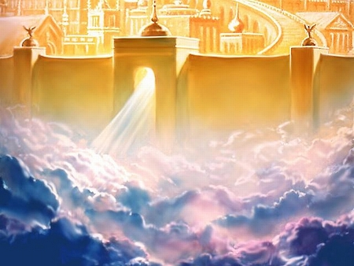
Law and Grace: Session 28 The SOM – Matthew 5:1–8:1 (Luke 6:17–49)
So How Does One Enter Heaven?

Slide 70

Law and Grace: Session 28 The SOM – Matthew 5:1–8:1 (Luke 6:17–49)
So How Does One Enter Heaven?
Are we to strive really hard, and work ourselves to the bone in order to enter the narrow gate?

Slide 71
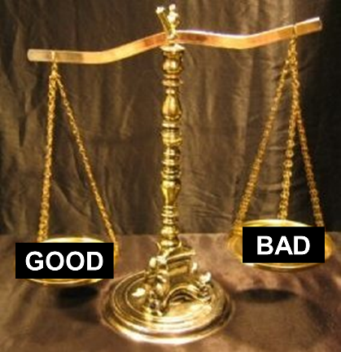
Law and Grace: Session 28 The SOM – Matthew 5:1–8:1 (Luke 6:17–49)
So How Does One Enter Heaven?
Do we do our best and hope that the scales of justice will swing in our favor when the time comes?

Slide 72

Law and Grace: Session 28 The SOM – Matthew 5:1–8:1 (Luke 6:17–49)
So How Does One Enter Heaven?
Secret: Keep going – don’t slip

Slide 73
Law and Grace: Session 28 The SOM – Matthew 5:1–8:1 (Luke 6:17–49)
So How Does One Enter Heaven?
Secret: Keep going – don’t slip

Slide 74
Law and Grace: Session 28 The SOM – Matthew 5:1–8:1 (Luke 6:17–49)
So How Does One Enter Heaven?
Secret: Keep going – don’t slip

Slide 75

Law and Grace: Session 28 The SOM – Matthew 5:1–8:1 (Luke 6:17–49)
So How Does One Enter Heaven?
I sure hope it turns out OK!

Slide 76
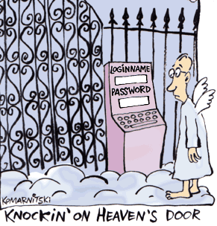
Law and Grace: Session 28 The SOM – Matthew 5:1–8:1 (Luke 6:17–49)
So How Does One Enter Heaven?

Slide 77
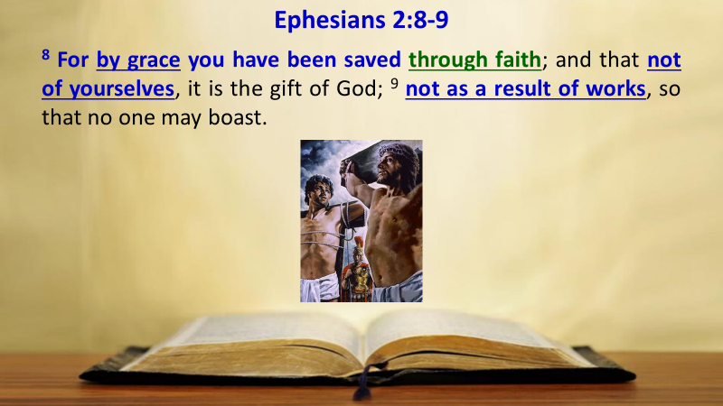
Law and Grace: Session 28 The SOM – Matthew 5:1–8:1 (Luke 6:17–49)
How One Enters Heaven!

Slide 78

Law and Grace: Session 28 The SOM – Matthew 5:1–8:1 (Luke 6:17–49)
How One Enters Heaven!
v. πιστεύω pisteúō…“to believe,” means, “to be persuaded of,” and hence, “to place confidence in, to trust,” signifies, in this sense of the word, reliance upon, not mere credence.
Vine, W. E., Unger, M. F., & White, W., Jr. (1996). Vine’s Complete Expository Dictionary of Old and New Testament Words (Vol. 2, p. 61). Nashville, TN: T. Nelson..

Slide 79
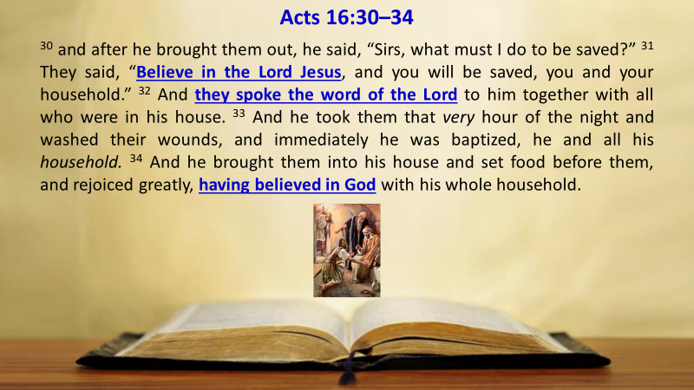
Law and Grace: Session 28 The SOM – Matthew 5:1–8:1 (Luke 6:17–49)
How One Enters Heaven!

Slide 80
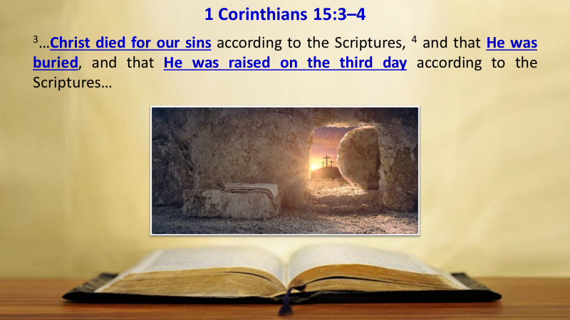
Law and Grace: Session 28 The SOM – Matthew 5:1–8:1 (Luke 6:17–49)
How One Enters Heaven!

Slide 81
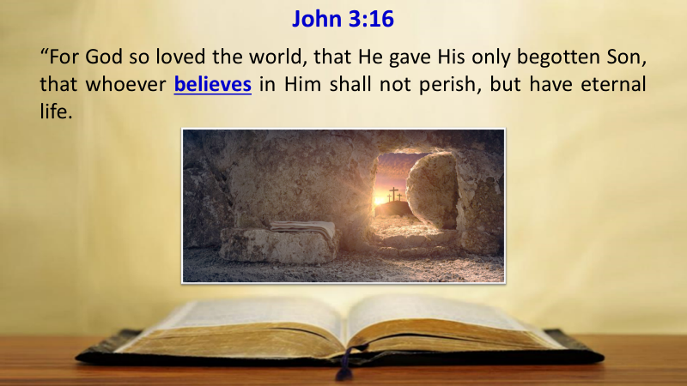
Law and Grace: Session 28 The SOM – Matthew 5:1–8:1 (Luke 6:17–49)
How One Enters Heaven!

Slide 82
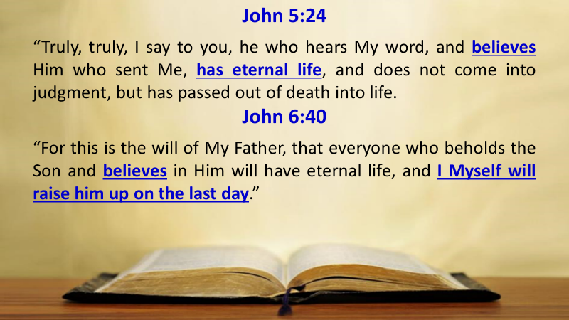
Law and Grace: Session 28 The SOM – Matthew 5:1–8:1 (Luke 6:17–49)
How One Enters Heaven!

Slide 83
Law and Grace: An Overview
Jim McGowan, Th.D.
Sugar Land Bible Church
07-18-2021
…but grace and truth were realized through Jesus Christ - John 1:17
For the Law was given through Moses…
Special thanks to Dr. Vern Peterman for access to his insights and resources.

