Slide 1
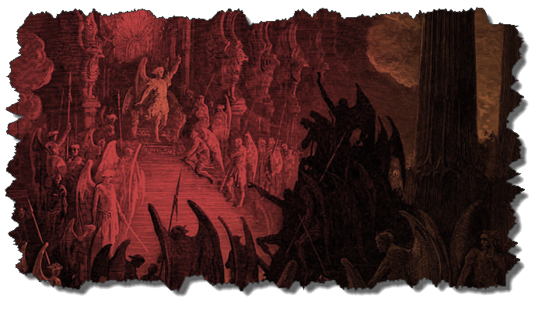

DEMONOLOGY
Dr. Andy Woods
Senior Pastor – Sugar Land Bible Church
President – Chafer Theological Seminary

Slide 2

Preview of Angelology
Good angels
Satanology
Demonology
Gen. 6:1-4 controversy

Slide 3
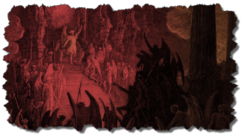
Overview
Existence Origin Personhood Characteristics | Powers Works Demon possession Defense

Slide 4
Overview
Existence Origin Personhood Characteristics | Powers Works Demon possession Defense

Slide 5
Christian’s Defense Against Satan/Demons
God’s responsibility
Believer’s responsibility

Slide 6
Christian’s Defense Against Satan/Demons
God’s responsibility
Believer’s responsibility

Slide 7
Christian’s Defense Against Satan/Demons
God’s responsibility
  Divine restraint (Job 1:10, 12; 2:6; 2 Thess 2:6; 1 John 5:18)
  Divine intercession (John 17:15; Rom 8:34; Heb 7:25)

Slide 8
Christian’s Defense Against Satan/Demons
God’s responsibility
Believer’s responsibility

Slide 9
Christian’s Defense Against Satan/Demons
Believer’s responsibility
  Our defensive posture (Rev 20:2-3, 10; 2 Pet 2:10-11)
  Avoid catering to the flesh (Eph 4:26-27)
  Resist (Jas 4:7; 1 Pet 5:8-9; Eph 6:13)
  Rely on the Spirit (1 John 4:4)
  Put on the full armor of God (Eph 6:10-20)

Slide 10
Christian’s Defense Against Satan/Demons
Believer’s responsibility
  Our defensive posture (Rev 20:2-3, 10; 2 Pet 2:10-11)
  Avoid catering to the flesh (Eph 4:26-27)
  Resist (Jas 4:7; 1 Pet 5:8-9; Eph 6:13)
  Rely on the Spirit (1 John 4:4)
  Put on the full armor of God (Eph 6:10-20)

Slide 11
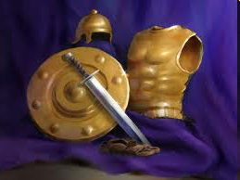
Ephesians
Dressed for Success!

Slide 12

8 Observations About the Armor
(Eph 6:14-17)
Paul’s imprisonment (Eph 3:1; 6:20; Philip 1:13)
Soldier metaphor
Six pieces of armor described
Significance of the armor in the ancient world
Notes:
12

Slide 13
8 Observations About the Armor
(Eph 6:14-17)
Paul is reinforcing prior concepts in Ephesians
Pieces mentioned in the order they are put on
Command: to put on the armor
Outline: description, represents, application
Notes:
13

Slide 14
  Six aspects of our weaponry will summarize the key concepts of the letter and call the church to action.
Notes:
Richard M. Cozart
14

Slide 15
EPHESIANS: WHAT IS INSIDE?
1–3 | 4–6
Relationship | Responsibility
Doctrine | Deed
Orthodoxy | Orthopraxy
Knowledge | Wisdom
Belief | Behavior
Position | Practice
Privileges | Responsibility

Slide 16
Ephesians 4:1
Therefore…
1-3
4-6

Slide 17
Galatians 5:1
Therefore…
1-4
5-6

Slide 18
Romans 12:1
Therefore…
1-11
12-16

Slide 19

Romans 12:1
“Therefore I urge you, brethren, by the mercies of God, to present your bodies a living and holy sacrifice, acceptable to God, which is your spiritual service of worship.”

Slide 20

6 Pieces of Armor
(Eph 6:14-17)
Belt of truth (14a)
Breastplate of righteousness (14b)
Sandals of peace (15)
Shield of faith (16)
Helmet of salvation (17a)
Sword of the Spirit (17b)
Notes:
20

Slide 21
6 Pieces of Armor
(Eph 6:14-17)
Belt of truth (14a)
Breastplate of righteousness (14b)
Sandals of peace (15)
Shield of faith (16)
Helmet of salvation (17a)
Sword of the Spirit (17b)
Notes:
21

Slide 22
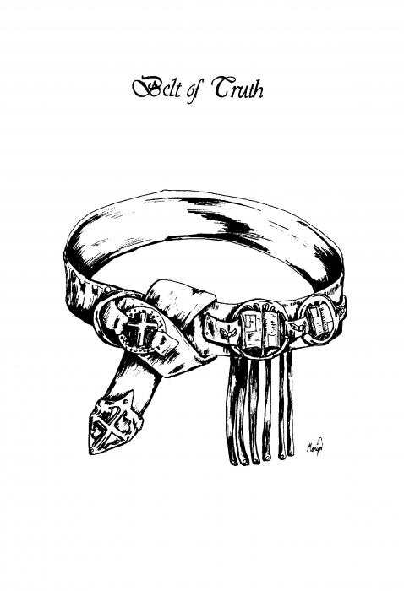
Belt of Truth
(Eph 6:14a)
Description
Notes:
22

Slide 23
Belt of Truth
(Eph 6:14a)
Represent
  “Truth” [alēthia] used 6 times
    Gospel (1:13; 4:21)
    Doctrinal orthodoxy/stability (4:15)
    Moral purity (4:24-25; 5:9)
Notes:
23

Slide 24
Belt of Truth
(Eph 6:14a)
Definition
  Foundation of our defense is standing firm in the truth of God’s Word as well as our personal integrity
Notes:
24

Slide 25
Belt of Truth
(Eph 6:14a)
Application
  Objective: Stand in the truth of God’s Word
  Subjective: Personal integrity
Notes:
25

Slide 26
6 Pieces of Armor
(Eph 6:14-17)
Belt of truth (14a)
Breastplate of righteousness (14b)
Sandals of peace (15)
Shield of faith (16)
Helmet of salvation (17a)
Sword of the Spirit (17b)
Notes:
26

Slide 27
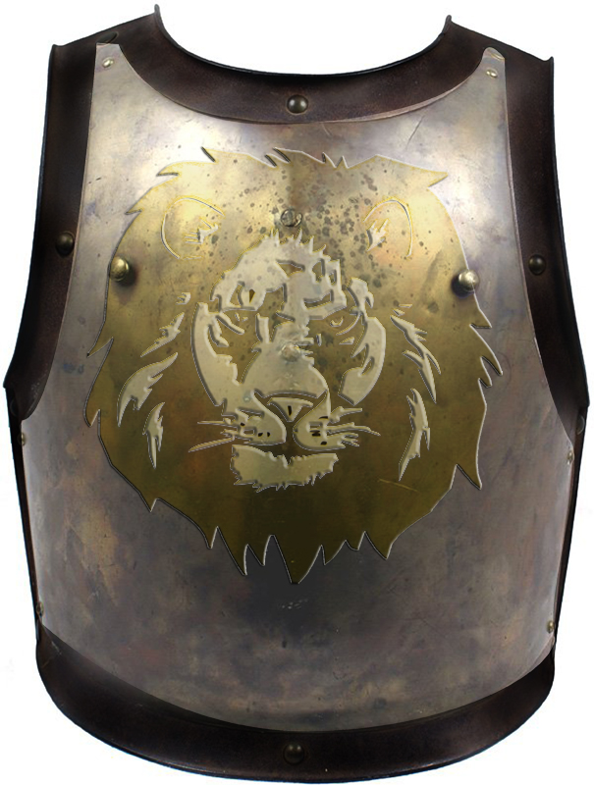
Breastplate of Righteousness
(Eph 6:14b)
Description
Notes:
27

Slide 28
Breastplate of Righteousness
(Eph 6:14b)
Represent
  “Righteousness [dikaiosynē] used 2 times
    4:24; 5:9
    Practical righteousness
Notes:
28

Slide 29
Breastplate of Righteousness
(Eph 6:14b)
Definition
  Our underlying protection includes our righteous character and deeds stemming from our positional righteousness
Notes:
29

Slide 30
Breastplate of Righteousness
(Eph 6:14b)
Application
  Live consistently with our position
  When we engage in a sinful or impure lifestyle, we are vulnerable and can take an arrow through the chest
Notes:
30

Slide 31
6 Pieces of Armor
(Eph 6:14-17)
Belt of truth (14a)
Breastplate of righteousness (14b)
Sandals of peace (15)
Shield of faith (16)
Helmet of salvation (17a)
Sword of the Spirit (17b)
Notes:
31

Slide 32
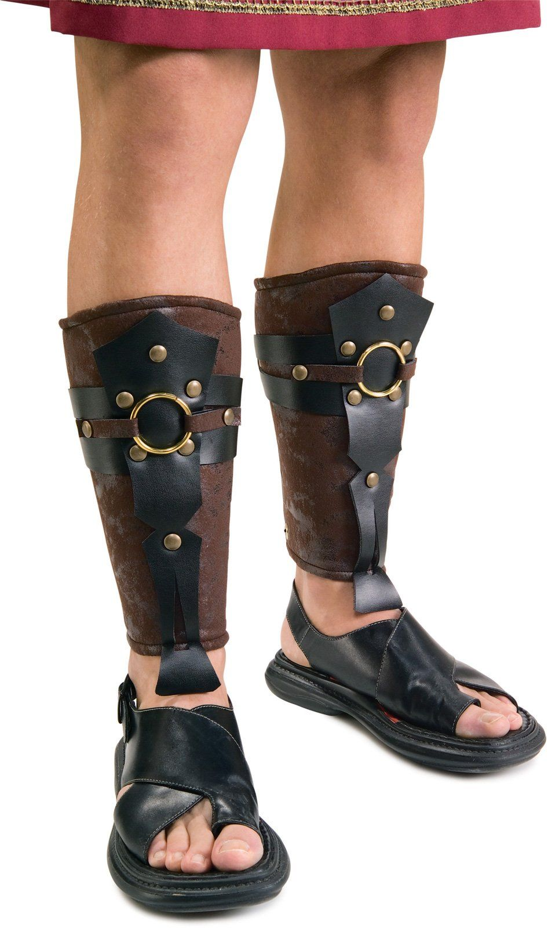
Sandals of Peace
(Eph 6:15)
Description
Notes:
32

Slide 33
Sandals of Peace
(Eph 6:15)
Represent
  “Peace” [eirēnē] used 7 times
    Positional peace (1:2; 6:23)
    Racial harmony (2:14, 15, 17)
    Unity (4:3)
Notes:
33

Slide 34
Sandals of Peace
(Eph 6:15)
Definition
  Because we are at peace with God, we should pursue peace and unity within the church
Notes:
34

Slide 35
Sandals of Peace
(Eph 6:15)
Application
  When we pursue unity in the church, we are putting on the sandals of peace
  Negative example: Philip 4:2-3
Notes:
35

Slide 36
6 Pieces of Armor
(Eph 6:14-17)
Belt of truth (14a)
Breastplate of righteousness (14b)
Sandals of peace (15)
Shield of faith (16)
Helmet of salvation (17a)
Sword of the Spirit (17b)
Notes:
36

Slide 37

Shield of Faith
(Eph 6:16)
Description
Notes:
37

Slide 38
Shield of Faith
(Eph 6:16)
Represent
  “Faith” [pistis, pisteuō] used 9 times
    Noun (1:15; 2:8; 3:12, 17; 4:5, 13; 6:23)
    Verb (1:13, 19)
    Content of what Christians believe
Notes:
38

Slide 39
Shield of Faith
(Eph 6:16)
Definition
  Our confident trust in God’s ways in order to withstand Satan’s attacks
Notes:
39

Slide 40
Shield of Faith
(Eph 6:16)
Application
  Flaming arrows in the ancient world
  Examples of Satan’s flaming arrows
  Our trust in God’s ways extinguishes them all
  Unbelieving believer
Notes:
40

Slide 41
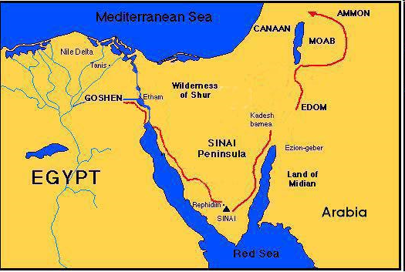

Slide 42
6 Pieces of Armor
(Eph 6:14-17)
Belt of truth (14a)
Breastplate of righteousness (14b)
Sandals of peace (15)
Shield of faith (16)
Helmet of salvation (17a)
Sword of the Spirit (17b)
Notes:
42

Slide 43
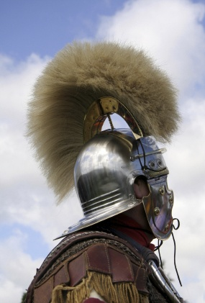
Helmet of Salvation
(Eph 6:17a)
Description
Notes:
43

Slide 44
Helmet of Salvation
(Eph 6:17a)
Represent
  “Salvation” [sōtēria, sōtērion] used 1 time
    Eph 1:13
    Full ramification of salvation
Notes:
44

Slide 45
Three Tenses of Salvation
Phase | Justification | Sanctification | Glorification
Tense | Past | Present | Future
Saved from sin’s: | Penalty | Power | Presence
Scripture | Eph 2:8-9; Titus 3:5 | Philip 2:12 | Rom 5:10

Slide 46
Helmet of Salvation
(Eph 6:17a)
Definition
  Maintaining confidence of our past, present, and future deliverance in the mist of battle
Notes:
46

Slide 47
Helmet of Salvation
(Eph 6:17a)
Application
  Confidence in the full ramifications of our salvation no matter what Satan throws at us that causes our assurance to wane
  John 10:28-29; Rom 8:35; Philip 1:6; 1 Pet 1:4-5
Notes:
47

Slide 48

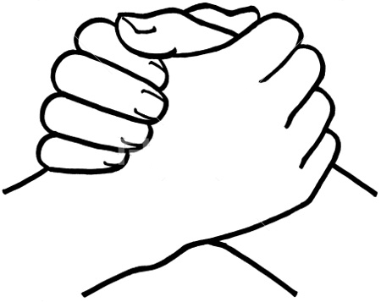
John 10:27-29
“²⁷ My sheep hear My voice, and I know them, and they follow Me; ²⁸ and I give eternal life to them, and they will never perish [ou mē; aiōnia]; and no one will snatch them out of My hand. ²⁹ My Father, who has given them to Me, is greater than all; and no one is able to snatch them out of the Father’s hand.”

Slide 49

Romans 8:29–30
²⁹ For those whom He foreknew, He also predestined to become conformed to the image of His Son, so that He would be the firstborn among many brethren; ³⁰ and these whom He predestined, He also called; and these whom He called, He also justified; and these whom He justified, He also glorified.

Slide 50
1 Peter 1:4–5
^{“4} to obtain an inheritance which is imperishable and undefiled and will not fade away, reserved in heaven for you, ⁵ who are protected by the power of God through faith for a salvation ready to be revealed in the last time.”

Slide 51
6 Pieces of Armor
(Eph 6:14-17)
Belt of truth (14a)
Breastplate of righteousness (14b)
Sandals of peace (15)
Shield of faith (16)
Helmet of salvation (17a)
Sword of the Spirit (17b)
Notes:
51

Slide 52

Sword of the Spirit
(Eph 6:17b)
Description
Notes:
52

Slide 53

Sword of the Spirit
(Eph 6:17b)
Represent
  Communication by the Spirit through the Word [rhēma] of God
  2 Pet 1:21
    Eph 1:8-9, 13, 17-18; 2:18; 3:5-6, 16
Notes:
53

Slide 54

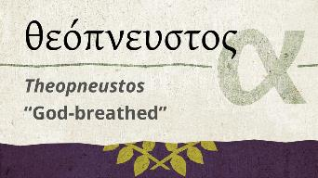
2 Timothy 3:16-17
“All Scripture is inspired by God [theopneustos] and profitable for teaching, for reproof, for correction, for training in righteousness; so that the man of God may be adequate, equipped for every good work.”

Slide 55
2 Peter 1:20-21
“²⁰ But know this first of all, that no prophecy of Scripture is a matter of one’s own interpretation, ²¹ for no prophecy was ever made by an act of human will, but men moved (pherō) by the Holy Spirit spoke from God.”

Slide 56
INSPIRATION OF SCRIPTURE
2 Peter 1:20-21
Men Wrote as they were inspired by Holy Spirit
  “pherō” = to carry
    Acts 27:15,17
Opposite of Knowledge of False Teachers
  Which is their own imagination
    Jer. 23:16

Slide 57
Sword of the Spirit
(Eph 6:17b)
Represent
  Communication by the Spirit through the Word [rhēma] of God
  2 Pet 1:21
    Eph 1:8-9, 13, 17-18; 2:18; 3:5-6, 16
Notes:
57

Slide 58
Sword of the Spirit
(Eph 6:17b)
Definition
  Specific skillful speaking and application of God’s written revelation in order to overcome Satan’s schemes
Notes:
58

Slide 59
CONCLUSION

Slide 60
6 Pieces of Armor
(Eph 6:14-17)
Belt of truth (14a)
Breastplate of righteousness (14b)
Sandals of peace (15)
Shield of faith (16)
Helmet of salvation (17a)
Sword of the Spirit (17b)
Notes:
60

Slide 61
Review
Existence Origin Personhood Characteristics | Powers Works Demon possession Defense

Slide 62
Preview of Angelology
Good angels
Satanology
Demonology
Gen. 6:1-4 controversy

