Slide 1
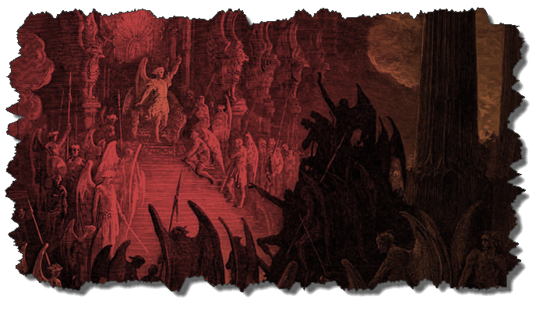

DEMONOLOGY
Dr. Andy Woods
Senior Pastor – Sugar Land Bible Church
President – Chafer Theological Seminary

Slide 2

Preview of Angelology
Good angels
Satanology
Demonology
Gen. 6:1-4 controversy

Slide 3
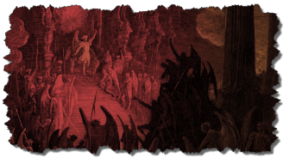
Overview
Existence Origin Personhood Characteristics | Powers Works Demon possession Defense

Slide 4
Overview
Existence Origin Personhood Characteristics | Powers Works Demon possession Defense

Slide 5
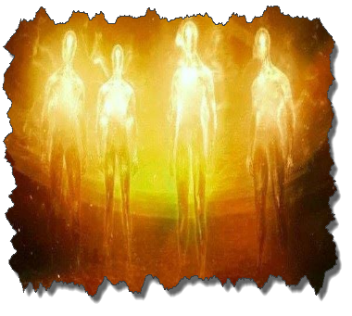
Existence
OT
  Deut 32:17
  Ps 106:37
NT
  Over 100x
  All NT writers (except Hebrews)
  Christ (Matt 8:29; 10:1; 12:43-45)

Slide 6
Overview
Existence Origin Personhood Characteristics | Powers Works Demon possession Defense

Slide 7
Origin
 | Demons | Fallen Angels
Satan is leader | Matt 12:24 | Matt 25:41; Rev 12:7-9
Spirit beings | Matt 8:16 | Heb 1:14
Capacity to enter people | Matt 12:22; Luke 11:14-15 | John 13:27

Slide 8
Overview
Existence Origin Personhood Characteristics | Powers Works Demon possession Defense

Slide 9
Personhood
Attributes of personhood
  Intellect – Acts 19:15
  Emotions – Luke 8:28; Jas 2:19
  Will – Luke 8:32
  Personal pronouns – Mark 1:24-25

Slide 10
Overview
Existence Origin Personhood Characteristics | Powers Works Demon possession Defense

Slide 11

Characteristics
Spirits-Matt 8:16; Eph 6:12
Corrupt
  Unclean – Matt 10:1
  Evil – Luke 7:21
  Rulers of darkness in spiritual wickedness – Eph 6:12
  Degrees of wickedness – Matt 12:45

Slide 12
Overview
Existence Origin Personhood Characteristics | Powers Works Demon possession Defense

Slide 13
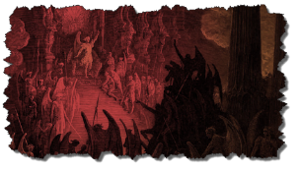
Powers
Great strength (Mark 5:3-4; Acts 19:16) but not omnipotent (Dan 10:13)
Superhuman intelligence (2 Sam. 14:20; Luke 8:28; 20:35-36) but not omniscient (Acts 19:15)
Not confined by physical space or barriers (Mark 5:9) but not omnipresent (Mark 5:12)

Slide 14
Overview
Existence Origin Personhood Characteristics | Powers Works Demon possession Defense

Slide 15

Works
General
  Satan’s lack of omnipresence (Job 1:7; 2:2) forces him to work through demons (Matt 12:24; 25:41; Rev 12:7; 2 Cor 12:7)
  Work in harmony with one another (Eph 6:11-12)
  Influence human government (Dan 10:13, 20)
  Promote false religion (1 Cor 10:20; 1 Tim 4:1)

Slide 16
Works (cont’d)
General
  Afflict the mind (Mark 5:3, 5)
  Afflict the body (Matt 12:22; Mark 9:22; Luke 13:11, 16)
  Hinder believers’ prayers (Dan 10:12-20)

Slide 17
Occult Works
NAME | DEFINITION | SCRIPTURE
Divination | Fortune telling | Deut 18:10; Acts 16:16
Spiritism | Contacting the dead | Deut 18:11
Magic | Performance of miraculous powers | Deut 18:11
Pharamkeia | Illicit drug use | Rev 9:20-21; 18:2, 23

Slide 18

Overview
Existence Origin Personhood Characteristics | Powers Works Demon possession Defense

Slide 19
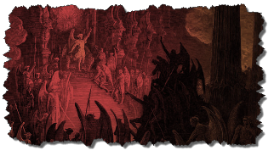
7. Demon Possession
Definition
Cause
Balance – Human evil is not all attributable to Satan/demons – Jer 17:9; Matt 15:19ff; Rev 20:7-9; Zech 14:16-18
Characteristics
Demon possession & the believer

Slide 20
E. The Christian & Demon Possession
Possession? No!
  1 Cor 6:19; John 14:16-17; 1 John 4:4
  No biblical references to:
    A Christian being demon possessed
    How to cast a demon out of a Christian
    Generation curses?

Slide 21
E. The Christian & Demon Possession
Oppression? Yes!
  1 Chr 21:1; Luke 13:11, 16; Matt 16:23; Acts 5:3-4; 2 Cor 12:7; Eph 6:12
  Temporary
  Not loss of salvation
  Sometimes the believer opens the door to oppression (Eph 4:26-27)

Slide 22
Overview
Existence Origin Personhood Characteristics | Powers Works Demon possession Defense

Slide 23
Christian’s Defense Against Satan/Demons
God’s responsibility
Believer’s responsibility

Slide 24
Christian’s Defense Against Satan/Demons
God’s responsibility
Believer’s responsibility

Slide 25
Christian’s Defense Against Satan/Demons
God’s responsibility
  Divine restraint (Job 1:10, 12; 2:6; 2 Thess 2:6; 1 John 5:18)
  Divine intercession (John 17:15; Rom 8:34; Heb 7:25)

Slide 26
Christian’s Defense Against Satan/Demons
God’s responsibility
  Divine restraint (Job 1:10, 12; 2:6; 2 Thess 2:6; 1 John 5:18)
  Divine intercession (John 17:15; Rom 8:34; Heb 7:25)

Slide 27

Job 1:10
⁸ The Lord said to Satan, “Have you considered My servant Job? For there is no one like him on the earth, a blameless and upright man, fearing God and turning away from evil.” 9 Then Satan answered the Lord, “Does Job fear God for nothing? ¹⁰ Have You not made a hedge about him and his house and all that he has, on every side? You have blessed the work of his hands, and his possessions have increased in the land.”

Slide 28

2 Thessalonians 2:6-7
“⁶ And you know what restrains him now, so that in his time he will be revealed. ⁷ For the mystery of lawlessness is already at work; only he who now restrains will do so until he is taken out of the way.”

Slide 29
Christian’s Defense Against Satan/Demons
God’s responsibility
  Divine restraint (Job 1:10, 12; 2:6; 2 Thess 2:6; 1 John 5:18)
  Divine intercession (John 17:15; Rom 8:34; Heb 7:25)

Slide 30
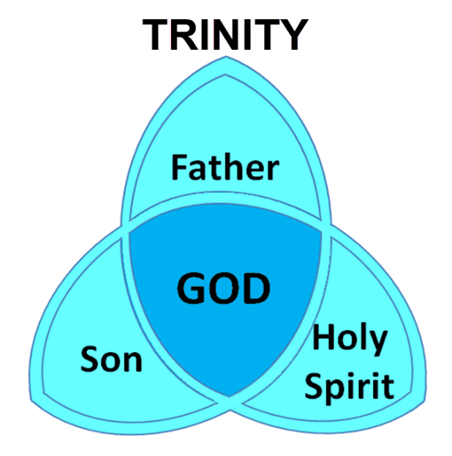

Slide 31
Christian’s Defense Against Satan/Demons
God’s responsibility
Believer’s responsibility

Slide 32
Christian’s Defense Against Satan/Demons
Believer’s responsibility
  Our defensive posture (Rev 20:2-3, 10; 2 Pet 2:10-11)
  Avoid catering to the flesh (Eph 4:26-27)
  Resist (Jas 4:7; 1 Pet 5:8-9; Eph 6:13)
  Rely on the Spirit (1 John 4:4)
  Put on the full armor of God (Eph 6:10-20)

Slide 33
Christian’s Defense Against Satan/Demons
Believer’s responsibility
  Our defensive posture (Rev 20:2-3, 10; 2 Pet 2:10-11)
  Avoid catering to the flesh (Eph 4:26-27)
  Resist (Jas 4:7; 1 Pet 5:8-9; Eph 6:13)
  Rely on the Spirit (1 John 4:4)
  Put on the full armor of God (Eph 6:10-20)

Slide 34

Revelation 20:1-3
“¹ Then I saw an angel coming down from heaven, holding the key of the abyss and a great chain in his hand. ² And he laid hold of the dragon, the serpent of old, who is the devil and Satan, and bound him for a thousand years; ³ and he threw him into the abyss, and shut it and sealed it over him, so that he would not deceive the nations any longer, until the thousand years were completed; after these things he must be released for a short time.”

Slide 35

Revelation 20:10
“And the devil who deceived them was thrown into the lake of fire and brimstone, where the beast and the false prophet are also; and they will be tormented day and night forever and ever.”

Slide 36
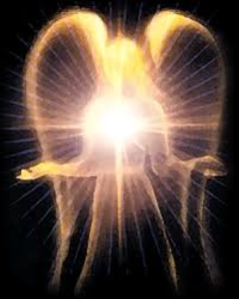
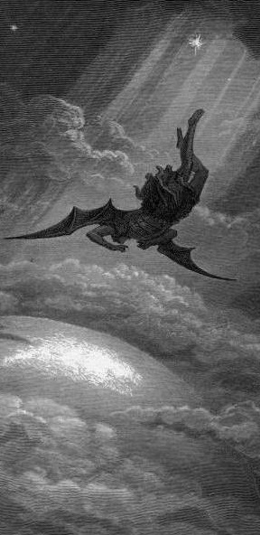
Satan’s Progressive Defeat
Initial eviction from heaven (Isa 14:12-15; Ezek 28:12-17)
Eden (Gen 3:15)
Pre-diluvian world (1 Pet 3:19-20)
Cross (John 12:31; 16:11; Col 2:15; Heb 2:14; 1 John 3:8)
Mid point of the Tribulation (Rev 12:9)
Beginning of millennium (Rev 20:2-3)
End of millennium (Rev 20:10)

Slide 37
Satan’s Progressive Defeat
Initial eviction from heaven (Isa 14:12-15; Ezek 28:12-17)
Eden (Gen 3:15)
Pre-diluvian world (1 Pet 3:19-20)
Cross (John 12:31; 16:11; Col 2:15; Heb 2:14; 1 John 3:8)
Mid point of the Tribulation (Rev 12:9)
Beginning of millennium (Rev 20:2-3)
End of millennium (Rev 20:10)

Slide 38

Revelation 11:15
“Then the seventh angel sounded; and there were loud voices in heaven, saying, ‘The kingdom of the world has become the kingdom of our Lord and of His Christ; and He will reign forever and ever.’”

Slide 39
Ultimate Exodus (Rev 11:15)
Sores | 6th plague (Ex 9:8-12) | 1st bowl (Rev 16:1-2)
Rivers to blood | 1st plague (Ex 7:19-21) | 3rd bowl (Rev 16:4-7)
Darkness | 9th plague (Ex 10:21-23) | 5th bowl (Rev 16:10-11)
Frogs | 2nd plague (Ex 7:25‒8:15) | 6th bowl (Rev 16:13)
Hail | 7th plague (Ex 9:22-26) | 7th bowl (Rev 16:17-21)

Slide 40
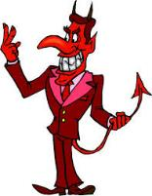
Names & Titles Demonstrating Satan’s Post-Fall, Earthly Authority
(Job 1:7; 2:2; Luke 4:5-8; Rom. 8:19-22)
Prince of this world (John 12:31; 14:30; 16:11)
God of this age (2 Cor. 4:4)
Prince and power of the air (Eph. 2:2)
Who the believer wrestles with (Eph. 6:12)
Roaring lion (1 Pet. 5:8)
Whole world lies in his power (1 John 5:19)

Slide 41




Slide 42
Christian’s Defense Against Satan/Demons
Believer’s responsibility
  Our defensive posture (Rev 20:2-3, 10; 2 Pet 2:10-11)
  Avoid catering to the flesh (Eph 4:26-27)
  Resist (Jas 4:7; 1 Pet 5:8-9; Eph 6:13)
  Rely on the Spirit (1 John 4:4)
  Put on the full armor of God (Eph 6:10-20)

Slide 43
Christian’s Defense Against Satan/Demons
Believer’s responsibility
  Our defensive posture (Rev 20:2-3, 10; 2 Pet 2:10-11)
  Avoid catering to the flesh (Eph 4:26-27)
  Resist (Jas 4:7; 1 Pet 5:8-9; Eph 6:13)
  Rely on the Spirit (1 John 4:4)
  Put on the full armor of God (Eph 6:10-20)

Slide 44
Christian’s Defense Against Satan/Demons
Believer’s responsibility
  Our defensive posture (Rev 20:2-3, 10; 2 Pet 2:10-11)
  Avoid catering to the flesh (Eph 4:26-27)
  Resist (Jas 4:7; 1 Pet 5:8-9; Eph 6:13)
  Rely on the Spirit (1 John 4:4)
  Put on the full armor of God (Eph 6:10-20)

Slide 45
Christian’s Defense Against Satan/Demons
Believer’s responsibility
  Our defensive posture (Rev 20:2-3, 10; 2 Pet 2:10-11)
  Avoid catering to the flesh (Eph 4:26-27)
  Resist (Jas 4:7; 1 Pet 5:8-9; Eph 6:13)
  Rely on the Spirit (1 John 4:4)
  Put on the full armor of God (Eph 6:10-20)

Slide 46
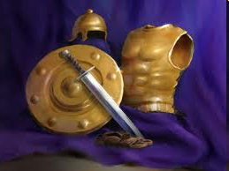
Ephesians
Dressed for Success!

Slide 47

Observations About the Armor
(Eph 6:14-17)
Paul’s imprisonment (Eph 3:1; 6:20; Philip 1:13)
Soldier metaphor
Six pieces of armor described
Significance of the armor in the ancient world
Notes:
47

Slide 48
Observations About the Armor
(Eph 6:14-17)
Paul is reinforcing a prior concept
Pieces mentioned in the order they are put on
Command: to put on the armor
Outline: description, represents, application
Notes:
48

Slide 49
  Six aspects of our weaponry will summarize the key concepts of the letter and call the church to action.
Notes:
Richard M. Cozart
49

Slide 50

6 Pieces of Armor
(Eph 6:14-17)
Belt of truth (14a)
Breastplate of righteousness (14b)
Sandals of peace (15)
Shield of faith (16)
Helmet of salvation (17a)
Sword of the Spirit (17b)
Notes:
50

Slide 51
CONCLUSION

Slide 52
Preview of Angelology
Good angels
Satanology
Demonology
Gen. 6:1-4 controversy

