Slide 1
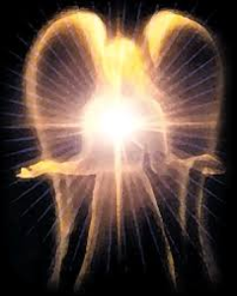
SATANOLOGY
Dr. Andy Woods
Senior Pastor – Sugar Land Bible Church
President – Chafer Theological Seminary

Slide 2
Preview of Angelology
Good angels
Satanology
Demonology
Gen. 6:1-4 controversy

Slide 3
Preview
Existence
Personhood
Names and titles
Original state and first sin
Works

Slide 4
Works
Past
Present
Future

Slide 5
Works
Past
Present
Future

Slide 6
Works - Past
Lied to Adam and Eve (Gen 3:1ff)
Corrupted the pre-flood gene pool (Gen 6:1-4)
Accused and afflicted Job (Job 1–2)
Disputed Michael regarding Moses’ body (Jude 9)
Tempted David to take a census (1 Chr 21:1)
Accused Joshua (Zech 3:1-3)

Slide 7
Works – Past (cont’d)
Tempted Christ (Matt 4:1-11)
Tested Peter (Luke 22:31-33)
Possessed Judas (John 13:27)
Hindered Paul (1 Thess 2:18)
Afflicted Paul (2 Cor 12:7-10)
Influenced Ananias & Sapphira to lie (Acts 5:3-4, 8)

Slide 8
Works
Past
Present
Future

Slide 9
Works – Present
Snatches God’s Word (Luke 8:12)
Rules world (1 John 5:19)
Blinds the mind (2 Cor 4:4)
Sends false ministers (2 Cor 11:14-15)
Sends false gospels (2 Cor 11:3-4)
Sows unbelievers among believers (Matt 13:38-39)
Performs miracles (2 Thess 2:9)
Promotes immorality (Eph 2:1-3)
Opposes God’s people (Eph 6:11-12)

Slide 10
Works – Present
Snatches God’s Word (Luke 8:12)
Rules world (1 John 5:19)
Blinds the mind (2 Cor 4:4)
Sends false ministers (2 Cor 11:14-15)
Sends false gospels (2 Cor 11:3-4)
Sows unbelievers among believers (Matt 13:38-39)
Performs miracles (2 Thess 2:9)
Promotes immorality (Eph 2:1-3)
Opposes God’s people (Eph 6:11-12)

Slide 11
Works – Present
Snatches God’s Word (Luke 8:12)
Rules world (1 John 5:19)
Blinds the mind (2 Cor 4:4)
Sends false ministers (2 Cor 11:14-15)
Sends false gospels (2 Cor 11:3-4)
Sows unbelievers among believers (Matt 13:38-39)
Performs miracles (2 Thess 2:9)
Promotes immorality (Eph 2:1-3)
Opposes God’s people (Eph 6:11-12)

Slide 12
Antichrist’s Satanic Miracles (2 Thessalonians 2:9)
MIRACLE | GREEK | CHRIST’S MINISTRY
Powers | Dynamis | Matt. 11:20
Signs | Semēion | John 20:30
Wonders | Teras | Acts 2:22

Slide 13
Satanic/Demonic Miracles
Exod. 7–8
Deut. 13:1-3
Matt. 7:21-23; 24:24
Acts 8:9; 16:16
Gal. 1:6-9
2 Thess. 2:9
Rev. 13:3, 13, 15; 16:13-14

Slide 14
Works – Present
Snatches God’s Word (Luke 8:12)
Rules world (1 John 5:19)
Blinds the mind (2 Cor 4:4)
Sends false ministers (2 Cor 11:14-15)
Sends false gospels (2 Cor 11:3-4)
Sows unbelievers among believers (Matt 13:38-39)
Performs miracles (2 Thess 2:9)
Promotes immorality (Eph 2:1-3)
Opposes God’s people (Eph 6:11-12)

Slide 15
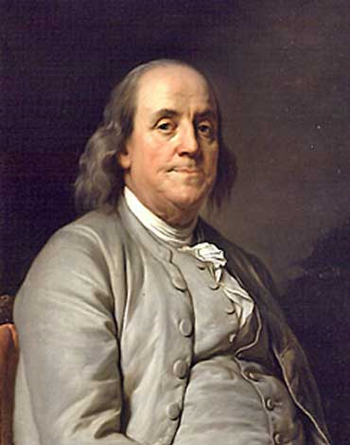
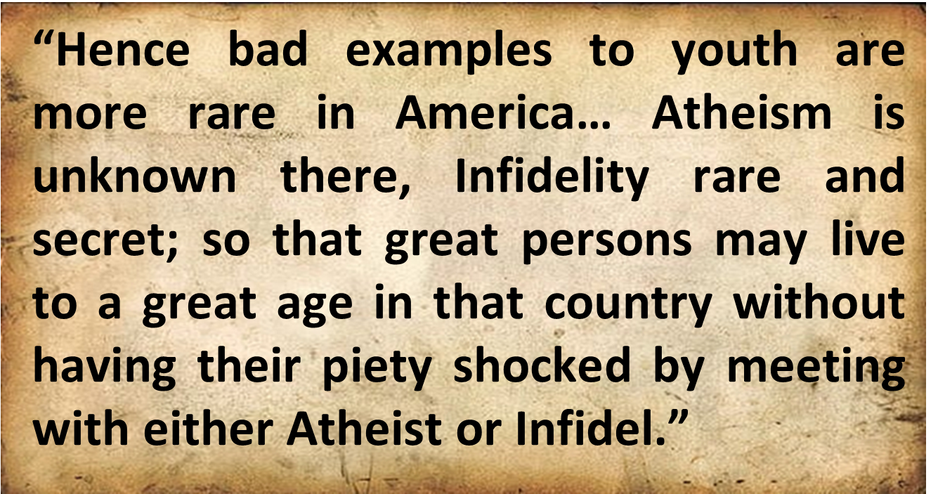
Benjamin Franklin
“Advice on Coming to America,” America in Person, ed. George D. Youstra, 109.

Slide 16
Works – Present
Snatches God’s Word (Luke 8:12)
Rules world (1 John 5:19)
Blinds the mind (2 Cor 4:4)
Sends false ministers (2 Cor 11:14-15)
Sends false gospels (2 Cor 11:3-4)
Sows unbelievers among believers (Matt 13:38-39)
Performs miracles (2 Thess 2:9)
Promotes immorality (Eph 2:1-3)
Opposes God’s people (Eph 6:11-12)

Slide 17
Works – Present (cont’d )
Tempts God’s people (1 Cor 7:5)
Uses the carnality of Christians (Eph 4:26-27)
Causes physical problems (Luke 13:11, 16)
Influences civil government (Dan 10:10ff)
Lies (John 8:44)
Deceives (Rev 12:9; 20:3)

Slide 18
Works – Present (cont’d )
Tempts God’s people (1 Cor 7:5)
Uses the carnality of Christians (Eph 4:26-27)
Causes physical problems (Luke 13:11, 16)
Influences civil government (Dan 10:10ff)
Lies (John 8:44)
Deceives (Rev 12:9; 20:3)

Slide 19
Romans 8:19-22
¹⁹ For the anxious longing of the creation waits eagerly for the revealing of the sons of God. ²⁰ For the creation was subjected to futility, not willingly, but because of Him who subjected it, in hope ²¹ that the creation itself also will be set free from its slavery to corruption into the freedom of the glory of the children of God. ²² For we know that the whole creation groans and suffers the pains of childbirth together until now.

Slide 20
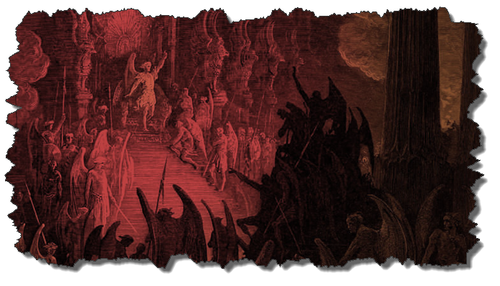
Not all Physical Infirmities are Attributable to Satan/Demon (works cont’d)
Matt 8:5-13
Matt 9:19-20, 27-30
Matt 12:9-14
Matt 14:35-36

Slide 21
Works – Present (cont’d )
Tempts God’s people (1 Cor 7:5)
Uses the carnality of Christians (Eph 4:26-27)
Causes physical problems (Luke 13:11, 16)
Influences civil government (Dan 10:10ff)
Lies (John 8:44)
Deceives (Rev 12:9; 20:3)

Slide 22
Works
Past
Present
Future

Slide 23
Works – Future
World government (Rev 13:3-4)
Oppose the 2nd Advent (Rev 17:14)
Attempt to annihilate Israel (Rev 12)
Bound (Rev 20:1-3)
Lead a final rebellion (Rev 20:7-9)
Cast into the Lake of Fire (Rev 20:10)

Slide 24
Works – Future
World government (Rev 13:3-4)
Oppose the 2nd Advent (Rev 17:14)
Attempt to annihilate Israel (Rev 12)
Bound (Rev 20:1-3)
Lead a final rebellion (Rev 20:7-9)
Cast into the Lake of Fire (Rev 20:10)

Slide 25
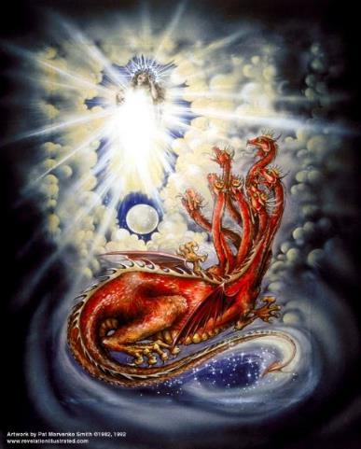
CAST OF 3 CHARACTERS Revelation 12:1-5
SON = MESSIAH
Ps. 2:9; Acts 1:9
DRAGON = SATAN
Rev. 12:9; 20:2
WOMAN = ISRAEL
Gen. 37:9-10

Slide 26
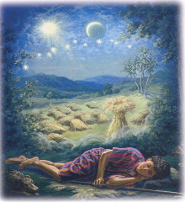
Genesis 37:9
Now he had still another dream, and related it to his brothers, and said, “Lo, I have had still another dream; and behold, the sun and the moon and eleven stars were bowing down to me.

Slide 27
Genesis 37:10
He related it to his father and to his brothers; and his father rebuked him and said to him, “What is this dream that you have had? Shall I and your mother and your brothers actually come to bow ourselves down before you to the ground?”

Slide 28
2 CYCLES OF SATANIC PERSECUTION
“Pursues the woman” = persecution of Israel 12:13-14
“Flood from his mouth” = tries to destroy Israel 12:15-16

Slide 29
Works – Future
World government (Rev 13:3-4)
Oppose the 2nd Advent (Rev 17:14)
Attempt to annihilate Israel (Rev 12)
Bound (Rev 20:1-3)
Lead a final rebellion (Rev 20:7-9)
Cast into the Lake of Fire (Rev 20:10)

Slide 30
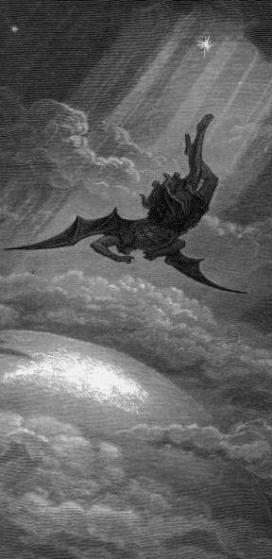
Satan’s Progressive Defeat
Initial eviction from heaven (Isa 14:12-15; Ezek 28:12-17)
Eden (Gen 3:15)
Pre-diluvian world (1 Pet 3:19-20)
Cross (John 12:31; 16:11; Col 2:15; Heb 2:14; 1 John 3:8)
Mid point of the Tribulation (Rev 12:9)
Beginning of millennium (Rev 20:2-3)
End of millennium (Rev 20:10)

Slide 31
Satan’s Progressive Defeat
Initial eviction from heaven (Isa 14:12-15; Ezek 28:12-17)
Eden (Gen 3:15)
Pre-diluvian world (1 Pet 3:19-20)
Cross (John 12:31; 16:11; Col 2:15; Heb 2:14; 1 John 3:8)
Mid point of the Tribulation (Rev 12:9)
Beginning of millennium (Rev 20:2-3)
End of millennium (Rev 20:10)

Slide 32
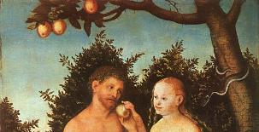
Genesis 3:15
“And I will put enmity between you and the woman, and between your seed and her seed; He shall bruise you on the head, and you shall bruise him on the heel.”

Slide 33
Satan’s Progressive Defeat
Initial eviction from heaven (Isa 14:12-15; Ezek 28:12-17)
Eden (Gen 3:15)
Pre-diluvian world (1 Pet 3:19-20)
Cross (John 12:31; 16:11; Col 2:15; Heb 2:14; 1 John 3:8)
Mid point of the Tribulation (Rev 12:9)
Beginning of millennium (Rev 20:2-3)
End of millennium (Rev 20:10)

Slide 34
 | David/Saul | Jesus/Satan
ANOINTED | David (1 Sam 16:13) | Jesus-Res./Ascension (Ps 2:7; 110:1)
NOW RULING | Saul (1 Sam 16:14) | Satan (Luke 4:5-7)
ILLEGITIMACY | Benjamin (Gen 49:10; 1 Sam. 9:21) | Gen. 1:26-28; 2:19-20; Dan 1:6-7)
FAITH | David (1 Sam 16:7) | Jesus (Heb 11:6)
MINORITY | David’s men (2 Sam 23:8-39) | Narrow road (Matt 7:14)
SIGHT | Saul (1 Sam 9:2) | Satan (2 Cor. 4:18; 1 John 2:15-17)
MAJORITY | Israel | Broad road (Matt. 7:13)
McClain, Greatness of the Kingdom, 440

Slide 35
CONCLUSION

Slide 36
Review
Existence
Personhood
Names and titles
Original state and first sin
Works

