Slide 1

Ecclesiology
Session 50
Dr. Andy Woods
Senior Pastor – Sugar Land Bible Church
President – Chafer Theological Seminary

Slide 2


Areas of Systematic Theology
Prolegomena – Introduction
Theology – Study of God
Christology – Study of Christ
Pneumatology – Study of the Holy Spirit
Anthropology – Study of Man
Hamartiology – Study of sin
Soteriology – Study of salvation
Angelology – Study of angels
Ecclesiology – Study of the Church
Eschatology – Study of the end

Slide 3

Ecclesiology Overview
Definition
Universal vs. local
Word pictures
Origin
Israel – Church differences
Intercalation
Purposes
Activities
Government
Officers
Ordinances
Purity

Slide 4

Purity of the Church
Ecclesiastical separation
Church discipline

Slide 5
Purity of the Church
Ecclesiastical separation
Church discipline

Slide 6
Ecclesiastical Separation
Why separate?
Biblical basis for separation
What to separate from?

Slide 7
Ecclesiastical Separation
Why separate?
Biblical basis for separation
What to separate from?

Slide 8
A. Why Separate?
Not hatred
Gives world a false sense of security
Loss of distinctiveness and power

Slide 9
Ecclesiastical Separation
Why separate?
Biblical basis for separation
What to separate from?

Slide 10

B. Biblical Basis for Separation?
2 Thess. 3:6, 14
1 Cor. 5:11
2 Cor. 6:14-18
Rom. 16:17
Eph. 5:11
Titus 3:9-11
2 John 9-11

Slide 11

2 John 7-11
“⁷ For many deceivers have gone out into the world, those who do not acknowledge Jesus Christ as coming in the flesh. This is the deceiver and the antichrist. ⁸ Watch yourselves, that you do not lose what we have accomplished, but that you may receive a full reward. ⁹ Anyone who goes too far and does not abide in the teaching of Christ, does not have God; the one who abides in the teaching, he has both the Father and the Son. ¹⁰ If anyone comes to you and does not bring this teaching, do not receive him into your house, and do not give him a greeting; ¹¹ for the one who gives him a greeting participates in his evil deeds.”

Slide 12
Ecclesiastical Separation
Why separate?
Biblical basis for separation
What to separate from?

Slide 13

C. What to Separate From?
False doctrine – 1 Tim. 4:16; Titus 1:9
Divisive persons – Rom. 16:17; Titus 3:9-11
Immorality – 1 Cor. 5:9-11; Eph. 5:11
General disobedience to Scripture –2 Thess. 3:6, 14

Slide 14
C. What to Separate From?
False doctrine – 1 Tim. 4:16; Titus 1:9
Divisive persons – Rom. 16:17; Titus 3:9-11
Immorality – 1 Cor. 5:9-11; Eph. 5:11
General disobedience to Scripture –2 Thess. 3:6, 14

Slide 15

Fundamentals of the Faith
Creation/Fall – Rom. 5:14
Inspiration/inerrancy of the Scripture – Matt. 5:18; John 17:17; 2 Tim. 3:16; 2 Pet. 1:20-21
Salvation by faith alone
Eternal existence of heaven/hell – Dan. 12:2; Matt. 25:46
Trinity
Virgin birth of Christ
Deity of Christ
Atoning death of Christ – Isa. 53:3-6; 1 Pet. 2:24
Bodily Resurrection of Christ – John 20:27-28; 1 Cor. 15:14
Bodily Second Advent of Christ – Job 19:25; Zech. 14:4; Acts 1:9-11

Slide 16
Fundamentals of the Faith
Creation/Fall – Rom. 5:14
Inspiration/inerrancy of the Scripture – Matt. 5:18; John 17:17; 2 Tim. 3:16; 2 Pet. 1:20-21
Salvation by faith alone
Eternal existence of heaven/hell – Dan. 12:2; Matt. 25:46
Trinity
Virgin birth of Christ
Deity of Christ
Atoning death of Christ – Isa. 53:3-6; 1 Pet. 2:24
Bodily Resurrection of Christ – John 20:27-28; 1 Cor. 15:14
Bodily Second Advent of Christ – Job 19:25; Zech. 14:4; Acts 1:9-11

Slide 17
Fundamentals of the Faith
Creation/Fall – Rom. 5:14
Inspiration/inerrancy of the Scripture – Matt. 5:18; John 17:17; 2 Tim. 3:16; 2 Pet. 1:20-21
Salvation by faith alone
Eternal existence of heaven/hell – Dan. 12:2; Matt. 25:46
Trinity
Virgin birth of Christ
Deity of Christ
Atoning death of Christ – Isa. 53:3-6; 1 Pet. 2:24
Bodily Resurrection of Christ – John 20:27-28; 1 Cor. 15:14
Bodily Second Advent of Christ – Job 19:25; Zech. 14:4; Acts 1:9-11

Slide 18
Fundamentals of the Faith
Creation/Fall – Rom. 5:14
Inspiration/inerrancy of the Scripture – Matt. 5:18; John 17:17; 2 Tim. 3:16; 2 Pet. 1:20-21
Salvation by faith alone
Eternal existence of heaven/hell – Dan. 12:2; Matt. 25:46
Trinity
Virgin birth of Christ
Deity of Christ
Atoning death of Christ – Isa. 53:3-6; 1 Pet. 2:24
Bodily Resurrection of Christ – John 20:27-28; 1 Cor. 15:14
Bodily Second Advent of Christ – Job 19:25; Zech. 14:4; Acts 1:9-11

Slide 19
Chart courtesy of Thomas Stegall

Slide 20
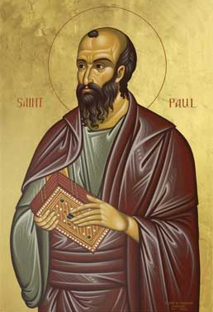
Romans 4:4-5
“ Now to the one who works, his wage is not credited as a favor, but as what is due. But to the one who does not work, but believes in Him who justifies the ungodly, his faith is credited as righteousness.” (cf. Gen. 15:6)

Slide 21

Galatians 1:6-9
“⁶ I am amazed that you are so quickly deserting Him who called you by the grace of Christ, for a different gospel; ⁷ which is really not another; only there are some who are disturbing you and want to distort the gospel of Christ. ⁸ But even if we, or an angel from heaven, should preach to you a gospel contrary to what we have preached to you, he is to be accursed (anathema)! ⁹ As we have said before, so I say again now, if any man is preaching to you a gospel contrary to what you received, he is to be accursed (anathema)!”

Slide 22
Fundamentals of the Faith
Creation/Fall – Rom. 5:14
Inspiration/inerrancy of the Scripture – Matt. 5:18; John 17:17; 2 Tim. 3:16; 2 Pet. 1:20-21
Salvation by faith alone
Eternal existence of heaven/hell – Dan. 12:2; Matt. 25:46
Trinity
Virgin birth of Christ
Deity of Christ
Atoning death of Christ – Isa. 53:3-6; 1 Pet. 2:24
Bodily Resurrection of Christ – John 20:27-28; 1 Cor. 15:14
Bodily Second Advent of Christ – Job 19:25; Zech. 14:4; Acts 1:9-11

Slide 23
Fundamentals of the Faith
Creation/Fall – Rom. 5:14
Inspiration/inerrancy of the Scripture – Matt. 5:18; John 17:17; 2 Tim. 3:16; 2 Pet. 1:20-21
Salvation by faith alone
Eternal existence of heaven/hell – Dan. 12:2; Matt. 25:46
Trinity
Virgin birth of Christ
Deity of Christ
Atoning death of Christ – Isa. 53:3-6; 1 Pet. 2:24
Bodily Resurrection of Christ – John 20:27-28; 1 Cor. 15:14
Bodily Second Advent of Christ – Job 19:25; Zech. 14:4; Acts 1:9-11

Slide 24
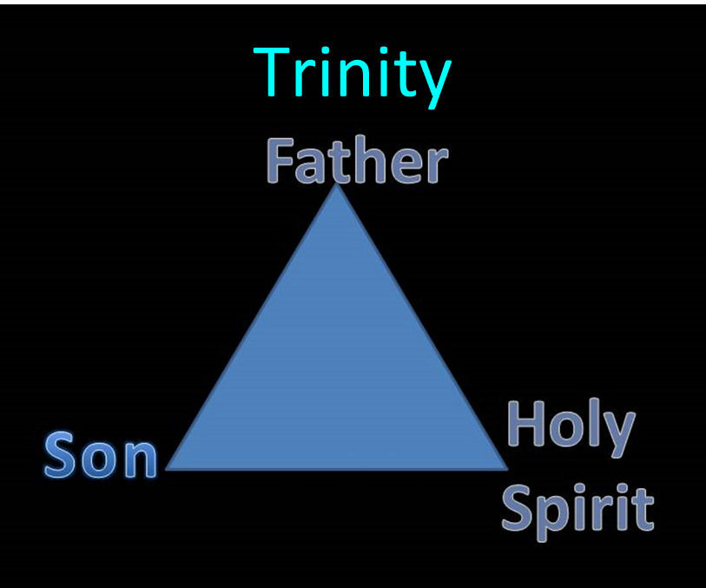

Slide 25
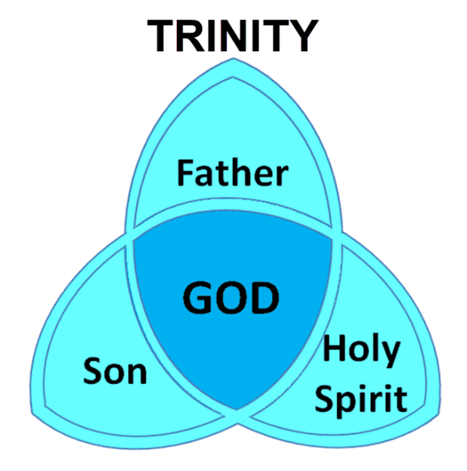

Slide 26
Fundamentals of the Faith
Creation/Fall – Rom. 5:14
Inspiration/inerrancy of the Scripture – Matt. 5:18; John 17:17; 2 Tim. 3:16; 2 Pet. 1:20-21
Salvation by faith alone
Eternal existence of heaven/hell – Dan. 12:2; Matt. 25:46
Trinity
Virgin birth of Christ
Deity of Christ
Atoning death of Christ – Isa. 53:3-6; 1 Pet. 2:24
Bodily Resurrection of Christ – John 20:27-28; 1 Cor. 15:14
Bodily Second Advent of Christ – Job 19:25; Zech. 14:4; Acts 1:9-11

Slide 27


Slide 28
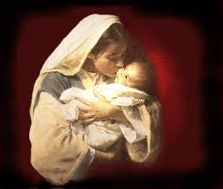

Why the Virgin Birth?
To fulfill OT prophecy
To emphasize Christ’s humanity and deity
To emphasize Christ’s eternality
To maintain Christ’s sinlessness
To protect the bodily atonement
To circumvent the curse of Jeconiah
To vindicate the NT

Slide 29
Fundamentals of the Faith
Creation/Fall – Rom. 5:14
Inspiration/inerrancy of the Scripture – Matt. 5:18; John 17:17; 2 Tim. 3:16; 2 Pet. 1:20-21
Salvation by faith alone
Eternal existence of heaven/hell – Dan. 12:2; Matt. 25:46
Trinity
Virgin birth of Christ
Deity of Christ
Atoning death of Christ – Isa. 53:3-6; 1 Pet. 2:24
Bodily Resurrection of Christ – John 20:27-28; 1 Cor. 15:14
Bodily Second Advent of Christ – Job 19:25; Zech. 14:4; Acts 1:9-11

Slide 30
Fundamentals of the Faith
Creation/Fall – Rom. 5:14
Inspiration/inerrancy of the Scripture – Matt. 5:18; John 17:17; 2 Tim. 3:16; 2 Pet. 1:20-21
Salvation by faith alone
Eternal existence of heaven/hell – Dan. 12:2; Matt. 25:46
Trinity
Virgin birth of Christ
Deity of Christ
Atoning death of Christ – Isa. 53:3-6; 1 Pet. 2:24
Bodily Resurrection of Christ – John 20:27-28; 1 Cor. 15:14
Bodily Second Advent of Christ – Job 19:25; Zech. 14:4; Acts 1:9-11

Slide 31
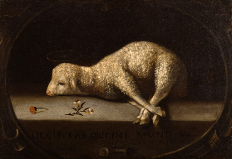
Christ’s Atoning Death
Substitution – Isa 53:3-6
Illustrations
  Secret serviceman
  Bee sting

Slide 32
Christ’s Atoning Death
Substitution – Isa 53:3-6
Illustrations
  Secret serviceman
  Bee sting

Slide 33

Isaiah 53:3–6
³ He was despised and forsaken of men, A man of sorrows and acquainted with grief; And like one from whom men hide their face He was despised, and we did not esteem Him. ⁴ Surely our griefs He Himself bore, And our sorrows He carried; Yet we ourselves esteemed Him stricken, Smitten of God, and afflicted. ⁵ But He was pierced through for our transgressions, He was crushed for our iniquities; The chastening for our well-being fell upon Him, And by His scourging we are healed. ⁶ All of us like sheep have gone astray, Each of us has turned to his own way; But the Lord has caused the iniquity of us all To fall on Him.

Slide 34
Christ’s Atoning Death
Substitution – Isa 53:3-6
Illustrations
  Secret serviceman
  Bee sting

Slide 35

Christ’s Atoning Death
Substitution – Isa 53:3-6
Illustrations
  Secret serviceman
  Bee sting

Slide 36

Christ’s Atoning Death
Substitution – Isa 53:3-6
Illustrations
  Secret serviceman
  Bee sting

Slide 37
Fundamentals of the Faith
Creation/Fall – Rom. 5:14
Inspiration/inerrancy of the Scripture – Matt. 5:18; John 17:17; 2 Tim. 3:16; 2 Pet. 1:20-21
Salvation by faith alone
Eternal existence of heaven/hell – Dan. 12:2; Matt. 25:46
Trinity
Virgin birth of Christ
Deity of Christ
Atoning death of Christ – Isa. 53:3-6; 1 Pet. 2:24
Bodily Resurrection of Christ – John 20:27-28; 1 Cor. 15:14
Bodily Second Advent of Christ – Job 19:25; Zech. 14:4; Acts 1:9-11

Slide 38
Fundamentals of the Faith
Creation/Fall – Rom. 5:14
Inspiration/inerrancy of the Scripture – Matt. 5:18; John 17:17; 2 Tim. 3:16; 2 Pet. 1:20-21
Salvation by faith alone
Eternal existence of heaven/hell – Dan. 12:2; Matt. 25:46
Trinity
Virgin birth of Christ
Deity of Christ
Atoning death of Christ – Isa. 53:3-6; 1 Pet. 2:24
Bodily Resurrection of Christ – John 20:27-28; 1 Cor. 15:14
Bodily Second Advent of Christ – Job 19:25; Zech. 14:4; Acts 1:9-11

Slide 39
David Reagan on Loraine Boettner
“The Beginning and the Ending,” online: http://christinprophecy.org/articles/the-beginning-and-the-ending/, accessed 19 April 2017, 1.
“Let me give you a classic example of spiritualization taken from the writings of a theologian by the name of Loraine Boettner. It has to do with his interpretation of Zechariah 14:1-9. That passage says that in the end times Jerusalem will be surrounded by enemy forces and will be ready to fall to them when the Lord will suddenly return to the Mount of Olives. When His feet touch the Mount, it will split down the middle. The Lord will then speak a supernatural word that will instantly destroy all the enemy forces. And on that day, the Lord will become King over all the earth. In his commentary on this passage, Boettner completely spiritualized it. He argued that the Mount of Olives stands for the human . . .

Slide 40
David Reagan on Loraine Boettner
“The Beginning and the Ending,” online: http://christinprophecy.org/articles/the-beginning-and-the-ending/, accessed 19 April 2017, 1.
. . . heart. The enemy forces symbolize the evil in this world that surrounds and attacks the heart. The Lord’s return represents what happens when a person accepts Jesus as Lord and Savior. Thus, when Jesus comes into a person’s heart, their heart (the Mount of Olives) splits in contrition, and all the evil influences in the person’s life are defeated, and Jesus becomes king of that person’s heart. That’s what I call an exercise in imagination!”

Slide 41
C. What to Separate From?
False doctrine – 1 Tim. 4:16; Titus 1:9
Divisive persons – Rom. 16:17; Titus 3:9-11
Immorality – 1 Cor. 5:9-11; Eph. 5:11
General disobedience to Scripture –2 Thess. 3:6, 14

Slide 42


Romans 16:17
“Now I urge you, brethren, keep your eye on those who cause dissensions and hindrances contrary to the teaching which you learned, and turn away from them.”

Slide 43

Titus 3:9-11
^{“9} But avoid foolish controversies and genealogies and strife and disputes about the Law, for they are unprofitable and worthless. ¹⁰ Reject a factious (hairetikos) man after a first and second warning,¹¹ knowing that such a man is perverted and is sinning, being self-condemned.”

Slide 44
C. What to Separate From?
False doctrine – 1 Tim. 4:16; Titus 1:9
Divisive persons – Rom. 16:17; Titus 3:9-11
Immorality – 1 Cor. 5:9-11; Eph. 5:11
General disobedience to Scripture –2 Thess. 3:6, 14

Slide 45
Ephesians 5:11
“Do not participate (synkoinōneō) in the unfruitful deeds of darkness, but instead even expose them.”

Slide 46
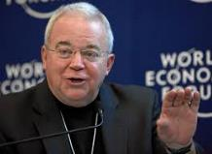
Jim Wallis
Mary Danielson, The Dangerous Truth About the Social-Justice “Gospel,” n. 21
“Abomination is a pretty strong word . . . there is a debate and questions over the meaning of the word ‘abomination.’” (Referring to Leviticus 18:22; as heard on Moody Christian Radio Network, in Chicago, Feb.19, 2008, when asked about government sanctions on civil unions for gays.)

Slide 47
C. What to Separate From?
False doctrine – 1 Tim. 4:16; Titus 1:9
Divisive persons – Rom. 16:17; Titus 3:9-11
Immorality – 1 Cor. 5:9-11; Eph. 5:11
General disobedience to Scripture –2 Thess. 3:6, 14

Slide 48
Conclusion

Slide 49
Ecclesiology Overview
Definition
Universal vs. local
Word pictures
Origin
Israel – Church differences
Intercalation
Purposes
Activities
Government
Officers
Ordinances
Purity

Slide 50
Purity of the Church
Ecclesiastical separation
Church discipline

Slide 51
Ecclesiastical Separation
Why separate?
Biblical basis for separation
What to separate from?

Slide 52
Purity of the Church
Ecclesiastical separation
Church discipline

