Slide 1
Biblical Dispensationalism
Jim McGowan, MTS, Th.D.

Slide 2
Biblical Dispensationalism
Session 4
History of Biblical Dispensationalism

Slide 3
Overview
The Early Church
The Alexandrian Abdication
The Dark Ages
Positive Contributions of the Reformers
The Reformers’ Incomplete Reforms
Contemporary Reformation Theology
Dispensationalism's Contribution
Notes:
Outline

Slide 4
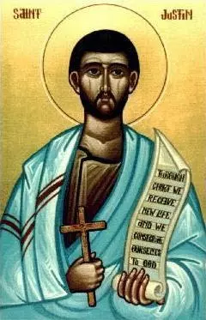
Justin Martyr (A.D. 110–165)
Justin in his Dialogue with Trypho recognizes several differing economies in the Old Testament. Justin acknowledges that prior to circumcision and the law, one can please God without being circumcised and without keeping the Sabbath. After God’s revelation to Abraham, circumcision was necessary to please Him; after the giving of the law to Moses, it was necessary to keep the Sabbath and observe the sacrificial system.
Justin Martyr held the essence of dispensationalism in his recognition of differing economies in the Old Testament.
Enns, P. P. (1989). The Moody Handbook of Theology (p. 513). Chicago, IL: Moody Press.

Slide 5
Irenaeus (A.D. 110–165)
Irenaeus refers in his writings to four principal covenants given to the human race, particularly drawing a distinction between three covenants of the Old Testament and the gospel. This distinction is typical of dispensationalism.
Clement of Alexandria (A.D. 150–220)
Clement identified four dispensations: Adamic, Noahic, Abrahamic, and Mosaic.
Enns, P. P. (1989). The Moody Handbook of Theology (p. 513-514). Chicago, IL: Moody Press.

Slide 6
Augustine (A.D. 354–430)
Augustine distinguishes between the “former dispensation” when sacrifices were offered and the present age when it is unsuitable to offer sacrifices. Augustine writes that while God Himself is unchanging, He enjoins one kind of offerings in the former period and a different kind of offering in the latter period. Augustine calls this “the changes of successive epochs.” Augustine recognizes that worshipers approach God in a different manner in different ages.
Enns, P. P. (1989). The Moody Handbook of Theology (p. 514). Chicago, IL: Moody Press.

Slide 7
Charles C. Ryrie Ryrie, C. C. (1995). Dispensationalism (Rev. and expanded., p. 74). Chicago: Moody Publishers.
Ryrie concludes, “It is not suggested nor should it be inferred that these early Church Fathers were dispensationalists in the modern sense of the word. But it is true that some of them enunciated principles which later developed into dispensationalism, and it may be rightly said that they held to primitive or early dispensational concepts.”
Enns, P. P. (1989). The Moody Handbook of Theology (p. 514). Chicago, IL: Moody Press.

Slide 8
Overview
The Early Church
The Alexandrian Abdication
The Dark Ages
Positive Contributions of the Reformers
The Reformers’ Incomplete Reforms
Contemporary Reformation Theology
Dispensationalism's Contribution
Notes:
Outline

Slide 9
Allegorization
Allegorizing is searching for a hidden or a secret meaning underlying but remote from and unrelated in reality to the more obvious meaning of a text. In other words the literal reading is a sort of code, which needs to be deciphered to determine the more significant and hidden meaning. In this approach the literal is superficial; the allegorical is the true meaning.
Zuck, Roy B. Basic Bible Interpretation: A Practical Guide to Discovering Biblical Truth (p. 29). Edited by Craig Bubeck Sr. Colorado Springs, CO: David C. Cook, 1991.

Slide 10
Alexander’s Four Generals Daniel 7:6; 8:8,22
Cassander Macedonia | Ptolemy Egypt
Lysimachus Thrace & Asia Minor | Seleucus Syria (including Israel)

Slide 11
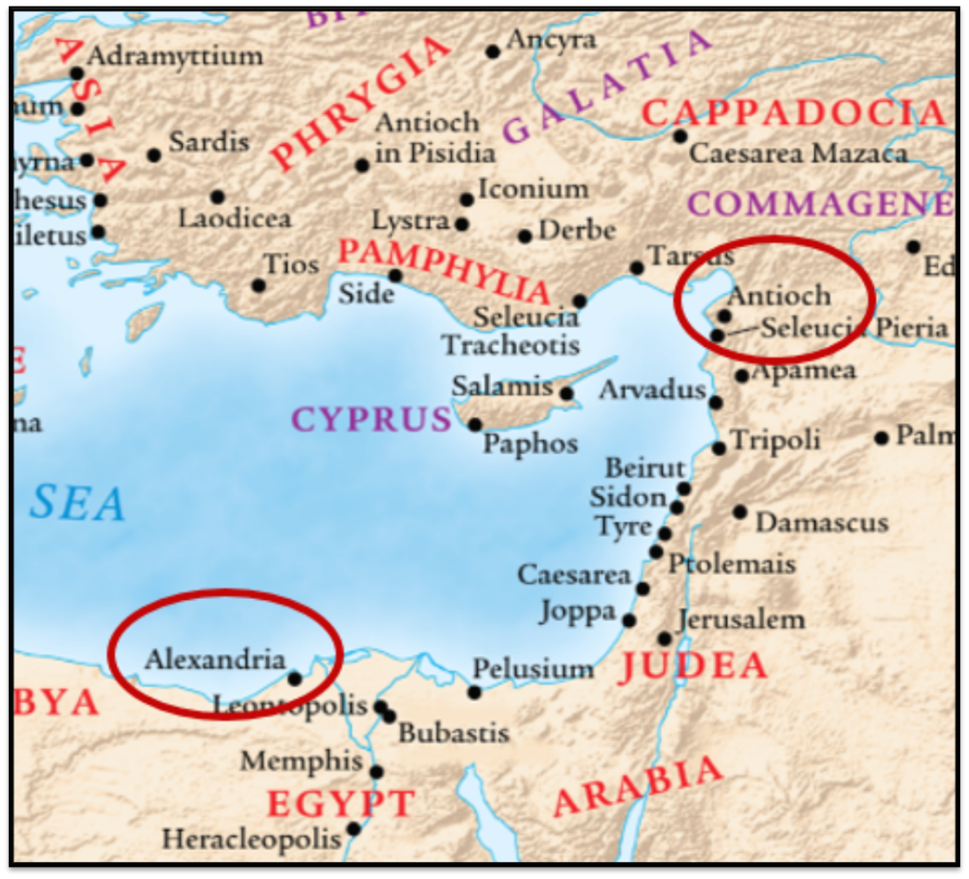
Alexandrian and Antiochene Fathers
Two schools of thought developed about 200 years or so after Christ, schools of hermeneutical views that had a strong impact on the church for centuries to come.
Zuck, Roy B. Basic Bible Interpretation: A Practical Guide to Discovering Biblical Truth (p. 35). Edited by Craig Bubeck Sr. Colorado Springs, CO: David C. Cook, 1991.

Slide 12
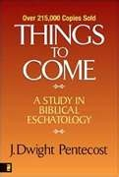
Dangers of Allegorization
Text is not being interpreted
Authority is transferred from text to interpreter
There is no way to test the interpreter
No mechanism for controlling the interpreter’s imagination
Pentecost, Things to Come, pps. 4-5

Slide 13
5 Causes for the Shift to Allegorism
Need for immediate relevance
Incorporation of human philosophy into interpretation
Gnostic dualism (Gen. 1:31; 1 John 2:22; 4:2-3; Acts 17:32; 1 Cor. 15:12)
Decline of the church's Jewish population
Constantine’s Edict of Milan (A.D. 313)

Slide 14
Results of the Shift to Allegorism
315: Constantine published the Edict of Milan which extended religious tolerance to Christians. Jews lost many rights with this edict. They were no longer permitted to live in Jerusalem, or to proselytize.
325: The Council of Nicea decided to separate the celebration of Easter from the Jewish Passover. They stated: "For it is unbecoming beyond measure that on this holiest of festivals we should follow the customs of the Jews. Henceforth let us have nothing in common with this odious people...We ought not, therefore, to have anything in common with the Jews...our worship follows a...more convenient course...we desire dearest brethren, to separate ourselves from the detestable company of the Jews...How, then, could we follow these Jews, who are almost certainly blinded."

Slide 15
Results of the Shift to Allegorism
337: Christian Emperor Constantius created a law which made the marriage of a Jewish man to a Christian punishable by death.
339: Converting to Judaism became a criminal offense.
343-381: The Laodicean Synod approved Cannon XXXVIII: "It is not lawful [for Christians] to receive unleavened bread from the Jews, nor to be partakers of their impiety."
367-376: St. Hilary of Poitiers referred to Jews as a perverse people who God has cursed forever. St. Ephroem refers to synagogues as brothels.
379-395: Emperor Theodosius the Great permitted the destruction of synagogues if it served a religious purpose. Christianity became the state religion of the Roman Empire at this time.

Slide 16
Results of the Shift to Allegorism
380: The bishop of Milan was responsible for the burning of a synagogue; he referred to it as "an act pleasing to God."
415: The Bishop of Alexandria, St. Cyril, expelled the Jews from that Egyptian city.
415: St. Augustine wrote "The true image of the Hebrew is Judas Iscariot, who sells the Lord for silver. The Jew can never understand the Scriptures and forever will bear the guilt for the death of Jesus."
418: St. Jerome, who created the Vulgate translation of the Bible wrote of a synagogue: "If you call it a brothel, a den of vice, the Devil's refuge, Satan's fortress, a place to deprave the soul, an abyss of every conceivable disaster or whatever you will, you are still saying less than it deserves."

Slide 17
Results of the Shift to Allegorism
489-519: Christian mobs destroyed the synagogues in Antioch, Daphne (near Antioch) and Ravenna.
528: Emperor Justinian (527-564) passed the Justinian Code. It prohibited Jews from building synagogues, reading the Bible in Hebrew, assemble in public, celebrate Passover before Easter, and testify against Christians in court.
535: The "Synod of Claremont decreed that Jews could not hold public office or have authority over Christians."
References
“A Calendar of Jewish Persecution” http://www.hearnow.org/caljp.html
Randy Felton, “Anti-Semitism and the Church” http://www.haydid.org/antsemr.htm
Fritz B. Voll, “A Short Review of a Troubled History” https://is.gd/uAAjtk

Slide 19
Biblical Dispensationalism
Session 5
History of Biblical Dispensationalism

Slide 20
Overview
The Early Church
The Alexandrian Abdication
THE DARK AGES
Positive Contributions of the Reformers
The Reformers’ Incomplete Reforms
Contemporary Reformation Theology
Dispensationalism's Contribution
Notes:
Outline

Slide 21
III. The Dark Ages (or the Middle Ages)
Lasted from the 4th to the 16th centuries
Obsolescence of prophetic studies
Domination of Augustinian Amillennialism
Only one church: Roman Catholicism
The Bible is removed from the people
Allegorization
Illiteracy
Mass read in Latin
Church in need of rescue
Notes:
Outline

Slide 22
III. The Dark Ages (or the Middle Ages)
Lasted from the 4th to the 16th centuries
Obsolescence of prophetic studies
Domination of Augustinian Amillennialism
Only one church: Roman Catholicism
The Bible is removed from the people
Allegorization
Illiteracy
Mass read in Latin
Church in need of rescue
Notes:
Outline

Slide 23
III. The Dark Ages (or the Middle Ages)
Lasted from the 4th to the 16th centuries
Obsolescence of prophetic studies
Domination of Augustinian Amillennialism
Only one church: Roman Catholicism
The Bible is removed from the people
Allegorization
Illiteracy
Mass read in Latin
Church in need of rescue
Notes:
Outline

Slide 24
Ronald E. Diprose
Israel in the Development of Christian Thought (Rome: IBEI, 2000), 86-87.
“Origen (185-254 a.d.) was also influenced by the example of Philo, a first-century Alexandrian Jew who had interpreted the Old Testament Scriptures allegorically in order to make them harmonize with his Platonism. Allegorism played an important part in Origen's theory of interpretation and, as he was the first biblical scholar to work out ‘a complete hermeneutical theory’, his work was destined to exert great influence on the Christian approach to the Hebrew Scriptures, for centuries to come…Origen is remembered for his philosophical speculation as the allegorist par excellence among Biblical interpreters.”

Slide 25
III. The Dark Ages (or the Middle Ages)
Lasted from the 4th to the 16th centuries
Obsolescence of prophetic studies
Domination of Augustinian Amillennialism
Only one church: Roman Catholicism
The Bible is removed from the people
Allegorization
Illiteracy
Mass read in Latin
Church in need of rescue
Notes:
Outline

Slide 26
Renald Showers
John Ankerberg and Renald Showers, The Most Asked Prophecy Questions (Chattanooga, TN: ATRI, 2000), 327-28.
“Augustine's allegorical amillennialism became the official doctrine of the church, and Premillennialism went underground. Some aspects of Premillennialism were even branded as heretical. The Roman Catholic Church strongly advocated and maintained Augustine's Amillennial view throughout the Middle Ages. During that span of time occasionally pre-millennial groups formed to challenge the doctrine and political power of the major part of organized Christendom, but they were not able to restore Premillennialism to its original position as the accepted, orthodox view of the Church.”

Slide 27
Augustine
354-430 a.d.
The City of God, trans., Marcus Dods (NY: Random House, 1950), Book XX, chap. 9, p. 725-26.
Augustine wrote, “the saints reign with Christ during the same thousand years, understood in the same way, that is, of the time of His first coming” and “Therefore the Church even now is the kingdom of Christ, and the kingdom of heaven. Accordingly, even now His saints reign with Him.”

Slide 28
III. The Dark Ages (or the Middle Ages)
Lasted from the 4th to the 16th centuries
Obsolescence of prophetic studies
Domination of Augustinian Amillennialism
Only one church: Roman Catholicism
The Bible is removed from the people
Allegorization
Illiteracy
Mass read in Latin
Church in need of rescue
Notes:
Outline

Slide 29
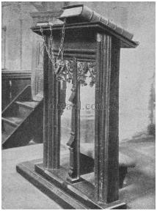
III. The Dark Ages (or the Middle Ages)
Lasted from the 4th to the 16th centuries
Obsolescence of prophetic studies
Domination of Augustinian Amillennialism
Only one church: Roman Catholicism
The Bible is removed from the people
Allegorization
Illiteracy
Mass read in Latin
Church in need of rescue
Notes:
Outline

Slide 30
III. The Dark Ages (or the Middle Ages)
Lasted from the 4th to the 16th centuries
Obsolescence of prophetic studies
Domination of Augustinian Amillennialism
Only one church: Roman Catholicism
The Bible is removed from the people
Allegorization
Illiteracy
Mass read in Latin
Church in need of rescue
Notes:
Outline

Slide 31
III. The Dark Ages (or the Middle Ages)
Lasted from the 4th to the 16th centuries
Obsolescence of prophetic studies
Domination of Augustinian Amillennialism
Only one church: Roman Catholicism
The Bible is removed from the people
Allegorization
Illiteracy
Mass read in Latin
Church in need of rescue
Notes:
Outline

Slide 32
III. The Dark Ages (or the Middle Ages)
Church in need of rescue
October 31, 1517
Notes:
Outline

Slide 33
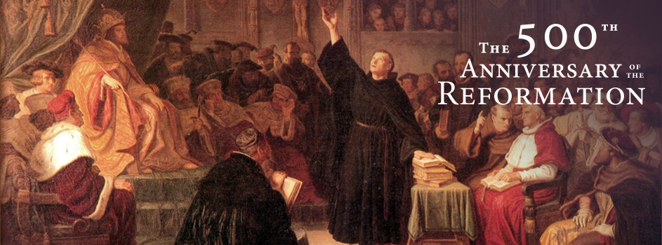
October 31, 1517
October 31, 2017

Slide 35
Overview
The Early Church
The Alexandrian Abdication
The Dark Ages
POSITIVE CONTRIBUTIONS OF THE REFORMERS
The Reformers’ Incomplete Reforms
Contemporary Reformation Theology
Dispensationalism's Contribution
Notes:
Outline

Slide 36
IV. Positive Contributions of the Reformers
Emphasis on literal interpretation
Denunciation of allegorization
Rejection of church tradition as a guide
Priesthood of all believers
Bible translations
Literacy
Five solas
Rejection of celibacy of the priesthood
Notes:
Outline

Slide 37
IV. Positive Contributions of the Reformers
Emphasis on literal interpretation
Denunciation of allegorization
Rejection of church tradition as a guide
Priesthood of all believers
Bible translations
Literacy
Five solas
Rejection of celibacy of the priesthood
Notes:
Outline

Slide 38
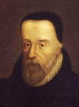
“The Scripture hath but one sense, which is the literal sense.”
William Tyndale
(1494 ‒ 1536 a.d.)
William Tyndale, "Obedience of a Christian Man," in Doctrinal Treatises and Introductions to Different Portions of the Holy Scriptures, ed. Henry Walter (Cambridge: Cambridge University Press, 1848), 304.

Slide 39
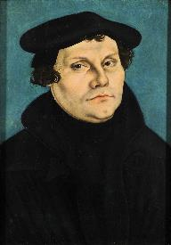
[The Scriptures] “are to be retained in their simplest meaning ever possible, and to be understood in their grammatical and literal sense unless the context plainly forbids”.
Martin Luther
(1483 – 1546 a.d.)
Quoted by Roy B. Zuck, Basic Bible Interpretation: A Practical Guide to
Discovering Biblical Truth (Colorado Springs, CO: Victor, 1991), 45.

Slide 40
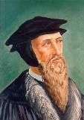
Calvin wrote in the preface of his commentary on Romans “it is the first business of an interpreter to let the author say what he does say, instead of attributing to him what we think he ought to say.”
John Calvin
(1509- 1564 a.d.)
Quoted by Roy B. Zuck, Basic Bible Interpretation: A Practical Guide to Discovering Biblical Truth (Colorado Springs, CO: Victor, 1991), 47.

Slide 41
IV. Positive Contributions of the Reformers
Emphasis on literal interpretation
Denunciation of allegorization
Rejection of church tradition as a guide
Priesthood of all believers
Bible translations
Literacy
Five solas
Rejection of celibacy of the priesthood
Notes:
Outline

Slide 42
Luther denounced the allegorical approach to Scripture in strong words. He said: “Allegories are empty speculations and as it were the scum of Holy Scripture.” “Origen’s allegories are not worth so much dirt.” “To allegorize is to juggle the Scripture.” “Allegorizing may degenerate into a mere monkey game.” “Allegories are awkward, absurd, inventive, obsolete, loose rags."
Martin Luther
(1483 – 1546 a.d.)
Quoted in Frederic W. Farrar, History of Interpretation (Grand Rapids: Baker, 1961; reprint, 1886), 328.

Slide 43
Calvin similarly rejected allegorical interpretations. He called them “frivolous games” and accused Origen and other allegorists of “torturing scripture, in every possible sense, from the true sense.”
John Calvin
(1509- 1564 a.d.)
Quoted by Roy B. Zuck, Basic Bible Interpretation: A Practical Guide to Discovering Biblical Truth (Colorado Springs, CO: Victor, 1991), 47.

Slide 44
IV. Positive Contributions of the Reformers
Emphasis on literal interpretation
Denunciation of allegorization
Rejection of church tradition as a guide
Priesthood of all believers
Bible translations
Literacy
Five solas
Rejection of celibacy of the priesthood
Notes:
Outline

Slide 45
Mark 7:13
“thus invalidating the word of God by your tradition which you have handed down; and you do many things such as that.”

Slide 46
IV. Positive Contributions of the Reformers
Emphasis on literal interpretation
Denunciation of allegorization
Rejection of church tradition as a guide
Priesthood of all believers
Bible translations
Literacy
Five solas
Rejection of celibacy of the priesthood
Notes:
Outline

Slide 47
Revelation 1:6
“and He has made us to be a kingdom, priests to His God and Father—to Him be the glory and the dominion forever and ever. Amen.”

Slide 48
IV. Positive Contributions of the Reformers
Emphasis on literal interpretation
Denunciation of allegorization
Rejection of church tradition as a guide
Priesthood of all believers
Bible translations
Literacy
Five solas
Rejection of celibacy of the priesthood
Notes:
Outline

Slide 49
“I am afraid that the schools will prove the very gates of hell, unless they diligently labor in explaining the Holy Scriptures and engraving them in the heart of the youth...I advise no one to place his child where the Scriptures do not reign paramount. Every institution in which men are not unceasingly occupied with the Word of God must become corrupt."
Martin Luther
(1483 – 1546 a.d.)
Luther's Works: The Christian in Society, ed. James Atkinson, vol. 44 (Philadelphia, PA: Fortress, 1966), 207.

Slide 50
IV. Positive Contributions of the Reformers
Emphasis on literal interpretation
Denunciation of allegorization
Rejection of church tradition as a guide
Priesthood of all believers
Bible translations
Literacy
Five solas
Rejection of celibacy of the priesthood
Notes:
Outline

Slide 51
IV. Positive Contributions of the Reformers
Number | Latin | Meaning
1. | Sola Scriptura | Scripture Alone
2. | Solus Christus | Christ Alone
3. | Sola Fide | Faith Alone
4. | Sola Graetia | Grace Alone
5. | Soli Deo Gloria | To the Glory of God Alone

Slide 52
IV. Positive Contributions of the Reformers
Emphasis on literal interpretation
Denunciation of allegorization
Rejection of church tradition as a guide
Priesthood of all believers
Bible translations
Literacy
Five solas
Rejection of celibacy of the priesthood
Notes:
Outline

Slide 53
Matthew 16:18
“I also say to you that you are Peter, and upon this rock I will build My church; and the gates of Hades will not overpower it.”

Slide 54
Matthew 8:14
“When Jesus came into Peter’s home, He saw his mother-in-law lying sick in bed with a fever.”

Slide 55
1 Corinthians 9:5
“Do we not have a right to take along a believing wife, even as the rest of the apostles and the brothers of the Lord and Cephas?”

Slide 56
Review
The Early Church
The Alexandrian Abdication
The Dark Ages
Positive Contributions Of The Reformers
The Reformers’ Incomplete Reforms
Contemporary Reformation Theology
Dispensationalism's Contribution
Notes:
Outline

Slide 57
Resources
Alva J. McClain, Law & Grace, Moody, 1967 978-088469-001-6
Arnold H. Ehlert, “A Bibliography of Dispensationalism,” Bibliotheca Sacra (January 1944–January 1946): 101:95–101, 199–209, 319–28, 447–60; 102:84–92, 207–19, 322–34, 455–67; 103:57–67.
Charles C. Ryrie, Dispensationalism, Moody, 2007, 080242189X
Christopher Cone, gen. ed., Dispensationalism Tomorrow & Beyond, Tyndale Seminary Press, 2008 9780981479101
Christopher Cone, gen. ed., An Introduction To The New Covenant, Tyndale Seminary Press, 2013, 9781938484100
Walvoord, J. F., The Prophecy Knowledge Handbook. Wheaton, IL: Victor Books. 1990.
Lewis S. Chafer, Major Bible Themes, Zondervan, 1974, 0-310-22390-3
Mike Stallard, gen .ed., Dispensational Understanding of the New Covenant, Regular Baptist Books, 2012, 9781607764946
Paul Enns, The Moody Handbook of Theology, Moody 1989,
Renald E. Showers, There Really Is A Difference, Friend of Israel Gospel Ministry, 1990, 0915540509
Rene Pache, The Inspiration and Authority of Scripture, Sheffield Pub Co, 1992
Roy B. Zuck, Basic Bible Interpretation, SP Publications, 1991
Charting the End Times CD-Rom: A Visual Guide to Understanding Bible Prophecy, ISBN-10: 0736917624
Materials from:
Dr. Andy Woods, Sugar Land Bible Church, www.slbc.org
Dr. Vern Peterman, Holly Hills Bible Church, www.hollyhillsbiblechurch.org
George Zeller, Middletown Bible Church, www.middletownbiblechurch.org
Ed Allsteadt, Sugar Land Bible Church, www.slbc.org

