Slide 1
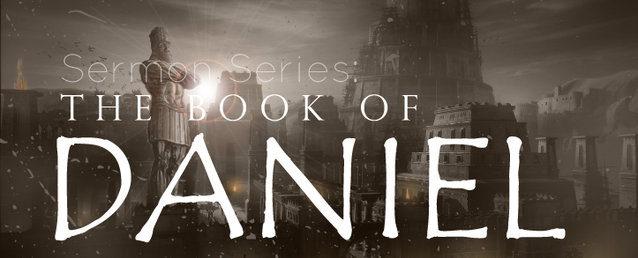
THE BOOK OF DANIEL
Dr. Andy Woods

Slide 2
Message
Times of the Gentiles are revealed prophetically (2, 7, 8-12) and ethically (1, 3-6)

Slide 3
Synthetic Outline
Historical (1-7):
Daniel interprets, 3rd person, gentile nations
Intro “Hebrew” (1)
Aramaic chiasm (2-7)

Slide 4
Synthetic Outline
Prophetic (8-12):
Angel interprets, 1st person, Jewish nation, Hebrew
Ram & Goat (8)
70 weeks (9)
Final vision (10-12)

Slide 5
Synthetic Outline
Historical (1-7):
Daniel interprets, 3rd person, gentile nations
Intro “Hebrew” (1)
Aramaic chiasm (2-7)

Slide 6
Synthetic Outline
Historical (1-7):
Daniel interprets, 3rd person, gentile nations
Intro “Hebrew” (1)
Aramaic chiasm (2-7)

Slide 7
Synthetic Outline
Chiasm “Aramaic” ( 2-7)
1. Gentile History (2)
2. Protection (3)
3. Revelation to a gentile king (4)
3. Revelation to a gentile king (5)
2. Protection (6)
1. Gentile history (7)

Slide 8
Synthetic Outline
Chiasm “Aramaic” ( 2-7)
1. Gentile History (2)
2. Protection (3)
3. Revelation to a gentile king (4)
3. Revelation to a gentile king (5)
2. Protection (6)
1. Gentile history (7)

Slide 9
Chapter 2 Outline
Nebuchadnezzar’s dream (2:1)
Nebuchadnezzar demands the revelation & interpretation (2:2-13)
Dream revealed to Daniel (2:14-23)
Daniel’s recitation & interpretation of the dream (2:24-30)
The dream’s contents & interpretation (2:31-45)
Daniel’s promotion (2:46-49)

Slide 10
Chapter 2 Outline
Nebuchadnezzar’s dream (2:1)
Nebuchadnezzar demands the revelation & interpretation (2:2-13)
Dream revealed to Daniel (2:14-23)
Daniel’s recitation & interpretation of the dream (2:24-30)
The dream’s contents & interpretation (2:31-45)
Daniel’s promotion (2:46-49)

Slide 11
CHAPTER AND VERSE IN DANIEL | CHRONOLOGICAL DATE | BIBLICAL DATE
1:1 | 605 | 3rd year of Jehoiakim
2:1 | 603 | 2nd year of Nebuchadnezzar
5 | Sat. night 10/12/539 (Hoehner)
7:1 | 553 | 1st year of Belshazzar
8:1 | 551 | 3rd year of Belshazzar
9:1 | 538 | 1st year of Darius
10:1 | 536 | 3rd year of Cyrus

Slide 12
Daniel’s Age
CHAPTER | EVENTS | AGE
1 | Taken into Babylonian Captivity | 15
2 | Interpreting Nebuchadnezzar’s 1st dream (huge image) | 17
3 | Daniel’s 3 friends cast into the fiery furnace | 19 or 20
4 | Interpreting Nebuchadnezzar’s 2nd dream (huge tree) | 45-50
5 | Interpreting handwriting of the wall at Belshazzar’s feast | Early 80’s
6 | Delivered from the den of lions | c.83
7-8 | Daniel’s visions and dreams | Mid-60’s
9 | Daniel’s seventy “sevens” prophecy | Early-80’s
10-12 | Final dreams and visions | Mid-80’s

Slide 13
Chapter 2 Outline
Nebuchadnezzar’s dream (2:1)
Nebuchadnezzar demands the revelation & interpretation (2:2-13)
Dream revealed to Daniel (2:14-23)
Daniel’s recitation & interpretation of the dream (2:24-30)
The dream’s contents & interpretation (2:31-45)
Daniel’s promotion (2:46-49)

Slide 14
Chapter 2 Outline
Nebuchadnezzar’s dream (2:1)
Nebuchadnezzar demands the revelation & interpretation (2:2-13)
Dream revealed to Daniel (2:14-23)
Daniel’s recitation & interpretation of the dream (2:24-30)
The dream’s contents & interpretation (2:31-45)
Daniel’s promotion (2:46-49)

Slide 15
Chapter 2 Outline
Nebuchadnezzar’s dream (2:1)
Nebuchadnezzar demands the revelation & interpretation (2:2-13)
Dream revealed to Daniel (2:14-23)
Daniel’s recitation & interpretation of the dream (2:24-30)
The dream’s contents & interpretation (2:31-45)
Daniel’s promotion (2:46-49)

Slide 16
Chapter 2 Outline
Nebuchadnezzar’s dream (2:1)
Nebuchadnezzar demands the revelation & interpretation (2:2-13)
Dream revealed to Daniel (2:14-23)
Daniel’s recitation & interpretation of the dream (2:24-30)
The dream’s contents & interpretation (2:31-45)
Daniel’s promotion (2:46-49)

Slide 17
Contents & Interpretation of the Dream (2:24-30)
Contents (2:31-35)
Interpretation (2:36-45)

Slide 18
Contents & Interpretation of the Dream (2:24-30)
Contents (2:31-35)
Interpretation (2:36-45)

Slide 19
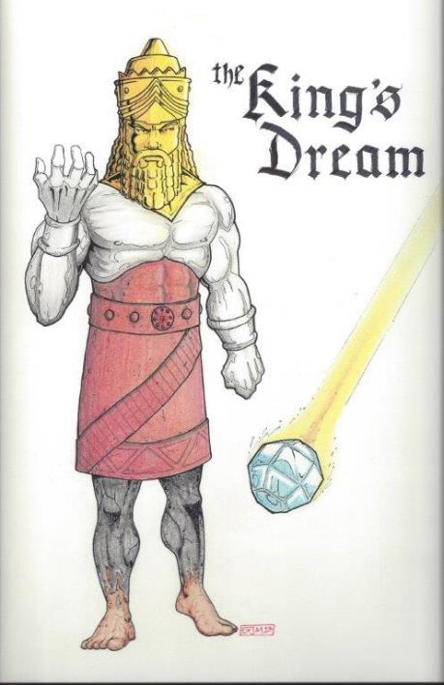
Statue & Stone

Slide 20
Contents & Interpretation of the Dream (2:24-30)
Contents (2:31-35)
Interpretation (2:36-45)

Slide 21
Daniel 2:36 (NASB)
This was the dream; now we will tell its interpretation before the king.

Slide 22
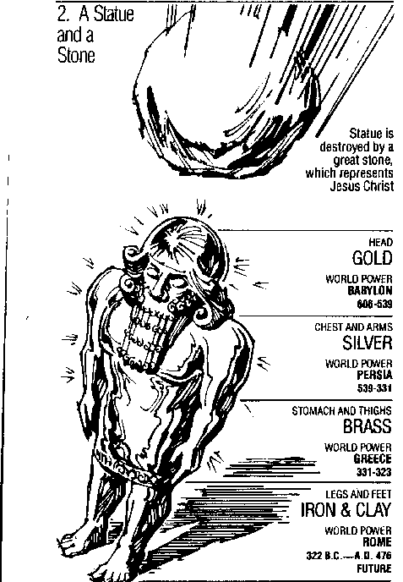
Statue & Stone

Slide 23
6 Empires
Babylon (2:36-38) 605-539 BC
Media-Persia (2:39a) 539-331 BC
Greece (2:39b) 331-63 BC
Rome I (2:40) 63 BC – 70 AD
Rome II (2:41-43) Tribulation
Kingdom (2:44-45) After 2nd Coming

Slide 24
6 Empires
Babylon (2:36-38) 605-539 BC
Media-Persia (2:39a) 539-331 BC
Greece (2:39b) 331-63 BC
Rome I (2:40) 63 BC – 70 AD
Rome II (2:41-43) Tribulation
Kingdom (2:44-45) After 2nd Coming

Slide 25
Daniel 2:37-38 (NASB)
You, O king, are the king of kings, to whom the God of heaven has given the kingdom, the power, the strength and the glory; ³⁸ and wherever the sons of men dwell, or the beasts of the field, or the birds of the sky, He has given them into your hand and has caused you to rule over them all. You are the head of gold.

Slide 26
Daniel 2:37-38 (NASB)
You, O king, are the king of kings, to whom the God of heaven has given the kingdom, the power, the strength and the glory; ³⁸ and wherever the sons of men dwell, or the beasts of the field, or the birds of the sky, He has given them into your hand and has caused you to rule over them all. You are the head of gold.

Slide 27
Daniel 4:30 (NASB)
“The king reflected and said, ‘Is this not Babylon the great, which I myself have built as a royal residence by the might of my power and for the glory of my majesty?’”

Slide 28
6 Empires
Babylon (2:36-38) 605-539 BC
Media-Persia (2:39a) 539-331 BC
Greece (2:39b) 331-63 BC
Rome I (2:40) 63 BC – 70 AD
Rome II (2:41-43) Tribulation
Kingdom (2:44-45) After 2nd Coming

Slide 29
Statue & Stone

Slide 30
Statue & Stone

Slide 31
Three Returns
 | Date | Duration | Persian king | Jewish leader | Scripture | Purpose | Number of returnees
1st return | 538–515 B.C. | 23 years | Cyrus (Isa 44:28‒45:1) | Zerubbabel | Ezra 1–6; Isaiah 44:28 | Rebuilding the temple | 50,000
2nd return | 458–457 B.C. | 2 years | Artaxerxes | Ezra | Ezra 7–10 | Adorning of the temple and reforming the people | 2,000
3rd return | 444–432 B.C. | 8 years | Artaxerxes | Nehemiah | Nehemiah | Rebuilding the wall

Slide 32
Cyrus Cylinder

Slide 33
6 Empires
Babylon (2:36-38) 605-539 BC
Media-Persia (2:39a) 539-331 BC
Greece (2:39b) 331-63 BC
Rome I (2:40) 63 BC – 70 AD
Rome II (2:41-43) Tribulation
Kingdom (2:44-45) After 2nd Coming

Slide 34
6 Empires
Babylon (2:36-38) 605-539 BC
Media-Persia (2:39a) 539-331 BC
Greece (2:39b) 331-63 BC
Rome I (2:40) 63 BC – 70 AD
Rome II (2:41-43) Tribulation
Kingdom (2:44-45) After 2nd Coming

Slide 35
Statue & Stone

Slide 36
Statue & Stone

Slide 37
6 Empires
Babylon (2:36-38) 605-539 BC
Media-Persia (2:39a) 539-331 BC
Greece (2:39b) 331-63 BC
Rome I (2:40) 63 BC – 70 AD
Rome II (2:41-43) Tribulation
Kingdom (2:44-45) After 2nd Coming

Slide 38
Synthetic Outline
Chiasm “Aramaic” ( 2-7)
1. Gentile History (2)
2. Protection (3)
3. Revelation to a gentile king (4)
3. Revelation to a gentile king (5)
2. Protection (6)
1. Gentile history (7)

Slide 39
Statue & Stone

Slide 40
Synthetic Outline
Chiasm “Aramaic” ( 2-7)
1. Gentile History (2)
2. Protection (3)
3. Revelation to a gentile king (4)
3. Revelation to a gentile king (5)
2. Protection (6)
1. Gentile history (7)

Slide 41
Isaiah 9:6-7 (NASB)
⁶ For a child will be born to us, a son will be given to us; And the government will rest on His shoulders; And His name will be called Wonderful Counselor, Mighty God, Eternal Father, Prince of Peace.⁷ There will be no end to the increase of His government or of peace, On the throne of David and over his kingdom, To establish it and to uphold it with justice and righteousness From then on and forevermore. The zeal of the Lord of hosts will accomplish this.

Slide 43
Regionalism
European Common Market
North American Union
Notes:
Outline

Slide 44
Statue & Stone

Slide 45
6 Empires
Babylon (2:36-38) 605-539 BC
Media-Persia (2:39a) 539-331 BC
Greece (2:39b) 331-63 BC
Rome I (2:40) 63 BC – 70 AD
Rome II (2:41-43) Tribulation
Kingdom (2:44-45) After 2nd Coming

Slide 46
Daniel 2:44-45 is Future
Christianity did not suddenly fill the whole earth
Christ did not destroy Rome
No 10 simultaneous kings in the time of Christ
Christ was not the smiting stone
Christ did not destroy all the kingdoms of the world
The church is not a political kingdom
J. Dwight Pentecost, Bible Knowledge Commentary, 1336

Slide 47
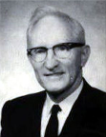
Merill F. Unger
Unger's Commentary on the Old Testament (Chicago: Moody, 1981; reprint, Chatanooga, TN: AMG, 2002), 1643.
“Hence, the iron kingdom with its feet of iron and clay (cf. 3:33-35, 40, 44) and the nondescript beast of 7:7-8 envision…the form in which it will exist after the church period, when God will resume His dealing with the nation Israel. How futile for conservative scholars to ignore that fact and to seek to find literal fulfillment of those prophecies in history or in the church, when those predictions refer to events yet future and have no application whatever to the church.”

Slide 48
College of Biblical Studies Doctrinal Statement
The imminent return of the Lord, which is the blessed hope of the Church, is to be followed in order by: the tribulation; the establishment of the reign of Christ on earth for one thousand years; the eternal state of punishment for the unsaved and the eternal state of blessing for the saved (Titus 2:13; 1 Thess. 1:10; 4:13‑18; 5:4‑10; Rev. 3:10; Matt. 24:21, 29, 30; 25:31; Rev. 20:1‑6, 11‑15; Matt. 25:46).

Slide 49
SLBC Position Statement No. 4
.
DISPENSATIONS - A Dispensation is a specific manner in which God governs during a particular period of time. We are a dispensational church. That is, we believe that God has chosen to administer or govern His purpose on earth through man under varying dispensations. These changes in government are a result of God’s choice, and do not indicate that His character ever changes. At least three of these dispensations are mentioned in the Bible and are the subject of extended revelation, viz.: the Dispensation of the Mosaic Law, the present Dispensation of Grace, and the future Dispensation of the Millennial Kingdom. In interpreting the Bible, we believe that these are distinct and should not be intermingled or confused.

Slide 50
Emergent: Kingdom
“He selected 12 and trained them in a new way of life. He sent them to teach everyone this new way of life...Even if only a few would practice this new way, many would benefit. Oppressed people would be free. Poor people would be liberated from poverty. Minorities would be treated with respect. Sinners would be loved, not resented.”
Brian McLaren, A Generous Orthodoxy, 111.

Slide 51
Emergent: Kingdom
“Industrialists would realize that God cares for sparrows and wildflowers-so their industries should respect, not rape, the environment. The homeless would be invited in for a hot meal. The kingdom of God would come – not everywhere at once, not suddenly, but gradually like a seed growing in a field, like yeast spreading in a lump of bread dough, like light spreading across the sky at dawn.”
Brian McLaren, A Generous Orthodoxy, 111.

Slide 52
Emergent: Kingdom
“The Kingdom of God is a central conversation in emerging communities… And let me tell you ‘Kingdom of God’ language is really big in the emerging church” (Italics added).
Doug Pagitt, cited in Roger Oakland, Faith Undone, 163.

Slide 53
Emergent: Kingdom
“If Revelation were a blueprint of the distant future, it would have been unintelligible to its original readers…In light of this, Revelation becomes a powerful book about the kingdom of God here and now, available to all.”
Brian McLaren, cited in Oakland, 158.

Slide 54
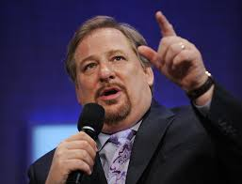
Kingdom
“I stand before you confidently right now and say to you that God is going to use you to change the world...I'm looking at a stadium full of people right now who are telling God they will do whatever it takes to establish God's Kingdom "on earth as it is in heaven. What will happen if the followers of Jesus say to Him, ‘We are yours?’ What kind of spiritual awakening will occur?”
Rick Warren, cited in Oakland, Kindle edition.

Slide 55
Kingdom
“If we are to be a part of this coming kingdom, God expects our lives – our churches and faith communities too – to be characterized by these authentic signs of our own transformation: compassion, mercy, justice, and love – demonstrated tangibly. Only then will our light break forth like the dawn, our healing quickly appear, and our cries for help be answered with a divine Here am I.”
Stearns, Hole in the Gospel, 57.

Slide 56
Kingdom
“The gospel that we have been given – the whole gospel – is God’s vision for a new way of living…Christ’s vision was of a redeemed world order populated by redeemed people – now. To accomplish this, we are to be salt and light in a dark and fallen world, the “yeast” that leavens the whole loaf of bread (the whole of society). We are the ones God has called to be His Church. It’s up to us. We are to be the change. But a changed world requires change agents, and change agents are people who have first been changed themselves.”
Stearns, Hole in the Gospel, 276, 243-44.

Slide 57
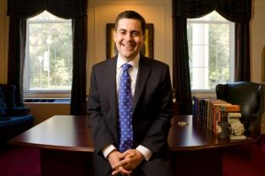
Russell Moore
President: Ethics and Religious Liberties Commission of the Southern Baptist Convention
“The locus of the kingdom of God in this age is within the church, where Jesus rules as king. As we live our lives together, we see the transforming power of the gospel and the in breaking of the future kingdom.”
Justin Taylor, “An Interview with Russell Moore,” www.thegospelcoalition.org.

Slide 58
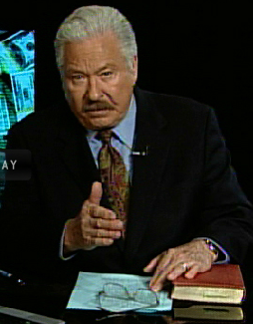
Hal Lindsey
The Road to Holocaust, 269
Bestselling author Hal Lindsey warned what could happen to the church in the last days if she began to see herself as the establisher of God's kingdom: “The last days of the church on the earth may be largely wasted seeking to accomplish a task that only the LORD Himself can and will do directly.”

Slide 59
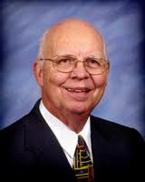
Purposes of the Local Church
Glorify God (Eph 3:21)
Edify the saints (Eph 4:11-16)
Fulfill the Great Commission (Matt 28:18-20)

Slide 60
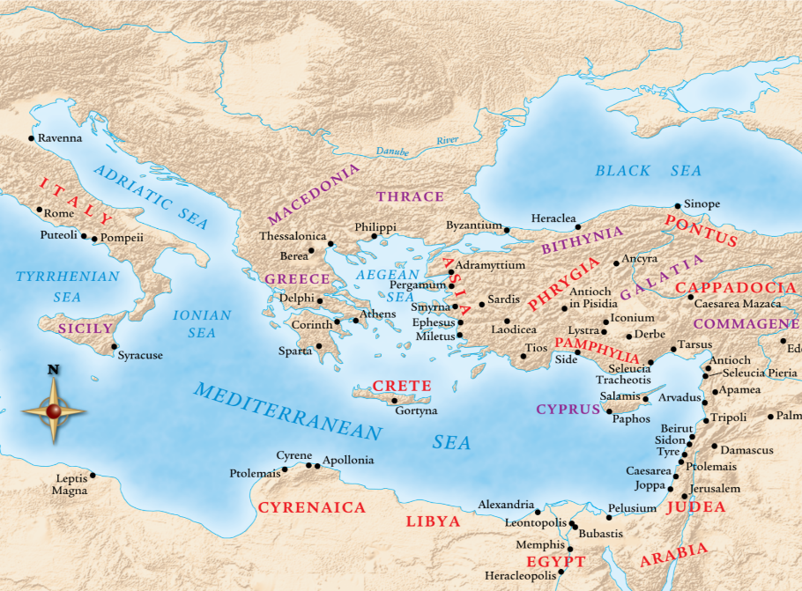

Slide 61
Chapter 2 Outline
Nebuchadnezzar’s dream (2:1)
Nebuchadnezzar demands the revelation & interpretation (2:2-13)
Dream revealed to Daniel (2:14-23)
Daniel’s recitation & interpretation of the dream (2:24-30)
The dream’s contents & interpretation (2:31-45)
Daniel’s promotion (2:46-49)

Slide 62
The Promotion of Daniel (2:46-49)
Personal honor (2:46)
Praise to God (2:47)
Promotion of Daniel (2:48)
Promotion of Shadrach, Meshach, & Abed-nego (2:49)

Slide 63
The Promotion of Daniel (2:46-49)
Personal honor (2:46)
Praise to God (2:47)
Promotion of Daniel (2:48)
Promotion of Shadrach, Meshach, & Abed-nego (2:49)

Slide 64
The Promotion of Daniel (2:46-49)
Personal honor (2:46)
Praise to God (2:47)
Promotion of Daniel (2:48)
Promotion of Shadrach, Meshach, & Abed-nego (2:49)

Slide 65
The Promotion of Daniel (2:46-49)
Personal honor (2:46)
Praise to God (2:47)
Promotion of Daniel (2:48)
Promotion of Shadrach, Meshach, & Abed-nego (2:49)

Slide 66
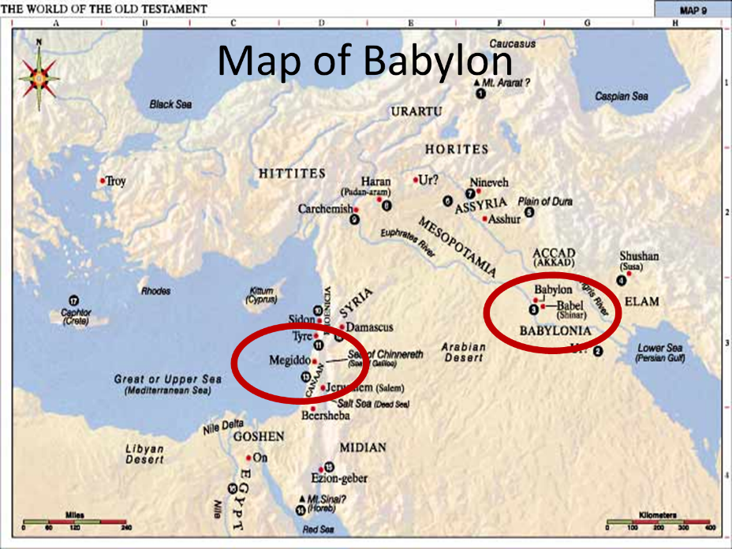

Slide 67
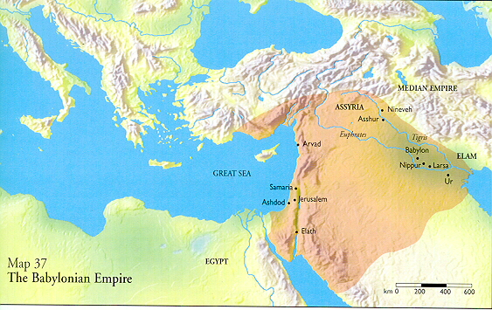

Slide 68
Messiah must present Himself to Israel on March 30, A.D. 33
Daniel 9:25

Slide 69
Numbers 24:17 (NASB)
“I see him, but not now; I behold him, but not near; A star shall come forth from Jacob, A scepter shall rise from Israel, And shall crush through the forehead of Moab, And tear down all the sons of Sheth.”

Slide 70
Deuteronomy 23:4 (NASB)
“because they did not meet you with food and water on the way when you came out of Egypt, and because they hired against you Balaam the son of Beor from Pethor of Mesopotamia, to curse you.”

Slide 72
The Promotion of Daniel (2:46-49)
Personal honor (2:46)
Praise to God (2:47)
Promotion of Daniel (2:48)
Promotion of Shadrach, Meshach, & Abed-nego (2:49)

Slide 73
Takeaways from Daniel 2
Mosaic Law taught Israel how to live inside the land
The examples of the four Hebrew youths taught them how to live outside the land
Consecrate themselves to God
Live by faith from crisis to crisis entrusting the results to God
Allow God to promote us in His due time
Our cue as well

Slide 74
Conclusion

Slide 75
Chapter 2 Outline
Nebuchadnezzar’s dream (2:1)
Nebuchadnezzar demands the revelation & interpretation (2:2-13)
Dream revealed to Daniel (2:14-23)
Daniel’s recitation & interpretation of the dream (2:24-30)
The dream’s contents & interpretation (2:31-45)
Daniel’s promotion (2:46-49)

