Slide 1


Zechariah
God Remembers!

Slide 2

Structure
Introductory call to repentance (1:1-6)
Eight-night visions (1:7–6:15)
Question and answers about fasting (7–8)
Two burdens (9–14)

Slide 3
II. Eight Night Visions
(1:7‒6:15)
  Riders & horses among the myrtle trees (1:7-17)
  Four horns & four craftsmen (1:18-21)
  Man with the measuring line (2)
  Cleansing of the High Priest Joshua (3)
  Lampstand & olive tree (4)
  Flying scroll (5:1-4)
  Woman in the basket (5:5-11)
  Four chariots (6:1-8)
  Conclusion: crowning of Joshua (6:9-15)

Slide 4
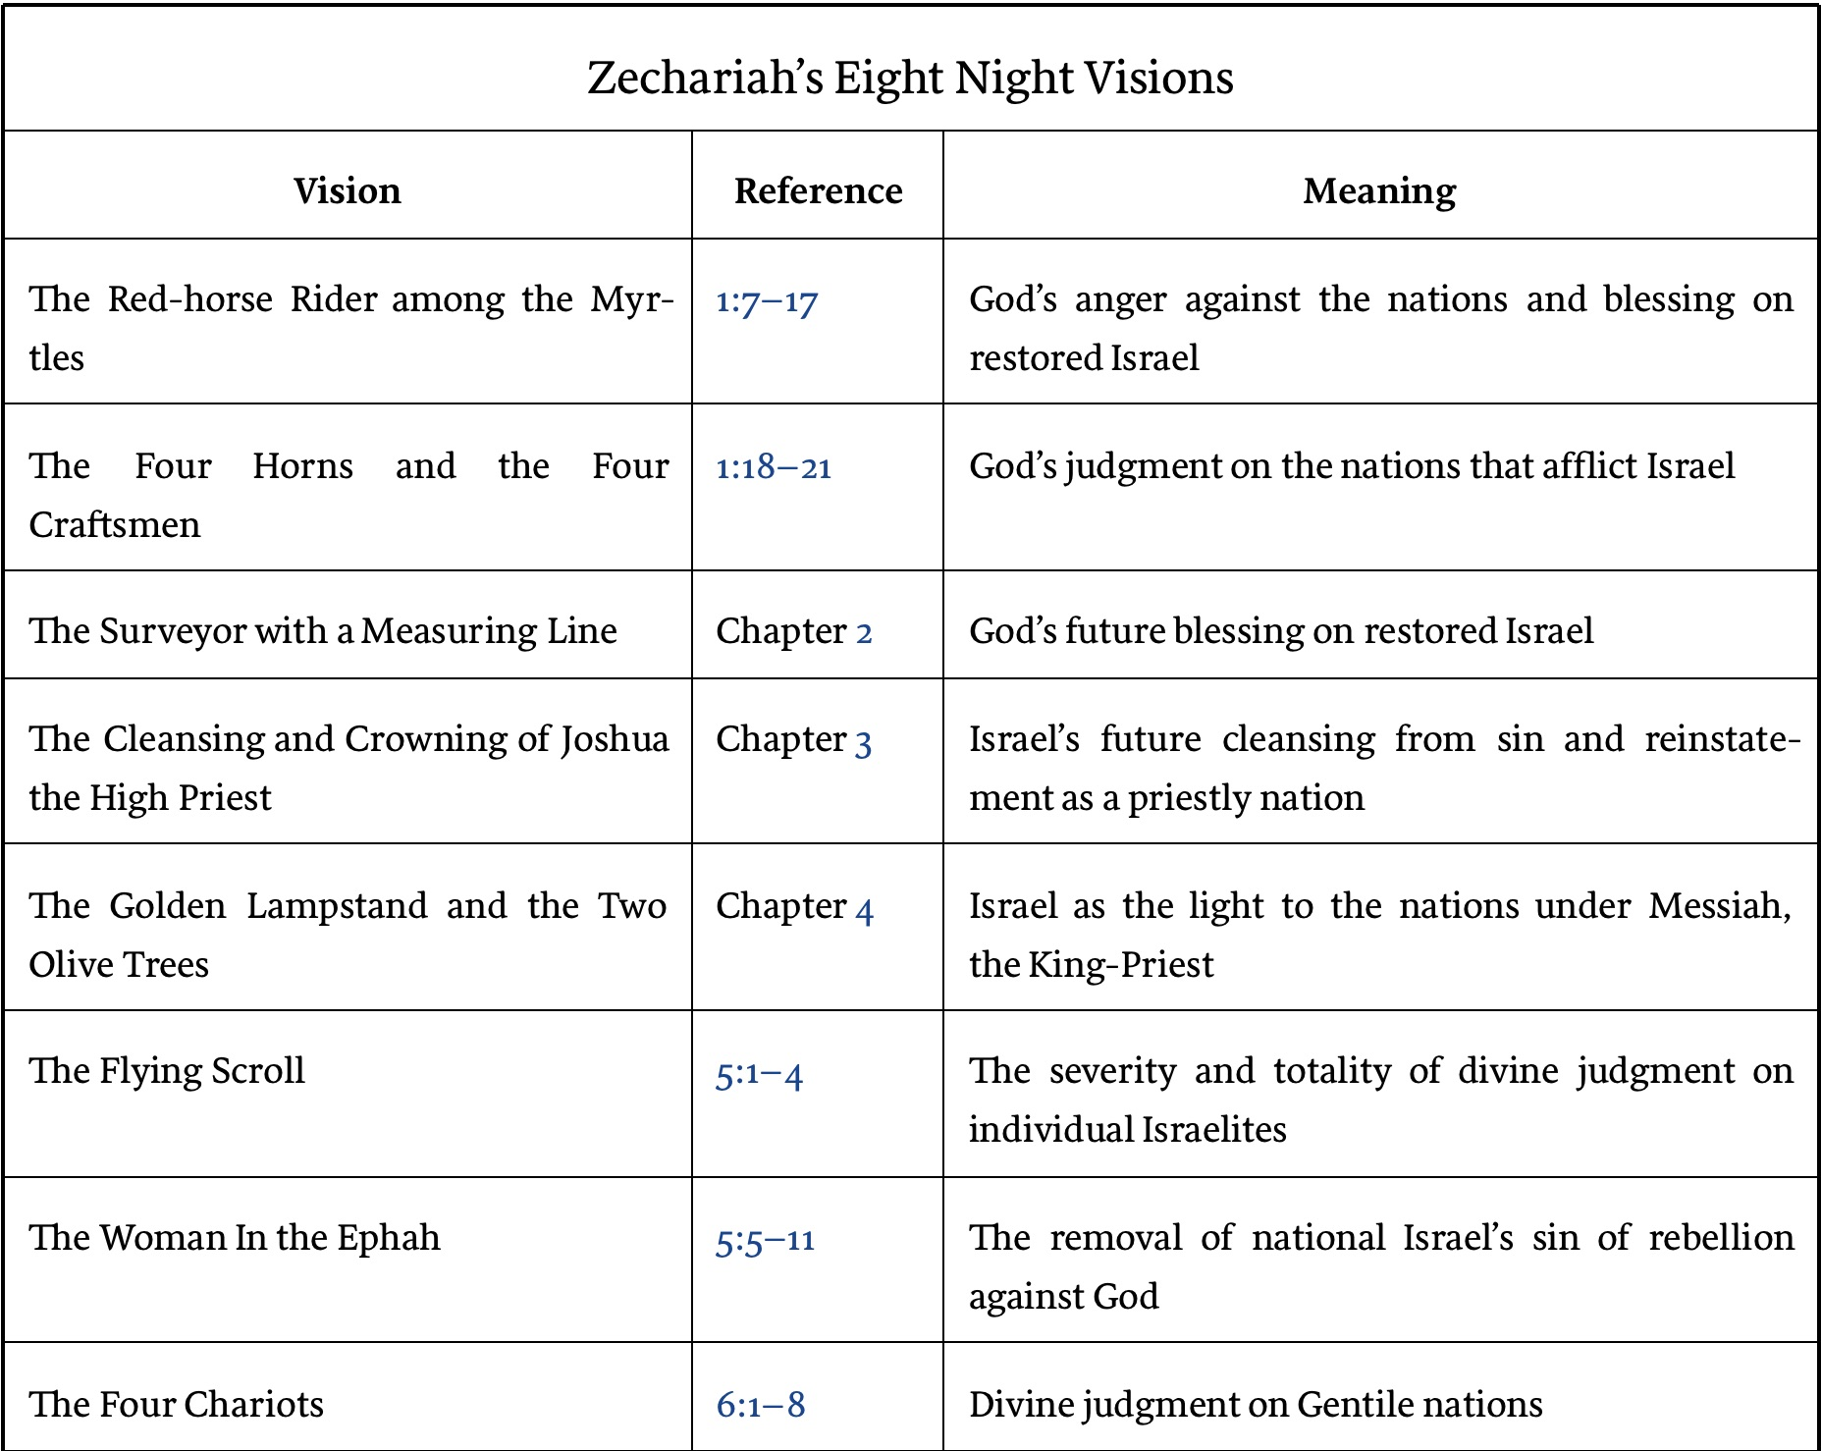

Slide 5

2. The Four Horses & Four Craftsmen
(1:18-21)
Four Horns (1:18-19)
    Description (1:18)
    Explanation (1:19)
Four Craftsmen (1:20-21)
    Description (1:20)
    Explanation (1:21)

Slide 6
2. The Four Horses & Four Craftsmen
(1:18-21)
Four Horns (1:18-19)
    Description (1:18)
    Explanation (1:19)
Four Craftsmen (1:20-21)
    Description (1:20)
    Explanation (1:21)

Slide 7
2. The Four Horses & Four Craftsmen
(1:18-21)
Four Horns (1:18-19)
    Description (1:18)
    Explanation (1:19)
Four Craftsmen (1:20-21)
    Description (1:20)
    Explanation (1:21)

Slide 8
2. The Four Horses & Four Craftsmen
(1:18-21)
Four Horns (1:18-19)
    Description (1:18)
    Explanation (1:19)
Four Craftsmen (1:20-21)
    Description (1:20)
    Explanation (1:21)

Slide 9


Slide 10
Six Parts of a Suzerain-Vassal Treaty in Deuteronomy
Preamble (1:1-5)
Prologue (1:6–4:40)
Covenant obligations (5–26)
Storage and reading instructions (27:2-3; 31:9, 24, 26)
Witnesses (32:1)
Blessings and curses (28)

Slide 11
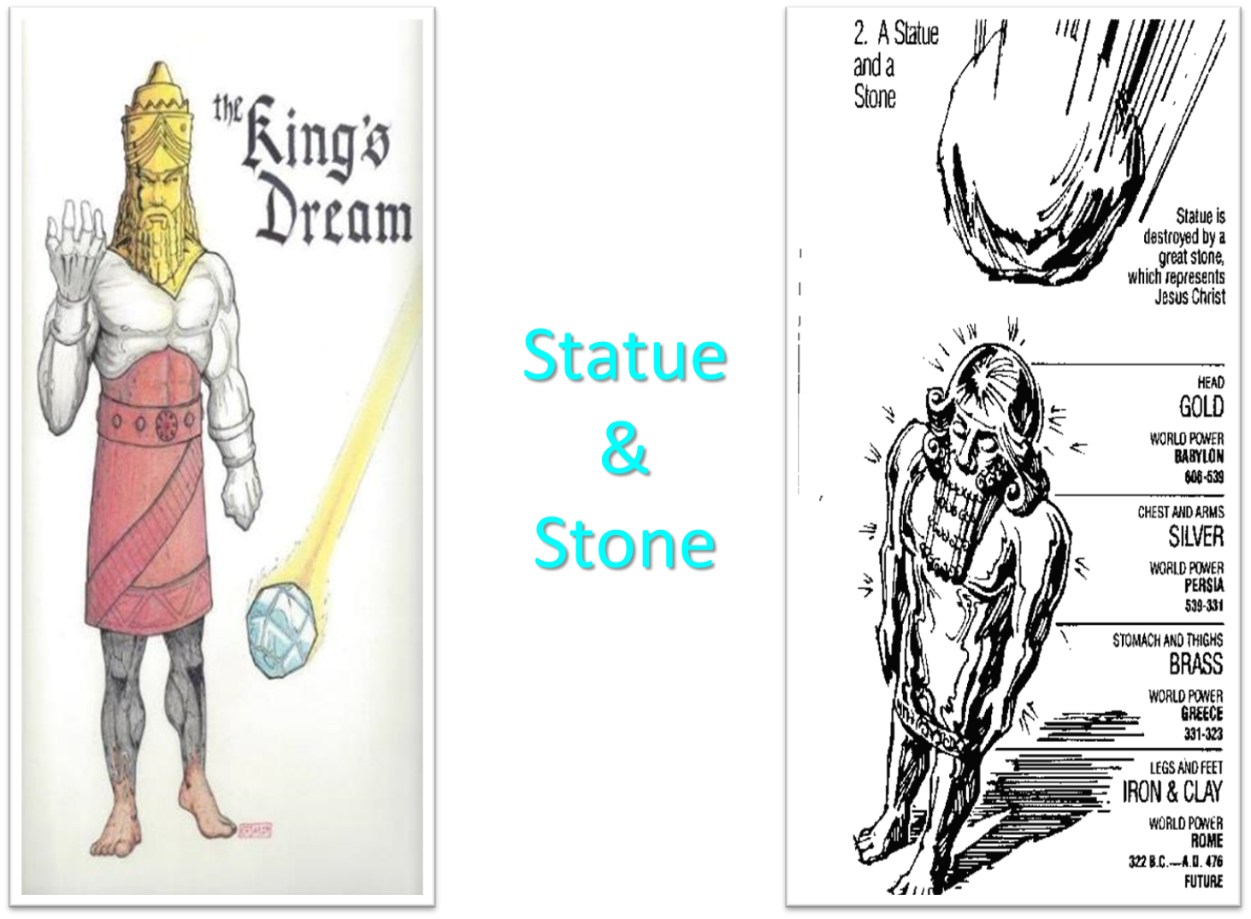

Slide 12


Slide 13

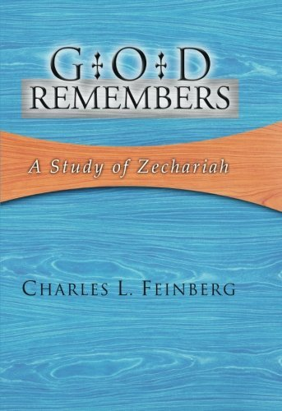
Charles L. Feinberg
God Remembers: A Study of Zechariah (Wheaton: Van Kampen, 1950, p. 39-40.
“First, it is claimed that the horns are contemporaneous, whereas the position just taken would make them successive. The objection falls down completely when we consider that there were not four powers in open opposition to Judah in the time of Zechariah. Those with whom Judah had to deal at this time period were subordinate to the Persian empire.”

Slide 14
2. The Four Horses & Four Craftsmen
(1:18-21)
Four Horns (1:18-19)
    Description (1:18)
    Explanation (1:19)
Four Craftsmen (1:20-21)
    Description (1:20)
    Explanation (1:21)

Slide 15
2. The Four Horses & Four Craftsmen
(1:18-21)
Four Horns (1:18-19)
    Description (1:18)
    Explanation (1:19)
Four Craftsmen (1:20-21)
    Description (1:20)
    Explanation (1:21)

Slide 16
2. The Four Horses & Four Craftsmen
(1:18-21)
Four Horns (1:18-19)
    Description (1:18)
    Explanation (1:19)
Four Craftsmen (1:20-21)
    Description (1:20)
    Explanation (1:21)

Slide 17
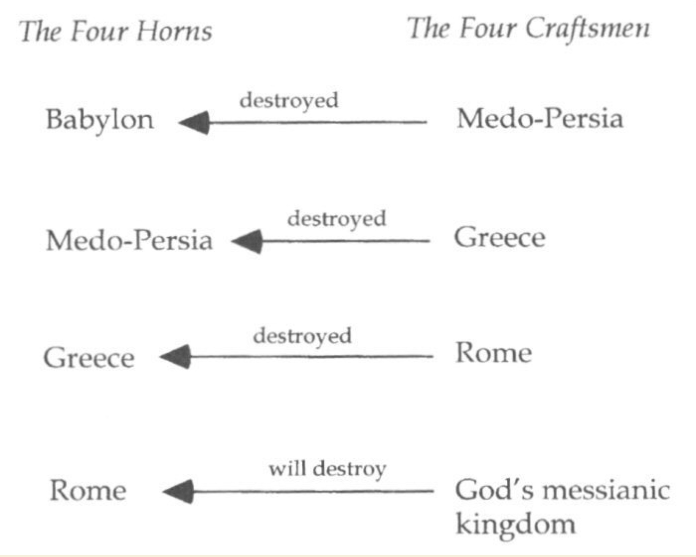

Slide 19

Herodotus, Histories, 1:191 (450 B.C.)
“…he (Cyrus) conducted the river by a channel into the lake…and so he made the former course of the river passable by the sinking of the stream. When this had been done, the Persians who had been posted for this very purpose entered by the bed of the river Euphrates into Babylon, the stream having sunk so far that it reached about to the middle of a man’s thigh…those Babylonians who dwelt in the middle did not know that they had been captured…”

Slide 20
Charles L. Feinberg
God Remembers: A Study of Zechariah (Wheaton: Van Kampen, 1950, p. 50.
“An interesting historical fulfillment of the prophecy of the judgment of God upon Babylon, although only a partial one, is the following. In the fourth year of Darius, the Babylonians, after much plotting, revolted and shut them selves up in their city, ready for a long siege.”

Slide 21
Charles L. Feinberg
God Remembers: A Study of Zechariah (Wheaton: Van Kampen, 1950, p. 50.
“Zopyrus, Darius’ friend and general, cut off his own ears and nose, and by pretending that he had been thus mutilated by Darius, gained entrance into the city and the confidence of the besieged ones. By his craft the gates were opened to the Persians, and when the city was mastered thousands of Babylonian nobles were crucified. Surely, uneasy should be the head that plots evil against Israel, and woeful indeed will be the fate of such.”

Slide 22

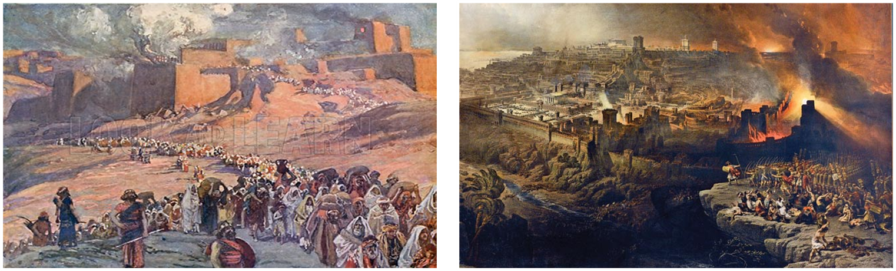
Charles Ryrie
The Ryrie Study Bible
“Zechariah 1:15 (RSB:NASB1995U): 1:15 they furthered the disaster. Lit., they helped for evil. Though the heathen nations were used of God to punish Israel, they went too far in trying to annihilate her.”

Slide 23
Charles L. Feinberg
God Remembers: A Study of Zechariah (Wheaton: Van Kampen, 1950, p. 42-43.
“Several features are noteworthy in this vision: (1) God takes account of everyone that lifts his hand against Israel; (2) He has complete knowledge of the dejected condition of His people and the extent of their injury; and (3) He has already provided the punishment for every foe of His chosen ones. As a definite matter of history three of the empires or kingdoms symbolized by the horns already know of the visitation of God upon them.”

Slide 24
II. Eight Night Visions
(1:7‒6:15)
  Riders & horses among the myrtle trees (1:7-17)
  Four horns & four craftsmen (1:18-21)
  Man with the measuring line (2)
  Cleansing of the High Priest Joshua (3)
  Lampstand & olive tree (4)
  Flying scroll (5:1-4)
  Woman in the basket (5:5-11)
  Four chariots (6:1-8)
  Conclusion: crowning of Joshua (6:9-15)

Slide 26
3. The Man with the Measuring Line
(2:1-13)
Vision (2:1-2)
Jerusalem’s restoration (2:3-5)
Exiles to return (2:6-7)
God and the nations (2:8-9)
God to inhabit Jerusalem (2:10-12)
Concluding exhortation (2:13)

Slide 27
3. The Man with the Measuring Line
(2:1-13)
Vision (2:1-2)
Jerusalem’s restoration (2:3-5)
Exiles to return (2:6-7)
God and the nations (2:8-9)
God to inhabit Jerusalem (2:10-12)
Concluding exhortation (2:13)

Slide 28
I. Vision
(2:1-2)
Vision (1)
Question (2a)
Answer (2b)

Slide 29
I. Vision
(2:1-2)
Vision (1)
Question (2a)
Answer (2b)

Slide 30
I. Vision
(2:1-2)
Vision (1)
Question (2a)
Answer (2b)

Slide 31
I. Vision
(2:1-2)
Vision (1)
Question (2a)
Answer (2b)

Slide 32
3. The Man with the Measuring Line
(2:1-13)
Vision (2:1-2)
Jerusalem’s restoration (2:3-5)
Exiles to return (2:6-7)
God and the nations (2:8-9)
God to inhabit Jerusalem (2:10-12)
Concluding exhortation (2:13)

Slide 33
II. Jerusalem’s
(2:3-5)
Angelic conversation (3)
Jerusalem's repopulation (4)
Jerusalem’s protection (5)

Slide 34
II. Jerusalem’s
(2:3-5)
Angelic conversation (3)
Jerusalem's repopulation (4)
Jerusalem’s protection (5)

Slide 35
II. Jerusalem’s
(2:3-5)
Angelic conversation (3)
Jerusalem's repopulation (4)
Jerusalem’s protection (5)

Slide 36
3. Biography
Common name
Son of Berechiah (1:1)
Called into ministry as a youth (2:4)
Born during Babylonian Captivity
Taken to Israel in first return
A priest
Member of the Great Synagogue

Slide 37
Charles L. Feinberg
God Remembers: A Study of Zechariah (Wheaton: Van Kampen, 1950, p. 44.
“The prophet is not designated as hanna’ar hallaz because of inexperience or ignorance, as some have inferred, but on account of his youthful age. The statement is not meant to be derogatory. Older men are no more competent to fathom God‘s glorious purposes of blessing for Israel without revelation from God himself, then are younger men.”

Slide 38


Ezekiel 38:12
“to capture spoil and to seize plunder, to turn your hand against the waste places which are now inhabited, and against the people who are gathered from the nations, who have acquired cattle and goods, who live at the center of the world.”

Slide 39
Charles L. Feinberg
God Remembers: A Study of Zechariah (Wheaton: Van Kampen, 1950, p. 45-46.
“What baseless and unfounded hermeneutical alchemy is this which will take all prophecies of judgment upon Israel at their face value, to be understood literally, but will transmute into indistinctness any blessing or promise of future glory for the same people?... The conditions here described have at no time been true in the past since the time of Zechariah.”

Slide 40
II. Jerusalem’s
(2:3-5)
Angelic conversation (3)
Jerusalem's repopulation (4)
Jerusalem’s protection (5)

Slide 41
3. The Man with the Measuring Line
(2:1-13)
Vision (2:1-2)
Jerusalem’s restoration (2:3-5)
Exiles to return (2:6-7)
God and the nations (2:8-9)
God to inhabit Jerusalem (2:10-12)
Concluding exhortation (2:13)

Slide 42
III. Jerusalem’s
(2:6-7)
Future worldwide return (6)
Historic local return (7)

Slide 43
III. Jerusalem’s
(2:6-7)
Future worldwide return (6)
Historic local return (7)

Slide 44


Slide 45

Isaiah 11:11-12
Then it will happen on that day that the Lord Will again recover the second time with His hand The remnant of His people, who will remain, From Assyria, Egypt, Pathros, Cush, Elam, Shinar, Hamath, And from the islands of the sea.¹² And He will lift up a standard for the nations And assemble the banished ones of Israel, And will gather the dispersed of Judah From the four corners of the earth.

Slide 46

Isaiah 27:13
“It will come about also in that day that a great trumpet will be blown, and those who were perishing in the land of Assyria and who were scattered in the land of Egypt will come and worship the Lord in the holy mountain at Jerusalem.”

Slide 47
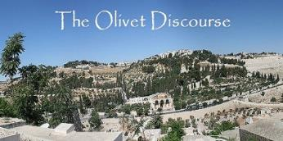
Matthew 24:31
“And He will send forth His angels with a great trumpet and they will gather together [episynagō] His elect from the four winds, from one end of the sky to the other.”

Slide 48
III. Jerusalem’s
(2:6-7)
Future worldwide return (6)
Historic local return (7)

Slide 49
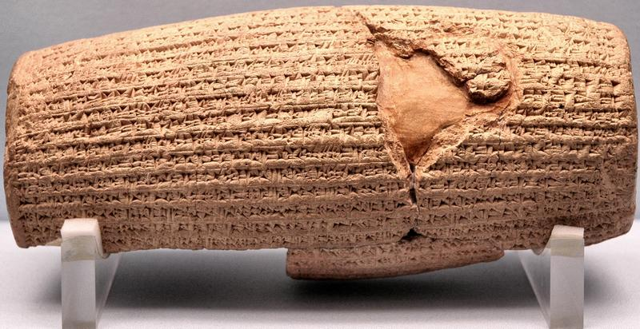
Cyrus Cylinder

Slide 50
Three Returns
 | DATE | DURATION | PERSIAN KING | JEWISH LEADER | SCRIPTURE | PURPOSE | NUMBER OF RETURNEES
1st return | 538–515 B.C. | 23 years | Cyrus (Isa 44:28‒45:1) | Zerubbabel | Ezra 1–6; Isaiah 44:28 | Rebuilding the temple | 50,000
2nd return | 458–457 B.C. | 2 years | Artaxerxes | Ezra | Ezra 7–10 | Adorning of the temple and reforming the people | 2,000
3rd return | 444–432 B.C. | 8 years | Artaxerxes | Nehemiah | Nehemiah | Rebuilding the wall

Slide 51

Genesis 11:1-4
¹ Now the whole earth used the same language and the same words. ² It came about as they journeyed east, that they found a plain in the land of Shinar and settled there. ³ They said to one another, “Come, let us make bricks and burn them thoroughly.” And they used brick for stone, and they used tar for mortar. ⁴ They said, “Come, let us build for ourselves a city, and a tower whose top will reach into heaven, and let us make for ourselves a name, otherwise we will be scattered abroad over the face of the whole earth.”

Slide 52
Spread of the Mother-Child Cult
 | MOTHER | CHILD
Assyria | Ishtar | Tammuz
Phoenicia | Astarte | Baal
Egypt | Isis | Osirus/Horus
Greece | Aphrodite | Eros
Rome | Venus | Cupid
Asia | Cybele | Desius
India | Isi | Aswara
Roman Catholicism | Mary | Jesus
Israel | Queen of Heaven (Jer. 7:18; 44:17) | Tammuz (Ezek. 8:14-15)
Alexander Hislop, Two Babylons

Slide 53
3. The Man with the Measuring Line
(2:1-13)
Vision (2:1-2)
Jerusalem’s restoration (2:3-5)
Exiles to return (2:6-7)
God and the nations (2:8-9)
God to inhabit Jerusalem (2:10-12)
Concluding exhortation (2:13)

Slide 54
IV. God and the Nations
(2:8-9)
God’s punishment of the nations (8)
Israel’s elevation (9)

Slide 55
IV. God and the Nations
(2:8-9)
God’s punishment of the nations (8)
Israel’s elevation (9)

Slide 56


Genesis 12:3
“And I will bless those who bless you, And the one who curses you I will curse. And in you all the families of the earth will be blessed.”

Slide 57
Genesis 12:3
“And I will bless those who bless you, And the one who curses you I will curse. And in you all the families of the earth will be blessed.”

Slide 58


Zechariah 2:8
“For thus says the Lord of hosts, “After glory He has sent me against the nations which plunder you, for he who touches you, touches the apple of His eye.”

Slide 59
Charles L. Feinberg
God Remembers: A Study of Zechariah (Wheaton: Van Kampen, 1950, p. 49-50.
“Though several MSS. have this reading, the better supported reading is ‘eno. Those who contend for the first, claim that the alteration was made that the text might be referred to the apple of a man’s eye; that is, whoever touches Israel, touches the apple of his own eye, doing himself irreparable damage.”

Slide 60
Charles L. Feinberg
God Remembers: A Study of Zechariah (Wheaton: Van Kampen, 1950, p. 49-50.
“In our opinion Deuteronomy 32:10 will allow no such interpretation, nor is it the most forceful here. True, that a man’s touching of the pupil of his own eye will bring him injury in a most sensitive part, how much more is this true if he touch the apple of God’s eye?”

Slide 61
IV. God and the Nations
(2:8-9)
God’s punishment of the nations (8)
Israel’s elevation (9)

Slide 62
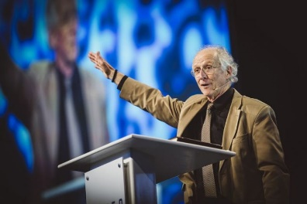
John Piper
John Piper, cited in Paul R. Wilkinson, Israel Betrayed: Volume 2: The Rise of Christian Palestinianism (San Antonio, TX: Ariel, 2018), 331-32.
“[God] has a saving purpose for Israel. All Israel will someday turn to the Lord Christ as a group. This is my deep understanding in belief of Romans 11. The broken off branches will be grafted in one day to the people of God, the bride of Christ, His church.”

Slide 63
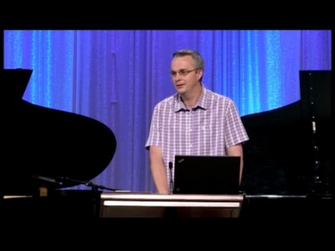
Paul Wilkinson
John Piper, cited in Paul R. Wilkinson, Israel Betrayed: Volume 2: The Rise of Christian Palestinianism (San Antonio, TX: Ariel, 2018), 332.
“On the basis of this kind of statement, many in the church are being misled into believing that Piper stands with Israel, but he does not. What Piper said is not what Paul taught. Israel’s destiny as a nation is not one of spiritual incorporation into the church, which is the classic Reformed, Calvinistic teaching. The church comprises individual Jews and Gentiles, not ‘Israel,’ which is a distinct national entity. The appointed destiny for Israel is for her to remain a nation in the sight of God and in the midst of all the nations, for as long as God’s ‘fixed order’ of creation endures (Jer. 31:36).”

Slide 64

Zechariah 14:16-18
“Then it will come about that any who are left of all the nations that went against Jerusalem will go up from year to year to worship the King, the Lord of hosts, and to celebrate the Feast of Booths. ¹⁷ And it will be that whichever of the families of the earth does not go up to Jerusalem to worship the King, the Lord of hosts, there will be no rain on them. ¹⁸ If the family of Egypt does not go up or enter, then no rain will fall on them; it will be the plague with which the Lord smites the nations who do not go up to celebrate the Feast of Booths.”

Slide 65

Isaiah 2:2-3
“Now it will come about that In the last days The mountain of the house of the Lord Will be established as the chief of the mountains, And will be raised above the hills; And all the nations will stream to it.³ And many peoples will come and say, ‘Come, let us go up to the mountain of the Lord, To the house of the God of Jacob; That He may teach us concerning His ways And that we may walk in His paths.’ For the law will go forth from Zion And the word of the Lord from Jerusalem.”

Slide 66

Revelation 20:7-9
“⁷ When the thousand years are completed, Satan will be released from his prison, ⁸ and will come out to deceive the nations which are in the four corners of the earth, Gog and Magog, to gather them together for the war; the number of them is like the sand of the seashore. ⁹ And they came up on the broad plain of the earth and surrounded the camp of the saints and the beloved city, and fire came down from heaven and devoured them.

Slide 67

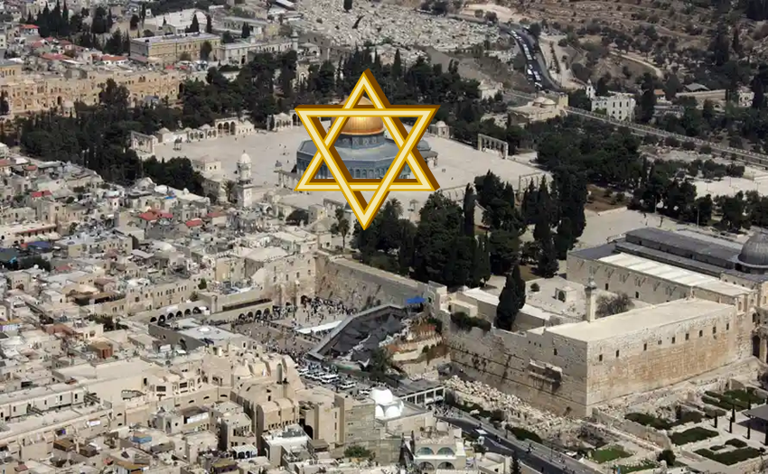
Robert Thomas
Four Views on the Book of Revelation, page 207.
“At the end of the Millennium that city will be Satan’s prime objective with his rebel army, because Israel will be a leader among the nations.”

Slide 68
3. The Man with the Measuring Line
(2:1-13)
Vision (2:1-2)
Jerusalem’s restoration (2:3-5)
Exiles to return (2:6-7)
God and the nations (2:8-9)
God to inhabit Jerusalem (2:10-12)
Concluding exhortation (2:13)

Slide 69
V. God to Inhabit Jerusalem
(2:10-12)
God to inhabit Jerusalem (10)
Nations to be blessed (11)
God to choose Jerusalem (12)

Slide 70
V. God to Inhabit Jerusalem
(2:10-12)
God to inhabit Jerusalem (10)
Nations to be blessed (11)
God to choose Jerusalem (12)

Slide 71
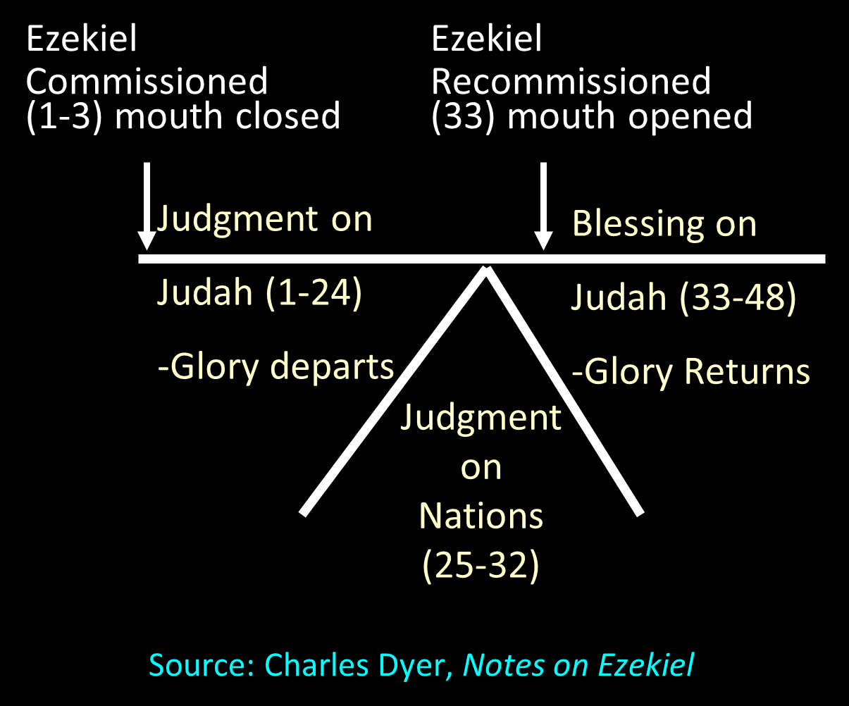

Slide 72
V. God to Inhabit Jerusalem
(2:10-12)
God to inhabit Jerusalem (10)
Nations to be blessed (11)
God to choose Jerusalem (12)

Slide 73
Charles L. Feinberg
God Remembers: A Study of Zechariah (Wheaton: Van Kampen, 1950, p. 52.
“The chapter reveals so vividly how little the nations of the earth realize how much their blessing depends upon Israel. They do well to take heed lest they fall into the hands of the living God, which is a fearful thing.”

Slide 74
V. God to Inhabit Jerusalem
(2:10-12)
God to inhabit Jerusalem (10)
Nations to be blessed (11)
God to choose Jerusalem (12)

Slide 75


Slide 76
3. The Man with the Measuring Line
(2:1-13)
Vision (2:1-2)
Jerusalem’s restoration (2:3-5)
Exiles to return (2:6-7)
God and the nations (2:8-9)
God to inhabit Jerusalem (2:10-12)
Concluding exhortation (2:13)

Slide 77
VI. Concluding Exhortation
(2:13)
The need for silence (13a)
Divine emotions (13b)
Heavenly action forthcoming (13c)

Slide 78
VI. Concluding Exhortation
(2:13)
The need for silence (13a)
Divine emotions (13b)
Heavenly action forthcoming (13c)

Slide 79
VI. Concluding Exhortation
(2:13)
The need for silence (13a)
Divine emotions (13b)
Heavenly action forthcoming (13c)

Slide 80
VI. Concluding Exhortation
(2:13)
The need for silence (13a)
Divine emotions (13b)
Heavenly action forthcoming (13c)

Slide 81
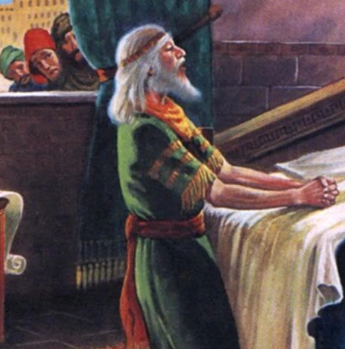
Daniel 2:44
“In the days of those kings the God of heaven will set up a kingdom which will never be destroyed, and that kingdom will not be left for another people; it will crush and put an end to all these kingdoms, but it will itself endure forever.”

Slide 82

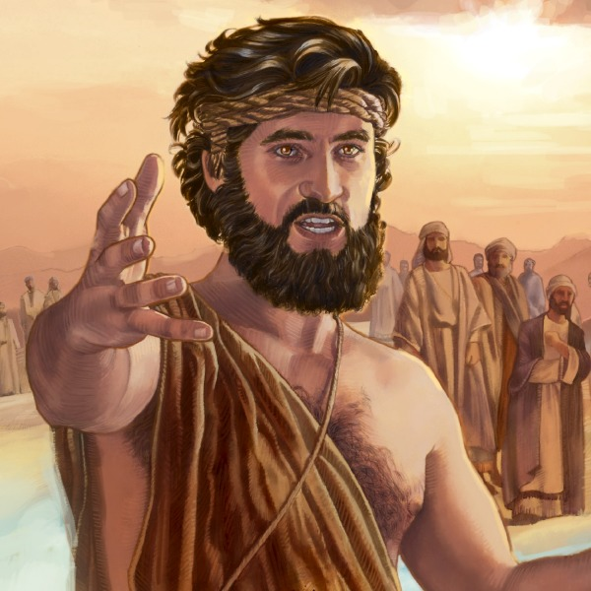
Matthew 3:1-2
“Now in those days John the Baptist came, preaching in the wilderness of Judea, saying, ‘Repent, for the kingdom of heaven is at hand.”

Slide 83
Messengers of the Kingdom In Matthew
John the Baptist – 3:2
Jesus Christ – 4:17
12 Apostles – 10:5-7
Seventy – Luke 10:1, 9
Toussaint, Behold the King, 18-20

Slide 84
Conclusion

Slide 85
3. The Man with the Measuring Line
(2:1-13)
Vision (2:1-2)
Jerusalem’s restoration (2:3-5)
Exiles to return (2:6-7)
God and the nations (2:8-9)
God to inhabit Jerusalem (2:10-12)
Concluding exhortation (2:13)

Slide 86
II. Eight Night Visions
(1:7‒6:15)
  Riders & horses among the myrtle trees (1:7-17)
  Four horns & four craftsmen (1:18-21)
  Man with the measuring line (2)
  Cleansing of the High Priest Joshua (3)
  Lampstand & olive tree (4)
  Flying scroll (5:1-4)
  Woman in the basket (5:5-11)
  Four chariots (6:1-8)
  Conclusion: crowning of Joshua (6:9-15)

