Slide 1
THE RAPTURE
What and When? – Part 65
Andrew Marshall Woods, Th.M., JD., PhD.
Sr. Pastor, Sugar Land Bible Church

Slide 2
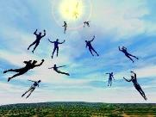
The Rapture Course Overview
What is the Rapture?
When is the Rapture?
Strengthening the Pre-Tribulational case
The opposing views
One second after the Rapture
Questions & Answers

Slide 3
MAIL BAG
Raise up at the Last Day (John 6:39, 40, 44)
Application of Olivet Discourse to the Church?
This generation?
No rapture?
Earth restored after Tribulation?
First seal already opened?
Salvation in the Tribulation?
Global reset & Revelation 13?

Slide 4
MAIL BAG
Raise up at the Last Day (John 6:39, 40, 44)
Application of Olivet Discourse to the Church?
This generation?
No rapture?
Earth restored after Tribulation?
First seal already opened?
Salvation in the Tribulation?
Global reset & Revelation 13?

Slide 6
Outline of John
1:1-18 | HEAVENLY GENEALOGY (Explains who Jesus is)
1:19-11:57 | PUBLIC MINISTRY ( 7 signs & discourses)
12:1-50 | TRIUMPHAL ENTRY (public national rejection of Christ-12:37)
13-17 | UPPER ROOM DISCOURSE (new dispensation)
18-21 | PASSION NARRATIVES (crucifixion to resurrection)

Slide 7
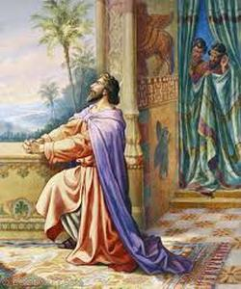
Daniel 12:2
“Many of those who sleep in the dust of the ground will awake, these to everlasting (olam) life, but the others to disgrace and everlasting (olam) contempt.”

Slide 8
Outline of John
1:1-18 | HEAVENLY GENEALOGY (Explains who Jesus is)
1:19-11:57 | PUBLIC MINISTRY ( 7 signs & discourses)
12:1-50 | TRIUMPHAL ENTRY (public national rejection of Christ-12:37)
13-17 | UPPER ROOM DISCOURSE (new dispensation)
18-21 | PASSION NARRATIVES (crucifixion to resurrection)

Slide 9
John 14:1–4
¹ “Do not let your heart be troubled; believe in God, believe also in Me. ² “In My Father’s house are many dwelling places; if it were not so, I would have told you; for I go to prepare a place for you. ³ “If I go and prepare a place for you, I will come again and receive you to Myself, that where I am, there you may be also. ⁴ “And you know the way where I am going.”

Slide 10
New Mystery Truth
“But here in John 14 the Lord gives a new and unique revelation; He speaks of something which no prophet had promised, or even could promise. Where is it written that this Messiah would come and instead of gathering His saints into an earthly Jerusalem, would take them to the Father's house, to the very place where He is? It is something new.”
Arno C. Gaebelein, The Gospel of John, 268.

Slide 11
Matthew 16:18
I also say to you that you are Peter, and upon this rock I will build [oikodomeō] My church; and the gates of Hades will not overpower it.

Slide 12
Ephesians 3:3-6
“³ that by revelation there was made known to me the mystery, as I wrote before in brief. ⁴ By referring to this, when you read you can understand my insight into the mystery of Christ, ⁵ which in other generations was not made known to the sons of men, as it has now been revealed to His holy apostles and prophets in the Spirit; ⁶ to be specific, that the Gentiles are fellow heirs and fellow members of the body, and fellow partakers of the promise in Christ Jesus through the gospel”.

Slide 13
Colossians 1:26
“that is, the mystery which has been hidden from the past ages and generations, but has now been manifested to His saints.”

Slide 14
“Mystery” Defined
“In the N.T, it [mystērion] denotes, not the mysterious (as with the Eng. word), but that which, being outside the range of unassisted natural apprehension, can be made known only by Divine revelation, and is made known in a manner and at a time appointed by God, and to those who are illumined by His Spirit.”
W. E. Vine, Merrill F. Unger, and William White, Vine's Complete Expository Dictionary of the Old and New Testament Words (Nashville: Nelson, 1996), 424.

Slide 15
1 Corinthians 15:51
“Behold, I tell you a mystery [mystērion]; we will not all sleep, but we will all be changed.”

Slide 16
1 Corinthians 15:20-23
“²⁰ But now Christ has been raised from the dead, the first fruits of those who are asleep. ²¹-For since by a man came death, by a man also came the resurrection of the dead. ²² For as in Adam all die, so also in Christ all will be made alive. ²³ But each in his own order (tagma): Christ the first fruits, after that those who are Christ’s at His coming.”

Slide 17
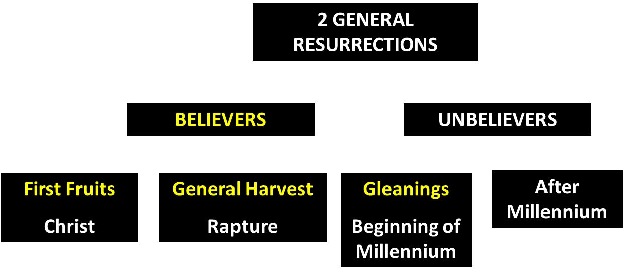
God’s Resurrection Program

Slide 18
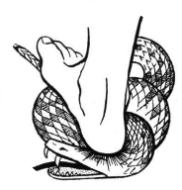
Genesis 3:15
“And I will put enmity Between you and the woman, And between your seed and her seed; He shall bruise you on the head, And you shall bruise him on the heel.”

Slide 19
MAIL BAG
Raise up at the Last Day (John 6:39, 40, 44)
Application of Olivet Discourse to the Church?
This generation?
No rapture?
Earth restored after Tribulation?
First seal already opened?
Salvation in the Tribulation?
Global reset & Revelation 13?

Slide 20
Matthew 24:15-16, 20
“¹⁵ Therefore when you see the abomination of desolation which was spoken of through Daniel the prophet, standing in the holy place (let the reader understand) ¹⁶ then those who are in Judea must flee to the mountains…²⁰ But pray that your flight will not be in the winter, or on a Sabbath.”

Slide 21
2 Timothy 3:16-17
“All Scripture is inspired by God [theopneustos] and profitable for teaching, for reproof, for correction, for training in righteousness; so that the man of God may be adequate, equipped for every good work.”
Notes:
hapaxlegomena

Slide 22
MAIL BAG
Raise up at the Last Day (John 6:39, 40, 44)
Application of Olivet Discourse to the Church?
This generation?
No rapture?
Earth restored after Tribulation?
First seal already opened?
Salvation in the Tribulation?
Global reset & Revelation 13?

Slide 23
Psalm 90:10
“As for the days of our life, they contain seventy years, Or if due to strength, eighty years, Yet their pride is but labor and sorrow; For soon it is gone and we fly away.”

Slide 24
Matthew 24:15-16, 20
“¹⁵ Therefore when you see the abomination of desolation which was spoken of through Daniel the prophet, standing in the holy place (let the reader understand) ¹⁶ then those who are in Judea must flee to the mountains…²⁰ But pray that your flight will not be in the winter, or on a Sabbath.”

Slide 26
MAIL BAG
Raise up at the Last Day (John 6:39, 40, 44)
Application of Olivet Discourse to the Church?
This generation?
No rapture?
Earth restored after Tribulation?
First seal already opened?
Salvation in the Tribulation?
Global reset & Revelation 13?

Slide 27
John 14:1–4
¹ “Do not let your heart be troubled; believe in God, believe also in Me. ² “In My Father’s house are many dwelling places; if it were not so, I would have told you; for I go to prepare a place for you. ³ “If I go and prepare a place for you, I will come again and receive you to Myself, that where I am, there you may be also. ⁴ “And you know the way where I am going.”

Slide 28
New Mystery Truth
“But here in John 14 the Lord gives a new and unique revelation; He speaks of something which no prophet had promised, or even could promise. Where is it written that this Messiah would come and instead of gathering His saints into an earthly Jerusalem, would take them to the Father's house, to the very place where He is? It is something new.”
Arno C. Gaebelein, The Gospel of John, 268.

Slide 29
1 Thessalonians 4:13-18
. . . have fallen asleep. ¹⁶ For the Lord Himself will descend from heaven with a shout, with the voice of the archangel and with the trumpet of God, and the dead in Christ will rise first. ¹⁷ Then we who are alive and remain will be caught up [harpazō] together with them in the clouds to meet the Lord in the air, and so we shall always be with the Lord. ¹⁸ Therefore comfort one another with these words."

Slide 30
Rapture Distinct from Second Advent
RAPTURE (1 Thess 4:13-18; 1 Cor 15:51-58) | SECOND COMING (Rev 19:11-16)
Christ comes in the air (1 Thess 4:16-17) | Christ comes to the earth (Zech 14:4)
For His saints (1 Thess 4:15-17) | With His saints (Rev 19:14)
Blessing (1 Thess 4:18) | Judgment (Rev 19:15)
Effects only believers (1 Thess 4:16) | Effects both believers & unbelievers (Rev 19:15)

Slide 31
Rapture Distinct from Second Advent
RAPTURE (1 Thess 4:13-18; 1 Cor 15:51-58) | SECOND COMING (Rev 19:11-16)
Invisible (1 Thess 4:16) | Visible to all (Rev 1:7)
Announced only by an archangel (1 Thess 4:16) | Involves myriads of angels (Jude 14)
Resurrection (1 Cor 15: 51) | No resurrection
Rescue of the Church (1 Thess 1:10) | Rescue of Israel (Matt 23:37-39)

Slide 32
MAIL BAG
Raise up at the Last Day (John 6:39, 40, 44)
Application of Olivet Discourse to the Church?
This generation?
No rapture?
Earth restored after Tribulation?
First seal already opened?
Salvation in the Tribulation?
Global reset & Revelation 13?

Slide 34
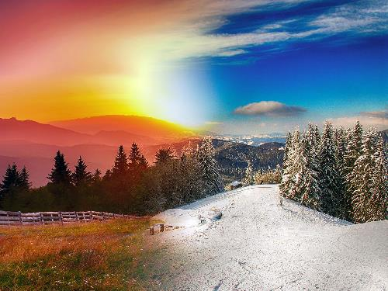
Genesis 8:22
While the earth remains, Seedtime and harvest, And cold and heat, And summer and winter, And day and night Shall not cease.

Slide 35
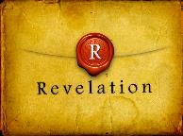
Revelation 1:6; 5:10
“^{1:6} and He has made us to be a kingdom, priests to His God and Father—to Him be the glory and the dominion forever and ever. Amen…^{5:10} You have made them to be a kingdom and priests to our God; and they will reign [basileuō] upon the earth [gē].”

Slide 37
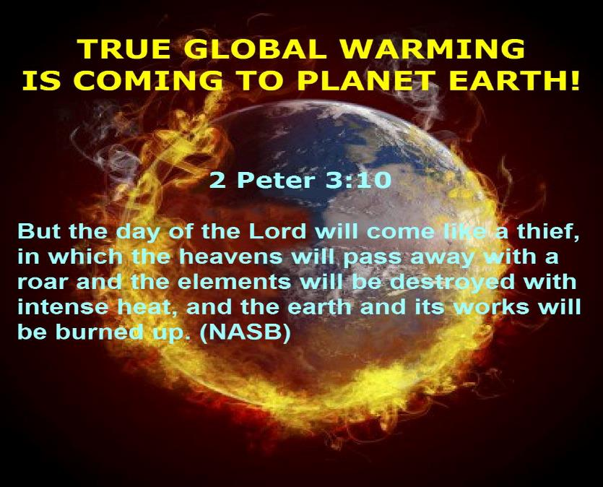

Slide 38
MAIL BAG
Raise up at the Last Day (John 6:39, 40, 44)
Application of Olivet Discourse to the Church?
This generation?
No rapture?
Earth restored after Tribulation?
First seal already opened?
Salvation in the Tribulation?
Global reset & Revelation 13?

Slide 40
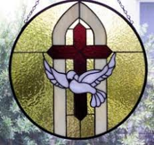
2 Thessalonians 2:6-7
⁶And you know what restrains [katechon; neuter] him now, so that in his time he will be revealed. ⁷For the mystery of lawlessness is already at work; only he who now restrains [katechōn; masculine] will do so until he is taken out of the way.

Slide 41
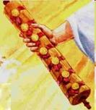
1st Six Seals (Revelation 6)
6:1-2 – Advent of antichrist
6:3-4 – War
6:5-6 – Famine
6:7-8 – Death
6:9-11 – Martyrdoms
6:12-17 – Cosmic disturbances

Slide 43
DESCRIPTION OF THE SEVEN CHURCHES REVELATION 2‒3
CHURCH | SCRIPTURE | DESCRIPTION
Ephesus | 2:1-7 | Loveless
Smyrna | 2:8-11 | Persecuted
Pergamum | 2:12-17 | Compromised
Thyatira | 2:18-29 | Corrupt
Sardis | 3:1-6 | Dead
Philadelphia | 3:7-13 | Missionary
Laodicea | 3:14-22 | Man-centered

Slide 44
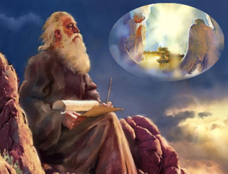
Twenty-Four Elders (Rev. 4:4; 5:8-10)
CHURCH
Crowned (Rev. 2:10; 3:11)
Resurrected (Rev. 4:4)
Clothed in White (Rev. 3:5)
Redeemed (Rev. 5:8-10)
Global (Rev. 5:9; Matt. 28:19)
Enthroned (Rev. 3:21)
Elders (Rev. 1 Tim. 3:1-7)
Kingdom of Priests (Rev. 1:6)
Twenty-four (Rev. 1:6)

Slide 45
MAIL BAG
Raise up at the Last Day (John 6:39, 40, 44)
Application of Olivet Discourse to the Church?
This generation?
No rapture?
Earth restored after Tribulation?
First seal already opened?
Salvation in the Tribulation?
Global reset & Revelation 13?

Slide 46
Distinctions Between 144,000 & Multitude
144,000 | MULTITUDE
Revelation 7:1-8 | Revelation 7:9-17
Numbered | Innumerable
Jews | All nations
Sealed (First Fruits) | Slain (Martyrs)
Sealed before the Tribulation | Converted out of the Tribulation
Hitchcock and Ice, The Truth Behind Left Behind, 77

Slide 47
MAIL BAG
Raise up at the Last Day (John 6:39, 40, 44)
Application of Olivet Discourse to the Church?
This generation?
No rapture?
Earth restored after Tribulation?
First seal already opened?
Salvation in the Tribulation?
Global reset & Revelation 13?

Slide 48
Revelation 13:16-18
¹⁶ And he causes all, the small and the great, and the rich and the poor, and the free men and the slaves, to be given a mark on their right hand or on their forehead, ¹⁷ and he provides that no one will be able to buy or to sell, except the one who has the mark, either the name of the beast or the number of his name. ¹⁸ Here is wisdom. Let him who has understanding calculate the number of the beast, for the number is that of a man; and his number is six hundred and sixty-six.
48

Slide 49
Daniel 7:23
“The fourth beast will be a fourth kingdom on the earth, which will be different from all the other kingdoms and will devour the whole earth and tread it down and crush it.”
49

Slide 51
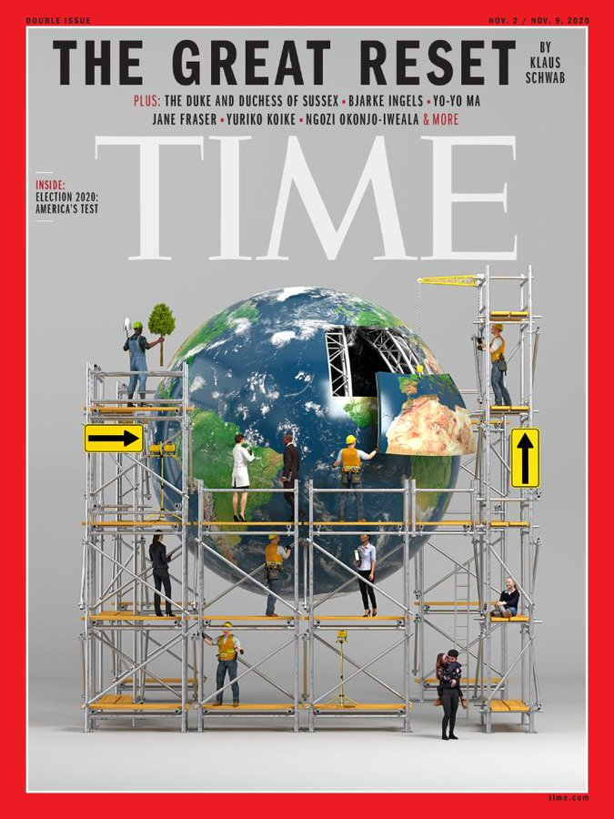

Slide 52
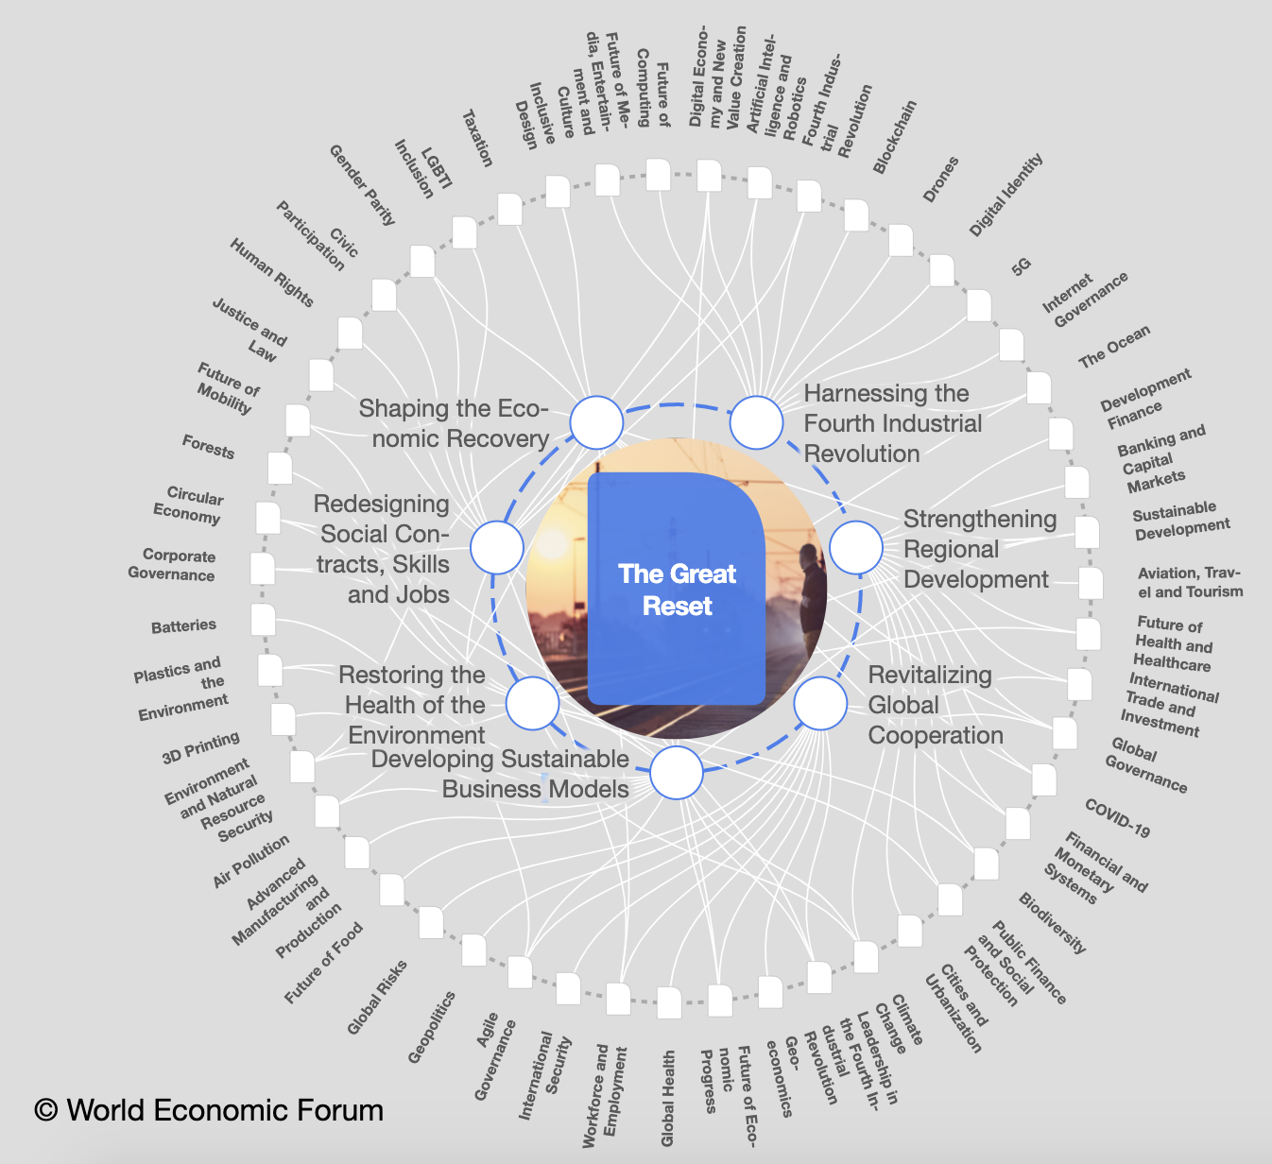

Slide 57
CONCLUSION

Slide 58
MAIL BAG
Raise up at the Last Day (John 6:39, 40, 44)
Application of Olivet Discourse to the Church?
This generation?
No rapture?
Earth restored after Tribulation?
First seal already opened?
Salvation in the Tribulation?
Global reset & Revelation 13?

