Slide 1


THE RAPTURE
What and When? – Part 56
Andrew Marshall Woods, Th.M., JD., PhD.
Sr. Pastor, Sugar Land Bible Church

Slide 2
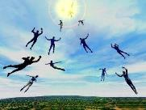
The Rapture
Course Overview
What is the Rapture?
When is the Rapture?
Strengthening the Pre-Tribulational case
The opposing views
One second after the Rapture

Slide 3
The Rapture
Course Overview
What is the Rapture?
When is the Rapture?
Strengthening the Pre-Tribulational case
The opposing views
One second after the Rapture

Slide 4

What is the Rapture?
An important doctrine
Distinct from the Second Advent
Catching away of all living believers (1 Thess 4:17)
Reunion (1 Thess 4:14-16)
Resurrection (1 Cor 15:50-54)
Exemption from death (1 Cor 15:51, 54-56)
Instantaneous (1 Cor 15:52)
Mystery (1 Cor 15:51)
Imminent (1 Cor 15:51; 1 Thess 4:15)
Traditional doctrine now being recovered

Slide 5
The Rapture
Course Overview
What is the Rapture?
When is the Rapture?
Strengthening the Pre-Tribulational case
The opposing views
One second after the Rapture

Slide 6
When is the Rapture?
7 Arguments Favoring the Pre-Tribulation View
Tribulation's purpose concerns Israel (Jer 30:7; Dan 9:24)
No biblical reference to the church on earth during the Tribulation period (Rev 4-22)
Church is promised an exemption from divine wrath (1 Thess 1:10; 5:9; Rom 5:9; Rev 3:10; 6:17)
Rapture is imminent (1 Cor 15:51; 1 Thess 4:15)
Rapture is a comfort (1 Thess 4:18)
Antichrist cannot come to power until the restrainer is removed (2 Thess 2:6-7)
Symbolic parallels (2 Peter 2:5-9)

Slide 7
The Rapture
Course Overview
What is the Rapture?
When is the Rapture?
Strengthening the Pre-Tribulational case
The opposing views
One second after the Rapture

Slide 8
Strengthening the Pre-Tribulation Case
John 14:1-4
Revelation 3:10
First Thessalonians 4‒5
Second Thessalonians 2:3a
Matthew 24‒25

Slide 9
The Rapture
Course Overview
What is the Rapture?
When is the Rapture?
Strengthening the Pre-Tribulational case
The opposing views
One second after the Rapture

Slide 10
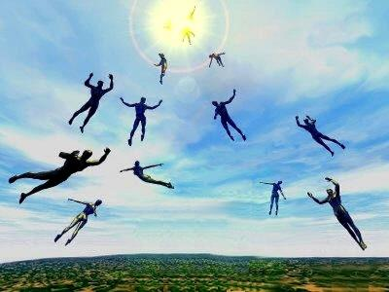
When Will the Rapture Take Place Relative to the Tribulation Period?
Pre-tribulation rapture theory
Mid-tribulation rapture theory
Post-tribulation rapture theory
Pre-wrath rapture theory
Partial rapture theory

Slide 11
Problems with Partial Rapturism?
Every divine blessing is given on the basis of His grace and not human effort (Eph. 2:8-9; Rom. 12:6)
Symbolic parallels mandate that carnal as well as sanctified Christians will be taken up in the rapture (Gen. 19:22)
The promise of the rapture is mentioned in Paul's letter to the carnal Corinthian church (1 Cor. 15:51)
A partial rapture would sever Christ's body (1 Cor 12:12-14)
The partial rapture view subjects believers to God's wrath (Thess 1:10)

Slide 12
Problems with Partial Rapturism?
Partial rapturism makes the Bema Seat Judgment unnecessary (1 Cor. 3:10-15)
Partial rapturists never objectively quantify the exact degree of faithfulness or spiritual maturity that is necessary to participate in the rapture
Partial rapturists appear individually biased
Partial rapturists dispensationally misapply Bible passages (Matt. 25:1-13)
Partial rapturists misapply passages promising a reward to faithful believers (Rev. 3:11)

Slide 13
DESCRIPTION OF THE SEVEN CHURCHES Revelation 2‒3
CHURCH | SCRIPTURE | DESCRIPTION
Ephesus | 2:1-7 | Loveless
Smyrna | 2:8-11 | Persecuted
Pergamum | 2:12-17 | Compromised
Thyatira | 2:18-29 | Corrupt
Sardis | 3:1-6 | Dead
Philadelphia | 3:7-13 | Missionary
Laodicea | 3:14-22 | Man-centered

Slide 14


Revelation 3:10
‘Because you have kept the word of My perseverance, I also will keep you from the hour of testing, that hour which is about to come upon the whole world, to test those who dwell on the earth.

Slide 15
Revelation 3:9-10
better reading
⁹ ‘Behold, I will cause those of the synagogue of Satan, who say that they are Jews and are not, but lie—I will make them come and bow down at your feet, and make them know that I have loved you ¹⁰ ‘because you have kept the word of My perseverance. I also will keep you from the hour of testing, that hour which is about to come upon the whole world, to test those who dwell on the earth.

Slide 16
Problems with Beginning the Sentence in Rev. 3:10 with “Because”
Not part of the original manuscripts: chapter & verse divisions & punctuation marks (periods, commas, or exclamation points).
These things were all added by later copyists.
Most English translations separate the two verses with a period.
Thus, it becomes cause for participating in the Rapture and not a cause for their enemies to worship before their feet.
However, the period should be placed in the middle of verse 10.
Thus, it becomes not a cause for participating the Rapture and a cause for their enemies to worship before their feet.
John Niemela, The Interpretation of Revelation 3:10: You Have Kept My Word, CTS Journal; As summarized by Dennis Rokser, A Golden Nugget in Revelation 3:10, Grace for the Race, no. 29.

Slide 17
Problems with Beginning the Sentence in Rev. 3:10 with “Because” (cont’d)
Rev. 3:10b becomes an additional unconditional promise of Rapture participation beyond the promises of Rev. 2:9b.
It is rare to begin a sentence with “because” (hoti) in a causative sense.
Instead, hoti (“because”), when casual in function, usually follows a statement or promise in providing a reason for what preceded it in the sentence.
Thus, Greek sentences rarely begin a sentence with the phrase “Because you have” when explaining the cause or reason for something, as Greek and English texts of Revelation 3:10 unfortunately do today. Instead, the “because” phraseology consistently follows later in the sentence.
John Niemela, The Interpretation of Revelation 3:10: You Have Kept My Word, CTS Journal; As summarized by Dennis Rokser, A Golden Nugget in Revelation 3:10, Grace for the Race, no. 29.

Slide 18
DESCRIPTION OF THE SEVEN CHURCHES Revelation 2‒3
CHURCH | SCRIPTURE | DESCRIPTION
Ephesus | 2:1-7 | Loveless
Smyrna | 2:8-11 | Persecuted
Pergamum | 2:12-17 | Compromised
Thyatira | 2:18-29 | Corrupt
Sardis | 3:1-6 | Dead
Philadelphia | 3:7-13 | Missionary
Laodicea | 3:14-22 | Man-centered

Slide 19

Revelation 2:22
“Behold, I will throw her on a bed of sickness, and those who commit adultery with her into great tribulation, unless they repent of her deeds.”

Slide 20
Revelation 7:13-14
“¹³ Then one of the elders responded, saying to me, ‘These who are clothed in the white robes, who are they, and where have they come from?’ ¹⁴ I said to him, ‘My lord, you know.’ And he said to me, ‘These are the ones who come out of the great tribulation, and they have washed their robes and made them white in the blood of the Lamb.’”

Slide 21
Great Tribulation?
Scripture | Rev 2:22 | Rev 7:13-14
Circumstance | Letter to the Church | Tribulation Period
Situation | Max. Divine Discipline | Divine Wrath
Opening Scroll | Before | After
Daniel’s 70th Week | Before | After
Audience | Church-Age Saint | Tribulation Saint
Church Presence? | Yes | No
Hebrew Context? | No | Yes
21

Slide 22
DESCRIPTION OF THE SEVEN CHURCHES Revelation 2‒3
CHURCH | SCRIPTURE | DESCRIPTION
Ephesus | 2:1-7 | Loveless
Smyrna | 2:8-11 | Persecuted
Pergamum | 2:12-17 | Compromised
Thyatira | 2:18-29 | Corrupt
Sardis | 3:1-6 | Dead
Philadelphia | 3:7-13 | Missionary
Laodicea | 3:14-22 | Man-centered

Slide 23



Slide 24

Revelation 3:2-3
“² Wake up, and strengthen the things that remain, which were about to die; for I have not found your deeds completed in the sight of My God. ³ So remember what you have received and heard; and keep it, and repent. Therefore if you do not wake up, I will come like a thief, and you will not know at what hour I will come to you.”

Slide 25
Revelation 3:2-3
“² Wake up, and strengthen the things that remain, which were about to die; for I have not found your deeds completed in the sight of My God. ³ So remember what you have received and heard; and keep it, and repent. Therefore if you do not wake up, I will come (hēkō) like a thief, and you will not know at what hour I will come (hēkō) to you.”

Slide 26
Revelation 3:2-3
“² Wake up, and strengthen the things that remain, which were about to die; for I have not found your deeds completed in the sight of My God. ³ So remember what you have received and heard; and keep it, and repent. Therefore if you do not wake up, I will come like a thief (kleptēs), and you will not know at what hour I will come to you.”

Slide 27
When is the Rapture?
7 Arguments Favoring the Pre-Tribulation View
Tribulation's purpose concerns Israel (Jer 30:7; Dan 9:24)
No biblical reference to the church on earth during the Tribulation period (Rev 4-22)
Church is promised an exemption from divine wrath (1 Thess 1:10; 5:9; Rom 5:9; Rev 3:10; 6:17)
Rapture is imminent (1 Cor 15:51; 1 Thess 4:15)
Rapture is a comfort (1 Thess 4:18)
Antichrist cannot come to power until the restrainer is removed (2 Thess 2:6-7)
Symbolic parallels (2 Peter 2:5-9)

Slide 28

John 14:1–4
¹ “Do not let your heart be troubled; believe in God, believe also in Me. ² “In My Father’s house are many dwelling places; if it were not so, I would have told you; for I go to prepare a place for you. ³ “If I go and prepare a place for you, I will come again and receive you to Myself, that where I am, there you may be also. ⁴ “And you know the way where I am going.”

Slide 29

1 Thessalonians 4:13-18
¹³ "But we do not want you to be uninformed, brethren, about those who are asleep, so that you will not grieve as do the rest who have no hope. ¹⁴ For if we believe that Jesus died and rose again, even so God will bring with Him those who have fallen asleep in Jesus. ¹⁵ For this we say to you by the word of the Lord, that we who are alive and remain until the coming of the Lord, will not . . .

Slide 30
1 Thessalonians 4:13-18
...precede those who have fallen asleep. ¹⁶ For the Lord Himself will descend from heaven with a shout, with the voice of the archangel and with the trumpet of God, and the dead in Christ will rise first. ¹⁷ Then we who are alive and remain will be caught up together with them in the clouds to meet the Lord in the air, and so we shall always be with the Lord. ¹⁸ Therefore comfort one another with these words."

Slide 31

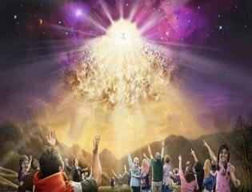

Titus 2:13
“Looking for the blessed hope and the appearing of the glory of our great God and Savior, Christ Jesus.”

Slide 33
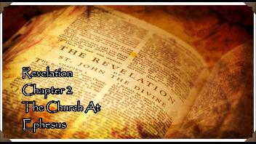
Revelation 2:4-5
“⁴ But I have this against you, that you have left your first love. ⁵ Therefore remember from where you have fallen, and repent and do the deeds you did at first; or else I am coming to you and will remove your lampstand out of its place—unless you repent.”

Slide 34
The Rapture
Course Overview
What is the Rapture?
When is the Rapture?
Strengthening the Pre-Tribulational case
The opposing views
One second after the Rapture

Slide 35
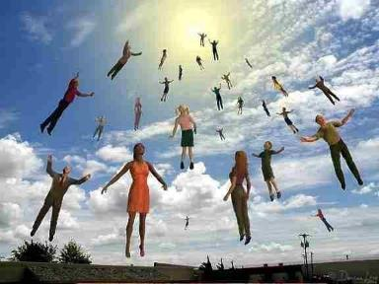

One Second After the Rapture
Sugar Land Bible Church 2021
Dr. Andy Woods
Senior Pastor – Sugar Land Bible Church
President – Chafer Theological Seminary

Slide 36

One Second After the Rapture
For the believer
For the unbeliever
So what?

Slide 37
One Second After the Rapture
For the believer
For the unbeliever
So what?

Slide 38

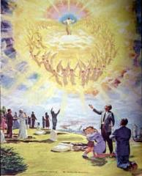
1. For the Believer
Reunion (1 Thess. 4:13-18)
Resurrection (1 Cor. 15:51, 53-55)
Reward (2 Cor. 5:10)

Slide 39
1. For the Believer
Reunion (1 Thess. 4:13-18)
Resurrection (1 Cor. 15:51, 53-55)
Reward (2 Cor. 5:10)

Slide 40

What is the Rapture?
An important doctrine
Distinct from the Second Advent
Catching away of all living believers (1 Thess 4:17)
Reunion (1 Thess 4:14-16)
Resurrection (1 Cor 15:50-54)
Exemption from death (1 Cor 15:51, 54-56)
Instantaneous (1 Cor 15:52)
Mystery (1 Cor 15:51)
Imminent (1 Cor 15:51; 1 Thess 4:15)
Traditional doctrine now being recovered

Slide 41
1 Thessalonians 4:13-18
¹³ "But we do not want you to be uninformed, brethren, about those who are asleep, so that you will not grieve as do the rest who have no hope. ¹⁴ For if we believe that Jesus died and rose again, even so God will bring with Him those who have fallen asleep in Jesus. ¹⁵ For this we say to you by the word of the Lord, that we who are alive and remain until the coming of the Lord, will not . . .

Slide 42
1 Thessalonians 4:13-18
...precede those who have fallen asleep. ¹⁶ For the Lord Himself will descend from heaven with a shout, with the voice of the archangel and with the trumpet of God, and the dead in Christ will rise first. ¹⁷ Then we who are alive and remain will be caught up together with them in the clouds to meet the Lord in the air, and so we shall always be with the Lord. ¹⁸ Therefore comfort one another with these words."

Slide 43
1. For the Believer
Reunion (1 Thess. 4:13-18)
Resurrection (1 Cor. 15:51, 53-55)
Reward (2 Cor. 5:10)

Slide 44
What is the Rapture?
An important doctrine
Distinct from the Second Advent
Catching away of all living believers (1 Thess 4:17)
Reunion (1 Thess 4:14-16)
Resurrection (1 Cor 15:50-54)
Exemption from death (1 Cor 15:51, 54-56)
Instantaneous (1 Cor 15:52)
Mystery (1 Cor 15:51)
Imminent (1 Cor 15:51; 1 Thess 4:15)
Traditional doctrine now being recovered

Slide 45

1 Corinthians 15:50-51
“⁵⁰ Now I say this, brethren, that flesh and blood cannot inherit the kingdom of God; nor does the perishable inherit the imperishable. ⁵¹ Behold, I tell you a mystery; we will not all sleep, but we will all be changed.”

Slide 46

Romans 8:19-23
¹⁹ “For the anxious longing of the creation waits eagerly for the revealing of the sons of God. ²⁰ For the creation was subjected to futility, not willingly, but because of Him who subjected it, in hope ²¹ that the creation itself also will be set free from its slavery to corruption into the freedom of the glory of the children of God. ²² For we know that the whole creation groans and suffers the . . .

Slide 47
Romans 8:19-23
. . . pains of childbirth together until now. ²³ And not only this, but also we ourselves, having the first fruits of the Spirit, even we ourselves groan within ourselves, waiting eagerly for our adoption as sons, the redemption of our body.”

Slide 48
1. For the Believer
Reunion (1 Thess. 4:13-18)
Resurrection (1 Cor. 15:51, 53-55)
Reward (2 Cor. 5:10)

Slide 49

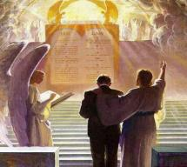
2 Corinthians 5:10
“For we must all appear before the judgment seat of Christ, so that each one may be recompensed for his deeds in the body, according to what he has done, whether good or bad.”

Slide 50
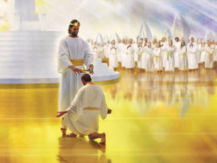
Our Performance Appraisals

Slide 51

Why?
Not to judge sin (John 19:30)
Not to determine salvation (John 5:24)
But rather to give or not give rewards

Slide 52

John 5:24
“Truly, truly, I say to you, he who hears My word, and believes Him who sent Me, has eternal life, and does not come into judgment, but has passed out of death into life.”

Slide 53
Scripture’s Five Crowns (Rev 4:10: 3:11; 2 John 8)
SCRIPTURE | CROWN | PURPOSE
1 Cor. 9:24-27 | Incorruptible | Gaining mastery over the flesh
1 Thess. 2:19-20 | Rejoicing | Soul winning
Jas. 1:12; Rev. 2:10 | Life | Enduring trials
1 Pet. 5:2-4 | Glory | Shepherding God’s people
2 Tim. 4:8 | Righteousness | Longing for His appearing

Slide 54

1 Corinthians 3:14-15
“¹⁴ If any man’s work which he has built on it remains, he will receive a reward. ¹⁵ If any man’s work is burned up, he will suffer loss; but he himself will be saved, yet so as through fire.”

Slide 55
One Second After the Rapture
For the believer
For the unbeliever
So what?

Slide 56
2. For the Unbeliever
A perverted explanation to be offered
Change in God’s program
Identification of the Antichrist
Global governance
One-world religion
Signs & wonders movement
The demise of America
God’s wrath

Slide 57
2. For the Unbeliever
A perverted explanation to be offered
Change in God’s program
Identification of the Antichrist
Global governance
One-world religion
Signs & wonders movement
The demise of America
God’s wrath

Slide 58

Explanation of the missing
“Your unfinished species is ready to evolve. The time has come on Earth for this quantum change to occur in many of you." Her "Christ" further informed her "I cannot 'return' until enough of you are attracted and linked." Hubbard's "Christ" explained, "I did not intend for you to deify me, but to deify yourselves as being at the same stage of evolution as I am." "Suffice it to say, that if you do not choose to evolve into a wholesome, co-creative human, then you shall not." "...the fundamental regression is self-centeredness, or the illusion that you are separate from God. I 'make war' on self-centeredness.“…
Barbara Marx Hubbard, The Revelation: A Message of Hope for the New Millennium, 2nd ed. (Novato, CA: Nataraj, 1995), 65, 66, 195, 233, 240, 255.

Slide 59
Explanation of the missing (cont’d)
…Furthermore, "At the co-creative stage of evolution, one self-centered soul is like a lethal cancer cell in a body; deadly to itself and to the whole." Thus, "The surgeon dare leave no cancer in the body when he closes up the wound after a delicate operation. We dare leave no self-centered person on Earth after the selection process.”
Barbara Marx Hubbard, The Revelation: A Message of Hope for the New Millennium, 2nd ed. (Novato, CA: Nataraj, 1995), 65, 66, 195, 233, 240, 255.

Slide 60

The Coming Synthesis
“The coming of the Aquarian age also stimulates in man a spirit of universality and a tendency towards fusion. This can be seen working out in the present trend towards synthesis in business, in religion and in politics. It produces an urge towards union, and among other unions, towards religious understanding and tolerance...False and true standards will emerge in man’s consciousness, and those choices will be made which will lay the foundation of the new order, which will inaugurate the new race, with its new laws and novel approaches, and so usher in the new religion of love and brotherhood, and that period wherein the group and the group-good will be the dominant note. Then separateness and hatreds will fade out and men will be merged in a true unity."
Alice A. Bailiey and Dijwhal Khul, The Seventh Ray: Revealer of the New Age (NY: Lucius Press, 1995), 198-99.

Slide 61
Explanation of the missing
New Age writer Randolph Price says that his spirit guide, an "awakened one" called "Asher," has informed him that "Nature will soon enter her cleansing cycle" during which those of "lower vibratory rates" will purified off the planet. Perhaps one of the factors which will bring the antichrist to power will be his ability to restore order from chaos by offering an acceptable explanation for all of the missing Christians.
Randall Baer, Inside the New Age Nightmare (Lafayette, LA: Huntington House, 1989), 169.

Slide 62
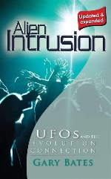
Explanation of the missing
“The people who leave the planet during the time of Earth changes do not fit in here any longer, and they are stopping the harmony of Earth. When the time comes that perhaps 20 million people leave the planet at one time there will be a tremendous shift in consciousness for those who are remaining.”
Barbara Marciniak, Bringers of the Dawn: Teachings from the Pleiadians (Rochester, VT: Bear and Co., 1992), cited in “Rapture: The New Age Version,” <www.redmoonrising.com/newage.htm>, 29 January, 2010. See Gary Bates, Alien Intrusion: UfOs and the Evolution Connection (Powder Springs, GA: Creation Book Publishers, 2004), 367-68.

Slide 63
2. For the Unbeliever
A perverted explanation to be offered
Change in God’s program
Identification of the Antichrist
Global governance
One-world religion
Signs & wonders movement
The demise of America
God’s wrath

Slide 64
b. Change in God’s Program
From the Church to Israel
In the Holy Spirit’s operation

Slide 65
b. Change in God’s Program
From the Church to Israel
In the Holy Spirit’s operation

Slide 66

Romans 11:25-26
“²⁵ For I do not want you, brethren, to be uninformed of this mystery—so that you will not be wise in your own estimation—that a partial hardening has happened to Israel until the fullness of the Gentiles has come in; ²⁶ and so all Israel will be saved; just as it is written, ‘The Deliverer will come from Zion, He will remove ungodliness from Jacob.’”

Slide 67
Jeremiah 31:35-37
Thus says the Lord, Who gives the sun for light by day And the fixed order of the moon and the stars for light by night, Who stirs up the sea so that its waves roar; The Lord of hosts is His name:³⁶ “If this fixed order departs From before Me,” declares the Lord, “Then the offspring of Israel also will cease From being a nation before Me forever.”³⁷ Thus says the Lord, “If the heavens above can be measured And the foundations of the earth searched out below, Then I will also cast off all the offspring of Israel For all that they have done,” declares the Lord.

Slide 68


Slide 69


Slide 70
Distinctions Between 144,000 & Multitude
144,000 | MULTITUDE
Revelation 7:1-8 | Revelation 7:9-17
Numbered | Innumerable
Jews | All nations
Sealed | Slain
Sealed before the Tribulation | Converted out of the Tribulation
Hitchcock and Ice, The Truth Behind Left Behind, 77

Slide 71
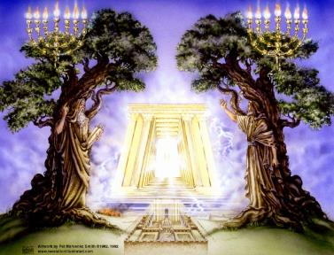
God’s Work Through Israel
Rev 7-144,000 Jews
Rev 11-Two Jewish witnesses
Rev 12-Israel flees

Slide 72


Jeremiah 30:7
“Alas! for that day is great, There is none like it; And it is the time of Jacob’s distress (Gen. 32:8; 35:10), But he will be saved from it.”

Slide 73
b. Change in God’s Program
From the Church to Israel
In the Holy Spirit’s operation

Slide 74


Slide 75

1 Samuel 16:13-14
¹³ Then Samuel took the horn of oil and anointed him in the midst of his brothers; and the Spirit of the Lord came mightily upon David from that day forward. And Samuel arose and went to Ramah. ¹⁴ Now the Spirit of the Lord departed from Saul, and an evil spirit from the Lord terrorized him.

Slide 76
John 14:16-17
¹⁶ I will ask the Father, and He will give you another Helper, that He may be with you forever; ¹⁷ that is the Spirit of truth, whom the world cannot receive, because it does not see Him or know Him, but you know Him because He abides with you and will be in you.

Slide 77
WORK OF THE SPIRIT IN THE OT
 | OT/GOSPELS | TODAY
External vs. Internal | Upon (1 Sam. 16:13) | Within (John 14:17)
Reception of all of the Spirit at the moment of salvation? | Subsequent to salvation (Exod 31:3) | At moment of salvation (Rom 8:9)
How long is the indwelling? | Temporary indwelling (1 Sam 16:14; Ps 51:11) | Permanent indwelling (John 14:16)
Who is indwelt? | Selective indwelling (Joel 2:28) | Universal indwelling (1 Cor 12:13)

Slide 78

Daniel 9:24
Seventy weeks have been decreed for your people and your holy city, to finish the transgression, to make an end of sin, to make atonement for iniquity, to bring in everlasting righteousness, to seal up vision and prophecy and to anoint the most holy place.

Slide 79


Slide 80
Daniel 9:24
Seventy weeks have been decreed for your people and your holy city, to finish the transgression, to make an end of sin, to make atonement for iniquity, to bring in everlasting righteousness, to seal up vision and prophecy and to anoint the most holy place.

Slide 81
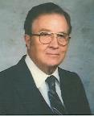

Robert Culver
Daniel and the Latter Days
(Chicago, IL: Moody Press, 1977), p. 149
“Let the postmillennial and amillennial commentators look long and steadily at this fact. This prophecy is a prophecy for Daniel’s people and Daniel’s city. No alchemy of Origenistic spiritualizing interpretation can change that.”

Slide 82
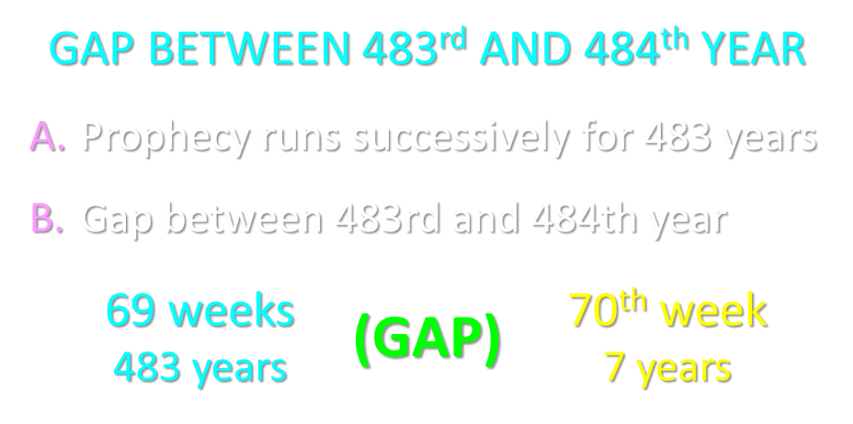

Slide 83
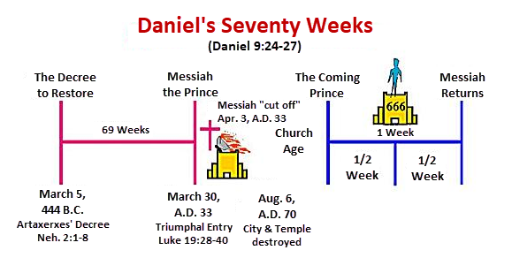

Slide 84
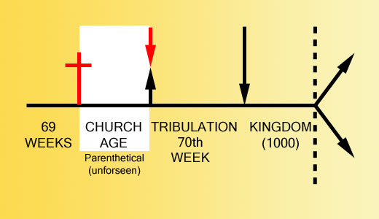

Slide 85


Slide 86
2. For the Unbeliever
A perverted explanation to be offered
Change in God’s program
Identification of the Antichrist
Global governance
One-world religion
Signs & wonders movement
The demise of America
God’s wrath

Slide 87
2 Thessalonians 2:6-7
⁶And you know what restrains [katechon; neuter] him now, so that in his time he will be revealed. ⁷For the mystery of lawlessness is already at work; only he who now restrains [katechōn; masculine] will do so until he is taken out of the way.

Slide 88
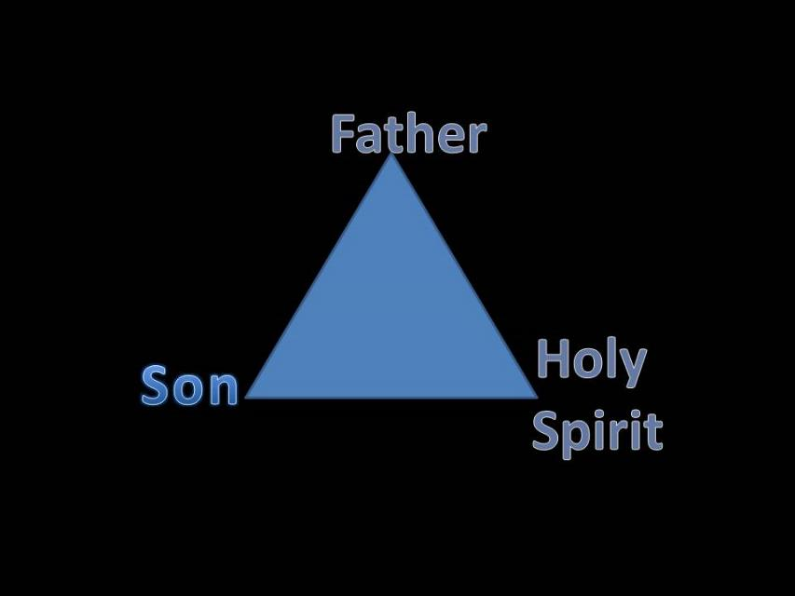
Trinity

Slide 89


Slide 90

3 Reasons Why the Restrainer is the Holy Spirit
(2 Thessalonians 2:6-7)
The Holy Spirit is omnipotent
The Holy Spirit view handles well the switch in gender from the neuter (vs. 6) to the masculine (vs. 7)
The Holy Spirit is active in the world (Gen. 6:3; John 16:7-11)

Slide 91
Who is the Antichrist?
“We will not, however, incur the risk of pronouncing positively as to the name of Antichrist; but if it had been necessary to announce his name plainly at the present time, it would have been spoken by him who saw the apocalypse. For it was not seen long ago, but almost in our own time, at the end of the reign of Domitian.”
Irenaeus Against Heresies 5.30.3

Slide 92

Ezekiel 28:13, 15
¹³ “You were in Eden, the garden of God; Every precious stone was your covering: The ruby, the topaz and the diamond; The beryl, the onyx and the jasper; The lapis lazuli, the turquoise and the emerald; And the gold, the workmanship of your settings and sockets, Was in you. On the day that you were created They were prepared… ¹⁵ “You were blameless in your ways From the day you were created Until unrighteousness was found in you.

Slide 93

Revelation 13:16-18
¹⁶ And he causes all, the small and the great, and the rich and the poor, and the free men and the slaves, to be given a mark on their right hand or on their forehead, ¹⁷ and he provides that no one will be able to buy or to sell, except the one who has the mark, either the name of the beast or the number of his name. ¹⁸ Here is wisdom. Let him who has understanding calculate the number of the beast, for the number is that of a man; and his number is six hundred and sixty-six.

Slide 94
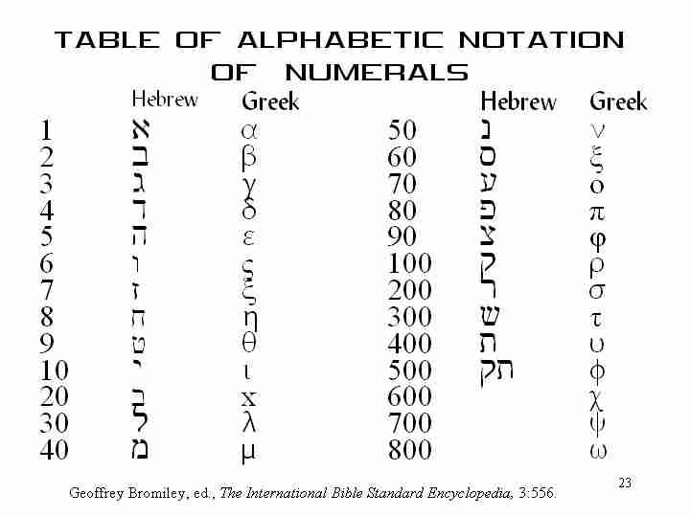

Slide 95
2. For the Unbeliever
A perverted explanation to be offered
Change in God’s program
Identification of the Antichrist
Global governance
One-world religion
Signs & wonders movement
The demise of America
God’s wrath

Slide 96
Zechariah 5:5-11
Woman (wickedness)
Ephah (commerce)
House (Temple-2 Sam 7; religion)
Shinar (Gen 10:10; 11:2; Dan 1:2)

Slide 97
2 Thessalonians 2:6-7
⁶And you know what restrains [katechon; neuter] him now, so that in his time he will be revealed. ⁷For the mystery of lawlessness is already at work; only he who now restrains [katechōn; masculine] will do so until he is taken out of the way.

Slide 98
Zechariah 5:5-11 | Revelation 17–18
Woman sitting in a basket | Woman sitting on beast, seven mountains, many waters (17: 3, 9, 15)
Emphasis on commerce (a basket for measuring grain) | Emphasis on commerce (merchant of grain, 18:13)
Woman’s name is wickedness | Woman’s name is Babylon the Great, Mother of Harlots and Abominations of the Earth
Focus on False worship (a temple is built for the woman) | Focus on False worship (17:5)
Woman is taken to Babylon | Woman is called Babylon
Hitchcock, The Second Coming of Babylon, 109.

Slide 99


Slide 100
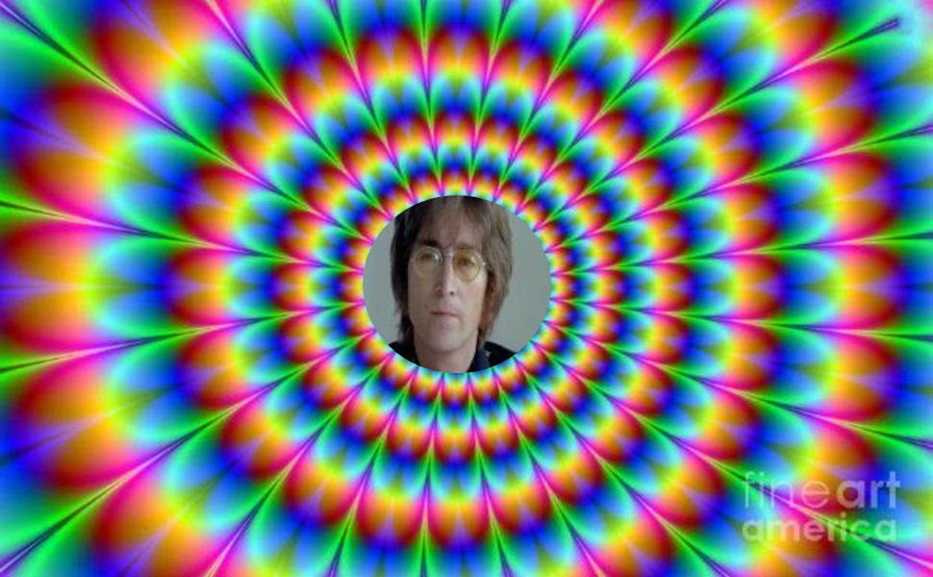
John Lennon
Song “Imagine”
… imagine a time when there will be “no countries,” “no religion,” “no heaven,” “no hell,” “no possessions,” everyone “living for today,” and the world “as one.”

Slide 101
2. For the Unbeliever
A perverted explanation to be offered
Change in God’s program
Identification of the Antichrist
Global governance
One-world religion
Signs & wonders movement
The demise of America
God’s wrath

Slide 102

2 Thessalonians 2:3, 7
“…the man of lawlessness is revealed, the son of destruction…For the mystery of lawlessness is already at work; only he who now restrains will do so until he is taken out of the way.”

Slide 103
1 John 4:3
“and every spirit that does not confess Jesus is not from God; this is the spirit of the antichrist, of which you have heard that it is coming, and now it is already in the world.”

Slide 104
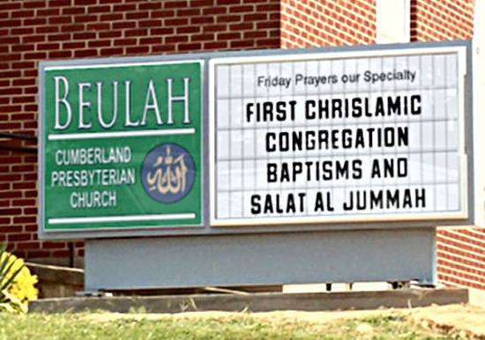
Chrislam?

Slide 105
2. For the Unbeliever
A perverted explanation to be offered
Change in God’s program
Identification of the Antichrist
Global governance
One-world religion
Signs & wonders movement
The demise of America
God’s wrath

Slide 106

2 Thessalonians 2:9
“that is, the one whose coming is in accord with the activity of Satan, with all power and signs and false wonders.”

Slide 107
Antichrist’s Satanic Miracles (2 Thessalonians 2:9)
MIRACLE | GREEK | CHRIST’S MINISTRY
Powers | Dynamis | Matt. 11:20
Signs | Semēion | John 20:30
Wonders | Teras | Acts 2:22

Slide 108

Satanic/Demonic Miracles
Exod. 7–8
Deut. 13:1-3
Job 1:12-19; 2:7-8
1 Sam. 28?
Matt. 7:21-23; 24:24
Acts 8:9; 16:16
Gal. 1:6-9
2 Thess. 2:9
Rev. 13:3, 13, 15; 16:13-14

Slide 109
2. For the Unbeliever
A perverted explanation to be offered
Change in God’s program
Identification of the Antichrist
Global governance
One-world religion
Signs & wonders movement
The demise of America
God’s wrath

Slide 110

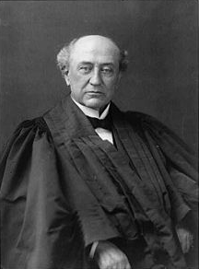
America is a “Christian Nation”
“This is historically true. From the discovery of this continent to the present hour, there is a single voice making this affirmation… These are not the sayings, declarations of private persons: they are organic utterances; they speak the voice of the entire people…These and many other matters which might be noticed, add a volume of unofficial declarations to the mass of organic utterances that this is a Christian nation.”
Church of the Holy Trinity v. U.S., 143 U.S. 457, 465, 470-71 (1892)

Slide 111


Slide 112
2. For the Unbeliever
A perverted explanation to be offered
Change in God’s program
Identification of the Antichrist
Global governance
One-world religion
Signs & wonders movement
The demise of America
God’s wrath

Slide 113
Pretribulationism is not Escapism
Trials (John 16:33)
Man’s wrath (2 Tim 3:12)
Satan’s wrath (Eph 6:11-12)
World’s wrath (John 15:18-19)

Slide 114

Promised Exemption from Divine Wrath
The promise (1 Thess 1:10; 5:9; Rom 5:9; 8:1; Rev 3:10)
Tribulation = divine wrath (Rev 6:16-17; 11:18; 15:1, 7; 16:1, 19)

Slide 115

God’s Role in Redemption (Rev 5)
Seven sealed scroll (5:1)
John weeps (5:2-4)
Christ is qualified to open the scroll (5:5-6)
Christ takes the scroll (5:7)
Christ praised by various entities (5:8-14)

Slide 116

Telescoping
7th judgment releases 1st in next series
Seals: 1 2 3 4 5 6 7
Trumpets: 1 2 3 4 5 6 7
Bowls: 1 2 3 4 5 6 7

Slide 117


Slide 118
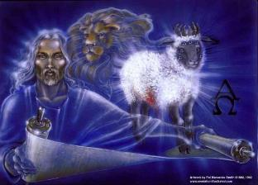
1st Six Seals (Rev 6)
6:1-2 – Advent of antichrist
6:3-4 – War
6:5-6 – Famine
6:7-8 – Death
6:9-11 – Martyrdoms
6:12-17 – Cosmic disturbances

Slide 119
Revelation 6:16-17
^{“16} and they said to the mountains and the rocks, ‘Fall on us and hide us from the sight of Him who sits on the throne, and from the wrath [orgḗ] of the Lamb; ¹⁷ for the great day of Their wrath [orgḗ] has come, and who is able to stand?’”

Slide 120

Robert L. Thomas
Rev. 6:16-17
"The verb ēlethen ("has come") is aorist indicative, referring to a previous arrival of wrath, not something that is about to take place. Men see the arrival of this day at least as early as the cosmic upheavals that characterize the sixth seal (6:12-14), but upon reflection they probably recognize that it was already in effect with the death of one-fourth of the population (6:7-8), the worldwide famine (6:5-6), and the global warfare (6:3-4). The rapid sequence of all of these events could not escape notice, but the light of their true explanation does not dawn upon human consciousness until the severe phenomena of the sixth seal arrive."
Robert L. Thomas, Revelation 1–7: An Exegetical Commentary, ed. Kenneth Barker (Chicago: Moody, 1992), 457-58.

Slide 121
2 Peter 2:7-9
“⁷ and if He rescued righteous Lot, oppressed by the sensual conduct of unprincipled men ⁸ (for by what he saw and heard that righteous man, while living among them, felt his righteous soul tormented day after day by their lawless deeds), ⁹ then the Lord knows how to rescue the godly from temptation, and to keep the unrighteous under punishment for the day of judgment.”

Slide 122
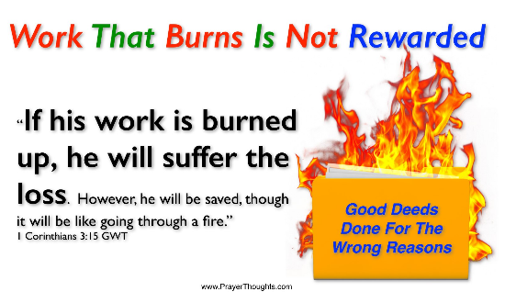
Genesis 19:22
“Hurry, escape there, for I cannot do anything until you arrive there.” Therefore the name of the town was called Zoar.”

Slide 123
2. For the Unbeliever
A perverted explanation to be offered
Change in God’s program
Identification of the Antichrist
Global governance
One-world religion
Signs & wonders movement
The demise of America
God’s wrath

Slide 124
One Second After the Rapture
For the believer
For the unbeliever
So what?

Slide 125
3. So What?
Uniformitarianism?
Live for Christ
Reach the lost
Believe the Gospel

Slide 126
3. So What?
Uniformitarianism?
Live for Christ
Reach the lost
Believe the Gospel

Slide 127

2 Peter 3:3-6
“³ Know this first of all, that in the last days mockers will come with their mocking, following after their own lusts, ⁴ and saying, ‘Where is the promise of His coming? For ever since the fathers fell asleep, all continues just as it was from the beginning of creation.’ ⁵ For when they maintain this, it escapes their notice that by the word of God the heavens existed long ago and the earth was formed out of water and by water. ⁶ through which the world at that time was destroyed by being flooded with water.”

Slide 128
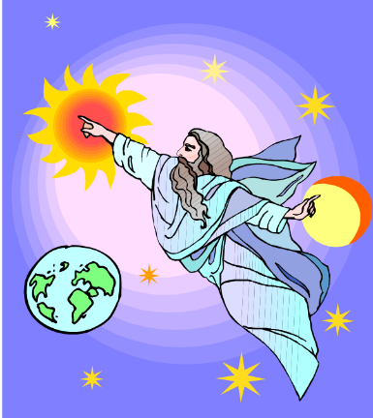
HISTORY
2 Pet. 3:5-7
Creation (5)
Flood (6-7)
  God will judge again via fire

Slide 129
3. So What?
Uniformitarianism?
Live for Christ
Reach the lost
Believe the Gospel

Slide 130
Romans 13:11-12
“Do this, knowing the time, that it is already the hour for you to awaken from sleep; for now salvation is nearer to us than when we believed. ¹² The night is almost gone, and the day is near. Therefore let us lay aside the deeds of darkness and put on the armor of light.”

Slide 131
3. So What?
Uniformitarianism?
Live for Christ
Reach the lost
Believe the Gospel

Slide 132
3. So What?
Uniformitarianism?
Live for Christ
Reach the lost
Believe the Gospel

Slide 133
John 5:24
“Truly, truly, I say to you, he who hears My word, and believes Him who sent Me, has eternal life, and does not come into judgment, but has passed out of death into life.”

Slide 134
Review: One Second After the Rapture
For the believer
For the unbeliever
So what?

Slide 135
CONCLUSION

Slide 136
The Rapture
Course Overview
What is the Rapture?
When is the Rapture?
Strengthening the Pre-Tribulational case
The opposing views
One second after the Rapture

