Slide 1


Genesis 6‒9
The Flood and Continuation of the Messianic Promise

Slide 2


GENESIS STRUCTURE
  Beginning of the Human race (Gen. 1‒11)
  Beginning of the Hebrew race (Gen. 12‒50)

Slide 3

GENESIS STRUCTURE
  Genesis 1-11 (four events)
    Creation (1-2)
    Fall (3-5)
    Flood (6-9)
    National dispersion (10-11)

Slide 4
GENESIS STRUCTURE
  Genesis 1-11 (four events)
    Creation (1-2)
    Fall (3-5)
    Flood (6-9)
    National dispersion (10-11)

Slide 5


Genesis 3:15
“And I will put enmity Between you and the woman, And between your seed and her seed; He shall bruise you on the head, And you shall bruise him on the heel.”

Slide 6
GENESIS STRUCTURE
  Genesis 1-11 (four events)
    Creation (1-2)
    Fall (3-5)
    Flood (6-9)
    National dispersion (10-11)

Slide 7
The Flood
(Gen 6–9)
  Events before the flood (Gen 6)
  The flood (Gen 7)
  The abating of the waters (Gen 8)
  Events following the flood (Gen 9)

Slide 8

Genesis 8:20–9:29
Post Flood events

Slide 9
Outline
  Noahic Covenant (Gen 8:20–9:17)
  Promise (Gen 8:20-22)
  Provision (Gen 9:1-7)
  Covenant and sign (Gen 9:8-17)
  Post Flood Sin (Gen 9:18-29)

Slide 10
Outline
  Noahic Covenant (Gen 8:20–9:17)
  Promise (Gen 8:20-22)
  Provision (Gen 9:1-7)
  Covenant and sign (Gen 9:8-17)
  Post Flood Sin (Gen 9:18-29)

Slide 11
Outline
  Noahic Covenant (Gen 8:20–9:17)
  Promise (Gen 8:20-22)
  Provision (Gen 9:1-7)
  Covenant and sign (Gen 9:8-17)
  Post Flood Sin (Gen 9:18-29)

Slide 12
Post Flood Sin
(Gen 9:18-29)
  Noah not the fulfillment of Gen 3:15 (Gen 9:18-21)
  Ham’s sin and Canaanites under a curse (Gen 9:22-27; 15:16)
  Noah’s death (Gen 9:28-29)

Slide 13
Post Flood Sin
(Gen 9:18-29)
  Noah not the fulfillment of Gen 3:15 (Gen 9:18-21)
  Ham’s sin and Canaanites under a curse (Gen 9:22-27; 15:16)
  Noah’s death (Gen 9:28-29)

Slide 14
Genesis 3:15
“And I will put enmity Between you and the woman, And between your seed and her seed; He shall bruise you on the head, And you shall bruise him on the heel.”

Slide 15
Post Flood Sin
(Gen 9:18-29)
  Noah not the fulfillment of Gen 3:15 (Gen 9:18-21)
  Ham’s sin and Canaanites under a curse (Gen 9:22-27; 15:16)
  Noah’s death (Gen 9:28-29)

Slide 16


Dr. Arnold G. Fruchtenbaum
The Book of Genesis, 197-98
“The sin of Ham was that he saw the nakedness of his father. For Ham this was an attack on Noah’s privacy. Ham perhaps showed his disrespect, for he saw the nakedness with glee, and so the moral rectitude of the father was now destroyed. The ‘seeing’ involved a violation of a boundary; the looking was a negative looking. It will be used again in Genesis 19:26, with Lot’s wife looking back; in Exodus 33:20, in that no one can look at God and live; in Judges 13:22, when Manoah said, We shall surely die, because we have seen [or looked upon] God, and in I Samuel 6:19, where those who looked into the ark died....However, it. . .

Slide 17
Dr. Arnold G. Fruchtenbaum
The Book of Genesis, 197-98
... does imply that he looked upon the nakedness of his father with glee; not necessarily to derive sexual pleasure from it, but certainly in a mocking tone, making fun of his father, and so he told his two brethren. The sin of Ham will cause the cursing of his fourth son, and the sin lay in three things: seeing but failing to cover the father himself, as he could have; telling others about it, further shaming him; and deriding his father.”

Slide 18
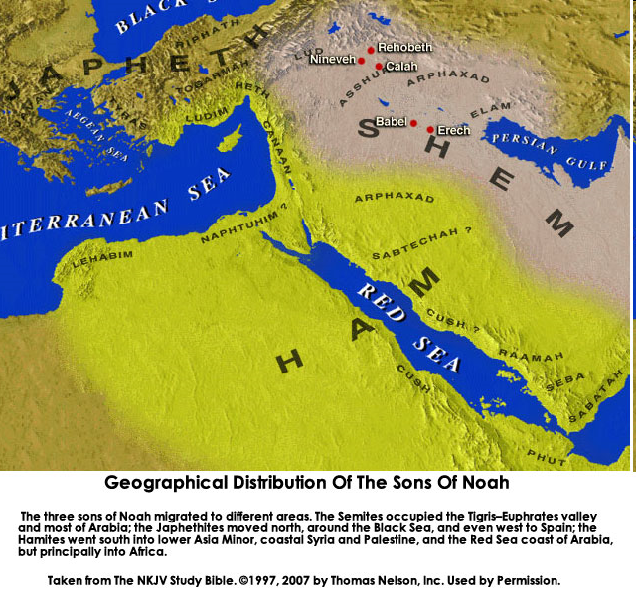

Slide 19

Reminder of God’s Sovereignty
  Messianic promise to come through Shem’s line (Gen 9:26)
  Continues selection of younger over older pattern (Abel over Cain, Seth over Cain, Japheth over Ham, Isaac over Ishmael, Jacob over Esau, Judah and Joseph over their brothers, and Ephraim over Manasseh)

Slide 20
Genesis 3:15
“And I will put enmity Between you and the woman, And between your seed and her seed; He shall bruise you on the head, And you shall bruise him on the heel.”

Slide 21
God’s Messianic Purposes Beginning in Genesis
Proto-evangelium from Adam & Eve (3:15)
Seth (4:25)
Noah (Gen 5:29)
Shem (9:26)
Abraham (12:3)
Isaac (21:12)
Jacob (25:23)
Judah (49:10)

Slide 23
Reminder of God’s Sovereignty
  Messianic promise to come through Shem’s line (Gen 9:26)
  Continues selection of younger over older pattern (Abel over Cain, Seth over Cain, Japheth over Ham, Isaac over Ishmael, Jacob over Esau, Judah and Joseph over their brothers, and Ephraim over Manasseh)

Slide 24
Dr. Arnold G. Fruchtenbaum
The Book of Genesis, 200
“In some circles in preceding times, it was taught that the curse of Canaan was upon the Negro or the Black race, which is simply not true to the text. While it is true that Blacks are the descendants of Ham, not all descendants of Ham were black-skinned people. Only one of Ham’s sons was cursed, and that was Canaan. As is known from the Egyptian portrayals of the Canaanites, the Canaanites were not black-skinned; they were white, or it would be more correct to say, olive-skinned. Therefore, black skin has nothing to do with this curse, and the curse of Canaan is not biblical grounds for the enslavement of Blacks.”

Slide 26
Curse of Ham’s Descendants?
(Gen 9:25-27)
  Curse upon the black race?
  No!
  One race
    All humans are God’s image bearers (Gen. 1:26-27; 9:6; Jas. 3:9)
    Humanity is equally redeemed (Gal. 3:28)
  Morality (Lev. 18; 20) and not race
  Canaanites – Gen. 9:25; 15:16; Joshua

Slide 27
Curse of Ham’s Descendants?
(Gen 9:25-27)
  Curse upon the black race?
  No!
  One race
    All humans are God’s image bearers (Gen. 1:26-27; 9:6; Jas. 3:9)
    Humanity is equally redeemed (Gal. 3:28)
  Morality (Lev. 18; 20) and not race
  Canaanites – Gen. 9:25; 15:16; Joshua

Slide 28
Curse of Ham’s Descendants?
(Gen 9:25-27)
  Curse upon the black race?
  No!
  One race
    All humans are God’s image bearers (Gen. 1:26-27; 9:6; Jas. 3:9)
    Humanity is equally redeemed (Gal. 3:28)
  Morality (Lev. 18; 20) and not race
  Canaanites – Gen. 9:25; 15:16; Joshua

Slide 29
Curse of Ham’s Descendants?
(Gen 9:25-27)
  Curse upon the black race?
  No!
  One race
    All humans are God’s image bearers (Gen. 1:26-27; 9:6; Jas. 3:9)
    Humanity is equally redeemed (Gal. 3:28)
  Morality (Lev. 18; 20) and not race
  Canaanites – Gen. 9:25; 15:16; Joshua

Slide 30
Curse of Ham’s Descendants?
(Gen 9:25-27)
  Curse upon the black race?
  No!
  One race
    All humans are God’s image bearers (Gen. 1:26-27; 9:6; Jas. 3:9)
    Humanity is equally redeemed (Gal. 3:28)
  Morality (Lev. 18; 20) and not race
  Canaanites – Gen. 9:25; 15:16; Joshua

Slide 31

Genesis 1:26-28
²⁶ Then God said, “Let Us make man in Our image, according to Our likeness; and let them rule over the fish of the sea and over the birds of the sky and over the cattle and over all the earth, and over every creeping thing that creeps on the earth.” ²⁷ God created man in His own image, in the image of God He created him; male and female He created them. ²⁸ God blessed them; and God said to them, “Be fruitful and multiply, and fill the earth, and subdue it; and rule over the fish of the sea and over the birds of the sky and over every living thing that moves on the earth.”

Slide 32


Genesis 9:6
“Whoever sheds man’s blood, By man his blood shall be shed, For in the image of God He made man.”

Slide 33

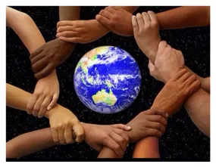
James 3:9
“With it we bless our Lord and Father, and with it we curse people, who have been made in the likeness of God.”

Slide 34
Acts 17:26
“and He made from one man every nation of mankind to live on all the face of the earth, having determined their appointed times and the boundaries of their habitation,”

Slide 35
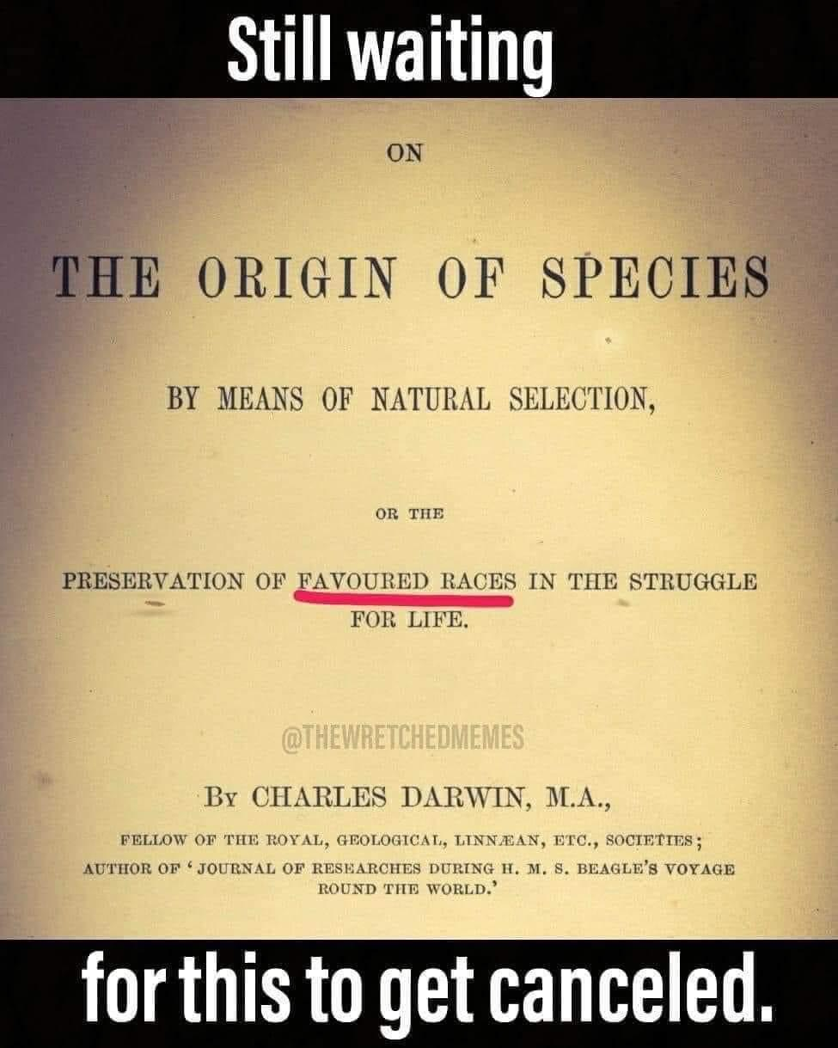

Slide 36
Curse of Ham’s Descendants?
(Gen 9:25-27)
  Curse upon the black race?
  No!
  One race
    All humans are God’s image bearers (Gen. 1:26-27; 9:6; Jas. 3:9)
    Humanity is equally redeemed (Gal. 3:28)
  Morality (Lev. 18; 20) and not race
  Canaanites – Gen. 9:25; 15:16; Joshua

Slide 37

John 4:9, 27
⁹ So the Samaritan woman said to Him, “How is it that You, though You are a Jew, are asking me for a drink, though I am a Samaritan woman?” (For Jews do not associate with Samaritans.)…²⁷ And at this point His disciples came, and they were amazed that He had been speaking with a woman, yet no one said, “What are You seeking?” or, “Why are You speaking with her?”

Slide 38

John 3:16
“For God so loved the world, that He gave His only Son, so that everyone who believes in Him will not perish, but have eternal life.”

Slide 39

Matthew 28:19-20
“¹⁹ Go, therefore, and make disciples of all the nations, baptizing them in the name of the Father and the Son and the Holy Spirit, ²⁰ teaching them to follow all that I commanded you; and behold, I am with you always, to the end of the age.”

Slide 40


Revelation 5:9
“And they sang a new song, saying, ‘Worthy are You to take the book and to break its seals; for You were slain, and purchased for God with Your blood men from every tribe and tongue and people and nation.’”

Slide 41

Galatians 3:28
“There is neither Jew nor Greek, there is neither slave nor free man, there is neither male nor female; for you are all one in Christ Jesus.”

Slide 42

Ephesians 2:14
“For He Himself is our peace, who made both groups into one and broke down the barrier of the dividing wall.”

Slide 43
Curse of Ham’s Descendants?
(Gen 9:25-27)
  Curse upon the black race?
  No!
  One race
    All humans are God’s image bearers (Gen. 1:26-27; 9:6; Jas. 3:9)
    Humanity is equally redeemed (Gal. 3:28)
  Morality (Lev. 18; 20) and not race
  Canaanites – Gen. 9:25; 15:16; Joshua

Slide 44
Curse of Ham’s Descendants?
(Gen 9:25-27)
  Curse upon the black race?
  No!
  One race
    All humans are God’s image bearers (Gen. 1:26-27; 9:6; Jas. 3:9)
    Humanity is equally redeemed (Gal. 3:28)
  Morality (Lev. 18; 20) and not race
  Canaanites – Gen. 9:25; 15:16; Joshua

Slide 45


Slide 46
Genesis 15:16
“Then in the fourth generation they will return here, for the wrongdoing of the Amorite is not yet complete.”

Slide 47
Post Flood Sin
(Gen 9:18-29)
  Noah not the fulfillment of Gen 3:15 (Gen 9:18-21)
  Ham’s sin and Canaanites under a curse (Gen 9:22-27; 15:16)
  Noah’s death (Gen 9:28-29)

Slide 48
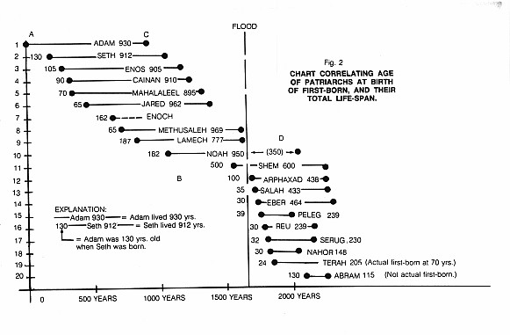

Slide 49
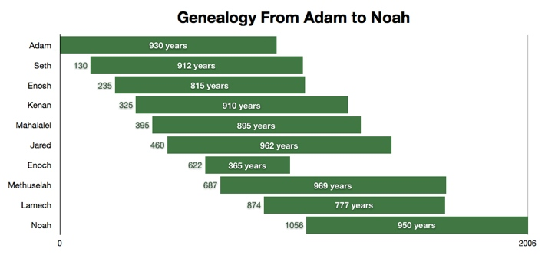

Slide 50
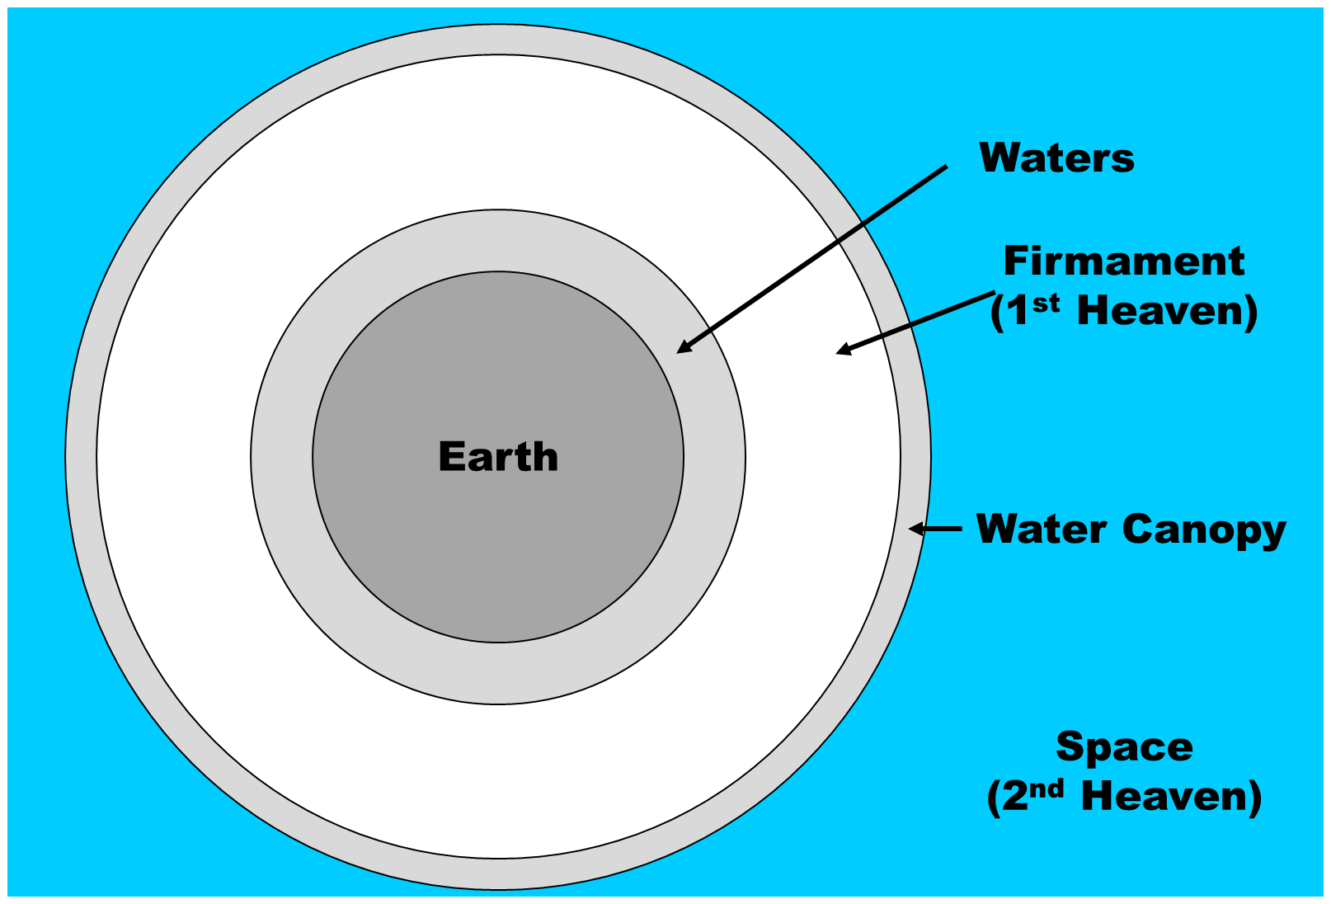

Slide 51
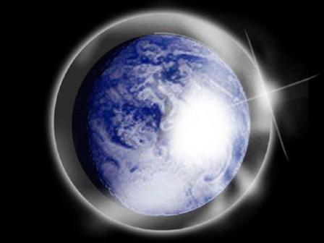

Slide 52
Genesis 3:15
“And I will put enmity Between you and the woman, And between your seed and her seed; He shall bruise you on the head, And you shall bruise him on the heel.”

Slide 53

Ephesians 2:10
“For we are His workmanship, created in Christ Jesus for good works, which God prepared beforehand so that we would walk (peripateō) in them.”

Slide 54
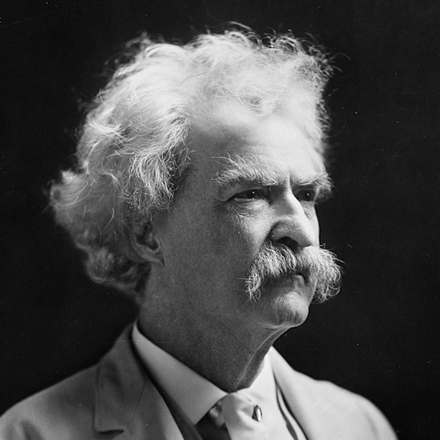
Mark Twain
Autobiography, 2:37
“A myriad of men are born; they labor and sweat and struggle for bread; they squabble and scold and fight; they scramble for little mean advantages over each other. Age creeps upon them and infirmities follow; shames and humiliations bring down their prides and their vanities. Those they love are taken from them, and the joy of life is turned to aching grief. The burden of pain, care, and misery grows heavier year by year. At length ambition is dead, pride is dead, vanity is dead; longing for release is in their place. It comes at last-the only un-poisoned gift earth ever had for them-and they vanish from a world where they were of no consequence; where they achieved nothing, where they were a mistake and a failure and a foolishness; where they left no sign that they have existed-a world that will lament them a day and forget them forever.”

Slide 55
2 Timothy 4:7-8
“⁷ I have fought the good fight, I have finished the course, I have kept the faith; ⁸ in the future there is reserved for me the crown of righteousness, which the Lord, the righteous Judge, will award to me on that day; and not only to me, but also to all who have loved His appearing.”

Slide 56
Conclusion

Slide 57
Genesis 8‒9 Outline
  Abating of the waters (8:1-5)
  Tests for dry land (8:6-14)
  Exit from the ark (8:15-19)
  Post-flood events (8:20‒9:29)

Slide 58
Outline
  Noahic Covenant (Gen 8:20–9:17)
  Promise (Gen 8:20-22)
  Provision (Gen 9:1-7)
  Covenant and sign (Gen 9:8-17)
  Post Flood Sin (Gen 9:18-29)

Slide 59
Post Flood Sin
(Gen 9:18-29)
  Noah not the fulfillment of Gen 3:15 (Gen 9:18-21)
  Ham’s sin and Canaanites under a curse (Gen 9:22-27; 15:16)
  Noah’s death (Gen 9:28-29)

Slide 60
GENESIS STRUCTURE
  Genesis 1-11 (four events)
    Creation (1-2)
    Fall (3-5)
    Flood (6-9)
    National dispersion (10-11)

Slide 61

“The Lord bless you and keep you; the Lord make his face shine on you and be gracious to you; the Lord turn his face toward you and give you peace.” (NIV)

