Slide 1
THE RAPTURE
What and When? – Part 48
Andrew Marshall Woods, Th.M., JD., PhD.
Sr. Pastor, Sugar Land Bible Church

Slide 2
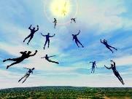
The Rapture Course Overview
What is the Rapture?
When is the Rapture?
Strengthening the Pre-Tribulational case
The opposing views
One second after the Rapture

Slide 3
The Rapture Course Overview
What is the Rapture?
When is the Rapture?
Strengthening the Pre-Tribulational case
The opposing views
One second after the Rapture

Slide 4
What is the Rapture?
An important doctrine
Distinct from the Second Advent
Catching away of all living believers (1 Thess 4:17)
Reunion (1 Thess 4:14-16)
Resurrection (1 Cor 15:50-54)
Exemption from death (1 Cor 15:51, 54-56)
Instantaneous (1 Cor 15:52)
Mystery (1 Cor 15:51)
Imminent (1 Cor 15:51; 1 Thess 4:15)
Traditional doctrine now being recovered

Slide 5
The Rapture Course Overview
What is the Rapture?
When is the Rapture?
Strengthening the Pre-Tribulational case
The opposing views
One second after the Rapture

Slide 6
When is the Rapture?
7 Arguments Favoring the Pre-Tribulation View
Tribulation's purpose concerns Israel (Jer 30:7; Dan 9:24)
No biblical reference to the church on earth during the Tribulation period (Rev 4-22)
Church is promised an exemption from divine wrath (1 Thess 1:10; 5:9; Rom 5:9; Rev 3:10; 6:17)
Rapture is imminent (1 Cor 15:51; 1 Thess 4:15)
Rapture is a comfort (1 Thess 4:18)
Antichrist cannot come to power until the restrainer is removed (2 Thess 2:6-7)
Symbolic parallels (2 Peter 2:5-9)

Slide 7
The Rapture Course Overview
What is the Rapture?
When is the Rapture?
Strengthening the Pre-Tribulational case
The opposing views
One second after the Rapture

Slide 8
Strengthening the Pre-Tribulation Case
John 14:1-4
Revelation 3:10
First Thessalonians 4‒5
Second Thessalonians 2:3a
Matthew 24‒25

Slide 9
The Rapture Course Overview
What is the Rapture?
When is the Rapture?
Strengthening the Pre-Tribulational case
The opposing views
One second after the Rapture

Slide 10
When Will the Rapture Take Place Relative to the Tribulation Period?
Pre-tribulation rapture theory
Mid-tribulation rapture theory
Post-tribulation rapture theory
Pre-wrath rapture theory
Partial rapture theory

Slide 12
Pre-Wrath Rapturism
Description of the view
Six problems with the view considering prior Pre-Tribulational Arguments
Four additional problems with the view

Slide 13
Pre-Wrath Rapturism
Description of the view
Six problems with the view considering prior Pre-Tribulational Arguments
Four additional problems with the view

Slide 14
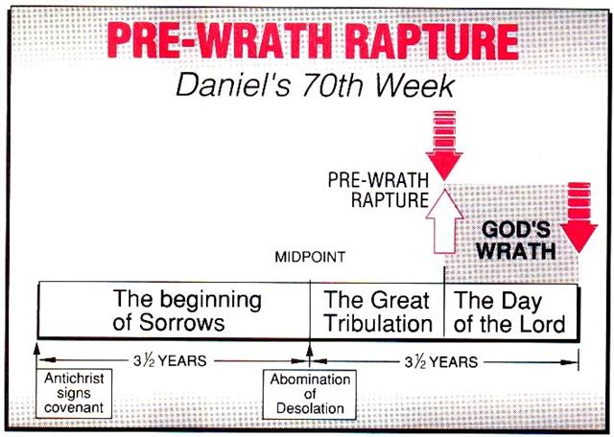
Marvin J. Rosenthal, The Pre-Wrath Rapture of the Church: A New Understanding of the Tribulation, and the Second Coming (Nashville, TN: Thomas Nelson, 1990), 112.

Slide 15
Pre-Wrath Rapturism
Description of the view
Six problems with the view considering prior Pre-Tribulational Arguments
Four additional problems with the view

Slide 16
II. Pre-Wrath Rapture Theory Problems
Places the Church in Daniel’s 70th Week
Fails to acknowledge the missing Church (Rev. 4‒22)
Confines God’s wrath to only a portion of the Tribulation's second half
Denies the Rapture’s imminency
Fails to consistently explain how the rapture is a comfort to the believer (John 14:1; 1 Thess. 4:18; Titus 2:13)
Misinterprets the restrainer (2 Thess. 2:6-7) as Michael the Archangel rather than the Holy Spirit

Slide 17
Pre-Wrath Rapturism
Description of the view
Six problems with the view considering prior Pre-Tribulational Arguments
Four additional problems with the view

Slide 18
III. Additional Problems with Pre-Wrath Rapturism
It imposes an artificial construct on Daniel’s 70th Week
Great Tribulation (unequaled distress) before God’s wrath?
It places the Rapture in Revelation 7:9-17
It places the Rapture in Matthew 24:31, 40-41

Slide 19
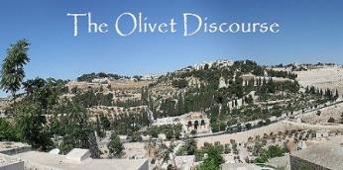
Matthew 24:31
“And He will send forth His angels with a great trumpet and they will gather together [episynagō] His elect from the four winds, from one end of the sky to the other.”

Slide 20
PRE-WRATH RAPTURIST – ALAN KURSCHNER
MATTHEW 24 | PARALLELS | REVELATION 6-7
4-5 | The Antichrist / False Christs | 1st Seal (6:1-2)
6-7 | Wars | 2nd Seal (6:3-4)
7 | Famine | 3rd Seal (6:5-6)
9, 21-22 | Martyrdom / (Great Tribulation) | 4th Seal (6:7-8)
9, 21-22 | Result of Martyrdom / (Great Tribulation) | 5th Seal (6:9-11)
29 | Celestial Disturbances | 6th Seal (6:12-17)
30-31 | Raptured Saints | Interlude (7:9-17))
14, 30, 37-40 | Day of the Lord’s Wrath | 7th Seal (Trumpet, Bowls)
Alan Kurschner, The Antichrist Before the Day of the Lord: What Every Christian Needs to Know About the Return of Christ (Pompton Lakes, NI: Eschatos, 2013, 99.

Slide 21
1 Thessalonians 4:16-18
¹⁶ For the Lord Himself will descend from heaven with a shout, with the voice of the archangel and with the trumpet of God, and the dead in Christ will rise first. ¹⁷ Then we who are alive and remain will be caught up together with them in the clouds to meet the Lord in the air, and so we shall always be with the Lord. ¹⁸ Therefore comfort one another with these words."

Slide 22
1 Corinthians 15:50-51
“⁵⁰ Now I say this, brethren, that flesh and blood cannot inherit the kingdom of God; nor does the perishable inherit the imperishable. ⁵¹ Behold, I tell you a mystery; we will not all sleep, but we will all be changed.”

Slide 23
Matthew 24:31
“And He will send forth His angels with a great trumpet and they will gather together [episynagō] His elect from the four winds, from one end of the sky to the other.”

Slide 24
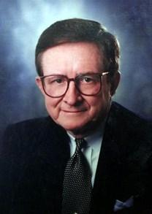
John A. Sproule
"An Exegetical Defense of Pretribulationalism" (Th.D. diss., Grace Theological Seminary, 1981), 53.
“Where does Paul mention the darkening of the sun (Matt. 24:29), the moon not giving its light (Matt. 24:29), the stars falling from the sky (Matt. 24:29), the powers of the heavens being shaken (Matt. 24:29), all the tribes of the earth mourning (Matt. 24:30), all the world seeing the coming of the Son of Man (Matt. 24:30), or God sending forth angels (Matt.24:31)?”

Slide 25
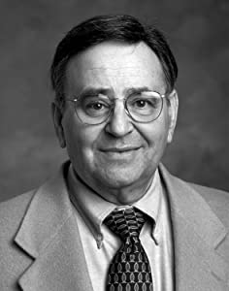
Paul D. Feinberg
"Response: Paul D. Feinberg," in The Rapture: Pre-, Mid-, or Posttribulational, ed. Richard R. Reiter (Grand Rapids: Zondervan, 1984), 225.
“Notice what happens when you examine both passages carefully. In Matthew the Son of Man comes on the clouds, while in 1 Thessalonians 4 the ascending believers are in them. In Matthew the angels gather the elect; in 1 Thessalonians the Lord Himself (note the emphasis) gathers the believers. Thessalonians only speaks of the voice of the archangel. In the Olivet Discourse nothing is said about a resurrection, while in the latter text it is the central point. In the two passages the differences in what will take place prior to the appearance of Christ is striking. Moreover, the order of ascent is absent from Matthew in spite of the fact that it is the central part of the epistle.”

Slide 26
Matthew 24:31
“And He will send forth His angels with a great trumpet and they will gather together [episynagō] His elect from the four winds, from one end of the sky to the other.”

Slide 27
2 Thessalonians 2:1
“Now we request you, brethren, with regard to the coming of our Lord Jesus Christ and our gathering (episynagōgē) together to Him.”

Slide 28
Illegitimate Totality Transfer
“Unwarranted adoption of an expanded semantic field: The fallacy in this instance lies in the supposition that the meaning of a word in a specific context is much broader than the context itself allows and may bring with it the word’s entire semantic range. This step is sometimes called illegitimate totality transfer.”
D. A. Carson, Exegetical Fallacies, 2nd ed. (Grand Rapids, MI: Baker Academic, 1996), 60-61.

Slide 29
George Gunn
John 14:1-3 – The Father’s House: Are We There Yet?, 30. www.pre-trib.org
“I ran out of ingredients for the salad, so I decided to make a quick run down to the store. While at the store, I left the car engine running while I made my purchase, thinking that I would be right out again. However, while I was in the store, I ran into my good friend Edward who was running for county supervisor. This resulted in my having to endure a somewhat long-winded rundown on how his campaign was running. Finally, fearing that my car would run out of gas, I ran with great haste out to the parking lot and returned home with the car surely running only on fumes.”

Slide 30
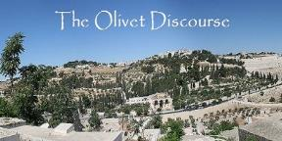
Preview of Matthew 24–25
The problem
The larger context
The immediate context (23:37-39)
The Disciples’ questions (24:1-3)
The Tribulation’s first half (24:4-14)
The Tribulation’s mid-point (24:15-20)
The Tribulation’s second half (24:21-22)
The Second Advent (24:23-31)
Eight parabolic exhortations (24:32‒25:46)

Slide 31
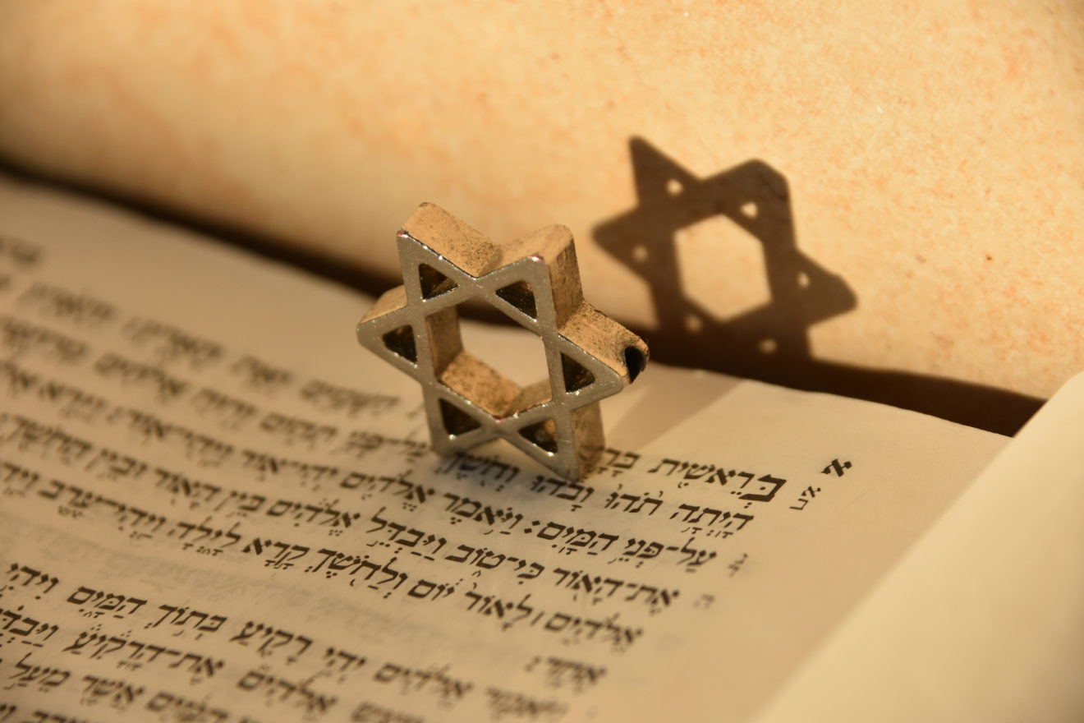
Matthew 24:15-16, 20
“¹⁵ Therefore when you see the abomination of desolation which was spoken of through Daniel the prophet, standing in the holy place (let the reader understand) ¹⁶ then those who are in Judea must flee to the mountains…²⁰ But pray that your flight will not be in the winter, or on a Sabbath.”

Slide 32
Exodus 20:8-11
⁸ “Remember the sabbath day, to keep it holy. ⁹ Six days you shall labor and do all your work, ¹⁰ but the seventh day is a sabbath of the Lord your God; in it you shall not do any work, you or your son or your daughter, your male or your female servant or your cattle or your sojourner who stays with you. ¹¹ For in six days the Lord made the heavens and the earth, the sea and all that is in them, and rested on the seventh day; therefore the Lord blessed the sabbath day and made it holy.”

Slide 33
Exodus 31:15-17
¹⁵ ‘For six days work may be done, but on the seventh day there is a sabbath of complete rest, holy to the Lord; whoever does any work on the sabbath day shall surely be put to death. ¹⁶ ‘So the sons of Israel shall observe the sabbath, to celebrate the sabbath throughout their generations as a perpetual covenant.’ ¹⁷ “It is a sign between Me and the sons of Israel forever; for in six days the Lord made heaven and earth, but on the seventh day He ceased from labor, and was refreshed.”

Slide 34
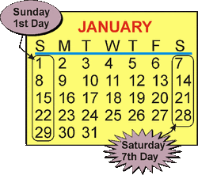
Acts 20:7
“On the first day of the week, when we were gathered together to break bread, Paul began talking to them, intending to leave the next day, and he prolonged his message until midnight.”

Slide 35
1 Corinthians 16:2
“¹ Now concerning the collection for the saints, as I directed the churches of Galatia, so do you also. ² On the first day of every week each one of you is to put aside and save, as he may prosper, so that no collections be made when I come.”

Slide 36
Matthew 23:37-39
³⁷ “Jerusalem, Jerusalem, who kills the prophets and stones those who are sent to her! How often I wanted to gather [episynagō] your children together, the way a hen gathers [episynagō] her chicks under her wings, and you were unwilling. ³⁸ Behold, your house is being left to you desolate! ³⁹ For I say to you, from now on you will not see Me until you say, ‘Blessed is He who comes in the name of the Lord!’”

Slide 37
Matthew 24:31
“And He will send forth His angels with a great trumpet and they will gather together [episynagō] His elect from the four winds, from one end of the sky to the other.”

Slide 38
Isaiah 27:13
“It will come about also in that day that a great trumpet will be blown, and those who were perishing in the land of Assyria and who were scattered in the land of Egypt will come and worship the Lord in the holy mountain at Jerusalem.”

Slide 39
Isaiah 11:11-12
^{“11} Then it will happen on that day that the Lord Will again recover the second time with His hand The remnant of His people, who will remain, From Assyria, Egypt, Pathros, Cush, Elam, Shinar, Hamath, And from the islands of the sea.¹² And He will lift up a standard for the nations And assemble the banished ones of Israel, And will gather the dispersed of Judah From the four corners of the earth.”

Slide 40
Matthew 24:36-41
³⁶ “But of that day and hour no one knows, not even the angels of heaven, nor the Son, but the Father alone. ³⁷ For the coming of the Son of Man will be just like the days of Noah. ³⁸ For as in those days before the flood they were eating and drinking, marrying and giving in marriage, until the day that Noah entered the ark, ³⁹ and they did not understand until the flood came and took (airō) them all away; so will the coming of the Son of Man be. ⁴⁰ Then there will be two men in the field; one will be taken (paralambanō) and one will be left. ⁴¹ “Two women will be grinding at the mill; one will be taken (paralambanō) and one will be left.”

Slide 41
John 14:1–4
¹ “Do not let your heart be troubled; believe in God, believe also in Me. ² “In My Father’s house are many dwelling places; if it were not so, I would have told you; for I go to prepare a place for you. ³ “If I go and prepare a place for you, I will come again and receive you (paralambanō) to Myself, that where I am, there you may be also. ⁴ “And you know the way where I am going.”

Slide 42
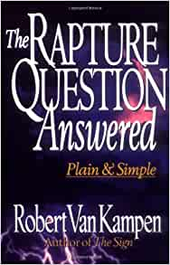
Robert Van Kampen
The Rapture Questioned Answered: Plain and Simple (Grand Rapids: Fleming Revell, 1997), 181-82.
“But is that what the text really teaches? The Greek answers, ‘No!’ The Greek word behind ‘took’ that is used in connection with Noah—‘the flood came and took them all away’—is from the Greek word aírō. But when Christ describes how it will be at ‘the coming of the Son of Man,’ when ‘one will be taken and one will be left,’ the Greek word for taken is entirely different. Here the Greek verb is paralambánō. That difference is both important and exciting! Paralambánō does not mean ‘to be taken away,’ as does the Greek verb aírō; it means ‘to embrace or to receive intimately, to or for oneself.’... Christ uses this word…in John 14:3…the most…

Slide 43
Robert Van Kampen
The Rapture Questioned Answered: Plain and Simple (Grand Rapids: Fleming Revell, 1997), 181-82.
…quoted of all Rapture passages in the New Testament… ‘Receive’ translates paralambánō. Rather than picturing someone who is being taken away to judgment, this Greek verb conveys quite the opposite. Paralambánō means to intimately receive someone to oneself, as in the passage above. It would be more than a little confusing, then, if Christ used the word paralambánō five times to refer to the wicked being taken away to judgment—which is absolutely contrary to the real intent of the Greek verb—and then the last time used it to refer to the righteous being received in an intimate manner by Himself at the rapture of His saints!”

Slide 44
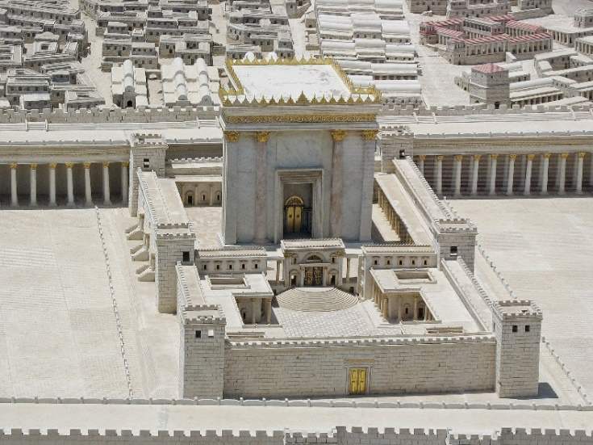
Matthew 4:5
“⁵ Then the devil took [paralambanō] Him into the holy city and had Him stand on the pinnacle of the temple.”

Slide 45
Matthew 4:8
“⁸ Again, the devil took [paralambanō] Him to a very high mountain and showed Him all the kingdoms of the world and their glory.”

Slide 46
Matthew 12:45
“⁴⁵ Then it goes and takes [paralambanō] along with it seven other spirits more wicked than itself, and they go in and live there; and the last state of that man becomes worse than the first. That is the way it will also be with this evil generation.”

Slide 47
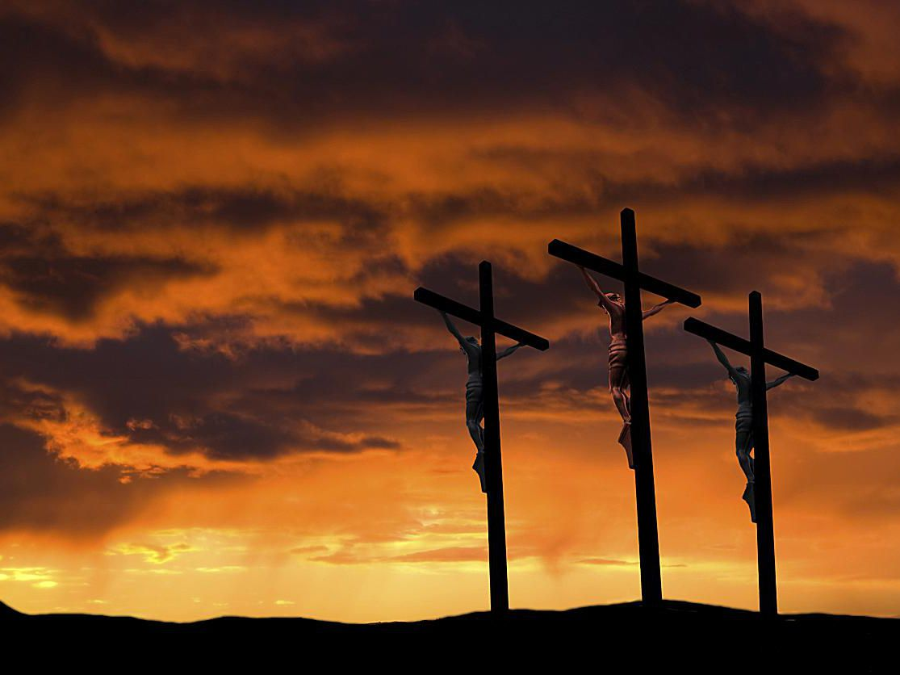
Matthew 27:27
“²⁷ Then the soldiers of the governor took [paralambanō] Jesus into the Praetorium and gathered the whole Roman cohort around Him.”

Slide 48
John 19:15-16
“¹⁵ So they cried out, “Away with Him [airō], away with Him, crucify Him!” Pilate said to them, “Shall I crucify your King?” The chief priests answered, “We have no king but Caesar.” ¹⁶ So he then handed Him over [paralambanō] to them to be crucified.

Slide 49
John 19:15-16
“¹⁵ So they cried out, “Away with Him [airō], away with Him, crucify Him!” Pilate said to them, “Shall I crucify your King?” The chief priests answered, “We have no king but Caesar.” ¹⁶ So he then handed Him over [paralambanō] to them to be crucified.

Slide 50
Conclusion

Slide 51
Pre-Wrath Rapturism
Description of the view
Six problems with the view considering prior Pre-Tribulational Arguments
Four additional problems with the view

