Slide 1


Genesis 6‒9
The Flood and Continuation of the Messianic Promise

Slide 2


GENESIS STRUCTURE
  Beginning of the Human race (Gen. 1‒11)
  Beginning of the Hebrew race (Gen. 12‒50)

Slide 3

GENESIS STRUCTURE
  Genesis 1-11 (four events)
    Creation (1-2)
    Fall (3-5)
    Flood (6-9)
    National dispersion (10-11)

Slide 4
GENESIS STRUCTURE
  Genesis 1-11 (four events)
    Creation (1-2)
    Fall (3-5)
    Flood (6-9)
    National dispersion (10-11)

Slide 5


Genesis 3:15
“And I will put enmity Between you and the woman, And between your seed and her seed; He shall bruise you on the head, And you shall bruise him on the heel.”

Slide 6
GENESIS STRUCTURE
  Genesis 1-11 (four events)
    Creation (1-2)
    Fall (3-5)
    Flood (6-9)
    National dispersion (10-11)

Slide 7
The Flood
(Gen 6–9)
  Events before the flood (Gen 6)
  The flood (Gen 7)
  The abating of the waters (Gen 8)
  Events following the flood (Gen 9)

Slide 8
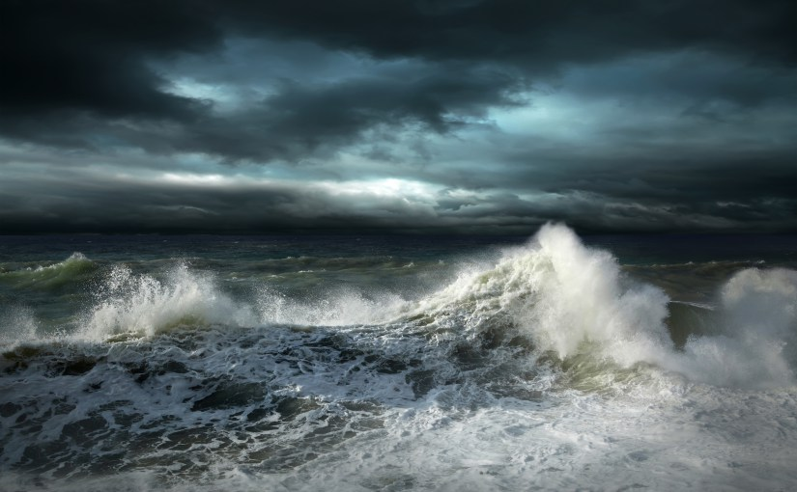
Genesis 7
The Flood

Slide 9
The Flood
(Gen 6–9)
  Events before the flood (Gen 6)
  The flood (Gen 7)
  The abating of the waters (Gen 8)
  Events following the flood (Gen 9)

Slide 10
Genesis 8‒9 Outline
  Abating of the waters (8:1-5)
  Tests for dry land (8:6-14)
  Exit from the ark (8:15-19)
  Post-flood events (8:20‒9:29)

Slide 11
Genesis 8‒9 Outline
  Abating of the waters (8:1-5)
  Tests for dry land (8:6-14)
  Exit from the ark (8:15-19)
  Post-flood events (8:20‒9:29)

Slide 12

Genesis 8:20–9:29
Post Flood events

Slide 13
Outline
  Noahic Covenant (Gen 8:20–9:17)
  Promise (Gen 8:20-22)
  Provision (Gen 9:1-7)
  Covenant and sign (Gen 9:8-17)
  Post Flood Sin (Gen 9:18-29)

Slide 14
Outline
  Noahic Covenant (Gen 8:20–9:17)
  Promise (Gen 8:20-22)
  Provision (Gen 9:1-7)
  Covenant and sign (Gen 9:8-17)
  Post Flood Sin (Gen 9:18-29)

Slide 15
Outline
  Noahic Covenant (Gen 8:20–9:17)
  Promise (Gen 8:20-22)
  Provision (Gen 9:1-7)
  Covenant and sign (Gen 9:8-17)
  Post Flood Sin (Gen 9:18-29)

Slide 16
Noahic Covenant: Promise
(Gen 8:20-22)
  Noah’s initial sacrifice (8:20)
  Divine promise not to flood the earth again (Gen 8:21a)
  Ongoing depravity thus necessitating the work of a future Messiah (Gen 8:21b)
  Uninterrupted season or cycles (Gen 8:22) – global warming?

Slide 17
Noahic Covenant: Promise
(Gen 8:20-22)
  Noah’s initial sacrifice (8:20)
  Divine promise not to flood the earth again (Gen 8:21a)
  Ongoing depravity thus necessitating the work of a future Messiah (Gen 8:21b)
  Uninterrupted season or cycles (Gen 8:22) – global warming?

Slide 18
God’s Provision
(3:20-24)
  Continuation of the race (3:20)
  Forgiveness (3:21, 7)
  Expulsion of Adam and Eve from Eden (3:22-24)

Slide 19

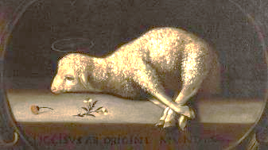
Exodus 12:5
“Your lamb shall be an unblemished male a year old; you may take it from the sheep or from the goats.”

Slide 20
John 1:29
“ The next day he saw Jesus coming to him, and said, ‘Behold, the Lamb of God who takes away the sin of the world.’”

Slide 21
Noahic Covenant: Promise
(Gen 8:20-22)
  Noah’s initial sacrifice (8:20)
  Divine promise not to flood the earth again (Gen 8:21a)
  Ongoing depravity thus necessitating the work of a future Messiah (Gen 8:21b)
  Uninterrupted season or cycles (Gen 8:22) – global warming?

Slide 22

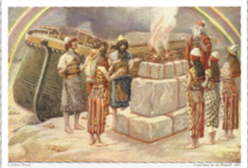
Genesis 8:21
The Lord smelled the soothing aroma; and the Lord said to Himself, “I will never again curse the ground on account of man, for the intent of man’s heart is evil from his youth; and I will never again destroy every living thing, as I have done.[emphasis mine].

Slide 23
Genesis 8:21
The Lord smelled the soothing aroma; and the Lord said to Himself, “I will never again curse the ground on account of man, for the intent of man’s heart is evil from his youth; and I will never again destroy every living thing, as I have done.[emphasis mine].

Slide 24

Genesis 12:1-3; 15:18

Slide 25
Genesis 8:21
The Lord smelled the soothing aroma; and the Lord said to Himself, “I will never again curse the ground on account of man, for the intent of man’s heart is evil from his youth; and I will never again destroy every living thing, as I have done.[emphasis mine].

Slide 26
Noahic Covenant: Promise
(Gen 8:20-22)
  Noah’s initial sacrifice (8:20)
  Divine promise not to flood the earth again (Gen 8:21a)
  Ongoing depravity thus necessitating the work of a future Messiah (Gen 8:21b)
  Uninterrupted season or cycles (Gen 8:22) – global warming?

Slide 27
Genesis 8:21
The Lord smelled the soothing aroma; and the Lord said to Himself, “I will never again curse the ground on account of man, for the intent of man’s heart is evil from his youth; and I will never again destroy every living thing, as I have done.[emphasis mine].

Slide 28


Psalm 51:5
“Behold, I was brought forth in guilt,
And in sin my mother conceived me.”

Slide 29
Jeremiah 17:9
“The heart is more deceitful than all else And is desperately sick; Who can understand it?.”

Slide 30
Mark 7:20-23
“²⁰ And He was saying, ‘That which proceeds out of the man, that is what defiles the man. ²¹ For from within, out of the heart of men, proceed the evil thoughts, fornications, thefts, murders, adulteries, ²² deeds of coveting and wickedness, as well as deceit, sensuality, envy, slander, pride and foolishness. ²³ All these evil things proceed from within and defile the man.’”

Slide 31


Romans 5:12
“Therefore, just as through one man sin entered into the world, and death through sin, and so death spread to all men, because all sinned—.”

Slide 32
Genesis 3:15
“And I will put enmity Between you and the woman, And between your seed and her seed; He shall bruise you on the head, And you shall bruise him on the heel.”

Slide 33
Noahic Covenant: Promise
(Gen 8:20-22)
  Noah’s initial sacrifice (8:20)
  Divine promise not to flood the earth again (Gen 8:21a)
  Ongoing depravity thus necessitating the work of a future Messiah (Gen 8:21b)
  Uninterrupted season or cycles (Gen 8:22) – global warming?

Slide 34


Genesis 8:22
While the earth remains, Seedtime and harvest, And cold and heat, And summer and winter, And day and night Shall not cease.

Slide 35
Genesis 8:22
While the earth remains, Seedtime and harvest, And cold and heat, And summer and winter, And day and night Shall not cease.

Slide 36
Genesis 8:22
While the earth remains, Seedtime and harvest, And cold and heat, And summer and winter, And day and night Shall not cease.

Slide 37

Genesis 1:14
Then God said, “Let there be lights in the expanse of the heavens to separate the day from the night, and let them be for signs and for seasons and for days and years.”

Slide 38
Genesis 8:22
While the earth remains, Seedtime and harvest, And cold and heat, And summer and winter, And day and night Shall not cease.

Slide 39
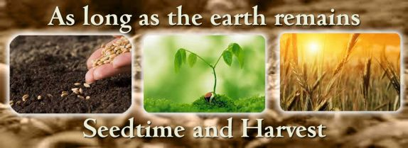
Genesis 8:22
While the earth remains, Seedtime and harvest, And cold and heat, And summer and winter, And day and night Shall not cease.

Slide 40
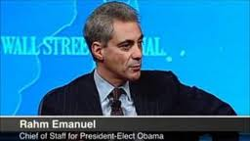
Management by Crisis
“You never let a serious crisis go to waste. And what I mean by that it’s an opportunity to do things you think you could not do before.” Rahm Emanuel
www.youtube.com/watch?v=Pb-YuhFWCr4

Slide 41
UN Globalism Conferences
UN CONFERENCE | STATED GOAL
Earth summit, Río de Janeiro, 1992 | Protect the environment
Human rights conference, Vienna, 1993 | Protect human rights
Population Conference, Cairo, 1994 | Prevent starvation and poverty
Women’s conference, Beijing, 1995 | Protect women’s rights
Habitat conference, Istanbul, 1996 | Provide global housing for all
Climate change conference, Copenhagen, 2009 | Implement climate change policy
Christopher Corbett, "The U.S. And Other U.N. Serfdoms," in Foreshocks of the Antichrist, ed. William T. James(Eugene, OR: Harvest House, 1997), 210-19.

Slide 42
Revelation 13:16–18
¹⁶ And he causes all, the small and the great, and the rich and the poor, and the free men and the slaves, to be given a mark on their right hand or on their forehead, ¹⁷ and he provides that no one will be able to buy or to sell, except the one who has the mark, either the name of the beast or the number of his name. ¹⁸ Here is wisdom. Let him who has understanding calculate the number of the beast, for the number is that of a man; and his number is six hundred and sixty-six.
42

Slide 43

Genesis 11:6
The Lord said, “Behold, they are one people, and they all have the same language. And this is what they began to do, and now nothing which they purpose to do will be impossible for them.”

Slide 44

God’s Doctrine of Nations
Since Babel | Deut. 32:8; Acts 17:26
Millennium | Isaiah 2:4; 66:18; Zech. 14:16-18; Rev. 12:5; 20:3
Eternal State | Rev. 21:24, 26

Slide 45

The Ultimate Crisis
“In searching for a new enemy to unite us, we came up with the idea that pollution, the threat of global warming, water shortages, famine and the like would fit the bill...”
Alexander King and Betrand Schneider, The First Global Revolution (New York: Pantheon, 1991), 115.

Slide 46
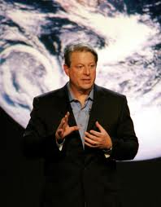
Gaia Hypothesis
According to Al Gore, “we must make the rescue of the environment the central organizing principle for civilization.”
Al Gore, Earth in the Balance (New York: Houghton Mifflin, 1992), 269.

Slide 47
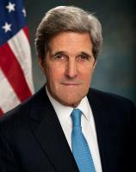
Remarks on Climate Change
“When I think about the array of…global threats –… terrorism, epidemics, poverty, the proliferation of weapons of mass destruction – all challenges that know no borders – the reality is that climate change ranks right up there with every single one of them...Or think about the proliferation of weapons of mass destruction. It doesn’t keep us safe if the United States secures its nuclear arsenal, while other countries fail to prevent theirs from falling into the hands of terrorists…”
http://www.state.gov/secretary/remarks/2014/02/221704.htm

Slide 48


Slide 49
Genesis 8:22
While the earth remains, Seedtime and harvest, And cold and heat, And summer and winter, And day and night Shall not cease.

Slide 50
Genesis 1:26-28
²⁶ Then God said, “Let Us make man in Our image, according to Our likeness; and let them rule over the fish of the sea and over the birds of the sky and over the cattle and over all the earth, and over every creeping thing that creeps on the earth.” ²⁷ God created man in His own image, in the image of God He created him; male and female He created them. ²⁸ God blessed them; and God said to them, “Be fruitful and multiply, and fill the earth, and subdue it; and rule over the fish of the sea and over the birds of the sky and over every living thing that moves on the earth.”

Slide 51
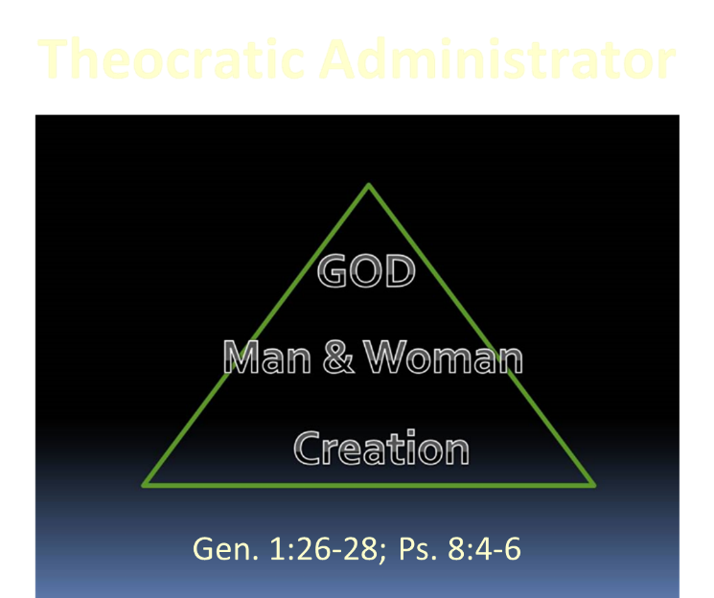

Slide 52
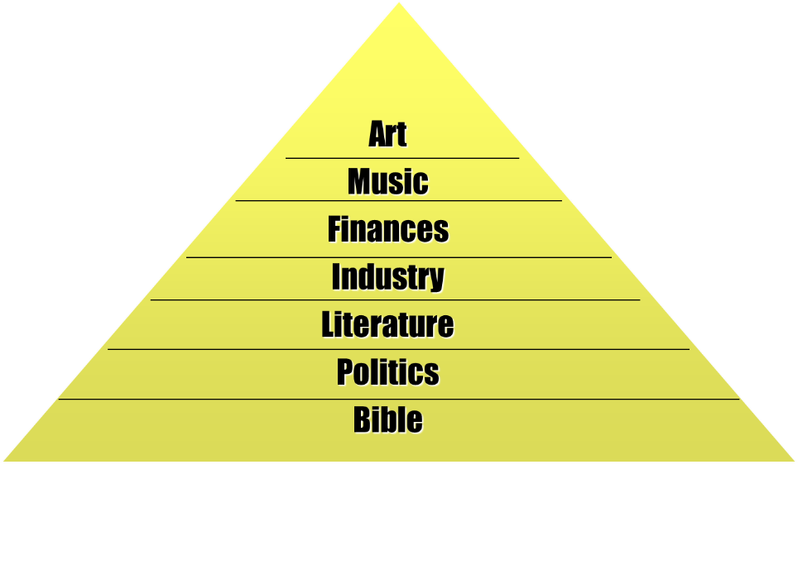

Slide 53
Conclusion

Slide 54
Genesis 8‒9 Outline
  Abating of the waters (8:1-5)
  Tests for dry land (8:6-14)
  Exit from the ark (8:15-19)
  Post-flood events (8:20‒9:29)

Slide 55
Outline
  Noahic Covenant (Gen 8:20–9:17)
  Promise (Gen 8:20-22)
  Provision (Gen 9:1-7)
  Covenant and sign (Gen 9:8-17)
  Post Flood Sin (Gen 9:18-29)

Slide 56
Noahic Covenant: Promise
(Gen 8:20-22)
  Noah’s initial sacrifice (8:20)
  Divine promise not to flood the earth again (Gen 8:21a)
  Ongoing depravity thus necessitating the work of a future Messiah (Gen 8:21b)
  Uninterrupted season or cycles (Gen 8:22) – global warming?

Slide 57
Outline
  Noahic Covenant (Gen 8:20–9:17)
  Promise (Gen 8:20-22)
  Provision (Gen 9:1-7)
  Covenant and sign (Gen 9:8-17)
  Post Flood Sin (Gen 9:18-29)

Slide 58
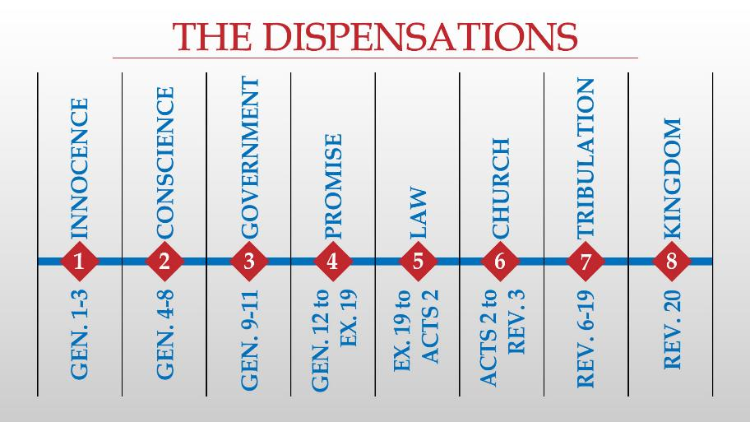

Slide 59
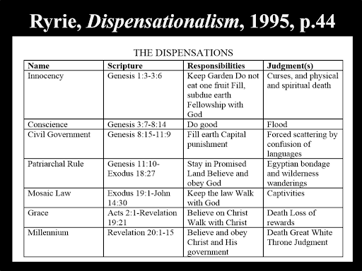

Slide 60

“The Lord bless you and keep you; the Lord make his face shine on you and be gracious to you; the Lord turn his face toward you and give you peace.” (NIV)

