Slide 1
THE RAPTURE
What and When? – Part 45
Andrew Marshall Woods, Th.M., JD., PhD.
Sr. Pastor, Sugar Land Bible Church

Slide 2
The Rapture Course Overview
What is the Rapture?
When is the Rapture?
Strengthening the Pre-Tribulational case
The opposing views
One second after the Rapture

Slide 3
The Rapture Course Overview
What is the Rapture?
When is the Rapture?
Strengthening the Pre-Tribulational case
The opposing views
One second after the Rapture

Slide 4
What is the Rapture?
An important doctrine
Distinct from the Second Advent
Catching away of all living believers (1 Thess 4:17)
Reunion (1 Thess 4:14-16)
Resurrection (1 Cor 15:50-54)
Exemption from death (1 Cor 15:51, 54-56)
Instantaneous (1 Cor 15:52)
Mystery (1 Cor 15:51)
Imminent (1 Cor 15:51; 1 Thess 4:15)
Traditional doctrine now being recovered

Slide 5
The Rapture Course Overview
What is the Rapture?
When is the Rapture?
Strengthening the Pre-Tribulational case
The opposing views
One second after the Rapture

Slide 6
When is the Rapture?
7 Arguments Favoring the Pre-Tribulation View
Tribulation's purpose concerns Israel (Jer 30:7; Dan 9:24)
No biblical reference to the church on earth during the Tribulation period (Rev 4-22)
Church is promised an exemption from divine wrath (1 Thess 1:10; 5:9; Rom 5:9; Rev 3:10; 6:17)
Rapture is imminent (1 Cor 15:51; 1 Thess 4:15)
Rapture is a comfort (1 Thess 4:18)
Antichrist cannot come to power until the restrainer is removed (2 Thess 2:6-7)
Symbolic parallels (2 Peter 2:5-9)

Slide 7
The Rapture Course Overview
What is the Rapture?
When is the Rapture?
Strengthening the Pre-Tribulational case
The opposing views
One second after the Rapture

Slide 8
Strengthening the Pre-Tribulation Case
John 14:1-4
Revelation 3:10
First Thessalonians 4‒5
Second Thessalonians 2:3a
Matthew 24‒25

Slide 9
The Rapture Course Overview
What is the Rapture?
When is the Rapture?
Strengthening the Pre-Tribulational case
The opposing views
One second after the Rapture

Slide 10
When Will the Rapture Take Place Relative to the Tribulation Period?
Pre-tribulation rapture theory
Mid-tribulation rapture theory
Post-tribulation rapture theory
Pre-wrath rapture theory
Partial rapture theory

Slide 12
Pre-Wrath Rapturism
Description of the view
Six problems with the view considering prior Pre-Tribulational Arguments
Four additional problems with the view

Slide 13
Pre-Wrath Rapturism
Description of the view
Six problems with the view considering prior Pre-Tribulational Arguments
Four additional problems with the view

Slide 14
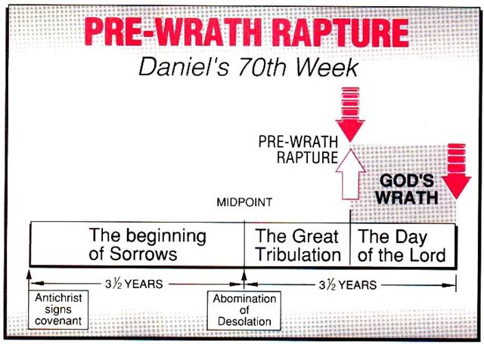
Marvin J. Rosenthal, The Pre-Wrath Rapture of the Church: A New Understanding of the Tribulation, and the Second Coming (Nashville, TN: Thomas Nelson, 1990), 112.

Slide 15
Pre-Wrath Rapturism
Description of the view
Six problems with the view considering prior Pre-Tribulational Arguments
Four additional problems with the view

Slide 16
II. Pre-Wrath Rapture Theory Problems
Places the Church in Daniel’s 70th Week
Fails to acknowledge the missing Church (Rev. 4‒22)
Confines God’s wrath to only a portion of the Tribulation's second half
Denies the Rapture’s imminency
Fails to consistently explain how the rapture is a comfort to the believer (John 14:1; 1 Thess. 4:18; Titus 2:13)
Misinterprets the restrainer (2 Thess. 2:6-7) as Michael the Archangel rather than the Holy Spirit

Slide 17
II. Pre-Wrath Rapture Theory Problems
Places the Church in Daniel’s 70th Week
Fails to acknowledge the missing Church (Rev. 4‒22)
Confines God’s wrath to only a portion of the Tribulation's second half
Denies the Rapture’s imminency
Fails to consistently explain how the rapture is a comfort to the believer (John 14:1; 1 Thess. 4:18; Titus 2:13)
Misinterprets the restrainer (2 Thess. 2:6-7) as Michael the Archangel rather than the Holy Spirit

Slide 18
Daniel 9:24
Seventy weeks have been decreed for your people and your holy city, to finish the transgression, to make an end of sin, to make atonement for iniquity, to bring in everlasting righteousness, to seal up vision and prophecy and to anoint the most holy place.

Slide 19
II. Pre-Wrath Rapture Theory Problems
Places the Church in Daniel’s 70th Week
Fails to acknowledge the missing Church (Rev. 4‒22)
Confines God’s wrath to only a portion of the Tribulation's second half
Denies the Rapture’s imminency
Fails to consistently explain how the rapture is a comfort to the believer (John 14:1; 1 Thess. 4:18; Titus 2:13)
Misinterprets the restrainer (2 Thess. 2:6-7) as Michael the Archangel rather than the Holy Spirit

Slide 20
II. Pre-Wrath Rapture Theory Problems
Places the Church in Daniel’s 70th Week
Fails to acknowledge the missing Church (Rev. 4‒22)
Confines God’s wrath to only a portion of the Tribulation's second half
Denies the Rapture’s imminency
Fails to consistently explain how the rapture is a comfort to the believer (John 14:1; 1 Thess. 4:18; Titus 2:13)
Misinterprets the restrainer (2 Thess. 2:6-7) as Michael the Archangel rather than the Holy Spirit

Slide 22
Marvin J. Rosenthal, The Pre-Wrath Rapture of the Church: A New Understanding of the Tribulation, and the Second Coming (Nashville, TN: Thomas Nelson, 1990), 112.

Slide 23
Revelation 6:16-17
^{“16} and they said to the mountains and the rocks, ‘Fall on us and hide us from the sight of Him who sits on the throne, and from the wrath [orgḗ] of the Lamb; ¹⁷ for the great day of Their wrath [orgḗ] has come [erchomai], and who is able to stand?’”

Slide 24
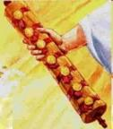
1st Six Seals (Revelation 6)
SEAL 1 – 6:1-2 – Advent of antichrist
SEAL 2 – 6:3-4 – War
SEAL 3 – 6:5-6 – Famine
SEAL 4 – 6:7-8 – Death
SEAL 5 – 6:9-11 – Martyrdoms
SEAL 6 – 6:12-17 – Cosmic disturbances

Slide 26
II. Pre-Wrath Rapture Theory Problems
Places the Church in Daniel’s 70th Week
Fails to acknowledge the missing Church (Rev. 4‒22)
Confines God’s wrath to only a portion of the Tribulation's second half
Denies the Rapture’s imminency
Fails to consistently explain how the rapture is a comfort to the believer (John 14:1; 1 Thess. 4:18; Titus 2:13)
Misinterprets the restrainer (2 Thess. 2:6-7) as Michael the Archangel rather than the Holy Spirit

Slide 27
Imminent (1 Cor 15:51; 1 Thess 4:15)
Imminency definition
James 5:8; 1 Thess 1:10; 1 Cor 1:7; Philip 3:20
We are to be looking for Jesus Christ and not the Antichrist!
Motivator (Holiness, Evangelism)
Pre-wrath Rapturism denies imminency

Slide 28
Imminent (1 Cor 15:51; 1 Thess 4:15)
Imminency definition
James 5:8; 1 Thess 1:10; 1 Cor 1:7; Philip 3:20
We are to be looking for Jesus Christ and not the Antichrist!
Motivator (Holiness, Evangelism)
Pre-wrath Rapturism denies imminency

Slide 29
Wayne Brindle
"Biblical Evidence for the Imminence of the Rapture," Bibliotheca Sacra 158, no. 630 (April-June 2001): 138-51.
“Four criteria may be suggested, any one of which indicates imminence:
The passage speaks of Christ’s return as at any moment.
The passage speaks of Christ’s return as ‘near,’ without stating any signs that must precede His coming.
The passage speaks of Christ’s return as something that gives believers hope and encouragement, without indicating that these believers will suffer tribulation.
The passage speaks of Christ’s return as giving hope without relating it to God’s judgment of unbelievers.”

Slide 30
Imminent (1 Cor 15:51; 1 Thess 4:15)
Imminency definition
James 5:8; 1 Thess 1:10; 1 Cor 1:7; Philip 3:20
We are to be looking for Jesus Christ and not the Antichrist!
Motivator (Holiness, Evangelism)
Pre-wrath Rapturism denies imminency

Slide 31
John 14:1–4
¹ “Do not let your heart be troubled; believe in God, believe also in Me. ² “In My Father’s house are many dwelling places; if it were not so, I would have told you; for I go to prepare a place for you. ³ “If I go and prepare a place for you, I will come again and receive you to Myself, that where I am, there you may be also. ⁴ “And you know the way where I am going.”

Slide 32
1 Thessalonians 4:13-15
¹³ "But we do not want you to be uninformed, brethren, about those who are asleep, so that you will not grieve as do the rest who have no hope. ¹⁴ For if we believe that Jesus died and rose again, even so God will bring with Him those who have fallen asleep in Jesus. ¹⁵ For this we say to you by the word of the Lord, that we who are alive and remain until the coming of the Lord, will not precede those who have fallen asleep.

Slide 33
1 Corinthians 15:51
“Behold, I tell you a mystery; we will not all sleep, but we will all be changed.”

Slide 34
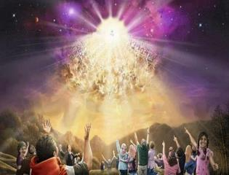
Titus 2:13
“Looking for the blessed hope and the appearing of the glory of our great God and Savior, Christ Jesus.”

Slide 35
Imminent (1 Cor 15:51; 1 Thess 4:15)
Imminency definition
James 5:8; 1 Thess 1:10; 1 Cor 1:7; Philip 3:20
We are to be looking for Jesus Christ and not the Antichrist!
Motivator (Holiness, Evangelism)
Pre-wrath Rapturism denies imminency

Slide 36
Robert H. Gundry, The Church and the Tribulation: Why Christ Won't Come Before the Antichrist Does (Grand Rapids: Zondervan, 1973).

Slide 37
Imminent (1 Cor 15:51; 1 Thess 4:15)
Imminency definition
James 5:8; 1 Thess 1:10; 1 Cor 1:7; Philip 3:20
We are to be looking for Jesus Christ and not the Antichrist!
Motivator (Holiness, Evangelism)
Pre-wrath Rapturism denies imminency

Slide 38
J. Dwight Pentecost
Prophecy For Today, Page 20
“A short time ago, I took occasion to go through the New Testament to mark each reference to the coming of the Lord Jesus Christ and to observe the use made of that teaching about His coming. I was struck a new with the fact that almost without exception, when the coming of Christ is mentioned in the New Testament, it is followed by an exhortation to godliness and holy living.”

Slide 39
1 John 3:2-3
^{“2} Beloved, now we are children of God, and it has not appeared as yet what we will be. We know that when He appears, we will be like Him, because we will see Him just as He is. ³ And everyone who has this hope set on Him purifies himself, just as He is pure.”

Slide 40
Matthew 24:46-50
^{“46} Blessed is that slave whom his master finds so doing when he comes. ⁴⁷ Truly I say to you that he will put him in charge of all his possessions. ⁴⁸ But if that evil slave says in his heart, ‘My master is not coming for a long time,’ ⁴⁹ and he begins to beat his fellow slaves, and he eats and drinks with those habitually drunk; ⁵⁰ then the master of that slave will come on a day that he does not expect, and at an hour that he does not know.”

Slide 41
Imminent (1 Cor 15:51; 1 Thess 4:15)
Imminency definition
James 5:8; 1 Thess 1:10; 1 Cor 1:7; Philip 3:20
We are to be looking for Jesus Christ and not the Antichrist!
Motivator (Holiness, Evangelism)
Pre-wrath Rapturism denies imminency

Slide 42
Marvin J. Rosenthal, The Pre-Wrath Rapture of the Church: A New Understanding of the Tribulation, and the Second Coming (Nashville, TN: Thomas Nelson, 1990), 112.

Slide 43
1st Six Seals (Revelation 6)
SEAL 1 – 6:1-2 – Advent of antichrist
SEAL 2 – 6:3-4 – War
SEAL 3 – 6:5-6 – Famine
SEAL 4 – 6:7-8 – Death
SEAL 5 – 6:9-11 – Martyrdoms
SEAL 6 – 6:12-17 – Cosmic disturbances

Slide 44
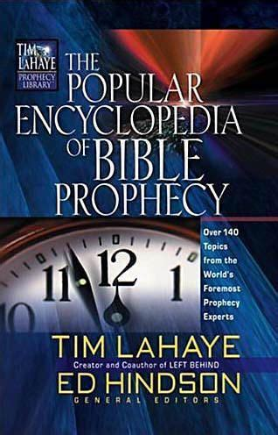
Tony Kessinger
“The doctrine of imminence holds that Christ can come to rapture His church at any moment. Believers in the early church, including the apostle Paul, believed that Christ could come in their lifetime (1 Thessalonians 1:10; 4:13-15; Titus 2:13). The church sees this doctrine as an incentive for ministry and godly living. Does this mean that Christ's return for His church will be at any moment, without any sign, and with no yet-to-be-fulfilled prophesied event to precede it?”
Tony Kessinger, "Pre-Wrath Rapture," in The Popular Encyclopedia of Bible Prophecy: Over 140 Topics from the World's Foremost Prophecy Experts, ed. Tim LaHaye and Ed Hindson (Eugene, OR: Harvest, 2004), 293.

Slide 45
Tony Kessinger
“Pre-wrath rapturists argue that Christ could come in any generation but that signs will herald the general time. Those signs include (1) the emergence of the antichrist, (2) wars and rumors of war, (3) famine, (4) pestilence, and (5) cosmic disturbance. Pre-wrath rapturists emphasize Christians' expectancy of Christ's return rather than its imminency. This expectancy of Christ's return is the catalyst for holy living.”
Tony Kessinger, "Pre-Wrath Rapture," in The Popular Encyclopedia of Bible Prophecy: Over 140 Topics from the World's Foremost Prophecy Experts, ed. Tim LaHaye and Ed Hindson (Eugene, OR: Harvest, 2004), 293.

Slide 46
Robert Lightner
“The prewrath Rapture view is different from the normal pretribulational view in that it does not consistently distinguish between God's program with Israel and His program with the church. The way it differs is that it has the church in Israel's seventieth week and does not hold to the doctrine of imminency”
Robert Lightner, Last Days Handbook: A Complete Guide to the End Times, Including the Meaning of the Year 2000 in Bible Prophecy, rev. ed. (Nashville: Thomas Nelson, 1997), 95.

Slide 47
Gerald B. Stanton
“Rosenthal‘s last chapter incorporates a final summary of his various positions, and also a final...attack against pre-tribulationalism and some of its leaders. The chapter sets forth the ‘pre-wrath rapture’ view as a ‘catalyst for holy living,’ without recognizing that much of that catalyst is lost if forty-two months of ‘sorrows’ and another twenty-one months of battle and martyrdom from the beast must come first.”
Gerald B. Stanton, Kept from the Hour: Biblical Evidence for the Pretribulational Return of Christ (Grand Rapids: Zondervan, 1956; reprint, Miami Springs, FL: Schoettle, 1991), 399.

Slide 49
II. Pre-Wrath Rapture Theory Problems
Places the Church in Daniel’s 70th Week
Fails to acknowledge the missing Church (Rev. 4‒22)
Confines God’s wrath to only a portion of the Tribulation's second half
Denies the Rapture’s imminency
Fails to consistently explain how the rapture is a comfort to the believer (John 14:1; 1 Thess. 4:18; Titus 2:13)
Misinterprets the restrainer (2 Thess. 2:6-7) as Michael the Archangel rather than the Holy Spirit

Slide 50
John 14:1–4
¹ “Do not let your heart be troubled; believe in God, believe also in Me. ² “In My Father’s house are many dwelling places; if it were not so, I would have told you; for I go to prepare a place for you. ³ “If I go and prepare a place for you, I will come again and receive you to Myself, that where I am, there you may be also. ⁴ “And you know the way where I am going.”

Slide 51
1 Thessalonians 4:16-18
¹⁶ For the Lord Himself will descend from heaven with a shout, with the voice of the archangel and with the trumpet of God, and the dead in Christ will rise first. ¹⁷ Then we who are alive and remain will be caught up [harpazō] together with them in the clouds to meet the Lord in the air, and so we shall always be with the Lord. ¹⁸ Therefore comfort one another with these words."

Slide 52
Titus 2:13
“Looking for the blessed hope and the appearing of the glory of our great God and Savior, Christ Jesus.”

Slide 54
Marvin J. Rosenthal, The Pre-Wrath Rapture of the Church: A New Understanding of the Tribulation, and the Second Coming (Nashville, TN: Thomas Nelson, 1990), 112.

Slide 55
1st Six Seals (Revelation 6)
SEAL 1 – 6:1-2 – Advent of antichrist
SEAL 2 – 6:3-4 – War
SEAL 3 – 6:5-6 – Famine
SEAL 4 – 6:7-8 – Death
SEAL 5 – 6:9-11 – Martyrdoms
SEAL 6 – 6:12-17 – Cosmic disturbances

Slide 56
Donald Grey Barnhouse
Cited in Mark Hitchcock, “An Overview of Pretribulational arguments,” online: www.pre-trib.org, accessed 27 August 2013, 29-30.
“Jesus may come today, Glad day! Glad day!
And I would see my friend;
Dangers and troubles would end If Jesus should come today.
Glad day! Glad day! Is it the crowning day?
I’ll live for today, nor anxious be, Jesus, my Lord, I soon shall see;
Glad day! Glad day! Is it the crowning day?”

Slide 57
Donald Grey Barnhouse
Cited in Mark Hitchcock, “An Overview of Pretribulational arguments,” online: www.pre-trib.org, accessed 27 August 2013, 29-30.
By way of parody, Dr. Barnhouse also pointed out that if the midtrib or posttrib [or prewrath] advocates sang this song, it would instead have to say:
“Jesus can’t come today, Sad day! Sad day!
And I won't see my friend;
Dangers and troubles won’t end
Because Jesus can’t come today.
Sad day! Sad day! Today is not the crowning day?
I won’t live for today, and anxious I’ll be,
The Beast and the False Prophet I soon shall see,
Sad day! Sad day! Today is not the crowning day?”

Slide 58
II. Pre-Wrath Rapture Theory Problems
Places the Church in Daniel’s 70th Week
Fails to acknowledge the missing Church (Rev. 4‒22)
Confines God’s wrath to only a portion of the Tribulation's second half
Denies the Rapture’s imminency
Fails to consistently explain how the rapture is a comfort to the believer (John 14:1; 1 Thess. 4:18; Titus 2:13)
Misinterprets the restrainer (2 Thess. 2:6-7) as Michael the Archangel rather than the Holy Spirit

Slide 59
2 Thessalonians 2:6-7
⁶And you know what restrains [katechon; neuter] him now, so that in his time he will be revealed. ⁷For the mystery of lawlessness is already at work; only he who now restrains [katechōn; masculine] will do so until he is taken out of the way.

Slide 60
Marvin Rosenthal
“…of paramount importance is the identification of the one who restraints or hinders the Antichrist until ‘he [the restrainer] be taken out of the way.’ The restrainer is neither the Holy Spirit nor human government. Evidence is strained to support either of those contentions. There is, however, substantial evidence to identify the restrainer. He who restraints until ‘he be taken out of the way’ is the Archangel Michael.”
Marvin J. Rosenthal, The Pre-Wrath Rapture of the Church: A New Understanding of the Tribulation, and the Second Coming (Nashville, TN: Thomas Nelson, 1990), 112.

Slide 61
Marvin J. Rosenthal, The Pre-Wrath Rapture of the Church: A New Understanding of the Tribulation, and the Second Coming (Nashville, TN: Thomas Nelson, 1990), 112.

Slide 62
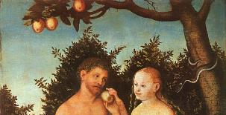
2 Thessalonians 2:9
“that is, the one whose coming is in accord with the activity of Satan, with all power and signs and false wonders.”

Slide 63
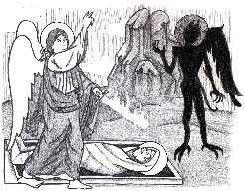
Jude 9
“But Michael the archangel, when he disputed with the devil and argued about the body of Moses, did not dare pronounce against him a railing judgment, but said, ‘The Lord rebuke you!’”

Slide 64
Daniel 12:1
“Now at that time Michael, the great prince who stands guard over the sons of your people [Israel], will arise. And there will be a time of distress such as never occurred since there was a nation until that time; and at that time your people, everyone who is found written in the book, will be rescued.”

Slide 65
2 Thessalonians 2:6-7
⁶And you know what restrains [katechon; neuter] him now, so that in his time he will be revealed. ⁷For the mystery of lawlessness is already at work; only he who now restrains [katechōn; masculine] will do so until he is taken out of the way.

Slide 66
Tony Kessinger
“The pre-wrath view holds to the rather inventive idea that Michael the archangel is the restrainer. This concept fails to take into consideration Michael's special protective ministry toward Israel.”
Tony Kessinger, "Pre-Wrath Rapture," in The Popular Encyclopedia of Bible Prophecy: Over 140 Topics from the World's Foremost Prophecy Experts, ed. Tim LaHaye and Ed Hindson (Eugene, OR: Harvest, 2004), 294.

Slide 67
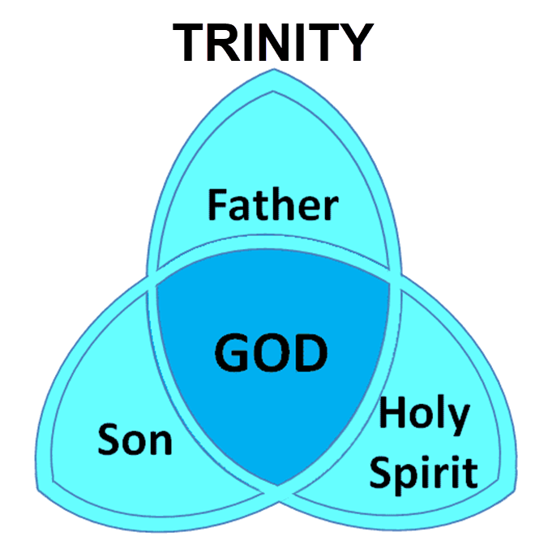

Slide 68
3 Reasons Why the Restrainer is the Holy Spirit (2 Thessalonians 2:6-7)
The Holy Spirit is omnipotent
The Holy Spirit view handles well the switch in gender from the neuter (vs. 6) to the masculine (vs. 7)
The Holy Spirit is active in the world (Gen. 6:3; John 16:7-11)

Slide 69
Restrainer Must First be Removed
Restrainer holds back the Antichrist (2 Thess 2:6-7)
Restrainer = the omnipotent Holy Spirit (2 Thess 2:9)
Holy Spirit permanently indwells all Christians (John 14:16; Rom 8:9)
Spirit indwelt Christians must first be removed prior to the Antichrist's advent

Slide 70
II. Pre-Wrath Rapture Theory Problems
Places the Church in Daniel’s 70th Week
Fails to acknowledge the missing Church (Rev. 4‒22)
Confines God’s wrath to only a portion of the Tribulation's second half
Denies the Rapture’s imminency
Fails to consistently explain how the rapture is a comfort to the believer (John 14:1; 1 Thess. 4:18; Titus 2:13)
Misinterprets the restrainer (2 Thess. 2:6-7) as Michael the Archangel rather than the Holy Spirit

Slide 71
Pre-Wrath Rapturism
Description of the view
Six problems with the view considering prior Pre-Tribulational Arguments
Four additional problems with the view

Slide 72
III. Additional Problems with Pre-Wrath Rapturism
It imposes an artificial construct on Daniel’s 70th Week
Great Tribulation (unequaled distress) before God’s wrath?
It places the Rapture in Revelation 7:9-17
It places the Rapture in Matthew 24:31

Slide 73
III. Additional Problems with Pre-Wrath Rapturism
It imposes an artificial construct on Daniel’s 70th Week
Great Tribulation (unequaled distress) before God’s wrath?
It places the Rapture in Revelation 7:9-17
It places the Rapture in Matthew 24:31

Slide 74
Daniel 9:27
And he will make a firm covenant with the many for one week, but in the middle of the week he will put a stop to sacrifice and grain offering; and on the wing of abominations will come one who makes desolate, even until a complete destruction, one that is decreed, is poured out on the one who makes desolate.

Slide 76
PROPHETIC SYNONYMNS
Division of the Tribulation into two 3½ year periods
42 months - Rev. 11:2; 13:5
1260 days – Rev. 11:3; 12:6
Time, times, and a half a time – Dan. 7:25; 12:7; 12:14

Slide 77
Matthew 24:15-16, 20
“¹⁵ Therefore when you see the abomination of desolation which was spoken of through Daniel the prophet, standing in the holy place (let the reader understand) ¹⁶ then those who are in Judea must flee to the mountains…²⁰ But pray that your flight will not be in the winter, or on a Sabbath.”

Slide 78
Marvin J. Rosenthal, The Pre-Wrath Rapture of the Church: A New Understanding of the Tribulation, and the Second Coming (Nashville, TN: Thomas Nelson, 1990), 112.

Slide 79
Three Parts?
“…the Scriptures never divide the Tribulation period into thirds. Daniel’s prophecy divides the seventieth week in two (Dan 9:27); half of the Tribulation is described as numbering 1260 days (Rev 11:3; 12:6). In fact, since Revelation 12:14 explains that God will protect fleeing Jews for ‘a time, and times, and half a time’ (1260 days); and since the beginning of this period is the beginning of the last three and one-half years, the Great Tribulation (Matt 24:15-22) must last for 1260 days. The Bible never divides the 1260 days into two 630 days.”
Larry D. Pettegrew, "The Messiah's Lecture on the Future of Israel," in Forsaking Israel: How It Happened and Why It Matters, ed. Larry D. Petegrew (The Woodlands, TX: Kress Biblical Resources, 2020), 340..

Slide 80
III. Additional Problems with Pre-Wrath Rapturism
It imposes an artificial construct on Daniel’s 70th Week
Great Tribulation (unequaled distress) before God’s wrath?
It places the Rapture in Revelation 7:9-17
It places the Rapture in Matthew 24:31

Slide 81
Marvin J. Rosenthal, The Pre-Wrath Rapture of the Church: A New Understanding of the Tribulation, and the Second Coming (Nashville, TN: Thomas Nelson, 1990), 112.

Slide 82
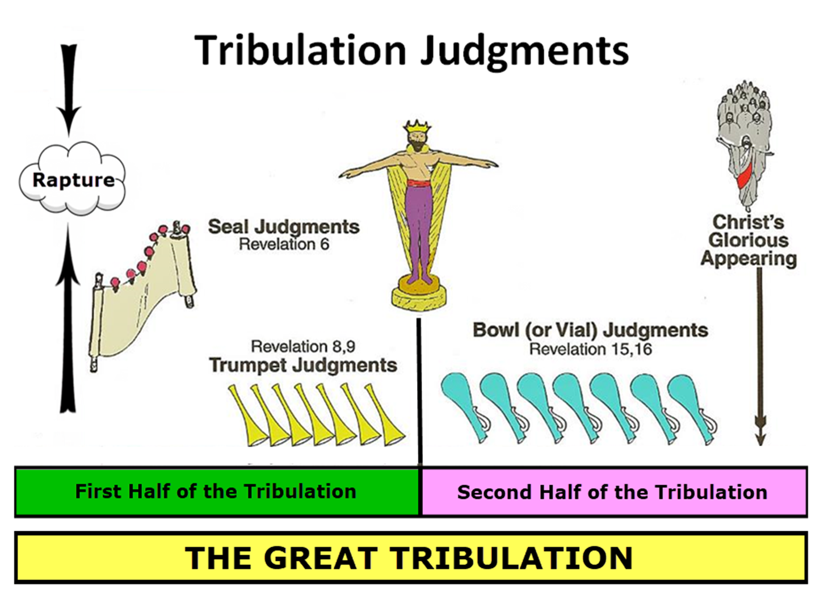
Matthew 24:21
“For then there will be a great tribulation, such as has not occurred since the beginning of the world until now, nor ever will.”

Slide 83
Marvin J. Rosenthal, The Pre-Wrath Rapture of the Church: A New Understanding of the Tribulation, and the Second Coming (Nashville, TN: Thomas Nelson, 1990), 112.

Slide 84
George Zeller "Pre-Wrath Confusion," online: http://www.middletownbiblechurch.org/proph/prewrath.htm, accessed 01 September 2015.
“The PRE-WRATH view teaches that the Day of the Lord begins after the Great Tribulation and that the Day of the Lord is the time of God's wrath. Matthew 24:21, Daniel 12:1 and Jeremiah 30:7 all teach that the Great Tribulation is the greatest time of trouble that the world has ever known. Therefore, if the Day of the Lord is distinct from the Great Tribulation, then the Day of the Lord must be LESS SEVERE than the Great Tribulation. But how can the great day of God's wrath be less severe and less troublesome than the Great Tribulation?”

Slide 85
George Zeller "Pre-Wrath Confusion," online: http://www.middletownbiblechurch.org/proph/prewrath.htm, accessed 01 September 2015.
“How can God's wrath be less severe than man's wrath? How can the trumpets and bowls be less severe than the fifth seal? How can God's wrath be less severe than Satan's wrath? How can unregenerate men and Satan cause more trouble for this world than the wrathful JUDGE Himself? The PRE-WRATH view, when compared with Matthew 24:21 and these other verses, makes the Day of the Lord an ANTICLIMAX!”

Slide 86
Unequaled Distress?
“A…flaw in the prewrath interpretation of Matthew 24:22 is its logical failure. The reason that the Great Tribulation is shortened, according to this verse, is that if it were not, no flesh would be saved. The point of the Scripture is that when the Great Tribulation is over, something better comes on the scene. In the prewrath scheme, however, something more horrible occurs after the Great Tribulation—the Day of the Lord.”
Larry D. Pettegrew, "The Messiah's Lecture on the Future of Israel," in Forsaking Israel: How It Happened and Why It Matters, ed. Larry D. Petegrew (The Woodlands, TX: Kress Biblical Resources, 2020), 341.

Slide 87
Unequaled Distress?
“If no flesh would have survived if the Great Tribulation were allowed to continue on twenty-one months, surely no flesh would survive if the Great Tribulation were to be cut short and followed by twenty-one months of a more horrible Day of the Lord. Moreover, Matthew 24:21 says that the Great Tribulation will be the worst time ever. So, how can it be replaced by the Day of the Lord which is more horrible? Wouldn’t that be the worst time ever? In fact, the Great Tribulation (Matt 24:21) and the Day of the Lord (Dan 12:1; Jer 30:7) are both said to be the worst time ever, so they must be the same time period or at least overlap.”
Larry D. Pettegrew, "The Messiah's Lecture on the Future of Israel," in Forsaking Israel: How It Happened and Why It Matters, ed. Larry D. Petegrew (The Woodlands, TX: Kress Biblical Resources, 2020), 341.

Slide 88
III. Additional Problems with Pre-Wrath Rapturism
It imposes an artificial construct on Daniel’s 70th Week
Great Tribulation (unequaled distress) before God’s wrath?
It places the Rapture in Revelation 7:9-17
It places the Rapture in Matthew 24:31

Slide 90
Revelation 7:9, 13-14
“⁹ After these things I looked, and behold, a great multitude which no one could count, from every nation and all the tribes, peoples, and languages, standing before the throne and before the Lamb, clothed in white robes, and palm branches were in their hands…¹³ Then one of the elders responded, saying to me, . . .

Slide 91
Revelation 7:9, 13-14
. . ‘These who are clothed in the white robes, who are they, and where have they come from?’ ¹⁴ I said to him, ‘My lord, you know.’ And he said to me, ‘These are the ones who come out of the great tribulation [thlípsis], and they have washed their robes and made them white in the blood of the Lamb.’”

Slide 92
Marvin Rosenthal
“That great multitude represents the true Church which goes into the Seventieth Week of Daniel. They are raptured and at the end of the Great Tribulation but before the Day of the Lord begins. They are raptured before God’s wrath is poured out but are not exempt from the ultimate rebellion of unregenerate men...Therefore, in chapter 7 the Church is raptured. But immediately prior to the rapture of the Church the 144,000 Jews are sealed...The 144,000 must be sealed for protection to go through the Day of the Lord before the Church can be caught up to the throne in heaven.”
Marvin J. Rosenthal, The Pre-Wrath Rapture of the Church: A New Understanding of the Tribulation, and the Second Coming (Nashville, TN: Thomas Nelson, 1990), 185.

Slide 93
Revelation 7:9, 13-14
¹³ . . .‘These who are clothed in the white robes, who are they, and where have they come from?’ ¹⁴ I said to him, ‘My lord, you know.’ And he said to me, ‘These are the ones who come out of the great tribulation [thlípsis], and they have washed their robes and made them white in the blood of the Lamb.’”

Slide 94
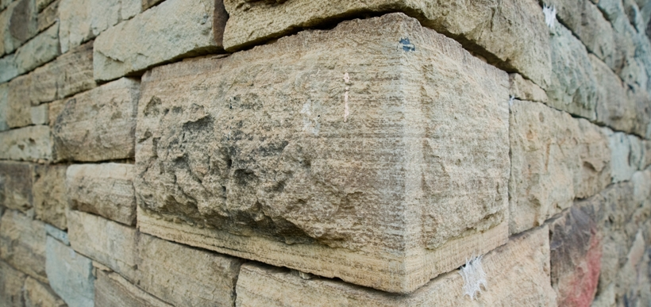
Ephesians 2:20
“having been built on the foundation of the apostles and prophets, Christ Jesus Himself being the corner stone.”

Slide 95
Revelation 7:9, 13-14
¹³ . . .‘These who are clothed in the white robes, who are they, and where have they come (erchomai) from?’ ¹⁴ I said to him, ‘My lord, you know.’ And he said to me, ‘These are the ones who come (erchomai) out of the great tribulation [thlípsis], and they have washed their robes and made them white in the blood of the Lamb.’”

Slide 96
1 Corinthians 15:52
“in a moment [atomos], in the twinkling of an eye, at the last trumpet; for the trumpet will sound, and the dead will be raised imperishable, and we will be changed.”

Slide 97
Rev. 7:14 Robert L. Thomas, Revelation 1–7: An Exegetical Commentary, ed. Kenneth Barker (Chicago: Moody, 1992), 497, n. 119.
"A…possible understanding that it is a departure after the Great Tribulation is completed (Marvin Rosenthal, The Pre-Wrath Rapture of the Church [Nashville: Thomas Nelson, 1990], p. 185) can be dismissed because it neglects the ongoing nature of the departure indicated by the present participle ἐρχόμενοι and rests on an unwarranted distinction between the Great Tribulation and the day of the God’s wrath."

Slide 98
Gerald B. Stanton
“However, the innumerable multitude is not like the Church, which goes to heaven as a group at the rapture. Rather, they are martyrs who one at a time lay down their lives throughout the seven-year period. The Greek present tense in Revelation 7:14 stresses that they ‘continually come’ out of great Tribulation, and obviously do not go to heaven as a single group. It is likewise strange, if they do represent the Church, that John could not recognize them, for John was an apostle of Christ, a member of the early Church, and part of its essential foundation. Also, the Church is composed of all believers since Pentecost, and cannot be limited solely to Tribulation martyrs.”
Gerald B. Stanton, Kept from the Hour: Biblical Evidence for the Pretribulational Return of Christ (Grand Rapids: Zondervan, 1956; reprint, Miami Springs, FL: Schoettle, 1991), 390.

Slide 99
Distinctions Between 144,000 & Multitude
144,000 | MULTITUDE
Revelation 7:1-8 | Revelation 7:9-17
Numbered | Innumerable
Jews | All nations
Sealed | Slain
Sealed before the Tribulation | Converted out of the Tribulation
Hitchcock and Ice, The Truth Behind Left Behind, 77

Slide 100
III. Additional Problems with Pre-Wrath Rapturism
It imposes an artificial construct on Daniel’s 70th Week
Great Tribulation (unequaled distress) before God’s wrath?
It places the Rapture in Revelation 7:9-17
It places the Rapture in Matthew 24:31

Slide 101
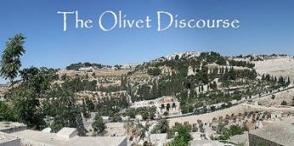
Matthew 24:31
“And He will send forth His angels with a great trumpet and they will gather together [episynagō] His elect from the four winds, from one end of the sky to the other.”

Slide 102
PRE-WRATH RAPTURIST – ALAN KURSCHNER
MATTHEW 24 | PARALLELS | REVELATION 6-7
4-5 | The Antichrist / False Christs | 1st Seal (6:1-2)
6-7 | Wars | 2nd Seal (6:3-4)
7 | Famine | 3rd Seal (6:5-6)
9, 21-22 | Martyrdom / (Great Tribulation) | 4th Seal (6:7-8)
9, 21-22 | Result of Martyrdom / (Great Tribulation) | 5th Seal (6:9-11)
29 | Celestial Disturbances | 6th Seal (6:12-17)
30-31 | Raptured Saints | Interlude (7:9-17)
14, 30, 37-40 | Day of the Lord’s Wrath | 7th Seal (Trumpet, Bowls)
Alan Kurschner, The Antichrist Before the Day of the Lord: What Every Christian Needs to Know About the Return of Christ (Pompton Lakes, NI: Eschatos, 2013, 99.

Slide 103
1 Thessalonians 4:16-18
¹⁶ For the Lord Himself will descend from heaven with a shout, with the voice of the archangel and with the trumpet of God, and the dead in Christ will rise first. ¹⁷ Then we who are alive and remain will be caught up together with them in the clouds to meet the Lord in the air, and so we shall always be with the Lord. ¹⁸ Therefore comfort one another with these words."

Slide 104
1 Corinthians 15:50-51
“⁵⁰ Now I say this, brethren, that flesh and blood cannot inherit the kingdom of God; nor does the perishable inherit the imperishable. ⁵¹ Behold, I tell you a mystery; we will not all sleep, but we will all be changed.”

Slide 105
Matthew 24:31
“And He will send forth His angels with a great trumpet and they will gather together [episynagō] His elect from the four winds, from one end of the sky to the other.”

Slide 106
John A. Sproule
"An Exegetical Defense of Pretribulationalism" (Th.D. diss., Grace Theological Seminary, 1981), 53.
“Where does Paul mention the darkening of the sun (Matt. 24:29), the moon not giving its light (Matt. 24:29), the stars falling from the sky (Matt. 24:29), the powers of the heavens being shaken (Matt. 24:29), all the tribes of the earth mourning (Matt. 24:30), all the world seeing the coming of the Son of Man (Matt. 24:30), or God sending forth angels (Matt.24:31)?”

Slide 107
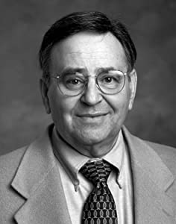
Paul D. Feinberg
"Response: Paul D. Feinberg," in The Rapture: Pre-, Mid-, or Posttribulational, ed. Richard R. Reiter (Grand Rapids: Zondervan, 1984), 225.
“Notice what happens when you examine both passages carefully. In Matthew the Son of Man comes on the clouds, while in 1 Thessalonians 4 the ascending believers are in them. In Matthew the angels gather the elect; in 1 Thessalonians the Lord Himself (note the emphasis) gathers the believers. Thessalonians only speaks of the voice of the archangel. In the Olivet Discourse nothing is said about a resurrection, while in the latter text it is the central point. In the two passages the differences in what will take place prior to the appearance of Christ is striking. Moreover, the order of ascent is absent from Matthew in spite of the fact that it is the central part of the epistle.”

Slide 108
Preview of Matthew 24–25
The problem
The larger context
The immediate context (23:37-39)
The Disciples’ questions (24:1-3)
The Tribulation’s first half (24:4-14)
The Tribulation’s mid-point (24:15-20)
The Tribulation’s second half (24:21-22)
The Second Advent (24:23-31)
Eight parabolic exhortations (24:32‒25:46)

Slide 109
Matthew 23:37-39
³⁷ “Jerusalem, Jerusalem, who kills the prophets and stones those who are sent to her! How often I wanted to gather [episynagō] your children together, the way a hen gathers [episynagō] her chicks under her wings, and you were unwilling. ³⁸ Behold, your house is being left to you desolate! ³⁹ For I say to you, from now on you will not see Me until you say, ‘Blessed is He who comes in the name of the Lord!’”

Slide 110
Matthew 24:31
“And He will send forth His angels with a great trumpet and they will gather together [episynagō] His elect from the four winds, from one end of the sky to the other.”

Slide 111
Isaiah 27:13
“It will come about also in that day that a great trumpet will be blown, and those who were perishing in the land of Assyria and who were scattered in the land of Egypt will come and worship the Lord in the holy mountain at Jerusalem.”

Slide 112
Isaiah 11:11-12
^{“11} Then it will happen on that day that the Lord Will again recover the second time with His hand The remnant of His people, who will remain, From Assyria, Egypt, Pathros, Cush, Elam, Shinar, Hamath, And from the islands of the sea.¹² And He will lift up a standard for the nations And assemble the banished ones of Israel, And will gather the dispersed of Judah From the four corners of the earth.”

Slide 113
Conclusion

Slide 114
Pre-Wrath Rapturism
Description of the view
Six problems with the view considering prior Pre-Tribulational Arguments
Four additional problems with the view

