Slide 1
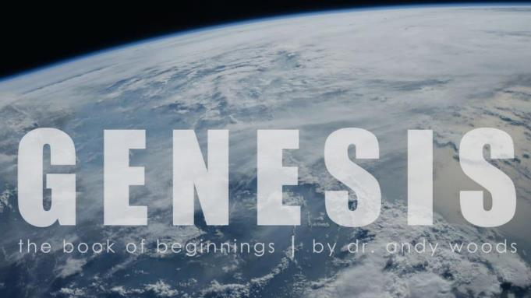
Genesis 6‒9
The Flood and Continuation of the Messianic Promise

Slide 2
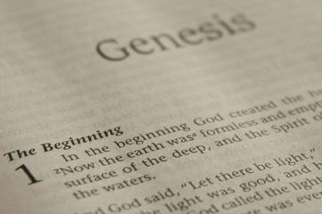
GENESIS STRUCTURE
Beginning of the Human race (Gen. 1‒11)
Beginning of the Hebrew race (Gen. 12‒50)

Slide 3
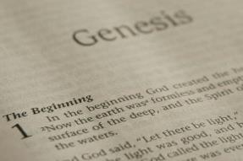
GENESIS STRUCTURE
Genesis 1-11 (four events)
Creation (1-2)
Fall (3-5)
Flood (6-9)
National dispersion (10-11)

Slide 4
GENESIS STRUCTURE
Genesis 1-11 (four events)
Creation (1-2)
Fall (3-5)
Flood (6-9)
National dispersion (10-11)

Slide 5
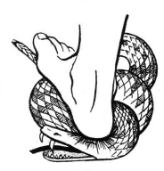
Genesis 3:15
“And I will put enmity Between you and the woman, And between your seed and her seed; He shall bruise you on the head, And you shall bruise him on the heel.”

Slide 6
GENESIS STRUCTURE
Genesis 1-11 (four events)
Creation (1-2)
Fall (3-5)
Flood (6-9)
National dispersion (10-11)

Slide 7
Genesis 6 Outline
God’s Grief (Gen 6:1-7)
God’s Grace (6:8-10)
God’s Destruction (6:11-13)
God’s Instruction (6:14-22)

Slide 8
Genesis 6 Takeaways
Corruption of man in Noah’s day and Noah’s “perfection” (Gen 6:1-13)
Building of the ark (Gen 6:14-22)

Slide 9
Genesis 6 Takeaways
Corruption of man in Noah’s day and Noah’s “perfection” (Gen 6:1-13)
Building of the ark (Gen 6:14-22)

Slide 10
IV. God’s Instruction (Gen 6:14-22)
The structure (6:14-16)
The reason (6:17-18)
The animals (6:19-20)
The food (6:21)
The obedience (6:22)

Slide 11
IV. God’s Instruction (Gen 6:14-22)
The structure (6:14-16)
The reason (6:17-18)
The animals (6:19-20)
The food (6:21)
The obedience (6:22)

Slide 12
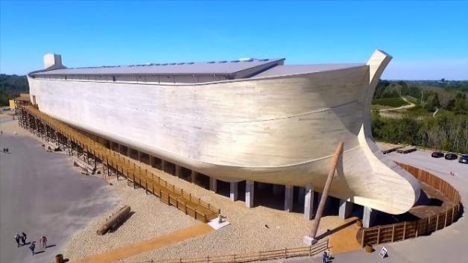
Dimensions of the Ark? (Genesis 6:15)
Ark = 450ft long, 75ft wide, 45 feet high
Ark capable of holding 125,000 animals

Slide 13
Hugh Ross
The Genesis Question (Navpress, Colorado Springs, CO 1998), 164-65.
“First, when God pours out judgment, He gives ample warning ahead of time. He sends a spokesperson, a prophet, and gives that prophet a kind of platform from which to be heard. For the antediluvians, Noah was that prophet and the scaffolding around the ark was his platform.”

Slide 14
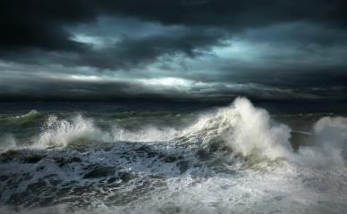
Dimensions of the Ark
Biblical flood account
Pagan flood accounts (300)
Similarities and differences

Slide 15
Biblical vs. Babylonian Flood Account
ITEM | GENESIS | GILGAMESH EPIC
Flood planned | God | Council
View of God | Monotheism | Polytheism
Revelation to a hero | God warned Noah | Ea warned Utnapishtim
Reason | Sin | Noise
Punishment | Ethics | Ambiguous, regretted
Salvation of hero | Included in God’s plan | Done secretly
Lives saved | 8 | Reps of all living things
Boat | 300x50x30 cubits-3 levels | 120x120x120 cubits-7 levels
Duration | 40 days, 40 nights | 6 days, 6 nights
Landing | Mountains of Ararat | Mount Nisir
Birds | Raven, dove (3x) | Dove, swallow, raven
Sacrifice | Worship | Appeasement
Blessing | Covenant | Divinity, immortality

Slide 16
Biblical vs. Babylonian Creation Account
GENESIS | ENUMA ELISH
Purpose: praise God | Purpose: praise Marduk
Starts with the deep | Starts with the deep
Sequence of days | No sequence of days
Ex nihlo (by speech) | Creation from formerly existing matter
Waters divided above & below firmament | Waters divided above and below corpse of Tiamat
Man to rule creation | Man created to ease the God’s work load
Man created from the soil | Man created from a slain super hero
Comparisons/contrasts taken from Walton, Chronological and Background charts of the OT, 80-81.

Slide 17
Dr. Arnold G. Fruchtenbaum
The Book of Genesis Record, 142
“The eleventh observation is connected with archeology. There are two kings’ lists from archeology that reflect what is happening in this chapter. The first is the Sumerian King List from Sumer in Mesopotamia, dating from about the year 2000 b.c. It lists a total of ten kings, with a total of 241,200 years. That is an average of about 24,000 years per king. Therefore, the concept of longevity of ten generations is something reflected in the Sumerian King List.”

Slide 18
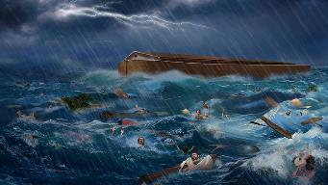
Dr. Arnold G. Fruchtenbaum
The Book of Genesis Record, 142
“It is also interesting that after the list of the ten kings, it then adds, ‘and then the flood came.’ The flood came with the tenth, just as it is in this Genesis 5 passage. The second is the Berussos King List. Berussos was a Babylonian priest of the third century b.c., and he also lists ten kings before the flood.”

Slide 19
Explanation of Similarities & Differences Between the Biblical and Pagan Flood Accounts
The pagans accounts (Babylonian creation – Enuma Elish & flood – Gilgamesh) borrowed from the Bible? – Unlikely since some pagan accounts (1800 B.C.) precede the time when Gen. was written (1446 B.C.)
The Bible borrowed from the pagan accounts? – A possibility

Slide 20
Explanation of Similarities & Differences Between the Biblical and Pagan Flood Accounts
Common source
Historical event
Spreading knowledge of historical event into all early cultures
Paganism’s adjustment (monotheism, sin, ethics)-Rom. 1:18-32
God’s readjustment-correction through Moses

Slide 21
Biblical vs. Babylonian Flood Account
ITEM | GENESIS | GILGAMESH EPIC
Flood planned | God | Council
View of God | Monotheism | Polytheism
Revelation to a hero | God warned Noah | Ea warned Utnapishtim
Reason | Sin | Noise
Punishment | Ethics | Ambiguous, regretted
Salvation of hero | Included in God’s plan | Done secretly
Lives saved | 8 | Reps of all living things
Boat | 300x50x30 cubits-3 levels | 120x120x120 cubits-7 levels
Duration | 40 days, 40 nights | 6 days, 6 nights
Landing | Mountains of Ararat | Mount Nisir
Birds | Raven, dove (3x) | Dove, swallow, raven
Sacrifice | Worship | Appeasement
Blessing | Covenant | Divinity, immortality

Slide 22
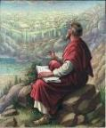
John 20:30-31
“³⁰ Therefore many other signs Jesus also performed in the presence of the disciples, which are not written in this book; ³¹ but these have been written so that you may believe that Jesus is the Christ, the Son of God; and that believing you may have life in His name.”

Slide 24
7 “I AM” statements in John
I am the Bread of Life | 6:35
I am the Light of the world | 8:12
I am the Gate for the sheep | 10:7; cf. v.9
I am the Good Shepherd | 10:11,14
I am the Resurrection and the Life | 11:25
I am the Way and the Truth and the Life | 14:6
I am the true Vine | 15:1; cf. v.5

Slide 25
IV. God’s Instruction (Gen 6:14-22)
The structure (6:14-16)
The reason (6:17-18)
The animals (6:19-20)
The food (6:21)
The obedience (6:22)

Slide 26
Noahic vs. Abrahamic & Mosaic Covenants
Name | NOAHIC | ABRAHAMIC | MOSAIC
Human agent | Noah | Abraham | Moses
Scripture | Gen. 8‒9 | Gen. 12‒17 | Exod. 19‒40
Covenant (Berith) | Gen. 9:9 | Gen. 15:18 | Exod. 19:5
Party | World, humanity | Israel, Hebrews | Israel, Hebrews
Israel | Pre-Israel | Post-Israel | Post-Israel

Slide 27
Noahic vs. Abrahamic & Mosaic Covenants
Covenant | NOAHIC | ABRAHAMIC | MOSAIC
Conditional or unconditional | Unconditional | Unconditional | Conditional
Promises | No more flood judgment, enduring earth, capital punishment | Ownership of land, seed, and blessing | Enjoyment or possession of land, seed, and blessing
Sign | Rainbow | Circumcision | Sabbath
Purpose | Restrain & preserve | Redemptive | Redemptive
Directly binding today? | Yes | No | No

Slide 28
Biblical vs. Babylonian Flood Account
ITEM | GENESIS | GILGAMESH EPIC
Flood planned | God | Council
View of God | Monotheism | Polytheism
Revelation to a hero | God warned Noah | Ea warned Utnapishtim
Reason | Sin | Noise
Punishment | Ethics | Ambiguous, regretted
Salvation of hero | Included in God’s plan | Done secretly
Lives saved | 8 | Reps of all living things
Boat | 300x50x30 cubits-3 levels | 120x120x120 cubits-7 levels
Duration | 40 days, 40 nights | 6 days, 6 nights
Landing | Mountains of Ararat | Mount Nisir
Birds | Raven, dove (3x) | Dove, swallow, raven
Sacrifice | Worship | Appeasement
Blessing | Covenant | Divinity, immortality

Slide 29
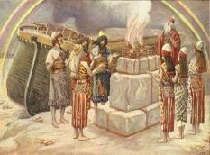
Genesis 8:21
The Lord smelled the soothing aroma; and the Lord said to Himself, “I will never again curse the ground on account of man, for the intent of man’s heart is evil from his youth; and I will never again destroy every living thing, as I have done.[emphasis mine].

Slide 30
Genesis 3:15
“And I will put enmity Between you and the woman, And between your seed and her seed; He shall bruise you on the head, And you shall bruise him on the heel.”

Slide 31
IV. God’s Instruction (Gen 6:14-22)
The structure (6:14-16)
The reason (6:17-18)
The animals (6:19-20)
The food (6:21)
The obedience (6:22)

Slide 32
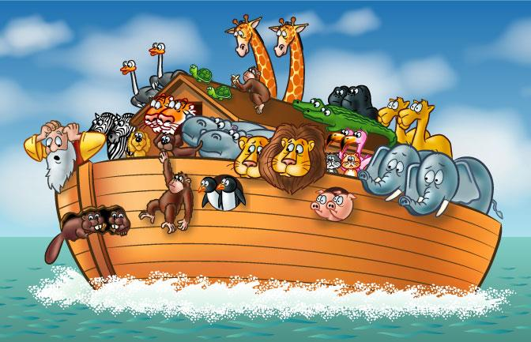

Slide 33
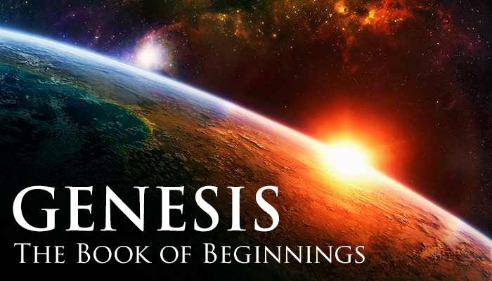
How Did Noah Fit All of the Animals on to the Ark? (John 3:12)
No
Sea creatures (6:20)
Insects (7:22)
Plants (6:20)
John Woodmoorape, Noah’s Ark: A Feasibility Study

Slide 34
How Did Noah Fit All of the Animals on to the Ark? (John 3:12)
Limitations
Seven pairs or just sevens? (7:2)
Only clean animals (7:2; Lev 11; Deut 14)
Kind (6:20)
Extinct animals overstated
Not fully grown
Hibernation

Slide 35
How Did Noah Fit All of the Animals on to the Ark? (John 3:12)
16,000 animals
Ark = 450ft long, 75ft wide, 45 feet high
Ark capable of holding 125,000 animals

Slide 36
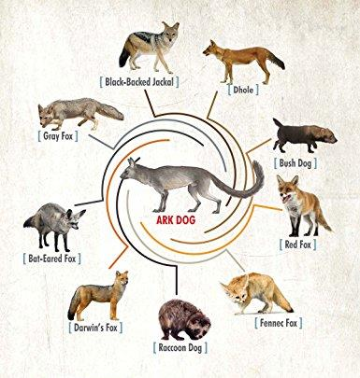

Slide 37
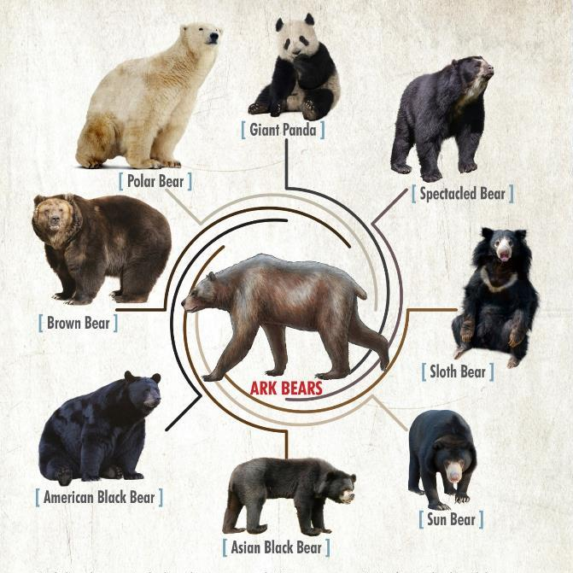

Slide 38
IV. God’s Instruction (Gen 6:14-22)
The structure (6:14-16)
The reason (6:17-18)
The animals (6:19-20)
The food (6:21)
The obedience (6:22)

Slide 39
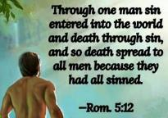
Genesis 1:29-30
“²⁹ Then God said, ‘Behold, I have given you every plant yielding seed that is on the surface of all the earth, and every tree which has fruit yielding seed; it shall be food for you; ³⁰ and to every beast of the earth and to every bird of the sky and to every thing that moves on the earth which has life, I have given every green plant for food’; and it was so.”

Slide 40
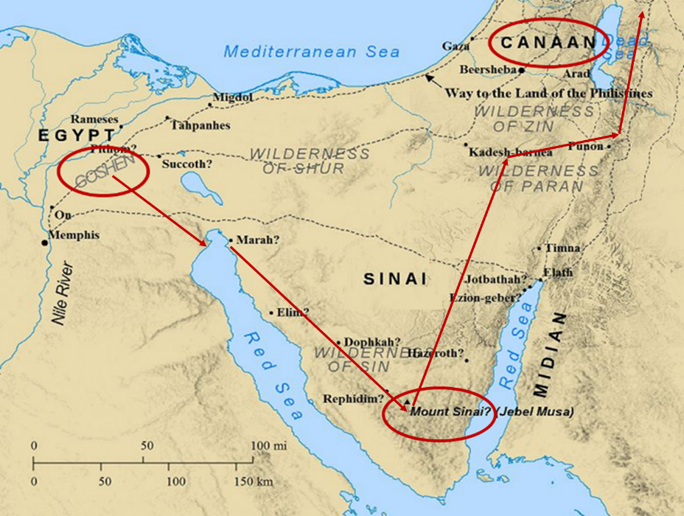

Slide 41
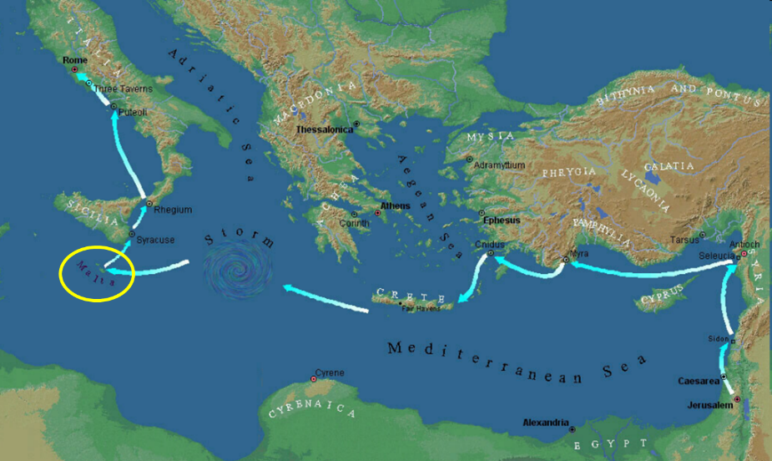

Slide 42
IV. God’s Instruction (Gen 6:14-22)
The structure (6:14-16)
The reason (6:17-18)
The animals (6:19-20)
The food (6:21)
The obedience (6:22)

Slide 43
Dimensions of the Ark? (Genesis 6:15)
Ark = 450ft long, 75ft wide, 45 feet high
Ark capable of holding 125,000 animals

Slide 44
Conclusion

Slide 45
GENESIS STRUCTURE
Genesis 1-11 (four events)
Creation (1-2)
Fall (3-5)
Flood (6-9)
National dispersion (10-11)

Slide 46
The Flood (Gen 6–9)
Events before the flood (Gen 6)
The flood (Gen 7)
The abating of the waters (Gen 8)
Events following the flood (Gen 9)

Slide 47
Genesis 6 Outline
God’s Grief (Gen 6:1-7)
God’s Grace (6:8-10)
God’s Destruction (6:11-13)
God’s Instruction (6:14-22)

Slide 48
IV. God’s Instruction (Gen 6:14-22)
The structure (6:14-16)
The reason (6:17-18)
The animals (6:19-20)
The food (6:21)
The obedience (6:22)

Slide 49
“The Lord bless you and keep you; the Lord make his face shine on you and be gracious to you; the Lord turn his face toward you and give you peace.” (NIV)

