Slide 1


THE RAPTURE
What and When? – Part 38
Andrew Marshall Woods, Th.M., JD., PhD.
Sr. Pastor, Sugar Land Bible Church

Slide 2
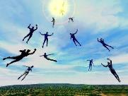
The Rapture
Course Overview
What is the Rapture?
When is the Rapture?
Strengthening the Pre-Tribulational case
The opposing views
One second after the Rapture

Slide 3
The Rapture
Course Overview
What is the Rapture?
When is the Rapture?
Strengthening the Pre-Tribulational case
The opposing views
One second after the Rapture

Slide 4

What is the Rapture?
An important doctrine
Distinct from the Second Advent
Catching away of all living believers (1 Thess 4:17)
Reunion (1 Thess 4:14-16)
Resurrection (1 Cor 15:50-54)
Exemption from death (1 Cor 15:51, 54-56)
Instantaneous (1 Cor 15:52)
Mystery (1 Cor 15:51)
Imminent (1 Cor 15:51; 1 Thess 4:15)
Traditional doctrine now being recovered

Slide 5
The Rapture
Course Overview
What is the Rapture?
When is the Rapture?
Strengthening the Pre-Tribulational case
The opposing views
One second after the Rapture

Slide 6
When is the Rapture?
7 Arguments Favoring the Pre-Tribulation View
Tribulation's purpose concerns Israel (Jer 30:7; Dan 9:24)
No biblical reference to the church on earth during the Tribulation period (Rev 4-22)
Church is promised an exemption from divine wrath (1 Thess 1:10; 5:9; Rom 5:9; Rev 3:10; 6:17)
Rapture is imminent (1 Cor 15:51; 1 Thess 4:15)
Rapture is a comfort (1 Thess 4:18)
Antichrist cannot come to power until the restrainer is removed (2 Thess 2:6-7)
Symbolic parallels (2 Peter 2:5-9)

Slide 7
The Rapture
Course Overview
What is the Rapture?
When is the Rapture?
Strengthening the Pre-Tribulational case
The opposing views
One second after the Rapture

Slide 8
Strengthening the Pre-Tribulation Case
John 14:1-4
Revelation 3:10
First Thessalonians 4‒5
Second Thessalonians 2:3a
Matthew 24‒25

Slide 9
The Rapture
Course Overview
What is the Rapture?
When is the Rapture?
Strengthening the Pre-Tribulational case
The opposing views
One second after the Rapture

Slide 10
When Will the Rapture Take Place Relative to the Tribulation Period?
Pre-tribulation rapture theory
Mid-tribulation rapture theory
Post-tribulation rapture theory
Pre-wrath rapture theory
Partial rapture theory

Slide 11
When Will the Rapture Take Place Relative to the Tribulation Period?
Pre-tribulation rapture theory
Mid-tribulation rapture theory
Post-tribulation rapture theory
Pre-wrath rapture theory
Partial rapture theory

Slide 12


Slide 13
Post-tribulation Rapture Theory
According to 1 Thessalonians 4:16 and 1 Corinthians 15:52, the rapture will take place at the sounding of the last trumpet which, according to Matthew 24:30-31, will take place upon Christ's return at the end of the Tribulation period.
The Rapture is found in Revelation 19:11-21.
According to Revelation 20:4-6, the resurrection of all believers will transpire at the end of the Tribulation period thereby necessitating that the rapture will also take place at this time.

Slide 14
Post-tribulation Rapture Theory
Although the church is exempted from God's wrath, the church will be on the earth during the entire Tribulation period because the Book of Revelation portrays God's people being supernaturally protected from many of the apocalyptic judgments during this time period.
The post-tribulational rapture position has been the dominant view held by theologians throughout the history of the church.

Slide 15


George Eldon Ladd
The Blessed Hope (Grand Rapids: Eerdmans, 1956), 31.
According to posttribulationalist George Ladd, "every church father who deals with the subject expects the church to suffer at the hands of the Antichrist" and "the prevailing view is post-tribulational premillennialism.”

Slide 16
Post-tribulationalism’s Appeal to Antiquity?
First, the issue is not when the view became popular but if it is taught in the Bible.
Second, the notion that the earliest Church Fathers were universally post-tribulational is a highly debatable proposition.
Third, prophetic truth is designed by the Holy Spirit to become progressively more understandable as the world approaches the allotted time period when the prophecies will be fulfilled.

Slide 17
Post-tribulationalism’s Appeal to Antiquity?
First, the issue is not when the view became popular but if it is taught in the Bible.
Second, the notion that the earliest Church Fathers were universally post-tribulational is a highly debatable proposition.
Third, prophetic truth is designed by the Holy Spirit to become progressively more understandable as the world approaches the allotted time period when the prophecies will be fulfilled.

Slide 18
Post-tribulationalism’s Appeal to Antiquity?
First, the issue is not when the view became popular but if it is taught in the Bible.
Second, the notion that the earliest Church Fathers were universally post-tribulational is a highly debatable proposition.
Third, prophetic truth is designed by the Holy Spirit to become progressively more understandable as the world approaches the allotted time period when the prophecies will be fulfilled.

Slide 20
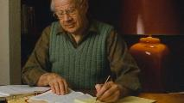
J. Dwight Pentecost
Things to Come, Page 168
“The early church lived in the light of the belief in the imminent return of Christ. Their expectation was that Christ might return at any time. Pre-tribulationism is the only position consistent with this doctrine of imminence.”

Slide 21
Post-tribulationalism’s Appeal to Antiquity?
First, the issue is not when the view became popular but if it is taught in the Bible.
Second, the notion that the earliest Church Fathers were universally post-tribulational is a highly debatable proposition.
Third, prophetic truth is designed by the Holy Spirit to become progressively more understandable as the world approaches the allotted time period when the prophecies will be fulfilled.

Slide 22

“The Rapture” a Traditional
Doctrine Now Being Recovered
Sola scriptura
Negative influence of Augustine and Origen
Pseudo Ephraem (4th-6th century A.D.)
Progressive illumination

Slide 23

Jude 3
“Beloved, while I was making every effort to write you about our common salvation, I felt the necessity to write to you appealing that you contend earnestly for the faith which was once for all handed down to the saints.”

Slide 24
Revelation 22:18-19
“I testify to everyone who hears the words of the prophecy of this book: if anyone adds to them, God will add to him the plagues which are written in this book; ¹⁹ and if anyone takes away from the words of the book of this prophecy, God will take away his part from the tree of life and from the holy city, which are written in this book.”

Slide 25

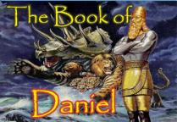
Daniel 12:4, 9
“⁴ But as for you, Daniel, conceal these words and seal up the book until the end of time; many will go back and forth, and knowledge will increase...⁹ Go your way, Daniel, for these words are concealed and sealed up until the end time.”

Slide 26
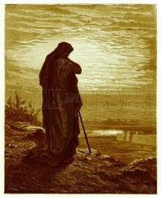
Amos 8:12
“People will stagger from sea to sea And from the north even to the east; They will go to and fro to seek the word of the Lord, But they will not find it.”

Slide 27
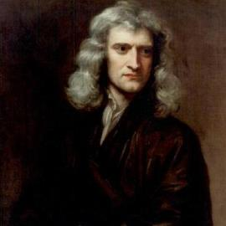
Sir Isaac Newton
(1642–1727)
"About the time of the end, a body of men will be raised up who will turn their attention to the Prophecies, and insist upon their literal interpretation, in the midst of much clamor and opposition."
Isaac Newton cited in Nathaniel West, The Thousand Years in Both Testaments, 462.

Slide 28

Daniel 8:27
“Then I, Daniel, was exhausted and sick for days. Then I got up again and carried on the king’s business; but I was astounded at the vision, and there was none to explain it.”

Slide 29
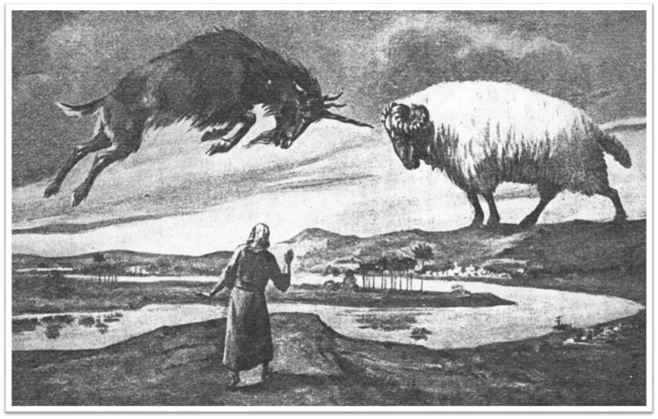

Slide 30
CHAPTER AND VERSE IN DANIEL | CHRONOLOGICAL DATE | BIBLICAL DATE
1:1 | 605 | 3rd year of Jehoiakim
2:1 | 603 | 2nd year of Nebuchadnezzar
5 | Sat. night 10/12/539 (Hoehner)
7:1 | 553 | 1st year of Belshazzar
8:1 | 551 | 3rd year of Belshazzar
9:1 | 538 | 1st year of Darius
10:1 | 536 | 3rd year of Cyrus

Slide 31

1 Peter 1:10-11
¹⁰ As to this salvation, the prophets who prophesied of the grace that would come to you made careful searches and inquiries, ¹¹ seeking to know what person or time the Spirit of Christ within them was indicating as He predicted the sufferings of Christ and the glories to follow.

Slide 32
History of Doctrine
Canon (A.D. 180)
Christology (A.D. 500)
Atonement (A.D. 1100)
Salvation (A.D. 1500)
Eschatology (A.D. 1800)

Slide 33
James Orr
The Progress of Dogma (Grand Rapids: Eerdmans, 1952), 21-31.
Orr outlines the progress of Christian dogma in a similar way. “The second century was the age of Apologetics. The doctrine of God and especially the Trinity then took center stage in the third and fourth centuries as the Church dealt with the Monarchian, Arian, and Macedonian controversies. Anthropology then became the Church's focus in the early fifth century during the Augustinian and Pelagian controversies...The late fifth and then sixth and seventh centuries were characterized by an ecclesiastical interest in Christological (Nestorian, Eutychian, Monphysite, Monothelite) matters. In the . . .

Slide 34
James Orr
The Progress of Dogma (Grand Rapids: Eerdmans, 1952), 21-31.
“. . .sixteenth century the reformers focused upon salvific or Soteriological concerns. Finally, the Church gave itself to correcting a Mythical and Mediaeval pre-reformation Eschatology.” Thus, Eschatology was the last of the branches of theology to be systematized since it was not designed to be progressively unsealed or illuminated by the Holy Spirit until just before the fulfillment of the predicted events (Dan. 12:4, 8-9).

Slide 35
Post-tribulation Rapture Theory
According to 1 Thessalonians 4:16 and 1 Corinthians 15:52, the rapture will take place at the sounding of the last trumpet which, according to Matthew 24:30-31, will take place upon Christ's return at the end of the Tribulation period.
The Rapture is found in Revelation 19:11-21.
According to Revelation 20:4-6, the resurrection of all believers will transpire at the end of the Tribulation period thereby necessitating that the rapture will also take place at this time.

Slide 36
Post-tribulation Rapture Theory
Although the church is exempted from God's wrath, the church will be on the earth during the entire Tribulation period because the Book of Revelation portrays God's people being supernaturally protected from many of the apocalyptic judgments during this time period.
The post-tribulational rapture position has been the dominant view held by theologians throughout the history of the church.

Slide 37
Post-tribulation Rapture Theory Problems
Who will populate the millennium?
The Hebrew Wedding Sequence.
The Pointlessness of the Preparation of the Believers' Heavenly Dwelling Places in John 14:1-3.
The Lack of Time necessary for the Bema Seat Judgment of Christ and the Marriage of the Lamb.
The Pointlessness of the Church Being Caught Up Only to Immediately Return to the Earth.

Slide 38
Post-tribulation Rapture Theory Problems
Who will populate the millennium?
The Hebrew Wedding Sequence.
The Pointlessness of the Preparation of the Believers' Heavenly Dwelling Places in John 14:1-3.
The Lack of Time necessary for the Bema Seat Judgment of Christ and the Marriage of the Lamb.
The Pointlessness of the Church Being Caught Up Only to Immediately Return to the Earth.

Slide 39

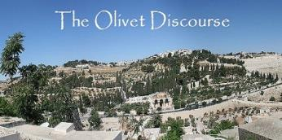
Matthew 24:21-22
“²¹ For then there will be a great tribulation, such as has not occurred since the beginning of the world until now, nor ever will. ²² Unless those days had been cut short, no life would have been saved; but for the sake of the elect those days will be cut short.”

Slide 40
Ezekiel 20:33-38
³³ “As I live,” declares the Lord God, “surely with a mighty hand and with an outstretched arm and with wrath poured out, I shall be king over you. ³⁴ I will bring you out from the peoples and gather you from the lands where you are scattered, with a mighty hand and with an outstretched arm and with wrath poured out; ³⁵ and I will bring you into the wilderness of the peoples, and there I will enter into judgment . . .

Slide 41
Ezekiel 20:33-38
…with you face to face. ³⁶ As I entered into judgment with your fathers in the wilderness of the land of Egypt, so I will enter into judgment with you,” declares the Lord God. ³⁷ “I will make you pass under the rod, and I will bring you into the bond of the covenant; ³⁸ and I will purge from you the rebels and those who transgress against Me; I will bring them out of the land where they sojourn, but they will not enter the land of Israel. Thus you will know that I am the Lord.

Slide 42
Scripture’s Four Judgments
NAME | SHEEP & GOAT | JUDGMENT OF THE JEWS | BEMA SEAT | GREAT WHITE THRONE
SCRIPTURE | Matt 25:31-46 | Ezek 20:33-44 | 1 Cor 3:10-15 | Rev 20:11-15
PLACE | Earth, Jerusalem | Earth, wilderness | Heaven | Earth
AUDIENCE | Gentile Tribulation survivors | Jewish Tribulation survivors | Church Age believers | All unsaved
WHEN | After Tribulation | After Tribulation | After rapture | After Millennium
PURPOSE | Saved Gentiles enter kingdom | Saved Jews enter kingdom | Reward believers | Degree of punishment in hell
EVALUATION | Treatment of Christ’s brethren | Passing under shepherd’s rod | Works taken through fire | Not in the book; judged by books

Slide 43

Revelation 20:7-9
“⁷ When the thousand years are completed, Satan will be released from his prison, ⁸ and will come out to deceive the nations which are in the four corners of the earth, Gog and Magog, to gather them together for the war; the number of them is like the sand of the seashore. ⁹ And they came up on the broad plain of the earth and surrounded the camp of the saints and the beloved city, and fire came down from heaven and devoured them.

Slide 44
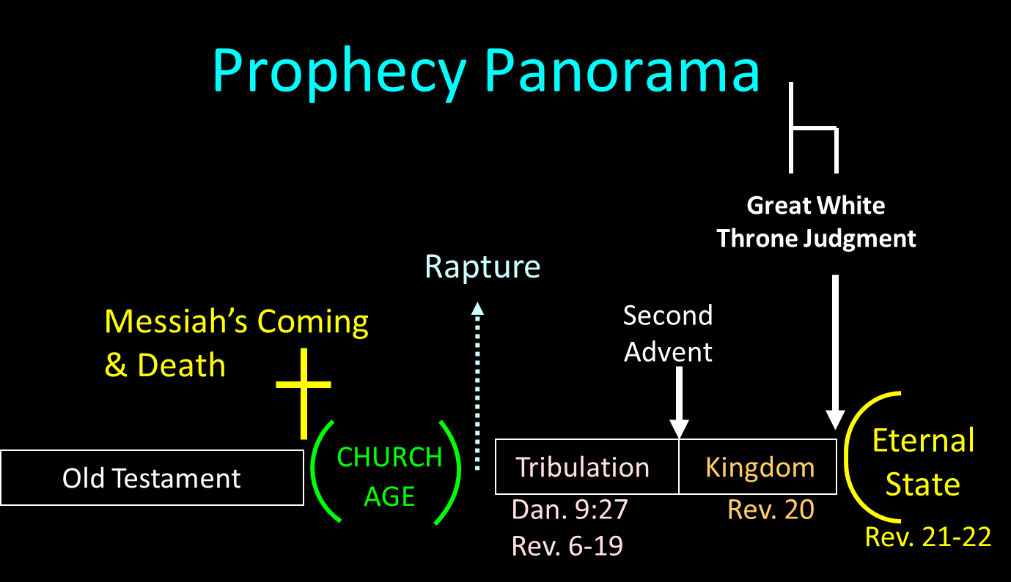

Slide 45


Matthew 22:30
“For in the resurrection they neither marry nor are given in marriage, but are like angels in heaven.”

Slide 46

1 Corinthians 15:50-51
“⁵⁰ Now I say this, brethren, that flesh and blood cannot inherit the kingdom of God; nor does the perishable inherit the imperishable. ⁵¹ Behold, I tell you a mystery; we will not all sleep, but we will all be changed.”

Slide 47


Psalm 51:5
“Behold, I was brought forth in iniquity,
And in sin my mother conceived me.”

Slide 48
Jeremiah 17:9
“The heart is more deceitful than all else And is desperately sick; Who can understand it?.”

Slide 49


Romans 5:12
“Therefore, just as through one man sin entered into the world, and death through sin, and so death spread to all men, because all sinned—.”

Slide 50

Zechariah 14:16-18
“Then it will come about that any who are left of all the nations that went against Jerusalem will go up from year to year to worship the King, the Lord of hosts, and to celebrate the Feast of Booths. ¹⁷ And it will be that whichever of the families of the earth does not go up to Jerusalem to worship the King, the Lord of hosts, there will be no rain on them. ¹⁸ If the family of Egypt does not go up or enter, then no rain will fall on them; it will be the plague with which the Lord smites the nations who do not go up to celebrate the Feast of Booths.”

Slide 51

Revelation 20:7-9
“⁷ When the thousand years are completed [teleō], Satan will be released from his prison, ⁸ and will come out to deceive the nations which are in the four corners of the earth, Gog and Magog, to gather them together for the war; the number of them is like the sand of the seashore. ⁹ And they came up on the broad plain of the earth and surrounded the camp of the saints and the beloved city, and fire came down from heaven and devoured them.”

Slide 52

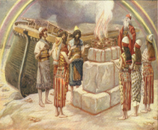
Genesis 8:21
The Lord smelled the soothing aroma; and the Lord said to Himself, “I will never again curse the ground on account of man, for the intent of man’s heart is evil from his youth; and I will never again destroy every living thing, as I have done.[emphasis mine].

Slide 53

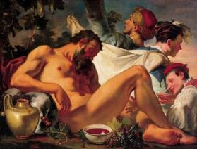
Genesis 9:20-21
“²⁰ Then Noah began farming and planted a vineyard. ²¹ He drank of the wine and became drunk, and uncovered himself inside his tent.”

Slide 54
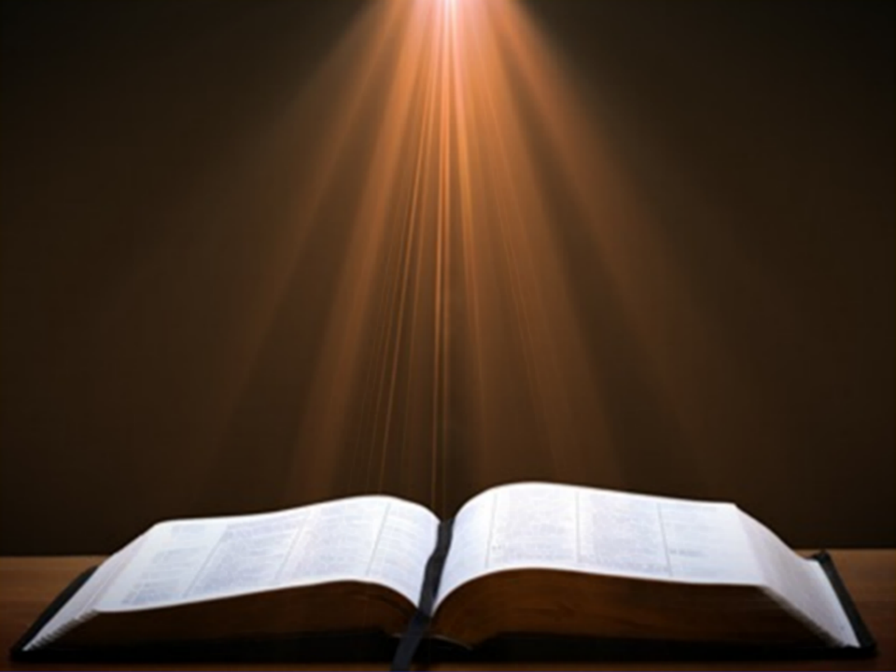
Genesis 11:6
The Lord said, “Behold, they are one people, and they all have the same language. And this is what they began to do, and now nothing which they purpose to do will be impossible for them.”

Slide 55
What is the Rapture?
An important doctrine
Distinct from the Second Advent
Catching away of all living believers (1 Thess 4:17)
Reunion (1 Thess 4:14-16)
Resurrection (1 Cor 15:50-54)
Exemption from death (1 Cor 15:51, 54-56)
Instantaneous (1 Cor 15:52)
Mystery (1 Cor 15:51)
Imminent (1 Cor 15:51; 1 Thess 4:15)
Traditional doctrine now being recovered

Slide 56
1 Thessalonians 4:16-18
¹⁶ For the Lord Himself will descend from heaven with a shout, with the voice of the archangel and with the trumpet of God, and the dead in Christ will rise first. ¹⁷ Then we who are alive and remain will be caught up [harpazō] together with them in the clouds to meet the Lord in the air, and so we shall always be with the Lord. ¹⁸ Therefore comfort one another with these words."

Slide 57
1 Corinthians 15:50-51
“⁵⁰ Now I say this, brethren, that flesh and blood cannot inherit the kingdom of God; nor does the perishable inherit the imperishable. ⁵¹ Behold, I tell you a mystery; we will not all sleep, but we will all be changed.”

Slide 59
Scripture’s Four Judgments
NAME | SHEEP & GOAT | JUDGMENT OF THE JEWS | BEMA SEAT | GREAT WHITE THRONE
SCRIPTURE | Matt 25:31-46 | Ezek 20:33-44 | 1 Cor 3:10-15 | Rev 20:11-15
PLACE | Earth, Jerusalem | Earth, wilderness | Heaven | Earth
AUDIENCE | Gentile Tribulation survivors | Jewish Tribulation survivors | Church Age believers | All unsaved
WHEN | After Tribulation | After Tribulation | After rapture | After Millennium
PURPOSE | Saved Gentiles enter kingdom | Saved Jews enter kingdom | Reward believers | Degree of punishment in hell
EVALUATION | Treatment of Christ’s brethren | Passing under shepherd’s rod | Works taken through fire | Not in the book; judged by books

Slide 60
Ezekiel 20:33-38
³³ “As I live,” declares the Lord God, “surely with a mighty hand and with an outstretched arm and with wrath poured out, I shall be king over you. ³⁴ I will bring you out from the peoples and gather you from the lands where you are scattered, with a mighty hand and with an outstretched arm and with wrath poured out; ³⁵ and I will bring you into the wilderness of the peoples, and there I will enter into judgment . . .

Slide 61
Ezekiel 20:33-38
…with you face to face. ³⁶ As I entered into judgment with your fathers in the wilderness of the land of Egypt, so I will enter into judgment with you,” declares the Lord God. ³⁷ “I will make you pass under the rod, and I will bring you into the bond of the covenant; ³⁸ and I will purge from you the rebels and those who transgress against Me; I will bring them out of the land where they sojourn, but they will not enter the land of Israel. Thus you will know that I am the Lord.

Slide 63
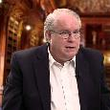
Ron Rhodes
Ron Rhodes, The Big Book of Bible Answers: A Gude to Understanding the Most Challenging Questions (Eugene, OR: Harvest, 2013), 276..
“If post-tribulationism is correct, then who will populate the millennial kingdom in mortal bodies? That is a very good question. Scripture is clear that people who become believers during the tribulation period will enter into Christ's millennial kingdom in their mortal bodies. Scripture says they will be married, bear children, grow old, and die (see Isaiah 65:20; Matthew 25:31–46). This is where the problem emerges for post-tribulationism. Obviously, if all believers are raptured at the second coming, no believers are left to enter the millennial kingdom in their mortal bodies. This is no problem for pretribulationism, which teaches that after the rapture, many will become believers during the tribulation.”

Slide 64
Conclusion

Slide 65
Post-tribulation Rapture Theory Problems
Who will populate the millennium?
The Hebrew Wedding Sequence.
The Pointlessness of the Preparation of the Believers' Heavenly Dwelling Places in John 14:1-3.
The Lack of Time necessary for the Bema Seat Judgment of Christ and the Marriage of the Lamb.
The Pointlessness of the Church Being Caught Up Only to Immediately Return to the Earth.

