Slide 1
PRACTICAL RIGHTEOUSNESS
Dr. Andy Woods
Senior Pastor – Sugar Land Bible Church
President – Chafer Theological Seminary

Slide 2
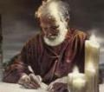
Answering Eleven Questions
Who wrote it? – James
What do we know about the author? – Christ’s ½ Brother
Who was the audience? – Believing Jews in the Diaspora
Where was if written from? – Jerusalem
When was the book written? – A.D. 44‒47
What was the book’s occasion? – Practical righteousness
What is the book’s purpose? – Achieving practical righteousness
What is the book about? – Practical righteousness
What is the book’s theme? – Daily living
What makes the book different? – Practicality
How is the book organized? – Faith and Wisdom

Slide 3
JAMES STRUCTURE
Faith (James 1:1‒3:12)
Wisdom (James 3:13‒5:20)

Slide 4
JAMES STRUCTURE
Faith (James 1:1‒3:12)
Wisdom (James 3:13‒5:20)

Slide 5
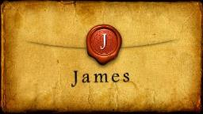
JAMES STRUCTURE
Faith (1:1–3:12)
Trials (1:2-18)
Obedience to the Word (1:19-27)
Favoritism (2:1-13)
Faith manifesting works (2:14-26)
Tongue (3:1-12)

Slide 6
JAMES STRUCTURE
Faith (1:1–3:12)
Trials (1:2-18)
Obedience to the Word (1:19-27)
Favoritism (2:1-13)
Faith manifesting works (2:14-26)
Tongue (3:1-12)

Slide 7
James 1:2-18
Trials – Jas 1:2-18
Rejoicing during trials – Jas 1:2-12
Command not to charge God with temptation – Jas 1:13-18

Slide 8
JAMES STRUCTURE
Faith (1:1–3:12)
Trials (1:2-18)
Obedience to the Word (1:19-27)
Favoritism (2:1-13)
Faith manifesting works (2:14-26)
Tongue (3:1-12)

Slide 9
Faith Obeys God (James 1:19-27)
Need for Slowness in Speaking & Anger (1:19-20)
Need for Obedience to God’s Word (1:21-25)
Need for True Religion (1:26-27)

Slide 10
JAMES STRUCTURE
Faith (1:1–3:12)
Trials (1:2-18)
Obedience to the Word (1:19-27)
Favoritism (2:1-13)
Faith manifesting works (2:14-26)
Tongue (3:1-12)

Slide 11
Favoritism (2:1-13)
Command: no favoritism (2:1)
Situation: favoritism in the assembly (2:2-3)
Reasoning: favoritism is contrary to God’s character & purposes (2:4-13)

Slide 12
JAMES STRUCTURE
Faith (1:1–3:12)
Trials (1:2-18)
Obedience to the Word (1:19-27)
Favoritism (2:1-13)
Faith manifesting works (2:14-26)
Tongue (3:1-12)

Slide 13
Three Tenses of Salvation
Phase | Justification | Sanctification | Glorification
Tense | Past | Present | Future
Saved from sin’s: | Penalty | Power | Presence
Scripture | Eph 2:8-9; Titus 3:5 | Philip 2:12 | Rom 5:10
Nature | Single | Dual | Single

Slide 14
Faith Obeys God (James 1:19-27)
Need for Slowness in Speaking & Anger (1:19-20)
Need for Obedience to God’s Word (1:21-25)
Need for True Religion (1:26-27)

Slide 15
Favoritism (2:1-13)
Command: no favoritism (2:1)
Situation: favoritism in the assembly (2:2-3)
Reasoning: favoritism is contrary to God’s character & purposes (2:4-13)

Slide 16
III. Reasoning: Favoritism is Contrary to God’s Character & Purposes (2:4-13)
We judge where God has not (4)
God elects all (2:5)
Rich oppressors (2:6-7)
Favoritism violates God’s Law (2:8-11)
God will judge those showing favoritism (2:12-13)

Slide 17
JAMES STRUCTURE
Faith (1:1–3:12)
Trials (1:2-18)
Obedience to the Word (1:19-27)
Favoritism (2:1-13)
Faith manifesting works (2:14-26)
Tongue (3:1-12)

Slide 18
Faith Manifesting Works (2:14-26)
Thesis: works accompany useful faith (2:14)
Five illustrations (2:15-26)
Needy brother (2:15-17)
Demonic monotheist (2:18-19)
Abraham (2:20-24)
Rahab (2:25)
Lifeless corpse (2:26)

Slide 19
Faith Manifesting Works (2:14-26)
Thesis: works accompany useful faith (2:14)
Five illustrations (2:15-26)
Needy brother (2:15-17)
Demonic monotheist (2:18-19)
Abraham (2:20-24)
Rahab (2:25)
Lifeless corpse (2:26)

Slide 20
Faith Manifesting Works (2:14-26)
Thesis: works accompany useful faith (2:14)
Five illustrations (2:15-26)
Needy brother (2:15-17)
Demonic monotheist (2:18-19)
Abraham (2:20-24)
Rahab (2:25)
Lifeless corpse (2:26)

Slide 21
Faith Manifesting Works (2:14-26)
Thesis: works accompany useful faith (2:14)
Five illustrations (2:15-26)
Needy brother (2:15-17)
Demonic monotheist (2:18-19)
Abraham (2:20-24)
Rahab (2:25)
Lifeless corpse (2:26)

Slide 22
Faith Manifesting Works (2:14-26)
Thesis: works accompany useful faith (2:14)
Five illustrations (2:15-26)
Needy brother (2:15-17)
Demonic monotheist (2:18-19)
Abraham (2:20-24)
Rahab (2:25)
Lifeless corpse (2:26)

Slide 23
James 2:14-26
“James does not call the belief of the demons a mere ‘recognition,’ but he states they actually ‘believe.’ In fact, their faith does cause them to ‘tremble.’ James’s point is that even the faith of demons results in some practical manifestation in their lives, so should not the genuine faith of these believers result in some profitable and demonstrable works toward other believers in need?”
Dennis Rokser, Faith & Works: A Clarification of “Faith Without Works is Dead,” p. 25

Slide 24
Faith Manifesting Works (2:14-26)
Thesis: works accompany useful faith (2:14)
Five illustrations (2:15-26)
Needy brother (2:15-17)
Demonic monotheist (2:18-19)
Abraham (2:20-24)
Rahab (2:25)
Lifeless corpse (2:26)

Slide 25
James 2:24
“You see that a man is justified [dikaioō] by works and not by faith alone.”

Slide 26
Harmony Between Paul and James
TERMS | PAUL | JAMES
Justification | Declaration of innocence before God | Evidence of usefulness of believer's faith before man
Save | Justification | Sanctification
Faith | Saving faith | Serving faith
Works | To gain favor with God | Believer's moral deeds

Slide 27
Matthew 12:33-37
“³³ Either make the tree good and its fruit good, or make the tree bad and its fruit bad; for the tree is known by its fruit. ³⁴ You brood of vipers, how can you, being evil, speak what is good? For the mouth speaks out of that which fills the heart. ³⁵ The good man brings out of his good treasure what is good; and the evil man brings out of his evil treasure what is evil. ³⁶ But I tell you that every careless word that people speak, they shall give an accounting for it in the day of judgment. ³⁷ For by your words you will be justified [dikaioō], and by your words you will be condemned.”

Slide 28
Thomas L. Constable
James notes, www.soniclight.com, 58.
“‘Abraham’ was declared righteous more than once. Most interpreters understand the first scriptural statement of his justification as describing his ‘new birth,’ to use the New Testament term (Gen. 15:6). This is when God declared Abraham righteous. James explained that about 20 years after Abraham was declared righteous, he was ‘justified’ again. Scripture consistently teaches that believers whom God declares righteous never lose their righteous standing before God (Rom. 5:1; 8:1; et al.). They do not need to be saved again. Abraham's subsequent, second ‘justification,’ evidently refers to …

Slide 29
Thomas L. Constable
James notes, www.soniclight.com, 58.
…a second declaration of his righteousness. James said this second time Abraham's works declared him righteous. They gave testimony (bore witness) to his faith. Works do not always evidence faith (v. 19), but sometimes they do. They do so, whenever a person who has become a believer by faith, continues to live by faith. Abraham is a good example of a believer whose good works (obedience to God) bore witness to his righteousness. He continued to live by faith, just as he had been declared righteous by faith.”

Slide 30
James 2:23
“and the Scripture was fulfilled which says, ‘And Abraham believed God, and it was reckoned to him as righteousness,’ [Gen. 15:16] and he was called the friend of God.” [Gen. 18:17]

Slide 31
John 15:14-15
“¹⁴ You are My friends if you do what I command you. ¹⁵ No longer do I call you slaves, for the slave does not know what his master is doing; but I have called you friends, for all things that I have heard from My Father I have made known to you.”

Slide 32
John 2:23-25
“²³ Now when He was in Jerusalem at the Passover, during the feast, many believed in (pisteuō eis) His name, observing His signs which He was doing. ²⁴ But Jesus, on His part, was not entrusting Himself to them, for He knew all men, ²⁵ and because He did not need anyone to testify concerning man, for He Himself knew what was in man.”

Slide 33
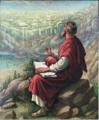
John 20:30-31
“³⁰ Therefore many other signs Jesus also performed in the presence of the disciples, which are not written in this book; ³¹ but these have been written so that you may believe (pisteuō eis) that Jesus is the Christ, the Son of God; and that believing you may have life in His name.”

Slide 34
John 20:30-31
“³⁰ Therefore many other signs Jesus also performed in the presence of the disciples, which are not written in this book; ³¹ but these have been written so that you may believe (pisteuō eis) that Jesus is the Christ, the Son of God; and that believing you may have life in His name.”

Slide 35
John 20:30-31
“³⁰ Therefore many other signs Jesus also performed in the presence of the disciples, which are not written in this book; ³¹ but these have been written so that you may believe (pisteuō eis) that Jesus is the Christ, the Son of God; and that believing you may have life in His name.”

Slide 36
 | SALVATION | FRIENDSHIP
CONDITION | FAITH | OBEDIENCE
Scripture | John 3:16 | John 15:14
Phase of Salvation | Justification | Sanctification
Benefit | Salvation From Sin’s Penalty | Divine Insight

Slide 38
Faith Manifesting Works (2:14-26)
Thesis: works accompany useful faith (2:14)
Five illustrations (2:15-26)
Needy brother (2:15-17)
Demonic monotheist (2:18-19)
Abraham (2:20-24)
Rahab (2:25)
Lifeless corpse (2:26)

Slide 39
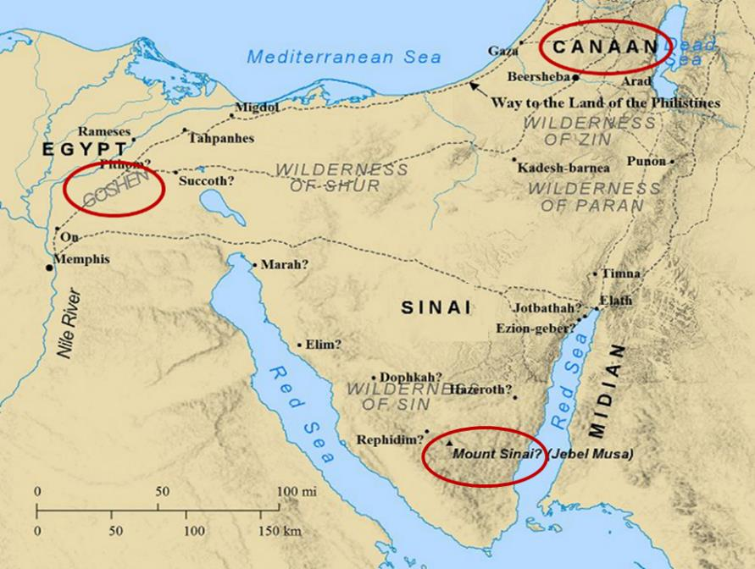

Slide 40
Joshua 2:9-13
“⁹ and said to the men, “I know that the Lord has given you the land, and that the terror of you has fallen on us, and that all the inhabitants of the land have melted away before you. ¹⁰ For we have heard how the Lord dried up the water of the Red Sea before you when you came out of Egypt, and what you did to the two kings of the Amorites who were beyond the Jordan, to Sihon and Og, whom you utterly destroyed. ¹¹ When we heard it, our hearts melted and no courage remained in any man . . .

Slide 41
Joshua 2:9-13
. . .any longer because of you; for the Lord your God, He is God in heaven above and on earth beneath. ¹² Now therefore, please swear to me by the Lord, since I have dealt kindly with you, that you also will deal kindly with my father’s household, and give me a pledge of truth, ¹³ and spare my father and my mother and my brothers and my sisters, with all who belong to them, and deliver our lives from death.”

Slide 42
James 2:25
“In the same way, was not Rahab the harlot also justified [dikaioō] by works when she received the messengers and sent them out by another way?”

Slide 43
Harmony Between Paul and James
TERMS | PAUL | JAMES
Justification | Declaration of innocence before God | Evidence of usefulness of believer's faith before man
Save | Justification | Sanctification
Faith | Saving faith | Serving faith
Works | To gain favor with God | Believer's moral deeds

Slide 44
Matthew 12:33-37
“³³ Either make the tree good and its fruit good, or make the tree bad and its fruit bad; for the tree is known by its fruit. ³⁴ You brood of vipers, how can you, being evil, speak what is good? For the mouth speaks out of that which fills the heart. ³⁵ The good man brings out of his good treasure what is good; and the evil man brings out of his evil treasure what is evil. ³⁶ But I tell you that every careless word that people speak, they shall give an accounting for it in the day of judgment. ³⁷ For by your words you will be justified [dikaioō], and by your words you will be condemned.”

Slide 45
Harmony Between Paul and James
TERMS | PAUL | JAMES
Justification | Declaration of innocence before God | Evidence of usefulness of believer's faith before man
Save | Justification | Sanctification
Faith | Saving faith | Serving faith
Works | To gain favor with God | Believer's moral deeds

Slide 46
Faith Manifesting Works (2:14-26)
Thesis: works accompany useful faith (2:14)
Five illustrations (2:15-26)
Needy brother (2:15-17)
Demonic monotheist (2:18-19)
Abraham (2:20-24)
Rahab (2:25)
Lifeless corpse (2:26)

Slide 47
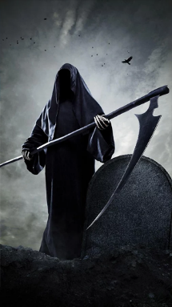
“Death” in the Old Testament
māwet: “Death is the consequences and the punishment of sin. It originated with sin. A grand theme of the Old Testament is God’s holiness, which separates Him from all that is in harmony with His character. Death, then, in the Old Testament means ultimate separation from God due to sin.”
Elmer B. Smick, “māwet," in Theological Wordbook of the Old Testament, ed. R. Laird Harris and Gleason L. Archer and Bruce K. Waltke(Chicago: Moody, 1980), 1:1169.
Notes:
Anachronistic exegetical fallacy death = annihilation

Slide 48
“Death” in the New Testament
thanatos: “that separation (whether natural or violent) of the soul from the body by which the life on earth is ended.”
Joseph Henry Thayer, Death - Thanatos, Greek-English Lexicon of the New Testament Being Grmm's Wilke's Clavis Novi Testamenti (Grand Rapids: Zondervan, 1977), 282.

Slide 49
Luke 16:22-25
“²² Now the poor man died and was carried away by the angels to Abraham’s bosom; and the rich man also died and was buried. ²³ In Hades he lifted up his eyes, being in torment, and saw Abraham far away and Lazarus in his bosom. ²⁴ And he cried out and said, ‘Father Abraham, have mercy on me, and send Lazarus so that he may dip the tip of his finger in water and cool off my tongue, for I am in agony in this flame.’ ²⁵ But Abraham said, ‘Child, remember that during your life you received your good things, and likewise Lazarus bad things; but now he is being comforted here, and you are in agony.”

Slide 50
James 2:14-26
“The word ‘dead’ in Scripture always carries the idea of ‘separation,’ never nonexistence. At physical death there is a separation of the soul and spirit from a person’s body, yet that person continues to exist either in Heaven or Hell. When we see the body of a deceased person lying in an open casket at a funeral, we do not conclude that the person never really existed in the first place.”
Dennis Rokser, Faith & Works: A Clarification of “Faith Without Works is Dead,” p. 22

Slide 51
James 2:14-26
“Just as there is a separation of the soul and spirit from the body without denying the reality of the soul and spirit, James is not denying the existence or reality of initial faith in Christ for first-tense salvation among his readers whose faith was separated from good works.”
Dennis Rokser, Faith & Works: A Clarification of “Faith Without Works is Dead,” p. 22

Slide 52
Harmony Between Paul and James
TERMS | PAUL | JAMES
Justification | Declaration of innocence before God | Evidence of usefulness of believer's faith before man
Save | Justification | Sanctification
Faith | Saving faith | Serving faith
Works | To gain favor with God | Believer's moral deeds

Slide 53
Lewis Sperry Chafer
Systematic Theology (Grand Rapids, MI: Kregel Publications, 1993), vol. 7, 148.
“In its larger usage, the word faith represents at least four varied ideas: (1) As above, it can be personal confidence in God. This the most common aspect of faith may be subdivided into three features: (a) Saving faith, which is the inwrought confidence in God’s promises and provisions respecting the Savior that leads one to elect to repose upon and trust in the One who alone can save. (b) Serving faith, which contemplates as true the fact of divinely bestowed gifts and all details respecting divine appointments for service. This faith is always a personal matter, and so one believer should not become a pattern for another. That such faith with its personal characteristic may be kept inviolate, …

Slide 54
Lewis Sperry Chafer
Systematic Theology (Grand Rapids, MI: Kregel Publications, 1993), vol. 7, 148.
“…the Apostle writes: “Hast thou faith? have it to thyself before God” (Rom. 14:22). Great injury may be wrought if one Christian imitates another in matters of appointment for service. (c) Sanctifying or sustaining faith, which lays hold of the power of God for one’s daily life. It is the life lived in dependence upon God, working upon a new life-principle (Rom. 6:4). The justified one, having become what he is by faith, must go ahead living on the same principle of utter dependence upon God.”

Slide 55
Romans 12:3-8
“³ For through the grace given to me I say to everyone among you not to think more highly of himself than he ought to think; but to think so as to have sound judgment, as God has allotted to each a measure of faith. ⁴ For just as we have many members in one body and all the members do not have the same function, ⁵ so we, who are many, are one body in Christ, and individually members one of another.…

Slide 56
Romans 12:3-8
…“⁶ Since we have gifts that differ according to the grace given to us, each of us is to exercise them accordingly: if prophecy, according to the proportion of his faith; ⁷ if service, in his serving; or he who teaches, in his teaching; ⁸ or he who exhorts, in his exhortation; he who gives, with liberality; he who leads, with diligence; he who shows mercy, with cheerfulness.”

Slide 57
1 Corinthians 3:10-12
“¹⁰ According to the grace of God which was given to me, like a wise master builder I laid a foundation, and another is building on it. But each man must be careful how he builds on it. ¹¹ For no man can lay a foundation other than the one which is laid, which is Jesus Christ. ¹² Now if any man builds on the foundation with gold, silver, precious stones, wood, hay, straw…”

Slide 58
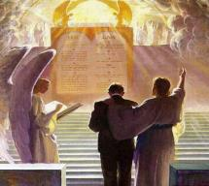
1 Corinthians 3:14-15
“¹⁴ If any man’s work which he has built on it remains, he will receive a reward. ¹⁵ If any man’s work is burned up, he will suffer loss; but he himself will be saved, yet so as through fire.”

Slide 59
CONCLUSION

Slide 60
Faith Manifesting Works (2:14-26)
Thesis: works accompany useful faith (2:14)
Five illustrations (2:15-26)
Needy brother (2:15-17)
Demonic monotheist (2:18-19)
Abraham (2:20-24)
Rahab (2:25)
Lifeless corpse (2:26)

Slide 61
JAMES STRUCTURE
Faith (1:1–3:12)
Trials (1:2-18)
Obedience to the Word (1:19-27)
Favoritism (2:1-13)
Faith manifesting works (2:14-26)
Tongue (3:1-12)

