Slide 1
Genesis 4
The First Murder and Continuation of the Messianic Promise

Slide 2
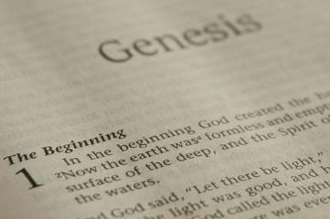
GENESIS STRUCTURE
Beginning of the Human race (Gen. 1‒11)
Beginning of the Hebrew race (Gen. 12‒50)

Slide 3
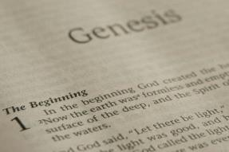
GENESIS STRUCTURE
Genesis 1-11 (four events)
Creation (1-2)
Fall (3-5)
Flood (6-9)
National dispersion (10-11)

Slide 4
GENESIS STRUCTURE
Genesis 1-11 (four events)
Creation (1-2)
Fall (3-5)
Flood (6-9)
National dispersion (10-11)

Slide 5
Genesis 4 Outline
First murder (Gen 4:1-15)
Ungodly line of Cain (4:16-24)
Godly line of Seth (4:25-26)

Slide 6
Genesis 4 Outline
First murder (Gen 4:1-15)
Ungodly line of Cain (4:16-24)
Godly line of Seth (4:25-26)

Slide 7
Genesis 4 Outline
First murder (Gen 4:1-15)
Ungodly line of Cain (4:16-24)
Godly line of Seth (4:25-26)

Slide 8
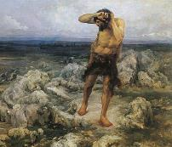
Ungodly Line of Cain (Gen 4:16-24)
Evil line that will not bring forth the Messiah (Gen 3:15)
Continuation of Cain’s line (4:16-18)
Immorality (4:19)
Technological but not spiritual advancement (4:20-22)
More immorality (4:23a)
Violence (4:23b)
Humanistic (4:24)

Slide 9
Ungodly Line of Cain (Gen 4:16-24)
Evil line that will not bring forth the Messiah (Gen 3:15)
Continuation of Cain’s line (4:16-18)
Immorality (4:19)
Technological but not spiritual advancement (4:20-22)
More immorality (4:23a)
Violence (4:23b)
Humanistic (4:24)

Slide 10
Genesis 2:24
For this reason a man shall leave his father and his mother, and be joined to his wife; and they shall become one flesh.

Slide 11
Revelation 9:20-21
“The rest of mankind, who were not killed by these plagues, did not repent of the works of their hands, so as not to worship demons, and the idols of gold and of silver and of brass and of stone and of wood, which can neither see nor hear nor walk; ²¹ and they did not repent of their murders nor of their sorceries (pharmakeia) nor of their immorality nor of their thefts.”

Slide 12
Ungodly Line of Cain (Gen 4:16-24)
Evil line that will not bring forth the Messiah (Gen 3:15)
Continuation of Cain’s line (4:16-18)
Immorality (4:19)
Technological but not spiritual advancement (4:20-22)
More immorality (4:23a)
Violence (4:23b)
Humanistic (4:24)

Slide 13
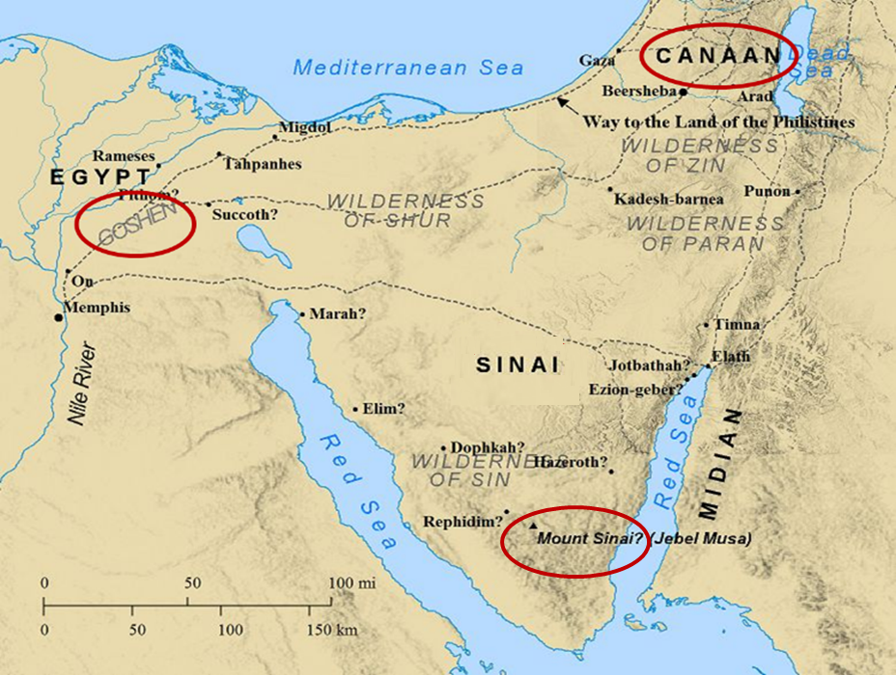

Slide 14
Genesis 6:11
“Now the earth was corrupt in the sight of God, and the earth was filled with violence.”

Slide 15
Revelation 9:20-21
“The rest of mankind, who were not killed by these plagues, did not repent of the works of their hands, so as not to worship demons, and the idols of gold and of silver and of brass and of stone and of wood, which can neither see nor hear nor walk; ²¹ and they did not repent of their murders nor of their sorceries (pharmakeia) nor of their immorality nor of their thefts.”

Slide 16
Ungodly Line of Cain (Gen 4:16-24)
Evil line that will not bring forth the Messiah (Gen 3:15)
Continuation of Cain’s line (4:16-18)
Immorality (4:19)
Technological but not spiritual advancement (4:20-22)
More immorality (4:23a)
Violence (4:23b)
Humanistic (4:24)

Slide 17
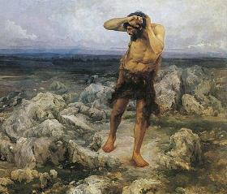
Provision of Protection Genesis 4:15
Divine Vengeance – Gen. 4:15a
Protective Mark – Gen. 4:15b

Slide 18
Humanist Beliefs
The non-existence or irrelevancy of god
Man as the center of all things
The reality of evolution
Man as an evolved animal rather than a special creature made in the image of his creator
The absence of any absolute morals or values
Confidence in the scientific method to solve the world’s problems
Eidsmoe, The Christian Legal Advisor, 180-87.

Slide 19
Fundamental Questions Christian Answers
“Who am I?” - a special creation of God
“Where did I come from?” - from God’s design
“Why am I here?” - to know and glorify God
“Where am I going?” - to heaven
“How can I get there?” - only through Jesus Christ

Slide 20
Fundamental Questions Humanistic Answers
“Who am I?” - a biological accident
“Where did I come from?” - from the primordial soup
“Why am I here?” - to fulfill self
“Where am I going?” - toward a planetary new world order
“How can I get there?” - the scientific method

Slide 21
Torcaso v. Watkins (1961)
“Among the religions in this country which do not teach what would generally be considered a belief in the existence of God are Buddhism, Taoism, Ethical Culture, Secular Humanism and others” (italics added).
Torcaso v. Watkins, 367 U.S. 488, 495, n. 11 (1961).

Slide 22
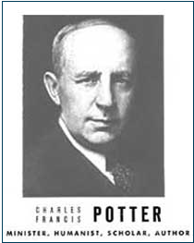
Humanist Proselytizing
“Education is thus a most powerful ally of Humanism, and every public school is a school of Humanism. What can the theistic Sunday-schools, meeting for an hour once a week, and teaching only a fraction of the children, do to stem the tide of a five-day program of humanistic teaching?”
Charles Francis Potter, Humanism: A New Religion (New York: Simon and Schuster, 1930), 128

Slide 23
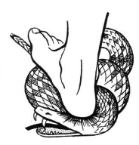
Genesis 3:15
“And I will put enmity Between you and the woman, And between your seed and her seed; He shall bruise you on the head, And you shall bruise him on the heel.”

Slide 24
Ungodly Line of Cain (Gen 4:16-24)
Evil line that will not bring forth the Messiah (Gen 3:15)
Continuation of Cain’s line (4:16-18)
Immorality (4:19)
Technological but not spiritual advancement (4:20-22)
More immorality (4:23a)
Violence (4:23b)
Humanistic (4:24)

Slide 25
Genesis 4 Outline
First murder (Gen 4:1-15)
Ungodly line of Cain (4:16-24)
Godly line of Seth (4:25-26)

Slide 26
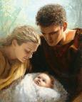
Godly Line of Seth (Gen 4:25-26)
Seth’s birth (4:25)
Enosh’s birth (4:26a)
Good line (4:26b) – How God continued the messianic line despite Satan’s attempt to preempt the messianic promise of Genesis 3:15

Slide 27
Godly Line of Seth (Gen 4:25-26)
Seth’s birth (4:25)
Enosh’s birth (4:26a)
Good line (4:26b) – How God continued the messianic line despite Satan’s attempt to preempt the messianic promise of Genesis 3:15

Slide 28
Satanic Attempts to Stop Messiah
Cain; Gen. 4, 1 Jn. 3:12
Sons of God; Gen. 6:1-4
Pharaoh; Ex. 1
Athaliah; 2 Chron. 22
Haman; Esther
Herod; Mt.2; Rev 12:4
Matt 4:5-7

Slide 29
Satanic Attempts to Stop Messiah
Cain; Gen. 4, 1 Jn. 3:12
Sons of God; Gen. 6:1-4
Pharaoh; Ex. 1
Athaliah; 2 Chron. 22
Haman; Esther
Herod; Mt.2; Rev 12:4
Matt 4:5-7

Slide 30
Godly Line of Seth (Gen 4:25-26)
Seth’s birth (4:25)
Enosh’s birth (4:26a)
Good line (4:26b) – How God continued the messianic line despite Satan’s attempt to preempt the messianic promise of Genesis 3:15

Slide 31
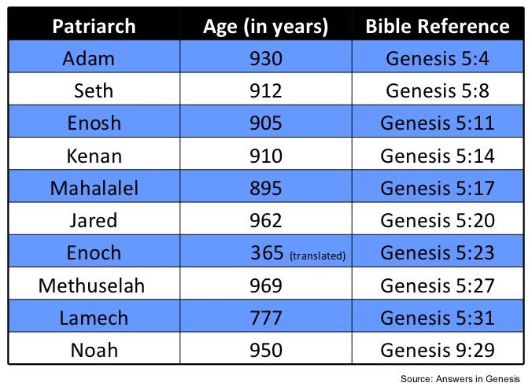

Slide 32
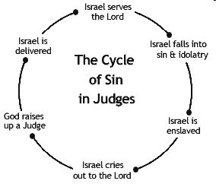

Slide 33
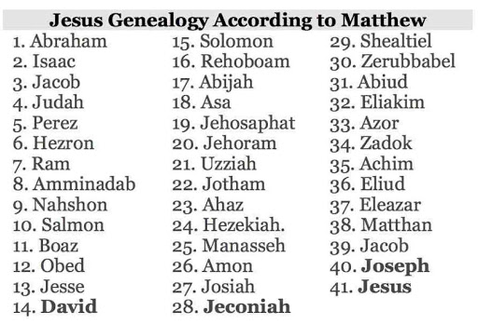

Slide 34
Godly Line of Seth (Gen 4:25-26)
Seth’s birth (4:25)
Enosh’s birth (4:26a)
Good line (4:26b) – How God continued the messianic line despite Satan’s attempt to preempt the messianic promise of Genesis 3:15

Slide 35
LINEAGE OF ADAM
UNGODLY LINE | GODLY LINE
Cain | Seth
Enoch | Enosh
Irad | Kenan
Mehujael | Mahalalel
Methushael | Jared
Lamech | Enoch
Juba, Tubal-Cain | Methuselah
 | Lamech
 | Noah
 | Shem, Ham, Japheth

Slide 36
Ungodly Line of Cain (Gen 4:16-24)
Evil line that will not bring forth the Messiah (Gen 3:15)
Continuation of Cain’s line (4:16-18)
Immorality (4:19)
Technological but not spiritual advancement (4:20-22)
More immorality (4:23a)
Violence (4:23b)
Humanistic (4:24)

Slide 37
Genesis 3:15
“And I will put enmity Between you and the woman, And between your seed and her seed; He shall bruise you on the head, And you shall bruise him on the heel.”

Slide 38
Renald Showers
What on Earth is God Doing: Satan’s Conflict with God (Bellmawr, NJ: Friends of Israel, 2003), 225.
“﻿SATAN WAS PRESENT IN EDEN TO hear God’s first promise of the coming Redeemer. He realized that it would be fatal for him and his cause if the Redeemer were to come. Thus Satan’s primary goal throughout Old Testament history became the prevention of the Redeemer’s coming. Sometime after Adam and Eve gave birth to Cain and Abel, it became evident that one son was godly in attitude and that the other was ungodly. Evidently Abel’s godly attitude convinced Satan that Abel was either the Redeemer or the one through whose line of descent the Redeemer would come.”

Slide 39
Renald Showers
What on Earth is God Doing: Satan’s Conflict with God (Bellmawr, NJ: Friends of Israel, 2003), 225.
“﻿Thus it became imperative to Satan to get rid of Abel. Inasmuch as Cain already was controlled by a rebellious, angry attitude, it didn’t take much to prompt him to kill his brother (Gen. 4:1–8). That Satan was involved in Cain’s slaying of his brother was made evident in 1 John 3:10–12. Because of Satan’s involvement Christ stated that the devil ‘was a murderer from the beginning’ (Jn. 8:44). Thus the first murder in history was committed because of Satan’s goal to prevent the Redeemer’s coming.”

Slide 40
Renald Showers
What on Earth is God Doing: Satan’s Conflict with God (Bellmawr, NJ: Friends of Israel, 2003), 226.
“In His war against Satan, God counteracted the murder of Abel by giving Adam and Eve another godly son named Seth (Gen. 4:25). Since this name means ‘substitute,’ it is apparent that God meant Seth to be a substitute for Abel. (H. C. Leupold, Exposition of Genesis, p. 226). The genealogies found in Genesis 5; 11:10–32; and Luke 3:23–38 reveal that God also intended the Redeemer to come through Seth’s line of descent.”

Slide 41
Conclusion

Slide 42
Genesis 4 Outline
First murder (Gen 4:1-15)
Ungodly line of Cain (4:16-24)
Godly line of Seth (4:25-26)

Slide 43
“The Lord bless you and keep you; the Lord make his face shine on you and be gracious to you; the Lord turn his face toward you and give you peace.” (NIV)

