Slide 1
Biblical Dispensationalism
Jim McGowan, MTS, Th.D.

Slide 2
What We’ve Covered So Far
Sessions 1-3: Introduction to Biblical Dispensationalism
Important Assumptions and Prerequisites
The Inspiration & Authority of Scripture
Definition of Biblical Dispensationalism
Biblical Dispensationalism is a theological system that emphasizes a CONSISTENT literal interpretation of the Bible, (including prophecy); recognizes a distinction between Israel and the church; and organizes the Bible into different dispensations, administrations, or economies.

Slide 3
What We’ve Covered So Far
Sessions 4-7: History of Biblical Dispensationalism
The Early Church
Justin Martyr – (A.D. 110–165)
Irenaeus – (A.D. 110–165)
Clement of Alexandria – (A.D. 150–220)
Augustine – (A.D. 354–430)
The Alexandrian Abdication
Two schools of opposing hermeneutical thought (Antiochian and Alexandrian) developed ~200 years after Christ, that greatly impacted the church for future generations.

Slide 4
What We’ve Covered So Far
Sessions 4-7: History of Biblical Dispensationalism
The Dark Ages
Lasted from the 4th to the 16th centuries (1200 yrs.)
Obsolescence of prophetic studies
Domination of Augustinian Amillennialism
Only one church: Roman Catholicism
The Bible is removed from the people
Illiteracy
Mass read in Latin
Church in need of rescue

Slide 5
What We’ve Covered So Far
Sessions 4-7: History of Biblical Dispensationalism
Positive Contributions of the Reformers
Emphasis on literal interpretation
Denunciation of allegorization
Rejection of church tradition as a guide
Priesthood of all believers
Bible translations
Literacy
Five solas
Rejection of celibacy of the priesthood

Slide 6
What We’ve Covered So Far
Sessions 4-7: History of Biblical Dispensationalism
The Reformers’ Incomplete Reforms
Selective literalism
“Irresponsibly” dealt with eschatology
Retained and Perpetuated Augustinian Amillennialism
Perpetuated Roman Catholicism’s Errors
Wanted to ‘reform’ not leave the Church
Infant baptism / Consubstantiation
Church = the earthly kingdom / Anti-Semitism

Slide 7
What We’ve Covered So Far
Sessions 4-7: History of Biblical Dispensationalism
Contemporary Reformation Theology
Erroneously assumes no further theological progress to be made.
Has Frozen theological progress: Creeds and confessions = authority rather than Scripture.
Augustinian Amillennialism fossilized into RT.
Eschatological texts are Commonly Allegorized (Zech. 14:4; Rev. 21-22; Ezek. 40-48)
Inconsistent literal hermeneutic.

Slide 8
What We’ve Covered So Far
Sessions 4-7: History of Biblical Dispensationalism
Dispensationalism's Contribution
Dispensational movement
Dispensational Systematized in 19th century
Key Dispensational Leaders
Reformers’ hermeneutic applied to the whole bible
Retrieved key doctrines: Chiliasm (Millennialism), Israel-church distinction, Pretribulationalism

Slide 9
What We’ve Covered So Far
Sessions 8-10: False Charges - Biblical Dispensationalism
Dispensationalists Teach More Than One Way of Salvation.
Dispensationalists are Guilty of Antinomianism
Dispensationalists Teach that the Sermon on the Mount is Not for the Church Today – “TRUE” and “FALSE”!
Dispensationalists Teach that the Death of Christ was an Afterthought and that the Church is "Plan B" in God's program.

Slide 10
What We’ve Covered So Far
Sessions 8-10: False Charges - Biblical Dispensationalism
Dispensationalism is a ‘New’ doctrine.
Dispensationalism Teaches a ‘Secret Rapture’.
Dispensationalism falsely claims that God made a bona fide offer of the Kingdom to Israel.
Dispensationalists revere C. I. Scofield but he was an immoral man, not qualified to be a spiritual leader.

Slide 11
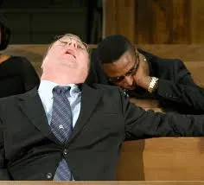
END OF REVIEW
FINALLY

Slide 12
THAT WAS YOUR 1ST LAUGH BREAK FOR THE EVENING!
ATTENTION!

Slide 13
Biblical Dispensationalism
Session 11
Israel and the Church

Slide 14
“Proper” Hermeneutics
– a CONSISTENTLY literal, or normal, interpretive grid which attaches to every word the same meaning that it would have in normal usage, whether in speaking, writing, or thinking. Often referred to as the “Literal, Historical, Grammatical,” method of interpretation.

Slide 15
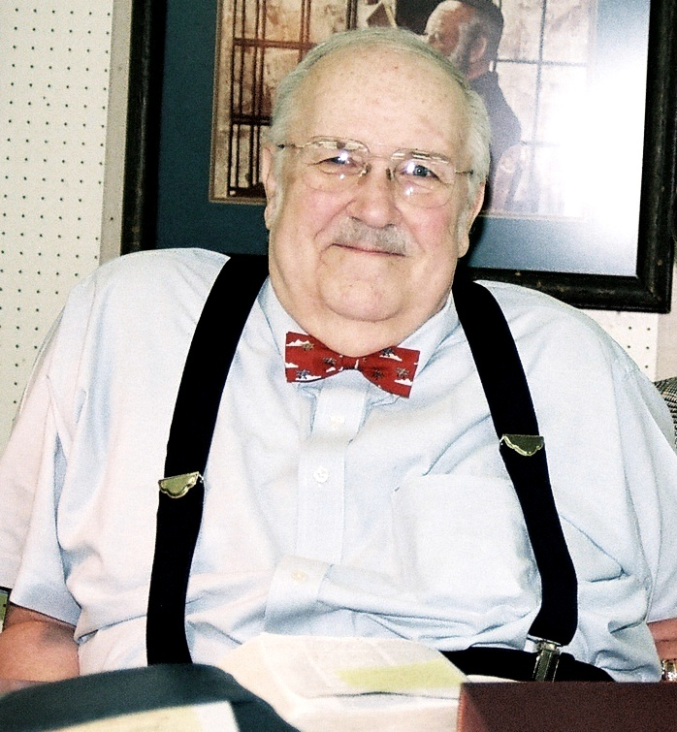
“Proper” Hermeneutics
Scripture interprets Scripture.
The meaning of words is to be established by their usage.
Context must be taken into account.
A grammatico-historical interpretation must be used.
The interpreter must begin assuming literal or normal interpretation in a passage unless otherwise indicated by common linguistic sense.
Figurative language such as poetry, figures of speech, metaphors, similes and illustrations attempt to convey very actual, even literal concepts.
Couch, M. (2000). An Introduction to Classical Evangelical Hermeneutics, A Guide to the History and Practice of Biblical Interpretation. Grand Rapids, MI: Kregel Publications.
Notes:
The Bible is a closed volume of literature, having a cohesive historical context that is obviously differentiated from all other writings.
The Holy Spirit chose human language to convey the Word of God. Thus, an ordinary use of language conveys to us what God wants us to know.
Words and thoughts must be understood within the setting, the time frame, the mood of the moment, the culture, etc.
A mastery of the historical setting and of the grammar used is imperative to comprehending the sense of a given sentence or paragraph.
Behind the poetry are literal concepts that in turn give meaning to the poetic language, i.e., “the hills skipped like lambs”
The Biblical interpreter must use common sense in interpreting figurative language.

Slide 16
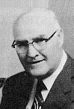
“Proper” Hermeneutics
THE “GOLDEN” RULE OF INTERPRETATION
When the plain sense of Scripture makes common sense, seek no other sense; therefore, take every word at its primary, ordinary, usual, and literal meaning unless the facts of the immediate context, studied in the light of related passages and axiomatic and fundamental truths, clearly indicate otherwise. – David L. Cooper

Slide 17
“Proper” Hermeneutics
“The one who spiritualizes tells spiritual lies.”

Slide 18
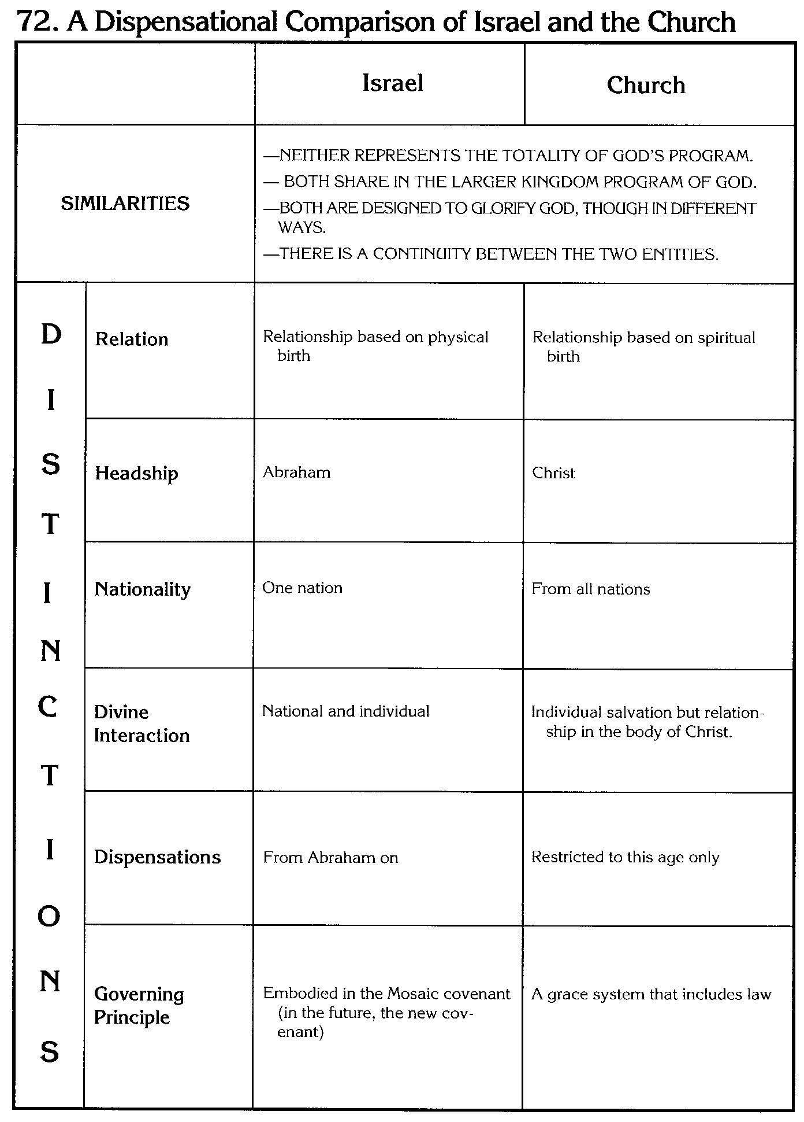
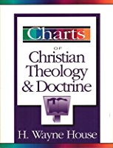
“Proper” Hermeneutics
Biblical Dispensationalism is a theological system that emphasizes a CONSISTENT literal interpretation of the Bible, (including prophecy); recognizes a distinction between Israel and the church; and organizes the Bible into different dispensations, administrations, or economies.

Slide 19
“Proper” Hermeneutics
Do biblical distinctions such as clarity of Identities & Relationships, ‘Really’ Matter?

Slide 20
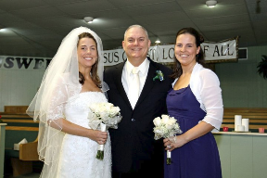
“Proper” Hermeneutics
Do biblical distinctions such as clarity of Identities & Relationships, ‘Really’ Matter?
My Wife
My Daughters.
Notes:
B. Does This Really Matter?
My wife and my daughters. Wife born in Houston, TX – Two daughters born in Houston, TX
Three females… one’s a wife, and two are daughters.
All born in the same city and state
All are part of the same family
All at one point had the same last name.
There’s a lot alike here isn’t there? And I love all three of them.
But it’s very important that I make a distinction regardless of what I see in common! If I fail to make the appropriate distinctions in spite of what is in common we’re going to have some big problems!
I can guarantee you that if I don’t keep the proper distinctions with regard to other women and my wife,… [CLICK HERE]
NEXT SLIDE

Slide 21
“Proper” Hermeneutics
Do Distinctions such as clarity of Identities & Relationships, ‘Really’ Matter?
Notes:
…she’s promised me that she will pluck that other woman baldheaded…She didn’t mention what she would do to me, [CLICK HERE] but…you get the idea.
NEXT SLIDE

Slide 22
THAT WAS YOUR FINAL LAUGH BREAK FOR THE EVENING!
ATTENTION!

Slide 23
“Proper” Hermeneutics
Do Distinctions such as clarity of Identities & Relationships, ‘Really’ Matter?
ABSOLUTELY!
Notes:
So, it’s very important then, in spite of what is in common, to see biblical distinctions and it matters greatly that we understand identities and relationships not only in our present earthly existence, but also in eternity.
NEXT SLIDE

Slide 24
“Proper” Hermeneutics
Do Distinctions such as clarity of Identities & Relationships, ‘Really’ Matter?
*Discontinuity Between Israel & the Church
 | ISRAEL | CHURCH
*clearly identifiable differences of characteristics
Notes:
CHART - *Discontinuity - clearly identifiable differences of characteristics

Slide 25
Discontinuity Between Israel & the Church
 | ISRAEL | CHURCH
Governing Principle | Law | NT
1. Relation to HS | Selective, temporary, subsequent | Universal, permanent, at moment of salvation
2. Farewell address | Olivet Discourse | Upper Room Discourse
3. Designation | First Born Son | Bride of Christ
4. Revealed in OT | Yes | No
5. Evangelism | Come & See | Go & Proclaim
6. Blessings | Earthly | Heavenly
7. Composition | Believers & Unbelievers | Believers Only
Notes:
CHART - Discontinuity Between Israel & the Church

Slide 26
A Comparison of the Olivet and Upper Room Discourses
Discourse | Olivet | Upper Room
Scripture | Matt 24─25 | John 13─17
Location | Mount of Olives | Upper Room
Passion week | Third day | Sixth day
General focus | Farewell: Israel | Hello: Church
Specific focus | Israel’s future | Divine provisions
Prompting | Temple's destruction | Christ's imminent departure
Explanations | Written OT | Unwritten NT
Apostles | Israel (Matt. 19:28) | Church (Eph. 2:20)
Notes:
CHART - A Comparison of the Olivet and Upper Room Discourses

Slide 27
Discontinuity Between Israel & the Church
 | ISRAEL | CHURCH
Governing Principle | Law | NT
1. Relation to HS | Selective, temporary, subsequent | Universal, permanent, at moment of salvation
2. Farewell address | Olivet Discourse | Upper Room Discourse
3. Designation | First Born Son | Bride of Christ
4. Revealed in OT | Yes | No
5. Evangelism | Come & See | Go & Proclaim
6. Blessings | Earthly | Heavenly
7. Composition | Believers & Unbelievers | Believers Only
Notes:
CHART - Discontinuity Between Israel & the Church

Slide 28
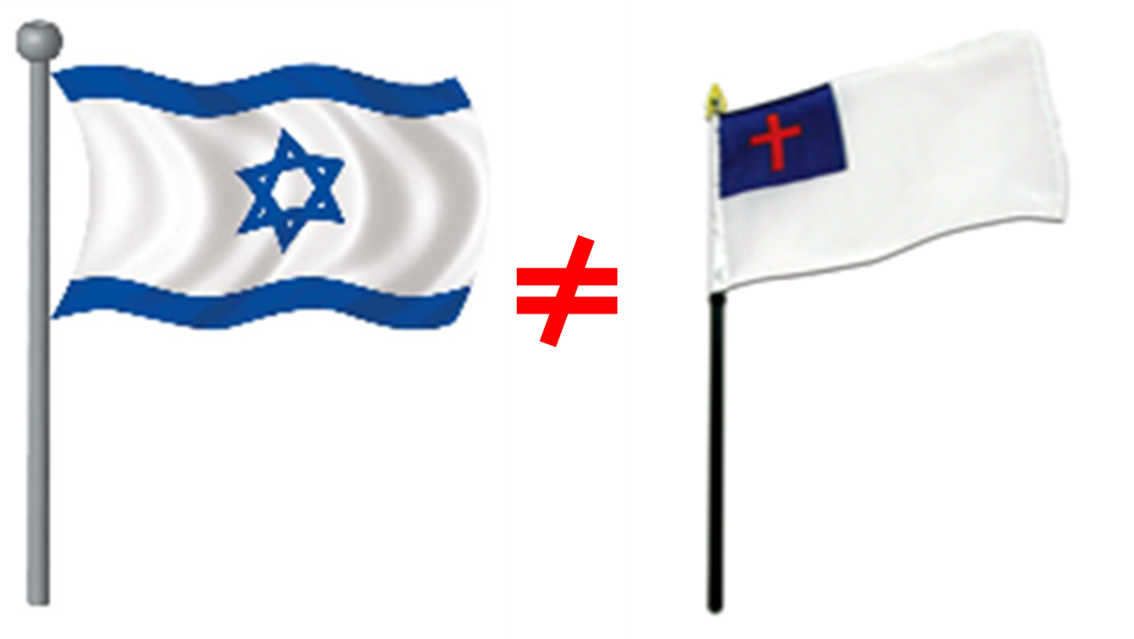
Israel and the Church
Comparison and Contrast
http://www.middletownbiblechurch.org/dispen/israelch.htm
Notes:
CHART - Israel and the Church Comparison and Contrast

Slide 29
A Comparison and Contrast Between Israel and the Church
ISRAEL | THE CHURCH
Israel is a nation chosen by God and sustained by covenant promises (Deut. 7:6-9). Not all individuals in this chosen nation are saved (Rom. 9:6; 11:28). | The Church is a called out assembly of believers who have been baptized into the body of Christ (1 Cor. 12:13). Every member of the body of Christ is saved, though there are multitudes of professing Christians who may not be saved (2 Tim. 2:19).
Israel traces its origin to Abraham, Isaac and Jacob (Jacob being the father of the twelve tribes). | The Church traces its origin to the day of Pentecost (Acts 2) when believers were first placed into the body of Christ.
In God’s program for Israel, His witnesses comprised a nation (Isaiah 43:10). | In God’s program for the Church, His witnesses are among all nations (Acts 1:8).
God’s program for Israel centered in Jerusalem (Matt. 23:37) and will again be centered in Jerusalem during the Tribulation (Matt. 24:15-20) and during the Millennium (Isa. 2:1-5). | God’s program for His Church began in Jerusalem and extended to the uttermost parts of the earth (Luke 24:47; Acts 1:8). The Church is identified with the risen Christ, not with any earthly city.

Slide 30
A Comparison and Contrast Between Israel and the Church
ISRAEL | THE CHURCH
The hope and expectancy of Israel was earthly, centering in the establishment of the Kingdom of the Messiah foretold by the prophets (Jer. 23:5-8; Isa. 2:1-5; 11:1-16). | The hope and expectancy of the Church is heavenly, centering in the glorious appearing of Christ to take His people to heaven (John 14:1-3; Phil. 3:20-21; Col. 3:1-4; 1 Thess. 4:13-18).
God’s purpose and program for Israel was revealed in the Old Testament Scriptures. | God’s purpose and program for the Church was a mystery not revealed in the Old Testament, but was revealed by the New Testament apostles and prophets (Eph. 3:5).
Israel’s history which is in view in Daniel 9:24 (the 70 weeks or 490 years) involved animal sacrifices. These years will include the tribulation. Israel’s millennial history will involve the same (Ezek. 43:27). | The Church’s history does not involve animal sacrifices. Messiah’s sacrifice is commemorated by means of the Lord’s Table.

Slide 31
A Comparison and Contrast Between Israel and the Church
ISRAEL | THE CHURCH
Israel’s history which is in view in Daniel 9:24 (the 490 years including also the Tribulation) involves a temple in Jerusalem. The same will be true in the Millennium (Ezek. chapters 40-48). | For the majority of the Church age there has been no Jewish temple in Jerusalem. In this age God manifests His glory in His believers, individually and collectively, designating them as His temple (1 Cor. 3:16; 6:19-20; Eph. 2:21-22). This is accomplished by the indwelling ministry of God the Holy Spirit.
Israel’s history which is in view in Daniel 9:24 (the 490 years) involves a priesthood limited to the sons of Aaron, and excluding most Israelites. The same applies to the Millennium when Zadokian priests (also sons of Aaron) will serve in the temple (Ezek. 40:46; 43:19; 44:15). | During the Church age every true believer is a priest and able to offer spiritual sacrifices to the Lord (Heb. 13:15; 1 Pet. 2:9; Rev. 1:6). Whereas Israel had a priesthood, the Church is a priesthood.
Israel’s prophetic history which is in view in Daniel 9:24 (the 490 years) will terminate with the 2nd Coming of the Messiah to the earth to establish His Kingdom reign. | The Church’s prophetic history will end at the Rapture of the Church when the fullness of the Gentiles comes in (1 Thess. 4:13-18; Rom. 11:25).

Slide 32
A Comparison and Contrast Between Israel and the Church
ISRAEL | THE CHURCH
During Israel’s history (the 490 years of Daniel 9:24 which also includes the Tribulation) the ethnic makeup of the world is bipartite: Jews and Gentiles. This division of all people into Jews and Gentiles will also apply to those in the Millennial Kingdom in natural bodies. | During the Church age from Pentecost to the Rapture the ethnic makeup of the world is tripartite: Jews, Gentiles, and the Church of God (1 Cor. 10:32), the Church being composed of saved Jews and Gentiles united together in one Body (Eph. 2:15; 3:6).
During Israel’s history, from Sinai to the Millennial Kingdom (excluding the Church age), Israel’s role in the world will be characterized by PRIORITY [that is, they will have a leading role as God’s chosen people]—see Deut. 4:6-8; Isa. 43:10; Matt. 10:5-6; Zech. 8:23. | During the Church age, Israel’s role in the world is characterized by EQUALITY—Jew and Gentiles united together in one body to bear testimony to a risen Christ (Col. 3:11; Gal. 3:28).
Male Jews were circumcised as a sign of the Abrahamic Covenant. Believing Jews were also circumcised in the heart (Jer. 4:4; Rom. 2:28–29). | Believers of this age enjoy an internal circumcision not made with hands (Col. 2:11; Phil. 3:3). Physical circumcision is not required.

Slide 33
A Comparison and Contrast Between Israel and the Church
ISRAEL | THE CHURCH
Israel was under the Law of Moses as a rule of life. | The Church is under Grace and the “new creature” rule of life (Gal. 6:15-16).
Unbelieving Jews were physical children of Abraham, Isaac, and Jacob, but spiritual children of the devil (John 8:37-44), as are all unbelievers, Jew and Gentile. | Every true believer in Christ, whether Jew or Gentile, is a spiritual child of Abraham and a child of God, through faith (Rom. 4:11-12; Gal. 3:26-29). This statement does not mean that Church age believers are Israelites.
Israel was to observe the Sabbath Day (Exodus 20:8). Sabbath observance will also take place in the Tribulation (Matt. 24:20) and in the Millennium (Ezek. 46:1,3). | The Church observes the Lord’s Day and is to be diligent and make every effort to enter into God’s faith rest (Acts 20:7; 1 Cor. 16:2; Heb. 4:9-11; Rev. 1:10). This is a daily duty.
Membership into the nation was by birth or by becoming a proselyte (a convert to Judaism). | Membership into the Church is by the new birth accomplished by the baptizing ministry of God (1 Cor. 12:13).
Notes:
Hebrews 4:9-11 - The Sabbath rest in view here is still future and is the rest (inheritance) that every generation of believers and every individual believer enters into when he or she, like God, faithfully finishes his or her work. …we Christians will enter into our rest when we receive our inheritance from Jesus Christ at His judgment seat (2 Cor. 5:10). Constable, T. (2003). (Heb 4:9). Galaxie Software.

Slide 34
A Comparison and Contrast Between Israel and the Church
Israel | The Church
Believing Jews prior to Pentecost, during the tribulation, and during the Kingdom reign of Christ are not members of the Body of Christ. | Believing Jews and Gentiles from Pentecost to the Rapture are members of the Body of Christ.
Israel’s place of worship is centered in Jerusalem (Dan. 6:10; John 4:20) and this will also be true in the Tribulation (Dan. 9:27) and in the Millennium (Isa. 2:1-5). | Christ is in the midst of His Churches (Rev. 1:13, 20). The Church’s place of worship is wherever believers are gathered together (Matt. 18:20; John 4:21-24).
Israel is likened to the wife of Jehovah, often an unfaithful wife (Hosea). | The Church is the beloved Bride of Christ (2 Cor. 11:2; Rev. 19:7-8) to be one day presented blameless and spotless (Eph. 5:27).
http://www.middletownbiblechurch.org/dispen/israelch.htm

Slide 35
Israel and the Church
Lewis Sperry Chafer’s 24 contrasts
Notes:
CHART - Lewis Sperry Chafer’s 24 contrasts

Slide 36
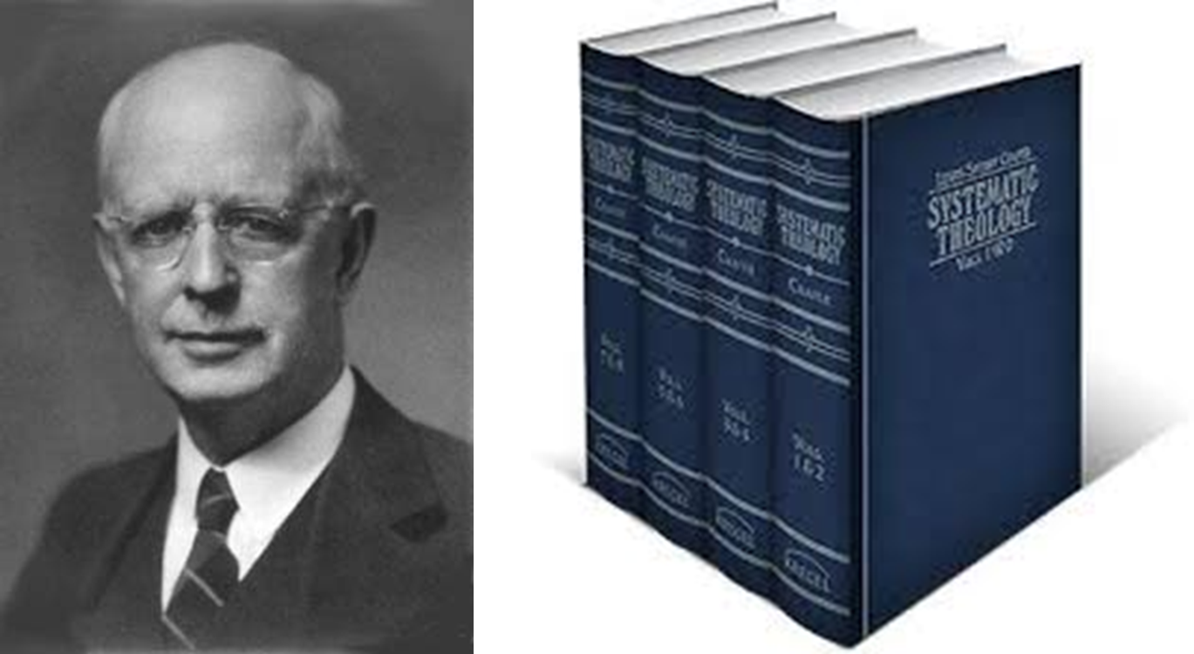
LEWIS SPERRY CHAFER SYSTEMATIC THEOLOGY Volume Four ECCLESIOLOGY ● ESCHATOLOGY

Slide 37
24 contrasts between Israel & the Church Systematic Theology, Volume 4, Pages 47-53
 | Israel | Church
1) The extent of Biblical revelation:
2) Two Divine purposes: | earthly promises & covenants | heavenly promises & covenants
3) The seed of Abraham, Isaac, and Jacob: | the physical seed, of whom some become a spiritual seed | a spiritual seed of Abraham
4) Birth: | physical birth | spiritual birth
5) Headship: | Abraham | Christ
6) Covenants: | Biblical Covenants Abrahamic to New Covenant | indirectly related to the Abrahamic and New Covenants
$${\sim 4}/5$$
$${\sim 1}/5$$

Slide 38
24 contrasts between Israel & the Church Systematic Theology, Volume 4, Pages 47-53
 | Israel | Church
7) Nationality: | one nation | Church—from all nations; not a nation
8) Divine dealing: | national and individual | individual only
9) Dispensations: | seen in all Dispensations from Abraham | a mystery seen only in this present age
10) Ministry: | no missionary activity or gospel to preach (come and see) | commissioned as a foreign missionary society (go & proclaim)
11) The death of Christ: | National guilt, but will be ultimately saved by it | a present & perfect salvation now
12) The Father: | known by titles, but not as the Father of the individual Israelite | individually begotten of God; Abba Father

Slide 39
24 contrasts between Israel & the Church Systematic Theology, Volume 4, Pages 47-53
 | Israel | Church
13) Christ: | Messiah, Immanuel, King | Savior, Lord, Bridegroom, Head
14) The Holy Spirit: | Temporary & exceptional filling | Permanent indwelling
15) Governing principle: | Law of Moses | Divine Grace
16) Divine enablement: | none | the indwelling Holy Spirit
17) Two farewell discourses: | Olivet Discourse (Farwell Israel) | Upper Room Discourse (Hello Church)
18) The promise of Christ’s return: | As King, in power & glory (2nd Coming) | to receive us to Himself (Rapture)
19) Position: | servants of Jehovah | “In Christ”; members of God’s household

Slide 40
24 contrasts between Israel & the Church Systematic Theology, Volume 4, Pages 47-53
 | Israel | Church
20) Christ’s earthly reign: | subjects of the King | co-reigners with the King
21) Priesthood: | had a priesthood | is a priesthood
22) Marriage: | Unfaithful, but restored, wife | bride to be married in heaven
23) Judgments: | must face God’s tribulation wrath | delivered from the wrath of God
24) Positions in eternity: | “spirits of just men made perfect” in the new earth | “church of the firstborn” in the new heavens

Slide 41
CONCLUSION

Slide 42
“Proper” Hermeneutics
Are there legitimate, identifiable, distinctions between Israel and the Church?
YES!
Notes:
NEXT SLIDE

Slide 43
ISRAEL IS NOT THE CHURCH
THE CHURCH IS NOT ISRAEL

Slide 44
Biblical Dispensationalism Session 12
What is a Dispensation?
The 8 Biblical Covenants
Notes:
NEXT SESSION 12
What is a Dispensation?
The 8 Biblical Covenants

Slide 45
Resources
Alva J. McClain, Law & Grace, Moody, 1967 978-088469-001-6
Charles C. Ryrie, Dispensationalism, Moody, 2007, 080242189X
Christopher Cone, gen. ed., Dispensationalism Tomorrow & Beyond, Tyndale Seminary Press, 2008 9780981479101
Christopher Cone, gen. ed., An Introduction To The New Covenant, Tyndale Seminary Press, 2013, 9781938484100
Walvoord, J. F., The Prophecy Knowledge Handbook. Wheaton, IL: Victor Books. 1990.
Lewis S. Chafer, Major Bible Themes, Zondervan, 1974, 0-310-22390-3
Mike Stallard, gen .ed., Dispensational Understanding of the New Covenant, Regular Baptist Books, 2012, 9781607764946
Paul Enns, The Moody Handbook of Theology, Moody 1989,
Renald E. Showers, There Really Is A Difference, Friend of Israel Gospel Ministry, 1990, 0915540509
Rene Pache, The Inspiration and Authority of Scripture, Sheffield Pub Co, 1992
Roy B. Zuck, Basic Bible Interpretation, SP Publications, 1991
Charting the End Times CD-Rom: A Visual Guide to Understanding Bible Prophecy, ISBN-10: 0736917624
Materials from:
Dr. Andy Woods, Sugar Land Bible Church, www.slbc.org
Dr. Vern Peterman, Holly Hills Bible Church, www.hollyhillsbiblechurch.org
George Zeller, Middletown Bible Church, www.middletownbiblechurch.org
Ed Allsteadt, Sugar Land Bible Church, www.slbc.org

