Slide 1


THE RAPTURE
What and When? – Part 19
Andrew Marshall Woods, Th.M., JD., PhD.
Sr. Pastor, Sugar Land Bible Church

Slide 2

What is the Rapture?
An important doctrine
Distinct from the Second Advent
Catching away of all living believers (1 Thess 4:17)
Reunion (1 Thess 4:14-16)
Resurrection (1 Cor 15:50-54)
Exemption from death (1 Cor 15:51, 54-56)
Instantaneous (1 Cor 15:52)
Mystery (1 Cor 15:51)
Imminent (1 Cor 15:51; 1 Thess 4:15)
Traditional doctrine now being recovered

Slide 3
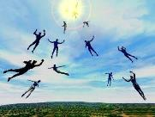
When Will the Rapture Take Place Relative to the Tribulation Period?
Pre-tribulation rapture theory
Mid-tribulation rapture theory
Post-tribulation rapture theory
Pre-wrath rapture theory
Partial rapture theory

Slide 4


Slide 5
When is the Rapture?
7 Arguments Favoring the Pre-Tribulation View
Tribulation's purpose concerns Israel (Jer 30:7; Dan 9:24)
No biblical reference to the church on earth during the Tribulation period (Rev 4-22)
Church is promised an exemption from divine wrath (1 Thess 1:10; 5:9; Rom 5:9; Rev 3:10; 6:17)
Rapture is imminent (1 Cor 15:51; 1 Thess 4:15)
Rapture is a comfort (1 Thess 4:18)
Antichrist cannot come to power until the restrainer is removed (2 Thess 2:6-7)
Symbolic parallels (2 Peter 2:5-9)

Slide 6
Strengthening the Pre-Tribulation Case
John 14:1-4
Revelation 3:10
First Thessalonians 4‒5
Second Thessalonians 2:3a
Matthew 24‒25

Slide 7


Apostasy or Rapture?
(2 Thessalonians 2:3A)
Dr. Andy Woods
Senior Pastor – Sugar Land Bible Church
President – Chafer Theological Seminary

Slide 8


2 Thessalonians 2:3
“Let no one in any way deceive you, for it will not come unless the apostasy [apostasia] comes first [prōton], and the man of lawlessness is revealed, the son of destruction.”

Slide 9


Slide 10

10 Reasons Favoring Physical Departure
There have always been doctrinal departures
2 Thess. was an early letter
The definite article before apostasia
Noun apostasia can refer to physical departure
Verb aphistēmi can refer to physical departure

Slide 11
10 Reasons Favoring Physical Departure
There have always been doctrinal departures
2 Thess. was an early letter
The definite article before apostasia
Noun apostasia can refer to physical departure
Verb aphistēmi can refer to physical departure

Slide 12
Order of Paul’s Letters
Galatians (A.D. 49)
1‒2 Thessalonians (A.D. 51)
1‒2 Corinthians (A.D. 56)
Romans (A.D. 57)
Ephesians, Colossians, Philemon, Philippians (A.D. 60‒62)
1 Timothy, Titus (A.D. 62‒66)
2 Timothy (A.D. 67)

Slide 13
10 Reasons Favoring Physical Departure
There have always been doctrinal departures
2 Thess. was an early letter
The definite article before apostasia
Noun apostasia can refer to physical departure
Verb aphistēmi can refer to physical departure

Slide 14

2 Thessalonians 2:3
“Let no one in any way deceive you, for it will not come unless the apostasy [apostasia] comes first, and the man of lawlessness is revealed, the son of destruction.”

Slide 15
10 Reasons Favoring Physical Departure
There have always been doctrinal departures
2 Thess. was an early letter
The definite article before apostasia
Noun apostasia can refer to physical departure
Verb aphistēmi can refer to physical departure

Slide 16

Entries for Apostasia in Liddell & Scott
Rebellion against God
Apostasy
Departure
Disappearance
Distance
Henry Liddell & Henry Scott, A Greek English Lexicon (Oxford: Oxford University Press, 1940), 218.

Slide 17
Entries for Apostasia in Lampe’s
A Patristic Greek Lexicon
Revolt
Defection
Apostasy from paganism, Judaism, Christianity, orthodoxy
Divorce
Departure
Standing aloof
G. W. H. Lampe, A Patristic Greek Lexicon (Oxford: Clarnedon Press, 1961), 208.

Slide 18

Definition of “Apostasy”
apos = away from
histēmi = to stand
Apostasy = to stand away from
Apostasy = a departure
A departure from what?
  From previously known truth
  Physically from something

Slide 19
10 Reasons Favoring Physical Departure
There have always been doctrinal departures
2 Thess. was an early letter
The definite article before apostasia
Noun apostasia can refer to physical departure
Verb aphistēmi can refer to physical departure

Slide 20
New Testament Meanings of Aphistēmi
15 New Testament uses
Spiritual departure – Luke 8:13; 1 Tim. 4:1; Heb. 3:12
Physical departure – Luke 2:37; 4:13; 13:27; Acts 5:37-38; 12:10; 13:13; 15:38; 19:9; 22:29; 2 Cor. 12:8; 2 Tim. 2:19

Slide 21
New Testament Meanings of Aphistēmi
15 New Testament uses
Spiritual departure – Luke 8:13; 1 Tim. 4:1; Heb. 3:12
Physical departure – Luke 2:37; 4:13; 13:27; Acts 5:37-38; 12:10; 13:13; 15:38; 19:9; 22:29; 2 Cor. 12:8; 2 Tim. 2:19

Slide 22
New Testament Meanings of Aphistēmi
15 New Testament uses
Spiritual departure – Luke 8:13; 1 Tim. 4:1; Heb. 3:12
Physical departure – Luke 2:37; 4:13; 13:27; Acts 5:37-38; 12:10; 13:13; 15:38; 19:9; 22:29; 2 Cor. 12:8; 2 Tim. 2:19

Slide 23

1 Timothy 4:1
“But the Spirit explicitly says that in later times some will fall away [aphistēmi] from the faith, paying attention to deceitful spirits and doctrines of demons.”

Slide 24
New Testament Meanings of Aphistēmi
15 New Testament uses
Spiritual departure – Luke 8:13; 1 Tim. 4:1; Heb. 3:12
Physical departure – Luke 2:37; 4:13; 13:27; Acts 5:37-38; 12:10; 13:13; 15:38; 19:9; 22:29; 2 Cor. 12:8; 2 Tim. 2:19

Slide 25
George Gunn
John 14:1-3 – The Father’s House: Are We There Yet?, 30. www.pre-trib.org
“I ran out of ingredients for the salad, so I decided to make a quick run down to the store. While at the store, I left the car engine running while I made my purchase, thinking that I would be right out again. However, while I was in the store, I ran into my good friend Edward who was running for county supervisor. This resulted in my having to endure a somewhat long-winded rundown on how his campaign was running. Finally, fearing that my car would run out of gas, I ran with great haste out to the parking lot and returned home with the car surely running only on fumes.”

Slide 26
Illegitimate Totality Transfer
“Unwarranted adoption of an expanded semantic field: The fallacy in this instance lies in the supposition that the meaning of a word in a specific context is much broader than the context itself allows and may bring with it the word’s entire semantic range. This step is sometimes called illegitimate totality transfer.”
D. A. Carson, Exegetical Fallacies, 2nd ed. (Grand Rapids, MI: Baker Academic, 1996), 60-61.

Slide 27

Acts 21:21
“and they have been told about you, that you are teaching all the Jews who are among the Gentiles to forsake [apostasia] Moses, telling them not to circumcise their children nor to walk according to the customs.”

Slide 28
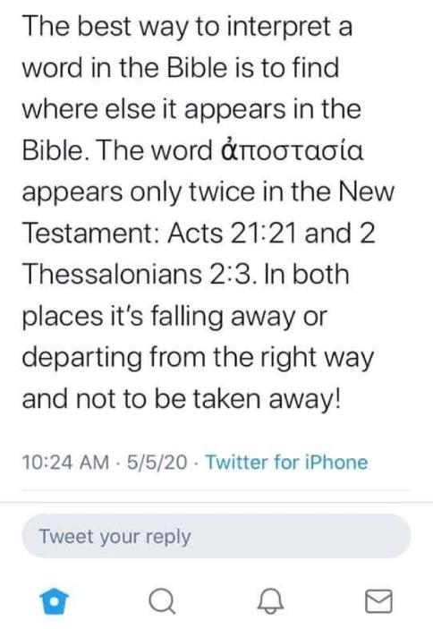

Slide 29
Acts 21:21
“and they have been told about you, that you are teaching all the Jews who are among the Gentiles to forsake [apostasia] Moses, telling them not to circumcise their children nor to walk according to the customs.”

Slide 30
2 Thessalonians 2:3
“Let no one in any way deceive you, for it will not come unless the apostasy [apostasia] comes first, and the man of lawlessness is revealed, the son of destruction.”

Slide 31
THE APOSTASIA
2 Thessalonians 2:3a | Acts 21:21
Pauline authorship | Lukan authorship
Paul speaking | Paul not speaking (v. 20)
Mosaic Law not mentioned | Departure from the Mosaic Law
Epistolary genre | Narrative genre
Definite article | No definite article

Slide 32
10 Reasons Favoring Physical Departure
Extended context favors physical departure
Immediate context favors physical departure
2 Thess. 2:2 is a review course
Early Bible translations favor physical departure
Physical departure is held by credible scholars

Slide 33
Unique Characteristics of 1 Thessalonians
Every chapter ends with a reference to the Second Advent
Small amount of time in between planting of the church and the first letter to the church

Slide 34
10 Reasons Favoring Physical Departure
Extended context favors physical departure
Immediate context favors physical departure
2 Thess. 2:2 is a review course
Early Bible translations favor physical departure
Physical departure is held by credible scholars

Slide 35
2 Thessalonians 2:1
“Now we request you, brethren, with regard to the coming of our Lord Jesus Christ and our gathering together to Him.”

Slide 36
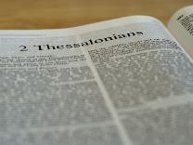
2 Thessalonians 2:1-12
Problem (2:1-2)
Prerequisites for the Day of the Lord (2:3-12)
  The apostasy (2:3a)
  Advent of the lawless one (2:3b-4)
  Removal of the restrainer (2:5-7)
  Destruction of the lawless one (2:8-9)
  Destruction of lawless one’s followers (2:10-12)

Slide 37

2 Thessalonians 2:6-7
⁶And you know what restrains [katechō; neuter] him now, so that in his time he will be revealed. ⁷For the mystery of lawlessness is already at work; only he who now restrains [katechō; masculine] will do so until he is taken out of the way.

Slide 38

Restrainer? (2:6-7)
Rome?
Satan?
Government?
Michael?
Spirit?

Slide 39
Restrainer? (2:6-7)
Rome?
Satan?
Government?
Michael?
Spirit?

Slide 40
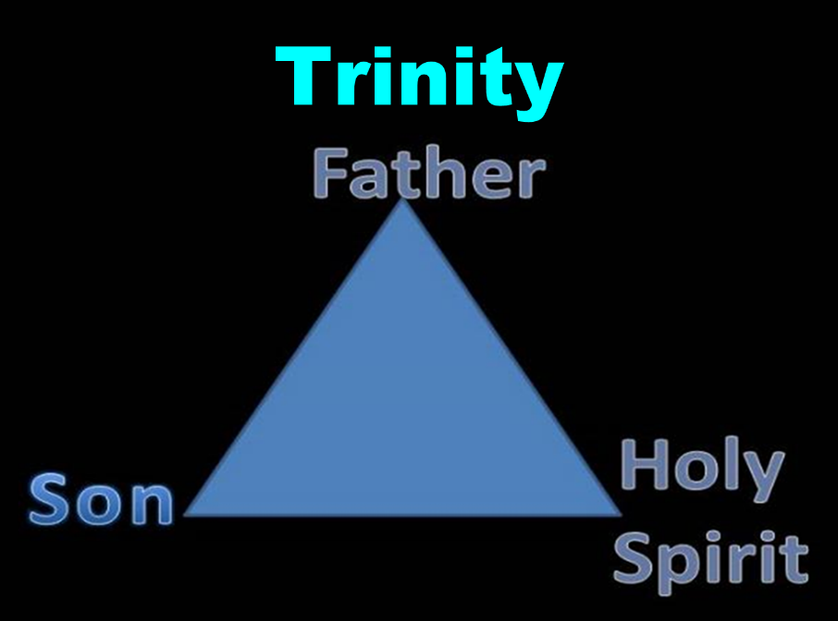

Slide 41


Slide 42

3 Reasons Why the Restrainer is the Holy Spirit
(2 Thessalonians 2:6-7)
The Holy Spirit is omnipotent (2 Thess. 2:9)
The Holy Spirit is active in the world (Gen. 6:3; John 16:7-11)
The Holy Spirit view handles well the switch in gender from the neuter (vs. 6) to the masculine (vs. 7)

Slide 43
3 Reasons Why the Restrainer is the Holy Spirit
(2 Thessalonians 2:6-7)
The Holy Spirit is omnipotent (2 Thess. 2:9)
The Holy Spirit is active in the world (Gen. 6:3; John 16:7-11)
The Holy Spirit view handles well the switch in gender from the neuter (vs. 6) to the masculine (vs. 7)

Slide 44


2 Thessalonians 2:9
“that is, the one whose coming is in accord with the activity of Satan, with all power and signs and false wonders.”

Slide 45
3 Reasons Why the Restrainer is the Holy Spirit
(2 Thessalonians 2:6-7)
The Holy Spirit is omnipotent (2 Thess. 2:9)
The Holy Spirit is active in the world (Gen. 6:3; John 16:7-11)
The Holy Spirit view handles well the switch in gender from the neuter (vs. 6) to the masculine (vs. 7)

Slide 46

Genesis 6:1-3
“¹ Now it came about, when men began to multiply on the face of the land, and daughters were born to them, ² that the sons of God saw that the daughters of men were beautiful; and they took wives for themselves, whomever they chose. ³ Then the Lord said, “My Spirit shall not strive with man forever, because he also is flesh; nevertheless his days shall be one hundred and twenty years.”

Slide 47
John 16:7-11
“⁷ But I tell you the truth, it is to your advantage that I go away; for if I do not go away, the Helper will not come to you; but if I go, I will send Him to you. ⁸ And He, when He comes, will convict the world concerning sin and righteousness and judgment; ⁹ concerning sin, because they do not believe in Me; ¹⁰ and concerning righteousness, because I go to the Father and you no longer see Me; ¹¹ and concerning judgment, because the ruler of this world has been judged.”

Slide 48
3 Reasons Why the Restrainer is the Holy Spirit
(2 Thessalonians 2:6-7)
The Holy Spirit is omnipotent (2 Thess. 2:9)
The Holy Spirit is active in the world (Gen. 6:3; John 16:7-11)
The Holy Spirit view handles well the switch in gender from the neuter (vs. 6) to the masculine (vs. 7)

Slide 49
2 Thessalonians 2:6-7
⁶And you know what restrains [katechō; neuter] him now, so that in his time he will be revealed. ⁷For the mystery of lawlessness is already at work; only he who now restrains [katechō; masculine] will do so until he is taken out of the way.

Slide 50

John 14:16-17
¹⁶ I will ask the Father, and He will give you another Helper, that He may be with you forever; ¹⁷ that is the Spirit of truth, whom the world cannot receive, because it does not see Him or know Him, but you know Him because He abides with you and will be in you.

Slide 51
John 16:7-11
“⁷ But I tell you the truth, it is to your advantage that I go away; for if I do not go away, the Helper will not come to you; but if I go, I will send Him to you. ⁸ And He, when He comes, will convict the world concerning sin and righteousness and judgment; ⁹ concerning sin, because they do not believe in Me; ¹⁰ and concerning righteousness, because I go to the Father and you no longer see Me; ¹¹ and concerning judgment, because the ruler of this world has been judged.”

Slide 52
Restrainer Must First be Removed
Restrainer holds back the Antichrist (2 Thess 2:6-7)
Restrainer = the omnipotent Holy Spirit (2 Thess 2:9)
Holy Spirit permanently indwells all Christians (John 14:16; Rom 8:9)
Sprit indwelt Christians must first be removed prior to the Antichrist's advent

Slide 53

1 Samuel 16:13-14
“¹³ Then Samuel took the horn of oil and anointed him in the midst of his brothers; and the Spirit of the Lord came mightily upon David from that day forward. And Samuel arose and went to Ramah. ¹⁴ Now the Spirit of the Lord departed from Saul, and an evil spirit from the Lord terrorized him.”

Slide 54

John 14:16-17
¹⁶ I will ask the Father, and He will give you another Helper, that He may be with you forever; ¹⁷ that is the Spirit of truth, whom the world cannot receive, because it does not see Him or know Him, but you know Him because He abides with you and will be in you.

Slide 55
Guessing the Identity of the Antichrist?
“We will not, however, incur the risk of pronouncing positively as to the name of Antichrist. But if it had been necessary to announce his name plainly at the present time, it would have been spoken by him who saw the apocalypse. For it was not seen long ago, but almost in our own time, at the end of the reign of Domitian.”
Irenaeus Against Heresies 5.30.3

Slide 56


Psalm 50:10
“For every beast of the forest is Mine,
The cattle on a thousand hills.”

Slide 57
10 Reasons Favoring Physical Departure
Extended context favors physical departure
Immediate context favors physical departure
2 Thess. 2:2 is a review course
Early Bible translations favor physical departure
Physical departure is held by credible scholars

Slide 58
1 Thessalonians 4:16-18
¹⁶ For the Lord Himself will descend from heaven with a shout, with the voice of the archangel and with the trumpet of God, and the dead in Christ will rise first. ¹⁷ Then we who are alive and remain will be caught up [harpazō] together with them in the clouds to meet the Lord in the air, and so we shall always be with the Lord. ¹⁸ Therefore comfort one another with these words."

Slide 59
2 Thessalonians 2:3
“Let no one in any way deceive you, for it will not come unless the apostasy [apostasia] comes first, and the man of lawlessness is revealed, the son of destruction.”

Slide 60

Paul’s Various Rapture Terms
parousia | 2 Thess. 2:1
episynagōgē | 2 Thess. 2:1
apokalypsis | 1 Cor. 1:7
epiphaneia | Titus 2:13
rhyomai | 1 Thess. 1:10
harpazō | 1 Thess. 4:17
apostasia | 2 Thess. 2:3a

Slide 61

2 Thessalonians 2:5
“Do you not remember that while I was still with you, I was telling you these things?”

Slide 62
10 Reasons Favoring Physical Departure
Extended context favors physical departure
Immediate context favors physical departure
2 Thess. 2:2 is a review course
Early Bible translations favor physical departure
Physical departure is held by credible scholars

Slide 63
“Departing First” or “Falling Away”
Year | Bible | Translation
1384 | Wycliffe Bible | Departynge First
1526 | Tyndale Bible | Departynge First
1535 | Coverdale Bible | Departynge First
1539 | Crammer Bible | Departing First
1576 | Breeches Bible | Departing First
1583 | Beeza Bible | Departing First
1608 | Geneva Bible | Departing First
1576 | Rheims Bible | The Protestant Revolt
1611 | King James V. | Falling Away
House, When the Trumpet Sounds, p. 270.

Slide 64
Thomas Ice
“The ‘Departure’ in 2 Thessalonians 2:3,”
online: www.pre-trib.org, accessed 7 May 2017, 2.
“Most scholars say that no one knows the reason for the translation shift. However, a plausible theory has been put forth by Martin Butalla in his Master of Theology thesis produced at Dallas Theology Seminary in 1998. It appears that the Catholic translation into English from Jerome’s Latin Vulgate known as the Rheims Bible (1576) was the first to break the translation trend. “Apostasia was revised from ‘the departure’ to ‘the Protestant Revolt,’” explains Butalla. “Revolution is the terminology still in use today when Catholicism teaches the history of the Protestant Reformation. Under this guise, apostasia would refer to a departure of Protestants from the Catholic Church.” The Catholic translators appear eager to engage in polemics against the Reformation by even allowing it to impact Bible translation.”

Slide 65

NKJV, NIV, RSV, ASV, JB, NASB
“apostasy”
“falling away”
“revolt”
“rejection”
“rebellion”

Slide 66
10 Reasons Favoring Physical Departure
Extended context favors physical departure
Immediate context favors physical departure
2 Thess. 2:2 is a review course
Early Bible translations favor physical departure
Physical departure is held by credible scholars

Slide 67

Physical Departure Adherents
Kenneth Wuest |  | Paul Lee Tan
E. Schuyler English |  | Arnold Fruchtenbaum*
J. Dwight Pentecost |  | Tim LaHaye
H. Wayne House |  | Thomas Ice
Stanley Ellison |  | Don Stewart
J.S. Mabie |  | Robert Thieme
Allen McRae |  | Gordon Olson*
Gordon Lewis |  | J. Vernon McGee*
Henry Morris* |  | Jimmy DeYoung*
John. R. Rice |  | J.D. Farag

Slide 68
C. Gordon Olson
C. Gordon Olson, The Resurrection New Testament (Lynchburg, VA: Global Gospel Publishers, 2017), 261, n. B.
“‘Let no one deceive you in anyway, for that day will not come unless the departure comes first and the man of lawlessness is revealed, the man doomed to destruction.’….The Greek Apostasy means a departure, as does its verb aphistēmi. It can refer to a physical departure, a spiritual departure, or a rebellion. The rapture of Christians would be a physical departure, which is supported by his announced subject in 2:1, ‘our gathering together unto him’ (cf. 1 Th. 4:13-18). Otherwise Paul never returned to his declared topic in a lapse of thought, which raises questions. Only two other versions so render it: GNV & WNB.”

Slide 69
Henry M. Morris
The Defender's Study Bible: King James Version (Iowa Falls, IA: World Bible Publishers, 1995), 1337-38.
“2:3 falling away. The ‘falling away’ (Greek apostasia) has commonly been translated as the apostasy (the definite article in the Greek indicates Paul had already told them about it), and then assumed to apply to the final, great religious apostasy at the end of the age. The context, however, as well as the etymology of the word itself, makes this interpretation unlikely. In this precise form, it is used nowhere else in the New Testament, so its meaning must be defined by its context here. It is derived from two Greek words, apo (meaning ‘away from’) and stasis (meaning ‘standing’). It could properly be rendered ‘standing away’ instead of ‘falling away.’”

Slide 70
Henry M. Morris
The Defender's Study Bible: King James Version (Iowa Falls, IA: World Bible Publishers, 1995), 1337-38.
“In Paul’s previous letter, he made no reference to a coming departure from the faith, but he had discussed, at length, a coming departure from the earth by all believers when Christ returns to meet them in the air (1 Thessalonians 4:13-18). This standing away from, in context, seems to refer to all the raptured believers standing away from the earth, as they stand before their returning Lord when they meet Him in the heavens. Here, Paul is reminding them that the ‘sudden destruction’ that would come upon unbelievers when the day of the Lord begins could not happen until the rapture - the standing away from the earth before Christ (Romans 14:10) - had taken place.”

Slide 71
Henry M. Morris
The Defender's Study Bible: King James Version (Iowa Falls, IA: World Bible Publishers, 1995), 1337-38.
“The entire context, before and after, fits this understanding of the text better than the idea of the apostasy from the faith. Over the 1950 years since Paul wrote these lines, there have been numerous great apostasies from the faith, and none of these introduced the day of the Lord, although the persecuted believers in each case might easily have so interpreted them.”

Slide 72
J. Vernon McGee
Thru the Bible with J. Vernon McGee. 5 vols. Pasadena, Calif.: Thru The Bible Radio; and Nashville: Thomas Nelson, Inc., 1983. 5:413.
"… (1) the organization of the church [as contrasted with the true church] has separated from the faith—it has apostatized and (2) there has been another departure, the departure of the true church from the earth. The departure of the true church leads into the total apostatizing of the organized church.“

Slide 73
Jimmy De Young
Prophetic Prospective – Daily Devotional
“Our key verse for this devotional, verse 3, has become somewhat controversial. There are those that believe that the Antichrist will come when the ‘falling away’ of the church, apostasy in the Church, has happened. This then seems to be saying that the church will be here when the Antichrist appears. This belief comes from a wrong understanding of the Greek word used in the passage and translated, ‘a falling away’…A close and careful word study of the Greek word apostasia will conclude that the true meaning of the word is found in the phrase, ‘departing from one place and going to another’, not a falling away from the doctrines of the church.”

Slide 74
Jimmy De Young
Prophetic Prospective – Daily Devotional
“If the word ‘apostasia’ was communicating that ‘apostasy’ was what it was talking about then the Rapture and the coming of the Antichrist would have happened during the writing of II Thessalonians. Apostasy had infiltrated the early church by the time Paul wrote this passage. What Paul is saying here is that the Antichrist, the ‘Son of Perdition’, would not come until the Church departs from one place and goes to another. That is what happens at the Rapture. The scenario for the future according to all prophetic passages is that the Rapture takes all Christians into Heaven and then the Antichrist appears on earth…Let me remind you that all preparations have been made for the temple to be built in . . .

Slide 75
Jimmy De Young
Prophetic Prospective – Daily Devotional
. . . Jerusalem. False teachers and deception presently are a part of our society today, which indicates that Antichrist is nearing his appearance on earth. Remember, before the appearance of Antichrist and the temple is built, the Rapture happens. Actually the Rapture could happen at any moment. Be ready!”

Slide 76

Answering Objections to the Physical Departure View
Subtraction from the Last Days will be characterized by continual apostasy?
Rapture is passive and apostasy is active?
Incongruence with verse 1?
Paul is re-assuring the Thessalonians that they had not already missed the rapture; therefore, it would be incomprehensible to read, “the rapture cannot have happened unless the rapture happens first”!

Slide 77
Answering Objections to the Physical Departure View
Subtraction from the Last Days will be characterized by continual apostasy?
Rapture is passive and apostasy is active?
Incongruence with verse 1?
Paul is re-assuring the Thessalonians that they had not already missed the rapture; therefore, it would be incomprehensible to read, “the rapture cannot have happened unless the rapture happens first”!

Slide 78
Order of Paul’s Letters
Galatians (A.D. 49)
1‒2 Thessalonians (A.D. 51)
1‒2 Corinthians (A.D. 56)
Romans (A.D. 57)
Ephesians, Colossians, Philemon, Philippians (A.D. 60‒62)
1 Timothy, Titus (A.D. 62‒66)
2 Timothy (A.D. 67)

Slide 79
1 Timothy 4:1
“But the Spirit explicitly says that in later times some will fall away [aphistēmi] from the faith, paying attention to deceitful spirits and doctrines of demons.”

Slide 80
2 Thessalonians 2:3
“Let no one in any way deceive you, for it will not come unless the apostasy [apostasia] comes first [prōton], and the man of lawlessness is revealed, the son of destruction.”

Slide 81
Answering Objections to the Physical Departure View
Subtraction from the Last Days will be characterized by continual apostasy?
Rapture is passive and apostasy is active?
Incongruence with verse 1?
Paul is re-assuring the Thessalonians that they had not already missed the rapture; therefore, it would be incomprehensible to read, “the rapture cannot have happened unless the rapture happens first”!

Slide 82
D. Edmond Hiebert
The Thessalonian Epistles. Chicago: Moody Press, 1971. Page 306
"Nowhere else does the Scripture speak of the rapture as 'the departure.' A departure denotes an act on the part of the individual or company departing. But the rapture is not an act of departure on the part of the saints. In the rapture the church is passive, not active. At the rapture, the church is 'caught up' or 'snatched away,' an event wherein the Lord acts to transport believers from earth into His presence (1 Thess. 4:16-17). Everything that takes place with the believers at the rapture is initiated by the Lord and done by Him.”

Slide 83

Matthew 4:4
“But He answered and said, “It is written, ‘Man shall not live on bread alone, but on every word that proceeds out of the mouth of God.’”

Slide 84
Matthew 5:18
“For truly I say to you, until heaven and earth pass away, not the smallest letter or stroke shall pass from the Law until all is accomplished.”

Slide 85
Answering Objections to the Physical Departure View
Subtraction from the Last Days will be characterized by continual apostasy?
Rapture is passive and apostasy is active?
Incongruence with verse 1?
Paul is re-assuring the Thessalonians that they had not already missed the rapture; therefore, it would be incomprehensible to read, “the rapture cannot have happened unless the rapture happens first”!

Slide 86
2 Thessalonians 2:1
“Now we request you, brethren, with regard to the coming [parousia] of our Lord Jesus Christ and our gathering [episynagōgē] together to Him.”

Slide 87
2 Thessalonians 2:3
“Let no one in any way deceive you, for it will not come unless the apostasy [apostasia] comes first, and the man of lawlessness is revealed, the son of destruction.”

Slide 88
D. Edmond Hiebert
The Thessalonian Epistles. Chicago: Moody Press, 1971. Page 306
"Paul has just referred to the rapture as 'our gathering together unto him' (v. 1); why then should he now use this unlikely term to mean the same thing?”

Slide 89
Paul’s Various Rapture Terms
parousia | 2 Thess. 2:1
episynagōgē | 2 Thess. 2:1
apokalypsis | 1 Cor. 1:7
epiphaneia | Titus 2:13
rhyomai | 1 Thess. 1:10
harpazō | 1 Thess. 4:17
apostasia | 2 Thess. 2:3a

Slide 90
Answering Objections to the Physical Departure View
Subtraction from the Last Days will be characterized by continual apostasy?
Rapture is passive and apostasy is active?
Incongruence with verse 1?
Paul is re-assuring the Thessalonians that they had not already missed the rapture; therefore, it would be incomprehensible to read, “the rapture cannot have happened unless the rapture happens first”!

Slide 91
2 Thessalonians 2:2
“that you not be quickly shaken from your composure or be disturbed either by a spirit or a message or a letter as if from us, to the effect that the day of the Lord has come.”

Slide 92
2 Thessalonians 2:1-12
Problem (2:1-2)
Prerequisites for the Day of the Lord (2:3-12)
  The apostasy (2:3a)
  Advent of the lawless one (2:3b-4)
  Removal of the restrainer (2:5-7)
  Destruction of the lawless one (2:8-9)
  Destruction of lawless one’s followers (2:10-12)

Slide 93
2 Thessalonians 2:1-12
Problem (2:1-2)
Prerequisites for the Day of the Lord (2:3-12)
  The apostasy (2:3a)
  Advent of the lawless one (2:3b-4)
  Removal of the restrainer (2:5-7)
  Destruction of the lawless one (2:8-9)
  Destruction of lawless one’s followers (2:10-12)

Slide 94
Conclusion

Slide 95
10 Reasons Favoring Physical Departure
There have always been doctrinal departures
2 Thess. was an early letter
The definite article before apostasia
Noun apostasia can refer to physical departure
Verb aphistēmi can refer to physical departure

Slide 96
10 Reasons Favoring Physical Departure
Extended context favors physical departure
Immediate context favors physical departure
2 Thess. 2:2 is a review course
Early Bible translations favor physical departure
Physical departure is held by credible scholars

Slide 97
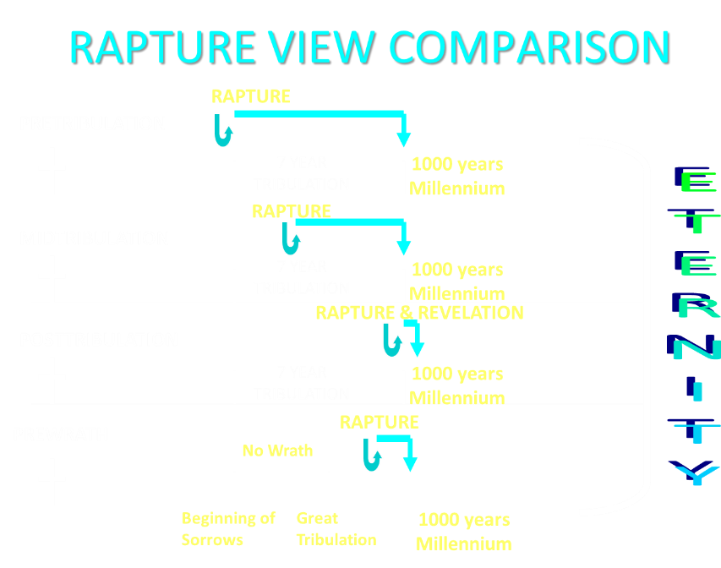

Slide 98

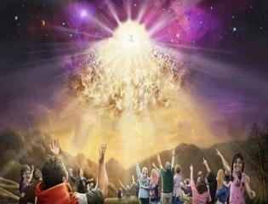
Titus 2:13
“Looking for the blessed hope and the appearing of the glory of our great God and Savior, Christ Jesus.”
98

Slide 99
Strengthening the Pre-Tribulation Case
John 14:1-4
Revelation 3:10
First Thessalonians 4‒5
Second Thessalonians 2:3a
Matthew 24‒25

