Slide 1
THE RAPTURE
What and When? – Part 10
Dr. Andy Woods
Senior Pastor – Sugar Land Bible Church
President – Chafer Theological Seminary

Slide 2
What is the Rapture?
An important doctrine
Distinct from the Second Advent
Catching away of all living believers (1 Thess 4:17)
Reunion (1 Thess 4:14-16)
Resurrection (1 Cor 15:50-54)
Exemption from death (1 Cor 15:51, 54-56)
Instantaneous (1 Cor 15:52)
Mystery (1 Cor 15:51)
Imminent (1 Cor 15:51; 1 Thess 4:15)
Traditional doctrine now being recovered

Slide 3
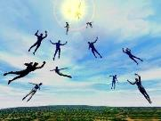
When Will the Rapture Take Place Relative to the Tribulation Period?
Pre-tribulation rapture theory
Mid-tribulation rapture theory
Post-tribulation rapture theory
Pre-wrath rapture theory
Partial rapture theory

Slide 5
When is the Rapture? 7 Arguments Favoring the Pre-Tribulation View
Tribulation's purpose concerns Israel (Jer 30:7; Dan 9:24)
No biblical reference to the church on earth during the Tribulation period (Rev 4-22)
Church is promised an exemption from divine wrath (1 Thess 1:10; 5:9; Rom 5:9; Rev 3:10; 6:17)
Rapture is imminent (1 Cor 15:51; 1 Thess 4:15)
Rapture is a comfort (1 Thess 4:18)
Antichrist cannot come to power until the restrainer is removed (2 Thess 2:6-7)
Symbolic parallels (2 Peter 2:5-9)

Slide 6
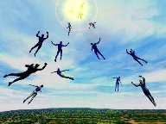
Restrainer Must First be Removed
Restrainer holds back the Antichrist (2 Thess 2:6-7)
Restrainer = the omnipotent Holy Spirit (2 Thess 2:9)
Holy Spirit permanently indwells all Christians (John 14:16; Rom 8:9)
Spirit indwelt Christians must first be removed prior to the Antichrist's advent

Slide 7
Restrainer Must First be Removed
Restrainer holds back the Antichrist (2 Thess 2:6-7)
Restrainer = the omnipotent Holy Spirit (2 Thess 2:9)
Holy Spirit permanently indwells all Christians (John 14:16; Rom 8:9)
Spirit indwelt Christians must first be removed prior to the Antichrist's advent

Slide 10
2 Thessalonians 2:6-7
⁶And you know what restrains [katechō; neuter] him now, so that in his time he will be revealed. ⁷For the mystery of lawlessness is already at work; only he who now restrains [katechō; masculine] will do so until he is taken out of the way.

Slide 11
Restrainer Must First be Removed
Restrainer holds back the Antichrist (2 Thess 2:6-7)
Restrainer = the omnipotent Holy Spirit (2 Thess 2:9)
Holy Spirit permanently indwells all Christians (John 14:16; Rom 8:9)
Spirit indwelt Christians must first be removed prior to the Antichrist's advent

Slide 12
Restrainer? (2:6-7)
Rome?
Satan?
Government?
Michael?
Spirit?

Slide 13
Restrainer? (2:6-7)
Rome?
Satan?
Government?
Michael?
Spirit?

Slide 14
Restrainer? (2:6-7)
Rome?
Satan?
Government?
Michael?
Spirit?

Slide 15
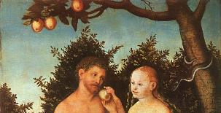
2 Thessalonians 2:9
“that is, the one whose coming is in accord with the activity of Satan, with all power and signs and false wonders.”

Slide 16
Matthew 12:24-26
“²⁴ But when the Pharisees heard this, they said, ‘This man casts out demons only by Beelzebul the ruler of the demons.’ ²⁵ And knowing their thoughts Jesus said to them, ‘Any kingdom divided against itself is laid waste; and any city or house divided against itself will not stand. ²⁶ If Satan casts out Satan, he is divided against himself; how then will his kingdom stand?”

Slide 17
Restrainer? (2:6-7)
Rome?
Satan?
Government?
Michael?
Spirit?

Slide 18
Genesis 9:6
“Whoever sheds man’s blood, By man his blood shall be shed, For in the image of God He made man.”

Slide 19
Romans 13:1-7
¹ Every person is to be in subjection to the governing authorities. For there is no authority except from God, and those which exist are established by God. ² Therefore whoever resists authority has opposed the ordinance of God; and they who have opposed will receive condemnation upon themselves. ³ For rulers are not a cause of fear for good behavior, but for evil. Do you want to have no fear of authority? Do what is good and you will have praise from the same; ⁴ for it is a minister of God to you for good. . . .

Slide 20
Romans 13:1-7
... But if you do what is evil, be afraid; for it does not bear the sword for nothing; for it is a minister of God, an avenger who brings wrath on the one who practices evil. ⁵ Therefore it is necessary to be in subjection, not only because of wrath, but also for conscience’ sake. ⁶ For because of this you also pay taxes, for rulers are servants of God, devoting themselves to this very thing. ⁷ Render to all what is due them: tax to whom tax is due; custom to whom custom; fear to whom fear; honor to whom honor.

Slide 21
Daniel 7:19, 23, 25
“Then I desired to know the exact meaning of the fourth beast, which was different from all the others, exceedingly dreadful, with its teeth of iron and its claws of bronze, and which devoured, crushed and trampled down the remainder with its feet…Thus he said: ‘The fourth beast will be a fourth kingdom on the earth, which will be different from all the other kingdoms and will devour the whole . . .

Slide 22
Daniel 7:19, 23, 25
. . . earth and tread it down and crush it…He will speak out against the Most High and wear down the saints of the Highest One, and he will intend to make alterations in times and in law; and they will be given into his hand for a time, times, and half a time.”

Slide 23
Restrainer? (2:6-7)
Rome?
Satan?
Government?
Michael?
Spirit?

Slide 24
Daniel 12:1
“Now at that time Michael, the great prince who stands guard over the sons of your people, will arise. And there will be a time of distress such as never occurred since there was a nation until that time; and at that time your people, everyone who is found written in the book, will be rescued.”

Slide 25
2 Thessalonians 2:9
“that is, the one whose coming is in accord with the activity of Satan, with all power and signs and false wonders.”

Slide 26
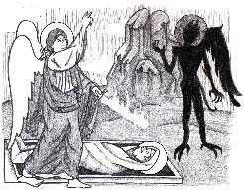
Jude 9
“But Michael the archangel, when he disputed with the devil and argued about the body of Moses, did not dare pronounce against him a railing judgment, but said, ‘The Lord rebuke you!’”

Slide 27
Restrainer? (2:6-7)
Rome?
Satan?
Government?
Michael?
Spirit?

Slide 28
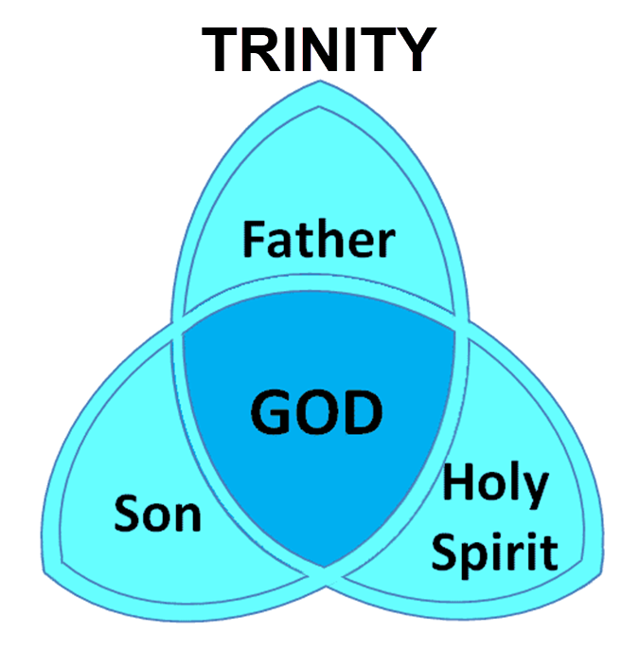

Slide 29
3 Reasons Why the Restrainer is the Holy Spirit (2 Thessalonians 2:6-7)
The Holy Spirit is omnipotent
The Holy Spirit view handles well the switch in gender from the neuter (vs. 6) to the masculine (vs. 7)
The Holy Spirit is active in the world (Gen. 6:3; John 16:7-11)

Slide 30
3 Reasons Why the Restrainer is the Holy Spirit (2 Thessalonians 2:6-7)
The Holy Spirit is omnipotent
The Holy Spirit view handles well the switch in gender from the neuter (vs. 6) to the masculine (vs. 7)
The Holy Spirit is active in the world (Gen. 6:3; John 16:7-11)

Slide 31
2 Thessalonians 2:9
“that is, the one whose coming is in accord with the activity of Satan, with all power and signs and false wonders.”

Slide 32
3 Reasons Why the Restrainer is the Holy Spirit (2 Thessalonians 2:6-7)
The Holy Spirit is omnipotent
The Holy Spirit view handles well the switch in gender from the neuter (vs. 6) to the masculine (vs. 7)
The Holy Spirit is active in the world (Gen. 6:3; John 16:7-11)

Slide 33
2 Thessalonians 2:6-7
⁶And you know what restrains [katechō; neuter] him now, so that in his time he will be revealed. ⁷For the mystery of lawlessness is already at work; only he who now restrains [katechō; masculine] will do so until he is taken out of the way.

Slide 34
John 14:16-17
¹⁶ I will ask the Father, and He will give you another Helper, that He may be with you forever; ¹⁷ that is the Spirit of truth, whom the world cannot receive, because it does not see Him or know Him, but you know Him because He abides with you and will be in you.

Slide 35
John 16:7-11
“⁷ But I tell you the truth, it is to your advantage that I go away; for if I do not go away, the Helper will not come to you; but if I go, I will send Him to you. ⁸ And He, when He comes, will convict the world concerning sin and righteousness and judgment; ⁹ concerning sin, because they do not believe in Me; ¹⁰ and concerning righteousness, because I go to the Father and you no longer see Me; ¹¹ and concerning judgment, because the ruler of this world has been judged.”

Slide 36
3 Reasons Why the Restrainer is the Holy Spirit (2 Thessalonians 2:6-7)
The Holy Spirit is omnipotent
The Holy Spirit view handles well the switch in gender from the neuter (vs. 6) to the masculine (vs. 7)
The Holy Spirit is active in the world (Gen. 6:3; John 16:7-11)

Slide 37
Genesis 6:1-4
“¹ Now it came about, when men began to multiply on the face of the land, and daughters were born to them, ² that the sons of God saw that the daughters of men were beautiful; and they took wives for themselves, whomever they chose. ³ Then the Lord said, ‘My Spirit shall not strive with man forever, because he also is flesh; nevertheless his days shall be one hundred and twenty years.’ . . .

Slide 38
Genesis 6:1-4
. . .⁴ The Nephilim were on the earth in those days, and also afterward, when the sons of God came in to the daughters of men, and they bore children to them. Those were the mighty men who were of old, men of renown.”

Slide 39
John 16:7-11
“⁷ But I tell you the truth, it is to your advantage that I go away; for if I do not go away, the Helper will not come to you; but if I go, I will send Him to you. ⁸ And He, when He comes, will convict the world concerning sin and righteousness and judgment; ⁹ concerning sin, because they do not believe in Me; ¹⁰ and concerning righteousness, because I go to the Father and you no longer see Me; ¹¹ and concerning judgment, because the ruler of this world has been judged.”

Slide 40
John 14:16-17
¹⁶ I will ask the Father, and He will give you another Helper, that He may be with you forever; ¹⁷ that is the Spirit of truth, whom the world cannot receive, because it does not see Him or know Him, but you know Him because He abides with you and will be in you.

Slide 41
Romans 8:5-6
^{5 “}For those who are according to the flesh set their minds on the things of the flesh, but those who are according to the Spirit, the things of the Spirit. ⁶ For the mind set on the flesh is death, but the mind set on the Spirit is life and peace.”

Slide 42
2 Thessalonians 2:5
“Do you not remember that while I was still with you, I was telling you these things?”

Slide 43
Restrainer Must First be Removed
Restrainer holds back the Antichrist (2 Thess 2:6-7)
Restrainer = the omnipotent Holy Spirit (2 Thess 2:9)
Holy Spirit permanently indwells all Christians (John 14:16; Rom 8:9)
Spirit indwelt Christians must first be removed prior to the Antichrist's advent

Slide 44
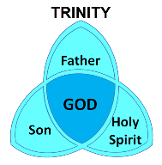
Romans 8:9
“However, you are not in the flesh but in the Spirit, if indeed the Spirit of God dwells in you. But if anyone does not have the Spirit of Christ, he does not belong to Him.”

Slide 45
1 Corinthians 6:19
“Or do you not know that your body is a temple of the Holy Spirit who is in you, whom you have from God, and that you are not your own?”

Slide 46
John 14:16-17
¹⁶ I will ask the Father, and He will give you another Helper, that He may be with you forever; ¹⁷ that is the Spirit of truth, whom the world cannot receive, because it does not see Him or know Him, but you know Him because He abides with you and will be in you.

Slide 47
Ephesians 4:30
“Do not grieve the Holy Spirit of God, by whom you were sealed for the day of redemption.”

Slide 48
Work of the Spirit in the OT vs. Church Age
 | OT/Gospels | Today
Reception of all of the Spirit at the moment of salvation? | Subsequent to salvation (Exod 31:3) | At moment of salvation (Rom 8:9)
How long is the indwelling? | Temporary indwelling (1 Sam 16:14; Ps 51:11) | Permanent indwelling (John 14:16)
Who is indwelt? | Selective indwelling (Joel 2:28) | Universal indwelling (1 Cor 12:13)

Slide 49
Restrainer Must First be Removed
Restrainer holds back the Antichrist (2 Thess 2:6-7)
Restrainer = the omnipotent Holy Spirit (2 Thess 2:9)
Holy Spirit permanently indwells all Christians (John 14:16; Rom 8:9)
Spirit indwelt Christians must first be removed prior to the Antichrist's advent

Slide 50
Psalm 139:7-8
“⁷ Where can I go from Your Spirit? Or where can I flee from Your presence? ⁸ If I ascend to heaven, You are there; If I make my bed in Sheol, behold, You are there..”

Slide 51
Distinctions Between 144,000 & Multitude
144,000 | MULTITUDE
Revelation 7:1-8 | Revelation 7:9-17
Numbered | Innumerable
Jews | All nations
Sealed | Slain
Sealed before the Tribulation | Converted out of the Tribulation
Hitchcock and Ice, The Truth Behind Left Behind, 77

Slide 52
Work of the Spirit in the OT vs. Church Age
 | OT/Gospels | Today
Reception of all of the Spirit at the moment of salvation? | Subsequent to salvation (Exod 31:3) | At moment of salvation (Rom 8:9)
How long is the indwelling? | Temporary indwelling (1 Sam 16:14; Ps 51:11) | Permanent indwelling (John 14:16)
Who is indwelt? | Selective indwelling (Joel 2:28) | Universal indwelling (1 Cor 12:13)

Slide 53
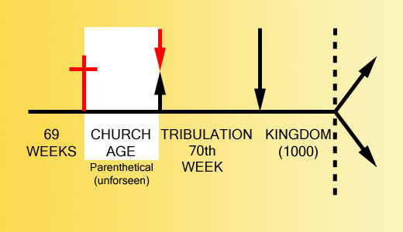

Slide 55
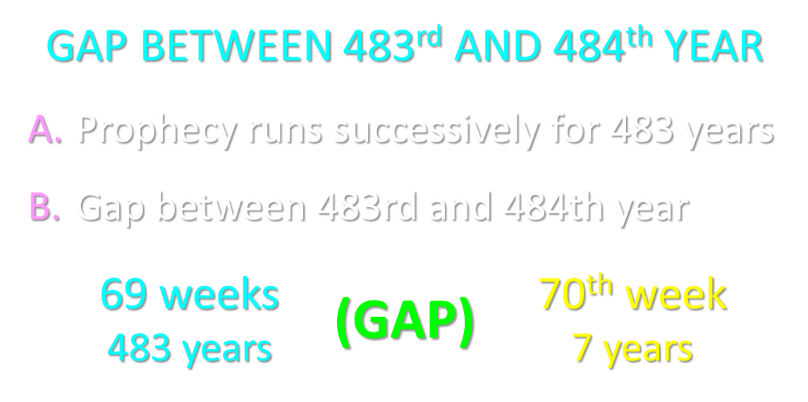

Slide 56
Late Date (A.D. 95) Irenaeus Against Heresies 5.30.3
“But if it had been necessary to announce his name plainly at the present time, it would have been spoken by him who saw the apocalypse. For it was not seen long ago, but almost in our own time, at the end of the reign of Domitian.”

Slide 57
Ezekiel 28:13, 15
“¹³ You were in Eden, the garden of God; Every precious stone was your covering: The ruby, the topaz and the diamond; The beryl, the onyx and the jasper; The lapis lazuli, the turquoise and the emerald; And the gold, the workmanship of your settings and sockets, Was in you. On the day that you were created They were prepared… ¹⁵ You were blameless in your ways From the day you were created Until unrighteousness was found in you.”

Slide 58
1 John 4:3
“and every spirit that does not confess Jesus is not from God; this is the spirit of the antichrist, of which you have heard that it is coming, and now it is already in the world.”

Slide 59
2 Thessalonians 2:7
“For the mystery of lawlessness is already at work; only he who now restrains will do so until he is taken out of the way.”

Slide 60
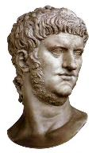

Slide 61
Conclusion

Slide 62
When is the Rapture? 7 Arguments Favoring the Pre-Tribulation View
Tribulation's purpose concerns Israel (Jer 30:7; Dan 9:24)
No biblical reference to the church on earth during the Tribulation period (Rev 4-22)
Church is promised an exemption from divine wrath (1 Thess 1:10; 5:9; Rom 5:9; Rev 3:10; 6:17)
Rapture is imminent (1 Cor 15:51; 1 Thess 4:15)
Rapture is a comfort (1 Thess 4:18)
Antichrist cannot come to power until the restrainer is removed (2 Thess 2:6-7)
Symbolic parallels (2 Peter 2:5-9)

