Slide 1
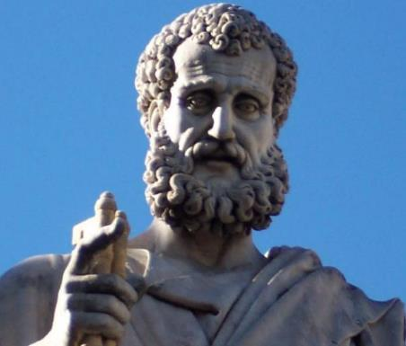

2 Peter
Dr. Andy Woods
Senior Pastor – Sugar Land Bible Church
President – Chafer Theological Seminary

Slide 2

INTRODUCTORY MATTERS
Authorship: Peter
Biography: Gospels & Acts
Date: A.D. 64
Recipients: Regenerated, Asia Minor, Hebrews
Place of writing: Babylon
Occasion for writing: Incipient Gnosticism
Purpose: Insulation from false teaching
Structure: 3 parts
Message: Protection from false teachers
Unique characteristics: Knowledge

Slide 3
STRUCTURE
2 Peter 1 – Call to maturity
2 Peter 2 – Characteristics of false teachers
2 Peter 3 – Doctrine of the false teachers (uniformitarianism)

Slide 4
STRUCTURE
2 Peter 1 – Call to maturity
2 Peter 2 – Characteristics of false teachers
2 Peter 3 – Doctrine of the false teachers (uniformitarianism)

Slide 5
2 PETER
Chapter 1
Introduction (1:1-2)
Call to Growth (1:3-11)
Purpose Statement (1:12-15)
Coming kingdom (1:16-21)

Slide 6
STRUCTURE
2 Peter 1 – Call to maturity
2 Peter 2 – Characteristics of false teachers
2 Peter 3 – Doctrine of the false teachers (uniformitarianism)

Slide 7

2 PETER 2 OUTLINE
Predicted arrival (2:1a)
Devices (2:1b-3)
Doom (2:4-9)
Depravity (2:10-16)
Emptiness (2:17-19)
Regression (2:20-22)

Slide 8
STRUCTURE
2 Peter 1 – Call to maturity
2 Peter 2 – Characteristics of false teachers
2 Peter 3 – Doctrine of the false teachers

Slide 9

RELEVANCE OF THE FUTURE
2 Peter 3:3-15

Slide 10
OVERVIEW OF 2 PETER 3:3-15
Heresy of the false teachers (v3-4)
Motive of the false teachers (v3-4)
Peter’s rebuttal (v5-10)
Application (v11-15)

Slide 11
OVERVIEW OF 2 PETER 3:3-15
Heresy of the false teachers (v3-4)
Motive of the false teachers (v3-4)
Peter’s rebuttal (v5-10)
Application (v11-15)

Slide 12

DOCTRINE OF FALSE TEACHERS
V.3-4
Deny 2nd Coming
  Scoffing
  Future tense

Slide 13
OVERVIEW OF 2 PETER 3:3-15
Heresy of the false teachers (v3-4)
Motive of the false teachers (v3-4)
Peter’s rebuttal (v5-10)
Application (v11-15)

Slide 14
MOTIVE OF FALSE TEACHERS
V.3-4
Deny 2nd Coming
  Lust & denial of judgment
  Uniformitarianism/ naturalism

Slide 15
Uniformitarianism Defined
https://www.britannica.com/science/uniformitarianism
“Uniformitarianism, in geology, the doctrine suggesting that Earth’s geologic processes acted in the same manner and with essentially the same intensity in the past as they do in the present and that such uniformity is sufficient to account for all geologic change. This principle is fundamental to geologic thinking and underlies the whole development of the science of geology... When William Whewell, a University of Cambridge scholar, introduced the term in 1832, the prevailing view (called catastrophism) was that . . .

Slide 16
Uniformitarianism Defined
https://www.britannica.com/science/uniformitarianism
“…Earth had originated through supernatural means and had been affected by a series of catastrophic events such as the biblical Flood. In contrast to catastrophism, uniformitarianism postulates that phenomena displayed in rocks may be entirely accounted for by geologic processes that continue to operate—in other words, the present is the key to the past.”

Slide 17
OVERVIEW OF 2 PETER 3:3-15
Heresy of the false teachers (v3-4)
Motive of the false teachers (v3-4)
Peter’s rebuttal (v5-10)
Application (v11-15)

Slide 18
PETER’S REBUTTAL
V.5-10
Arguments from:
History (5-7)
Scripture (8)
God’s character (9)
Divine promise (10)

Slide 19
PETER’S REBUTTAL
V.5-10
Arguments from:
History (5-7)
Scripture (8)
God’s character (9)
Divine promise (10)

Slide 20
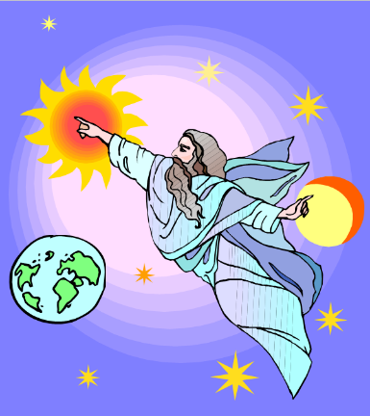
HISTORY
V. 5-7
Creation (5)
Flood (6-7)
  God will judge again via fire

Slide 21
HISTORY
V. 5-7
Creation (5)
Flood (6-7)
  God will judge again via fire

Slide 22

Genesis 1:1-3
“¹ In the beginning God created the heavens and the earth. ² The earth was formless and void, and darkness was over the surface of the deep, and the Spirit of God was moving over the surface of the waters. ³ Then God said, ‘Let there be light’; and there was light.”

Slide 23
HISTORY
V. 5-7
Creation (5)
Flood (6-7)
  God will judge again via fire

Slide 24
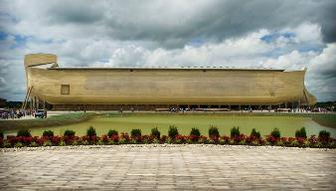
REASONS AGAINST A LOCAL FLOOD
Size of the ark (450 ft. long, 75 ft. wide, 45 ft. deep)?
Analogy to global Second Advent (Matt 24:37-39; Rev 1:7; 2 Pet 3:5-7)
Animals and birds on the ark?

Slide 25

Genesis 7:19-23
“They rose greatly on the earth, and all the high mountains under the entire heaven were covered…Every living thing that moved on the earth perished—birds, livestock, wild animals, all the creatures that swarm over the earth, and all mankind. Everything on dry land that had the breath of life in its nostrils died. Every living thing on the face of the earth was wiped out; men and animals and the creatures that move along the ground and the birds of the air were wiped from the earth. Only Noah was left, and those with him in the ark.”

Slide 26
H.C. Leupold
Exposition of Genesis (Grand Rapids: Baker, 1942), vol. 1, p. 301-302.
“… ‘all the high mountains under all the heavens.’ One of these expressions alone would almost necessitate the impression that the author intends to convey the idea of the absolute universality of the Flood…Yet since ‘all’ is known to be used in a relative sense, the writer removes all ambiguity by adding the phrase ‘under all the heavens.’ A double ‘all’ (kol) cannot allow for so relative a sense. It almost constitutes a Hebrew superlative. So we believe that the text disposes of the question of the universality of the flood. By way of objection to this interpretation, those who believe in a limited flood…urge the fact that kol is used in a relative sense, as is clearly the case in passages such as Genesis 41:57; Exodus 9:25, 10:15; Deuteronomy 2:25; and 1 Kings 10:24. However, we still insist that this fact could overthrow a single kol, never a double kol, as our verse has it.”

Slide 27
BELIEVER OR UNBELIEVER?
Writer | Local Flood | Global Flood
Philo |  | X
Josephus |  | X
Justin Martyr |  | X
Theophilus of Antioch |  | X
Tertullian |  | X
Gregory of Nazianus |  | X
John Chrysostom |  | X
Augustine of Hippo |  | X
SOURCE: Jonathan Sarfati, Refuting Compromise (Green Forest, AR: Master Books), 244.

Slide 28
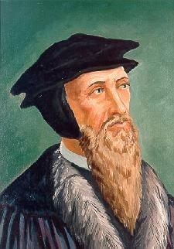
John Calvin
Genesis, 1554 (Edinburgh, UK: Banner of Truth, 1984), p. 272, emphasis mine.
“And the flood was forty days, etc. Moses conspicuously insists on this fact, in order to show that the whole world was immersed in the waters.”

Slide 29
2 Peter 3:5 (KJV)
“For this they willingly are ignorant of [thelō], that by the word of God the heavens were of old, and the earth standing out of the water and in the water.”

Slide 30

Romans 1:18–20
¹⁸ For the wrath of God is revealed from heaven against all ungodliness and unrighteousness of men who suppress the truth in unrighteousness, ¹⁹ because that which is known about God is evident within them; for God made it evident to them. ²⁰ For since the creation of the world His invisible attributes, His eternal power and divine nature, have been clearly seen, being understood through what has been made, so that they are without excuse.

Slide 31
UNIFORMITARIANISM IS NOT BIBLICISM
 | ERA | SCRIPTURE | DISTINCTIVES
1. | CREATION | Genesis 1-2 | No death
2. | FALL | Genesis 3-6 | Death, painful pregnancy & toil, long life spans, no human government
3. | FLOOD | Genesis 7-10 | Shorter life spans, human government, one language, no nations
4. | BABEL | Genesis 11-present | No global government, multiple languages, nations, ethnicities
5. | ANTICHRIST | Rapture to 2nd Advent | Global government, restrainer removed
6. | KINGDOM | Rev. 20:1-10 | Long life spans, kingdom conditions, reality of death, renovated earth
7. | ETERNAL STATE | Rev. 21-22 | No death, new earth

Slide 32
PETER’S REBUTTAL
V.5-10
Arguments from:
History (5-7)
Scripture (8)
God’s character (9)
Divine promise (10)

Slide 33
SCRIPTURE
V. 8
God’s timing is not the same as ours

Slide 34
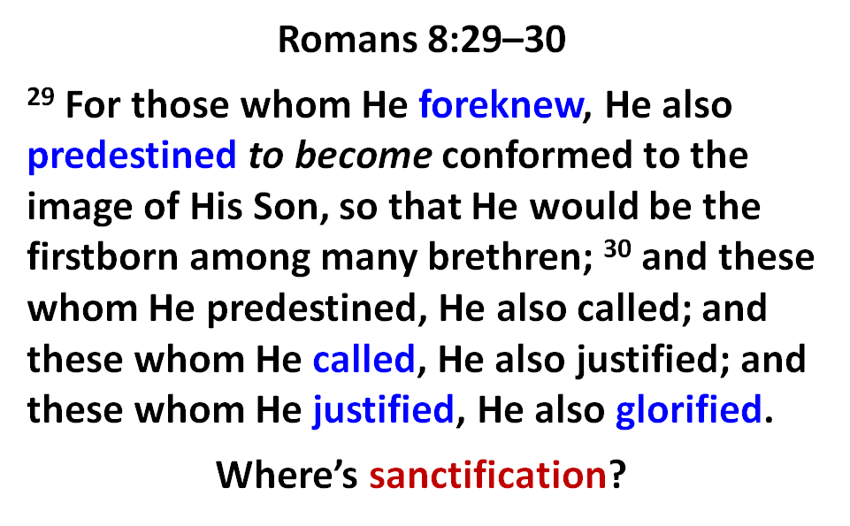

Slide 35
Jude 14–15
¹⁴ It was also about these men that Enoch, in the seventh generation from Adam, prophesied, saying, “Behold, the Lord came with many thousands of His holy ones, ¹⁵ to execute judgment upon all, and to convict all the ungodly of all their ungodly deeds which they have done in an ungodly way, and of all the harsh things which ungodly sinners have spoken against Him.”

Slide 36
PETER’S REBUTTAL
V.5-10
Arguments from:
History (5-7)
Scripture (8)
God’s character (9)
Divine promise (10)

Slide 37
GOD’S CHARACTER
V. 9
Delay ≠ no 2nd Coming
Delay = patience

Slide 38

Genesis 6:1-4
“¹ Now it came about, when men began to multiply on the face of the land, and daughters were born to them, ² that the sons of God saw that the daughters of men were beautiful; and they took wives for themselves, whomever they chose. ³ Then the Lord said, ‘My Spirit shall not strive with man forever, because he also is flesh; nevertheless his days shall be one hundred and twenty years.’ ⁴ The Nephilim were on the earth in those days, and also afterward, when the sons of God came in to the daughters of men, and they bore children to them. Those were the mighty men who were of old, men of renown.”

Slide 39

1 Peter 3:19-20
“¹⁹ in which also He went and made proclamation the spirits now in prison, ²⁰ who once were disobedient, when the patience of God kept waiting in the days of Noah, during the construction of the ark, in which a few, that is, eight persons, were brought safely through the water.”

Slide 40

Calvin said: “By predestination we mean the eternal decree of God, by which he determined with himself whatever he wished to happen with regard to every man. All are not created on equal terms, but some are preordained to eternal life, others to eternal damnation; and, accordingly, as each has been created for one or other of these ends, we say that he has been predestinated to life or to death.”
John Calvin
John Calvin, Institutes of the Christian Religion, Vol. 3, (Orlando, Signalman Publishing, from the 4th edition, 2009, Kindle edition), Chapter 21, section 5, Kindle location 17221.

Slide 41
Calvin said: “We say, then, that Scripture clearly proves this much, that God by his eternal and immutable counsel determined once for all those whom it was his pleasure one day to admit to salvation, and those whom, on the other hand, it was his pleasure to doom to destruction.”
John Calvin
John Calvin, Institutes of the Christian Religion, Vol. 3, Chapter 23, section 7.

Slide 42
Calvin said: “I say with Augustine, that the Lord has created those who, as he certainly foreknow, were to go to destruction, and he did so because he so willed. Why he willed it is not ours to ask, as we cannot comprehend, nor can it become us even to raise a controversy as to the justice of the divine will. Whenever we speak of it, we are speaking of the supreme standard of justice.”
John Calvin
John Calvin, Institutes of the Christian Religion, Vol. 3, Chapter 23, section 5.

Slide 43
Calvin wrote: “Now, since the arrangement of all things is in the hand of God, since to him belongs the disposal of life and death, he arranges all things by his sovereign counsel, in such a way that individuals are born, who are doomed from the womb to certain death, and are to glorify him by their destruction.”
John Calvin
John Calvin, Institutes of the Christian Religion, Vol. 3, Chapter 23, section 6.

Slide 44
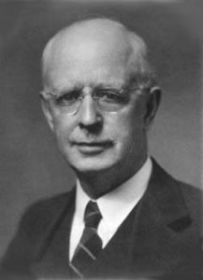

Slide 45

Lewis Sperry Chafer
vol. 7, Systematic Theology (Grand Rapids, MI: Kregel Publications, 1993), 265-66.
“This vital newness of mind is a part of believing, after all, and therefore it may be and is used as a synonym for believing at times (cf. Acts 17:30; 20:21; 26:20; Rom. 2:4; 2Tim. 2:25; 2 Pet. 3:9). Repentance nevertheless cannot be added to believing as a condition of salvation, because upwards of 150 passages of Scripture condition salvation upon believing only (cf. John 3:16; Acts 16:31).”

Slide 46
PETER’S REBUTTAL
V.5-10
Arguments from:
History (5-7)
Scripture (8)
God’s character (9)
Divine promise (10)

Slide 47
GOD’S PROMISE
V. 10
Despite delay,
  the day will come:
Like a thief
According to God’s promise

Slide 48
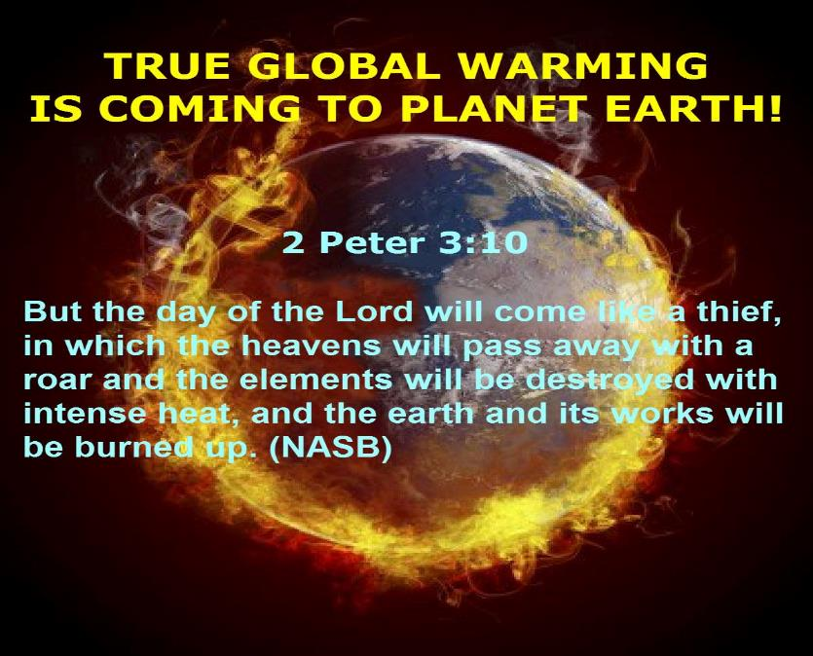

Slide 49
Genesis 1:1-3
“¹ In the beginning God created the heavens and the earth. ² The earth was formless and void, and darkness was over the surface of the deep, and the Spirit of God was moving over the surface of the waters. ³ Then God said, ‘Let there be light’; and there was light.”

Slide 50
Genesis 6:1-4
“¹ Now it came about, when men began to multiply on the face of the land, and daughters were born to them, ² that the sons of God saw that the daughters of men were beautiful; and they took wives for themselves, whomever they chose. ³ Then the Lord said, ‘My Spirit shall not strive with man forever, because he also is flesh; nevertheless his days shall be one hundred and twenty years.’ ⁴ The Nephilim were on the earth in those days, and also afterward, when the sons of God came in to the daughters of men, and they bore children to them. Those were the mighty men who were of old, men of renown.”

Slide 51

Revelation 21:1, 4
¹ Then I saw a new heaven and a new earth; for the first heaven and the first earth passed away [apérchomai], and there is no longer any sea…⁴ and He will wipe away every tear from their eyes; and there will no longer be any death; there will no longer be any mourning, or crying, or pain; the first things have passed away [apérchomai].

Slide 52

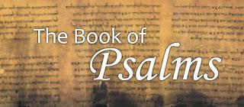
Psalm 90:2
“Before the mountains were born Or You gave birth to the earth and the world, Even from everlasting (olam) to everlasting (olam), You are God.”

Slide 53
GOD’S PROMISE
V. 10
Despite delay,
  the day will come:
Like a thief
According to God’s promise

Slide 54

1 Thessalonians 4:13-18
. . . have fallen asleep. ¹⁶ For the Lord Himself will descend from heaven with a shout, with the voice of the archangel and with the trumpet of God, and the dead in Christ will rise first. ¹⁷ Then we who are alive and remain will be caught up together with them in the clouds to meet the Lord in the air, and so we shall always be with the Lord. ¹⁸ Therefore comfort one another with these words."

Slide 55
PETER’S REBUTTAL
V.5-10
Arguments from:
History (5-7)
Scripture (8)
God’s character (9)
Divine promise (10)

Slide 56
OVERVIEW OF 2 PETER 3:3-15
Heresy of the false teachers (v3-4)
Motive of the false teachers (v3-4)
Peter’s rebuttal (v5-10)
Application (v11-15)

Slide 57
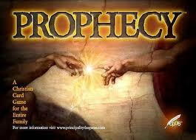
BIBLICAL PROPHECY: IMPORTANCE
27% of Scripture was prophetic at the time it was written
2 Pet 1:19

Slide 58

J. Dwight Pentecost
Prophecy For Today, Page 20
“A short time ago, I took occasion to go through the New Testament to mark each reference to the coming of the Lord Jesus Christ and to observe the use made of that teaching about His coming. I was struck a new with the fact that almost without exception, when the coming of Christ is mentioned in the New Testament, it is followed by an exhortation to godliness and holy living.”

Slide 59
2 Peter 1:19-21
“¹⁹ So we have the prophetic word made more sure, to which you do well to pay attention as to a lamp shining in a dark place, until the day dawns and the morning star arises in your hearts. ²⁰ But know this first of all, that no prophecy of Scripture is a matter of one’s own interpretation, ²¹ for no prophecy was ever made by an act of human will, but men moved by the Holy Spirit spoke from God.”

Slide 60

AUTHORITY OF SCRIPTURE
V. 19

Slide 61
APPLICATION
V. 11-15
Holy Living (11b, 14)
Evangelism (12)
Hope (13)
Patience (15)

Slide 62
APPLICATION
V. 11-15
Holy Living (11b, 14)
Evangelism (12)
Hope (13)
Patience (15)

Slide 63
APPLICATION
V. 11-15
Holy Living (11b, 14)
Evangelism (12)
Hope (13)
Patience (15)

Slide 64
Romans 11:25
“For I do not want you, brethren, to be uninformed of this mystery—so that you will not be wise in your own estimation—that a partial hardening has happened to Israel until the fullness of the Gentiles has come in.”

Slide 65
APPLICATION
V. 11-15
Holy Living (11b, 14)
Evangelism (12)
Hope (13)
Patience (15)

Slide 66
APPLICATION
V. 11-15
Holy Living (11b, 14)
Evangelism (12)
Hope (13)
Patience (15)

Slide 67
CONCLUSION

Slide 68
OVERVIEW OF 2 PETER 3:3-15
Heresy of the false teachers (v3-4)
Motive of the false teachers (v3-4)
Peter’s rebuttal (v5-10)
Application (v11-15)

