Slide 1
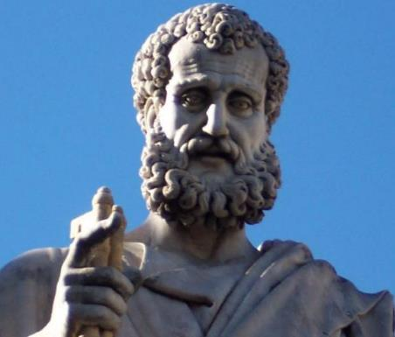

2 Peter
Dr. Andy Woods
Senior Pastor – Sugar Land Bible Church
President – Chafer Theological Seminary

Slide 2

INTRODUCTORY MATTERS
Authorship: Peter
Biography: Gospels & Acts
Date: A.D. 64
Recipients: Regenerated, Asia Minor, Hebrews
Place of writing: Babylon
Occasion for writing: Incipient Gnosticism
Purpose: Insulation from false teaching
Structure: 3 parts
Message: Protection from false teachers
Unique characteristics: Knowledge

Slide 3
STRUCTURE
2 Peter 1 – Call to maturity
2 Peter 2 – Characteristics of false teachers
2 Peter 3 – Doctrine of the false teachers (uniformitarianism)

Slide 4
STRUCTURE
2 Peter 1 – Call to maturity
2 Peter 2 – Characteristics of false teachers
2 Peter 3 – Doctrine of the false teachers (uniformitarianism)

Slide 5
2 PETER
Chapter 1
Introduction (1:1-2)
Call to Growth (1:3-11)
Purpose Statement (1:12-15)
Coming kingdom (1:16-21)

Slide 6
STRUCTURE
2 Peter 1 – Call to maturity
2 Peter 2 – Characteristics of false teachers
2 Peter 3 – Doctrine of the false teachers (uniformitarianism)

Slide 7

2 PETER 2 OUTLINE
Predicted arrival (2:1a)
Devices (2:1b-3)
Doom (2:4-9)
Depravity (2:10-16)
Emptiness (2:17-19)
Regression (2:20-22)

Slide 8
STRUCTURE
2 Peter 1 – Call to maturity
2 Peter 2 – Characteristics of false teachers
2 Peter 3 – Doctrine of the false teachers

Slide 9
PURPOSE STATEMENT
V. 12-15
Last Will:
  To Remind You of Previously Revealed Truth to Prepare You for Coming False Teachers

Slide 10

PETER’S 2nd PURPOSE STATEMENT
(3:1-2)
Back to the basics
True source of knowledge
Inspiration of both the prophets and apostles

Slide 11

RELEVANCE OF THE FUTURE
2 Peter 3:3-15

Slide 12
OVERVIEW OF 2 PETER 3:3-15
Heresy of the false teachers (v3-4)
Motive of the false teachers (v3-4)
Peter’s rebuttal (v5-10)
Application (v11-15)

Slide 13
OVERVIEW OF 2 PETER 3:3-15
Heresy of the false teachers (v3-4)
Motive of the false teachers (v3-4)
Peter’s rebuttal (v5-10)
Application (v11-15)

Slide 14

DOCTRINE OF FALSE TEACHERS
V.3-4
Deny 2nd Coming
  Scoffing
  Future tense

Slide 15

Rick Warren
Purpose Driven Life, 285-86.
“When the disciples wanted to talk about prophecy, Jesus quickly switched the conversation to evangelism. He wanted them to concentrate on their mission in the world. He said in essence, “The details of my return are none of your business. What is your business is the mission I have given you. Focus on that!” If you want Jesus to come back sooner, focus on fulfilling your mission, not figuring out prophecy. Speculating on the exact timing of Christ’s return is futile, because Jesus said, “No one knows about that day or hour, not even the angels in heaven, nor the Son, but only the Father.” Since Jesus said He didn’t know the day or hour, why should you try to figure it out? What we do know for sure is this: Jesus will not return until everyone God wants to hear the Good News has heard it.”

Slide 16
Rick Warren
Purpose Driven Life, 285-86.
Jesus said, “The Good News about God’s kingdom will be preached in all the world, to every nation. Then the end will come.” If you want Jesus to come back sooner, focus on fulfilling your mission, not figuring out prophecy. It is easy to get distracted and sidetracked from your mission because Satan would rather have you do anything besides sharing your faith. He will let you do all kinds of good things as long as you don’t take anyone to heaven with you. But the moment you become serious about your mission, expect the Devil to throw all kinds of diversions at you. When that happens, remember the words of Jesus: “Anyone who lets himself be distracted from the work I plan for him is not fit for the Kingdom of God.”

Slide 17

Eschatology A Sin?
“Therefore, I conclude that it is sin to divide the body of Christ—to divide the body that he prayed would be united. Therefore for us to conclude that we must agree upon a certain view of alcohol, or a certain view of schooling, or a certain view of meat sacrificed to idols, or a certain view of the millennium in order to have fellowship together is, I think, not only unnecessary for the body of Christ, but it is therefore both unwarranted and therefore condemned by scripture. So if you’re a pastor and you’re listening to me, you understand me correctly if you think I’m saying you are in sin if you lead your congregation to have a statement of faith that requires a particular millennial view. I do not understand why that has to be a matter of uniformity in order to have Christian unity in a local congregation.”
17
Justin Taylor, “Dever: ‘You Are in Sin If You Lead Your Congregation to Have a Statement of Faith that Requires a Particular Millennial View,’” online: https://www.thegospelcoalition.org/blogs/justin-taylor/dever-you-are-in-sin-if-you-lead-your/, July 14 2009, accessed May 28, 2019.
Notes:
WRONG!!!

Slide 18
DOCTRINE OF FALSE TEACHERS
V.3-4
Deny 2nd Coming
  Scoffing
  Future tense

Slide 19
OVERVIEW OF 2 PETER 3:3-15
Heresy of the false teachers (v3-4)
Motive of the false teachers (v3-4)
Peter’s rebuttal (v5-10)
Application (v11-15)

Slide 20
MOTIVE OF FALSE TEACHERS
V.3-4
Deny 2nd Coming
  Lust & denial of judgment
  Uniformitarianism / naturalism

Slide 21

DOMINOES IN A ROW

Slide 22
OVERVIEW OF 2 PETER 3:3-15
Heresy of the false teachers (v3-4)
Motive of the false teachers (v3-4)
Peter’s rebuttal (v5-10)
Application (v11-15)

Slide 23
PETER’S REBUTTAL
V.5-10
Arguments from:
History (5-7)
Scripture (8)
God’s character (9)
Divine promise (10)

Slide 24
PETER’S REBUTTAL
V.5-10
Arguments from:
History (5-7)
Scripture (8)
God’s character (9)
Divine promise (10)

Slide 25

HISTORY
V. 5-7
Creation (5)
Flood (6-7)
  God will judge again via fire

Slide 26
HISTORY
V. 5-7
Creation (5)
Flood (6-7)
  God will judge again via fire

Slide 27

Genesis 1:1-3
“¹ In the beginning God created the heavens and the earth. ² The earth was formless and void, and darkness was over the surface of the deep, and the Spirit of God was moving over the surface of the waters. ³ Then God said, ‘Let there be light’; and there was light.”

Slide 28
HISTORY
V. 5-7
Creation (5)
Flood (6-7)
  God will judge again via fire

Slide 29
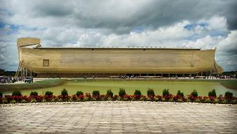
REASONS AGAINST A LOCAL FLOOD
Size of the ark (450 ft. long, 75 ft. wide, 45 ft. deep)?
Analogy to global Second Advent (Matt 24:37-39; Rev 1:7; 2 Pet 3:5-7)
Animals and birds on the ark?

Slide 30

Genesis 7:19-23
“They rose greatly on the earth, and all the high mountains under the entire heaven were covered…Every living thing that moved on the earth perished—birds, livestock, wild animals, all the creatures that swarm over the earth, and all mankind. Everything on dry land that had the breath of life in its nostrils died. Every living thing on the face of the earth was wiped out; men and animals and the creatures that move along the ground and the birds of the air were wiped from the earth. Only Noah was left, and those with him in the ark.”

Slide 31
H.C. Leupold
Exposition of Genesis (Grand Rapids: Baker, 1942), vol. 1, p. 301-302.
“… ‘all the high mountains under all the heavens.’ One of these expressions alone would almost necessitate the impression that the author intends to convey the idea of the absolute universality of the Flood…Yet since ‘all’ is known to be used in a relative sense, the writer removes all ambiguity by adding the phrase ‘under all the heavens.’ A double ‘all’ (kol) cannot allow for so relative a sense. It almost constitutes a Hebrew superlative. So we believe that the text disposes of the question of the universality of the flood. By way of objection to this interpretation, those who believe in a limited flood…urge the fact that kol is used in a relative sense, as is clearly the case in passages such as Genesis 41:57; Exodus 9:25, 10:15; Deuteronomy 2:25; and 1 Kings 10:24. However, we still insist that this fact could overthrow a single kol, never a double kol, as our verse has it.”

Slide 32
BELIEVER OR UNBELIEVER?
Writer | Local Flood | Global Flood
Philo |  | X
Josephus |  | X
Justin Martyr |  | X
Theophilus of Antioch |  | X
Tertullian |  | X
Gregory of Nazianus |  | X
John Chrysostom |  | X
Augustine of Hippo |  | X
SOURCE: Jonathan Sarfati, Refuting Compromise (Green Forest, AR: Master Books), 244.

Slide 33
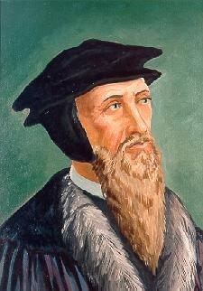
John Calvin
Genesis, 1554 (Edinburgh, UK: Banner of Truth, 1984), p. 272, emphasis mine.
“And the flood was forty days, etc. Moses conspicuously insists on this fact, in order to show that the whole world was immersed in the waters.”

Slide 34

Romans 1:18–20
¹⁸ For the wrath of God is revealed from heaven against all ungodliness and unrighteousness of men who suppress the truth in unrighteousness, ¹⁹ because that which is known about God is evident within them; for God made it evident to them. ²⁰ For since the creation of the world His invisible attributes, His eternal power and divine nature, have been clearly seen, being understood through what has been made, so that they are without excuse.

Slide 35
UNIFORMITARIANISM IS NOT BIBLICISM
 | ERA | SCRIPTURE | DISTINCTIVES
1. | CREATION | Genesis 1-2 | No death
2. | FALL | Genesis 3-6 | Death, painful pregnancy & toil, long life spans, no human government
3. | FLOOD | Genesis 7-10 | Shorter life spans, human government, one language, no nations
4. | BABEL | Genesis 11-present | No global government, multiple languages, nations, ethnicities
5. | ANTICHRIST | Rapture to 2nd Advent | Global government, restrainer removed
6. | KINGDOM | Rev. 20:1-10 | Long life spans, kingdom conditions, reality of death, renovated earth
7. | ETERNAL STATE | Rev. 21-22 | No death, new earth

Slide 36
PETER’S REBUTTAL
V.5-10
Arguments from:
History (5-7)
Scripture (8)
God’s character (9)
Divine promise (10)

Slide 37
SCRIPTURE
V. 8
God’s timing is not the same as ours

Slide 38
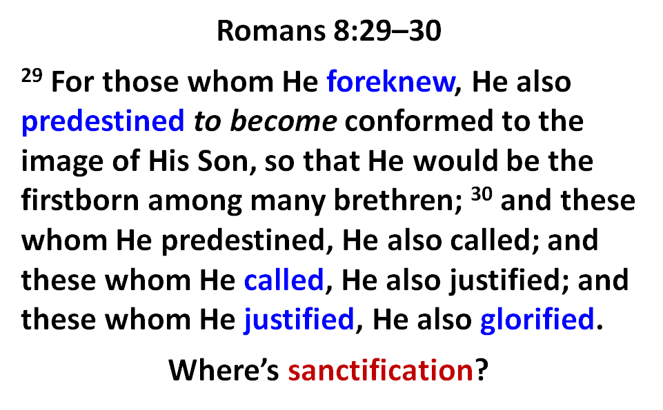

Slide 39
Jude 14–15
¹⁴ It was also about these men that Enoch, in the seventh generation from Adam, prophesied, saying, “Behold, the Lord came with many thousands of His holy ones, ¹⁵ to execute judgment upon all, and to convict all the ungodly of all their ungodly deeds which they have done in an ungodly way, and of all the harsh things which ungodly sinners have spoken against Him.”

Slide 40
PETER’S REBUTTAL
V.5-10
Arguments from:
History (5-7)
Scripture (8)
God’s character (9)
Divine promise (10)

Slide 41
GOD’S CHARACTER
V. 9
Delay ≠ no 2nd Coming
Delay = patience

Slide 42

Genesis 6:1-4
“¹ Now it came about, when men began to multiply on the face of the land, and daughters were born to them, ² that the sons of God saw that the daughters of men were beautiful; and they took wives for themselves, whomever they chose. ³ Then the Lord said, ‘My Spirit shall not strive with man forever, because he also is flesh; nevertheless his days shall be one hundred and twenty years.’ ⁴ The Nephilim were on the earth in those days, and also afterward, when the sons of God came in to the daughters of men, and they bore children to them. Those were the mighty men who were of old, men of renown.”

Slide 43

1 Peter 3:19-20
“¹⁹ in which also He went and made proclamation the spirits now in prison, ²⁰ who once were disobedient, when the patience of God kept waiting in the days of Noah, during the construction of the ark, in which a few, that is, eight persons, were brought safely through the water.”

Slide 44
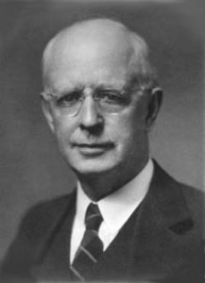

Slide 45

Lewis Sperry Chafer
vol. 7, Systematic Theology (Grand Rapids, MI: Kregel Publications, 1993), 265-66.
“This vital newness of mind is a part of believing, after all, and therefore it may be and is used as a synonym for believing at times (cf. Acts 17:30; 20:21; 26:20; Rom. 2:4; 2Tim. 2:25; 2 Pet. 3:9). Repentance nevertheless cannot be added to believing as a condition of salvation, because upwards of 150 passages of Scripture condition salvation upon believing only (cf. John 3:16; Acts 16:31).”

Slide 46
PETER’S REBUTTAL
V.5-10
Arguments from:
History (5-7)
Scripture (8)
God’s character (9)
Divine promise (10)

Slide 47
GOD’S PROMISE
V. 10
Despite delay,
  the day will come:
Like a thief
According to God’s promise

Slide 48
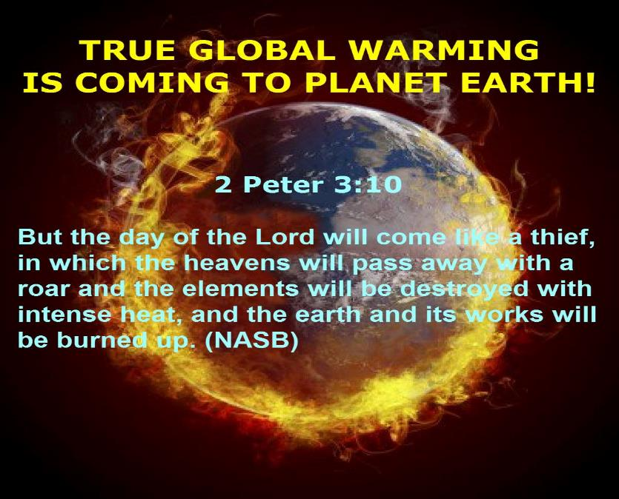

Slide 49
Genesis 6:1-4
“¹ Now it came about, when men began to multiply on the face of the land, and daughters were born to them, ² that the sons of God saw that the daughters of men were beautiful; and they took wives for themselves, whomever they chose. ³ Then the Lord said, ‘My Spirit shall not strive with man forever, because he also is flesh; nevertheless his days shall be one hundred and twenty years.’ ⁴ The Nephilim were on the earth in those days, and also afterward, when the sons of God came in to the daughters of men, and they bore children to them. Those were the mighty men who were of old, men of renown.”

Slide 50
GOD’S PROMISE
V. 10
Despite delay,
  the day will come:
Like a thief
According to God’s promise

Slide 51
PETER’S REBUTTAL
V.5-10
Arguments from:
History (5-7)
Scripture (8)
God’s character (9)
Divine promise (10)

Slide 52
OVERVIEW OF 2 PETER 3:3-15
Heresy of the false teachers (v3-4)
Motive of the false teachers (v3-4)
Peter’s rebuttal (v5-10)
Application (v11-15)

Slide 53
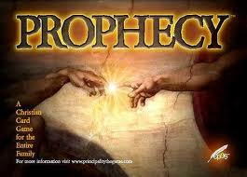
BIBLICAL PROPHECY: IMPORTANCE
27% of Scripture was prophetic at the time it was written
2 Pet 1:19

Slide 54

J. Dwight Pentecost
Prophecy For Today, Page 20
“A short time ago, I took occasion to go through the New Testament to mark each reference to the coming of the Lord Jesus Christ and to observe the use made of that teaching about His coming. I was struck a new with the fact that almost without exception, when the coming of Christ is mentioned in the New Testament, it is followed by an exhortation to godliness and holy living.”

Slide 55
2 Peter 1:19-21
“¹⁹ So we have the prophetic word made more sure, to which you do well to pay attention as to a lamp shining in a dark place, until the day dawns and the morning star arises in your hearts. ²⁰ But know this first of all, that no prophecy of Scripture is a matter of one’s own interpretation, ²¹ for no prophecy was ever made by an act of human will, but men moved by the Holy Spirit spoke from God.”

Slide 56
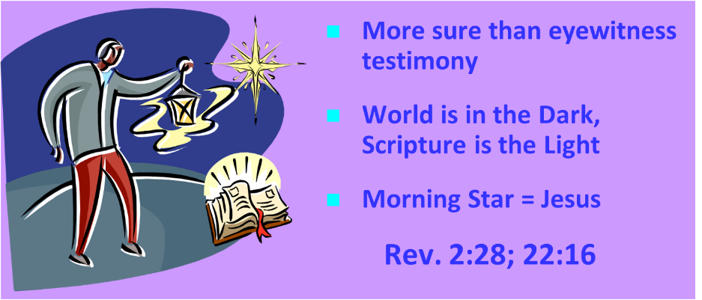
AUTHORITY OF SCRIPTURE
V. 19

Slide 57
APPLICATION
V. 11-15
Holy Living (11b, 14)
Evangelism (12)
Hope (13)
Patience (15)

Slide 58
APPLICATION
V. 11-15
Holy Living (11b, 14)
Evangelism (12)
Hope (13)
Patience (15)

Slide 59
APPLICATION
V. 11-15
Holy Living (11b, 14)
Evangelism (12)
Hope (13)
Patience (15)

Slide 60
APPLICATION
V. 11-15
Holy Living (11b, 14)
Evangelism (12)
Hope (13)
Patience (15)

Slide 61
APPLICATION
V. 11-15
Holy Living (11b, 14)
Evangelism (12)
Hope (13)
Patience (15)

Slide 62
CONCLUSION

Slide 63
OVERVIEW OF 2 PETER 3:3-15
Heresy of the false teachers (v3-4)
Motive of the false teachers (v3-4)
Peter’s rebuttal (v5-10)
Application (v11-15)

