Slide 1
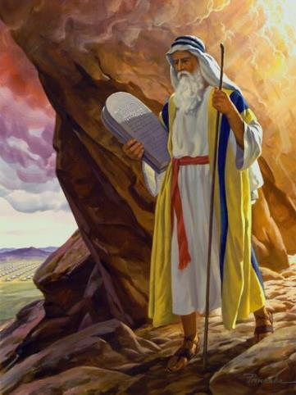
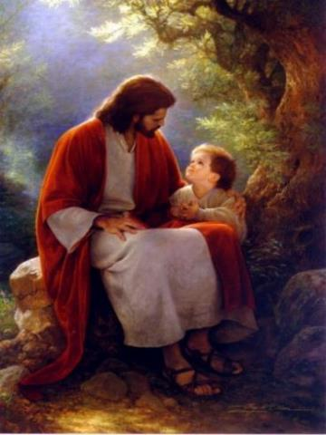
Law and Grace: An Overview Jim McGowan, Th.D. Sugar Land Bible Church 02-09-2020
…but grace and truth were realized through Jesus Christ - John 1:17
For the Law was given through Moses…
Special thanks to Middletown Bible Church for access to their resources.

Slide 2
OUR PURPOSE, AIM AND OBJECTIVE
Law and Grace
…is to Compare and Contrast Law and Grace so as to properly understand these two important themes and how they are related to the life of the New Testament Believer.

Slide 3
C. I. SCOFIELD, D. D.
The Grace of God, The Fundamentals Vol. 3, Chapter VII, p. 98
We have, most of us, been reared and now live under the influence of Galatianism. Protestant theology, alas, is for the most part, thoroughly Galatianized, in that neither law nor grace are given their distinct and separated places, as in the counsels of God, but are mingled together in one incoherent system.
The law is no longer, as in the Divine intent, a ministration of death (2 Cor. 3:7), of cursing (Gal. 3:10), of conviction (Rom. 3:19), because we are taught that we must try to keep it, and that by Divine help we may.
Nor, on the other hand, does grace bring us blessed deliverance from the dominion of sin, for we are kept under the law as a rule of life despite the plain declaration, “Sin shall not have dominion over you: for ye are not under the law, but under grace” (Rom. 6:14). (emphasis mine)

Slide 4
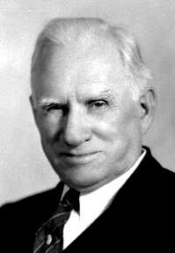
William R. Newell
Romans Verse-by-Verse (p. 274).
Grand Rapids, MI: Christian Classics Ethereal Library.
It is because Reformed theology has kept us Gentiles under the Law,—if not as a means of righteousness, then as “a rule of life,” that all the trouble has arisen. The Law is no more a rule of life than it is a means of righteousness. Walking in the Spirit has now taken the place of walking by ordinances. God has another principle under which He has put his saints: “Ye are not under law, but, under grace!” (Rom. 6:14; emphasis mine)

Slide 5
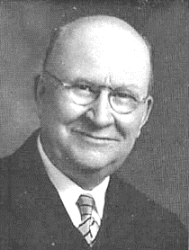
Henry Ironside
The Continual Burnt Offering: Daily Meditations on the Word of God (p. 265). Neptune, NJ: Loizeaux Brothers.
In Romans 7 we have a man renewed by the Spirit of God, but struggling under law, hoping thereby to subdue or find deliverance from the power of the old Adamic nature. In chapter 8 we have God’s way of deliverance through the death and resurrection of Christ with which the believer is identified before God. The chapter begins with “no condemnation” and ends with “no separation.” All who are in Christ Jesus are accepted in the Beloved and as free from every charge of guilt as He is Himself. He paid our penalty on the cross. Now we are linked up with Him in resurrection, not under law but under grace. (emphasis mine)

Slide 6
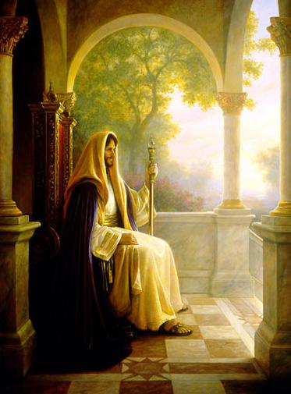
An Introduction to the Sermon on the Mount Matthew 5:1–8:1 (cf. Luke 6:17–49) Part 1
Jim McGowan, Th.D.

Slide 7
Session 24 Outline
Matthew’s Purpose & Message
Various Approaches to ‘The Sermon on the Mount’
The Soteriological Interpretation
The Sociological Interpretation
The Kingdom (Millennial) Interpretation
The Penitential Interpretation
The Interim Ethic Interpretation
The Believer’s Ethic (Ecclesiastical) Interpretation
The Ecumenical Interpretation
Occasion & Background
What is the Sermon on the Mount?
What it is Not
What it is
Dispensationalists Teach…

Slide 8
Session 24 Outline
Matthew’s Purpose & Message
Various Approaches to ‘The Sermon on the Mount’
The Soteriological Interpretation
The Sociological Interpretation
The Kingdom (Millennial) Interpretation
The Penitential Interpretation
The Interim Ethic Interpretation
The Believer’s Ethic (Ecclesiastical) Interpretation
The Ecumenical Interpretation
Occasion & Background
What is the Sermon on the Mount?
What it is Not
What it is
Dispensationalists Teach…

Slide 9
Matthew’s Purposes
Law and Grace: Session 24 The SOM – Matthew 5:1–8:1 (Luke 6:17–49)
To explain that Jesus in whom they had believed was the long-awaited Jewish Messiah-King
To explain why the kingdom had been postponed despite the fact that the king had arrived
To explain the interim program of God during the kingdom’s absence

Slide 10
Matthew’s Message
Law and Grace: Session 24 The SOM – Matthew 5:1–8:1 (Luke 6:17–49)
Jesus is the predicted Jewish king who ushered in an interim program by building the sons of the kingdom into the church in between Israel’s past rejection and future acceptance of her king

Slide 11
Matthew & the Kingdom
Law and Grace: Session 24 The SOM – Matthew 5:1–8:1 (Luke 6:17–49)
Kingdom offered (Matt. 1-11)
Kingdom rejected (Matt. 12-22)
Kingdom postponed (Matt. 13; 21:43)
Interim program (Matt. 13; 16:18)
Kingdom ultimately accepted (Matt. 23:37-39; 24-25)

Slide 12
5 Major Discourses In Matthew “when Jesus had ended these sayings” 7:28; 11:1; 13:53; 19:1; 26:1
Law and Grace: Session 24 The SOM – Matthew 5:1–8:1 (Luke 6:17–49)
The Sermon on the Mount (Matt. 5-7)
Theme: True Righteousness
The Mission Discourse (Matt. 10)
Theme: Ministry
Parabolic Discourse (Matt. 13)
Theme: The Kingdom
The Discipleship Discourse (Matt. 18)
Theme: Humility
The Olivet Discourse (Matt. 24-25)
Theme: The Second Coming

Slide 13
Law and Grace: Session 24 The SOM – Matthew 5:1–8:1 (Luke 6:17–49)
How do we approach the Sermon on the Mount?

Slide 14
SLBC CONSTITUTION & POSITION STATEMENTS, pg. 23
Law and Grace: Session 24 The SOM – Matthew 5:1–8:1 (Luke 6:17–49)
HERMENEUTICS – Hermeneutics is the art and sci­ence of interpretation. The goal of the Biblical in­terpreter is to discover what the text (the Bible) meant in the mind of its original author for his intended audi­ence. The means of accomplishing this is by applying a literal, grammatical, historical approach to interpre­tation. By literal, grammatical, historical we mean the customary, socially acknowledged meaning of a word or phrase within its context. The Bible uses figurative and poetic language and these portions should be interpreted accordingly. However, we reject any at­tempt to allegorize or spiritualize scripture which is not so intended.

Slide 15
Law and Grace: Session 24 The SOM – Matthew 5:1–8:1 (Luke 6:17–49)
How do we approach the Sermon on the Mount?
A fundamental principle in grammatico-historical exposition is that the words and sentences can have but one significance in one and the same connection. Milton S. Terry
“But here we must remember the old adage: ‘Interpretation is one, application is many.’ This means that there is only one meaning to a passage of Scripture which is determined by careful study.” Bernard Ramm
The value of following the principle of single meaning is beyond estimation. It eliminates all sorts of hindrances to letting the text speak for itself, which is, of course, the goal in Bible interpretation. Robert L. Thomas, Biblical Hermeneutics—Single Meaning and its Effects: Chafer Conference, 2009
https://www.deanbibleministries.org/dbmfiles/notes/2009-ChaferConf-Thomas-Paper-02.pdf

Slide 16
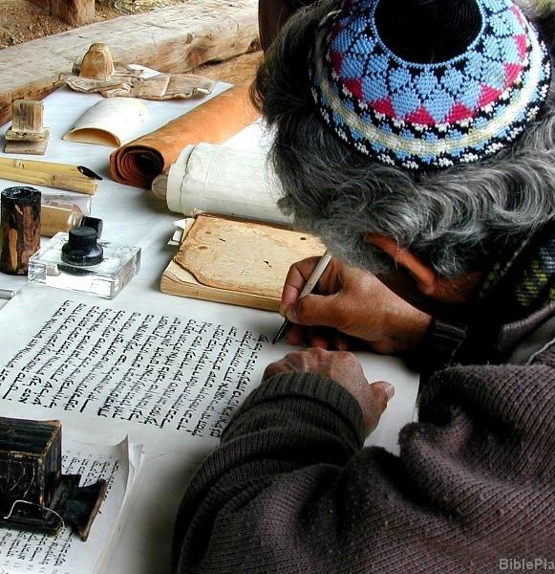
Law and Grace: Session 24 The SOM – Matthew 5:1–8:1 (Luke 6:17–49)
How do we approach the Sermon on the Mount?
We must approach the SOM so that we arrive at the explicit assertion of the words that God through Matthew, intended to convey.
We must approach the SOM so that we arrive at the one intended meaning for each passage that God through Matthew, intended to convey. (2 Tim. 3:16,17)
We must ask and answer the question, “What message did God inspire and what meaning did the apostle Matthew intend to convey?”

Slide 17
Law and Grace: Session 24 The SOM – Matthew 5:1–8:1 (Luke 6:17–49)

Slide 18
Session 24 Outline
Matthew’s Purpose & Message
Various Approaches to ‘The Sermon on the Mount’
The Soteriological Interpretation
The Sociological Interpretation
The Kingdom (Millennial) Interpretation
The Penitential Interpretation
The Interim Ethic Interpretation
The Believer’s Ethic (Ecclesiastical) Interpretation
The Ecumenical Interpretation
Occasion & Background
What is the Sermon on the Mount?
What it is Not
What it is
Dispensationalists Teach…

Slide 19
Session 24 Outline
Matthew’s Purpose & Message
Various Approaches to ‘The Sermon on the Mount’
The Soteriological Interpretation
The Sociological Interpretation
The Kingdom (Millennial) Interpretation
The Penitential Interpretation
The Interim Ethic Interpretation
The Believer’s Ethic (Ecclesiastical) Interpretation
The Ecumenical Interpretation
Occasion & Background
What is the Sermon on the Mount?
What it is Not
What it is
Dispensationalists Teach…

Slide 20
The Soteriological Interpretation
Law and Grace: Session 24 The SOM – Matthew 5:1–8:1 (Luke 6:17–49)
This interpretation suggests that the purpose of the Sermon was to enable people to know what God required so that by obeying they might obtain salvation.
This view contradicts the many passages of Scripture that present salvation as something impossible to attain by good works.
The extremely high standards that Jesus taught in the Sermon make the attaining of these requirements impossible for anyone and everyone.
Constable, T. (2003). Tom Constable’s Expository Notes on the Bible (Mt 4:21). Galaxie Software.

Slide 21
Session 24 Outline
Matthew’s Purpose & Message
Various Approaches to ‘The Sermon on the Mount’
The Soteriological Interpretation
The Sociological Interpretation
The Kingdom (Millennial) Interpretation
The Penitential Interpretation
The Interim Ethic Interpretation
The Believer’s Ethic (Ecclesiastical) Interpretation
The Ecumenical Interpretation
Occasion & Background
What is the Sermon on the Mount?
What it is Not
What it is
Dispensationalists Teach…

Slide 22
The Sociological Interpretation
Law and Grace: Session 24 The SOM – Matthew 5:1–8:1 (Luke 6:17–49)
This interpretation suggests that the purpose of the Sermon is not as a guide to personal salvation but to the salvation of society.
This view assumes that people can improve their society simply by applying the principles that Jesus taught in the Sermon.
This view stresses the social dimension of Jesus’ teaching to the exclusion of the personal dimension, which Jesus also emphasized.
Constable, T. (2003). Tom Constable’s Expository Notes on the Bible (Mt 4:21). Galaxie Software.

Slide 23
Session 24 Outline
Matthew’s Purpose & Message
Various Approaches to ‘The Sermon on the Mount’
The Soteriological Interpretation
The Sociological Interpretation
The Kingdom (Millennial) Interpretation
The Penitential Interpretation
The Interim Ethic Interpretation
The Believer’s Ethic (Ecclesiastical) Interpretation
The Ecumenical Interpretation
Occasion & Background
What is the Sermon on the Mount?
What it is Not
What it is
Dispensationalists Teach…

Slide 24
The Kingdom (Millennial) Interpretation
Law and Grace: Session 24 The SOM – Matthew 5:1–8:1 (Luke 6:17–49)
This interpretation suggests that the Sermon applies exclusively to the earthly messianic kingdom set up by Christ during the Millennium.
Jesus frequently references conditions in the SOM (persecution 5:11-12; abounding wickedness 5:13-16; pray for the coming of the kingdom (6:10); false prophets 7:15), that do not match the messianic kingdom that Old Testament prophets describe.
Constable, T. (2003). Tom Constable’s Expository Notes on the Bible (Mt 4:21). Galaxie Software.

Slide 25
Session 24 Outline
Matthew’s Purpose & Message
Various Approaches to ‘The Sermon on the Mount’
The Soteriological Interpretation
The Sociological Interpretation
The Kingdom (Millennial) Interpretation
The Penitential Interpretation
The Interim Ethic Interpretation
The Believer’s Ethic (Ecclesiastical) Interpretation
The Ecumenical Interpretation
Occasion & Background
What is the Sermon on the Mount?
What it is Not
What it is
Dispensationalists Teach…

Slide 26
The Penitential Interpretation
Law and Grace: Session 24 The SOM – Matthew 5:1–8:1 (Luke 6:17–49)
This interpretation suggests that the primary purpose of the Sermon was to convict Jesus’ hearers and make them realize that their only hope of salvation and participation in His kingdom was God’s grace.
The SOM is an intensification of the Law, but believers are NOT under the Law.
This view is too narrow. It fails to realize that the primary listeners to the Sermon were Jesus’ own disciples who were still under the Law (5:2, 13-14; 6:9, 24-34).
Constable, T. (2003). Tom Constable’s Expository Notes on the Bible (Mt 4:21). Galaxie Software.

Slide 27
Session 24 Outline
Matthew’s Purpose & Message
Various Approaches to ‘The Sermon on the Mount’
The Soteriological Interpretation
The Sociological Interpretation
The Kingdom (Millennial) Interpretation
The Penitential Interpretation
The Interim Ethic Interpretation
The Believer’s Ethic (Ecclesiastical) Interpretation
The Ecumenical Interpretation
Occasion & Background
What is the Sermon on the Mount?
What it is Not
What it is
Dispensationalists Teach…

Slide 28
The Interim Ethic Interpretation
Law and Grace: Session 24 The SOM – Matthew 5:1–8:1 (Luke 6:17–49)
This interpretation suggests that the primary purpose of the Sermon presents ethical instructions for Jesus’ disciples that apply from the time Jesus gave them until the beginning of the kingdom.
This view fits best into the historical context for the giving of the Sermon (the kingdom was at hand).
This view anticipates the inauguration of the kingdom.
This view recognizes that the primary recipients were Jesus’ disciples whom He taught (5:1–2, 19; 7:29).
The content of the Sermon favors the interim interpretation.
Constable, T. (2003). Tom Constable’s Expository Notes on the Bible (Mt 4:21). Galaxie Software.

Slide 29
Session 24 Outline
Matthew’s Purpose & Message
Various Approaches to ‘The Sermon on the Mount’
The Soteriological Interpretation
The Sociological Interpretation
The Kingdom (Millennial) Interpretation
The Penitential Interpretation
The Interim Ethic Interpretation
The Believer’s Ethic (Ecclesiastical) Interpretation
The Ecumenical Interpretation
Occasion & Background
What is the Sermon on the Mount?
What it is Not
What it is
Dispensationalists Teach…

Slide 30
The Believer’s Ethic (Ecclesiastical) Interpretation
Law and Grace: Session 24 The SOM – Matthew 5:1–8:1 (Luke 6:17–49)
This interpretation suggests that the primary purpose of the Sermon is to present ethical instructions for the Church.
This view fails to see clear distinctions between the Church and the Kingdom.
It is improper to interpret the Sermon in light of latter revelation, since Jesus’ audience did not have later Scripture.
Jesus did not deal with the Church until Matt. 16:18, and only in seed form there. The Church was a future reality until Acts 2.
“Similar” does not mean “same”.
Constable, T. (2003). Tom Constable’s Expository Notes on the Bible (Mt 4:21). Galaxie Software.

Slide 31
Session 24 Outline
Matthew’s Purpose & Message
Various Approaches to ‘The Sermon on the Mount’
The Soteriological Interpretation
The Sociological Interpretation
The Kingdom (Millennial) Interpretation
The Penitential Interpretation
The Interim Ethic Interpretation
The Believer’s Ethic (Ecclesiastical) Interpretation
The Ecumenical Interpretation
Occasion & Background
What is the Sermon on the Mount?
What it is Not
What it is
Dispensationalists Teach…

Slide 32
The Ecumenical Interpretation
Law and Grace: Session 24 The SOM – Matthew 5:1–8:1 (Luke 6:17–49)

Slide 33
Session 24 Outline
Matthew’s Purpose & Message
Various Approaches to ‘The Sermon on the Mount’
The Soteriological Interpretation
The Sociological Interpretation
The Kingdom (Millennial) Interpretation
The Penitential Interpretation
The Interim Ethic Interpretation
The Believer’s Ethic (Ecclesiastical) Interpretation
The Ecumenical Interpretation
Occasion & Background
What is the Sermon on the Mount?
What it is Not
What it is
Dispensationalists Teach…

Slide 34
Occasion
Law and Grace: Session 24 The SOM – Matthew 5:1–8:1 (Luke 6:17–49)
Matthew 5:1-2 records that Jesus went up into the mountain hence the title, “The Sermon on the Mount.” In Matthew’s account, Jesus spoke specifically to His disciples.
Luke 6:17-19 gives a more detailed account. Luke records that Not only were the disciples there, but there were multitudes from all over the country, even Judaea and Jerusalem, though this occurred up in the Galilee. Furthermore, there were even Jews from outside the Land, from the coastal plain of Phoenicia and the cities of Tyre and Sidon.
Fruchtenbaum, A. G. (1983). The Messianic Bible Study Collection (Vol. 94, p. 4). Tustin, CA: Ariel Ministries..

Slide 35
Background
Law and Grace: Session 24 The SOM – Matthew 5:1–8:1 (Luke 6:17–49)
The Sermon on the Mount occurred after:
intense interest in the person of Jesus was stirred up.
the selection of the Twelve Disciples.
several conflicts with the Pharisees regarding the authority of Pharisaic Judaism and the Pharisaic interpretation of the Mosaic Law.
Fruchtenbaum, A. G. (1983). The Messianic Bible Study Collection (Vol. 94, p. 4). Tustin, CA: Ariel Ministries..

Slide 36
Background
Law and Grace: Session 24 The SOM – Matthew 5:1–8:1 (Luke 6:17–49)
The sermon occurred when the Jewish people were looking for the Messiah to come and establish His Kingdom in opposition to the kingdom of Rome.
The question being raised among the Jewish masses was, “What kind of righteousness is necessary for entering into the Kingdom?” Was it “Pharisaic righteousness” or was it righteousness, according to the Old Testament prophets, which Jesus taught?
From that perspective, the most important single statement in the Sermon on the Mount is Matthew 5:20.
Fruchtenbaum, A. G. (1983). The Messianic Bible Study Collection (Vol. 94, p. 4). Tustin, CA: Ariel Ministries..

Slide 37
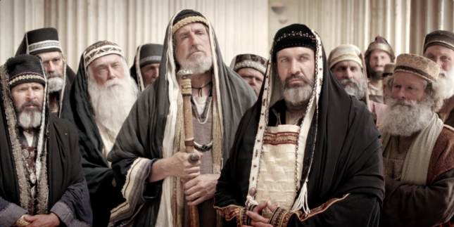
Matthew 5:20
“For I say to you that unless your righteousness surpasses that of the scribes and Pharisees, you will not enter the kingdom of heaven.

Slide 38
Session 24 Outline
Matthew’s Purpose & Message
Various Approaches to ‘The Sermon on the Mount’
The Soteriological Interpretation
The Sociological Interpretation
The Kingdom (Millennial) Interpretation
The Penitential Interpretation
The Interim Ethic Interpretation
The Believer’s Ethic (Ecclesiastical) Interpretation
The Ecumenical Interpretation
Occasion & Background
What is the Sermon on the Mount?
What it is Not
What it is
Dispensationalists Teach…

Slide 39
Session 24 Outline
Matthew’s Purpose & Message
Various Approaches to ‘The Sermon on the Mount’
The Soteriological Interpretation
The Sociological Interpretation
The Kingdom (Millennial) Interpretation
The Penitential Interpretation
The Interim Ethic Interpretation
The Believer’s Ethic (Ecclesiastical) Interpretation
The Ecumenical Interpretation
Occasion & Background
What is the Sermon on the Mount?
What it is Not
What it is
Dispensationalists Teach…

Slide 40
The Sermon on the Mount - What it is not
The Sermon on the Mount - Matthew 5:1–8:1 and Luke 6:17–49
In no sense is the sermon a means of attaining righteousness; instead, it is a revelation of the righteousness of God and reflects the demands God’s holiness makes on those (Jews) who would walk in fellowship with Him and enjoy the benefits of the kingdom He is offering.
Pentecost, J. D. (1995). Thy Kingdom Come: Tracing God’s Kingdom Program and Covenant Promises throughout History (pp. 205–206). Grand Rapids, MI: Kregel Publications.

Slide 41
The Sermon on the Mount - What it is not
The Sermon on the Mount - Matthew 5:1–8:1 and Luke 6:17–49
Taken in its totality, as a unit, it is not the “constitution” of the Messianic Kingdom, for that would require the reinstitution of the entire Mosaic Law, and that will not happen.
Taken in its totality, as a unit, it is not the means of salvation, for that would mean that salvation is by means of works. This view is often expressed when someone says, “Well, all I need to get into Heaven is to follow the “golden rule” found in the Sermon on the Mount.” Even if one followed the golden rule, he still would not be saved or get into Heaven, because merely following the golden rule will not save anyone. This is not a means of salvation.
Fruchtenbaum, A. G. (1983). The Messianic Bible Study Collection
(Vol. 94, pp. 6–7). Tustin, CA: Ariel Ministries.

Slide 42
The Sermon on the Mount - What it is not
The Sermon on the Mount - Matthew 5:1–8:1 and Luke 6:17–49
Taken in its totality, as a unit, it is not Christian ethics for this age, for this would require the believer to keep the entire Law of Moses.…There are things mentioned in the Sermon that later do become Christian ethics for this age. But as a unit, that was not its intent. If it were, then the keeping of the entire Mosaic Law, all 613 commandments, would be obligatory as Christian ethics for this age. Yet the Bible teaches that this is not the case. So, as a unit, it is not Christian ethics for this age, though things, which are said in the Sermon later, become Christian ethics for this age.
Fruchtenbaum, A. G. (1983). The Messianic Bible Study Collection
(Vol. 94, pp. 6–7). Tustin, CA: Ariel Ministries.

Slide 43
Session 24 Outline
Matthew’s Purpose & Message
Various Approaches to ‘The Sermon on the Mount’
The Soteriological Interpretation
The Sociological Interpretation
The Kingdom (Millennial) Interpretation
The Penitential Interpretation
The Interim Ethic Interpretation
The Believer’s Ethic (Ecclesiastical) Interpretation
The Ecumenical Interpretation
Occasion & Background
What is the Sermon on the Mount?
What it is Not
What it is
Dispensationalists Teach…

Slide 44
The Sermon on the Mount - What it is
The Sermon on the Mount - Matthew 5:1–8:1 and Luke 6:17–49
The sermon was designed to lead [the Jewish] multitude away from a false concept of righteousness to a true concept of righteousness; from a false hope of entrance into the kingdom to a sure foundation for entrance into Messiah’s kingdom…the Sermon on the Mount in its historical setting was Christ’s instruction to that generation to which He was offering Himself as Saviour and Sovereign…
Pentecost, J. D. (1995). Thy Kingdom Come: Tracing God’s Kingdom Program and Covenant Promises throughout History (pp. 205–206). Grand Rapids, MI: Kregel Publications.

Slide 45
The Sermon on the Mount - What it is
The Sermon on the Mount - Matthew 5:1–8:1 and Luke 6:17–49
In its context—in the Jewish frame of reference in which it was spoken—the Sermon on the Mount is the Messiah’s interpretation of the standard of righteousness, which the Law demanded, put in contrast with the Pharisaic interpretation of the kind of righteousness, which the Law demanded. A better title for this “sermon” would be “The Messiah’s Interpretation of the Righteousness of the Law.” So, as a unit, it is the Messiah’s interpretation of the kind of righteousness, which the Law demanded, stated in contradistinction to the Pharisaic interpretation of the kind of righteousness that the Law demanded. The difference is between mere external conformity in contrast to internal conformity that naturally lends itself to external conformity.
Fruchtenbaum, A. G. (1983). The Messianic Bible Study Collection
(Vol. 94, pp. 6–7). Tustin, CA: Ariel Ministries.

Slide 46
Session 24 Outline
Matthew’s Purpose & Message
Various Approaches to ‘The Sermon on the Mount’
The Soteriological Interpretation
The Sociological Interpretation
The Kingdom (Millennial) Interpretation
The Penitential Interpretation
The Interim Ethic Interpretation
The Believer’s Ethic (Ecclesiastical) Interpretation
The Ecumenical Interpretation
Occasion & Background
What is the Sermon on the Mount?
What it is Not
What it is
Dispensationalists Teach…

Slide 47
Dispensationalists Teach that the Sermon on the Mount is Not for the Church Today – “False!”
The Sermon on the Mount - Matthew 5:1–8:1 and Luke 6:17–49
The original Scofield Reference Bible (1909) stated that the Sermon on the Mount "clearly has a beautiful moral application to the Christian" (p.1000).
Arno Gaebelein, wrote, concerning the Beatitudes, "The blessings in themselves are most wonderful in their scope and inexhaustible in their meaning" (p. 112).
John Walvoord – "The Sermon on the Mount is clearly intended to be a definitive statement of Christ’s teaching and should not be pushed aside lightly by unnecessary stricture which would relegate it to unimportant truth" (Matthew—Thy Kingdom Come, p. 45).

Slide 48
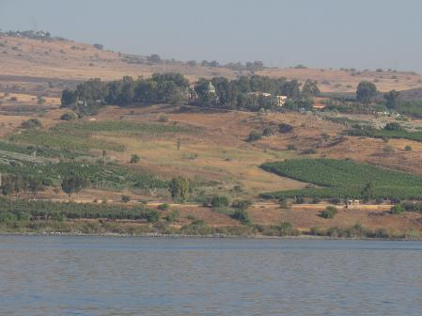
Dispensationalists Teach that the Sermon on the Mount is Not for the Church Today – “False!”
The Sermon on the Mount - Matthew 5:1–8:1 and Luke 6:17–49
It is profitable for us (2 Tim. 3:16-17).
God has included it in His Word, and everything in the Bible is of immense value to us! All of God’s Word is important.

Slide 49
2 Tim. 3:16-17
"¹⁶ All Scripture is inspired by God and profitable for teaching, for reproof, for correction, for training in righteousness; ¹⁷ so that the man of God may be adequate, equipped for every good work."

Slide 50
Dispensationalists Teach that the Sermon on the Mount is Not for the Church Today – “False!”
The Sermon on the Mount - Matthew 5:1–8:1 and Luke 6:17–49
It is to be preached. (Matt. 4:4, Acts 20:27).
Dispensationalists are known for *exegetical and *expository preaching of God’s Word, preaching through books of the Bible verse by verse.
*Exegetical preaching is an explanation of a text based on a careful, objective analysis which includes linguistics. Exegesis literally means “to lead out of.” The interpreter is led to his conclusions by following the text.
*Expository preaching involves a comprehensive explanation, of the Scripture; that is, the meaning and intent of a biblical text, providing commentary and examples to make the passage clear and understandable.

Slide 51
Matthew 4:4
⁴ But He answered and said, “It is written, ‘Man shall not live on bread alone, but on every word that proceeds out of the mouth of God.’ ”
Acts 20:27
“For I have not shunned to declare unto you all the counsel of God”
2 Timothy 4:2
"Preach the word; be instant in season, out of season; reprove, rebuke, exhort with all longsuffering and doctrine"

Slide 52
Dispensationalists Teach that the Sermon on the Mount is Not for the Church Today – “False!”
The Sermon on the Mount - Matthew 5:1–8:1 and Luke 6:17–49
It is precious and valuable. There is rich secondary spiritual application in:
the Beatitudes (5:1-12),
the ‘Disciple’s’ [Lord’s] prayer (6:9-15),
the passage on needless anxiety (6:25-34)
the parable of the two builders (7:24-27)

Slide 53
Matthew 5:16
"Let your light shine before men in such a way that they may see your good works, and glorify your Father who is in heaven."
Matthew 6:8
"So do not be like them; for your Father knows what you need before you ask Him."
Matthew 6:20-21
“²⁰ But store up for yourselves treasures in heaven, where neither moth nor rust destroys, and where thieves do not break in or steal; ²¹ for where your treasure is, there your heart will be also."

Slide 54
Matthew 6:24
"No man can serve two masters"
Matthew 6:26-34
"Behold the fowls of the air....consider the lilies....be not anxious....seek ye first...." "Be therefore not anxious about tomorrow".

Slide 55
Dispensationalists Teach that the Sermon on the Mount is Not for the Church Today – “False!”
The Sermon on the Mount - Matthew 5:1–8:1 and Luke 6:17–49
Believers of all dispensations:
are to recognize their own spiritual bankruptcy (5:3).
are to rejoice in spite of adverse circumstances (5:10-12).
are to abound in good works (5:16).
struggle with lust (5:28).
need to pray in secret (6:6).

Slide 56
Dispensationalists Teach that the Sermon on the Mount is Not for the Church Today – “False!”
The Sermon on the Mount - Matthew 5:1–8:1 and Luke 6:17–49
Principles for all saints of all times.
Believers of all dispensations need to pray, "Thy will be done" (6:10).
Believers of all dispensations need to lay up treasures in heaven (6:20).
Believers of all dispensations struggle with the sin of worry (6:25-34).
Believers of all dispensations need to put God first (6:33).
Believers of all dispensations need to build their lives upon God’s Word (7:24-27).

Slide 57
Dispensationalists Teach that the Sermon on the Mount is Not for the Church Today – “False!”
The Sermon on the Mount - Matthew 5:1–8:1 and Luke 6:17–49
Trans-dispensational truths for all dispensations.
Those who hunger and thirst after righteousness will be filled (5:6).
God shines and showers His goodness on all men (5:45).
God sees what is done is secret (6:1-6).
God knows the needs of His believers (6:8,32).
What a man treasures reveals his heart (6:21).
No man can serve two masters (6:24).
Those who honor God will be honored by God (6:33).

Slide 58
Dispensationalists Teach that the Sermon on the Mount is Not for the Church Today – “False!”
The Sermon on the Mount - Matthew 5:1–8:1 and Luke 6:17–49
Trans-dispensational for all dispensations. (cont’d)
Before we can righteously judge, we must first judge ourselves (7:1-5).
Those who truly seek will truly find (7:7).
Men are evil and depraved (7:11).
The majority are headed for destruction; few will be saved (7:13-14).

Slide 59
Dispensationalists Teach that the Sermon on the Mount is Not for the Church Today – “False!”
The Sermon on the Mount - Matthew 5:1–8:1 and Luke 6:17–49
Trans-dispensational for all dispensations. (cont’d)
A tree is known by its fruit (7:17-20).
Mere profession does not necessarily mean true possession (7:21-23).
Our lives need to be built on a rock-solid foundation (7:24-27).

Slide 60
Theological Bias? ‘Reformed Theology’ teaches that the SOM is for the Church Today!
The Sermon on the Mount - Matthew 5:1–8:1 and Luke 6:17–49
Reformed Doctrine:
the Sermon was delivered to the Church.
the Church is made up of the saints of all ages.
the Church existed in the Old Testament and during our Lord’s earthly ministry.
there is but one people of God, and therefore the Sermon applies equally to the one people of God no matter when they live on earth.

Slide 61
Dispensationalists Teach that the Sermon on the Mount is Not for the Church Today – “False!”
The Sermon on the Mount - Matthew 5:1–8:1 and Luke 6:17–49

Slide 62
Dispensationalists Teach that the Sermon on the Mount is Not for the Church Today – “True!”
The Sermon on the Mount - Matthew 5:1–8:1 and Luke 6:17–49
The Lord gave this sermon to the Jews, not to the Church.
The Church was not even in existence at the time this sermon was given. The SOM was a pre-cross message given to Jews who were told that the kingdom was near (Matthew 4:17).

Slide 63
Dispensationalists Teach that the Sermon on the Mount is Not for the Church Today – “True!”
The Sermon on the Mount - Matthew 5:1–8:1 and Luke 6:17–49
The Sermon DOES NOT set forth distinctive Church truth.
The Sermon contains truth that is useful and precious to the Church but not distinctive to the Church. Distinctive Church truth is found in the Upper Room Discourse (John chapters 13-17) and in the New Testament epistles.

Slide 64
Dispensationalists Teach that the Sermon on the Mount is Not for the Church Today – “True!”
The Sermon on the Mount - Matthew 5:1–8:1 and Luke 6:17–49
The SOM is TOTALLY SILENT concerning truths revealed to the Church by the Apostles and N.T. Prophets including truths regarding:
The Body of Christ (Ephesians 1).
The Building of Christ (Ephesians 2).
The Bride of Christ (Ephesians 5).
The ("YE IN ME") baptism— (John 14:20). We are IN CHRIST!
The ("I IN YOU") indwelling—(John 14:20). Christ is IN US!

Slide 65
Dispensationalists Teach that the Sermon on the Mount is Not for the Church Today – “True!”
The Sermon on the Mount - Matthew 5:1–8:1 and Luke 6:17–49
The Mystery of the Body of Christ— See Eph. 3:1-12; 5:30-32; Col. 1:26-27, etc.
The believer’s identification with Christ in His death and in His life (Romans 6). The believer’s heavenly position and standing (Col. 1:1-4; Eph. 2:6; Heb. 3:1).
The believer’s heavenly position and standing (Col. 1:1-4; Eph. 2:6; Heb. 3:1).
The believer’s deliverance from the Law, and death to the Law (Gal. 2:19; Rom. 7:1-6).

Slide 66
Dispensationalists Teach that the Sermon on the Mount is Not for the Church Today – “True!”
The Sermon on the Mount - Matthew 5:1–8:1 and Luke 6:17–49
“We cannot put into the [SOM] discourse exclusively church teachings and say that all found here is to be applied to the church, and that it is the guide for the church, as some have said. If the Lord had had the church in her heavenly calling and character in mind, the place given to the discourse would be all wrong. The Lord mentions the church the first time in the sixteenth chapter, and if following the sixteenth chapter He had spoken these words we might say that we should find in it the church....Not here (in the sermon on the mount), but in the Epistles, written after the death, resurrection and ascension of our Lord Jesus Christ and after the Holy Spirit had come down from heaven, do we find all about the church. The magna carta of the church is in the Epistles of Paul, to whom the full revelation of the church was given. Out of this misconception has sprung a good deal of error”. Arno Gaebelein: The Gospel of Matthew, pages 108-109

Slide 67
Dispensationalists Teach that the Sermon on the Mount is Not for the Church Today – “True!”
The Sermon on the Mount - Matthew 5:1–8:1 and Luke 6:17–49
The purpose of the Sermon was primarily legal in character and condemnatory in effect (2 Cor. 3:6–9).
The Jews were very excited about the prospects of the kingdom, but they were not “spiritually prepared” to enter the kingdom which was announced to be “at hand” (Matt. 4:17; cf. Matt. 3:2).

Slide 68
2 Corinthians 3:6–9
⁶ [God] also made us adequate as servants of a new covenant, not of the letter [Mosaic Covenant] but of the Spirit; for THE LETTER KILLS [Mosaic Covenant], but the Spirit gives life. ⁷ But if THE MINISTRY OF DEATH, in letters engraved on stones [Mosaic Covenant], came with glory, so that the sons of Israel could not look intently at the face of Moses because of the glory of his face, fading as it was, ⁸ how will the ministry of the Spirit fail to be even more with glory? ⁹ For if THE MINISTRY OF CONDEMNATION [Mosaic Covenant] has glory, much more does the ministry of righteousness abound in glory. (cf. Rom. 7:3)

Slide 69
Matthew 3:1–2
¹ Now in those days John the Baptist came, preaching in the wilderness of Judea, saying, ² “Repent, for the kingdom of heaven is at hand.”
Matthew 4:17
From that time Jesus began to preach and say, “Repent, for the kingdom of heaven is at hand.”

Slide 70
CONCLUSION

Slide 71
Session 24 Review
Matthew’s Purpose & Message
Various Approaches to ‘The Sermon on the Mount’
The Soteriological Interpretation
The Sociological Interpretation
The Kingdom (Millennial) Interpretation
The Penitential Interpretation
The Interim Ethic Interpretation
The Believer’s Ethic (Ecclesiastical) Interpretation
The Ecumenical Interpretation
Occasion & Background
What is the Sermon on the Mount?
What it is Not
What it is
Dispensationalists Teach…

Slide 72
Law and Grace: An Overview Jim McGowan, Th.D. Sugar Land Bible Church 02-09-2020
…but grace and truth were realized through Jesus Christ - John 1:17
For the Law was given through Moses…
Special thanks to Middletown Bible Church for access to their resources.

