Slide 1
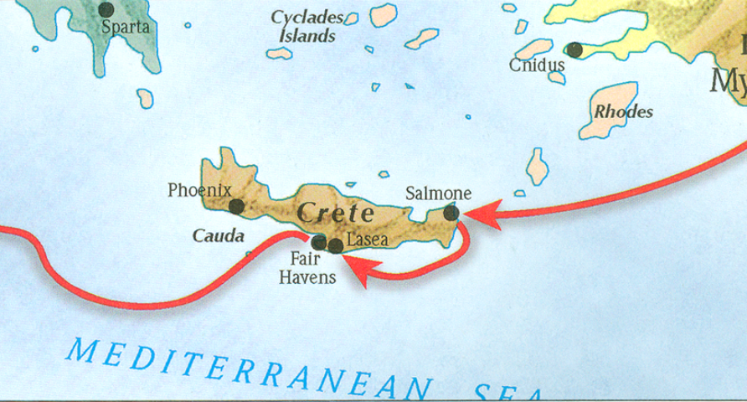
The book of Titus
Worthy of the Gospel

Slide 2
Introduction
The Book of Titus

Slide 3
8 Questions?
Who wrote it?
What do we know about the author?
Who was the book written to?
When was the book written?
Where was the book written from?
What’s the purpose of the book?
What’s in the book? (Outline)
What makes this book unique?

Slide 4
8 Questions?
Who wrote it?
What do we know about the author?
Who was the book written to?
When was the book written?
Where was the book written from?
What’s the purpose of the book?
What’s in the book? (Outline)
What makes this book unique?

Slide 5
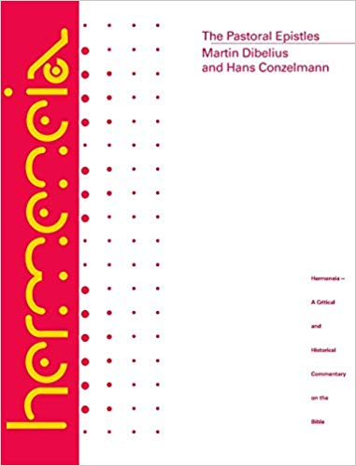
Dibelius and Conzelmann:
“The style of the polemic against heresy is unlike that of the earlier (authentic) Pauline writings.”
“The situations reflected in the Pastorals do not seem to fit the life of Paul as told by Acts and Paul’s undisputed writings.”
Dibelius and Conzelmann, Hermenia: The Pastoral Epistles: A Commentary on the Pastoral Epistles, Philadelphia, PA, Fortress Press, 1972.

Slide 6
Mounce:
“I propose to begin with the starting point of the PE themselves. They claim to be written by Paul and addressed to two associates in order to answer specific questions…”
Mounce, William D. Pastoral Epistles. Vol. 46. Word Biblical Commentary. Dallas: Word, Incorporated, 2000, 47.

Slide 7
Titus 1:1
“Paul, a bond-servant of God and an apostle of Jesus Christ, for the faith of those chosen of God and the knowledge of the truth which is according to godliness…”

Slide 8
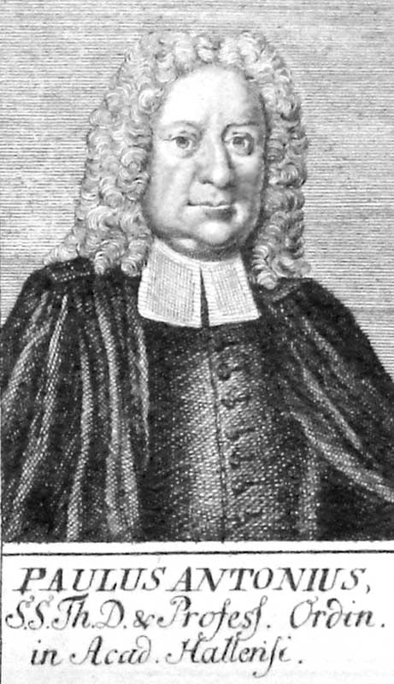
Paul Anton - 1726
“Pastoral Epistles”

Slide 9
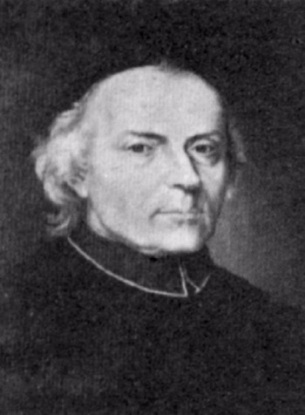
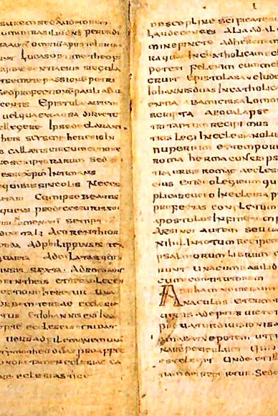
Ludovico Muratori
The Muratorian Fragment, Ad 180

Slide 10
8 Questions?
Who wrote it? -Paul the Apostle
What do we know about the author?
Who was the book written to?

Slide 11
8 Questions?
Who wrote it? -Paul the Apostle
What do we know about the author?
Who was the book written to?

Slide 12
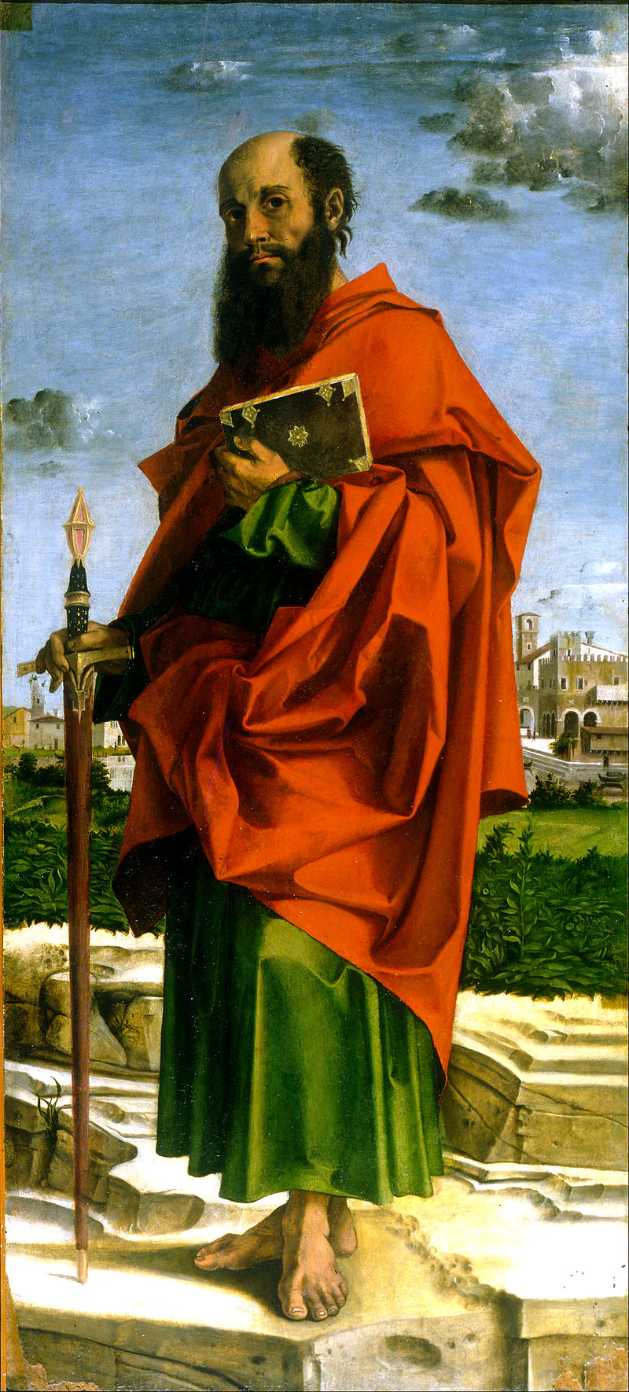
What do we know about Paul?
Born around AD 10
An Israelite, Tribe of Benjamin, Pharisee (Phil 3:5)
Raised in Jerusalem, educated in Tarsus (Acts 26:4-5)
Mentored by Gamaliel (Acts 21:40
Fluent in Hebrew (Acts 21:40)
From Tarsus of Cecilia (Acts 9:11; 21:39)
Roman citizen (Acts 22:25-28)
Saul (Hebrew- šā˒ûl) / Paul (Grk – Paulos)
Persecutor of the Church
Converted by Christ Himself (Acts 9)
Instrument and sufferer of Christ (Acts 9:16)
Greatest missionary and theologian
Greatest contributor to the Bible (13 books)
Bartolomeo Montagna - Saint Paul

Slide 13
8 Questions?
Who wrote it? -Paul the Apostle
What do we know about the author? – Greatest missionary, theologian, and contributor of the NT.
Who was the book written to?

Slide 14
Titus 1:4a
“To Titus, my true child in a common faith…”

Slide 15
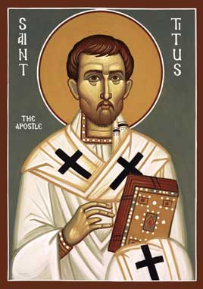
Who was the book written to?
Titus
A believer in Christ (1:4)
Brother to Paul (2 Cor 2:13)
Reliable (2 Cor 7:6)
Greek Gentile (Gal 2:3)
Test case in the Jerusalem Council of AD 49 (Gal2:1-4; Acts 11:27-30)
Courier for 2 Corinthians letter
Minister to Corinth believers
Loved God’s people (2 Cor 8:16-17)
Joy to Paul (2 Cor 7:13)
Prominent church leader in Crete (Titus 1:5)

Slide 16
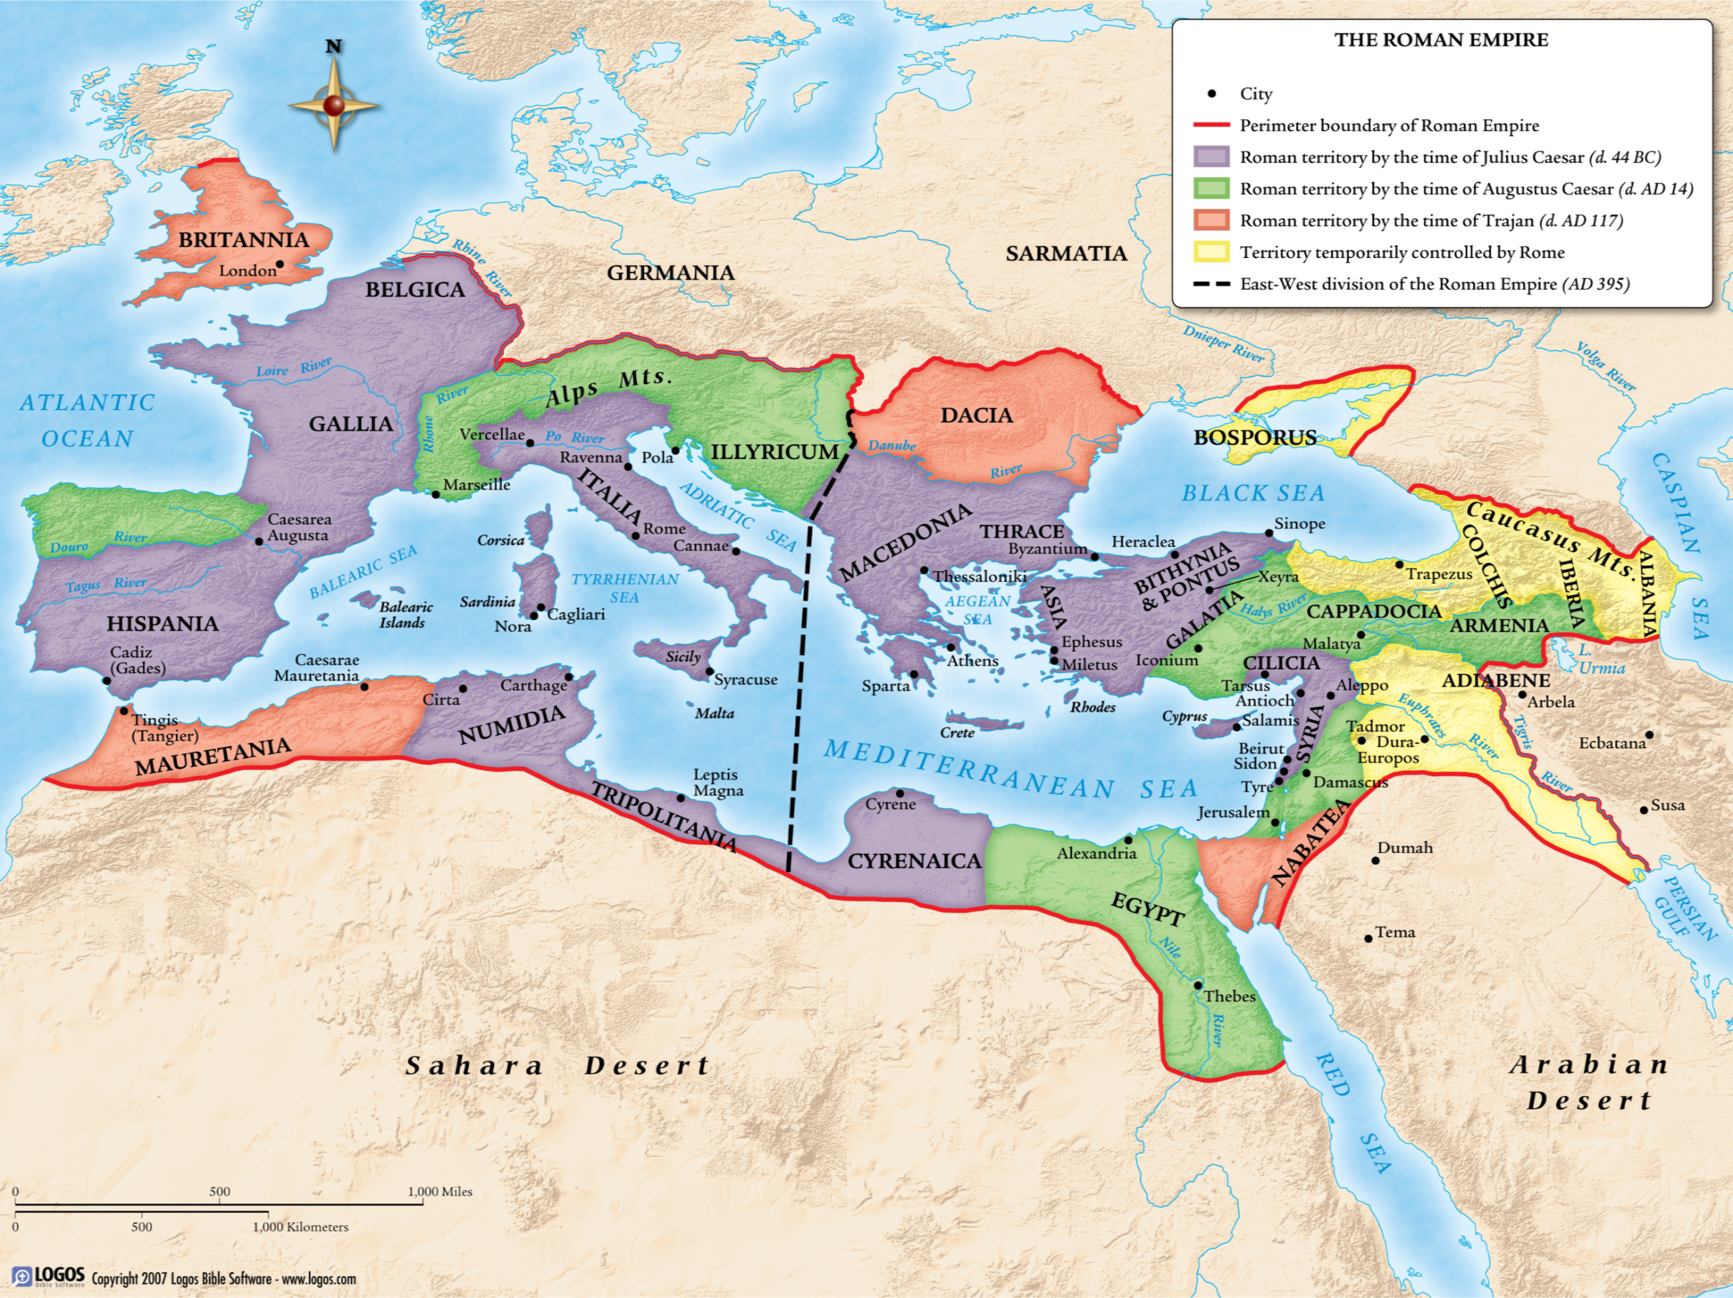
The Roman Empire

Slide 17
The Roman Empire

Slide 18
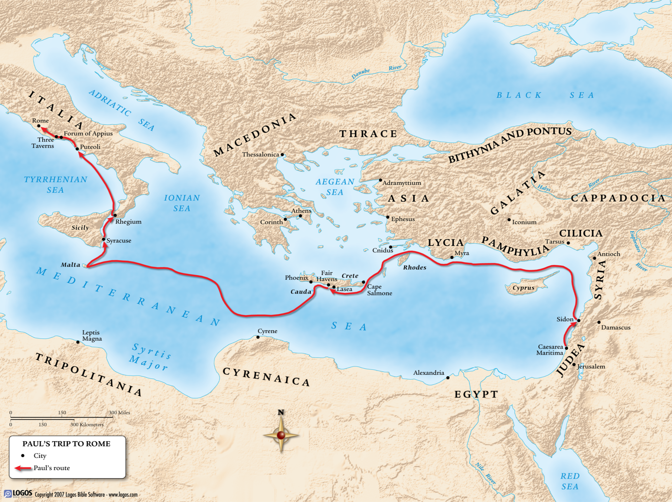

Slide 19
Acts 27:7-8

Slide 20
Titus 1:5
“For this reason I left you in Crete, that you would set in order what remains and appoint elders in every city as I directed you…”

Slide 21
Who was the book written to?
Titus
A believer in Christ (1:4)
Brother to Paul (2 Cor 2:13)
Reliable (2 Cor 7:6)
Greek Gentile (Gal 2:3)
Test case in the Jerusalem Council of AD 49 (Gal2:1-4; Acts 11:27-30)
Courier for 2 Corinthians letter
Minister to Corinth believers
Loved God’s people (2 Cor 8:16-17)
Joy to Paul (2 Cor 7:13)
Prominent church leader in Crete (Titus 1:5)
Left for ministry to Dalmatia (2 Tim 4:10)

Slide 22
8 Questions?
Who wrote it? -Paul the Apostle
What do we know about the author? – Greatest missionary, theologian, and contributor of the NT.
Who was the book written to? - Titus

Slide 23
8 Questions?
When was the book written?
Where was the book written?
What is the purpose of the book?

Slide 24
Paul’s Journeys
Journey | Date | Scripture Location
1st Missionary Journey | AD 47-49 | Acts 13.1-14.28
Jerusalem Council | AD 49 | Acts 15.1-35
2nd Missionary Journey | AD 49-52 | Acts 15.36-18.22
3rd Missionary Journey | AD 52-56 | Acts 18.23-20.38
Arrest and Imprisonment | AD 56-60 | Acts 21.27-26.32
Voyage to Rome to death | AD 60-68 | Acts 27.1-28.29
Adapted from House, H Wayne. Chronological and Background Charts of the New Testament. Grand Rapids, MI: Zondervan, 1981, 124.

Slide 25
8 Questions?
When was the book written?
AD 63-66
Where was the book written?
What is the purpose of the book?

Slide 26
8 Questions?
When was the book written?
AD 63-66
Where was the book written?
What is the purpose of the book?

Slide 27
8 Questions?
When was the book written?
AD 63-66
Where was the book written? Macedonia
What is the purpose of the book?

Slide 28
Paul’s Journeys
Journey | Date | Scripture Location
1st Missionary Journey | AD 47-49 | Acts 13.1-14.28
Jerusalem Council | AD 49 | Acts 15.1-35
2nd Missionary Journey | AD 49-52 | Acts 15.36-18.22
3rd Missionary Journey | AD 52-56 | Acts 18.23-20.38
Arrest and Imprisonment | AD 56-60 | Acts 21.27-26.32
Voyage to Rome to death | AD 60-68 | Acts 27.1-28.29
Adapted from House, H Wayne. Chronological and Background Charts of the New Testament. Grand Rapids, MI: Zondervan, 1981, 124.

Slide 30
8 Questions?
Who wrote it? -Paul the Apostle
What do we know about the author? – Greatest missionary, theologian, and contributor of the NT.
Who was the book written to? - Titus

Slide 31
8 Questions?
When was the book written?
AD 63-66
Where was the book written? Macedonia
What is the purpose of the book?

Slide 32
The book of Titus
Worthy of the Gospel

