Slide 1


Dr. Andy Woods
Senior Pastor – Sugar Land Bible Church
President – Chafer Theological Seminary

Slide 2

“After These Things”
(Rev. 4‒22)
Before the Tribulation (4‒5)
During the Tribulation (6‒19)
After the Tribulation (20‒22)
  Kingdom (20:1-10)
  Great White Throne Judgment (20:11-15)
  Destruction of the Earth (21:1)
  New Heaven and New Earth (21‒22)

Slide 3
“After These Things”
(Rev. 4‒22)
Before the Tribulation (4‒5)
During the Tribulation (6‒19)
After the Tribulation (20‒22)
  Kingdom (20:1-10)
  Great White Throne Judgment (20:11-15)
  Destruction of the Earth (21:1)
  New Heaven and New Earth (21‒22)

Slide 4


Slide 5


Slide 6
“After These Things”
(Rev. 4‒22)
Before the Tribulation (4‒5)
During the Tribulation (6‒19)
After the Tribulation (20‒22)
  Kingdom (20:1-10)
  Great White Throne Judgment (20:11-15)
  Destruction of the Earth (21:1)
  New Heaven and New Earth (21‒22)

Slide 7


Slide 8
“After These Things”
(Rev. 4‒22)
Before the Tribulation (4‒5)
During the Tribulation (6‒19)
After the Tribulation (20‒22)
  Kingdom (20:1-10)
  Great White Throne Judgment (20:11-15)
  Destruction of the Earth (21:1)
  New Heaven and New Earth (21‒22)

Slide 9
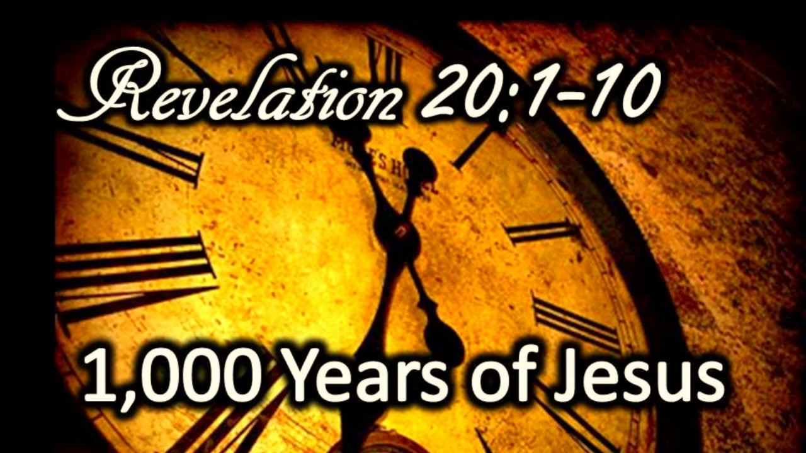
The Millennial Kingdom
Revelation 20:1-10
Satan: The Great Chain (1-3)
Saints: The Great Reign (4-6)
Sinners: The Great Revolt (7-10)
Willmington, Outline Bible, p. 772-73

Slide 10
The Millennial Kingdom
Revelation 20:1-10
Satan: The Great Chain (1-3)
Saints: The Great Reign (4-6)
Sinners: The Great Revolt (7-10)
Willmington, Outline Bible, p. 772-73

Slide 11
I. Satan: The Great Chain
Revelation 20:1-3
The Prisoner (1-2)
The Prison (3)
Willmington, Outline Bible, p. 772-73

Slide 12

Robert Thomas
Revelation 8 to 22: An Exegetical Commentary (Chicago: Moody Press, 1992), 408.
Robert Thomas observes that, "no number in Revelation is verifiably a symbolic number.”

Slide 13
The Millennial Kingdom
Revelation 20:1-10
Satan: The Great Chain (1-3)
Saints: The Great Reign (4-6)
Sinners: The Great Revolt (7-10)
Willmington, Outline Bible, p. 772-73

Slide 14
II. Saints: The Great Reign
Revelation 20:4-6
The Resurrection of the Just (4a)
The Rule of the Just (4b-6)
Willmington, Outline Bible, p. 772-73

Slide 15
II. Saints: The Great Reign
Revelation 20:4-6
The Resurrection of the Just (4a)
The Rule of the Just (4b-6)
Willmington, Outline Bible, p. 772-73

Slide 16

Revelation 20:4-6
“⁴ Then I saw thrones, and they sat on them, and judgment was given to them. And I saw the souls of those who had been beheaded because of their testimony of Jesus and because of the word of God, and those who had not worshiped the beast or his image, and had not received the mark on their forehead and on their hand; and they came to life [zaō] and reigned with Christ for a thousand years….

Slide 17

1 Corinthians 15:20-23
“²⁰ But now Christ has been raised from the dead, the first fruits of those who are asleep. ²¹-For since by a man came death, by a man also came the resurrection of the dead. ²² For as in Adam all die, so also in Christ all will be made alive. ²³ But each in his own order: Christ the first fruits, after that those who are Christ’s at His coming.”

Slide 18
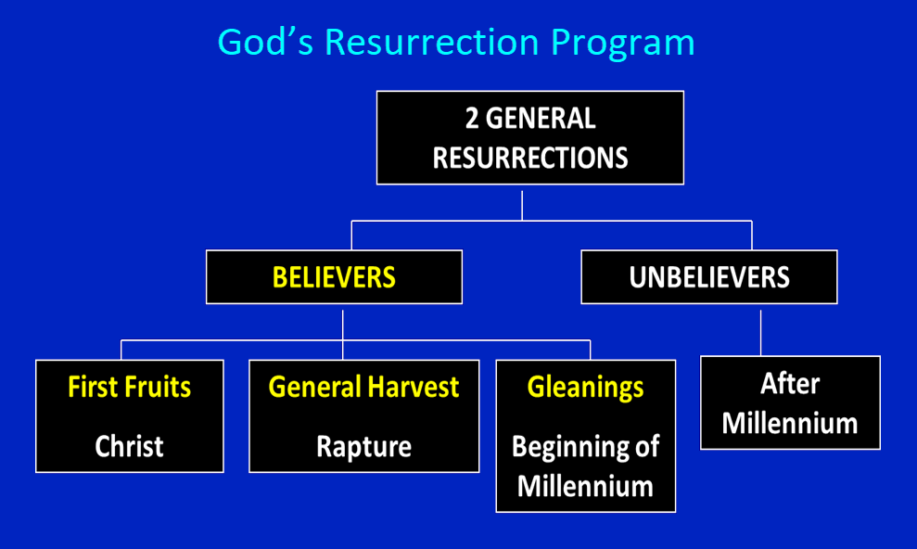

Slide 19
1 Corinthians 15:20-23
“²⁰ But now Christ has been raised from the dead, the first fruits of those who are asleep. ²¹-For since by a man came death, by a man also came the resurrection of the dead. ²² For as in Adam all die, so also in Christ all will be made alive. ²³ But each in his own order (tagma): Christ the first fruits, after that those who are Christ’s at His coming.”

Slide 20
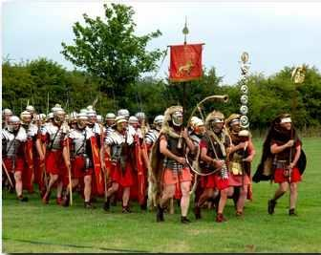
Order or Tagma (1 Cor. 15:23)
General – Christ’s resurrection (1 Cor 15:23)
Officer – Rapture (1 Thess 4:13-18)
Soldiers – OT saints & Tribulation martyrs (Rev 20:4)
Captives – Unsaved of all ages (Rev 20:5)

Slide 21
II. Saints: The Great Reign
Revelation 20:4-6
The Resurrection of the Just (4a)
The Rule of the Just (4b-6)
Willmington, Outline Bible, p. 772-73

Slide 22
Revelation 20:4-6
“⁴ Then I saw thrones, and they sat on them, and judgment was given to them. And I saw the souls of those who had been beheaded because of their testimony of Jesus and because of the word of God, and those who had not worshiped the beast or his image, and had not received the mark on their forehead and on their hand; and they came to life [zaō] and reigned with Christ for a thousand years….

Slide 23


Revelation 3:21
PROMISE TO THE OVERCOMERS
“He who overcomes, I will grant to him to sit down with Me on My throne, as I also overcame and sat down with My Father on His throne.”

Slide 24

Revelation 1:6
“and He has made us to be a kingdom, priests to His God and Father—to Him be the glory and the dominion forever and ever. Amen.”

Slide 25
Revelation 5:10
“You have made them to be a kingdom and priests to our God; and they will reign [basileuō] upon the earth [gē].”

Slide 26

OT PROPHETS DESCRIBE THE KINGDOM
Established by God (Dan. 2:44)
Eternal (Dan. 7:27)
Christ’s direct rule (Zech. 9:9-10)
Earthly (Zech. 14:9)
Land promises realized (Gen. 15:18-21)
Israel’s preeminence (Isa. 49:22-23)
Millennial Temple (Ezek. 40‒46)

Slide 27
OT PROPHETS DESCRIBE THE KINGDOM
Millennial David (Jer. 30:9)
Righteousness (Isa. 9:6-7)
Curse curtailed (Isa. 65:20, 22)
Peace (Isa. 2:4)
Prosperity (Amos 9:13-14; Isa 65:22)
Topographical changes (Ezek. 47:1-12)
Immediate answers to prayer (Isa. 65:24)

Slide 28

Justin Martyr
Dialogue with Trypho, 80.
“But I and every other completely orthodox Christian feel certain that there will be a resurrection of the flesh, followed by a thousand years in the rebuilt, embellished, and enlarged city of Jerusalem as was announced by the prophets Ezekiel, Isaiah, and the others.”

Slide 29
Revelation 20:4-6
…⁵ The rest of the dead did not come to life [zaō] until the thousand years were completed. This is the first resurrection [anastasis]. ⁶ Blessed and holy is the one who has a part in the first resurrection [anastasis]; over these the second death has no power, but they will be priests of God and of Christ and will reign with Him for a thousand years.”

Slide 30
1 Corinthians 15:20-23
“²⁰ But now Christ has been raised from the dead, the first fruits of those who are asleep. ²¹-For since by a man came death, by a man also came the resurrection of the dead. ²² For as in Adam all die, so also in Christ all will be made alive. ²³ But each in his own order: Christ the first fruits, after that those who are Christ’s at His coming.”

Slide 32
1 Corinthians 15:20-23
“²⁰ But now Christ has been raised from the dead, the first fruits of those who are asleep. ²¹-For since by a man came death, by a man also came the resurrection of the dead. ²² For as in Adam all die, so also in Christ all will be made alive. ²³ But each in his own order (tagma): Christ the first fruits, after that those who are Christ’s at His coming.”

Slide 33
Order or Tagma (1 Cor. 15:23)
General – Christ’s resurrection (1 Cor 15:23)
Officer – Rapture (1 Thess 4:13-18)
Soldiers – OT saints & Tribulation martyrs (Rev 20:4)
Captives – Unsaved of all ages (Rev 20:5)

Slide 34

Daniel 12:2
“Many of those who sleep in the dust of the ground will awake, these to everlasting (olam) life, but the others to disgrace and everlasting (olam) contempt.”

Slide 35
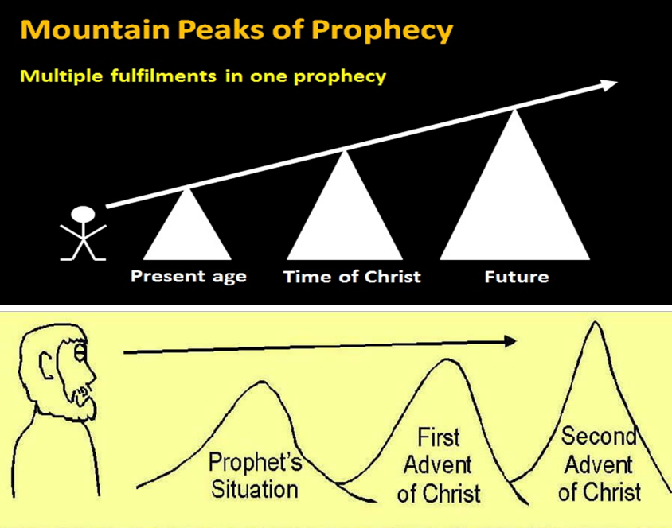

Slide 36
Isaiah 9:6-7
⁶ For a child will be born to us, a son will be given to us; And the government will rest on His shoulders; And His name will be called Wonderful Counselor, Mighty God, Eternal Father, Prince of Peace.⁷ There will be no end to the increase of His government or of peace, On the throne of David and over his kingdom, To establish it and to uphold it with justice and righteousness From then on and forevermore. The zeal of the Lord of hosts will accomplish this.

Slide 37
Isaiah 61:1-2
¹ The Spirit of the Lord God is upon me, Because the Lord has anointed me To bring good news to the afflicted; He has sent me to bind up the brokenhearted, To proclaim liberty to captives And freedom to prisoners; ² To proclaim the favorable year of the Lord And the day of vengeance of our God; To comfort all who mourn.

Slide 38
Luke 4:16-21
¹⁶ And He came to Nazareth, where He had been brought up; and as was His custom, He entered the synagogue on the Sabbath, and stood up to read. ¹⁷ And the book of the prophet Isaiah was handed to Him. And He opened the book and found the place where it was written,¹⁸ “The Spirit of the Lord is upon Me, Because He anointed Me to preach the gospel to the poor. He has sent Me to proclaim release to the …

Slide 39

Luke 4:16-21
… captives, And recovery of sight to the blind, To set free those who are oppressed,¹⁹ To proclaim the favorable year of the Lord.” ²⁰ And He closed the book, gave it back to the attendant and sat down; and the eyes of all in the synagogue were fixed on Him. ²¹ And He began to say to them, “Today this Scripture has been fulfilled in your hearing.”

Slide 40
Isaiah 61:1-2
¹ The Spirit of the Lord God is upon me, Because the Lord has anointed me To bring good news to the afflicted; He has sent me to bind up the brokenhearted, To proclaim liberty to captives And freedom to prisoners; ² To proclaim the favorable year of the Lord And the day of vengeance of our God; To comfort all who mourn.

Slide 41


Statue
&
Stone

Slide 42

CHART1

Slide 43
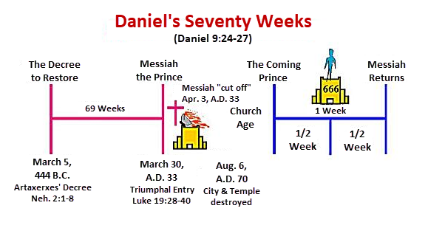

Slide 44
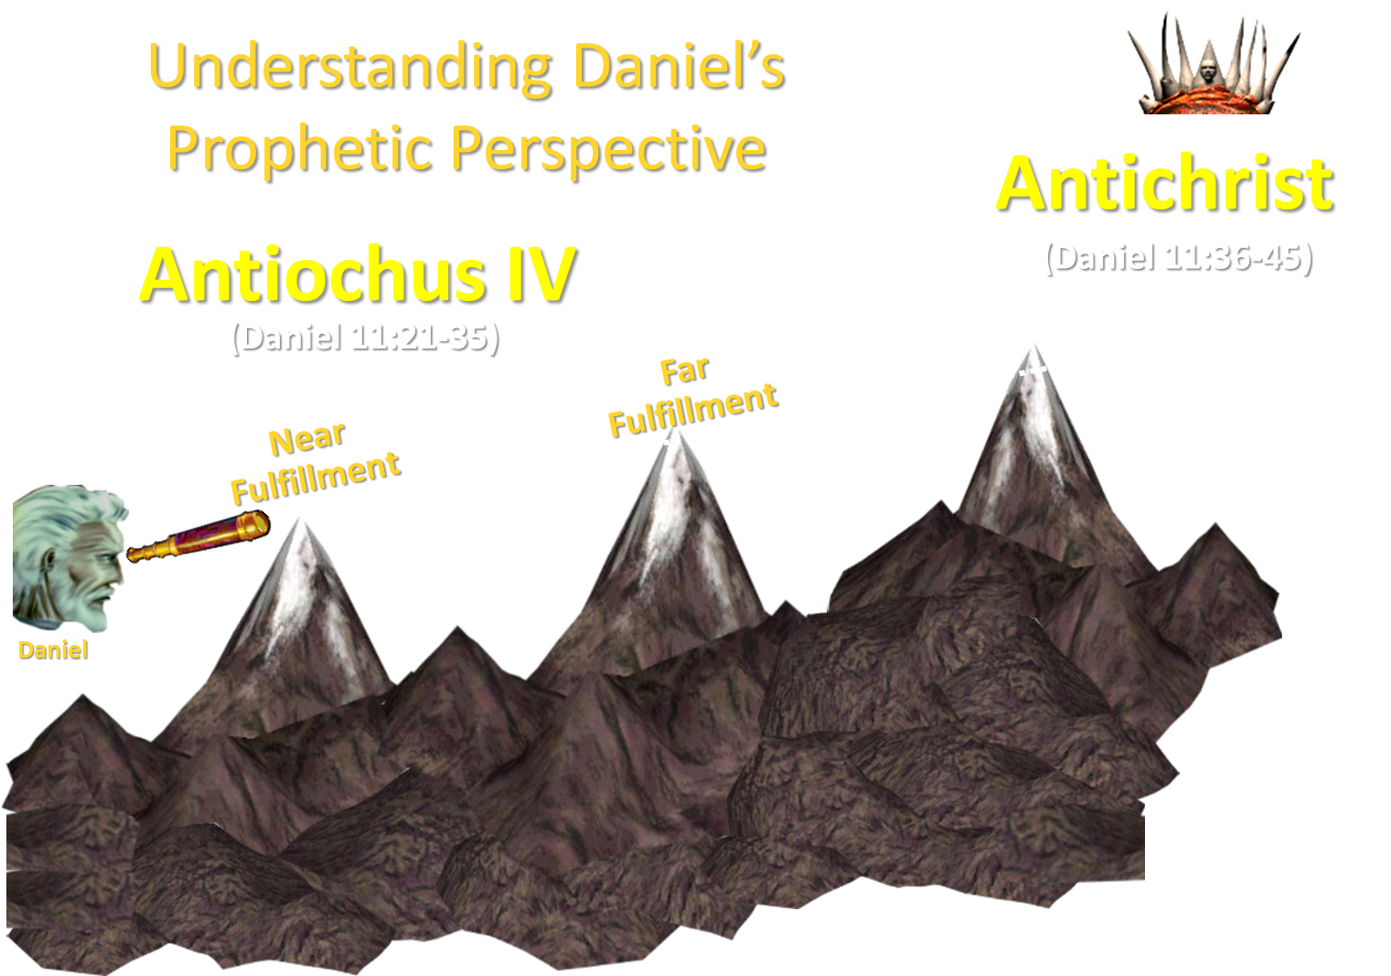

Slide 45
Revelation 20:4-6
…⁵ The rest of the dead did not come to life [zaō] until the thousand years were completed. This is the first resurrection [anastasis]. ⁶ Blessed and holy is the one who has a part in the first resurrection [anastasis]; over these the second death has no power, but they will be priests of God and of Christ and will reign with Him for a thousand years.”

Slide 46
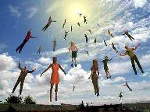
When Will the Rapture Take Place Relative to the Tribulation Period?
Pre-tribulation rapture theory
Mid-tribulation rapture theory
Post-tribulation rapture theory
Pre-wrath rapture theory
Partial rapture theory

Slide 47


Slide 48
Revelation 20:4-6
…⁵ The rest of the dead did not come to life [zaō] until the thousand years were completed. This is the first resurrection [anastasis]. ⁶ Blessed [makarios] and holy is the one who has a part in the first resurrection [anastasis]; over these the second death has no power, but they will be priests of God and of Christ and will reign with Him for a thousand years.”

Slide 49

Seven Beatitudes of Revelation:
“Blessed” (makarios)
Blessing upon the reader & heeder of Revelation (1:3)
Blessing upon the Tribulation martyrs (14:13)
Blessing upon the spiritually prepared (16:15)
Blessing upon the Marriage Supper invitees (19:9)
Blessing upon the First Resurrection’s participants (20:6)
Blessing upon the heeder of Revelation (22:7)
Blessing upon the eternal city’s citizens (22:14)
John F. Walvoord, "Revelation," in Bible Knowledge Commentary, ed. John F. Walvoord and Roy B. Zuck (Colorado Springs, CO: Victor, 1983), 929

Slide 50
Seven Beatitudes of Revelation:
“Blessed” (makarios)
Blessing upon the reader & heeder of Revelation (1:3)
Blessing upon the Tribulation martyrs (14:13)
Blessing upon the spiritually prepared (16:15)
Blessing upon the Marriage Supper invitees (19:9)
Blessing upon the First Resurrection’s participants (20:6)
Blessing upon the heeder of Revelation (22:7)
Blessing upon the eternal city’s citizens (22:14)
John F. Walvoord, "Revelation," in Bible Knowledge Commentary, ed. John F. Walvoord and Roy B. Zuck (Colorado Springs, CO: Victor, 1983), 929

Slide 51
Revelation 20:4-6
…⁵ The rest of the dead did not come to life [zaō] until the thousand years were completed. This is the first resurrection [anastasis]. ⁶ Blessed [makarios] and holy is the one who has a part in the first resurrection [anastasis]; over these the second death has no power, but they will be priests of God and of Christ and will reign with Him for a thousand years.”

Slide 52
Revelation 20:4-6
…⁵ The rest of the dead did not come to life [zaō] until the thousand years were completed. This is the first resurrection [anastasis]. ⁶ Blessed [makarios] and holy is the one who has a part in the first resurrection [anastasis]; over these the second death has no power, but they will be priests of God and of Christ and will reign with Him for a thousand years.”

Slide 53
Revelation 1:6
“and He has made us to be a kingdom, priests to His God and Father—to Him be the glory and the dominion forever and ever. Amen.”

Slide 54
Revelation 5:10
“You have made them to be a kingdom and priests to our God; and they will reign [basileuō] upon the earth [gē].”

Slide 55
The Millennial Kingdom
Revelation 20:1-10
Satan: The Great Chain (1-3)
Saints: The Great Reign (4-6)
Sinners: The Great Revolt (7-10)
Willmington, Outline Bible, p. 772-73

Slide 56
III. Sinners: The Great Revolt
Revelation 20:7-10
The Adversary (7)
The Apostasy (8)
The Attack (9a)
The Annihilation (9b-10)
Willmington, Outline Bible, p. 772-73

Slide 57
III. Sinners: The Great Revolt
Revelation 20:7-10
The Adversary (7)
The Apostasy (8)
The Attack (9a)
The Annihilation (9b-10)
Willmington, Outline Bible, p. 772-73

Slide 58

Revelation 20:7-9
“⁷ When the thousand years are completed [teleō], Satan will be released from his prison, ⁸ and will come out to deceive the nations which are in the four corners of the earth, Gog and Magog, to gather them together for the war; the number of them is like the sand of the seashore. ⁹ And they came up on the broad plain of the earth and surrounded the camp of the saints and the beloved city, and fire came down from heaven and devoured them.

Slide 59
III. Sinners: The Great Revolt
Revelation 20:7-10
The Adversary (7)
The Apostasy (8)
The Attack (9a)
The Annihilation (9b-10)
Willmington, Outline Bible, p. 772-73

Slide 60
Revelation 20:7-9
“⁷ When the thousand years are completed, Satan will be released from his prison, ⁸ and will come out to deceive the nations which are in the four corners of the earth, Gog and Magog, to gather them together for the war; the number of them is like the sand of the seashore. ⁹ And they came up on the broad plain of the earth and surrounded the camp of the saints and the beloved city, and fire came down from heaven and devoured them.

Slide 61

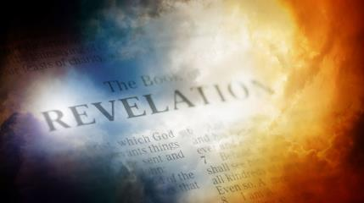
David Hocking
The Book of Revelation: Understanding the Future (Tustin, CA: Hope For Today Publications, 2014), 530. .
“God demonstrates by this one final event that even under the best conditions, mankind‘s problem is the heart. God demonstrates that Satan’s depravity cannot be cured. God demonstrates that He is fully justified in exacting eternal punishment.”

Slide 62
Revelation 20:1-3
“¹ Then I saw an angel coming down from heaven, holding the key of the abyss and a great chain in his hand. ² And he laid hold of the dragon, the serpent of old, who is the devil and Satan, and bound him for a thousand years; ³ and he threw him into the abyss, and shut it and sealed it over him, so that he would not deceive the nations any longer, until the thousand years were completed; after these things he must be released for a short time.”

Slide 63
Revelation 20:7-9
“⁷When the thousand years are completed, Satan will be released from his prison, ⁸ and will come out to deceive the nations which are in the four corners of the earth, Gog and Magog, to gather them together for the war; the number of them is like the sand of the seashore. ⁹ And they came up on the broad plain of the earth and surrounded the camp of the saints and the beloved city, and fire came down from heaven and devoured them.

Slide 64

Revelation 20:7-9
“⁷When the thousand years are completed, Satan will be released from his prison, ⁸ and will come out to deceive the nations which are in the four corners of the earth, Gog and Magog, to gather them together for the war; the number of them is like the sand of the seashore. ⁹And they came up on the broad plain of the earth and surrounded the camp of the saints and the beloved city, and fire came down from heaven and devoured them.”

Slide 66
Millennial Fulfillment?
EZEK. 38-39 | REV. 20:7-9
Northern invasion | All nation invade
Invasion leads to Millennium (Ezek 40-48) | Invasion comes at end of Millennium
Invasion leads to Millennium (Ezek 40-48) | Invasion leads to Eternal State (Rev 21-22)
7 months necessary to dispose of the dead (39:12) | Dead disposed of instantaneously (20:9)
Satan not bound prior to invasion | Satan bound prior to invasion (Rev 20:2)
Pentecost, Things To Come, 349-50

Slide 67
David J. MacLeod
David J. MacLeod, “The Fifth ‘Last Thing’: The Release of Satan and Man’s Final Rebellion (Rev. 20: 7–10),” Bibliotheca Sacra 157, no. 626 (April 2000): p. 209.
“How can Gog and Magog refer to a battle in Revelation 19 before the millennium and this battle at the end of the millennium? The most likely explanation is that Antichrist is Gog and will be defeated at the Second Coming. During the millennium his defeat will become a legend among the nations, something like Napoleon’s defeat at Waterloo. Then at the end of the millennial kingdom the Gog and Magog ‘legend’ is applied to a new historical situation (20: 8), with Satan leading the new ‘Gog and Magog.’ Satan will meet his ‘Waterloo’—his ‘Gog and Magog.’”

Slide 68
Revelation 20:7-9
“⁷ When the thousand years are completed, Satan will be released from his prison, ⁸ and will come out to deceive the nations which are in the four corners of the earth, Gog and Magog, to gather them together for the war [polemos]; the number of them is like the sand of the seashore. ⁹ And they came up on the broad plain of the earth and surrounded the camp of the saints and the beloved city, and fire came down from heaven and devoured them.

Slide 69
Revelation 20:7-9
“⁷ When the thousand years are completed, Satan will be released from his prison, ⁸ and will come out to deceive the nations which are in the four corners of the earth, Gog and Magog, to gather them together for the war; the number of them is like the sand of the seashore. ⁹ And they came up on the broad plain of the earth and surrounded the camp of the saints and the beloved city, and fire came down from heaven and devoured them.

Slide 70

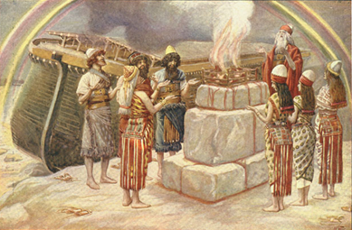
Genesis 8:21
The Lord smelled the soothing aroma; and the Lord said to Himself, “I will never again curse the ground on account of man, for the intent of man’s heart is evil from his youth; and I will never again destroy every living thing, as I have done.[emphasis mine].

Slide 71

Jeremiah 17:9
“The heart is more deceitful than all else And is desperately sick; Who can understand it?.”

Slide 72
Mark 7:20-23
“²⁰ And He was saying, ‘That which proceeds out of the man, that is what defiles the man. ²¹ For from within, out of the heart of men, proceed the evil thoughts, fornications, thefts, murders, adulteries, ²² deeds of coveting and wickedness, as well as deceit, sensuality, envy, slander, pride and foolishness. ²³ All these evil things proceed from within and defile the man.’”

Slide 73
David Hocking
The Book of Revelation: Understanding the Future (Tustin, CA: Hope For Today Publications, 2014), 530.
“God demonstrates by this one final event that even under the best conditions, mankind‘s problem is the heart. God demonstrates that Satan’s depravity cannot be cured. God demonstrates that He is fully justified in exacting eternal punishment.”

Slide 74
III. Sinners: The Great Revolt
Revelation 20:7-10
The Adversary (7)
The Apostasy (8)
The Attack (9a)
The Annihilation (9b-10)
Willmington, Outline Bible, p. 772-73

Slide 75
Revelation 20:7-9
“⁷ When the thousand years are completed, Satan will be released from his prison, ⁸ and will come out to deceive the nations which are in the four corners of the earth, Gog and Magog, to gather them together for the war; the number of them is like the sand of the seashore. ⁹ And they came up on the broad plain of the earth and surrounded the camp of the saints and the beloved city, and fire came down from heaven and devoured them.

Slide 76

Isaiah 2:2-3
“Now it will come about that In the last days The mountain of the house of the Lord Will be established as the chief of the mountains, And will be raised above the hills; And all the nations will stream to it.³ And many peoples will come and say, ‘Come, let us go up to the mountain of the Lord, To the house of the God of Jacob; That He may teach us concerning His ways And that we may walk in His paths.’ For the law will go forth from Zion And the word of the Lord from Jerusalem.”

Slide 77

Zechariah 14:16-18
“Then it will come about that any who are left of all the nations that went against Jerusalem will go up from year to year to worship the King, the Lord of hosts, and to celebrate the Feast of Booths. ¹⁷ And it will be that whichever of the families of the earth does not go up to Jerusalem to worship the King, the Lord of hosts, there will be no rain on them. ¹⁸ If the family of Egypt does not go up or enter, then no rain will fall on them; it will be the plague with which the Lord smites the nations who do not go up to celebrate the Feast of Booths.”

Slide 78

Robert Thomas
Four Views on the Book of Revelation, page 207.
“At the end of the Millennium that city will be Satan’s prime objective with his rebel army, because Israel will be a leader among the nations.”

Slide 79
III. Sinners: The Great Revolt
Revelation 20:7-10
The Adversary (7)
The Apostasy (8)
The Attack (9a)
The Annihilation (9b-10)
Willmington, Outline Bible, p. 772-73

Slide 80
D. The Annihilation
Revelation 20:9b-10
Satan’s henchmen are consumed by the fires of heaven (9b)
Satan himself is consumed by the fires of hell (10)
Willmington, Outline Bible, p. 772-73

Slide 81
D. The Annihilation
Revelation 20:9b-10
Satan’s henchmen are consumed by the fires of heaven (9b)
Satan himself is consumed by the fires of hell (10)
Willmington, Outline Bible, p. 772-73

Slide 82
Revelation 20:7-9
“⁷ When the thousand years are completed, Satan will be released from his prison, ⁸ and will come out to deceive the nations which are in the four corners of the earth, Gog and Magog, to gather them together for the war; the number of them is like the sand of the seashore. ⁹ And they came up on the broad plain of the earth and surrounded the camp of the saints and the beloved city, and fire came down from heaven and devoured them.

Slide 83
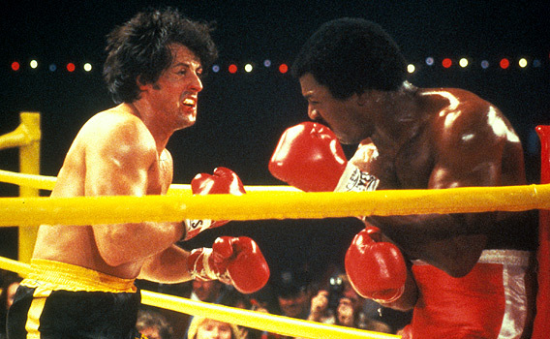
NO DUALISM!
NO CONTEST!

Slide 84

Ezekiel 28:13, 15
“¹³ You were in Eden, the garden of God; Every precious stone was your covering: The ruby, the topaz and the diamond; The beryl, the onyx and the jasper; The lapis lazuli, the turquoise and the emerald; And the gold, the workmanship of your settings and sockets, Was in you. On the day that you were created They were prepared… ¹⁵ You were blameless in your ways From the day you were created Until unrighteousness was found in you.”

Slide 85
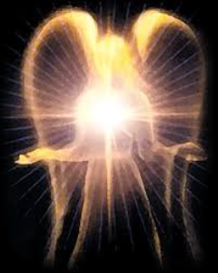
Original State and First Sin
Ezek 28:12-17
  Attributes
    Creature (15)
    Angel (14, 16)
    Powerful (14)
    Without sin (15)
    Beautiful (12-13)
    Intelligent (12)
  Nature of 1st sin (17)

Slide 86
D. The Annihilation
Revelation 20:9b-10
Satan’s henchmen are consumed by the fires of heaven (9b)
Satan himself is consumed by the fires of hell (10)
Willmington, Outline Bible, p. 772-73

Slide 87
Revelation 20:10
“And the devil who deceived them was thrown into the lake of fire and brimstone, where the beast and the false prophet are also; and they will be tormented day and night forever and ever.”

Slide 88
Revelation 20:10
“And the devil who deceived them was thrown into the lake of fire and brimstone, where the beast and the false prophet are also; and they will be tormented day and night forever and ever.”

Slide 89

Satan’s Progressive Defeat
Initial eviction from heaven (Isa 14:12-15; Ezek 28:12-17)
Eden (Gen 3:15)
Pre-diluvian world (1 Pet 3:19-20)
Cross (John 12:31; 16:11; Col 2:15; Heb 2:14; 1 John 3:8)
Mid point of the Tribulation (Rev 12:9)
Beginning of millennium (Rev 20:2-3)
End of millennium (Rev 20:10)

Slide 90
Satan’s Progressive Defeat
Initial eviction from heaven (Isa 14:12-15; Ezek 28:12-17)
Eden (Gen 3:15)
Pre-diluvian world (1 Pet 3:19-20)
Cross (John 12:31; 16:11; Col 2:15; Heb 2:14; 1 John 3:8)
Mid point of the Tribulation (Rev 12:9)
Beginning of millennium (Rev 20:2-3)
End of millennium (Rev 20:10)

Slide 91

Genesis 3:15
“And I will put enmity Between you and the woman, And between your seed and her seed; He shall bruise you on the head, And you shall bruise him on the heel.”

Slide 92
Revelation 20:10
“And the devil who deceived them was thrown into the lake of fire and brimstone, where the beast and the false prophet are also; and they will be tormented day and night forever and ever.”

Slide 93
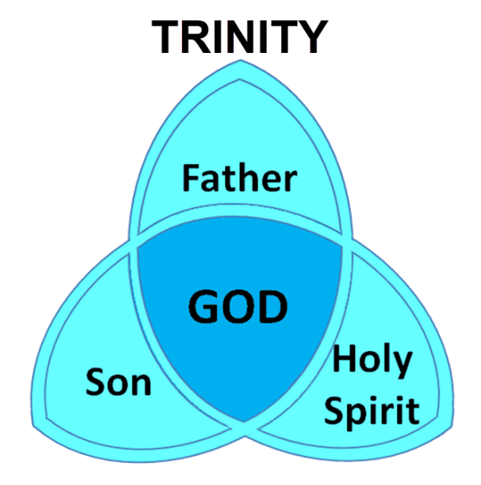

Slide 94
Revelation 20:10
“And the devil who deceived them was thrown into the lake of fire and brimstone, where the beast and the false prophet are also; and they will be tormented day and night forever and ever.”

Slide 95
Revelation 20:10
“And the devil who deceived them was thrown into the lake of fire and brimstone, where the beast and the false prophet are also; and they will be tormented day and night forever and ever.”

Slide 96
Revelation 20:10
“And the devil who deceived them was thrown into the lake of fire and brimstone, where the beast and the false prophet are also; and they will be tormented day and night forever (aiōn) and ever (aiōn).”

Slide 97
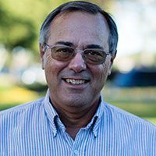
Dr. Alan W. Gomes
(Summer 1991). “Evangelicals and the Annihilation of Hell” (Part 2). In the Christian Research Journal. Page 11.
“A punishment [such as torment] that is not felt is not a punishment. It is an odd use of language to speak of an insensate state (i.e., unfeeling), an inanimate object receiving punishment. To say, ‘I punished my car for not starting by slowly plucking out it’s spark plug wires, one by one,’ would invoke laughter, not serious consideration.”

Slide 98
Daniel 12:2
“Many of those who sleep in the dust of the ground will awake, these to everlasting (olam) life, but the others to disgrace and everlasting (olam) contempt.”

Slide 99
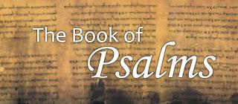
Psalm 90:2
“Before the mountains were born Or You gave birth to the earth and the world, Even from everlasting (olam) to everlasting (olam), You are God.”

Slide 100
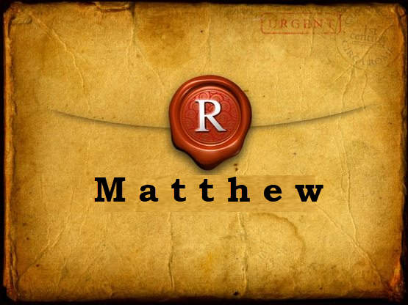
Matthew 25:46
“These will go away into eternal (aiōnios) punishment, but the righteous into eternal (aiōnios) life.

Slide 101
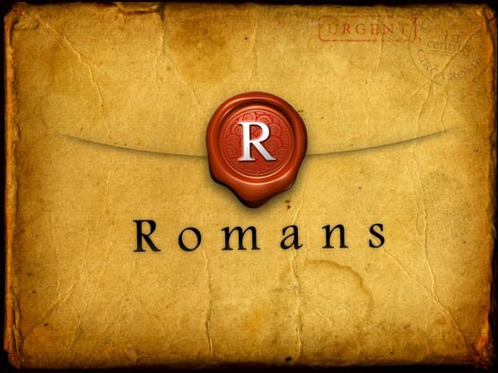
Romans 16:26
“but now is manifested, and by the Scriptures of the prophets, according to the commandment of the eternal (aiōnios) God, has been made known to all the nations, leading to obedience of faith.

Slide 102
Revelation 14:11
“And the smoke of their torment goes up forever (aiōn) and ever (aiōn); they have no rest day and night, those who worship the beast and his image, and whoever receives the mark of his name.”

Slide 103
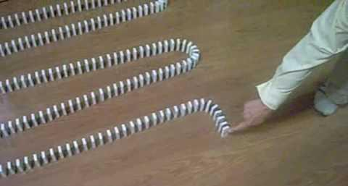
Dominoes in a Row

Slide 104
Conclusion

Slide 105
The Millennial Kingdom
Revelation 20:1-10
Satan: The Great Chain (1-3)
Saints: The Great Reign (4-6)
Sinners: The Great Revolt (7-10)
Willmington, Outline Bible, p. 772-73

Slide 106

“The Lord bless you and keep you; the Lord make his face shine on you and be gracious to you; the Lord turn his face toward you and give you peace.” (NIV)

